Slide 1
ICG-PTWS Working Group 1
Understanding Tsunami Risk
Beijing, China
April 7, 2025
Co chairs: Christopher Moore, Silvia Chacón
Key input from WG1 members: Bill Fry, Nic Aros, Anthony Jamelot, et al

Slide 2
OVERVIEW OF ICG/PTWS-WG1
Develop and promote best practice tsunami risk assessment material, programmes standards, and tools for understanding tsunami risk, to support emergency management and early warning, including but not limited to:
hazard assessment and coastal inundation models and products
risk assessment methodology and risk forecasting
scenario assessments including maximum credible events to
understand likely exposure, vulnerability, and event frequency
forecast and threat models
evacuation and inundation modelling
use of new and improved data including DEM, GNSS and paleotsunami information
Work with scientific experts to support Member State tsunami risk assessment.
Improve best practice for assessing risk of local source and non-seismic tsunami sources.
Develop projects to address gaps or areas for improvement in tsunami risk assessment, this may include land-use planning, vertical evacuation or supporting early warning improvements.

Slide 3
OVERVIEW OF ICG/PTWS-WG1
Develop and promote best practice tsunami risk assessment material, programmes standards, and tools for understanding tsunami risk, to support emergency management and early warning, including but not limited to:
hazard assessment and coastal inundation models and products
risk assessment methodology and risk forecasting
scenario assessments including maximum credible events to
understand likely exposure, vulnerability, and event frequency
forecast and threat models
evacuation and inundation modelling
use of new and improved data including DEM, GNSS and paleotsunami information
Work with scientific experts to support Member State tsunami risk assessment.
Improve best practice for assessing risk of local source and non-seismic tsunami sources.
Develop projects to address gaps or areas for improvement in tsunami risk assessment, this may include land-use planning, vertical evacuation or supporting early warning improvements.

Slide 4
ICG-XXX Requests WG1 to:
● Continue to support Tsunami Hazard Assessment (THA) studies in the Pacific as part of
comprehensive risk assessment, consistent with the first objective of the UN Ocean
Decade Tsunami Programme (UN ODTP), to achieve 100% coverage for coasts at risk of
tsunamis.
● Support and encourage regional workshops of seismic experts in tsunami sources. Such
regional workshops are best way to include local experts into THA studies.
● Support further development of the tsunami hazard and risk assessment tools for use in
THA (TsuCAT, ComMIT, Tweb and others).
● Encourage development of new and improved methods and promote use of best practices for THA.
● Encourage creation of a clearing house for access to the results of the THA studies.
● Encourage use of THA results for use in various IOC programs such as ITIC training,
Tsunami Ready Program, IOC/ICG/PTWS WG 2 and WG 3 activities and UN ODTP.

Slide 5
ICG-XXX Requests WG1 to:
● Continue to support Tsunami Hazard Assessment (THA) studies in the Pacific as part of
comprehensive risk assessment, consistent with the first objective of the UN Ocean
Decade Tsunami Programme (UN ODTP), to achieve 100% coverage for coasts at risk of
tsunamis.
● Support and encourage regional workshops of seismic experts in tsunami sources. Such
regional workshops are best way to include local experts into THA studies.
● Support further development of the tsunami hazard and risk assessment tools for use in
THA (TsuCAT, ComMIT, Tweb and others).
● Encourage development of new and improved methods and promote use of best practices for THA.
● Encourage creation of a clearing house for access to the results of the THA studies.
● Encourage use of THA results for use in various IOC programs such as ITIC training,
Tsunami Ready Program, IOC/ICG/PTWS WG 2 and WG 3 activities and UN ODTP.

Slide 6
SOME KEY INTERSESSIONAL ACTIVITITES
- Vanuatu Source Expert meeting report
- Tsunami Hazard Assessment (THA) studies in support of TsunamiReady, sites in the Pacific:
Fiji, Pohnpei, Majuro, Palau, Chuuk and Yap.
- NTHMP/USGS Powell Center efforts to develop PTHA
- Continued work with the ASCE to improve US building codes
- Improvements to inundation modeling for THA:
Addition of sediment transport model to real-time inundation
- Study of paleo-tsunami deposits in Discovery Bay
- Tsunami Hazard Assessment tools development:
TsuCAT update v4.5, including new features:
Real-time event notification, with suggested nearest comparable catalog source
PTWC training Tsunami Exercise Messages feature used in training in Chile in August
- Tweb update: Taiwan sea level gauges and inundation modeling
- NCEI work:
Natural Hazards Viewer improvements
Global Historical Tsunami Database data dashboard and FAQ
Updated the global relief model, ETOPO1, using IceSAT-2 Validation of Elevations Reporting Tool
- Feedback on Capacity Questionnaire

Slide 7
Tsunami Sources meeting, Vanuatu May 13-17, 2024
Co-chair: Ken Gledhill
The Expert Meeting was organized in Port Vila, Vanuatu during 14-17 May 2024 in close coordination with the Vanuatu Meteorology and Geo-Hazard Department (VMGD), bringing together 23 experts and 7 observers from ten Member States of the Intergovernmental Coordination Group for the Pacific Tsunami Warning and Mitigation System (ICG/PTWS) (Australia, France, Fiji, Japan, Indonesia, New Zealand, Papua New Guinea, Solomon Islands, USA and Vanuatu)
Report published January 2025
Review of latest research on New Britain, Solomon Islands, New Hebrides trenches and related tectonic features
Overall tectonics considered, including arrangement and rates of the tectonic plates and likely segmentation, including multi-segment ruptures
Landslides and VGTs catalogued
Mmax(min) and Mmax(max) updated, source parameters suggested

Slide 8
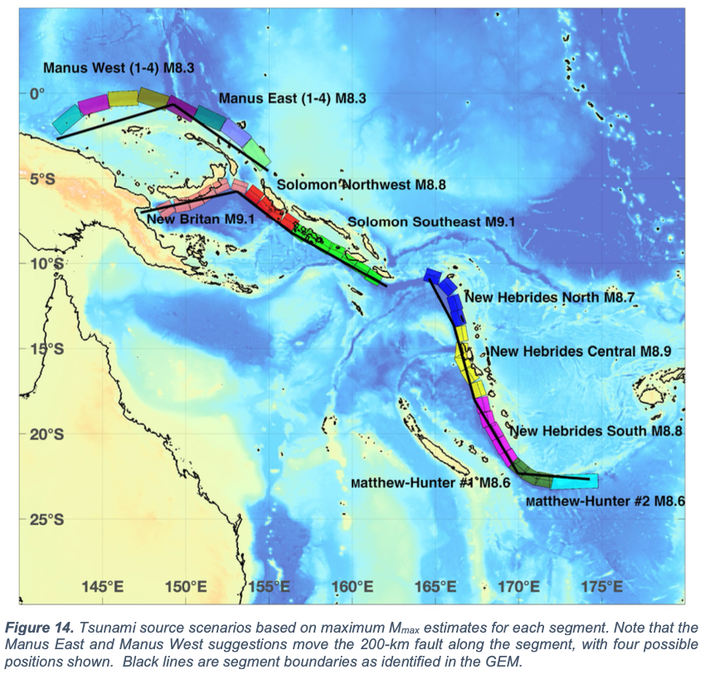
UNESCO Publication IOC-WR-315 UNESCO-IOC. 2025. Expert Meeting on Tsunami Sources, Hazards, Risk and Uncertainties Associated with the Vanuatu, Solomon and New Britain Subduction Zones, Port Vila, Vanuatu, 14–17 May 2024. Paris, UNESCO. (Workshop Reports, 315).

Slide 9
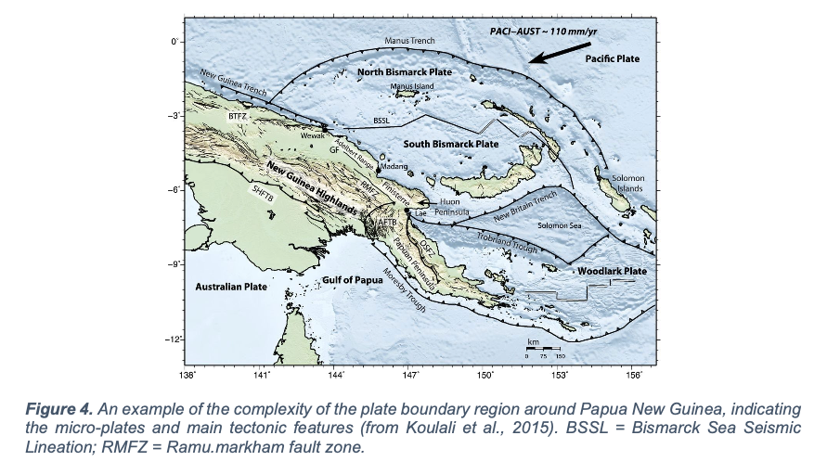
Complicated Regional Seismicity

Slide 10
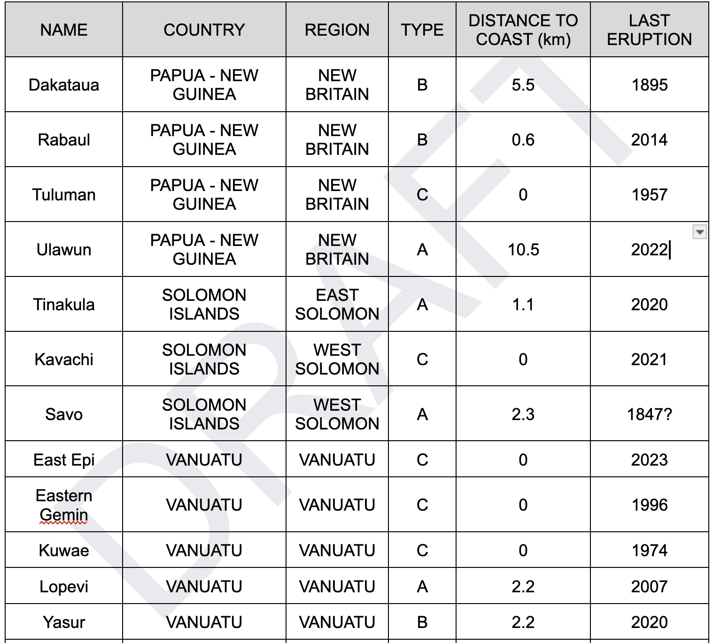
Volcanogenic/Landslide tsunami assessments

Slide 11
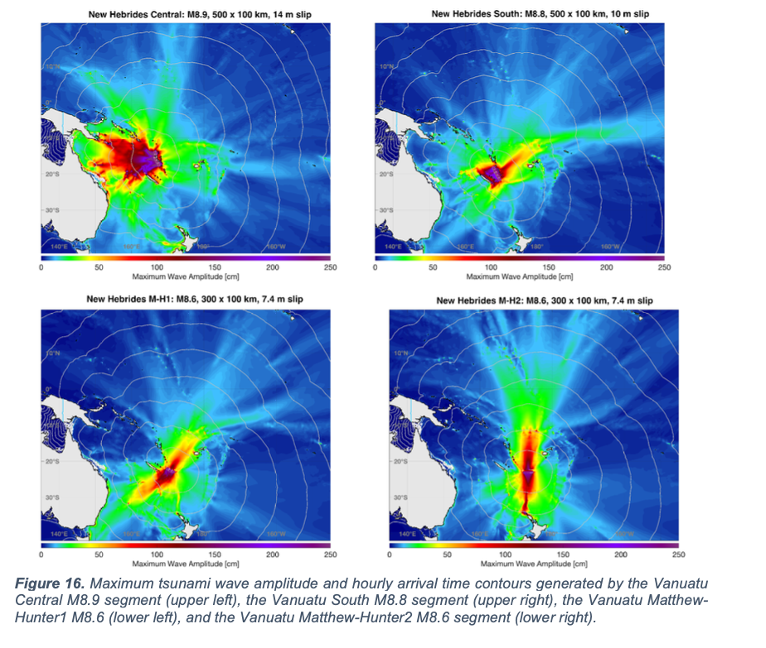
Published suggested segment fault parameters for simple deterministic THA assistance

Slide 12
UNESCO/IOC Tsunami Ready needs/crossover
Tsunami Hazard Assessment modeling
Pacific: Fiji, Pohnpei, Majuro, Palau, (Chuuk,Yap)
Caribbean: Antigua & Barbuda
TsuCAT release 4.4
use in TRRP
Exercise messages feature
Real-time event notification:

Slide 13
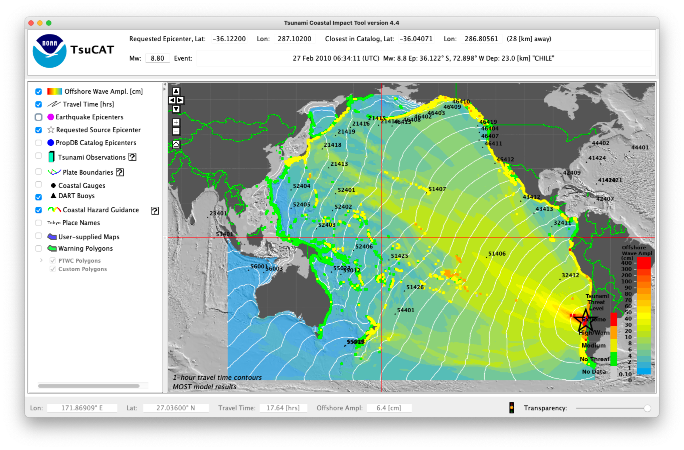
TsuCAT v 4.5
Real-time event notification
(nearest catalog impact shown)
Improved PTWC Exercise Messsages

Slide 14
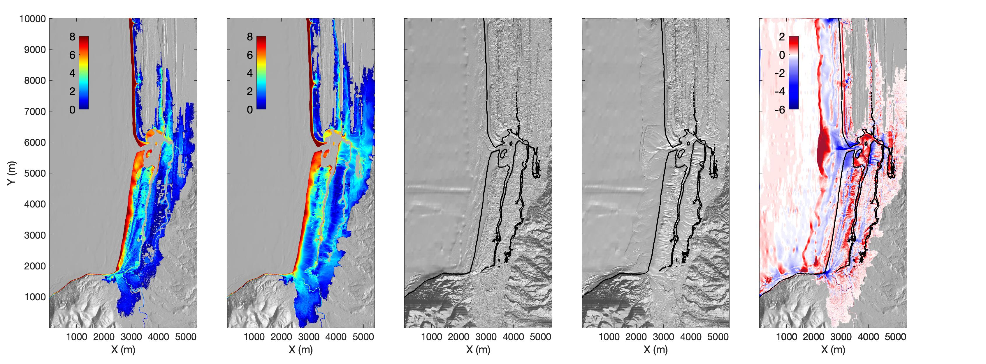
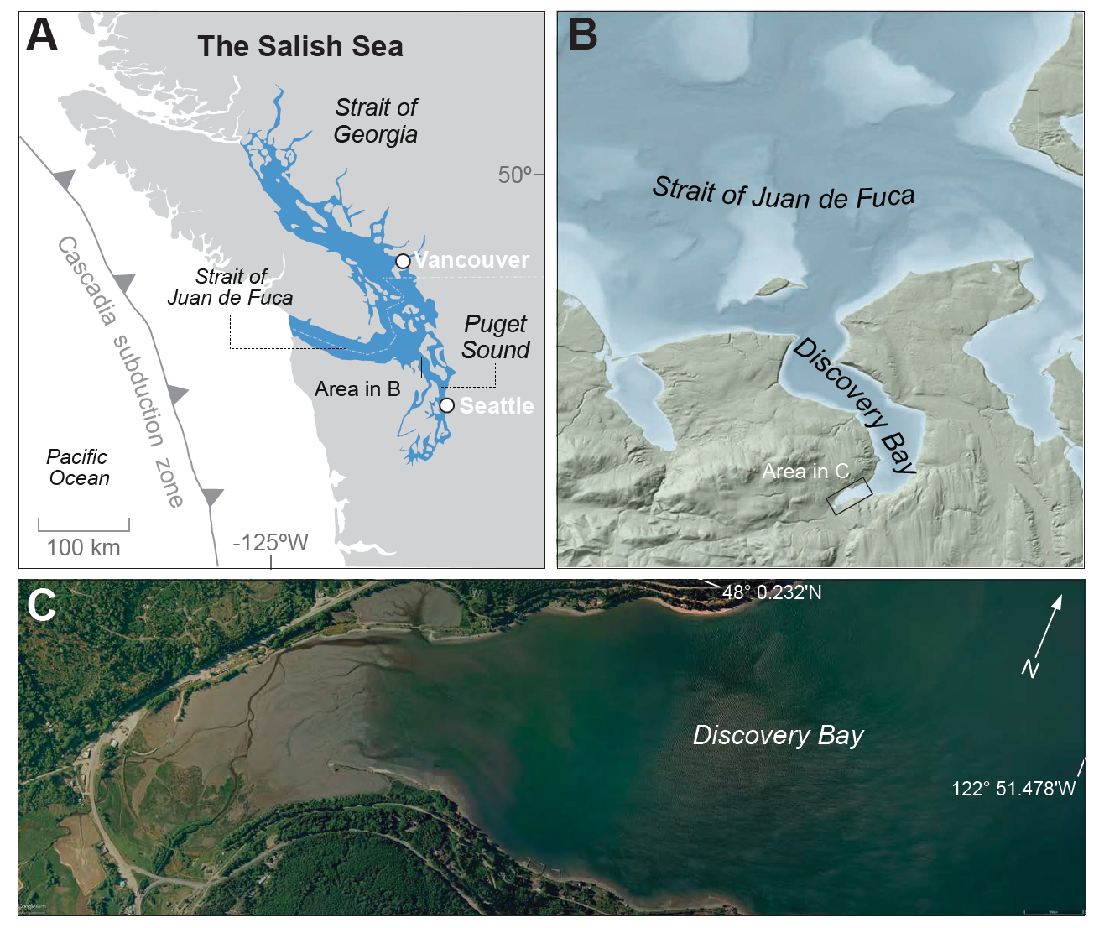
Other efforts: NOAA PMEL
Continued work with the ASCE to improve US building codes – Yong Wei
Addition of sediment transport to real-time inundation – Ernesto Fernandez
Study of paleo-tsunami deposits in Discovery Bay – Carrie Garrison-Laney
Deposits
site
Inundation depth (m) and extent without sediment
Inundation depth (m) and extent with sediment
Erosion (-) and deposition (+) in m

Slide 15
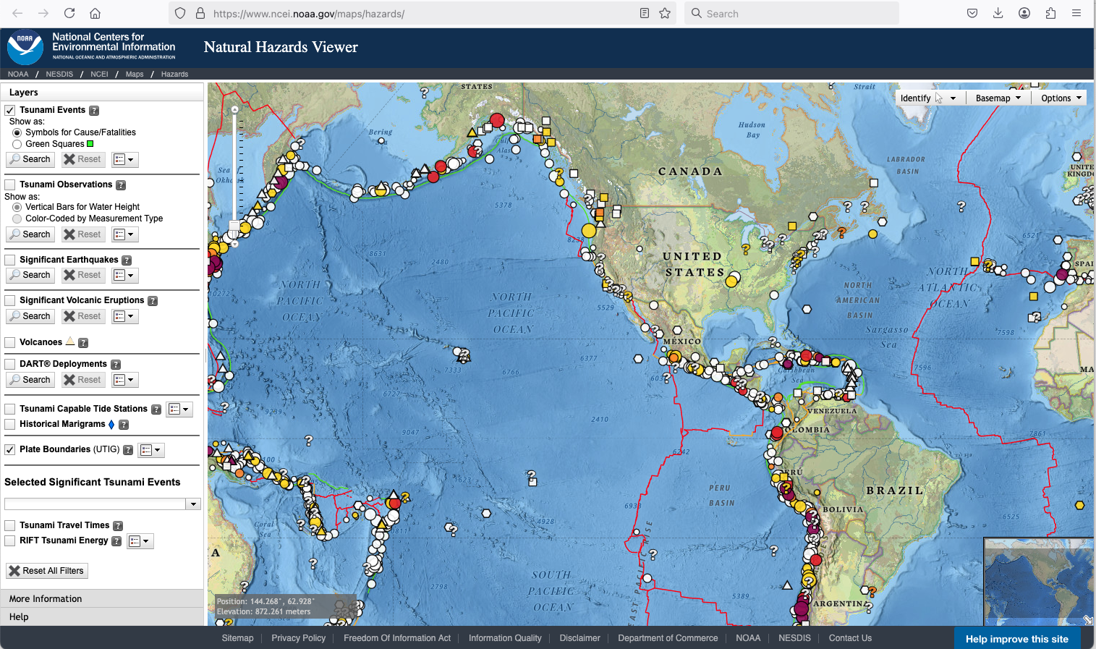
Other efforts: NOAA NCEI Natural Hazards Viewer

Slide 16
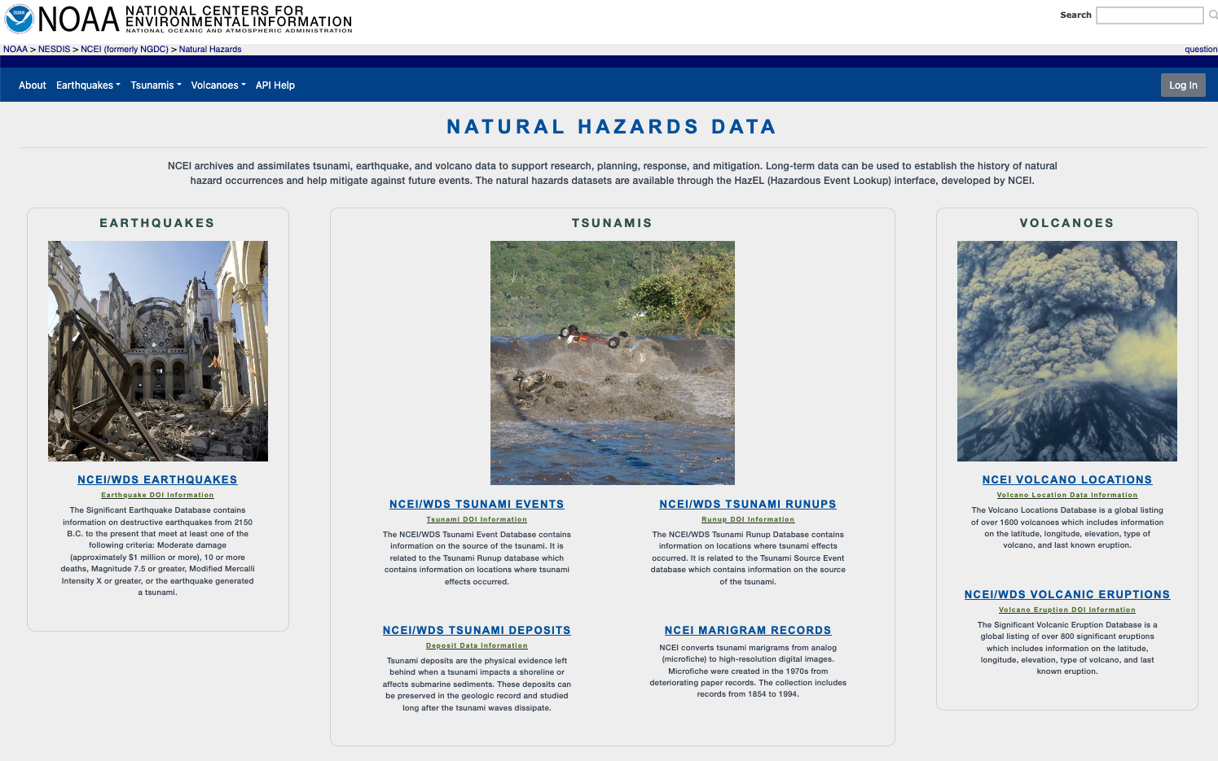
Other efforts: NOAA NCEI Global Historical Tsunami DB

Slide 17
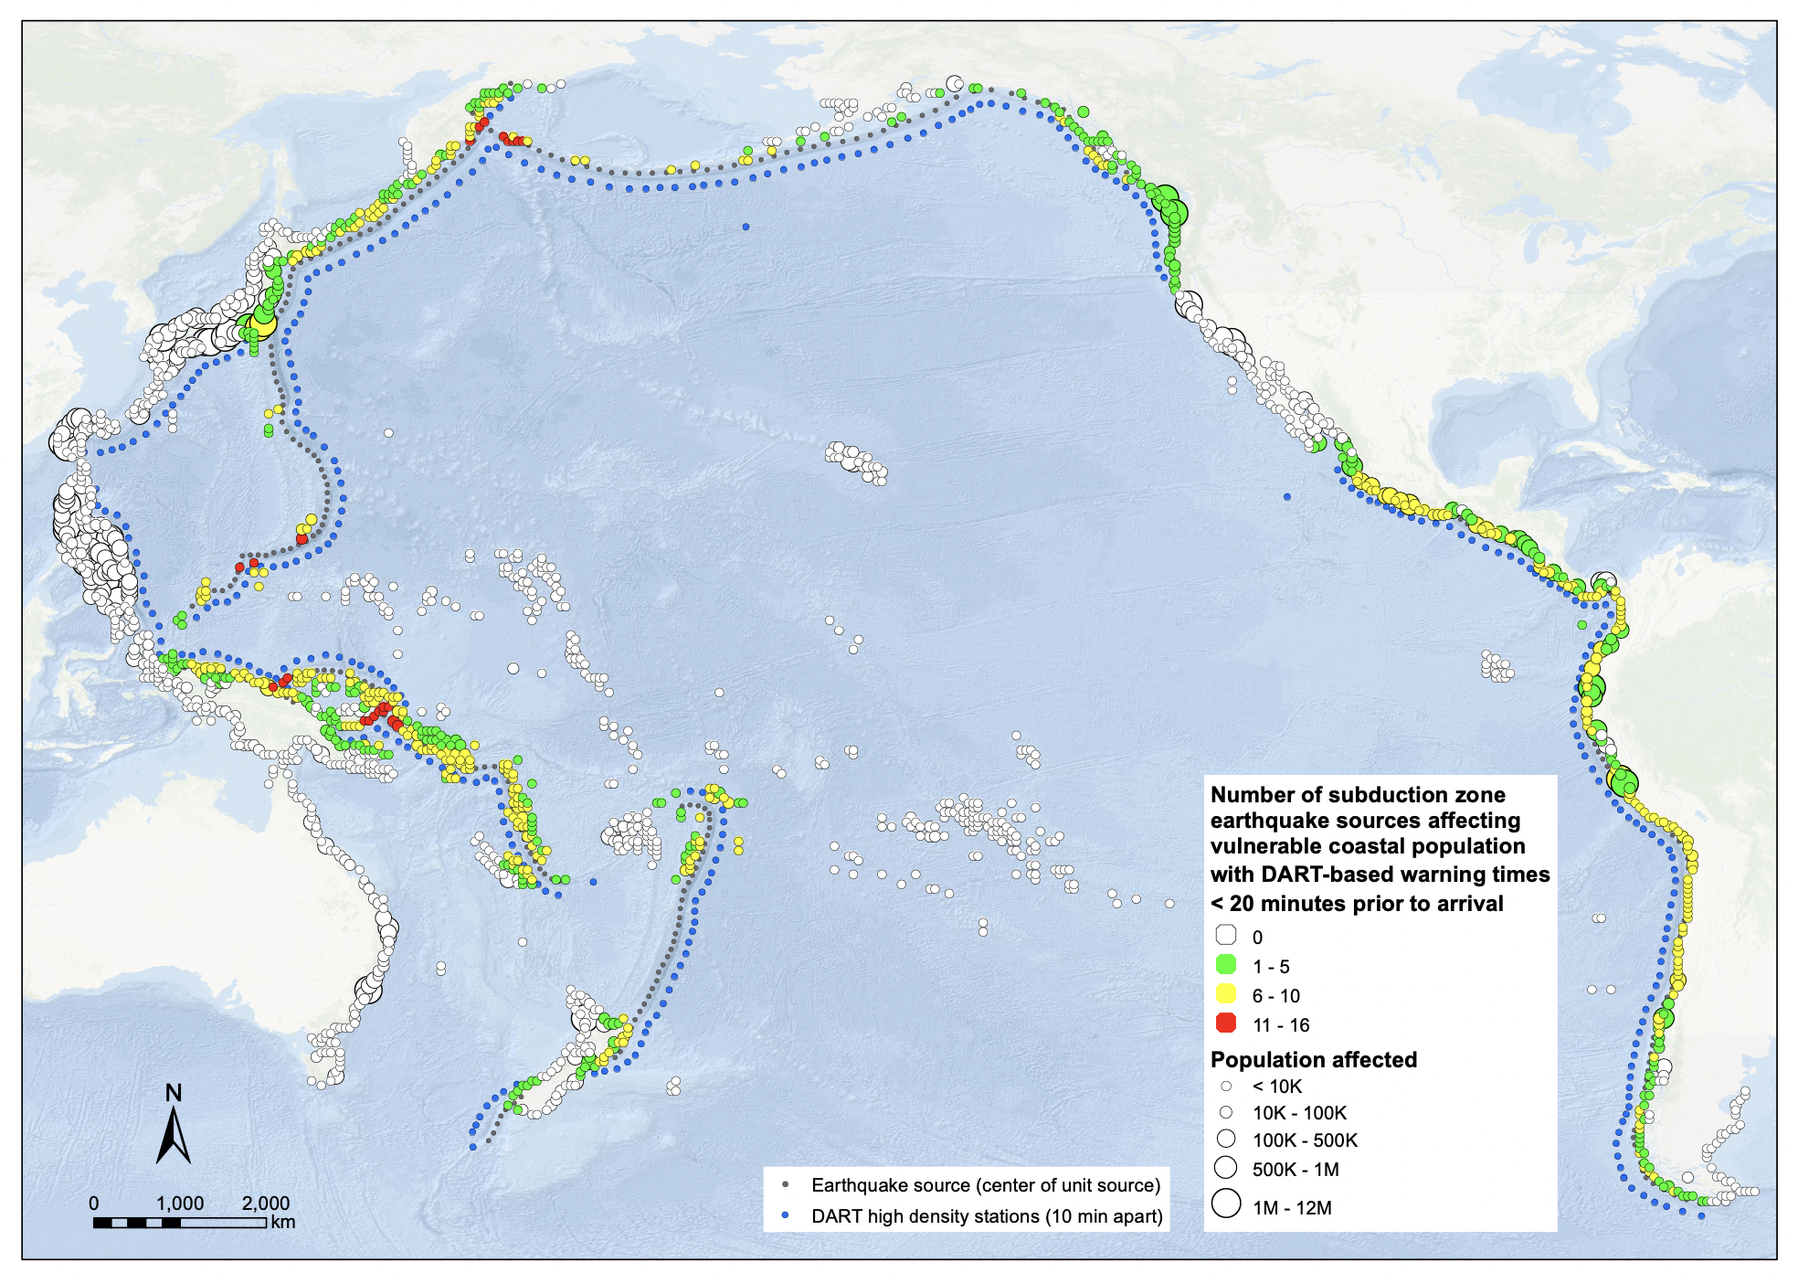
Ongoing Work:
assessing risk basin-wide
Bill Fry, GNS Science
New Zealand
Coastal dots represent exposed populations. Colour represents the relative number of earthquake sources for which at least 20 minutes of pre-impact warning could not be given. We note that these sources are near-field sources with travel times ~<45 minutes.

Slide 18
Other efforts/needs
Establish a baseline source model – in coordination with GTM (Loreto?)
NZ is also near to completing a Pacific-wide source model
USGS Powell Center source model also nearing completion
WG1/WG2 alignment for event response capabilities
French-Polynesia is involved in the GTM effort (Jamelot, discussion: AGU, Washington DC)

Slide 19
PTHA/M: Tiered Hazard Assessments / Models
"Tiered" recommendations on hazard assessments:
inundation mapping should not rely on stochastic assessment - we need ideas for cheaper engineering soln’s: tiered best-practice ideas gold, silver, bronze standards
Recommendation:
Gathering info on model resolution, isobath depth, tools available
Catalogue the sources used in each: Circum-Pacific Source Model
Possible Tsunami Source workshop to include PTHA
Requested an agenda item for April ICG meeting

Slide 20
PTHA/M use case for TsunamiReady (and others)
From the catalog of tsunami sources database
Provide tools to allow easy comparison of impact of a source on a given coastline to aid in choosing a return period/probability
Provides open-ocean/deep-water wave amplitudes offshore
Allow for varying needs from member states:
No high resolution DEM …. or no hydrodynamic modeling support:
Extend PTHA wave amplitudes by extrapolation to the coast
Some high-resolution DEM:
Provide MCE for a given probability to allow modeling
High-res DEM and full hydrodynamic modeling resources:
Full multi-source inundation probabilistic modeling assessment

Slide 21
Some Recommendations
Outcome of New Hebrides/Solomon/New Britain Tsunami Sources meeting
Discussion on PTHA
Possible Tsunami Source workshop to include PTHA
Gathering info on all regional PTHA efforts
"Tiered" recommendations on hazard assessments: inundation mapping should not rely on stochastic. best-practice ideas, gold/silver/bronze standards,
TsunamiReady crossover:
TsuCAT release 4.5, use in
Needs regional assessment: can it be based on PTHA work (Matthieu Peroche’s GIS study in the Caribbean)
Volcanogenic tsunami assessment - WG2 connection
Proposal on an Experts Meeting for the Scotia Arc and South Sandwich Islands region inter-ICG with the Caribbean
Social scientists involved with this WG, improve risk and vulnerability assessments

Slide 22
Next Regional Experts Meeting recommendation
We propose an Experts Meeting for the Scotia Arc and South Sandwich Islands region inter-ICG joint with the Caribbean
Multi-basin impact
Discussion in SC
(EC57 decision associated during IOC-EC 2024 regarding hosting and regional impact)

