Slide 1

re
ICG/PTWS-XXXI
3.10 Reports from UN/non-UN organisations
Temily Baker
Programme Management Officer (Trust Fund for Tsunami, Disaster and Climate Preparedness), ESCAP
Temily.baker@un.org
April 8, 2025
Notes:
PTC Members
Bangladesh (o)
India (o)
Iran (o)
Maldives (o)
Myanmar (o)
Oman
Pakistan (o)
Qatar
Saudi Arabia
Sri Lanka (o)
Thailand (o)
UAE
Yemen

Slide 2
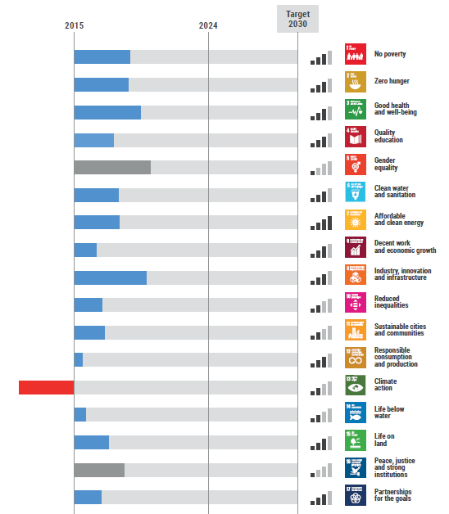
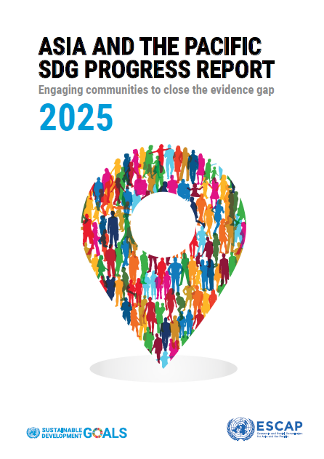
SDG Progress in Asia and the Pacific
Out of the 117 targets with sufficient data only 16 are on track to be achieved – however 18 are regressing, of these include many of the indicators relating resilience to disasters.

Slide 3
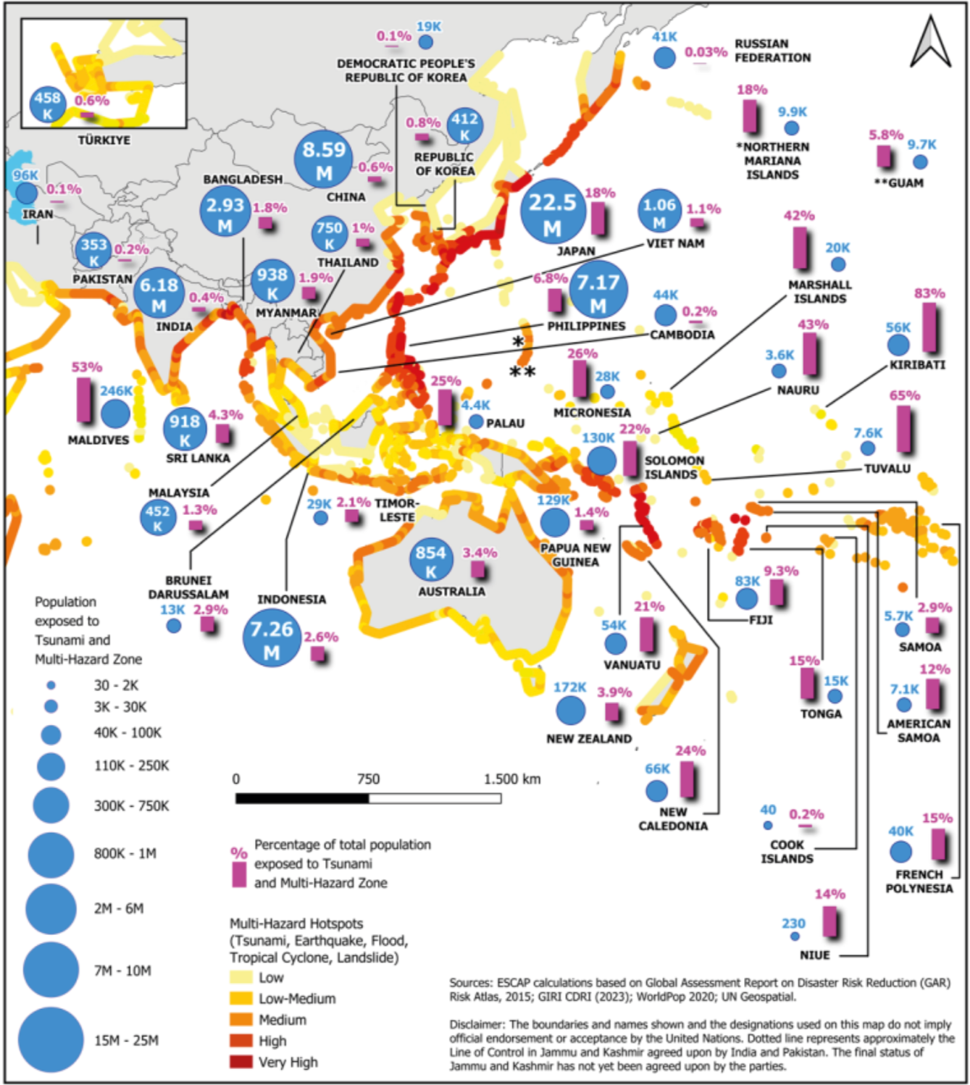
Exploring Tsunami in Multi-hazard contexts
Targeting coastal risk hotspots
People at Risk: 68 million population are exposed in the Asia-Pacific region, for the Pacific:
Kiribati: 83% of the population exposed (highest proportion).
Japan: 22.5 million people exposed (largest population at risk).
Building stock at risk: US$2.4 trillion building stock is exposed in the Asia-Pacific region
Kiribati: 82.5% of the building stock exposed (highest proportion).
Japan: US$1.7 trillion building stock is exposed
Tonga: 43% of Health facilities exposed
Tuvalu: 100% Education facilities exposed
China: 73 Energy facilities exposed (powerplants)
Population exposed to tsunami and multi-hazard hotspots in the Asia-Pacific Region (500-year return period)

Slide 4
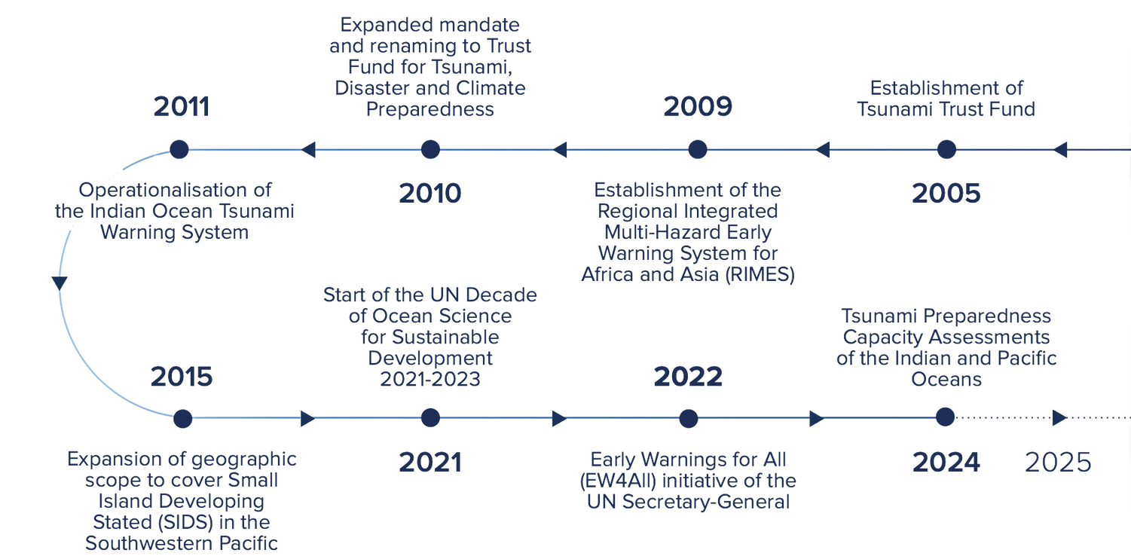

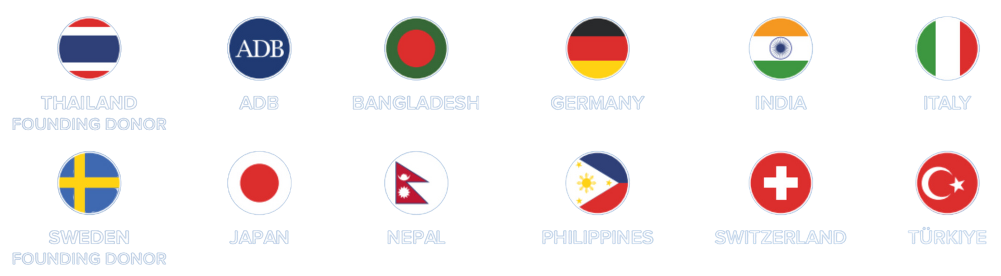
ESCAP’s Trust Fund for Tsunami, Disaster and Climate Preparedness
Following the 2004 Indian Ocean tsunami, the Multi-Donor Trust Fund for Tsunami, Disaster and Climate Preparedness was established with a founding grant of $10 million from Thailand and soon joined by Sweden.
10 other donors have since contributed, for a currently total of $17 million of regional commitment to strengthen early warning systems, directly benefitting 23 countries.

