Slide 1

ICG/PTWS XXXI April 2025
Tsunami Ready ‘Equivalency’
In the Pacific
Task Team Tsunami Ready Co Chairs:
Laura Kong, ITIC
Ashleigh Fromont, NZ NEMA

Slide 2
ICG/PTWS XXXI April 2025
The pathway to equivalency
WG3 recommends that the ICG/PTWS:
Recalling the ICG/PTWS-XXIX.1 recommendation for WG3 to explore ways to recognize communities that choose not to implement the UNESCO IOC Tsunami Ready Recognition Programme as compliant with the Tsunami Ready Indicators,
Recalling the proposed Tsunami Ready Equivalency Approach shared at the Thirty-first session of the ICG/PTWS by Working Group Three, and the establishment of the Task Team Tsunami Ready under PTWS Working Group Three during this Session,
Recalling further the ICG/PTWS-XXX.5 recommendation that WG3 develop formal guidance for ICG/PTWS on the application of the proposed Tsunami Ready Equivalency Approach, led by WG3 Task Team Tsunami Ready, in consultation with Regional Working Groups
Noting the TOWS WG-XVII (2024) appreciation of the progress made by ICG/PTWS concerning exploring mechanisms of how to include national tsunami preparedness and readiness programmes and initiatives in the UN Ocean Decade Programme, and that Tsunami Ready Equivalency Approach framed under other similar initiatives seeks to enable reporting on tsunami preparedness in a manner compatible with the TRRP, using existing national frameworks and requirements.

Slide 3
ICG/PTWS XXXI April 2025
TRRP “Equivalency”
The UN Ocean Decade Goal is to make ”100% of communities at risk of tsunami prepared for and resilient to tsunamis by 2030 through the implementation of the UNESCO/IOC Tsunami Ready Recognition Programme and other initiatives.”
For the proposed ‘equivalency’ concept, the 12 indicators of the Tsunami Ready Recognition Programme are taken as the definition of ‘prepared and resilient’
The purpose of this ‘equivalency approach’ is to ensure that every country can contribute to progress reporting for the UN Ocean Decade Goal.
This process does not require application to IOC/UNESCO for formal TR recognition but will support ICG reporting.
.

Slide 4

ICG/PTWS XXXI April 2025
TRRP “Equivalency”
The approach proposed at ICG/PTWS-XXX (September 2023) has the following principles:
        Countries have a strong motivation to ensure tsunami resilience
Builds upon existing programmes, capacities and strengths
We use the 12 indicators of the Tsunami Ready Framework
Contributes to ICG progress reporting for UNOD Tsunami Programme
        Where possible, the TRRP should be implemented as a first option
Notes:
Last one is a new one

Slide 5
ICG/PTWS XXXI April 2025
TRRP “Equivalency” is a country action
Approach proposed at ICG/PTWS-XXX had 4 steps, since simplified to 3:
Identify / establish national governance
Assess tsunami preparedness & resiliency against TRRP indicators
Report progress toward UNOD Goal to ICG.
This process would be applied to the most pragmatic definition of community, so that the assessment can be conducted in a meaningful but sustainable manner.
It is important that this is appropriate for each countries existing disaster management context
The Tsunami Ready Recognition Programme gives similar flexibility.

Slide 6
ICG/PTWS XXXI April 2025
1. Identify or Establish Governance
National governance should be in place in order to provide oversight of this process. In many cases an existing governance body may be able to be identified for this purpose to avoid duplication, or a bespoke National Tsunami Ready Board could be established.
The functions of this governance group will be to:
Provide expert interpretation of the tsunami ready indicators in the country's own context
Provide expert commentary on the definition of community in the country’s own context
Coordinate and oversee implementation of this equivalency process
Should formal Tsunami Ready Recognition appropriately wish to be pursued by any individual community, this governance structure may be able to be utilized for the recognition process as per IOC MG 74.

Slide 7
ICG/PTWS XXXI April 2025
2. Cross-Referencing Process
A cross-referencing guide is provided in the documentation, which is intended to be broad enough for multiple contexts, while remaining a high standard of tsunami preparedness. if the community's existing reporting to the state does not allow for explicit determination of preparedness activities, if it is believed that known or implied preparedness activities contribute to an indicator this can be recorded as justification to meet the overall indicator. An example of this would be when laws related to disaster prevent mandate certain activities to occur in the community.
This process is a self-assessment, and countries are encouraged to apply it according to the principles of the equivalency process.
This review, along with supporting documentation such as plans, should then be reviewed by the established governance mechanism.
The cross-referencing process should be completed at least once every four years, in alignment with the Tsunami Ready Recognition Programme renewal timeframe.
Notes:
At a national level, a review should be conducted of all existing activities and strategies that contribute to tsunami preparedness as described by the Tsunami Ready Recognition Programme indicators. The purpose of this is the identification of where Tsunami Ready indicators are already being met through existing national or community disaster management or tsunami preparedness efforts.
Before the ICG we will be trying to provide examples of how this might practically be applied in a few countries

Slide 8
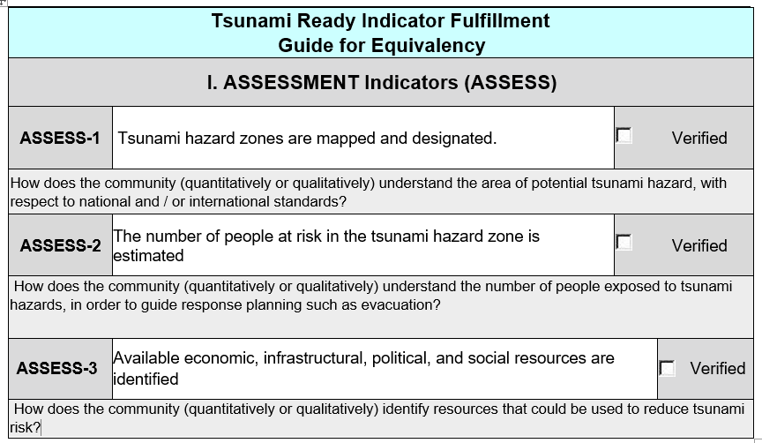
ICG/PTWS XXXI April 2025
2. Cross-Referencing Process cont.

Slide 9
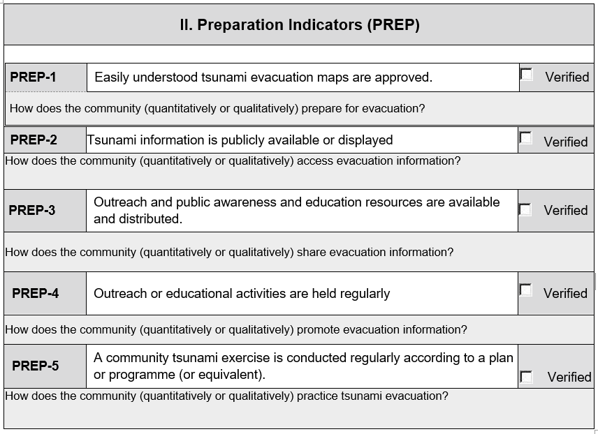
ICG/PTWS XXXI April 2025
2. Cross-Referencing Process cont.

Slide 10
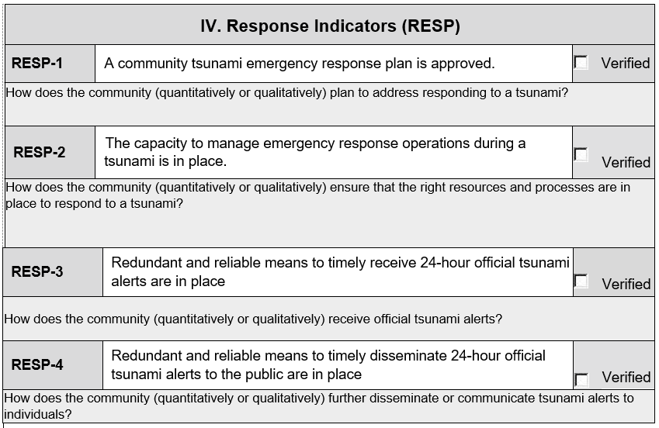
ICG/PTWS XXXI April 2025
2. Cross-Referencing Process cont.

Slide 11
ICG/PTWS XXXI April 2025
3. Reporting
PTWS Member States should report the progress of the preparedness and resilience of at-risk communities either through the Tsunami Ready Recognition Programme Implementation or through the equivalency approach through national reporting to the ICG.
Ideally, these should be integrated with future PTWS KPI and National Reporting frameworks, but reporting could be along the lines of the following:
What % of your at-risk communities are ‘prepared for and resilient to tsunami’?
This will need to continue to be closely aligned to global reporting methods for UNOD goals and the Tsunami Ready recognition programme.

Slide 12
ICG/PTWS XXXI April 2025
3. Reporting
PTWS Member States should report the progress of the preparedness and resilience of at-risk communities either through the Tsunami Ready Recognition Programme Implementation or through the equivalency approach through national reporting to the ICG.
Ideally, these should be integrated with future PTWS KPI and National Reporting frameworks, but reporting could be along the lines of the following:
What % of your at-risk communities are ‘prepared for and resilient to tsunami’?
This will need to continue to be closely aligned to global reporting methods for UNOD goals and the Tsunami Ready recognition programme.

Slide 13
ICG/PTWS XXXI April 2025
Next Steps
Working Group 3 Task Team Tsunami ready now proposes that this guidance receives provisional approval and progresses to a pilot stage.
A pilot is required to test the usability and feasibility of the equivalency approach in multiple contexts, noting the diversity of the Member States the guidance is intended to support.
The Task Team would like to welcome Member States to engage with us regarding implementation of the guidance, to facilitate a report back to ICG/PTWS XXXII.
We suggest this recommendation is tested in an intersessional working group.

Slide 14
ICG/PTWS XXXI April 2025
Next steps
WG3 recommends that the ICG/PTWS:
Noting the progress made in the intersessional period on the development of a Guideline for the PTWS Tsunami Ready Equivalency Framework by ICG/PTWS WG3 TT Tsunami Ready,
Recommends the provisional approval of the Tsunami Ready Equivalency Guidance, as described in IOC ICG/PTWS-XXXI Draft Document (Agenda 4.2).
Welcomes the ICG/PTWS WG3 Task Team Tsunami Ready proposal to pilot the PTWS Tsunami Ready Equivalency Guidance,
Encourages Member States to consider working with the ICG/PTWS WG3 TT Tsunami Ready to contribute to a pilot of the PTWS Tsunami Ready Equivalency Guidance, in order to report back on the feasibility and usability of the approach,
Recommends the ICG/PTWS WG3 TT TR to utilize the results of pilot applications to prepare the guidance for final approval at the Thirty-Second Session of the ICG/PTWS.

