Slide 1
INDONESIA NATIONAL REPORT
Suci Dewi Anugrah
Directorate for Earthquake and Tsunami, BMKG
suci.anugrah@bmkg.go.id
XXXI Session of the Intergovernmental Coordination Group for the Pacific Ocean Tsunami Warning and Mitigation System (ICG/PTWS-XXXI), Beijing, China
7, 8–11 April 2025

Slide 2
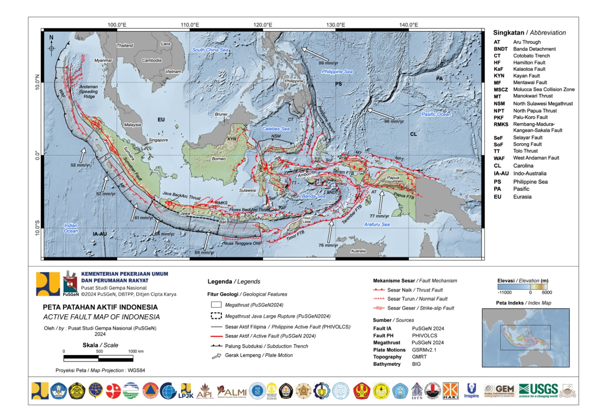
SEISMOTECTONIC OF INDONESIA
TECTONIC SETTING
Philippines
Plate
Pacific
Plate
Indonesia is located at the meeting point of 3 major world plates (Indo-Australia, Pacific, Eurasia)
There are 14 subduction/megathrust earthquake source segments
There are 402 active fault earthquake source segments that have been identified, and many more have not been identified

Slide 3
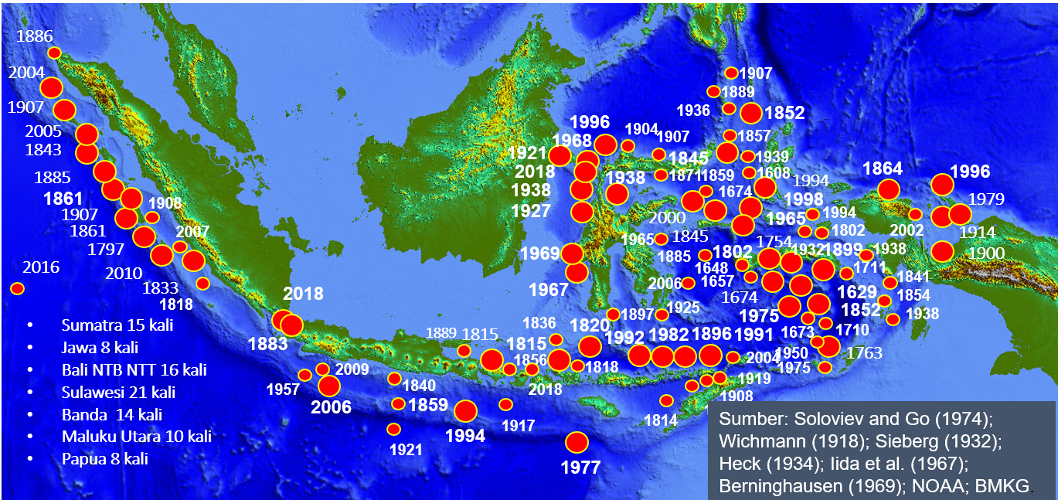
INDONESIAN TSUNAMI HISTORY
Tsunamis occur along the subduction zone
The Eastern Region experiences the most frequent tsunamis
The 1864Tsunami in West Papua, 250 people died
The 1996 Tsunami in West Papua, 110 people died
The 1871 Tsunami in North Sulawesi, 400 people died
The 1897 Tsunami in North Sulawesi, 100 people died

Slide 4
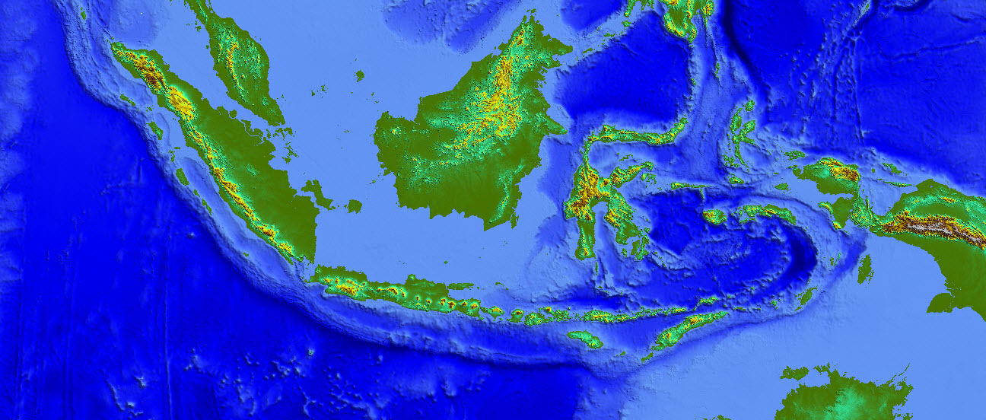
VOLCANO TSUNAMI
Gunung Awu
2 Maret 1856
2.806 tewas
7
6
Gunung Gamkonora
20 Mei 1673
Merusak banyak desa
Gunung Ruang
3 Maret 1871
416 tewas
8
5
Gunung Gamalama
1 September 1763
9 meter di Ternate
Gunung Gamalama
14 Feb 1840
Merusak pesisir Ternate
9 Volcanos potentially generate tsunami
Krakatau
Tambora
Rokatenda
Teon
Gamalama
Ruang
Awu
Gamkonora
Illeweung
Krakatau
26-27 Agustus 1883
1
Rokatenda
4 Agustus 1928
4
Tambora
10 April 1815
Gunung Teon
11 November 1659
Kerusakan dan korban tewas
2
3
9
Illiwerung
4 Agustus 1928

Slide 5
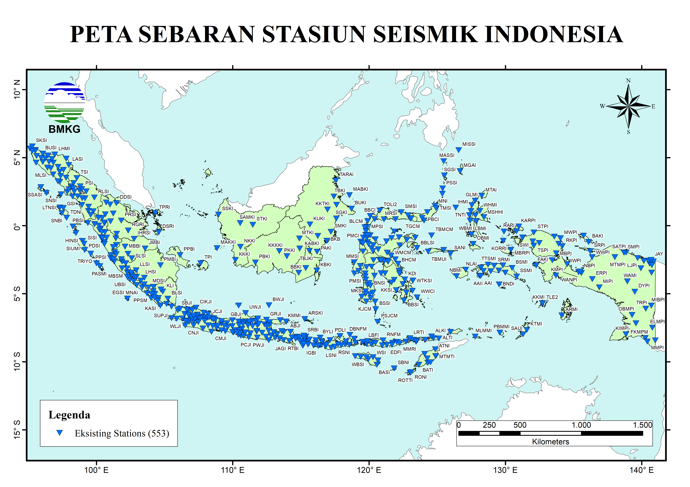
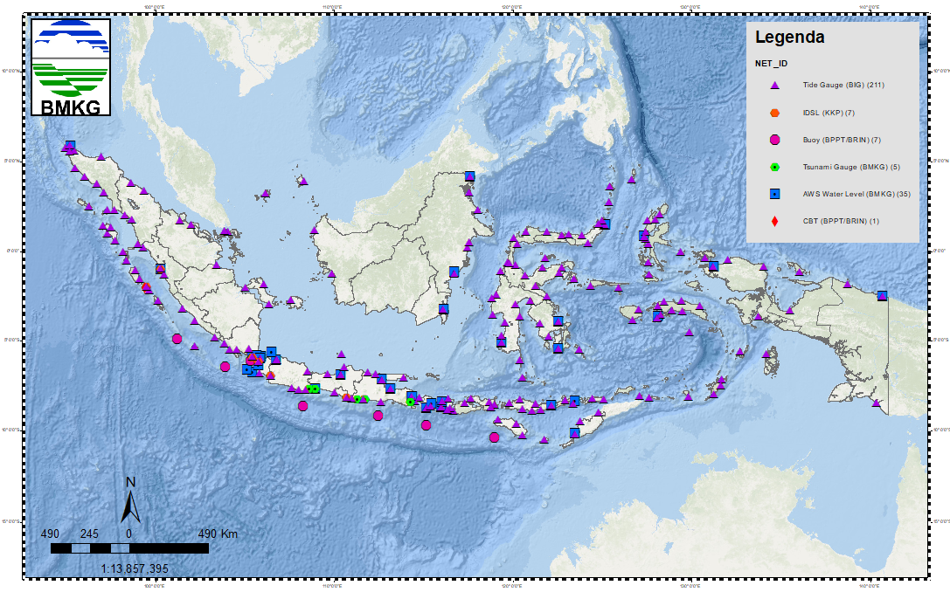
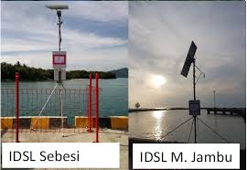
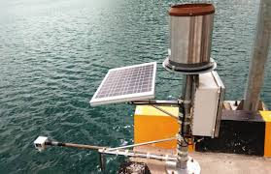
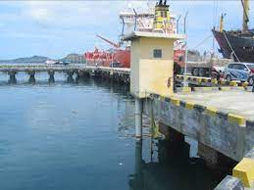
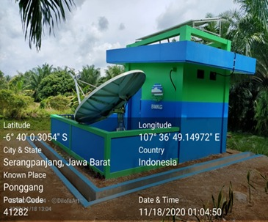
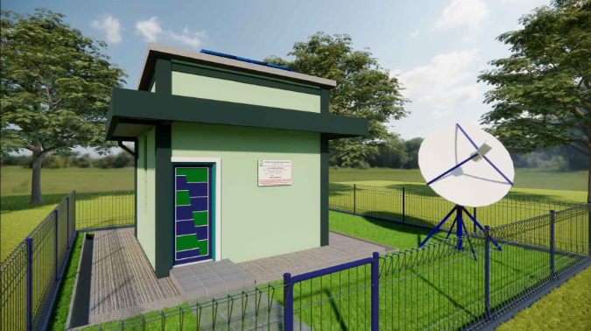
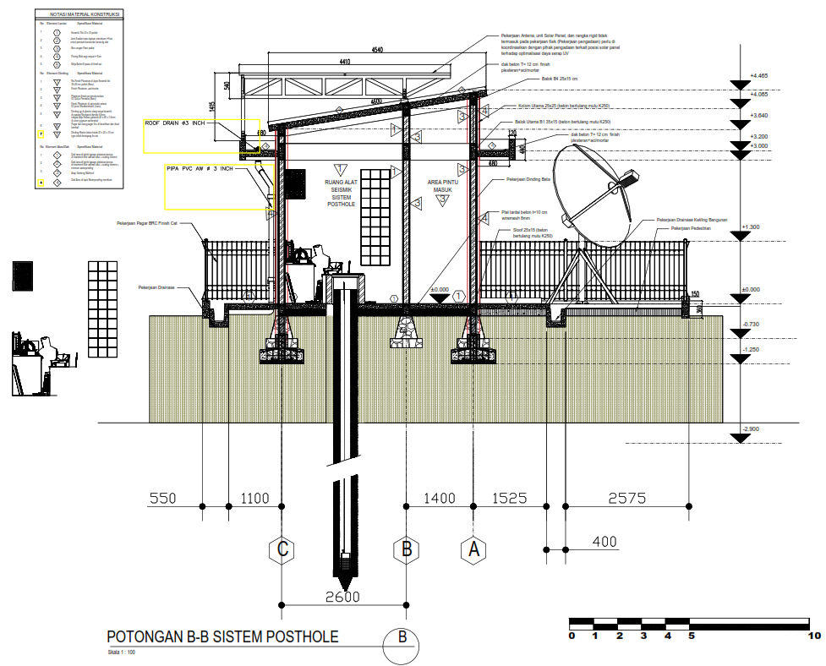
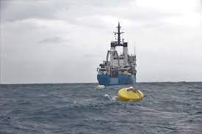
EARTHQUAKE AND SEA LEVEL MONITORING NETWORK
Water Level
Sea Level Detection Network
211 Tide Gauge (BIG)
5 Tsunami Gauge (BMKG)
35 Automatic Water Level (BMKG)
13 IDSL Water Level (KKP – BRIN)
7 Tsunami BUOY (BRIN)
533 Seismic Sites for Earthquake Detection
413 Pier Installation
140 Post Hole Instalations
Tide Gauge
Pier and Post Hole Seismograph
Buoy

Slide 6
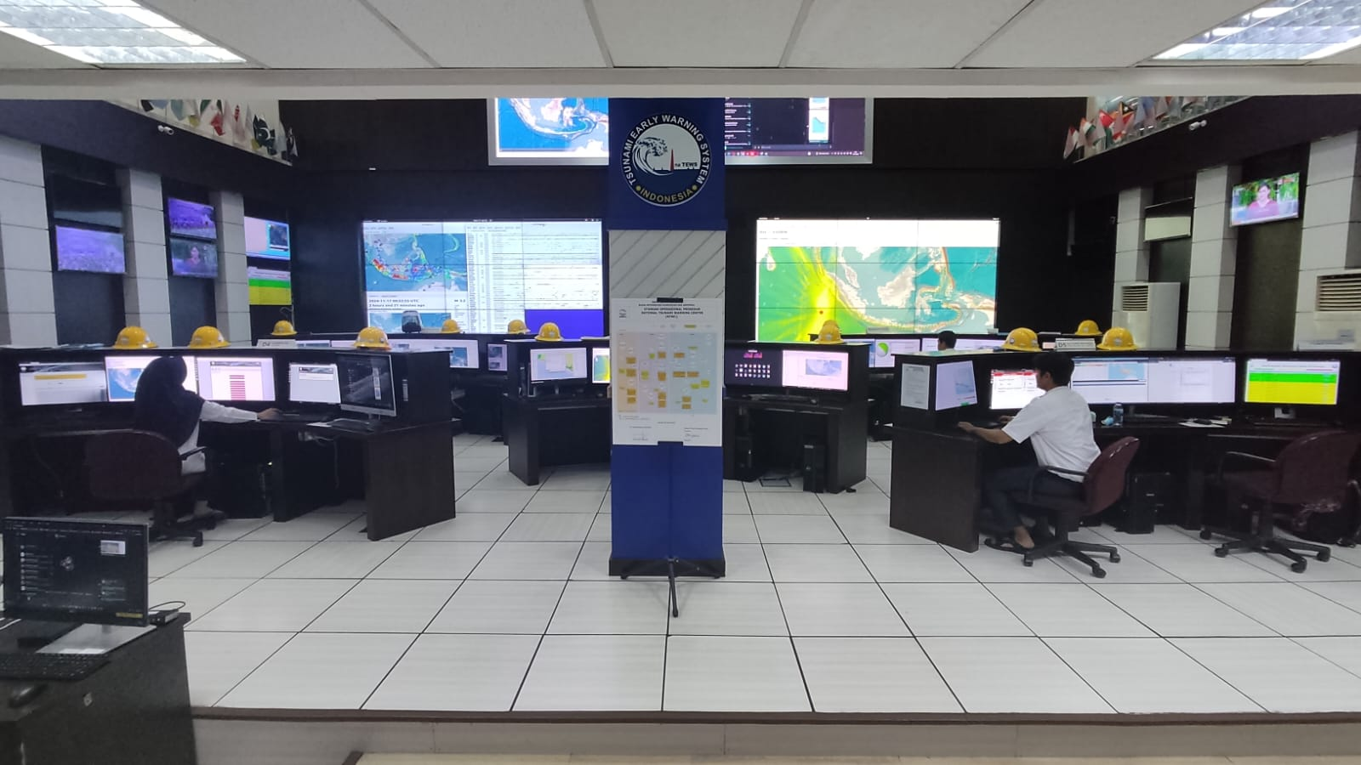

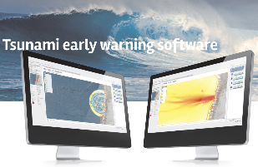
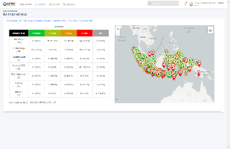
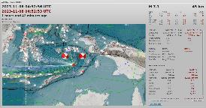
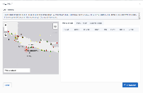
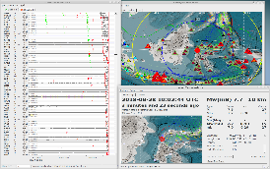
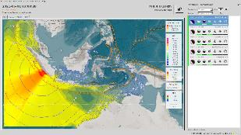
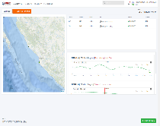
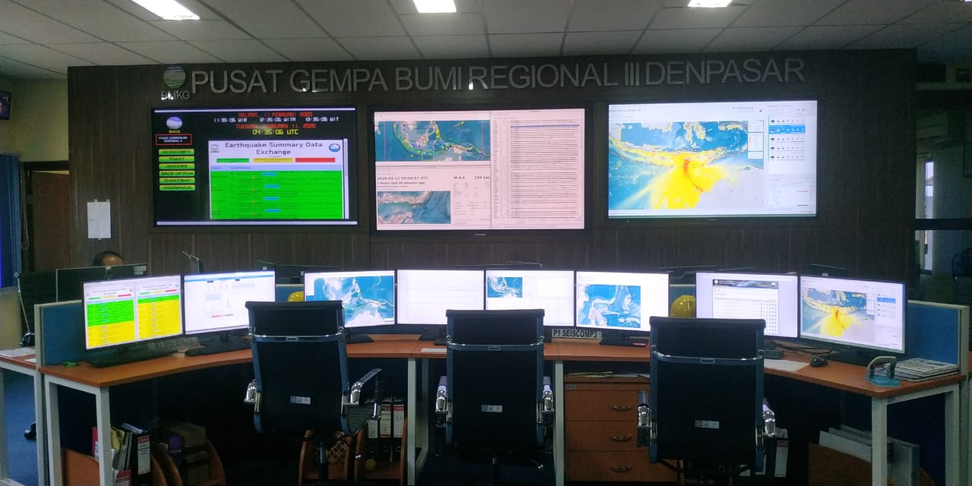
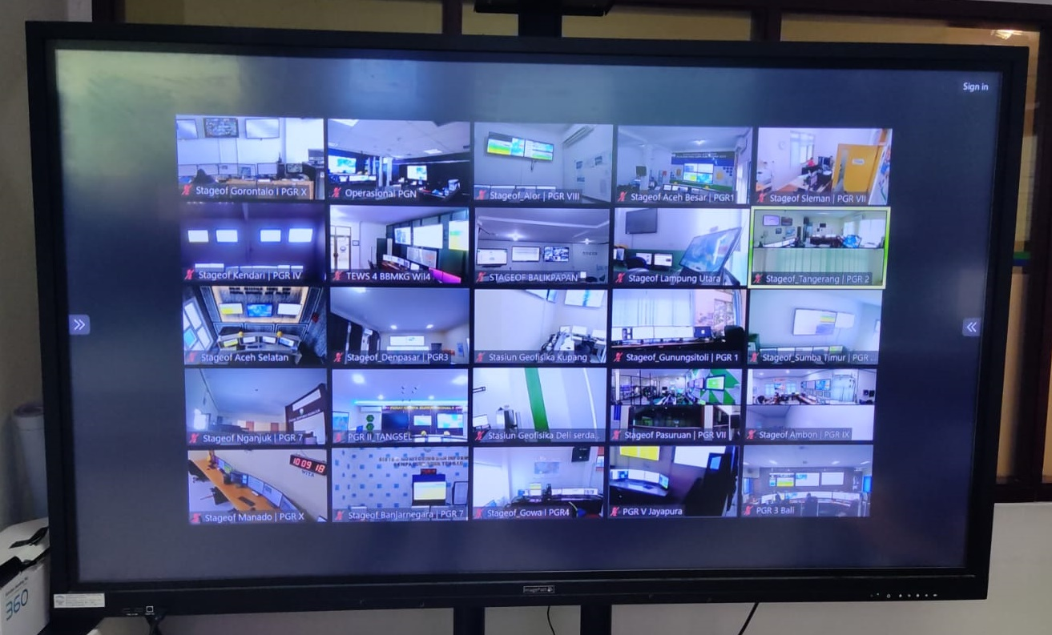
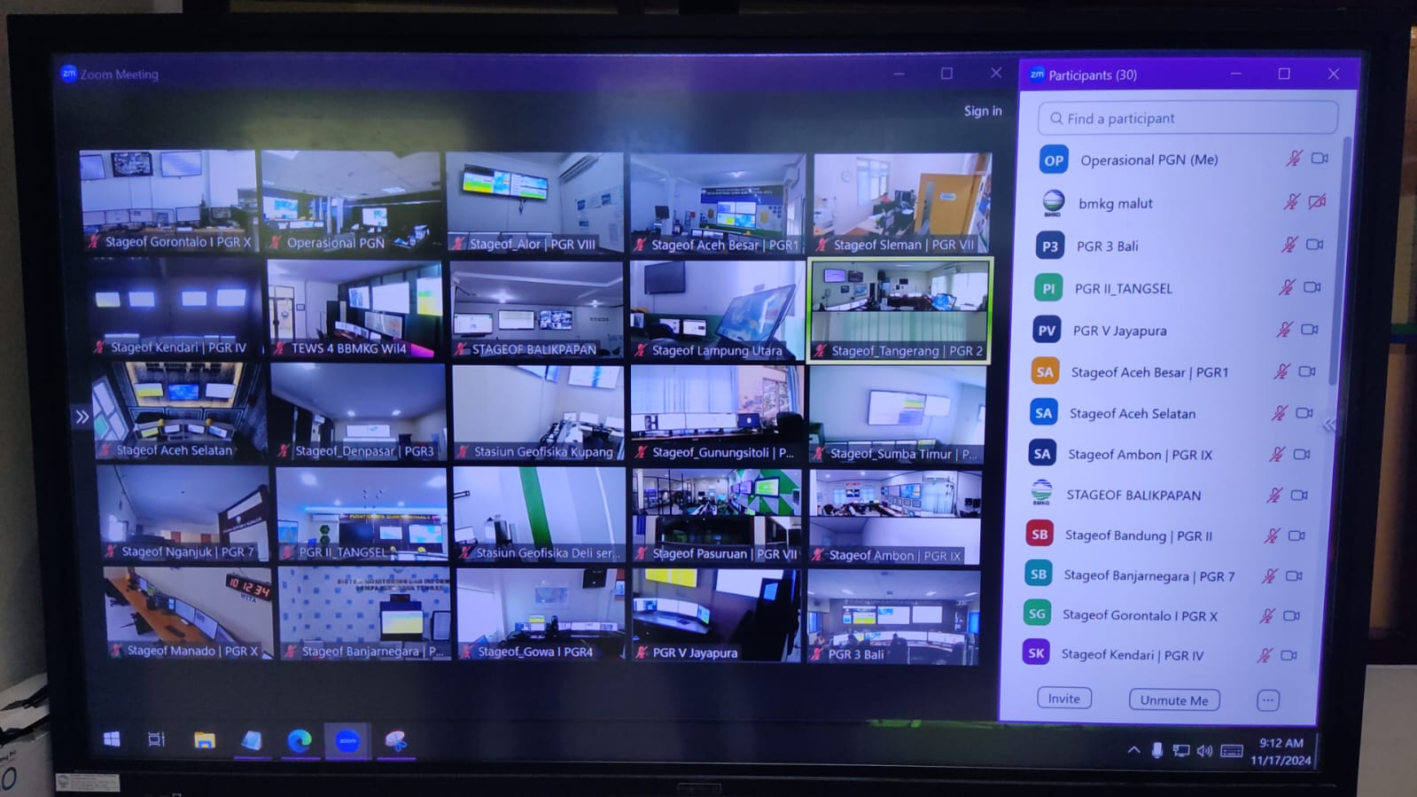
Earthquake and tsunami processing system
SEISCOMP
TOAST
InaTNT
Main System (JAKARTA)
24/7 communication and coordination with the local BMKG directly as part of the confirmation process of earthquake events and the coordination with the InaTEWS operational system (Jakarta and Bali).
Backup System (BALI)

Slide 7
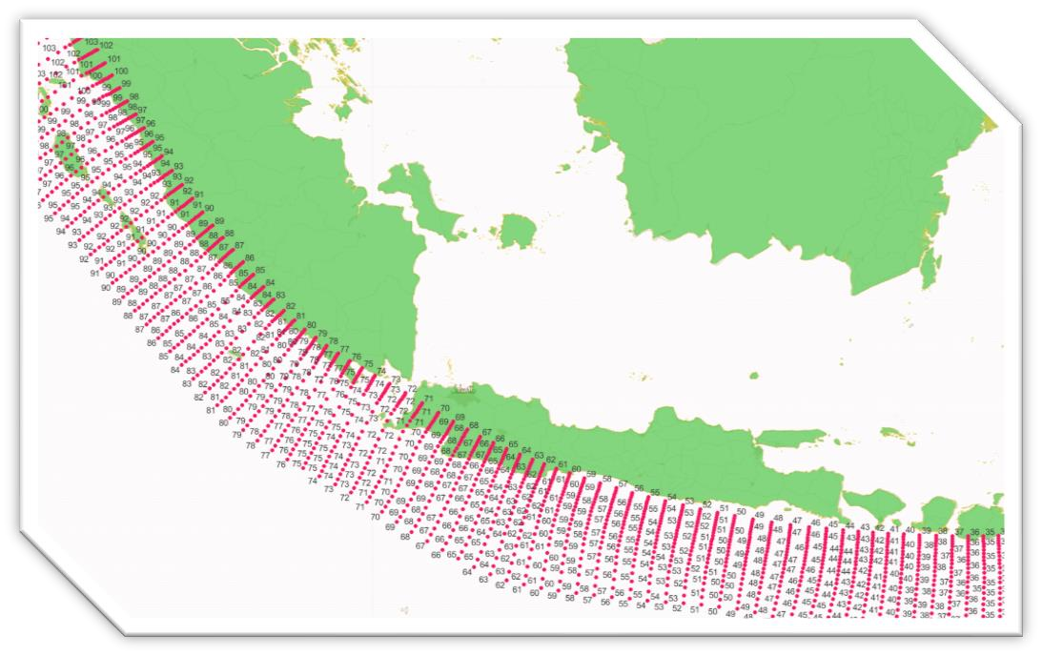
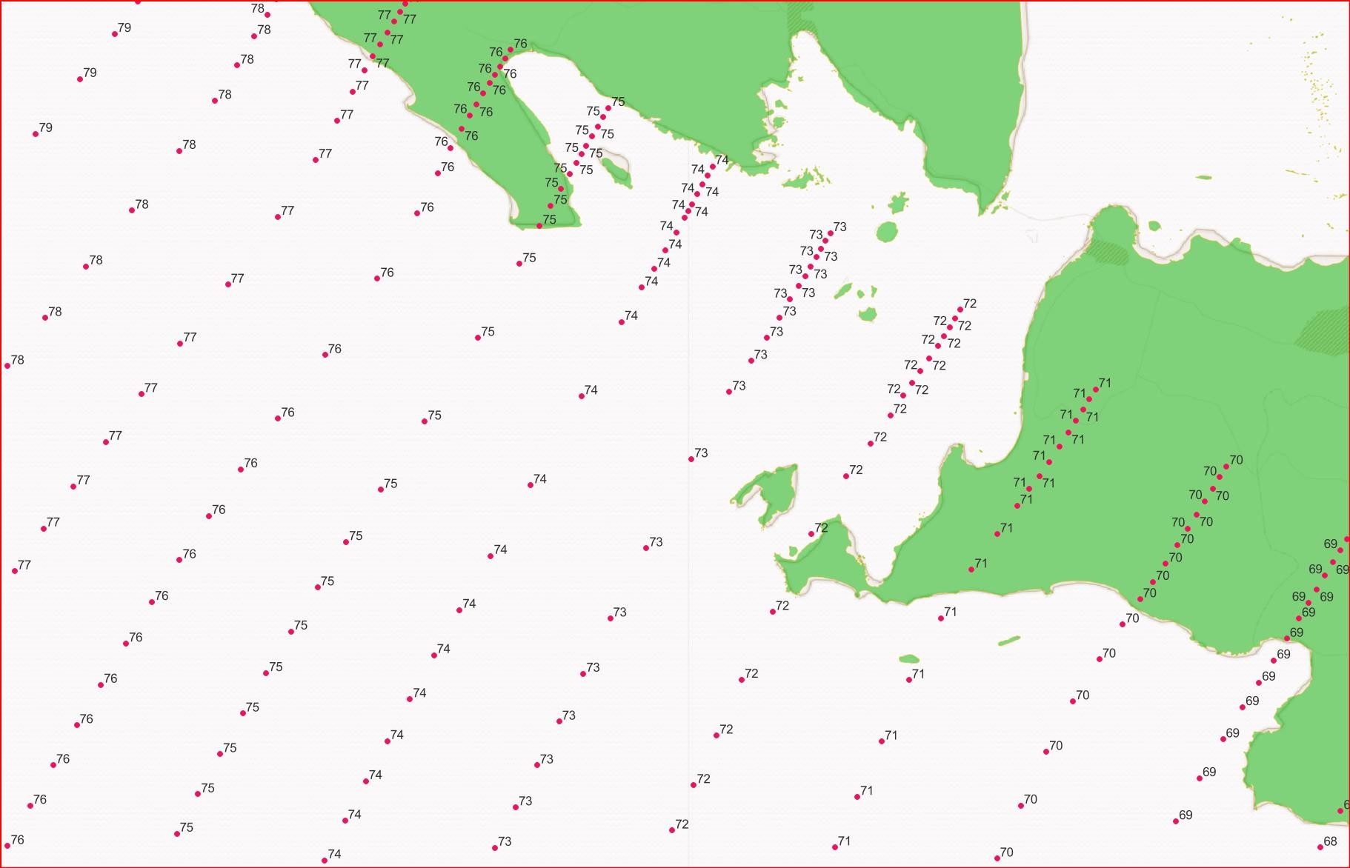































Expanding Pre-Calculated Tsunami Database
Goals :
Extending pre-calculated tsunami scenario database with ‘odd’ magnitudes in the Sunda Zone (West Sumatra-South Java-Bali and Sumbawa subduction).
Developing 1800 pre-calculated tsunami database with magnitude ranging from Mw 7.1 to M 7.3
9
Year | Magnitude Ranges | Number of Tsunami Scenarios
2024 | M 7.1 to M 7.3 | 11.800
2025 | M 7.5 to M 8.1 | 42.700
2026 | M 8.3 to M 8.9 | 1425
Existing : “Even” Magnitude Scenarios (Eq. 7.0, 7.2, 7.3 to 9.0)
New : “Odd” Magnitude Scenarios (Eq. 7.1, 7.3, 7.5 to 8.9)
55.925

Slide 8
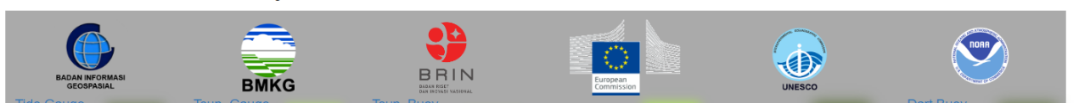
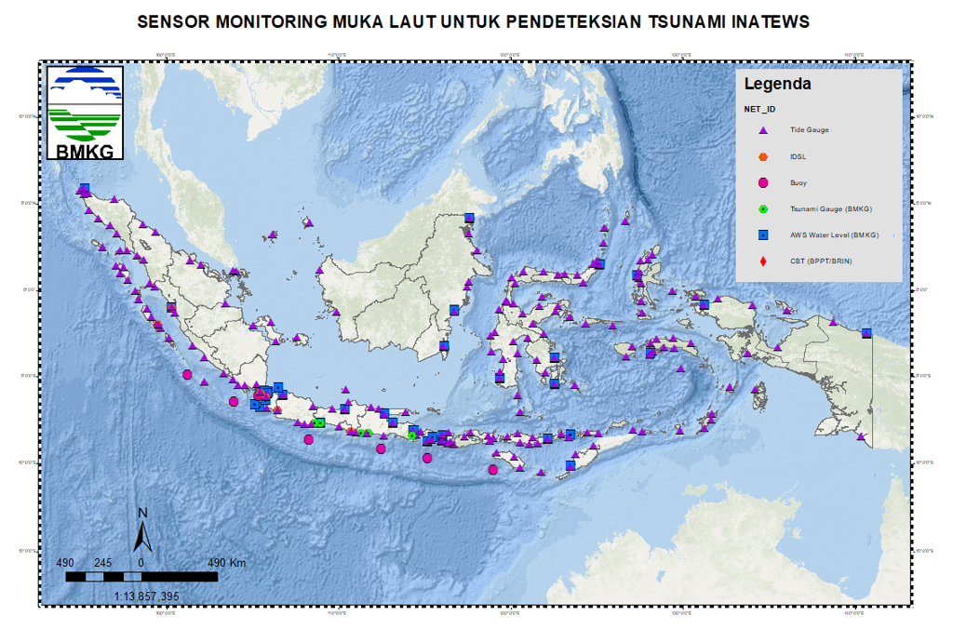
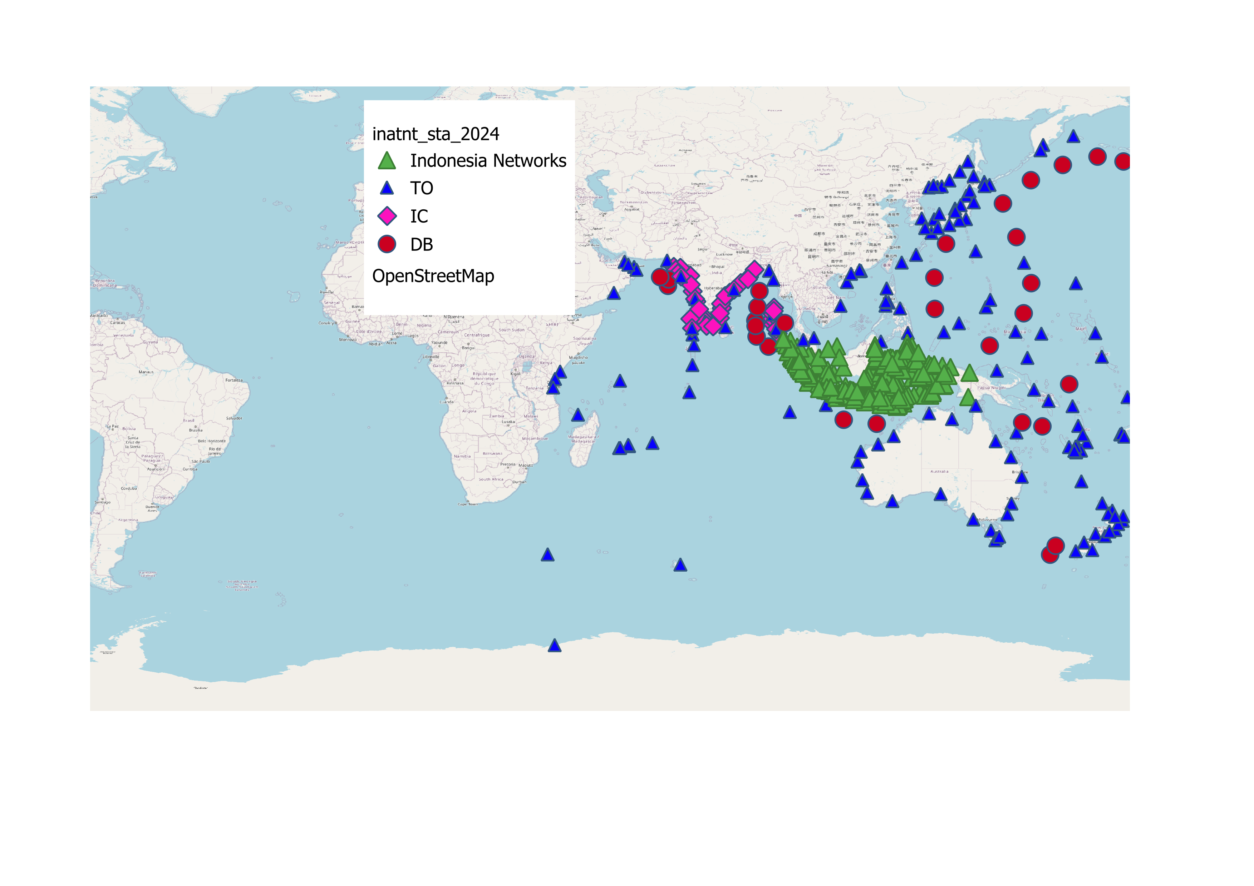
InaTNT (Indonesia Tsunami Non Tektonik)
InaTNT is an integrated system that functions to detect sea level change anomalies that indicate a tsunami recorded by sea level observation sensors from many data sources in Indonesia (BMKG, BIG, BRIN, and KKP) and outside. The presence of InaTNT is expected to improve the performance of the InaTEWS system in detecting tsunamis caused by tectonic and non-tectonic sources.
Number of Integrated Sea Level Monitoring Sensors:
318 Sensors
(165)
(7)
(33)

Slide 9
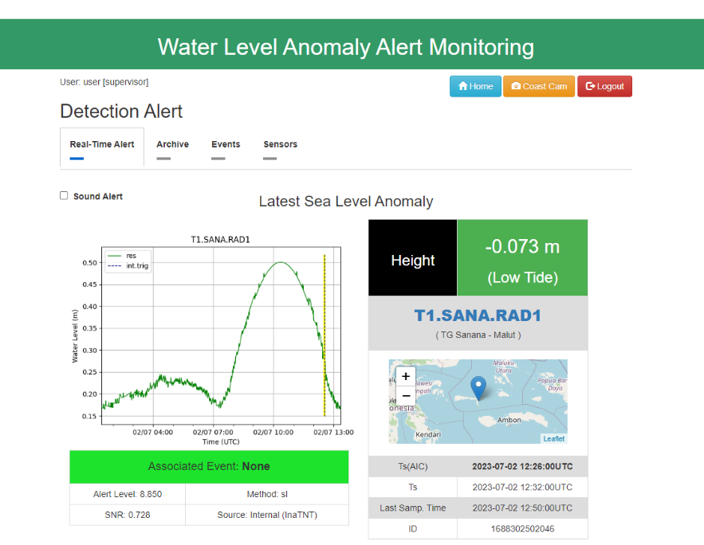
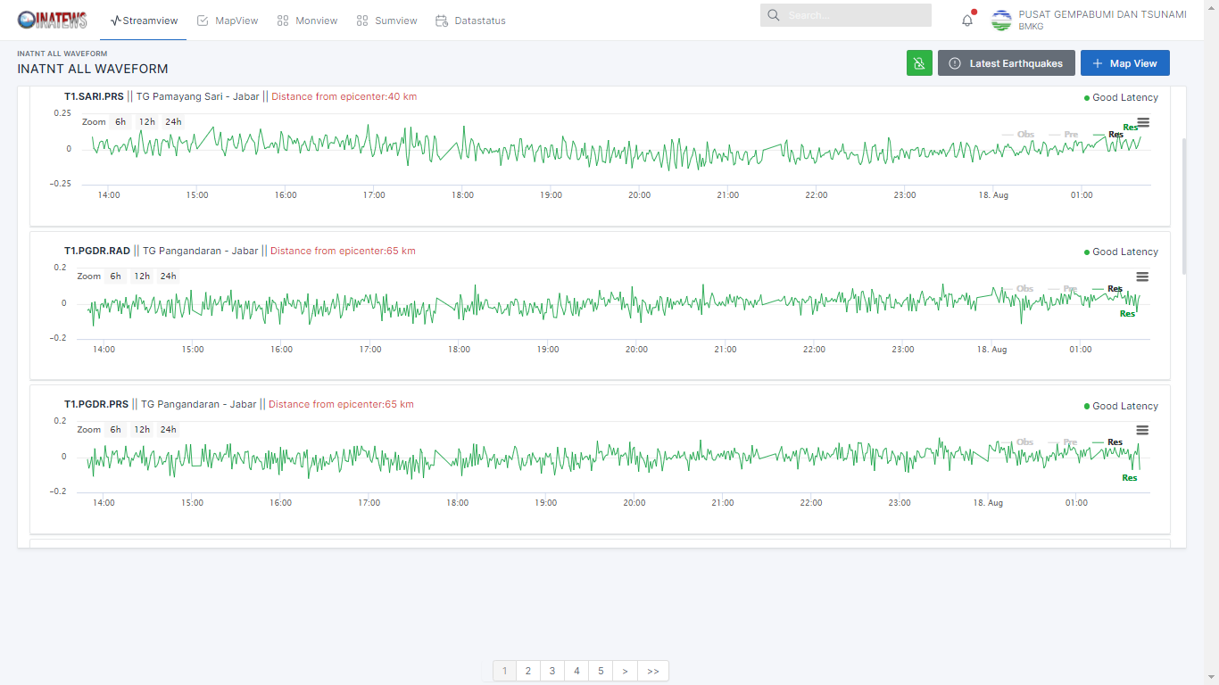
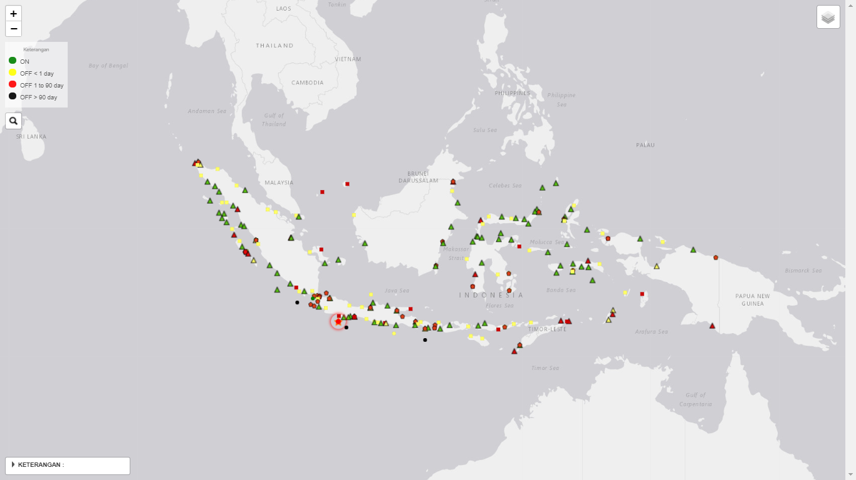
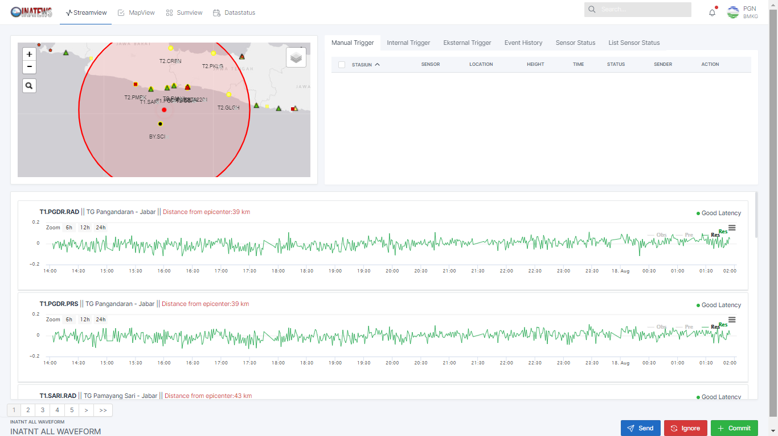
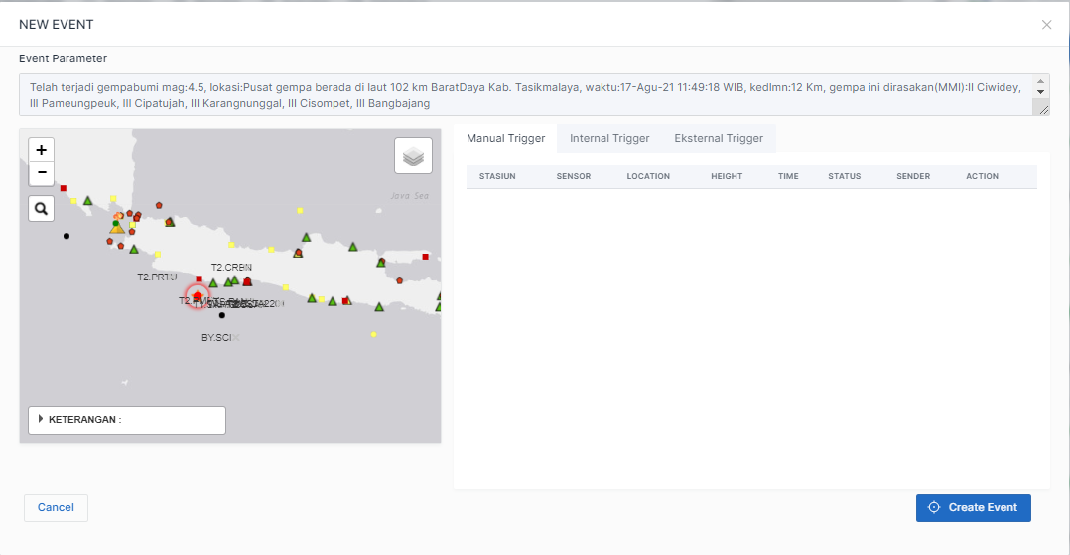


Graphical User Interface (GUI) of the InaTNT
STREAM VIEW
MAP VIEW
MON VIEW
CREATE EVENT
DATA STATUS
SUMMARY VIEW
Alert notifications will be activated on this GUI when any detected sea level anomaly occurs, displaying the tsunami height, arrival time, potential earthquake event associated with the anomaly, and the detection method used. Each anomaly alert meeting specific criteria will be forwarded via WhatsApp message to the InaTNTInfo group.
InaTNT displays the predicted time travel and arrival time of the tsunami at each water level station for all possible earthquake events

Slide 10
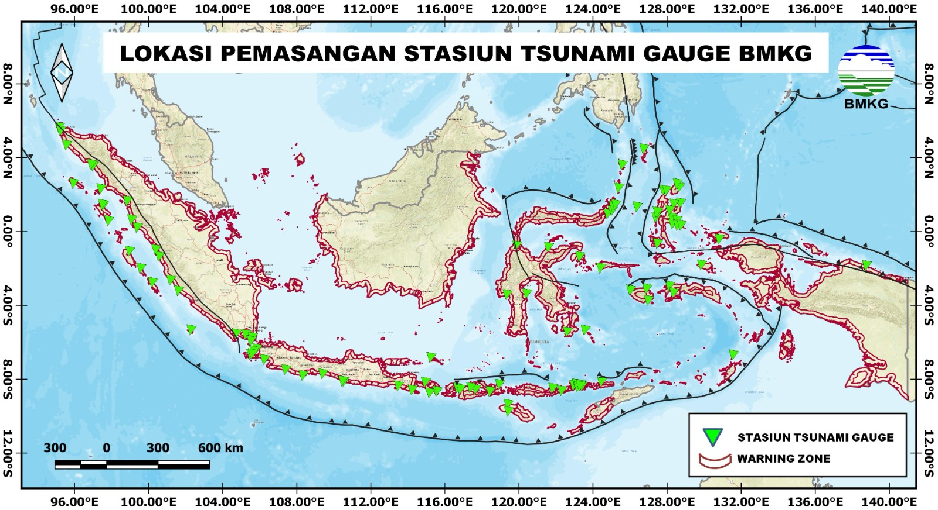
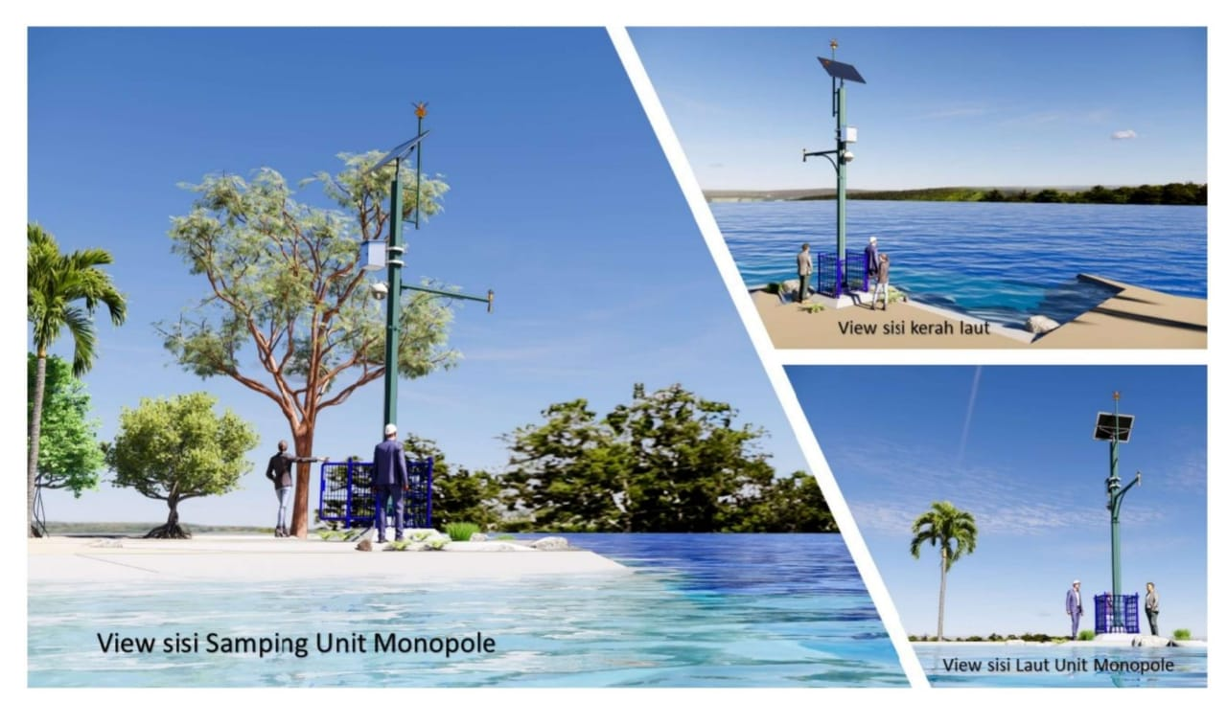
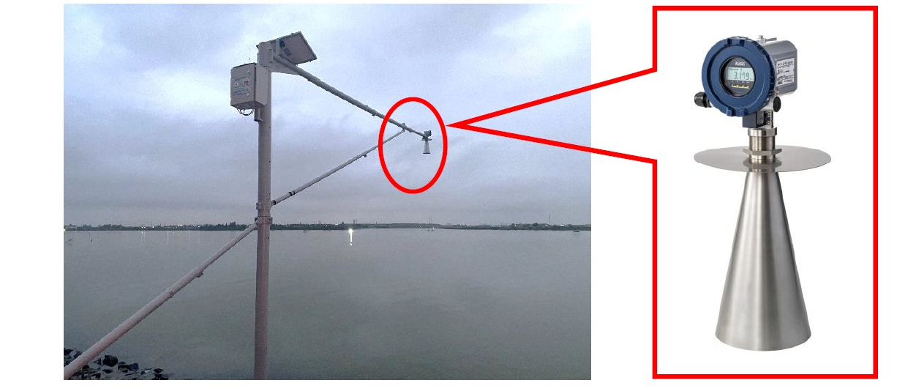

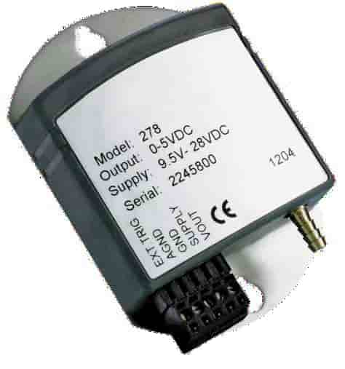
ON GOING DEVELOPMENT OF TSUNAMI DETECTION NETWORK
Deployment 100 Tsunami Gauge Stations (2024 - 2025)
Tsunami Gauge Locations Planning (2024-2025)
MAIN SENSOR
Barometric /
Air Pressure Sensor
Coastal Cam/CCTV
Meteotsunami
shockwace detection

Slide 11
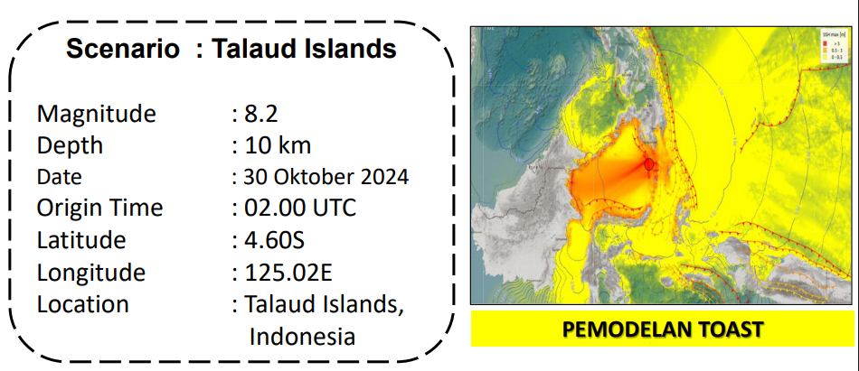
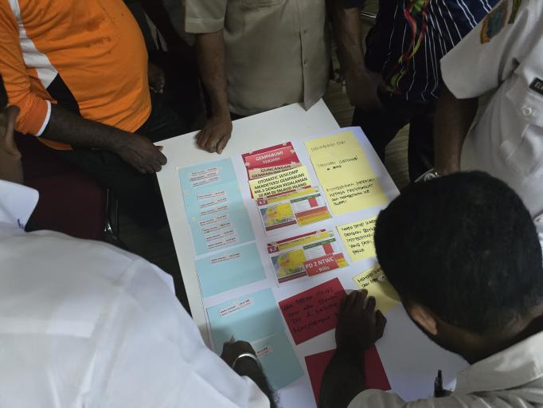
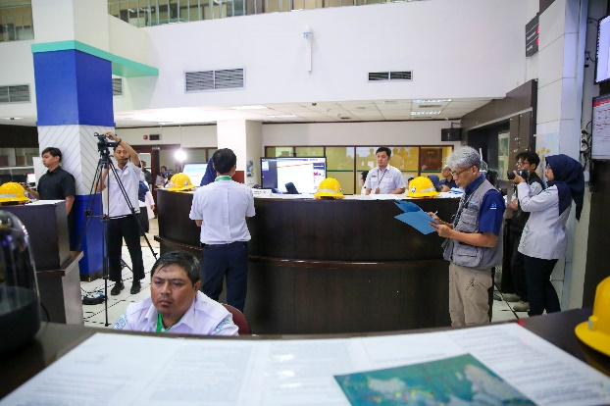
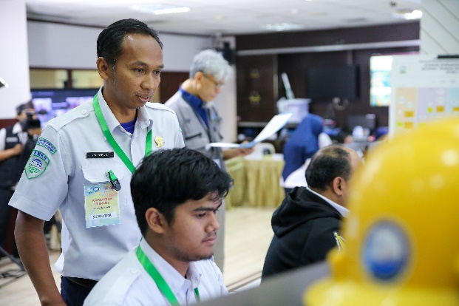
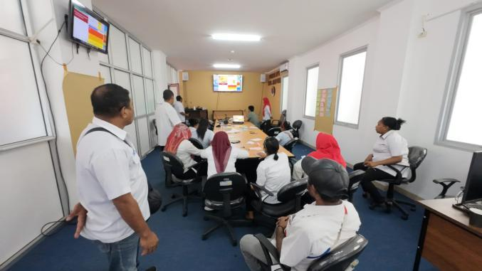
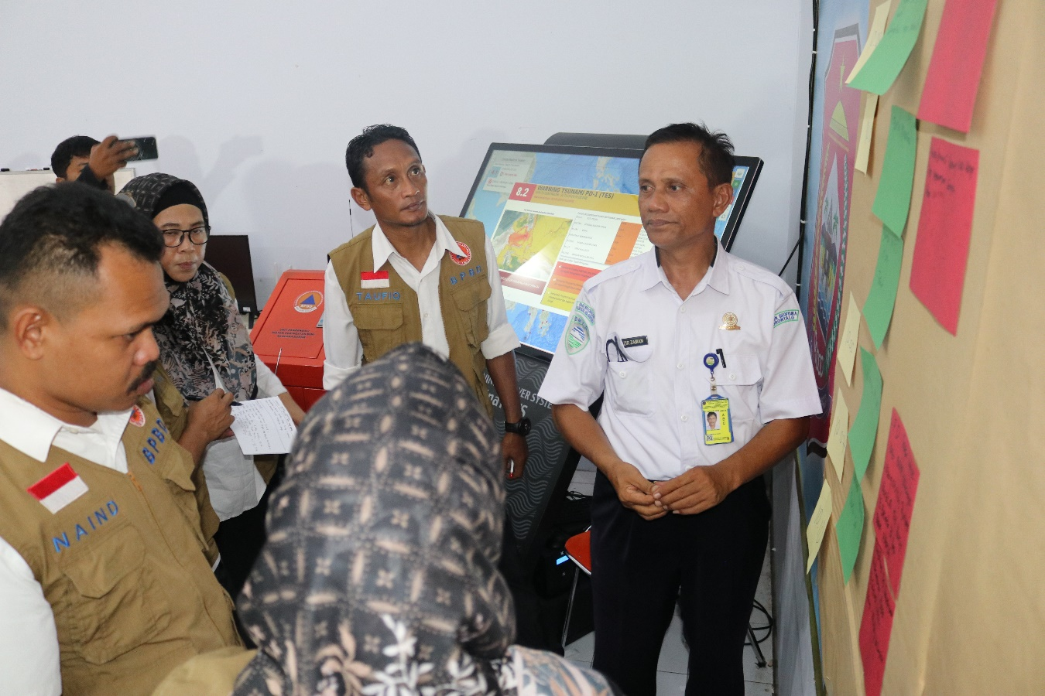
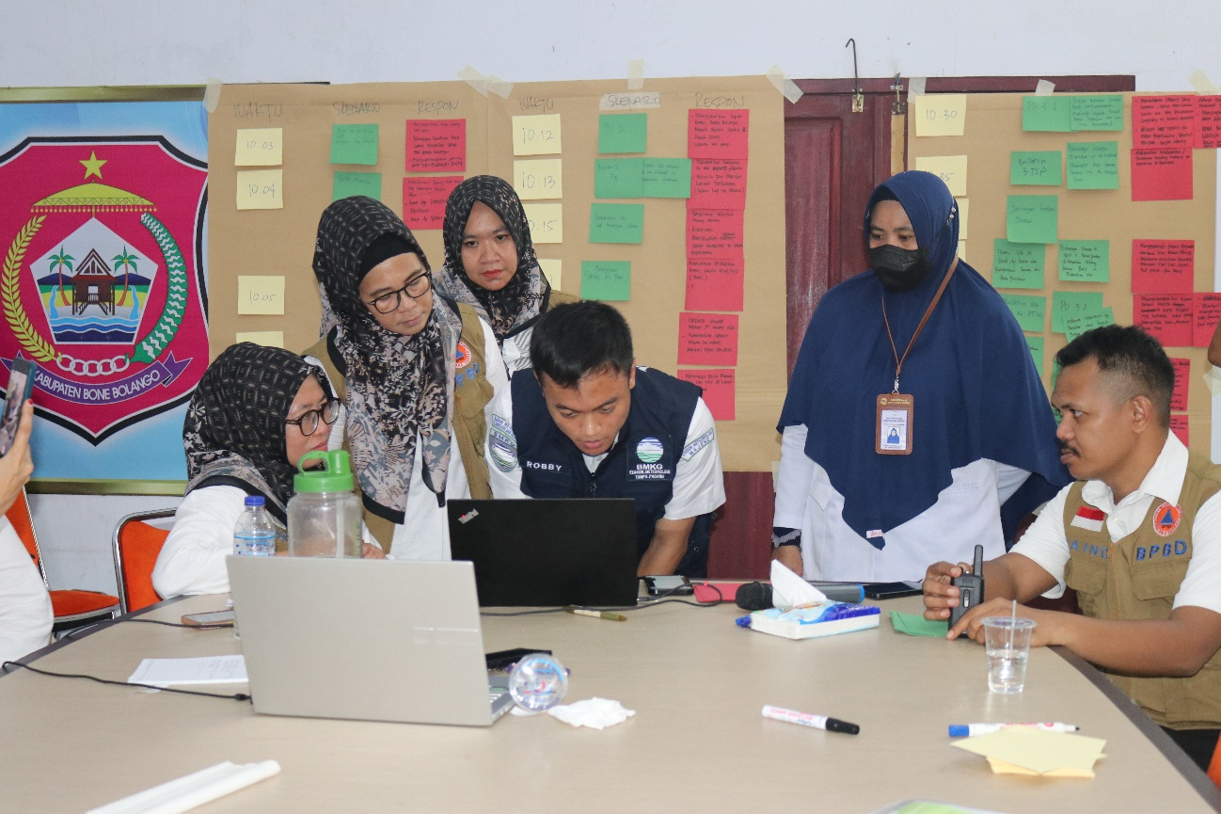
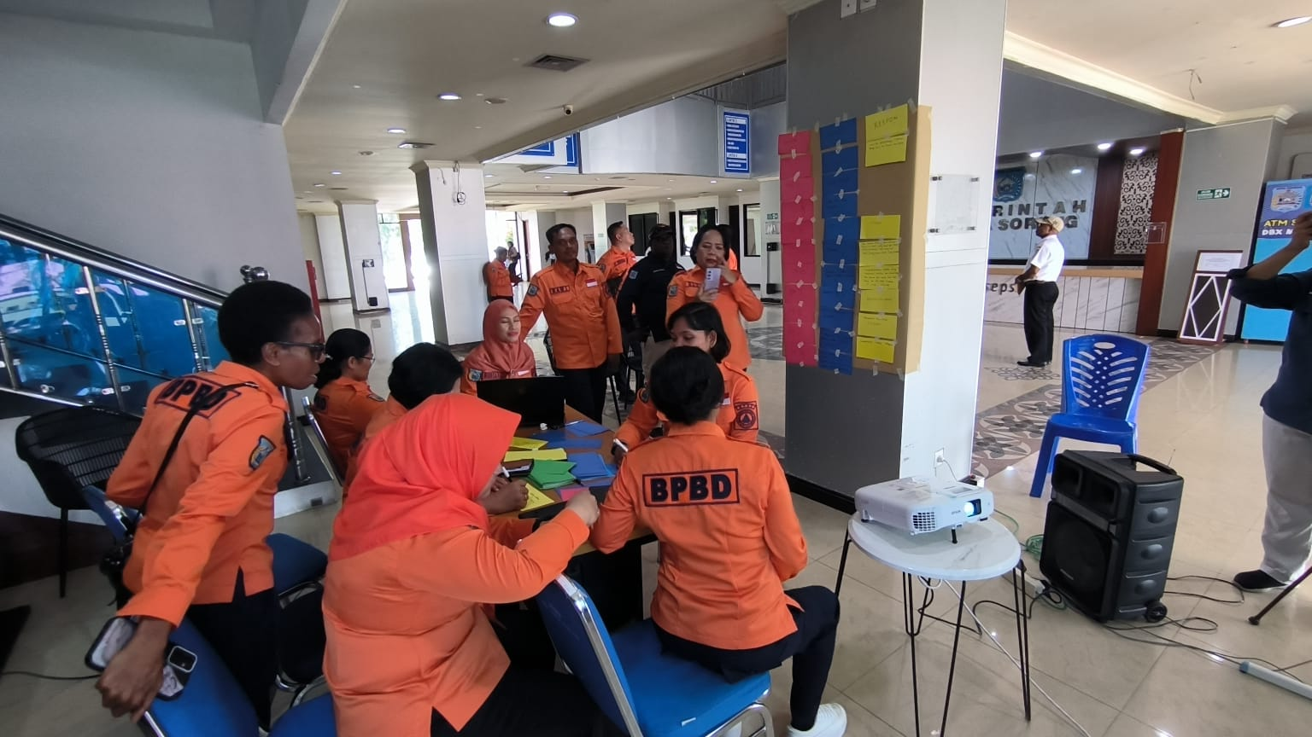
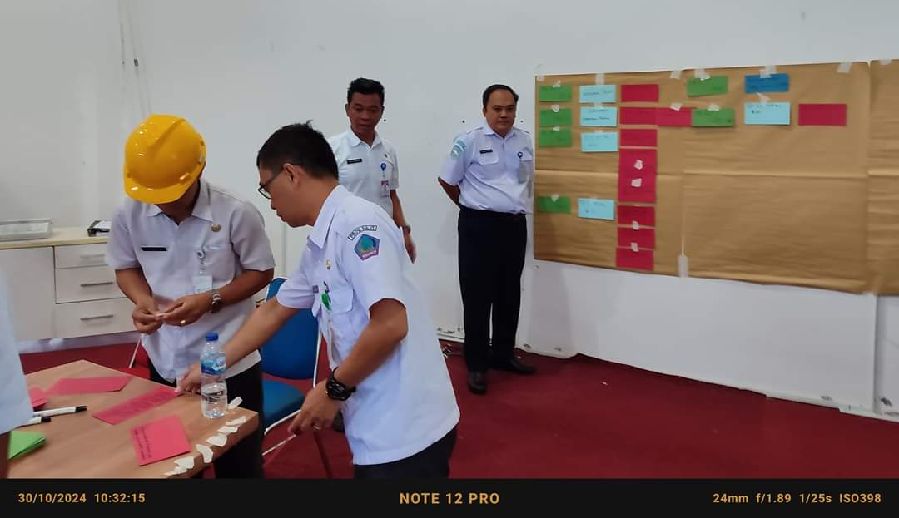
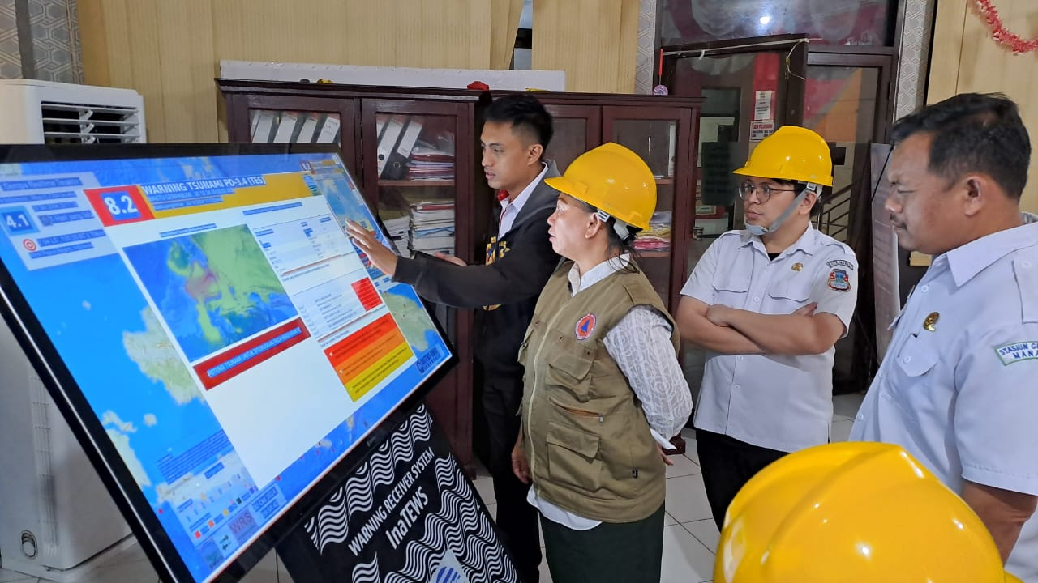
PACWAVE 2024
Date: 30 Oktober 2024, jam 09.00-12.00 WIB
Scenario: North Talaud M8.2
Method: Table Top Exercise and Communication Drill
Participant: 162 participants
NTWC (BMKG), 17 participants
NDMO (BNPB), 3 participants
BPBD of the North Sulawesi, 11 participants
BPBD Manado City, 20 participants
BPBD BPBD Provinsi Gorontalo, 6 participants
BPBD Bone Bolango, 28 participants
BPBD Ternate, 5 participants
BPBD Papua Province, 11 participants
BPBD Jayapura, 18 participants
BPBD Center Papua, 5 participants
BPBD Nabire, 5 participants
BPBD Supiori, 16 participants
BPBD Sorong City, 7 participants
BPBD Sorong District, 7 participants
After Action Review Team from UNESCO, BRIN, and Kominfo
Additional action/coordination is required from the PTWC Bulletin for example from the Philippines in the next PacWave
24/7 zoom communication mode display with countries within the ICG region.

Slide 12
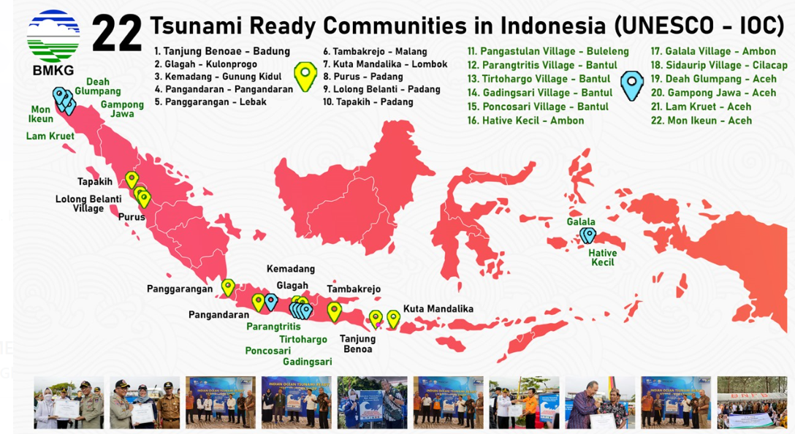
PELAKSANAAN SLG DAN BGTS 2015-2023

Slide 13
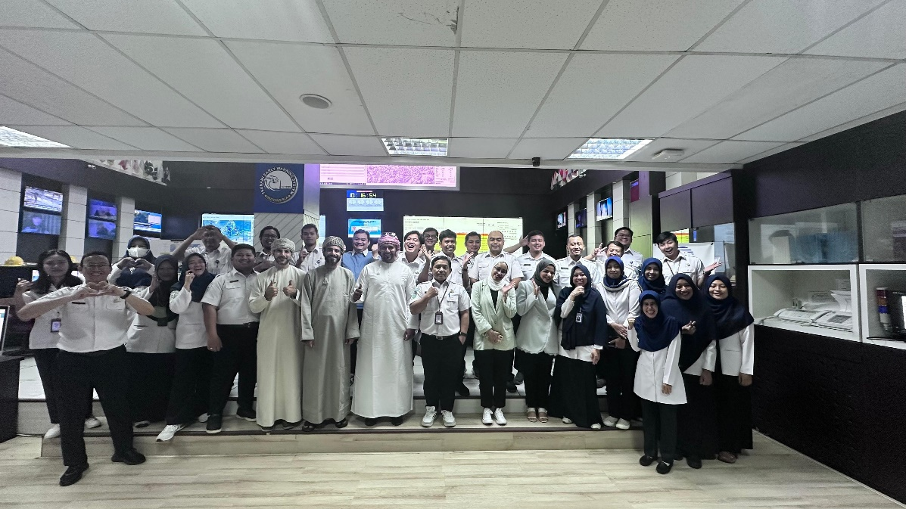
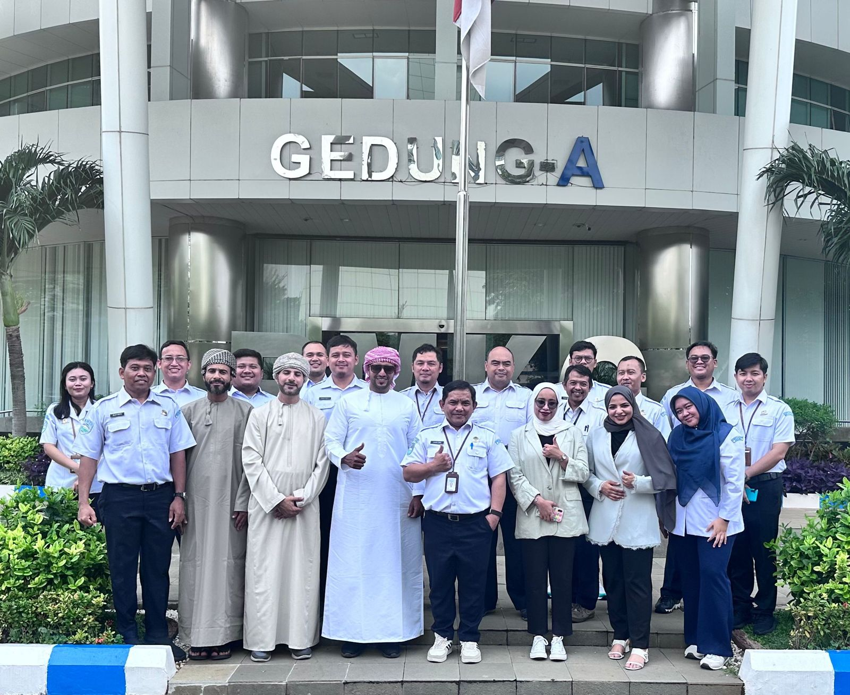
On the Job Training
Indonesia NTWC has been hosting the On Job Training (OJT) for other NTWC officer to learn, observe the operational duties in the InaTEWS.
The OJT is covering:
Lecture Class for
Seismology and Earthquake
Tsunami Modeling
Tsunami Ready
Field Observation:
Fault Observation, and earthquake impact
Tsunami Ready Village
The operation of InaTEWS Back Up in Bali
On Job at the operational room:
5 officers from DG MET OMAN were trained on the On Job Training, on May 2024

Slide 14
FUTURE PLAN
Utilization of GNSS data into the Earthquake Processing System (test phase).
Continue work on developing maritime product for NAVAREAs.
Continue work on developing Mbmkg To achieve a more accurate determination of magnitude at an earlier stage, calculations from the accelerograph is incorporated
Developing “Merah Putih” Earthquake and Tsunami Processing.
Tsunami Ready Recognition for the Communities facing the Pacific Ocean

