Slide 1



    3.8 ICG/PTWS-XXXI- PacWave24 exercise
Task Team PacWave24 Co Chairs:
Margarita Martinez, SENAPRED Chile
Laitia Fifita, Meteorological Services, Tonga
Assistance:
Laura Kong, International Tsunami Information Center

Slide 2
Contents:
  Preliminary results Post-Exercise Evaluation Form.
    TSPs Communication Test and NAVAREA trial
    Regional Communication and Cooperation

Slide 3
3.1 Joint TOWS TT- PacWave exercise February 2025
,.
Exercise Aim and Objectives (IOC Circular Letter No 2999)
PacWave24 tested PTWS Tsunami Service Provider (TSP), and country operational plans and procedures to respond to a destructive tsunami. PacWave24 was the eleventh in a series of PacWave exercises that have been conducted biennially since 2006
      Steering Committee decided to provide special tsunami maritime safety products to NAVAREA coordinators through the NTWC from the PTWC, and further decided to conduct a trial dissemination of the dummy message from the PTWC to the NAVAREA coordinators through the NTWCs as part of Exercise Pacific Wave 2024.

Slide 4
3.1 Joint TOWS TT- PacWave exercise February 2025
,.
SUBMITTED RESPONSES
Comm test /Navarea trial (11):
Japan
Australia
New Zealand
Chile
Tonga
Hong Kong, China
French Polynesia
Guatemala
Argentina
Singapore
Republic of Korea
Regional (*) /National (20)
-Ecuador
-Colombia
-Hong Kong, China
-Malaysia
-Japan
-Australia
-Mexico
-Costa Rica
-French Polynesia
-Chile
-Vietnam
-Tonga
-Samoa
-Kiribati
-China
-Russian Federation
-New Zealand
-Vanuatu
-Singapore
-Republic of Korea

Slide 5
PacWave 24 Results
TSPs Communication
Test and NAVAREA trial

Slide 6
3.1 Joint TOWS TT- PacWave exercise February 2025
1.1 Please select which Tsunami Service Provider you subscribed to receive tsunami bulletin?

Slide 7
3.1 Joint TOWS TT- PacWave exercise February 2025
1.5 How did you receive the message(s)? Please tick methods.

Slide 8
3.1 Joint TOWS TT- PacWave exercise February 2025
ICG/PTWS Steering Committee September 2024
1.7 Please indicate if your country was part of the NAVAREA trial transmission.

Slide 9
NAVAREA comments
In general, all participating countries in NAVAREA trial indicated development test proceeded without issues.
  Australia: While AMSA (NAVAREA X) received the test warning from PTWC at 0100 UTC as expected, we also received the same message an hour earlier at 0000 UTC from the Airservices Network Coordination Centre. We are uncertain as to why this occurred
For open-ended question: Please indicate if the NAVAREA coordinator received the message successfully and when. Responses were:
  Received fine
    NAVAREA XI coodinator received emails from NTWC in Japan, which is the Japan Meteorological Agency, without any problems.
    The message went to AMSA's 24/7 response center. NAVAREA X co-ordinator was present when testing occurred.
    Successfully received 050101 UTC November 2024
    Yes, they received it right after we did (we forward the message)
    2300UTC
    Yes, we received the message at 00:00 utc
    NAVAREA (NAVAREA XI) coordinator has received the message successfully at 01:03 November 5, 2024 (UTC).
    Yes, the message was forwarded to RCCNZ, who advised they received our (NEMA) email at 1405hrs, along with the original NAVAREA email from PTWC at 1401hrs.
  Did not receive: Argentina.
  The message was never received by the Navarea Coordinator. We could not determine the reason for the failure.

Slide 10
PacWave24
National/Regional Communication and Cooperation Post-Exercise Evaluation Form

Slide 11
2.1 The warning was disseminated to:
3.1 Joint TOWS TT- PacWave exercise February 2025

Slide 12
2.3 How did you send the warning to emergency, national, science, and local government agencies in Q2.1? Tick all that apply.
3.1 Joint TOWS TT- PacWave exercise February 2025

Slide 13
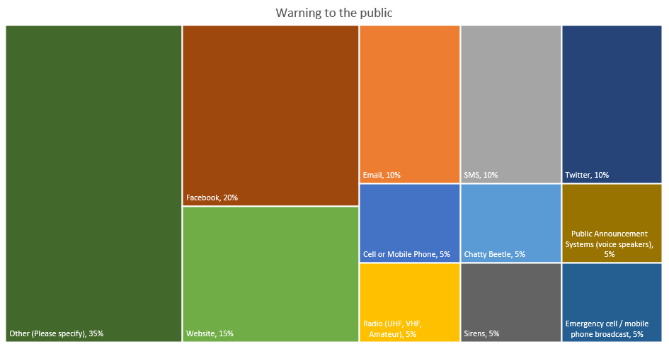
2.4 How did you send the warning to the Public? Tick all that apply.
3.1 Joint TOWS TT- PacWave exercise February 2025

Slide 14
2.16 A country tsunami emergency response plan (standard operating procedures) for tsunamis exists? Tick all that apply.
3.1 Joint TOWS TT- PacWave exercise February 2025

Slide 15
2.20 Tsunami-related curriculum programmes are in place for all levels (pre, primary, secondary, post-secondary) of education?
3.1 Joint TOWS TT- PacWave exercise February 2025

Slide 16
2.21 All tsunami-vulnerable communities have tsunami evacuation maps, signage, and assembly points for evacuation?
3.1 Joint TOWS TT- PacWave exercise February 2025

Slide 17
2.22 What type of exercise did you conduct?
3.1 Joint TOWS TT- PacWave exercise February 2025

Slide 18
3.6 What type of national information did you share? Tick all that apply.
3.1 Joint TOWS TT- PacWave exercise February 2025

Slide 19
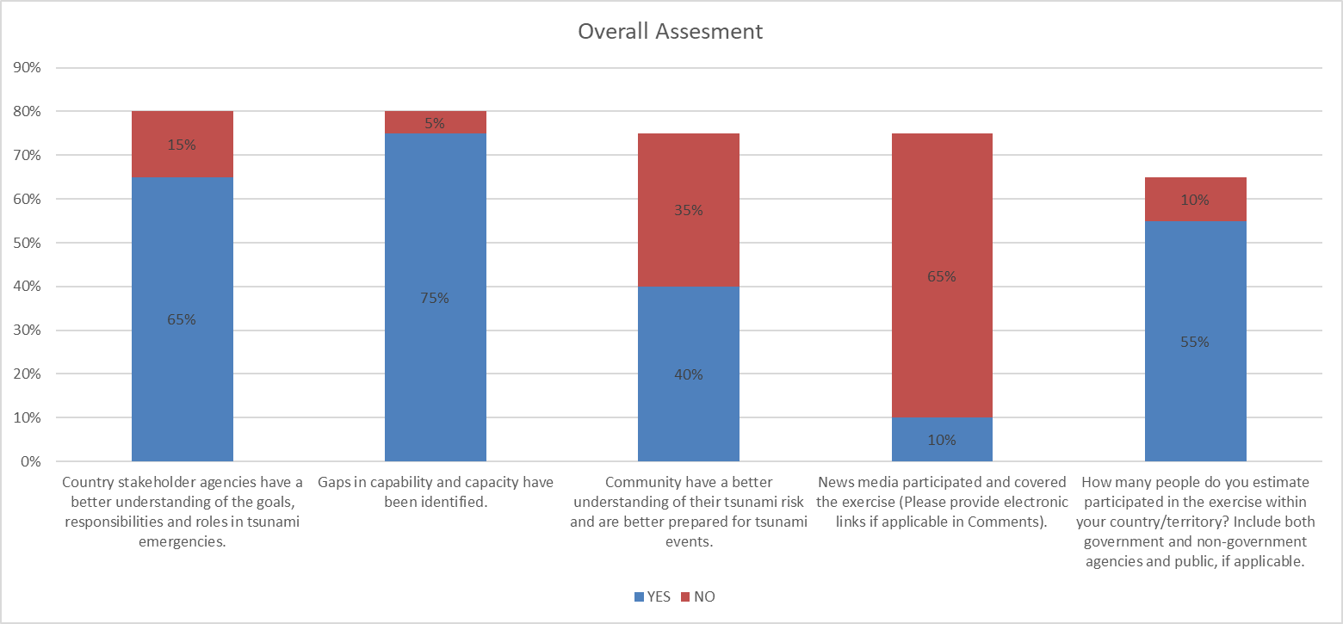
Overall assessment
3.1 Joint TOWS TT- PacWave exercise February 2025

Slide 20
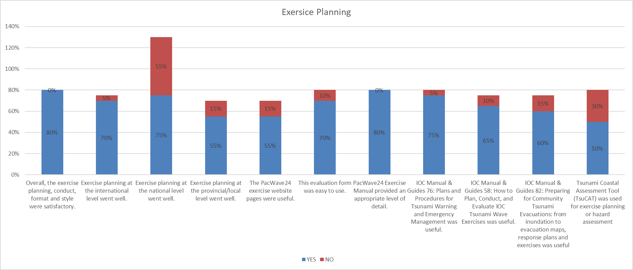
Exercise planning (please make comment for each in the comments section)
3.1 Joint TOWS TT- PacWave exercise February 2025
Answered: 18 Skipped: 9

