Slide 1
ICG/PTWS-XXXI Session
8 - 11 April 2025
4.6. TSUNAMI SERVICE PROVISION CONSIDERATIONS FOR EVENTS OUTSIDE PTWS EARTHQUAKE SOURCE ZONE
NISHIMAE Yuji
Chair of ICG/PTWS

Slide 2
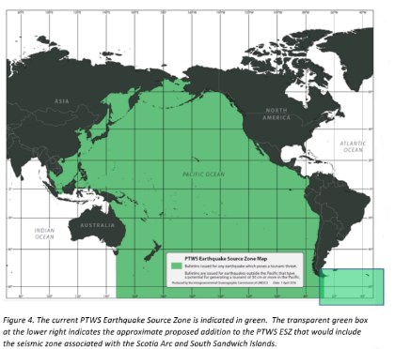
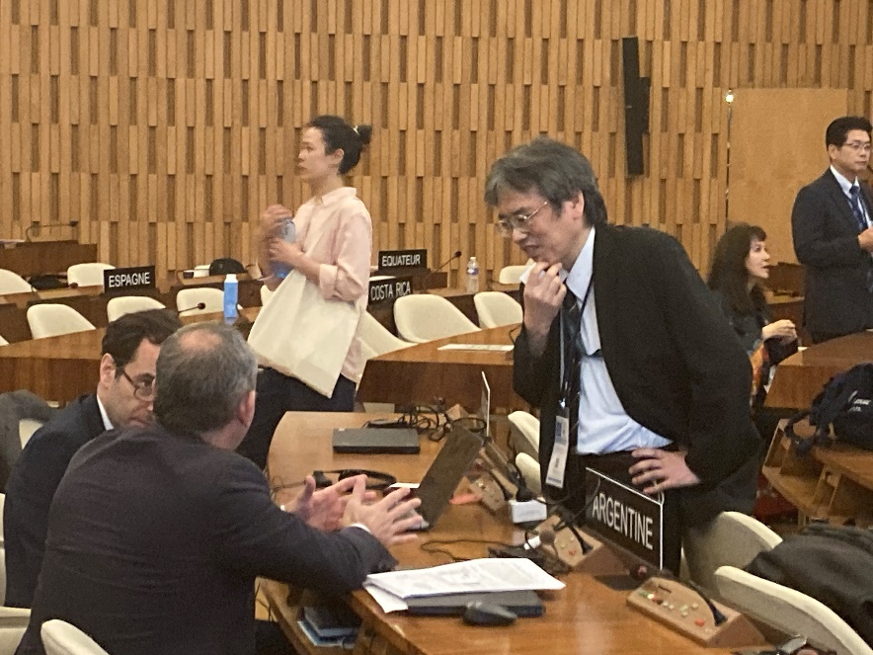
Expansion of the ICG/PTWS Earthquake Source Zone
Recommendation ICG/PTWS-XXX.3
Decides to expand the PTWS Earthquake Source Zone to include an area from 63º to 52º south latitude and from 72º to 18º west longitude to include the Scotia Arc and its adjacent seismic zones.
Adopted decision about the ESZ
The related paragraph to the Recommendation ICG/PTWS-XXX.3 was deleted.
Notes:
(i) the concerns of ICG/PTWS regarding the seismic activity in the Scotia Arc region as reflected in the Executive Summary of the ICG/PTWS-XXX (IOC/ICG/PTWS-XXX/3s);
(ii) that tsunami bulletins are issued by the PTWC for the ICG/CARIBE-EWS and ICG/PTWS for earthquakes in the Scotia Arc and its adjacent seismic zones for events fulfilling certain criteria as reflected in the IOC Technical Series, 130, ‘Tsunami Watch Operations-Global Service Definition Document’;
(iii) the need for the active engagement of Argentina with the ICG/CARIBE-EWS and ICG/PTWS regarding Argentinian Search and Rescue (SAR) and NAVAREA VI coordination responsibilities;
Notes:
Argentina disagreed with the PTWS proposal regarding the expansion of the PTWS earthquake source zone.
PTWS chair and IOC and relevant countries had informal consultation in order to reach the consensus.
As a result of the consultation, PTWS proposal for the expansion was deleted and some notes were added.

Slide 3
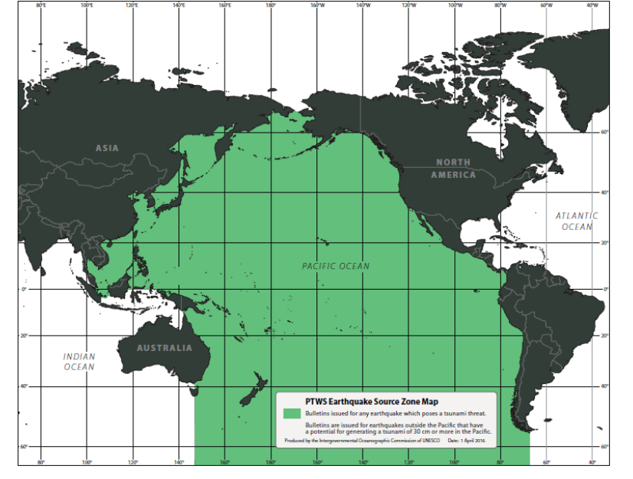
Earthquake Source Zone Map of the ICG/PTWS
Bulletine issued by any earthquakes which poses a tsunmi threat
Bulletines are issued earthquakes outside the Paicific that have a potensial for generating a tsunami 30 cm or more in the Pacific
PTWS Earthquake Source Zone Map (Reference: IOC/TOWS-WG-IX/3 Annex IV, page 52)

Slide 4
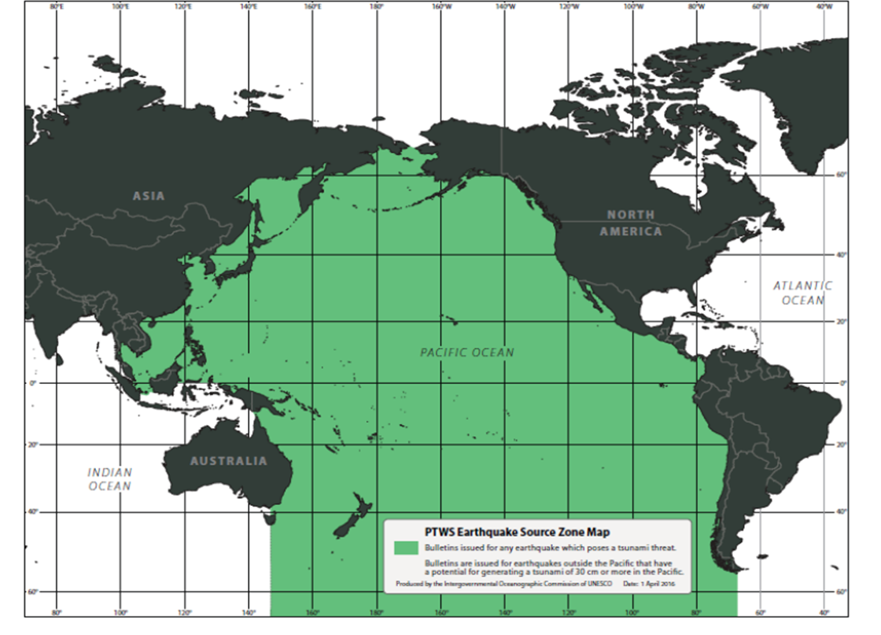
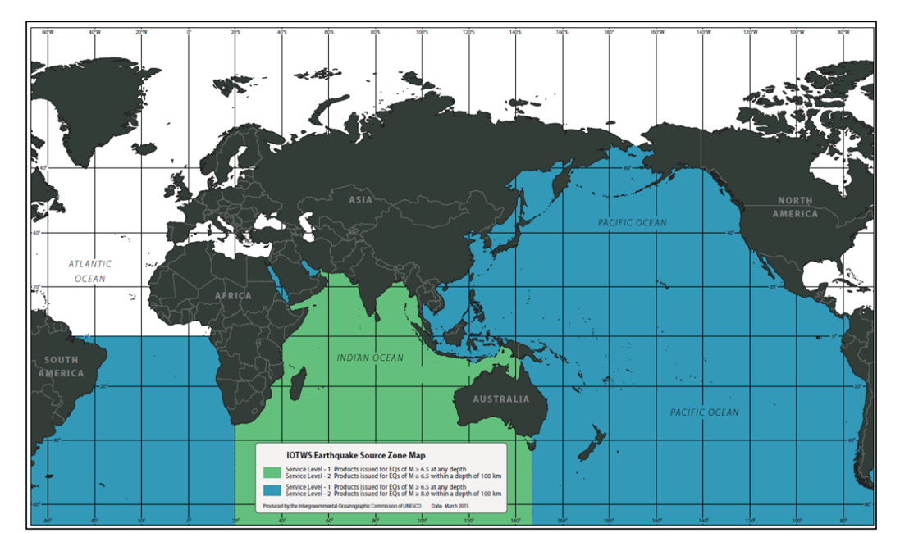
Instruction from the TOWS-WG regarding the TSP services in the boundary of IOTWMS and PTWS
The TOWS-WG further instructed the TT-TWO to investigate the status of the TSP service provisions in in the boundary of IOTWMS and PTWS that are currently outside of the framework of the IOC coordinated tsunami warning systems;
Earthquake Source Zone Map of the ICG/PTWS
Earthquake Source Zone Map of the ICG/IOTWMS

Slide 5
Recommendation ICG/PTWS-XXVIII.2
Tsunami Detection, Warning and Dissemination
Also noting that by existing PTWS procedures, for earthquakes that occur outside of that region the PTWS TSPs are only to issue products when there is an expectation that tsunami waves exceeding 0.3 meters amplitude are expected within that TSP’s coastal service area,
Considering that there are cases when large earthquakes occur just outside the boundary, such as for the 2018 Palu, Indonesia, earthquake and tsunami, when it would be useful for a TSP to issue an Information Statement indicating no tsunami threat to its service area,
Decides the following:
The ICG/PTWS agrees to retain its guidance that TSPs only issue threat messages for earthquakes outside the designated PTWS source area when tsunami amplitudes within that TSP’s coastal service area are expected to exceed 0.3 meters; and
The ICG/PTWS agrees to add guidance to allow TSPs to issue Tsunami Information Statements for large earthquakes that occur close to but outside of the defined PTWS source boundary when it is judged by the TSP that the event may cause concern within its service area either because of the large earthquake magnitude, because a tsunami threat or warning message has been issued closer to the earthquake, or because a tsunami has been observed;
TSPs will include special language within such Tsunami Information Statements to make it especially clear that it is forecasting no tsunami threat only for the coasts within its service area, and the boundary of the service area in that general region will be clearly stated.
Chair's proposal is that TSP messages to the earthquake outside the ESZ should follow the recommendation-XXVIII.2 at the ICG/PTWS-XXVIII Session.

