Slide 1
STATUS OF GLOSS CORE NETWORK Andrew Matthews GLOSS GE XVIII 11-14 March 2025

Slide 2
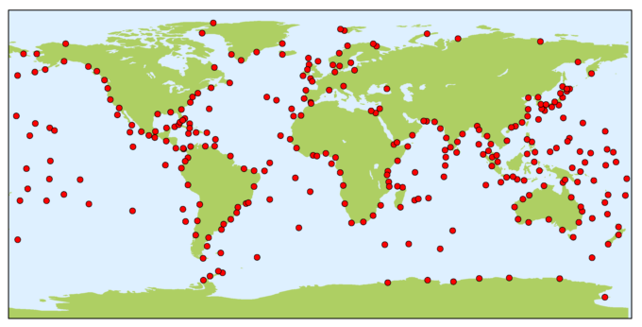
The GLOSS core network
Initially defined in 1990
Originally 307 sites
Periodically redefined
Currently 294 sites
List from 2012 GLOSS Implementation plan (GCN2010)
Plus 4 sites on Pacific islands added in GE XVI (Busan, 2019)

Slide 3
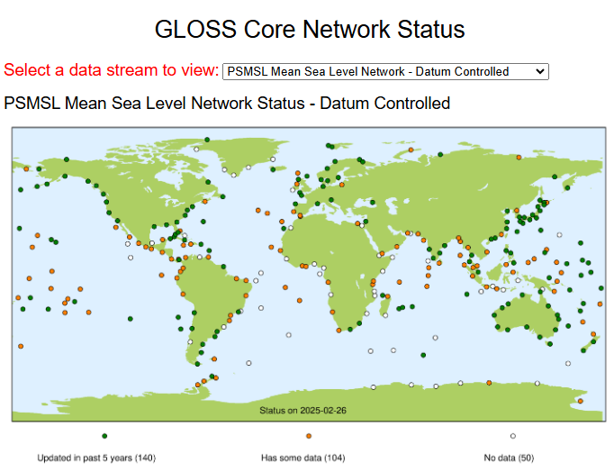
GLOSS network status pages at PSMSL.ORG
https://psmsl.org/products/gloss/status.php
Status of network at each GLOSS data centre Note some currently broken Some work here done manually

Slide 4
Methodology
For now, just trying to establish if there’s an installation, and it’s providing data to each data centre
So not e.g. “is this site transmitting in real-time now”
but “is someone trying to provide real-time data from this site, even if it’s not working at the moment”
Looked at the last date provided to a data centre

Slide 5
Which data streams?
Real Time: Sea Level Station Monitoring Facility at VLIZ
High Frequency Fast Mode: University of Hawaii Sea Level Center
Monthly Means: PSMSL (both datum controlled RLR and “Metric”)
GNSS: SONEL
High Frequency Delayed Mode: GESLA (from November 2021)
Notes:
I was working on the assumption that JASL wasn’t being updated, but it is again now, so I’ve used GESLA here for high frequency delayed mode
That’s using GESLA sites within 10 km of the GLOSS location, so may not accurate

Slide 6
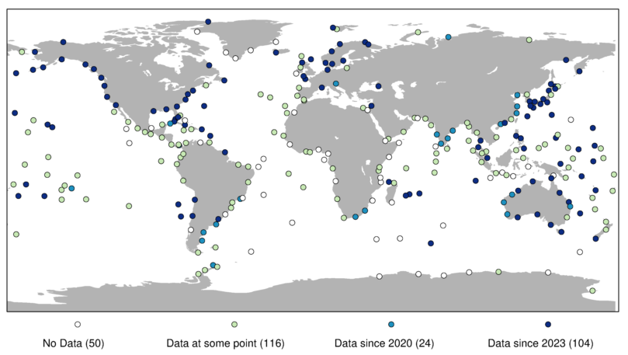
PSMSL RLR (MONTHLY MEANS: datum controlled)

Slide 7
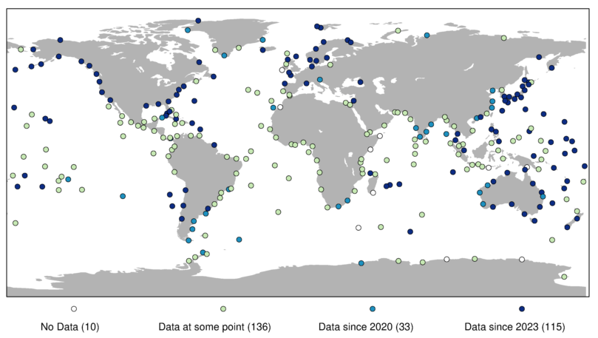
PSMSL METRIC (MONTHLY MEANS: no datum control)

Slide 8
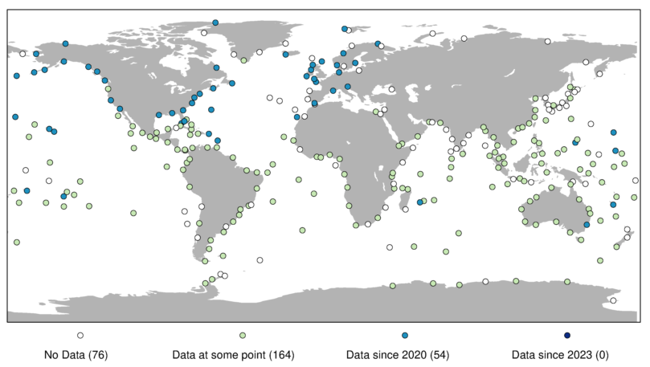
GESLA (HIGH FREQUENCY DELAYED MODE)

Slide 9
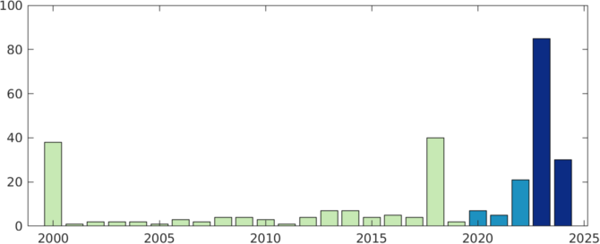
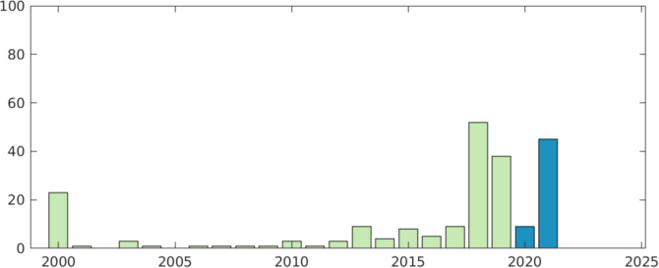
Histogram of Last year available: PSMSL METRIC vs GESLA
2000 or before
PSMSL Metric
GESLA
2000 or before
Notes:
As GESLA was last updated in 2021, here’s a quick comparison with last year of update compared with PSMSL
Shows GESLA has a similar profile, and lots of the “bad” stuff is just a couple of years out of date
Note lots from 2018 onwards, so I’ll be using this date later

Slide 10
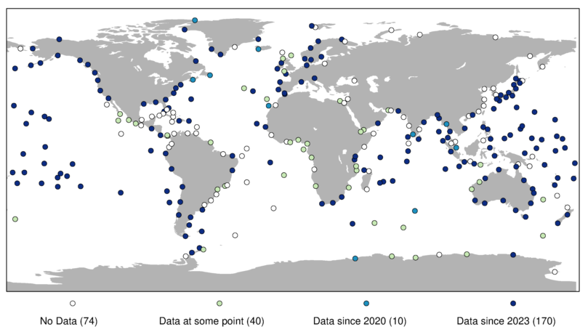
UHSLC (HIGH FREQUENCY FAST MODE)

Slide 11
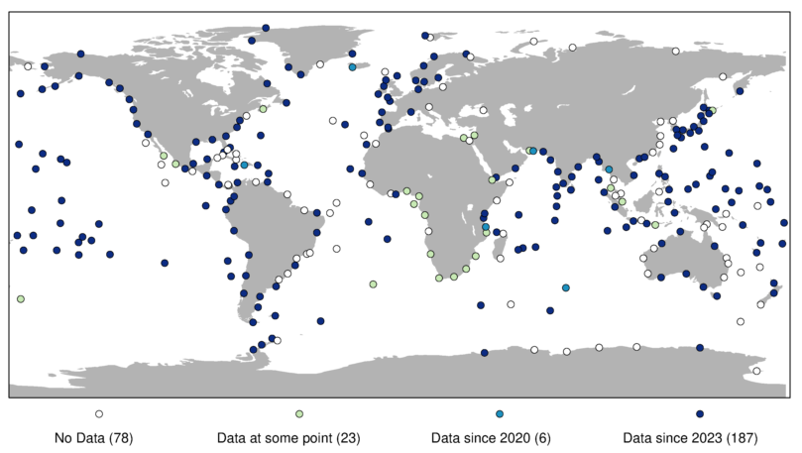
SLSMF @ VLIZ (REAL TIME)

Slide 12
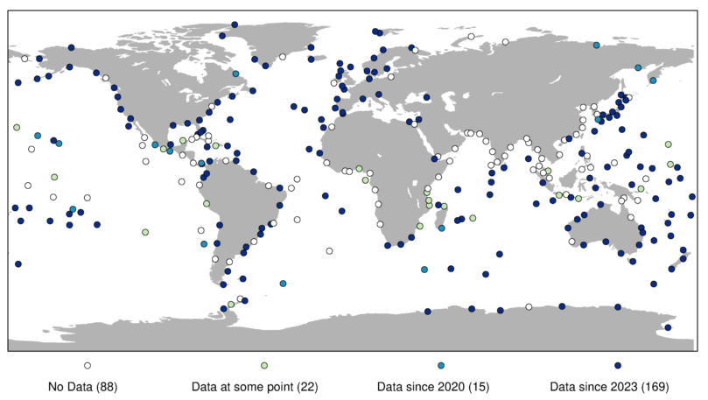
SONEL (GNSS observations)

Slide 13
Overall summary – a best guess based on data since 2018
No installation ever: 6 sites
No current installation: 52 sites
Not quality controlled: 34 sites (only in VLIZ / UHSLC Fast)
Not datum controlled: 8 sites (in PSMSL, but not RLR)
Missing from one or more data centres: 87 sites
Working: 107 sites (84 have GNSS too)
Notes:
I’ve attempted to summarise what’s happening overall based on sites providing data since 2018 to each centre
I’m leaving SONEL aside for the moment as we’re just looking at the sea level observations
By looking at combinations of data centres we’re trying to work out what’s happening
e.g. If there’s real time / fast mode data, but nothing else, it’s probably not being quality controlled

