Slide 1

China’s National Sea Level Network
Report to the 18th Session of the Group of Experts for the Global Sea Level Observing System
Yuxi Jiang
National Marine Data and Information Service
March 12th, 2025
Eighteenth Session of the Group of Experts for the Global Sea Level Observing System
Panama City, Panama, 11-14 March 2025

Slide 2
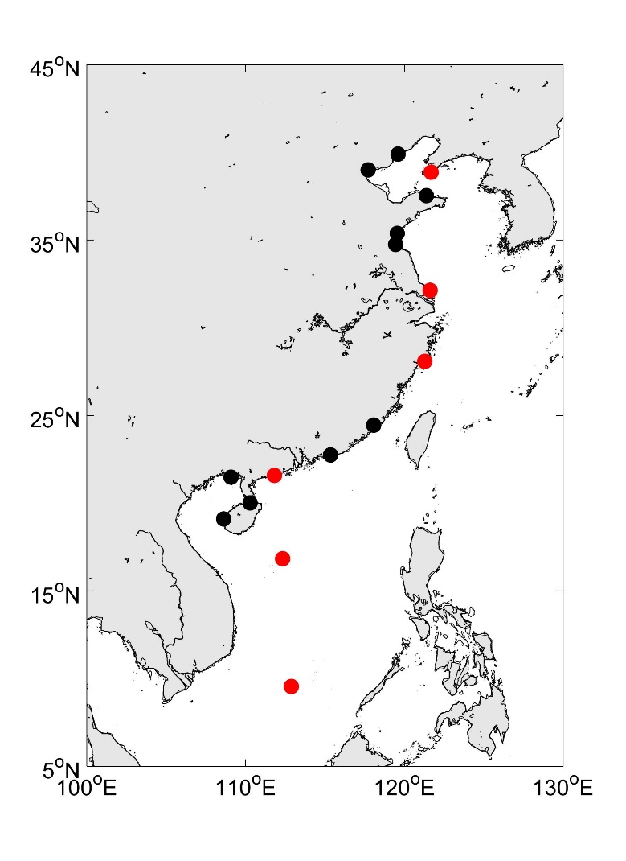
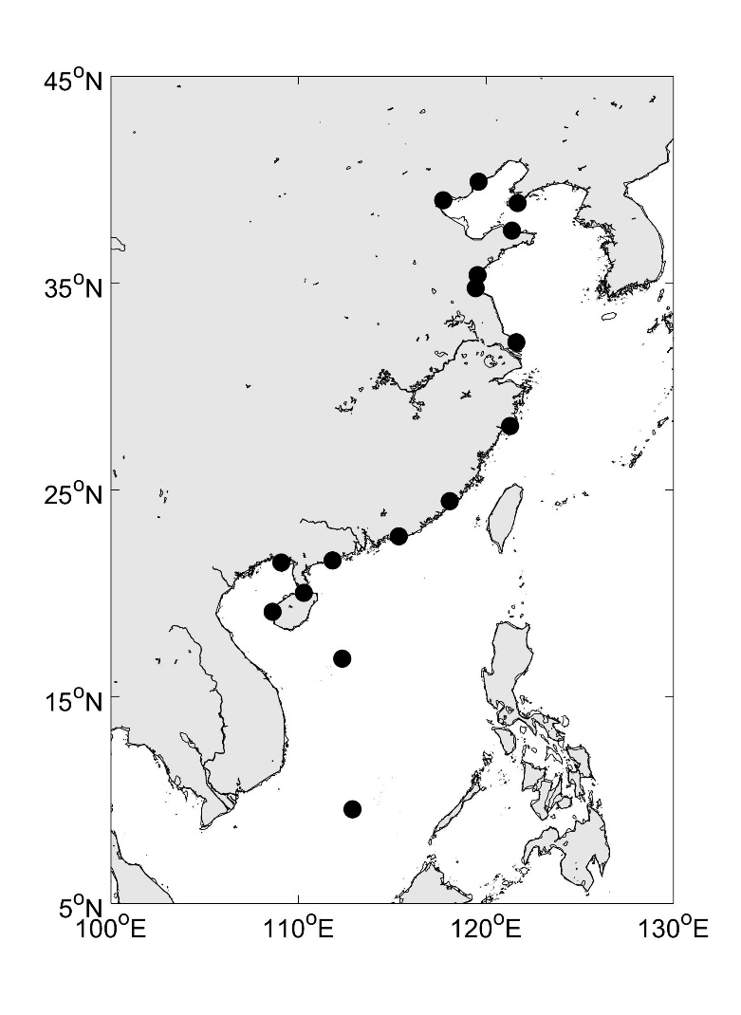
1. National SL Observing Network of China
The national network of sea level observation in China is operated by National Marine Data and Information Service, Ministry of Natural Resources.
Seventeen key stations and other basic stations along China’s coast.
Six stations have been registered in GLOSS Core Network and monthly MSL data are sent to PSMSL on time.
Measure vertical land motion at most of the tide gauge locations (GNSS).
Optimize the China sea level observing network.
Eighteenth Session of the Group of Experts for the Global Sea Level Observing System
Panama City, Panama, 11-14 March 2025
Notes:
Seventeen key stations on Permanent Service for Mean Sea Level (https://psmsl.org/)

Slide 3
GLOSS Core Network Stations in China
GLOSS ID | Station Name | Location | Status
 |  |  | Temporal Range | Hourly height data | Monthly MSL data
934 | KANMEN | 28º05’N 121º17’E | Jan 1959 till now | Jan 1975 to Dec 1999 | Jan 1959 to Dec 2024
723 (1513) | DALIAN (LAOHUTAN) | 38.867°N 121.683°E | Jan 1954 till now | Jan 1980 to Dec 1999 | Jan 1954 to Dec 2024
979 | LUSI | 32º08’N 121º37’E | Oct 1959 till now | Jan 1975 to Dec 1999 | Jan 1961 to Dec 2024
933 | ZHAPO | 21º35’N 111º50’E | Jan 1959 till now | Jan 1975 to Dec 1999 | Jan 1959 to Dec 2024
1745 | XISHA | 16°50’N 112º20’E | Jan 1990 till now | - | Jan 1990 to Dec 2024
1730 | NANSHA | 9°33’N 112º53’E | Jan 1990 till now | - | Jan 1998 to Dec 2024
Eighteenth Session of the Group of Experts for the Global Sea Level Observing System
Panama City, Panama, 11-14 March 2025

Slide 4
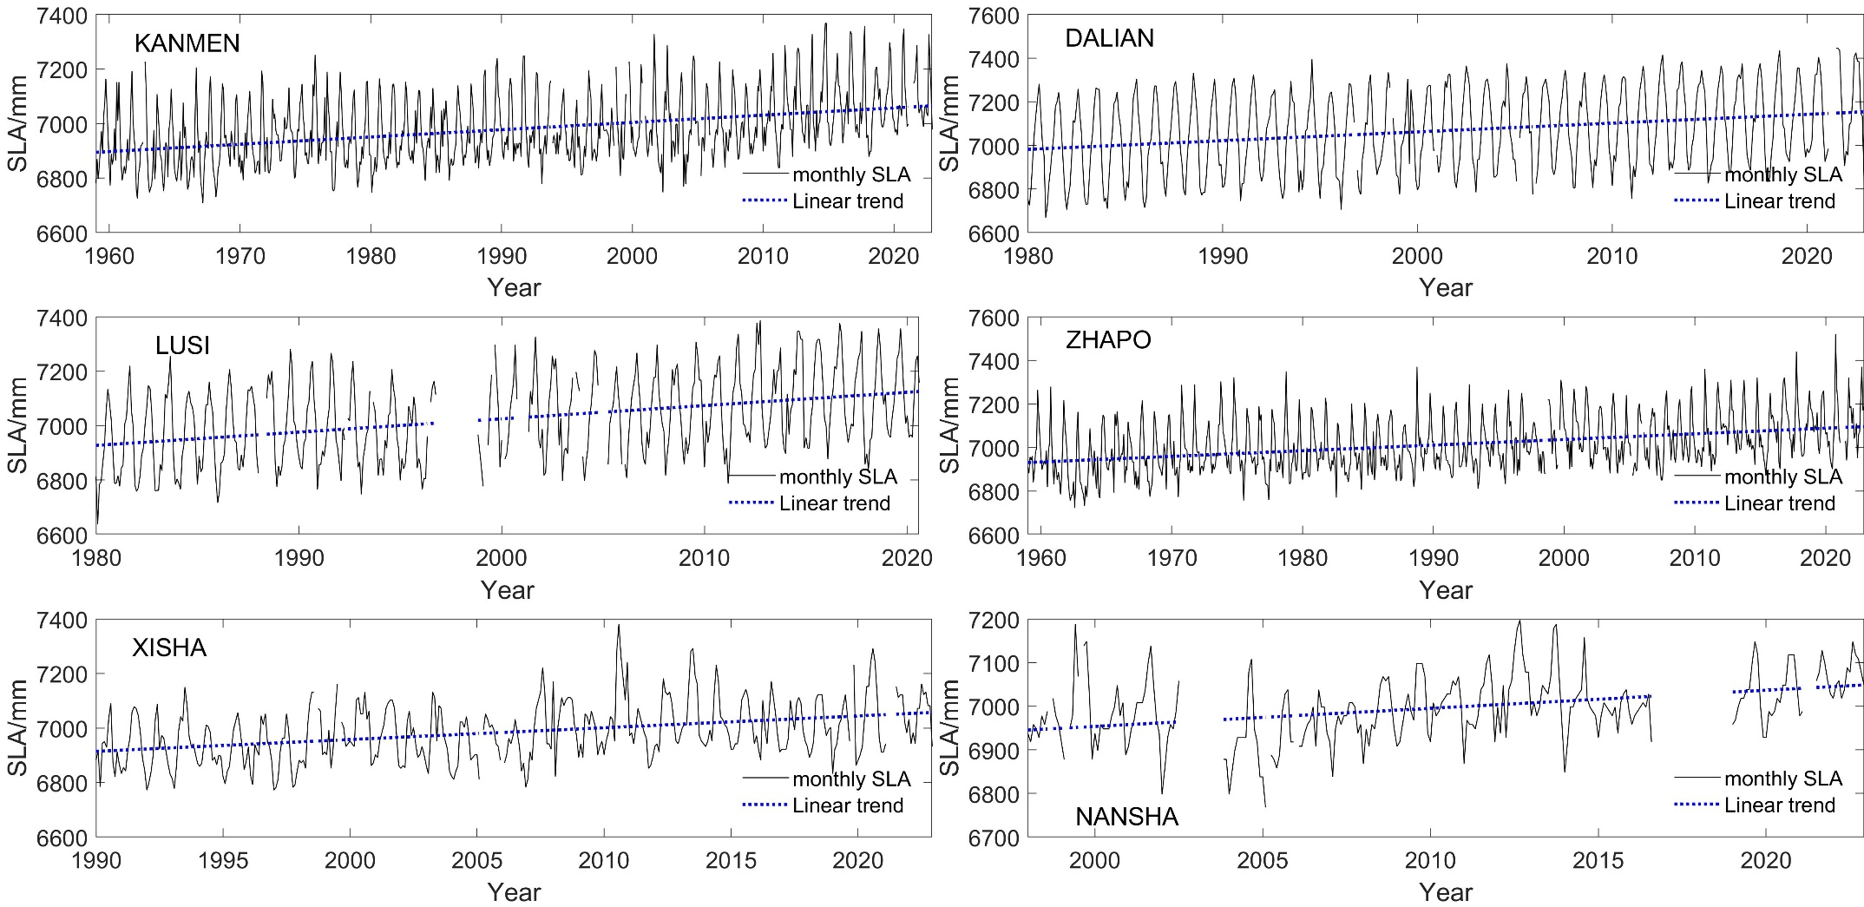
GLOSS Core Network Stations in China
Eighteenth Session of the Group of Experts for the Global Sea Level Observing System
Panama City, Panama, 11-14 March 2025

Slide 5
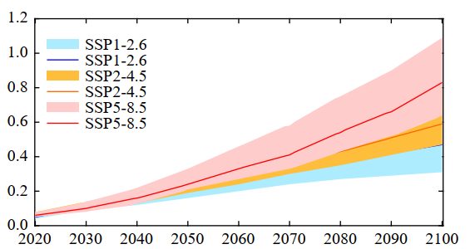
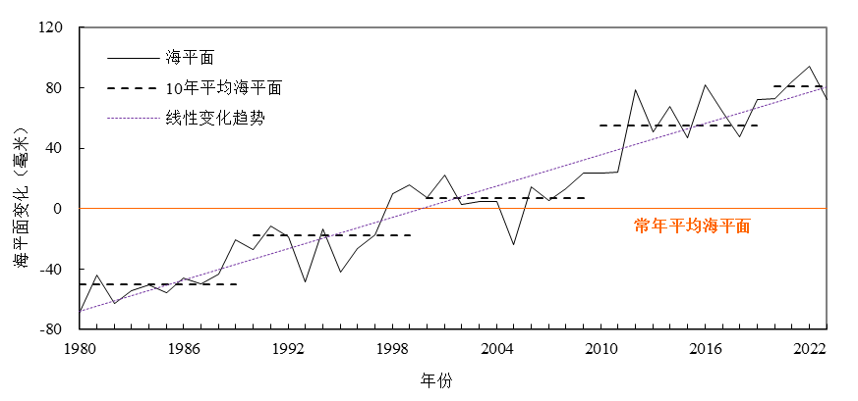
2. Sea Level Change and Projection
The sea-level rise along the China’s coast is accelerating, with the rate increasing from 3.5 mm/yr during 1980-2023 to 4.0 mm/yr during 1993-2023.
SLA
10-year average SLA
Linear trend
China SLR/m
SLA/mm
1993-2011 MSL
YEAR
YEAR
Year | China SLR/m
 | SSP1-2.6 | SSP2-4.5 | SSP5-8.5
2050 | 0.21 [0.16-0.26] | 0.22 [0.19-0.28] | 0.24 [0.21-0.33]
2100 | 0.47 [0.31-0.64] | 0.59 [0.47-0.80] | 0.83 [0.64-1.09]
NOTE: Relative to 1995-2014
Eighteenth Session of the Group of Experts for the Global Sea Level Observing System
Panama City, Panama, 11-14 March 2025

Slide 6
International Cooperation
Participate in international cooperation in marine fields;
  GLOSS, JCOMM, IODE, DBCP, NEARGOOS, ODINWESTPAC, CMOC-CHINA etc.
  Implement EMOD-PACE&CEMDnet joint projects, collaborate with EMODnet and release Regional Assessment of Costal Hazards Connected to Sea Level Rise.
  OTGA (OceanTeacher Global Academy) Training Center.
  Update China’s coastal observation data and other data processed by NMDIS. The website linkage: http://near-goos.coi.gov.cn, http://www.odinwestpac.org.cn and http://www.cmoc-china.cn.
Eighteenth Session of the Group of Experts for the Global Sea Level Observing System
Panama City, Panama, 11-14 March 2025

Slide 7

Thanks for listening!
Hui Wang, E-mail: wh_cherry@126.com
Wenshan Li, E-mail: liwenshan@nmdis.org.cn
Eighteenth Session of the Group of Experts for the Global Sea Level Observing System
Panama City, Panama, 11-14 March 2025

