Slide 1
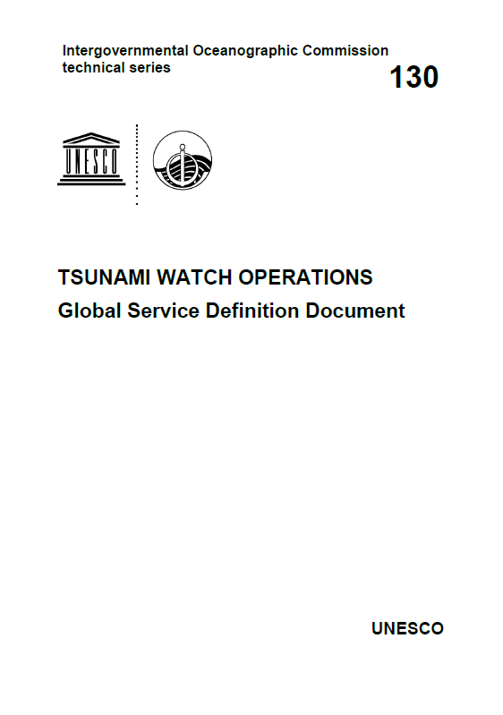
TOWS-WG Task Team on Tsunami Watch Operations Meeting – February 21-22, 2025
Updates to the Global Services Definition Document (GSDD)
Chip McCreery
Director, PTWC

Slide 2
Background
The Tsunami Watch Operations Global Services Definition Document (GSDD) was written and first published as IOC Technical Document 130 in December of 2016 to describe the basic capabilities and services of the TSPs in the four regional Tsunami Warning Systems coordinated by the IOC.
Changes in the four Systems and their respective TSPs warranted a revision of the GSDD
A draft update was written and distributed last year to get feedback before a final acceptance and re-publication by the IOC.
Goals of the revision
  Update old or incorrect information
  Make the GSDD more descriptive and less prescriptive
  Align terms and definitions with the Tsunami Glossary
Feedback has now been incorporated, and with the exception of a few additional minor edits to include IOC content, it is ready for final approval.

Slide 3
Table of Contents
1. INTRODUCTION 1
2. SYSTEM ARCHITECTURE OF THE GLOBAL TSUNAMI WARNING SYSTEM 1
3. COASTAL AREAS COVERED BY EACH RTWS AND ITS TSPS 2
4. OPERATIONAL ELEMENTS OF A REGIONAL TSUNAMI WARNING SYSTEM 2
4.1 TSUNAMI SERVICE PROVIDER 2
4.2 NATIONAL TSUNAMI WARNING CENTRE 2
4.3 TSUNAMI WARNING FOCAL POINT 3
4.4 TSUNAMI NATIONAL CONTACT 3
4.5 BILATERAL, MULTILATERAL, AND SUB-REGIONAL ARRANGEMENTS 3
4.6 OBSERVATIONAL NETWORKS 5
4.7 FORECASTING TECHNIQUES 6
4.8 STANDARD OPERATING PROCEDURES (SOPS) 7
5. REQUIREMENTS FOR TSPS, NTWCS, and TWFPS 10
5.1 ROLES AND RESPONSIBILITIES OF A TSP 10
5.2 ROLES AND RESPONSIBILITIES OF AN NTWC: 10
5.3 ROLES AND RESPONSIBILITIES OF TWFP 10
5.4 CAPABILITY REQUIREMENTS FOR A TSP 11
6. TSP SERVICES OF EACH RTWS 11
6.1 CARIBE-EWS 11
6.2 IOTWMS 12
6.3 NEAMTWS 12
6.4 PTWS 12
7. TSP PRODUCTS 12
7.1 PUBLIC PRODUCTS 12
7.2 NON-PUBLIC PRODUCTS 13
7.3 TEXT PRODUCTS 13
7.4 GRAPHICAL PRODUCTS 14

Slide 4
Table of Contents (continued)
8. TSP PRODUCTS FOR THE MARITIME COMMUNITY 15
9. COMMON SPATIAL DATASET 15
10. EVENT ASSESSMENTS & PROCEDURES 15
10.1 EVENT ASSESSMENTS 15
10.2 PROCEDURE FOR INITIAL NAMING OF TSUNAMIGENIC EARTHQUAKES 15
10.3 PROCEDURE FOR HANDLING MULTIPLE EARTHQUAKES IN QUICK SUCCESSION 16
10.4 PROCEDURES FOR NON-SEISMIC TSUNAMI SOURCES 16
10.5 PROCEDURES FOR HANDLING NEAR-FIELD TSUNAMIS 17
10.6 PROCEDURES FOR REPORTING FORECAST AND OBSERVED TSUNAMI WAVES 17
10.7 PROCEDURES FOR TERMINATING EVENT SERVICES 19
10.8 PROCEDURES IN CASE A FALSE OR INCORRECT PRODUCT IS ISSUED 19
10.9 COMMUNICATIONS TESTS AND WAVE EXERCISES 19
DISSEMINATION METHODS 19
12. KEY PERFORMANCE INDICATORS 20
12.1 TSP PERFORMANCE 21
12.2 TSP FUNCTIONAL STATUS 21
12.3 NTWC FUNCTIONAL STATUS 21
12.4 TWFP FUNCTIONAL STATUS 22
13. LIMITATIONS OF THE SYSTEMS/PROCEDURES 22
13.1 EARTHQUAKE PARAMETERS 23
13.2 INITIAL ESTIMATED ARRIVAL TIMES AND WAVE AMPLITUDES 23
13.3 AREA OF THREAT AND NO THREATS 23
14. TRAINING AND CAPACITY BUILDING 24
15. CONCLUSION 24
ANNEX I - Earthquake Source Zone Maps of the Regional Tsunami Warning Systems 1
ANNEX II - List of Acronyms 1

Slide 5
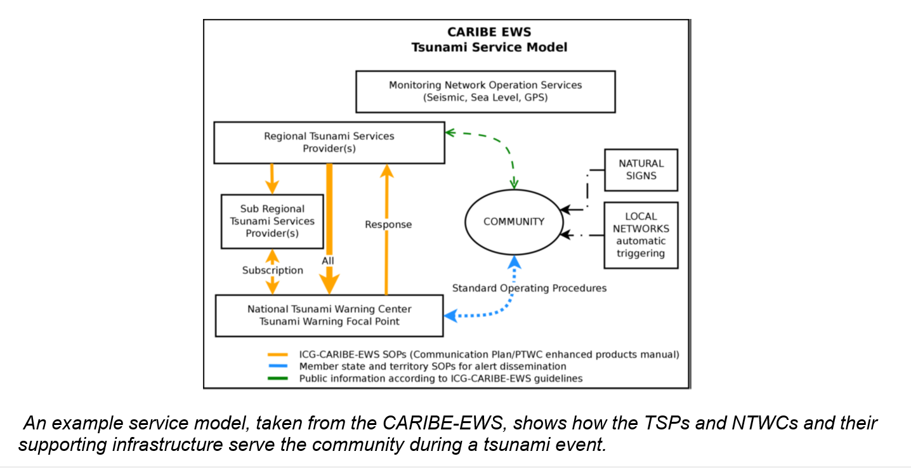
Added a figure in section 4 of the GSDD as an example from the CARIBE-EWS of the flow of information to the community from various sources as part of their tsunami warning process (suggestion from Christa von Hillebrandt).

Slide 6
Added a bullet point in Section 11 to note the elimination of fax service from TSPs unless it is requested as essential (suggestion from the Steering Group for IOTWMS)
Note that TSP dissemination by FAX has become increasingly unreliable. It is scheduled to be discontinued by March 31, 2025, across all four RTWSs unless a recipient TWFP or NTWC requests that their service be continued because they do not have sufficient redundancy with other methods to ensure they can reliably receive the TSP products. In those cases, TSPs and their respective ICGs will work to provide redundancy using methods other than FAX.

Slide 7
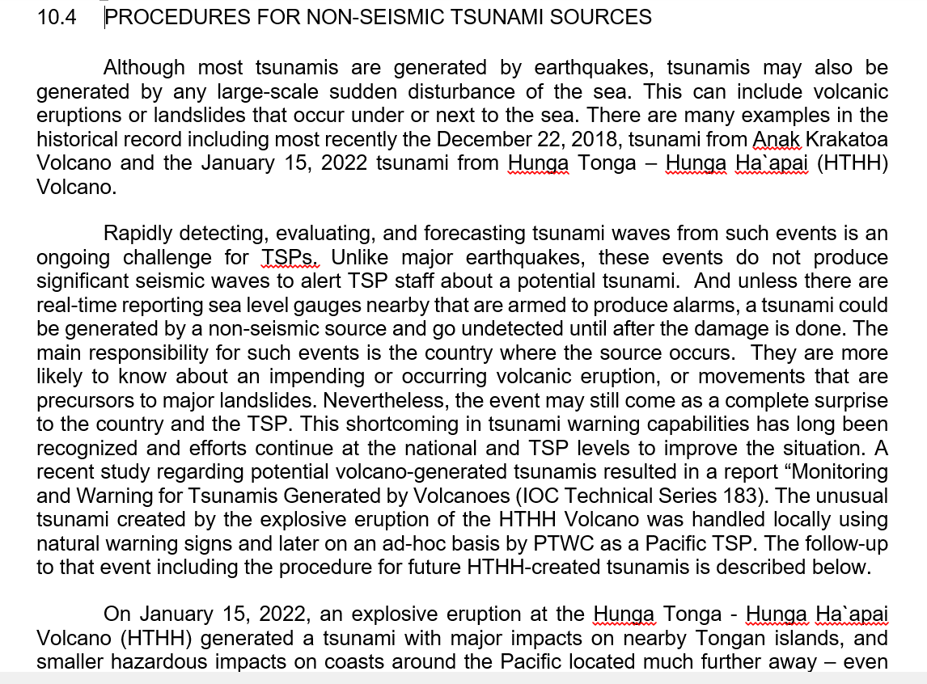
Changed Section 10.4 from Procedures for Hunga Tonga to Procedures for Non-Seismic Events (suggestion from the Steering Group for IOTWMS)

Slide 8
Changed “and” to “and/or” for the dissemination by GTS and internet in Section 5.4. (Chip McCreery suggestion to be less prescriptive)
5.4 CAPABILITY REQUIREMENTS FOR A TSP
In order for a TSP to provide the required services, they need to have certain essential capabilities common to all TSPs of the four RTWSs. They may also need to have additional capabilities as prescribed by the ICGs of each RTWS. Some of the key essential capabilities are listed below:
Access to real time seismic data and the capability to rapidly analyze earthquakes within their ESZ to determine their hypocenter location and depth as well as their magnitude
Access to real time data from coastal sea-level gauges and deep-ocean tsunameters in the region of their ESZ and AoS and the capability to measure and interpret tsunami signals recorded on those gauges.
Access to historical data of earthquakes and tsunamis within the region of their ESZ and AoS.
Capability to forecast tsunami arrival times and coastal amplitudes using a database of pre-run tsunami scenarios and/or by running tsunami forecast models in real time.
Capability to validate and/or revise forecasts in light of additional seismic and sea-level data
Capability to create and disseminate tsunami advisory products in a standardized format in conformance with any standards agreed upon by the IOC or the ICG of their RTWS.
Capability to disseminate tsunami advisory products freely and timely to TWFPs and NTWCs within their AoS as well as to any other TSPs within their RTWS using the Global Telecommunications System (GTS), the Internet, and/or any other means that ensure a secure and reliable receipt.
Have adequately trained and experienced staff, utilities, and resources to operate functionally 24 hours per day, seven days per week (24/7).
Have adequate infrastructure, redundancies, and back-up facilities to continue operating during power cuts and other emergencies and outages.
TSP staff should be able to communicate in English.

