Slide 1
TT-TWO Meeting
21-22 February 2025
Agenda Item 10.3: Other non-seismic sources
Öcal Necmioğlu
Technical Secretary of ICG/CARIBE-EWS
Tsunami Resilience Section

Slide 2
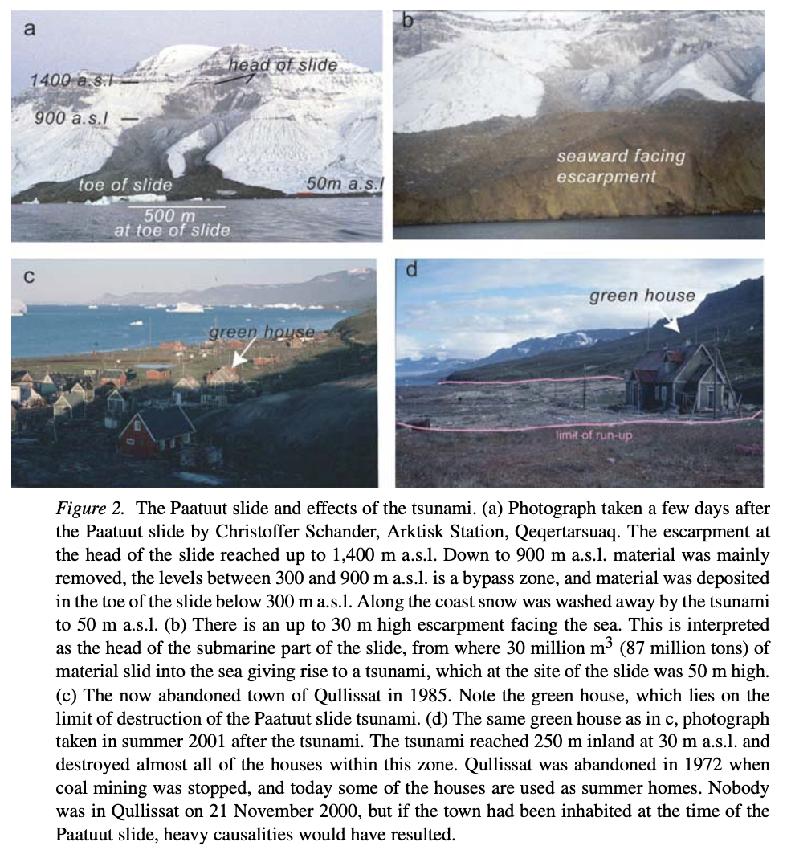
21 November 2000 Paatuut (West Greenland) Landslide and Tsunami
A large landslide occurred November 21, 2000 at Paatuut, facing the Vaigat Strait on the west coast of Greenland. 90 million m3 (260 million tons) of mainly basaltic material slid very rapidly (average velocity 140 km/h) down from 1,000–1,400 m altitude. Approximately 30 million m3 (87 million tons) entered the sea, creating a tsunami with an run-up height of 50 m close to the landslide and 28 m at Qullissat, an abandoned mining town opposite Paatuut across the 20 km wide Vaigat strait.
Trine Dahl-Jensen, 2003

Slide 3
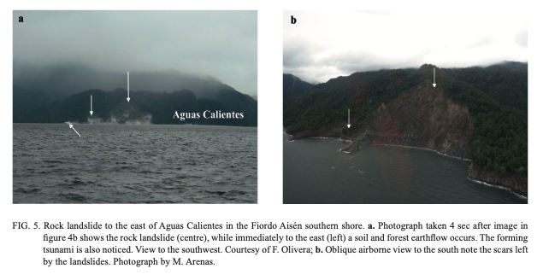
2007 Patagonian Fjordland seismic crisis in Aisén (45o25’S), Chile
The epicentre of the long-lasting seismic crisis started on the evening of January 22, 2007 and it was located 20 km to the west of Puerto Chacabuco in the Patagonian fjordland, Chile. Approximately 7,000 events were recorded up to early May, four of which reached magnitudes greater than 5 (Richter), with local intensities up to VII in Puerto Chacabuco and Puerto Aisén and VI in Coihaique. The seismic swarm was located within the Liquiñe-Ofqui Fault Zone (LOFZ), which controls the emplacement of several monogenetic volcanic cones and larger stratovolcanoes.
The January 23 (Ms 5,2) and April 1 (Ms 5,4) events caused minor damages in salmon industry installations near the epicentral zone, however the earthquake that occurred at 13:54 hours (local time) on April 21 (Mw 6,2) triggered various mass movements on the Fiordo Aisén slopes and generated tsunamis. Debris flows and tsunami waves caused the death of three people and the disappearance of seven, in addition to severe damages to the salmon industry installations. A similar phenomenon had occurred in 1927, but then fewer people inhabited the area.
Naranjo et al., 2009

Slide 4
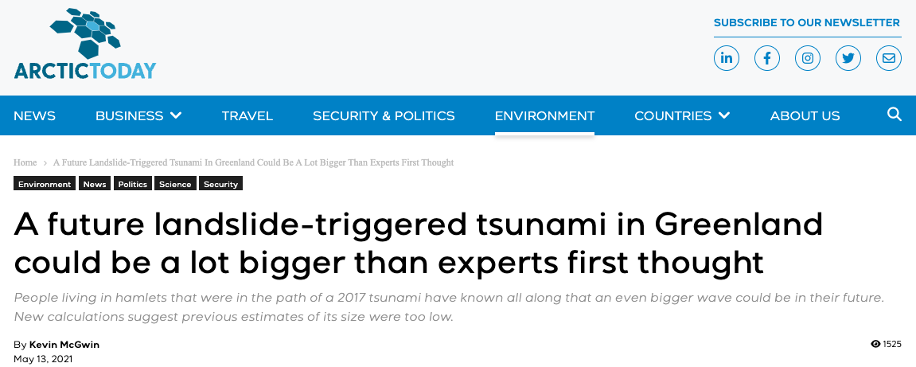
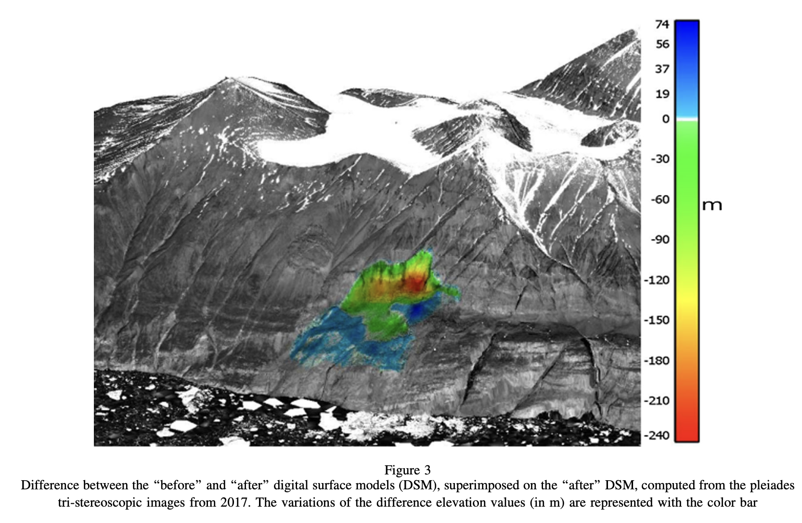
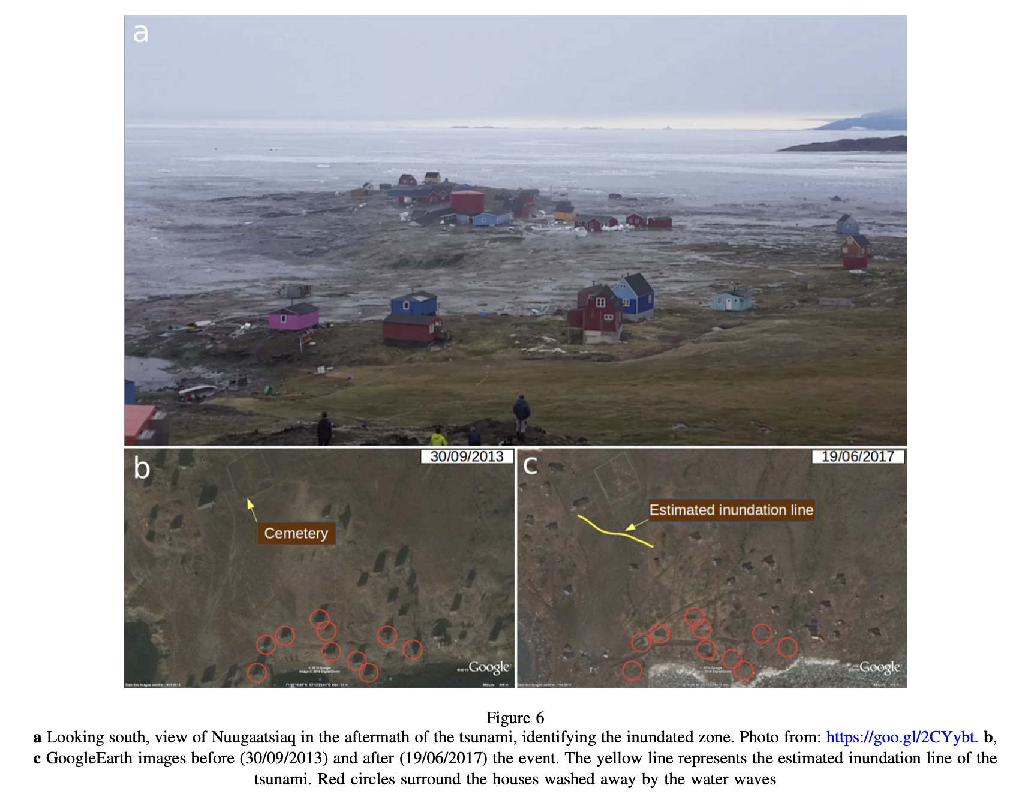
2017 Karrat Fjord Tsunami in Greenland
Greenland’s Karrat Fjord in 2017 flooded the village of Nuugaatsiaq, destroying 11 houses and killing four people.
Paris et al., 2019

Slide 5
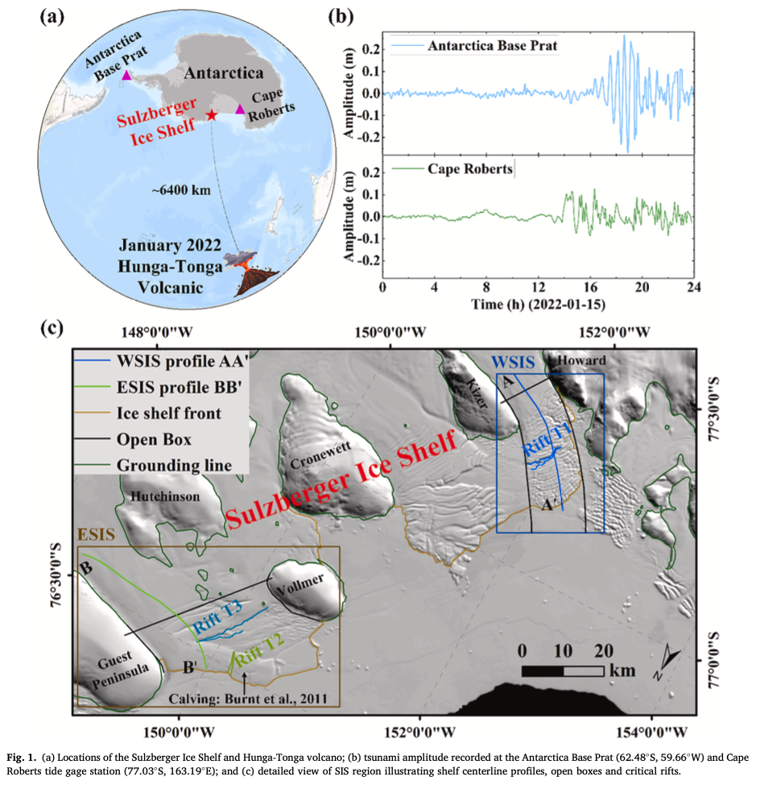
HTHH 2022 vs Sulzberger Ice Shelf (West Antarctica)
On January 15, 2022, the eruption of the Hunga-Tonga volcano unleashed a tsunami that rapidly traversed the Pacific Ocean, soon reaching the Sulzberger Ice Shelf (SIS), West Antarctica. In the aftermath, the West Sulzberger Ice Shelf (WSIS) experienced a significant calving event, shedding 106 km2 of ice and reducing its size to the smallest recorded since 1948.
Zhao et al, 2024

Slide 6
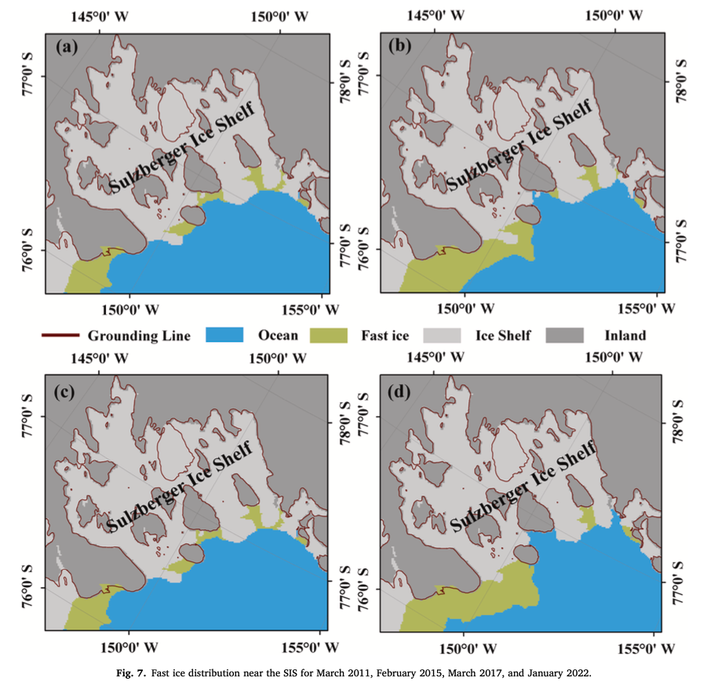
HTHH 2022 vs Sulzberger Ice Shelf (West Antarctica)
While the tsunami had an effect on the ice shelf, but the relatively small tsunami-induced flexural strains in the ice shelves suggest that the tsunami itself may not have been sufficient to cause the calving of stable ice shelves. However, for ice shelves already prone to calving, the additional stresses imposed by the tsunami may act as the final trigger for calving.
Zhao et al, 2024

Slide 7
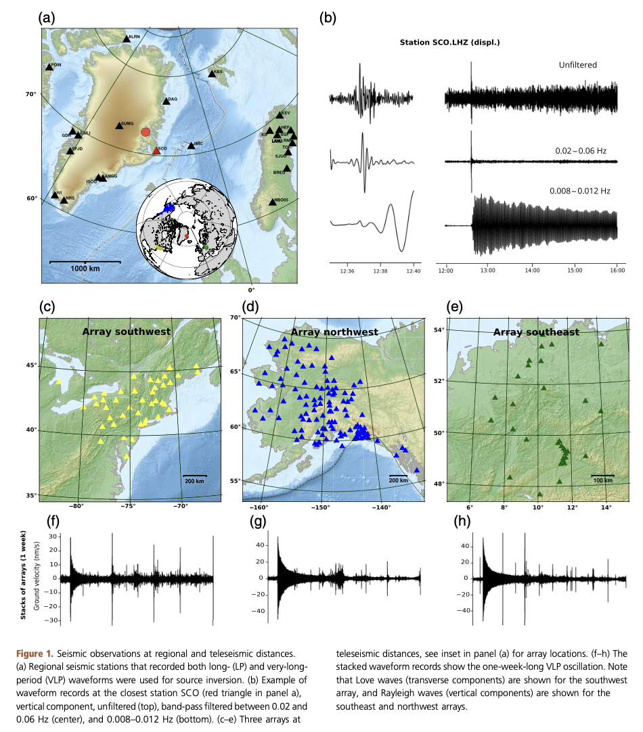
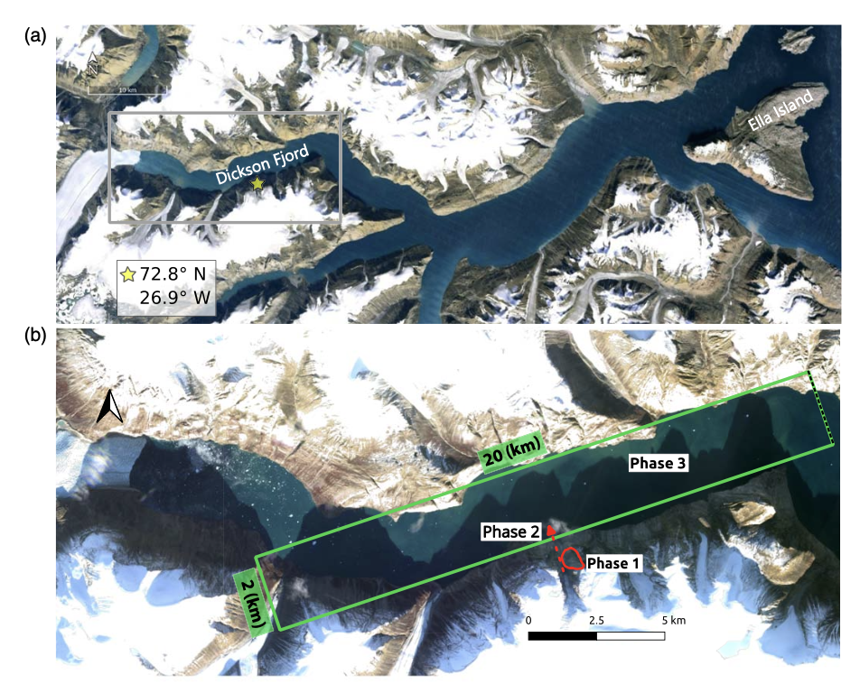
16 September 2023 mega-tsunami in Greenland
On 16 September 2023, a mega-tsunami ripped through eastern Greenland. The waters reached 200 metres high in some places and damaged an empty military base.
Carrillo-Ponce et al., 2024

Slide 8
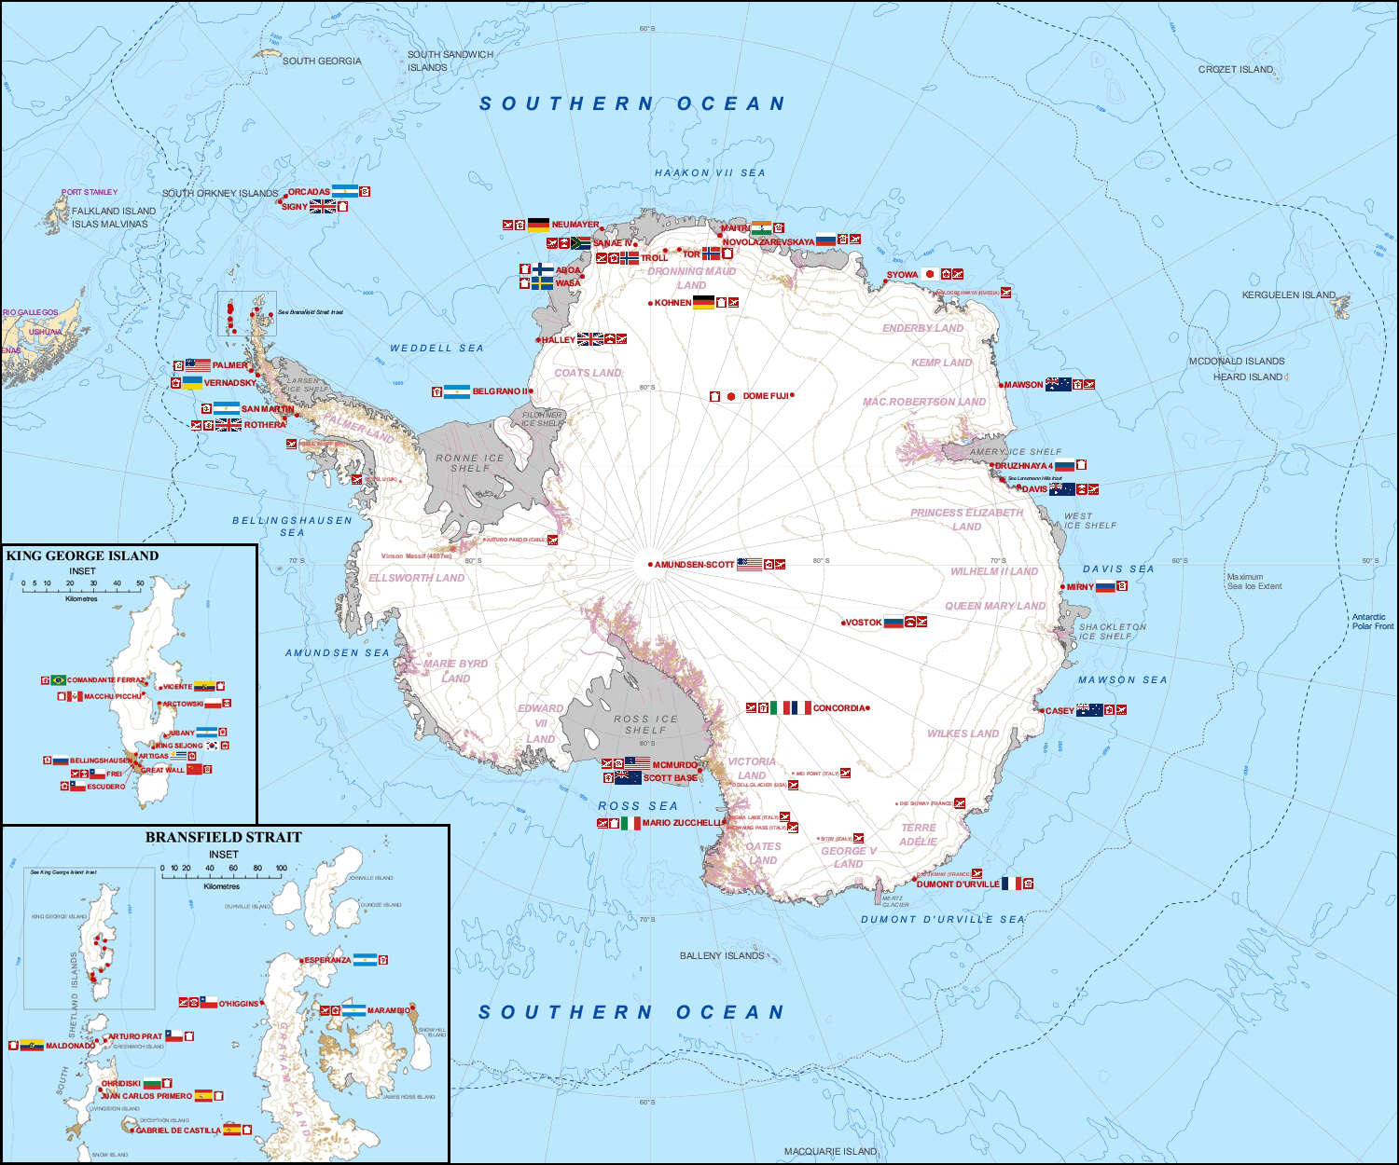
Landslide generated tsunamis in the context of climate change
- Tsunami risk can be considered on the rise as a result of landslides due to increased rainfall or glacial melting as a result of global warming/climate change.
- Tsunamis generated by landslides (in a non-volcanic setting) remains as a challenge.
- Antarctica’s continental margins may pose an unknown submarine landslide-generated tsunami risk to Southern Hemisphere populations and infrastructure.
- The issue of landslide generated tsunamis in the glacial context (tsunamis created by glacier break-up) may need closer attention, both from the scientific/resilience and intergovernmental point of view.

