Slide 1






3.1 ICG/CARIBE EWS:
CARIBE WAVE 2024 & 2025 Significant Events
Dr. Elizabeth Vanacore
Seismologist, Puerto Rico Seismic Network
Member, ICG CARIBE EWS CARIBE WAVE TT
Christa G. von Hillebrandt-Andrade
Manager, ITIC Caribbean Office
ICG CARIBE EWS WG III Chair
Dr. Charles McCreery
Director, Pacific Tsunami Warning Center
Alison Brome
Programme Officer, UNESCO-IOC Caribbean Tsunami Information Centre
Kimberly Maisonet
Contractor,ITIC Caribbean Office
Joint TOWS TT DMP & TT TOWS Meeting 20 February 2025

Slide 2
Presentation Outline
CARIBE WAVE Exercises 2024 & 2025
Significant CARIBE EWS Events February 2024 – February 2025

Slide 3
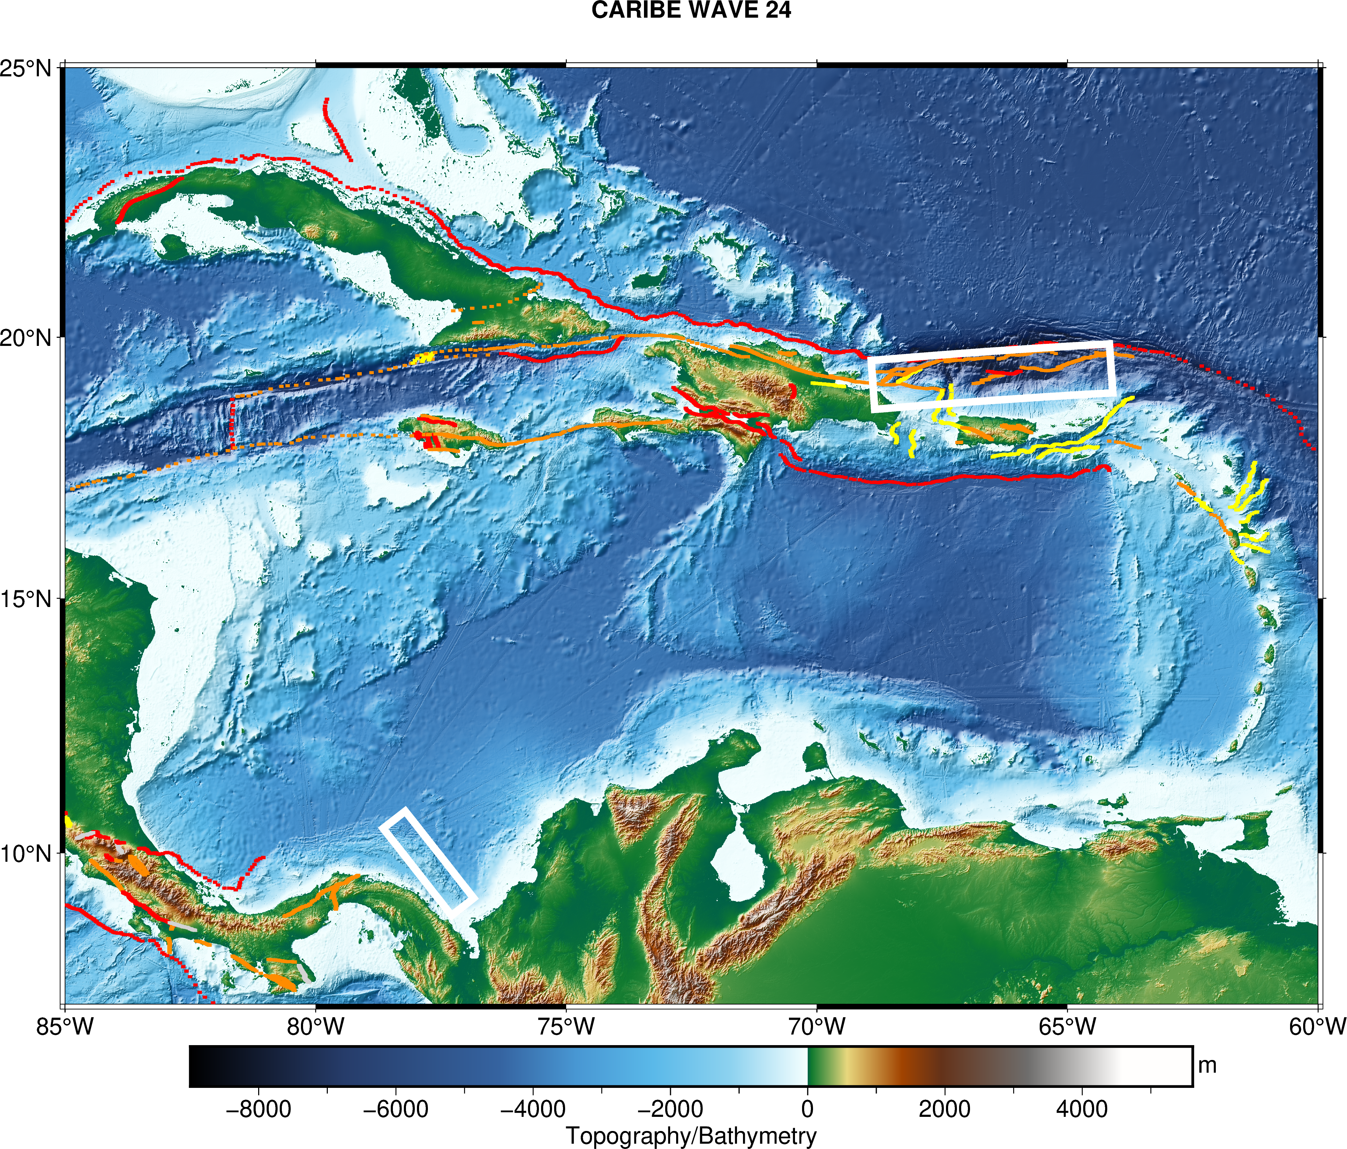
CARIBE WAVE- 2024
Participation:
  45 out of 48 Member States and Territories
  470,423 individuals registered as participant
Scenario: Panama & Puerto Rico Trench

Slide 4
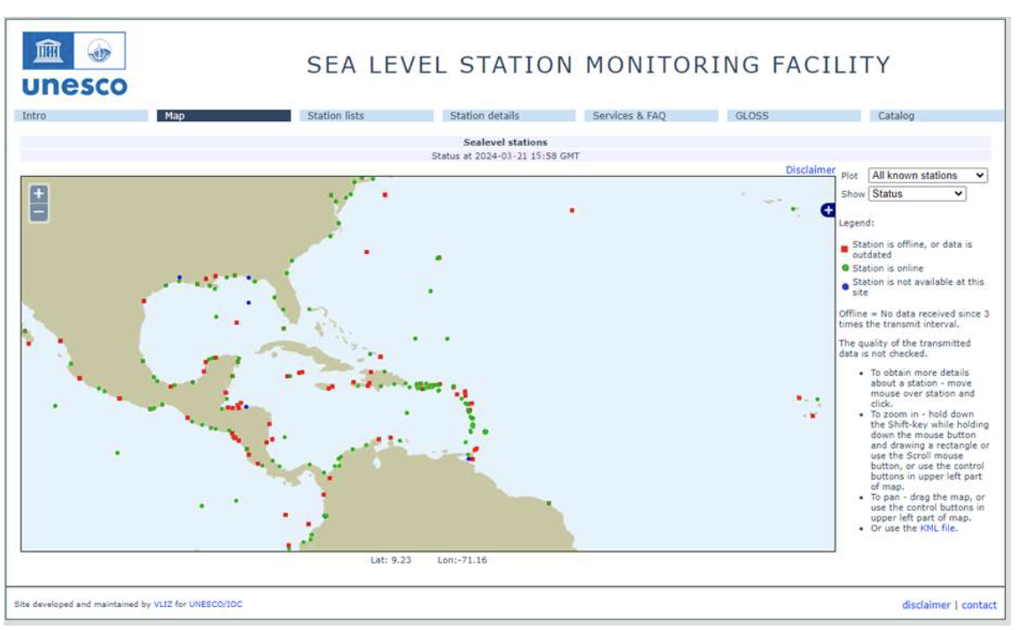
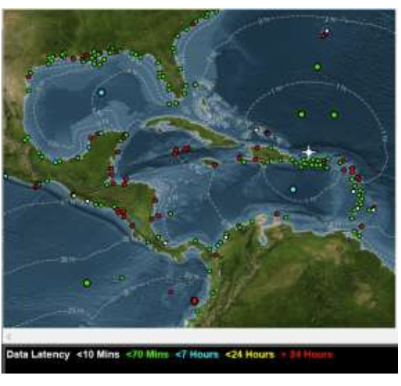
CARIBE WAVE- 2024 Sea Level Station Status

Slide 5
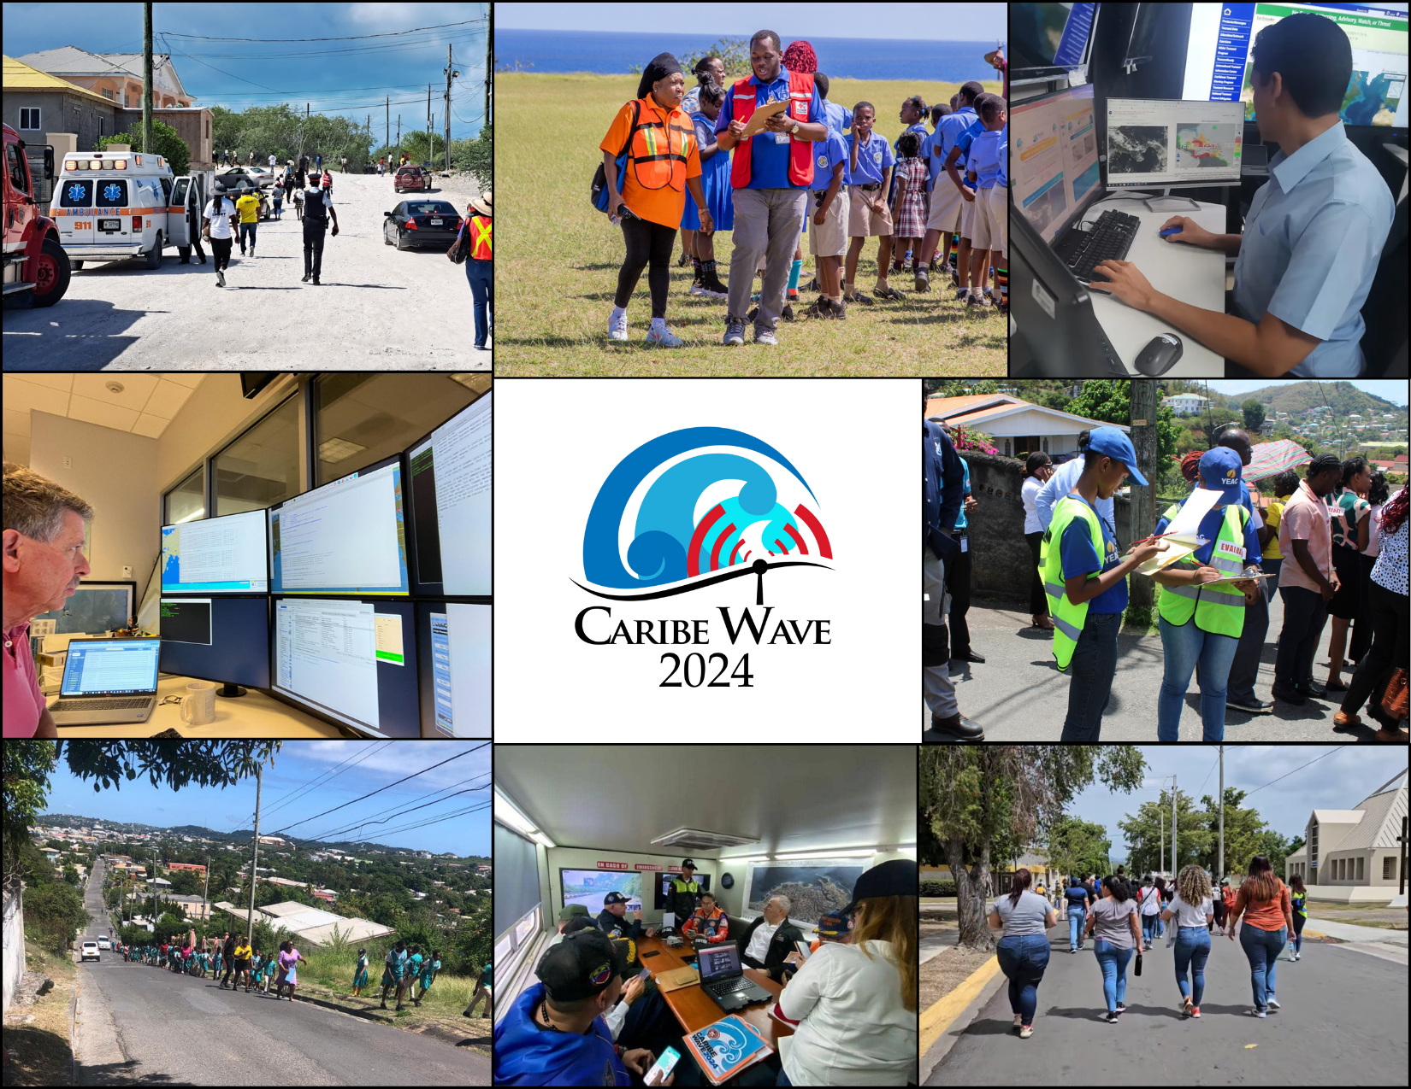
CARIBE WAVE- 2024 Evaluation and Recommendations
Evaluation:
  Dummy message was received by 100% of Member States.
  Few countries reported delays.
  36% of the news media participated and most countries and territories publicized the exercise through social media to using the hashtag #CARIBEWAVE.
  100% of satisfaction of MS and territories according to survey.
General recommendations
  Make text messages available online.
  New strategies to increase participation (workshops, challenges, promotional videos, mock 'readings').
Scenario sources recommendations:
  Non seismic sources (Kick 'em Jenny and La Soufriere)
  Remote scenarios
  Martinique scenario and Muertos Through scenario
Pictures from left to right, top to bottom, Turks and Caicos, St. Kitts and Nevis, Panama, PTWC, Grenada, Antigua and Barbuda, Venezuela, and Puerto Rico.

Slide 6
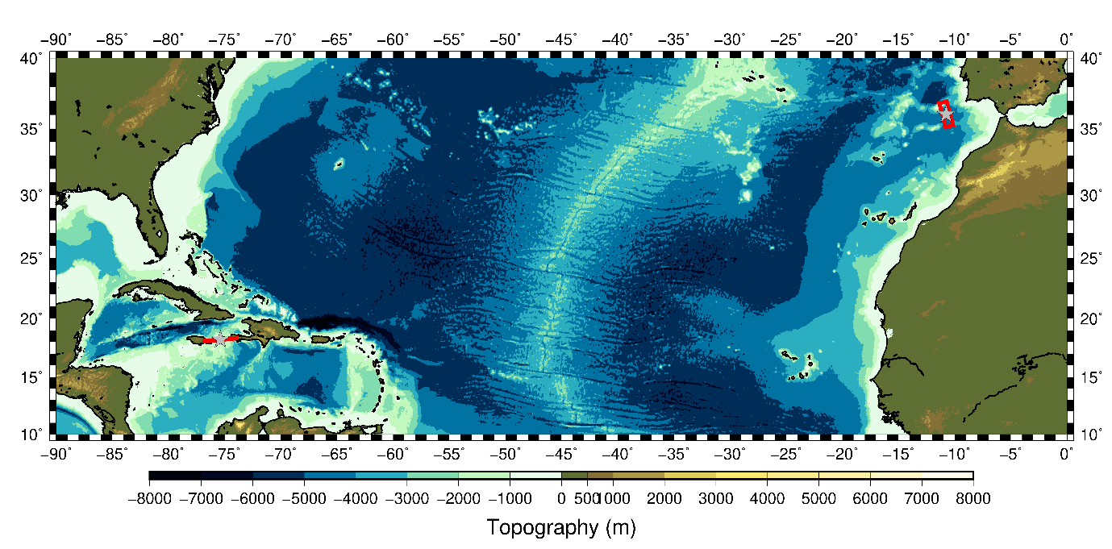
CARIBE WAVE- 2025
Portugal
Jamaica
CARIBE WAVE 25 will take place on 20 March 2025 at 1500 UTC.
Scenarios:
  Jamaica: A magnitude 8.0 earthquake located along the Enriquillo-Plantain Garden Fault Zone (EPGFZ)
  Portugal: A magnitude 8.6 earthquake located approximately 270 km off the Portugal coast.
157,167 participants are registered in the 2025 TsunamiZone.org as of 02/19/2025.
26 member states and territories have selected their scenario as of 2/19/2025 (Deadline: Thursday, 6 March 2025).

Slide 8
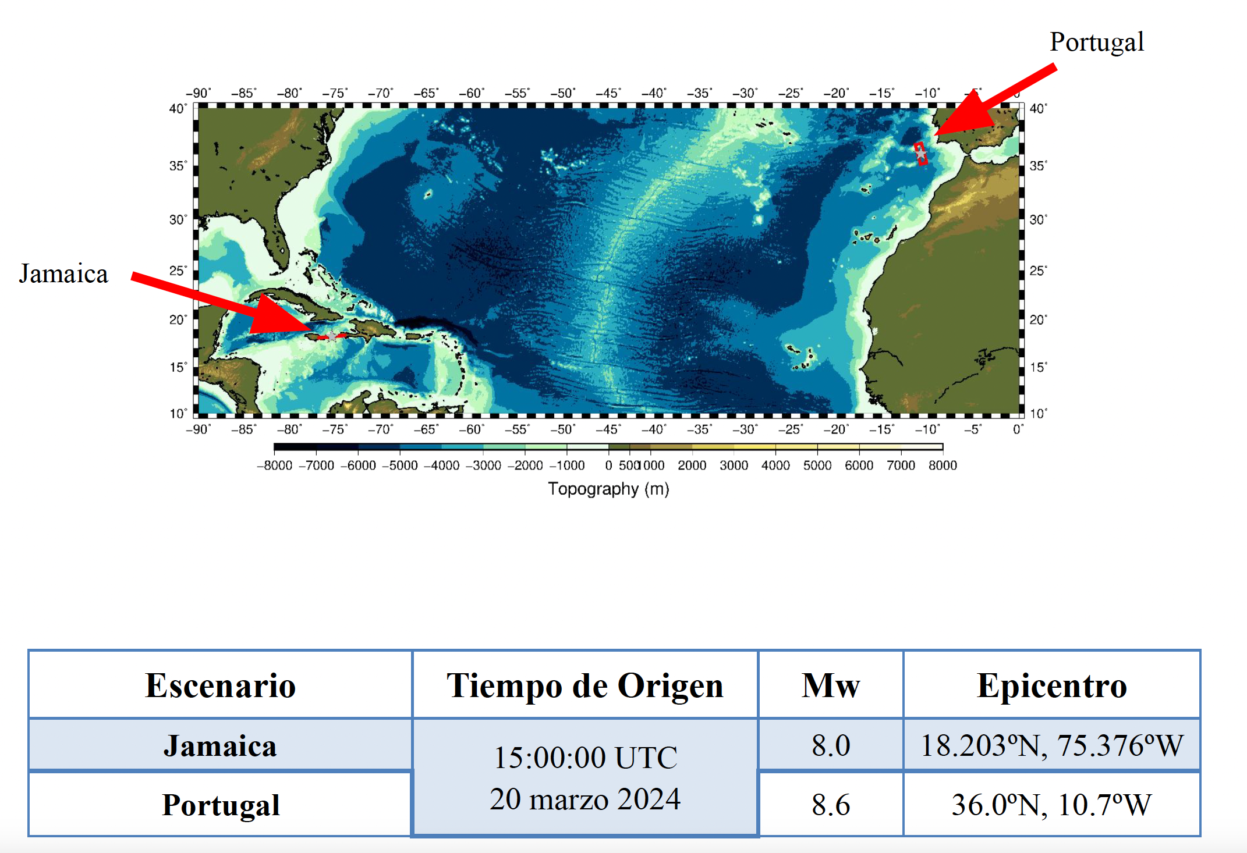
CARIBE WAVE- 2025 Scenarios

Slide 9
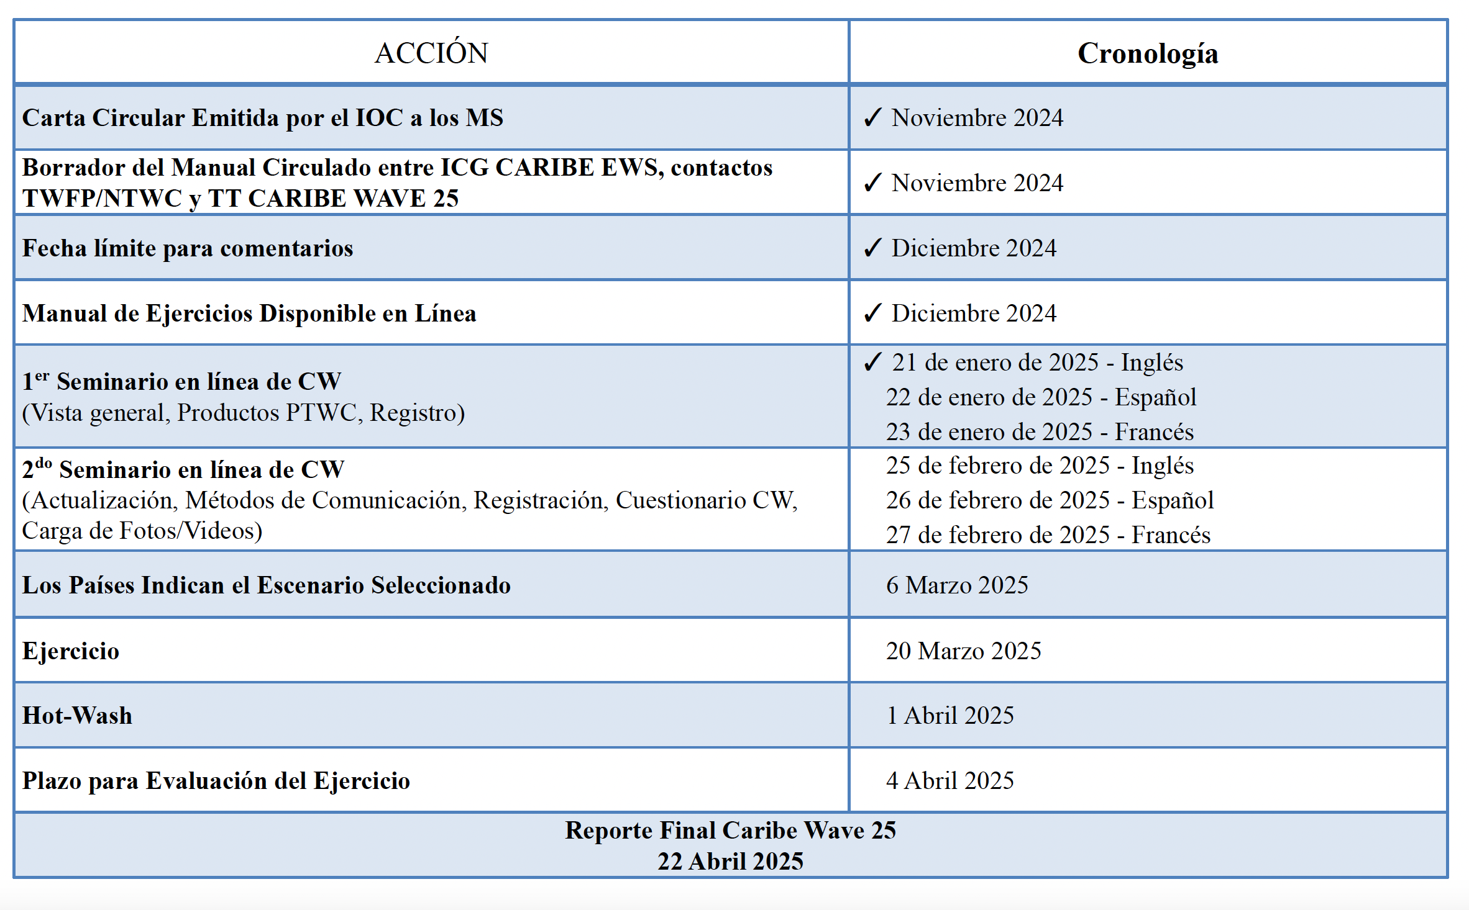
CARIBE WAVE- 2025 Timeline

Slide 10
Only Two PTWC Product-Level Events .
PRELIMINARY EARTHQUAKE PARAMETERS
---------------------------------
* MAGNITUDE 6.8
* ORIGIN TIME 1650 UTC NOV 10 2024
* COORDINATES 19.8 NORTH 77.0 WEST
* DEPTH 13 KM / 8 MILES
* LOCATION CUBA REGION
PRELIMINARY EARTHQUAKE PARAMETERS
---------------------------------
* MAGNITUDE 7.6
* ORIGIN TIME 2323 UTC FEB 8 2025
* COORDINATES 17.8 NORTH 82.5 WEST
* DEPTH 33 KM / 20 MILES
* LOCATION NORTH OF HONDURAS

Slide 11
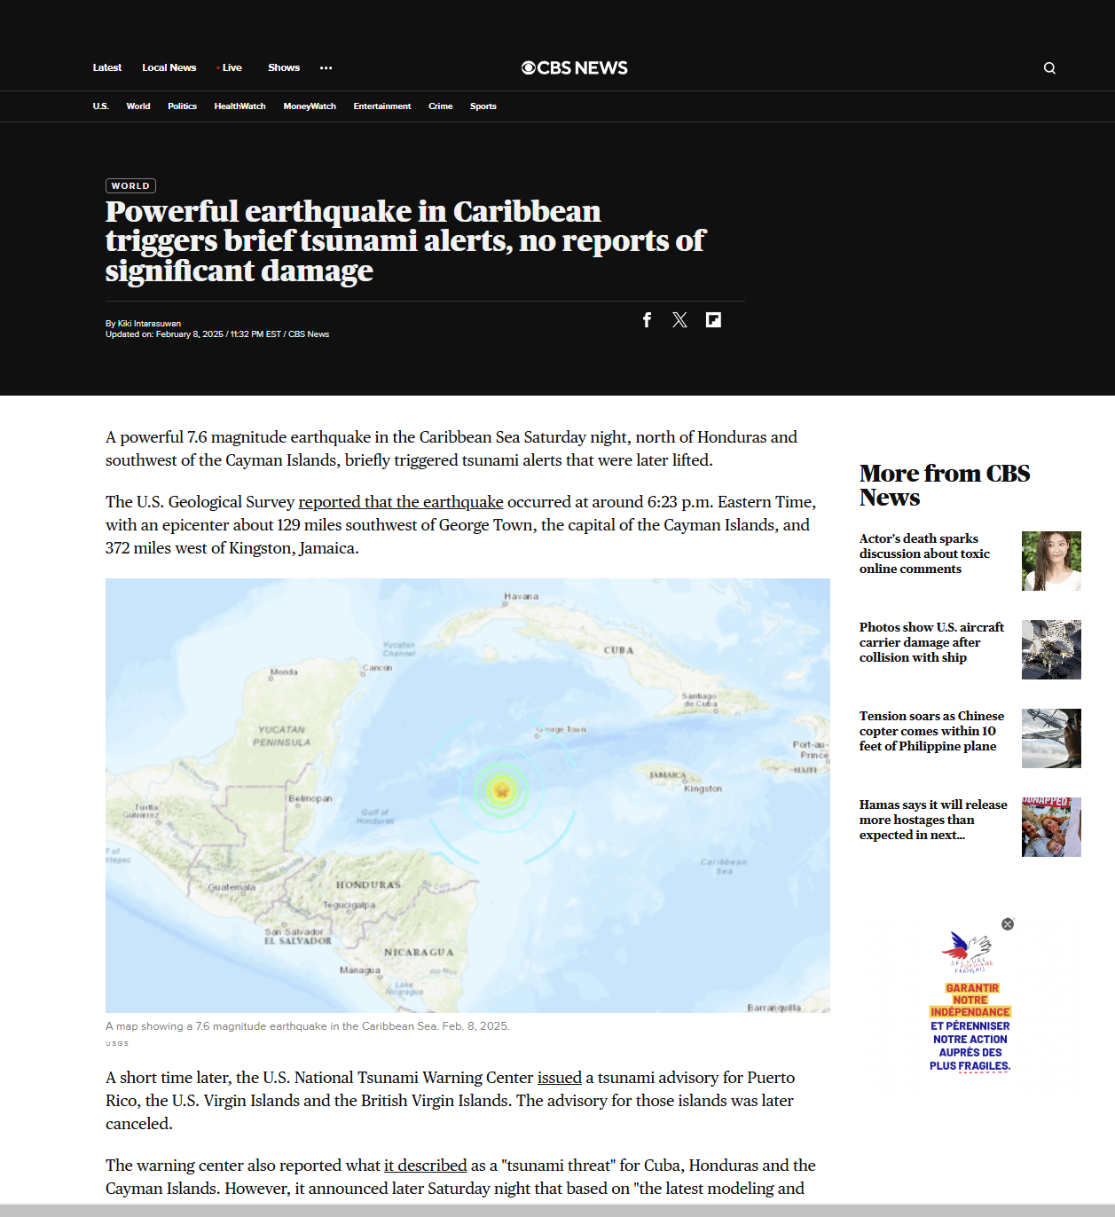
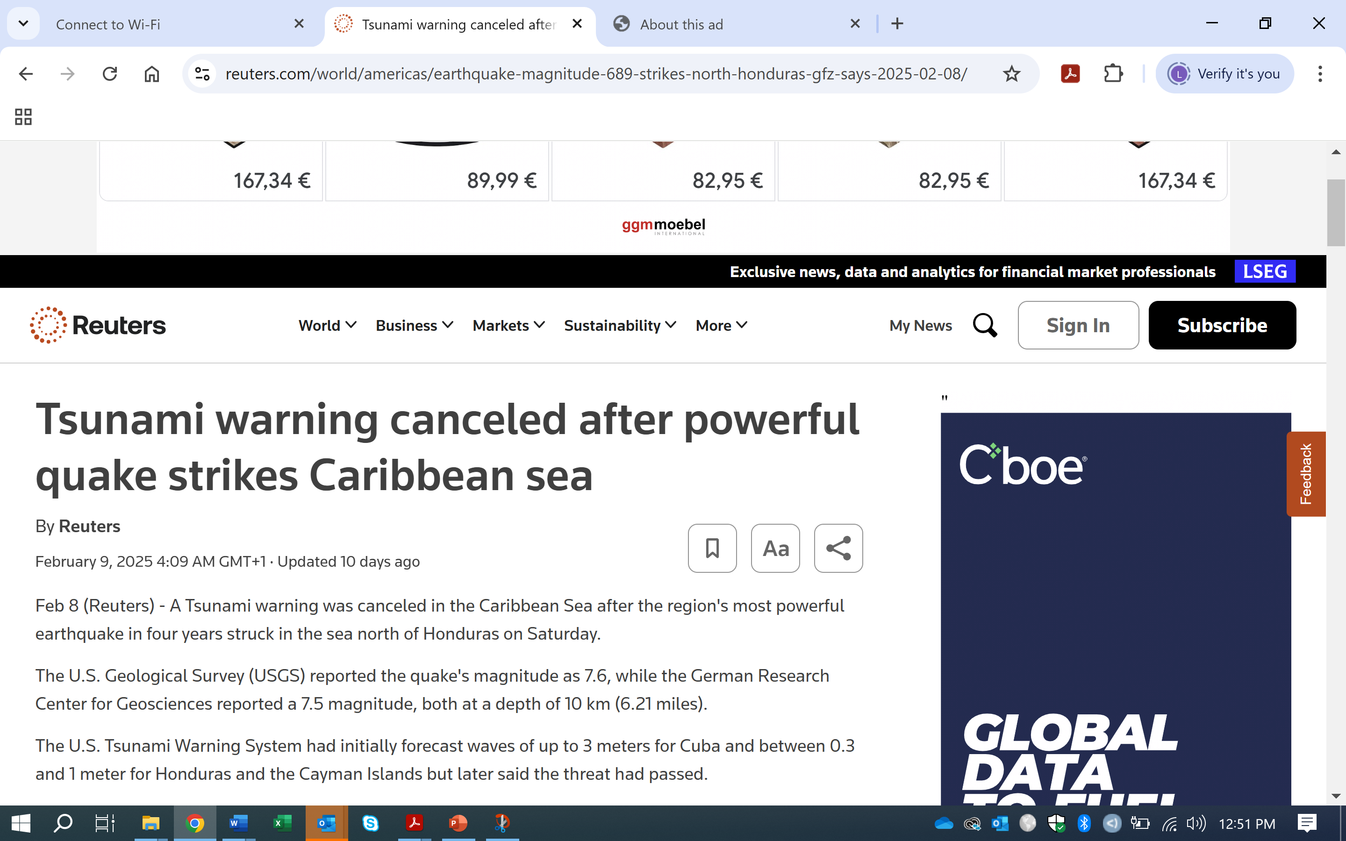
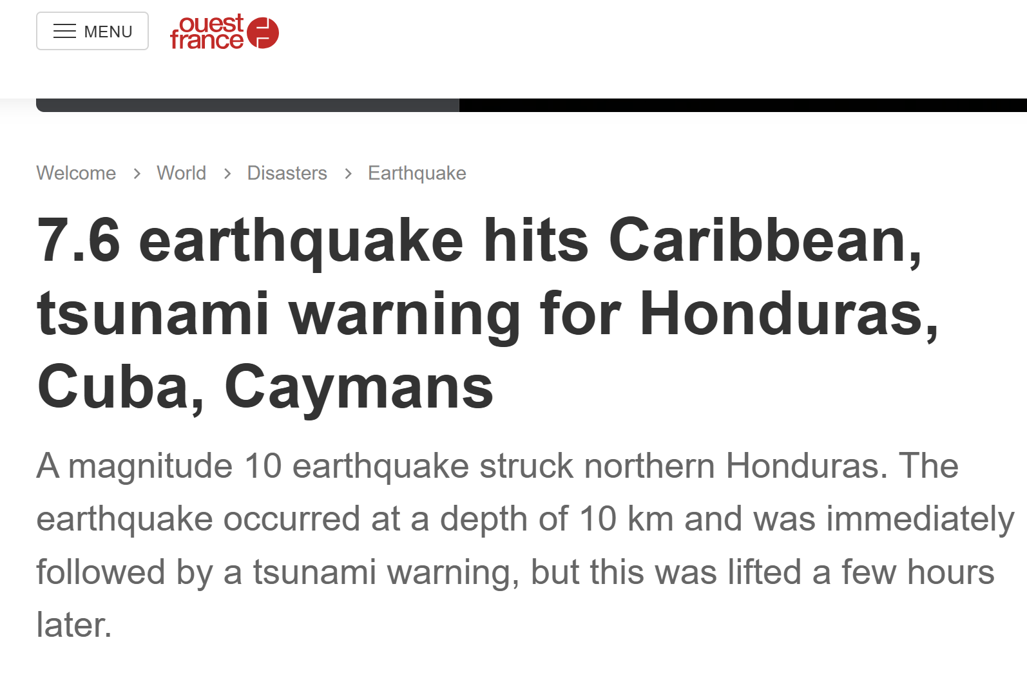
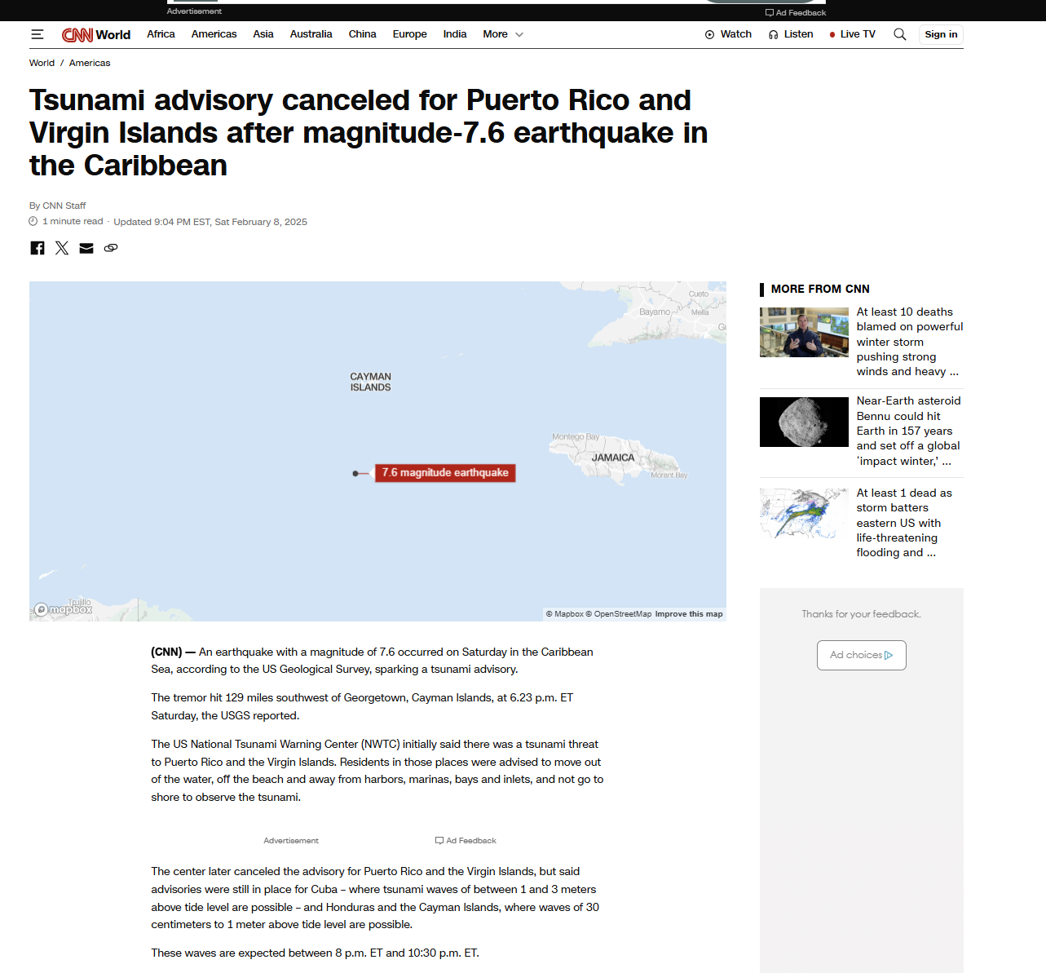
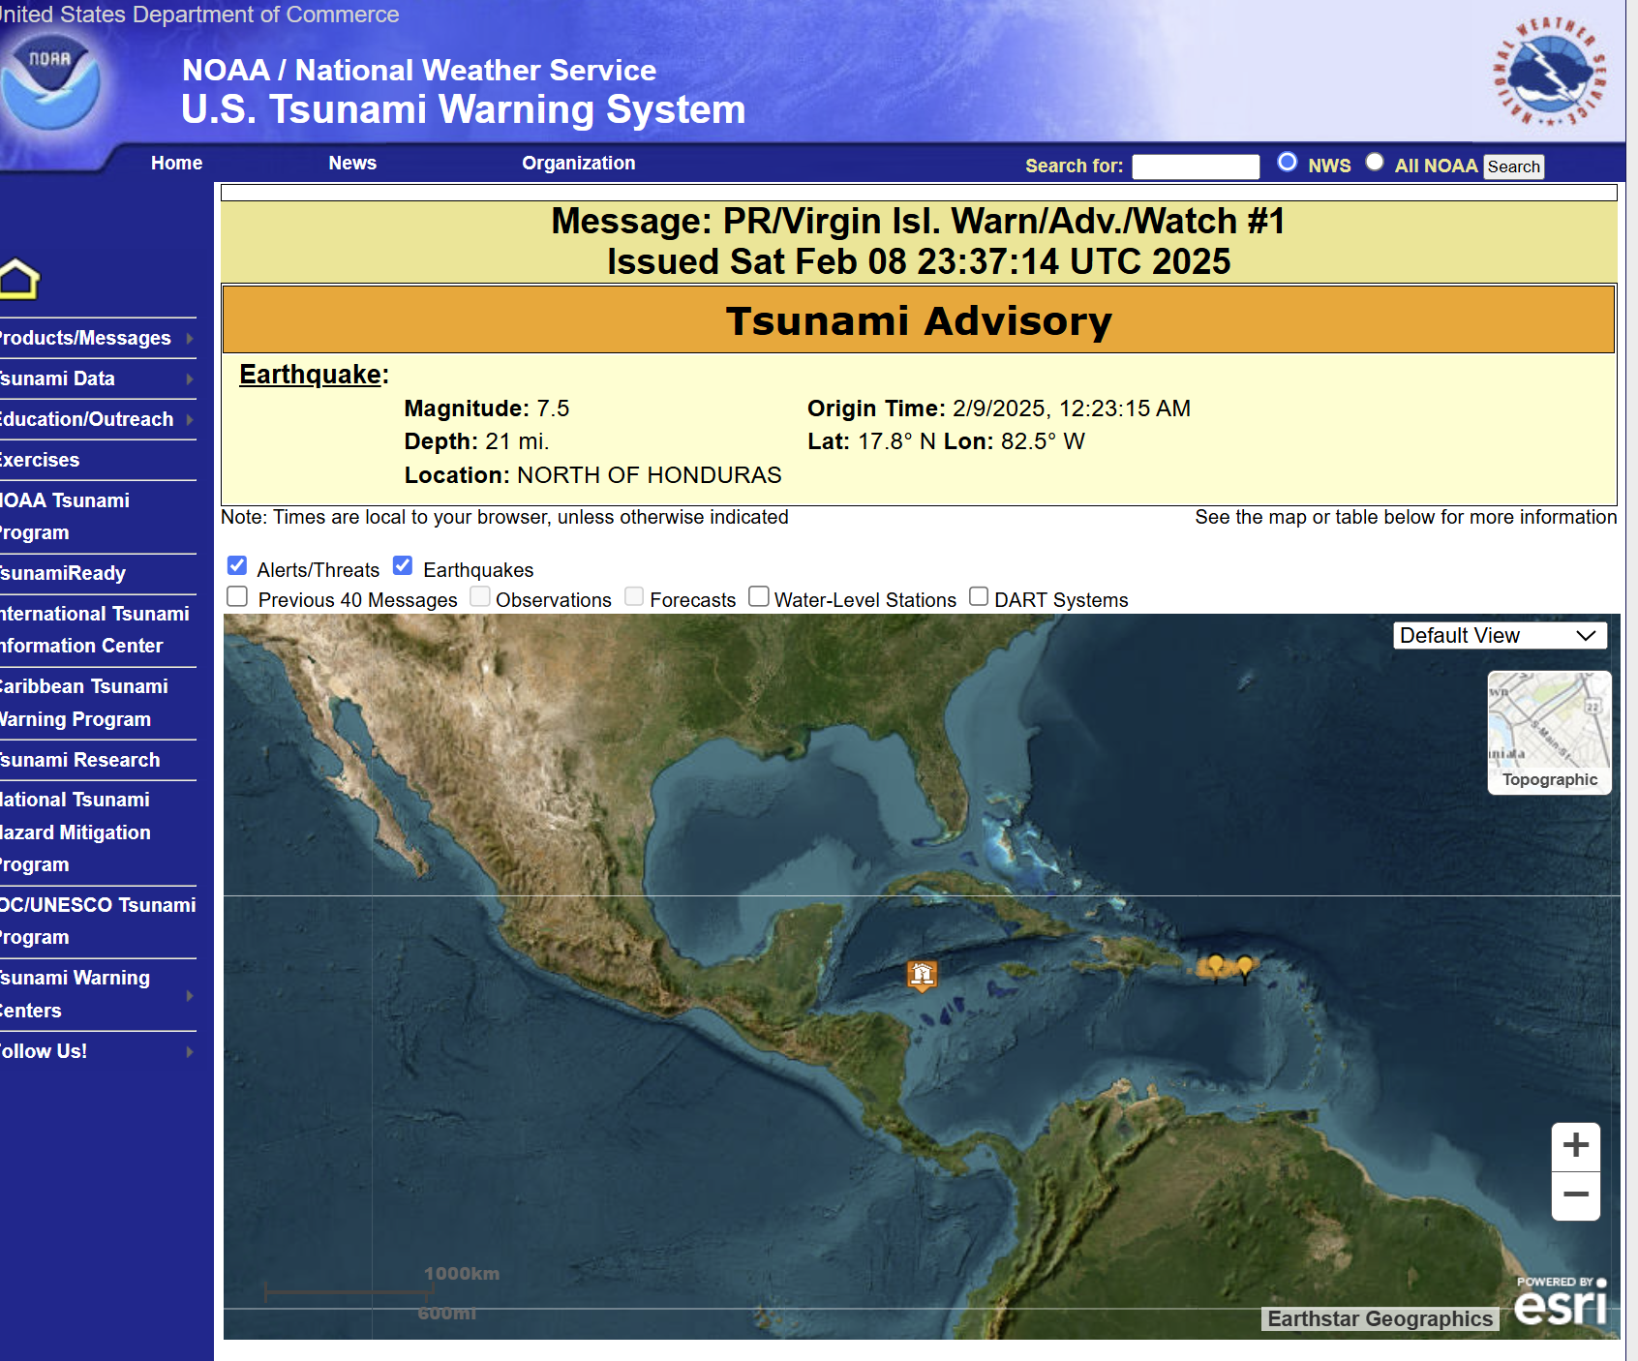
WESTERN CARIBBEAN M7.6 EARTHQUAKE AND TSUNAMI, February 08, 2025

Slide 12
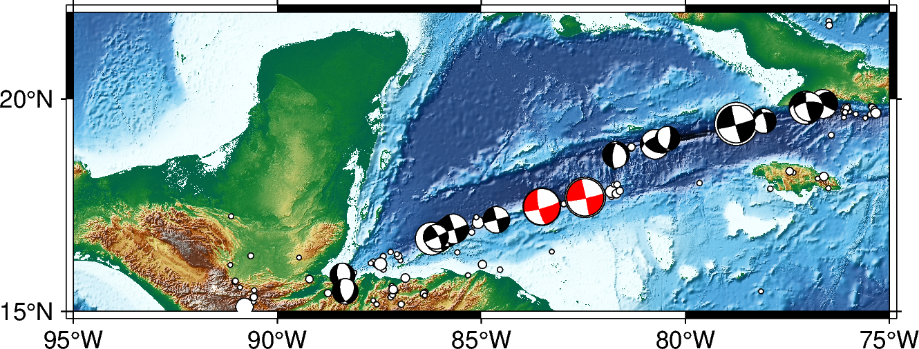
Regional Focal Mechanisms: Swan Island Transform Fault

Slide 15
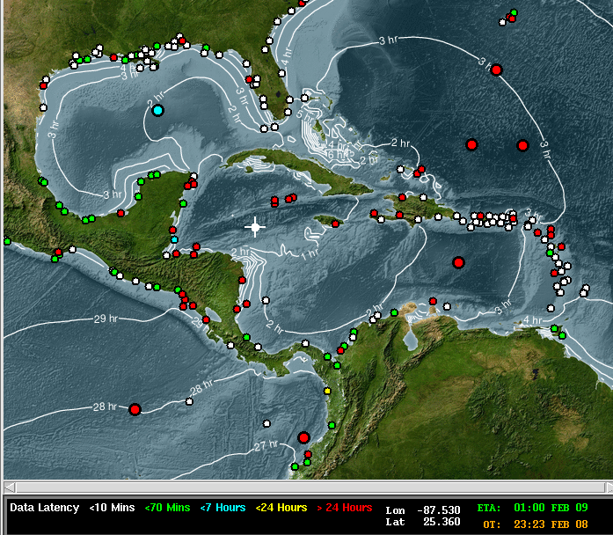
02/08/25 Cayman Islands Event – Epicenter, Tsunami Travel Times, and Sea Level Stations

Slide 17
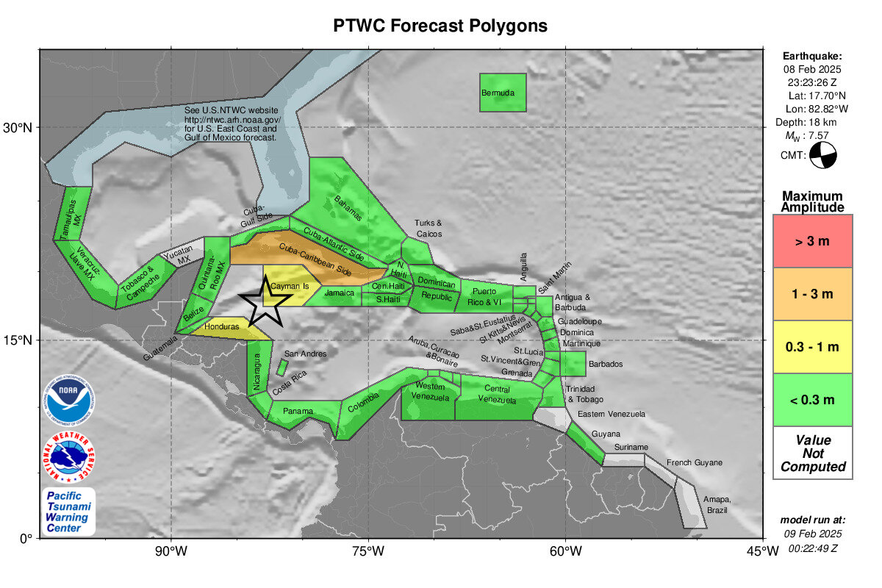
02/08/25 Cayman Islands Event

Slide 18
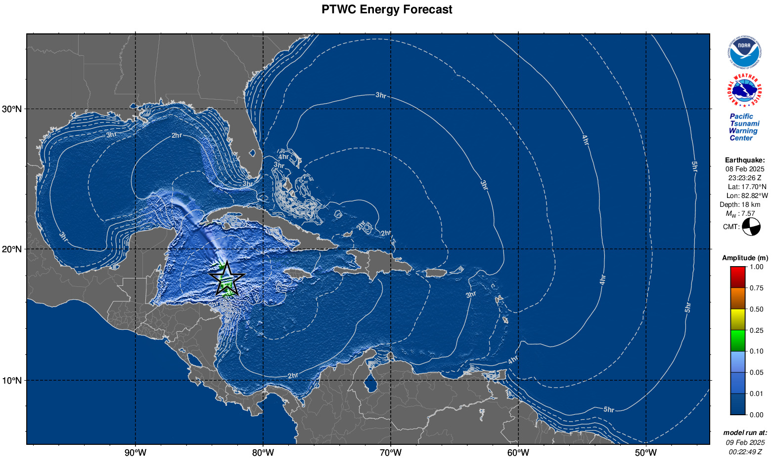
02/08/25 Cayman Islands Event

Slide 19
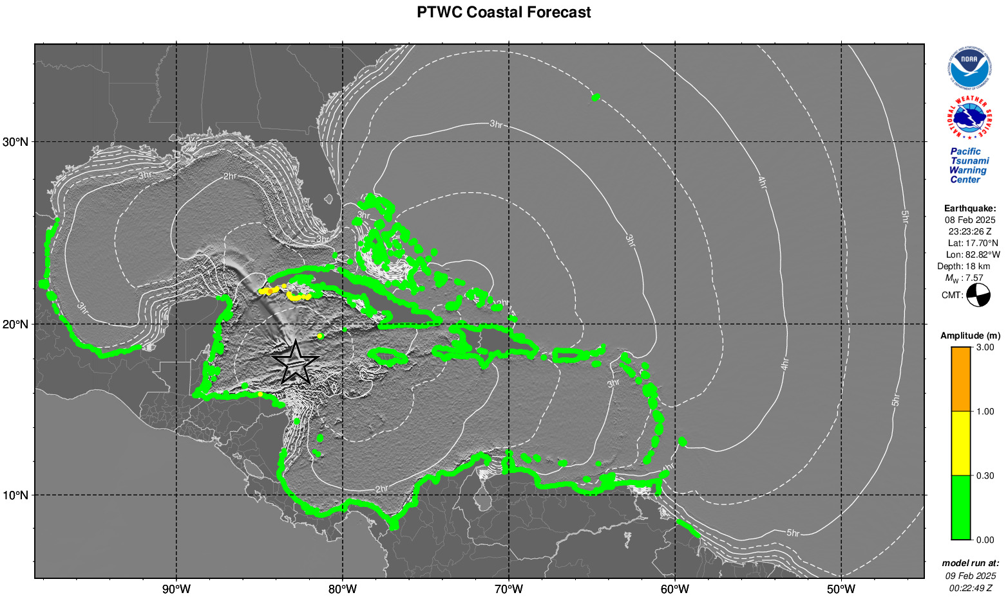
02/08/25 Cayman Islands Event

Slide 21
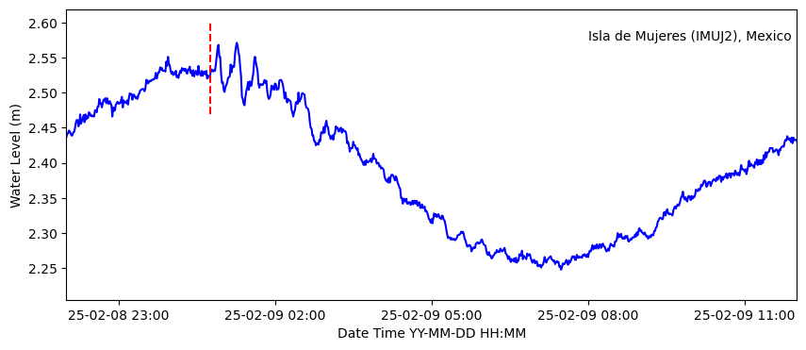
Tsunami Observation: Isla de Mujeres, Mexico

Slide 22
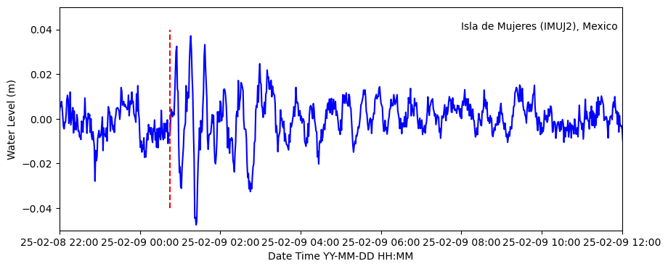
Tsunami Observation: Isla de Mujeres, Mexico
Tides Filtered Out

Slide 23
WESTERN CARIBBEAN M7.6 EARTHQUAKE AND TSUNAMI, February 08, 2025
IOC/TOWS-WG-VIII/3 (2015) approved Post-Event Assessment Questionnaire, endorsed by IOC Assembly, Paris, 18–25 June 2015 (IOC-XXVIII/3), as follows:
“The Task Teams further recommend that the trigger for implementing an assessment should be a tsunami threat of >1 m amplitude forecast in 1 or more countries in a region. Over and above this trigger level, the final decision to implement a survey should be decided by the regional Tsunami Information Centre (TIC) in consultation with the ICG Steering Group and Secretariat taking into consideration whether the tsunami resulted in a national response in one or more countries.”
PTWC TSUNAMI MESSAGES NUMBER 3 and 4 09 Feb 2025, indicated: TSUNAMI WAVES REACHING 1 TO 3 METERS ABOVE THE TIDE LEVEL ARE POSSIBLE ALONG SOME COASTS OF CUBA. Maximum instrumental sea-level observation reported as 0.04M at ISLA MUJERES, MEXICO in the TSUNAMI MESSAGE NUMBER 5.

Slide 24
WESTERN CARIBBEAN M7.6 EARTHQUAKE AND TSUNAMI, February 08, 2025
Post-Event Assessment “Hot-Wash” Webinar, 12 February 2025 attended by at least 106 representatives from 25 ICG/CARIBE-EWS Member States/Territories, regional stakeholders (UNDRR, CDEMA, PRSN, UWI-SRC).
Post Hotwash, matter referred to ICG/CARIBE EWS SC, preliminary feedback supports conduct of post-event assessment questionnaire to be conducted by CTIC
If agreed by ICG/CARIBE EWS SC, questionnaire to be digitized for implementation via SurveyMonkey, initial review recommends modifications to reflect regional ICG organizational structure and shortening questionnaire to avoid duplication with CARIBE WAVE Exercise survey and strain of MS for completion – accepted as a global approach?
Questionnaire execution 03 -14 March 2025, evaluated, reviewed and finalized by 11 April 2025 for reporting to ICG XVIII, May 2025

Slide 25
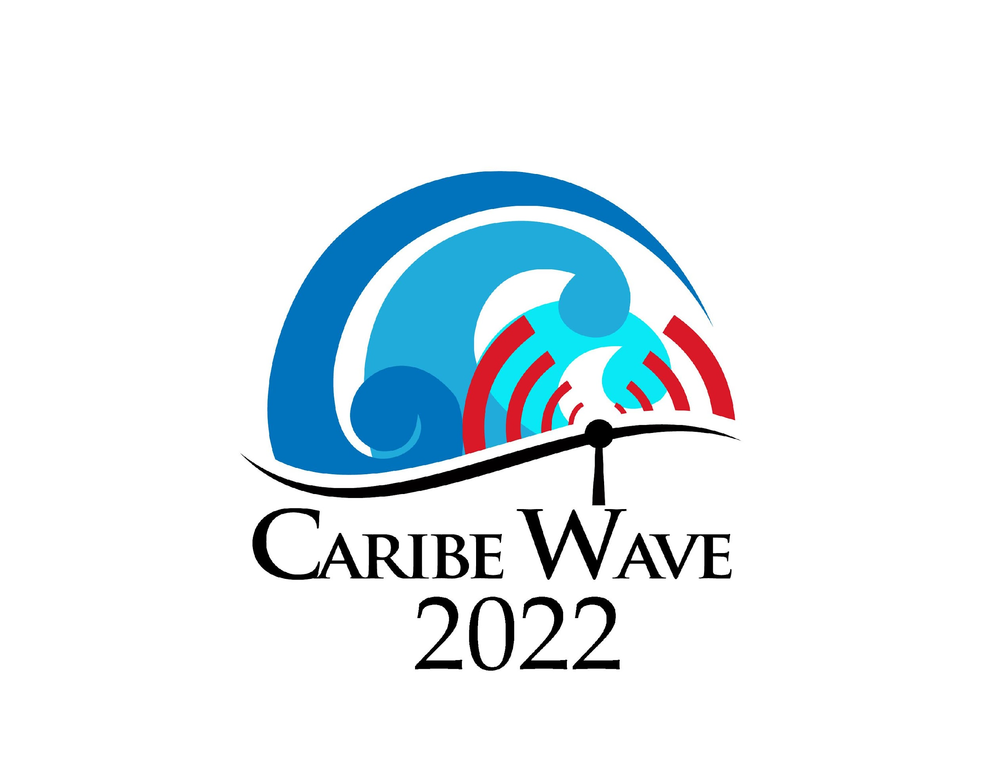



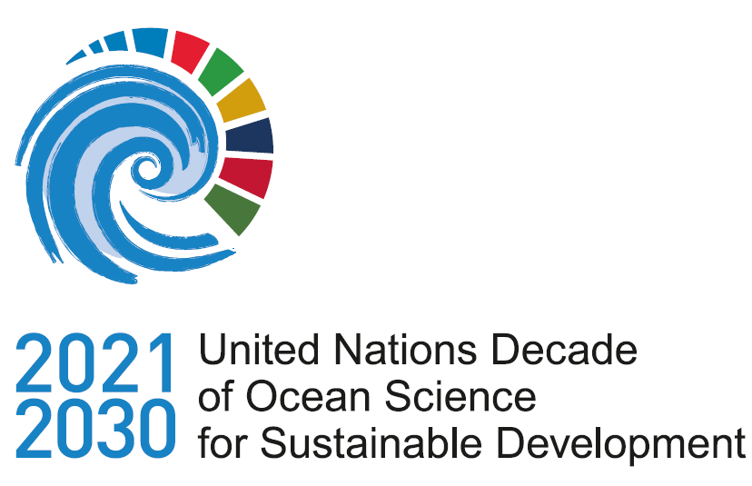

Thanks for your attention
elizabeth.vanacore@upr.edu
christa.vonh@noaa.gov
Charles.Mccreery@noaa.gov
a.brome@unesco.org

