Slide 1
TOWS-WG 18th Session
Task Team on Tsunami Watch Operation
21 – 22 February 2025
Agenda 5. Tsunami Watch Operations Status and Plans in ICG/PTWS
NISHIMAE Yuji
TTTWO Chair
ICG/PTWS Chair

Slide 2
ICG/PTWS Major Events in 2025
ICG/PTWS XXXI Session and Joint Tsunami Workshop
ESCAP Tsunami Capacity Assessment Project (Phase II)
Start of the official full functional operation of the Central America Tsunami Advisory Center (CATAC)
TSP Messages for the Maritime Community
TSP Users’ Guide with Common Format

Slide 3
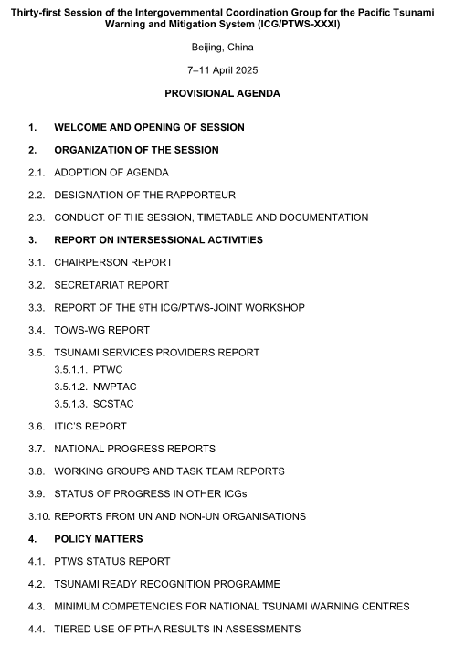
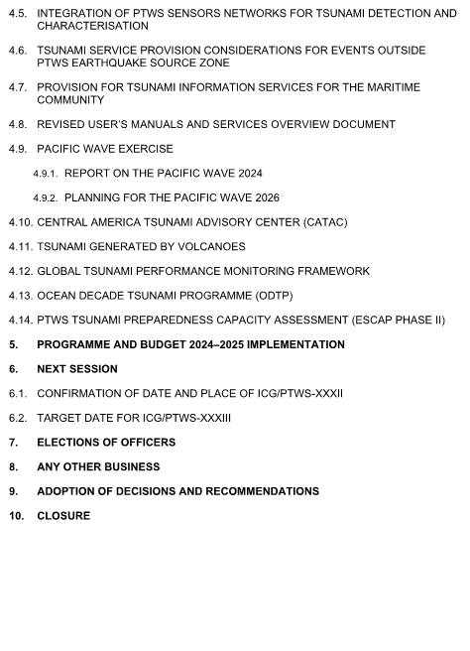
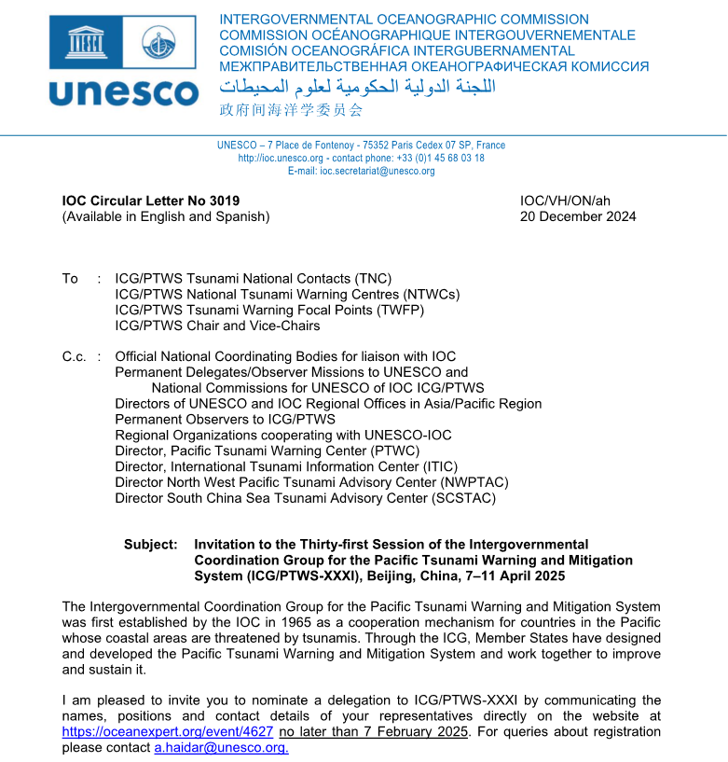
ICG/PTWS XXXI session and Joint Tsunami Workshop (April 2025, Beijing)
ICG/PTWS XXXI Session
Date: 8 – 11 April
Venue: Beijing, China

Slide 4
9th ICG/PTWS – IUGG JTC Joint Tsunami Workshop
60th Anniversary of the ICG/PTWS - Past and Future
1 April (Online)
Aims
7 April (Hybrid)
Aims
Guide 5-year research and development strategy for detection, monitoring and forecasting through:
1) Investigating challenges to achieving Decade forecasting goals
2) Exploring emergent data technologies to achieve Decade forecasting goals
3) Exploring emergent forecasting technologies to achieve Decade forecasting goals
4) Exploring impact-based forecasting including challenges faced when forecasting inundation and time-dependence
1) Recognition of contributions of 60 years of PTWS
2) Prospective of the future of PTWS
3) Tsunami DRR within the context of the IODTP – lessons from 60 years

Slide 5

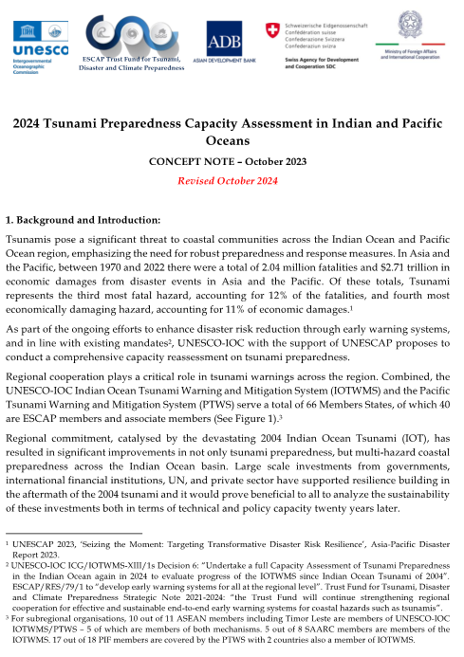
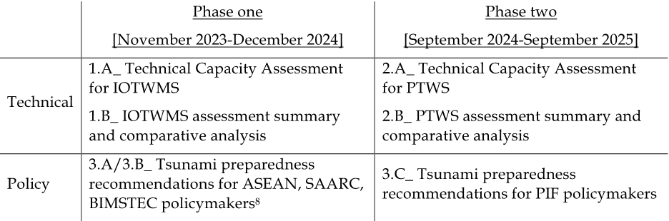
ESCAP Tsunami Preparedness Capacity Assessment
The key objectives of this assessment have been identified as follows:
To evaluate the existing capacity of the UNESCO-IOC Indian Ocean Tsunami Warning and Mitigation System (IOTWMS) (Phase I) and Pacific Tsunami Warning and Mitigation System (PTWS) (Phase II) and highlight the progress made since 2004 IOT and subsequent assessments.
To identify specific gaps and capacity development requirements at regional and national levels for strengthening the technical and policy aspects of the tsunami warning and mitigation systems in the region.
To provide recommendations for the next strategic phase of ESCAP's Trust Fund for Tsunami Disaster and Climate Preparedness, aiming to address the identified gaps through regional cooperation and mainstreaming science.
Output of the assessment

Slide 6
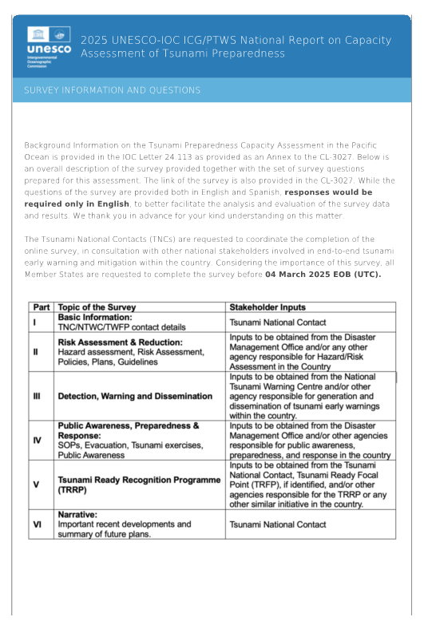
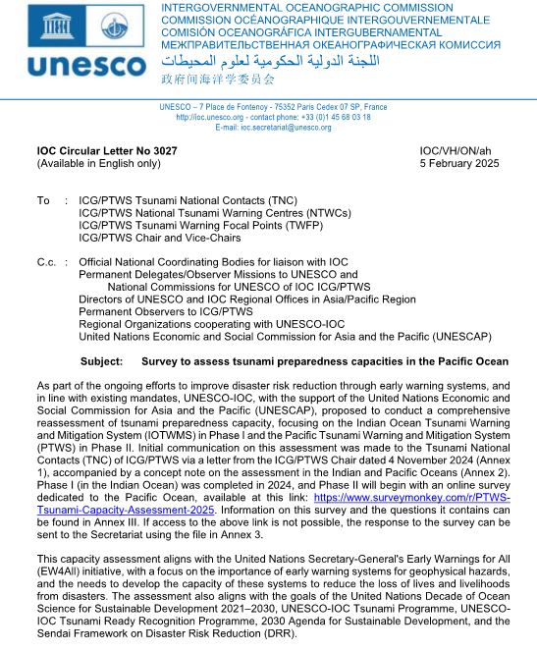
IOC CL No.3027 dated on 5 February
Questions and Answers for Survey by 4 March
ICG/PTWS XXXI
in April in Beijing
Validation Workshop in May in Manila
IOC/UNESCO 32nd Assembly in June
Technical report and Policy Report to be distributed to ICG/PTWS Member States in October
ESCAP Tsunami Preparedness Capacity Assessment (Timeline)
Steering Committee members will attend
Draft Technical Report and its Summary will be made available
A preliminary compilation of the survey results will be presented

Slide 7
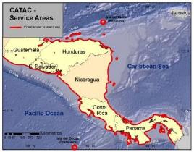
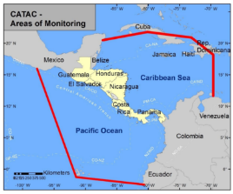
Start of the official full functional operation of the Central America Tsunami Advisory Center (CATAC)
Recommendation ICG/PTWS-XXX-6
Decides to admit the start of the official full functional operations of CATAC, starting after the IOC governing body meeting in 2024, with the specific starting date to be decided after the coordination with the ICG/CARIBE-EWS
Recommendation ICG/CARIBE-EWS-XVII.8
Recommends CATAC to continue with the implementation of EEW methods for the acceleration and improvement of the tsunami warning for Central America.
Recommends the use of additional methods for the transmission of CATAC’s products to its users.
Recommends that CATAC continues full functionality in an interim manner to be able to support the National Tsunami Warning Centers (NTWCs), Tsunami Warning Focal Points 18 (TWFPs), and emergency management authorities of Central America in addressing those challenges,
Further recommends the consideration of CATAC as a TSP in its XVIII Session in 2025 to enable the IOC Assembly to consider the final admission of CATAC as TSP in June 2025

Slide 8
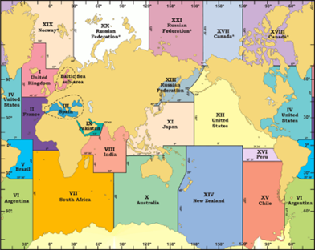
TSP Messages for the Maritime Community
IOC Decision A-32/3.4.1
Warning and Mitigation Systems for Ocean Hazards
TOWS-WG Instructs the regional Intergovernmental Coordination Groups (ICGs) to;
Recommendation ICG/PTWS-XXX.4
ICG/PTWS Recommends the PTWC to finalize necessary preparations to provide special tsunami maritime safety products specifically for ships for all NAVAREA Coordinators in the Pacific and in the Southwest Atlantic (e.g. NAVAREAs VI, X, XI, XII, XIII, XIV, XV, and XVI) to transmit to the NTWCs to be forwarded to the NAVAREA Coordinators of their countries, or upon their request directly to the NAVAREA Coordinators in the absence of a NTWC,
IOC/TOWS-WG-XVII DECISIONS AND RECOMMENDATIONS
The TOWS-WG Group recommended to Intergovernmental Coordination Groups (ICGs):
TSPs in collaboration with NAVAREA operators of the International Hydrographic Organization (IHO) test the tsunami maritime safety products in 2023/24, with a view to operationally implementing them in 2024-2025
TSPs identified for each ICG to trial dissemination of maritime bulletins to respective NAVAREA operators in their Area of Service (AoS) in the second half of 2024 for full operational implementation in 2025;
Trial Transmission of a dummy message to the NAVAREA coordinators in the PacWave24

Slide 9
Timeline for full-scale operation of provision of special tsunami maritime safety products to the NAVAREA coordinators
Time | Event | Remarks
18 – 20 September | ICG/PTWS Steering Committee | Finalization of the timeline to the full-scale operation
5 November 2024 | Trial Transmission in the PacWave 24 | Trial transmission of the dummy test message to the NAVAREA Coordinators
6 February 2025 | Meeting with the WWNWS | Direct Transmission from PTWC to NAVAREA Coordinators NAVAREA Coordinators updated by WWNWS
February 2025 | TOWS-WG and TOWS-WG TTTWO
April 2025 | ICG/PTWS- XXXI Session | Finalization of the information format Finalization of the date for the full-scale operation
June 2025 | IOC 33rd Assembly
September 2025 | WWNWS Meeting
Within 2025 | Full Scale Operation

Slide 10
ICG/PTWS TSP Users’ Guide with the Common Format
March 2024 PTWS-SC
Confirmation of the schedule for editing
September 2024 PTWS-SC
Report on progress status from each TSP
April 2024
ICG/PTWS XXXI-Session
Report on progress status from each TSP
Possibly finalized
Common PTWS TSP Users’ Guide Table of Contents
1. Overview
1.1. Background
1.2. Area of Service
1.3. Earthquake Source Zone
1.4. Tsunami Hazard
2. Operations
2.1. TSP Facility
2.2. Operational Tools and Procedures
3. Products
3.1. Product Types and Criteria
3.2. Product Content
4. Dissemination
4.1. Methodologies
4.2. Communication Testing
4.3. Contact Information
ANNEXES
I. Example Products
II. Forecast Points
III. Observation Sites
Editing Users’ Guide
Discussion in each Regional WG

