Slide 1

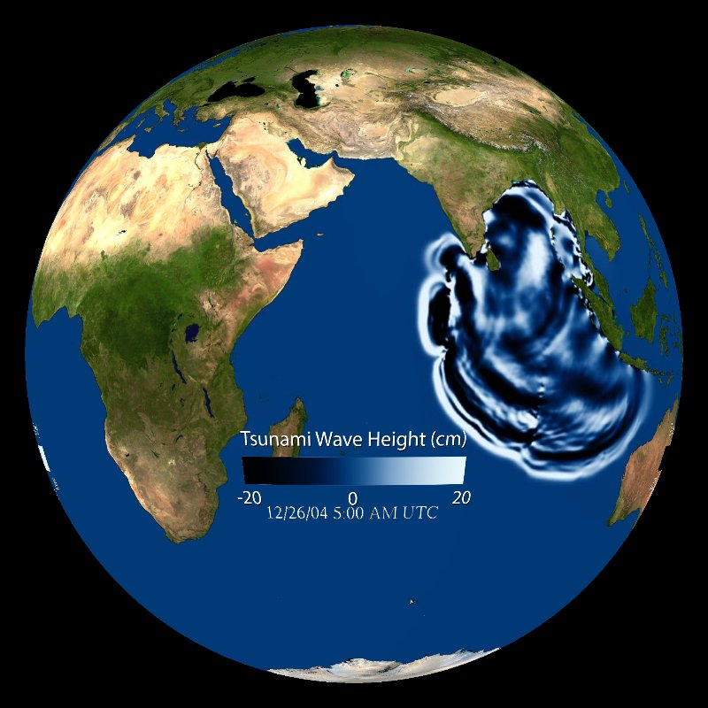
International Tsunami Symposium 2025 in India
Sunanda Manneela
Indian National Centre for Ocean Information Services (INCOIS)
Ministry of Earth Sciences, Govt. of India
5th Meeting of Scientific Committee for the UN Ocean Decade Tsunami Programme
16 - 17 January 2025, Paris, France

Slide 2
Plans for International Tsunami Symposium 2025
Dates: 5 – 7 November 2025
Venue: INCOIS, Hyderabad
Duration: 3 days
  Day 0: Participants’ Arrival at Hyderabad
  Day 1 to Day 3 Symposium at Hyderabad
    Opening
    Keynote Talks
    Tsunami Commission Business Meeting
    Technical Sessions (Plenary & Parallel)
    Posters
    Public Session / Pre-conference training session for students ??
    Local Tour & Visit to INCOIS Facilities
International / National Organising Committees
Conference Website by INCOIS
  Announcement
  Abstract Submission
  Abstract Reviews by Experts
  Communication of Acceptance
  Registration
  Payment of Conference Fees
  Information on Technical Sessions
  Information on Accommodation & Local Logistics
  Symposium Proceedings
Symposium at INCOIS Campus
Accommodation for participants will be blocked in Hotels at negotiated rates
On-Campus Accommodation for Students
Local Transport from Hotel to Venue by INCOIS
Local Tours & Conference Dinner by INCOIS

Slide 3

International Tsunami Symposium 2025
Major Theme: Tsunamis caused by non-seismic and complex sources: challenges, lessons learnt and Way forward
Objectives
To report on and document the achievements in Tsunami Science
To identify the challenges and gaps in the early warning system and work that still needs to be done
To enhance interdisciplinary collaboration especially for non-seismic tsunami source detection and tsunami forecasting
To advance tsunami detection and warning system through AI/ML
To promote global tsunami preparedness through UNESCO-IOC Tsunami Ready Recognition Programme and similar programmes/projects
To leverage on the Ocean Decade Tsunami Programme for improving Tsunami Services

Slide 4
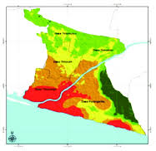
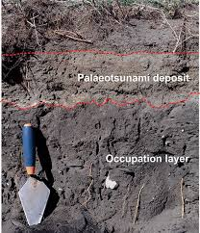
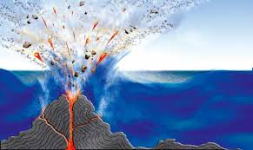
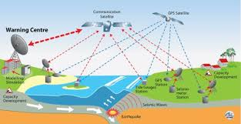
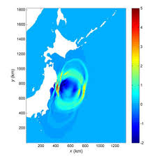


International Tsunami Symposium 2025
Themes
Tsunami hazard, vulnerability and risk assessment
Paleotsunami Studies
Instrumentation and observation network
Tsunamigenic earthquake source mechanisms
Non-seismic and Complex tsunami sources
Tsunami modelling
AI/ML for Tsunami early warning system
Field Surveys
Tsunami Awareness and Preparedness
International Cooperation and Private Partnerships

Slide 5
International Tsunami Symposium 2025
Organizing committees
International Advisory and Planning Committee (Strategic guidance on Programme)
  Prof Yuichiro TANIOKA (Japan), Hokkaido University
  Dr Maria Ana BAPTISTA (Portugal), Lisbon University
  Dr Diana GREENSLADE (Australia), Bureau of Meteorology, Melbourne, Australia
  Dr Alexander RABINOVICH (Canada), Institute of Ocean Science, Canada
  Dr Mohammad HEIDARZADEH (UK), Brunel University, UK
  Dr Laura KONG (USA), International Tsunami Information Centre
  Ms. Suci Dewi ANUGRAH, (Indonesia), BMKG
  Dr Srinivasa Kumar TUMMALA, ICG/IOTWMS, IOC-UNESCO
  Dr Ravichandran MUTHALAGU (India), Ministry of Earth Sciences
  Dr Balakrishnan NAIR (India), INCOIS
Scientific Advisory Committee (Review Abstracts, Recommend Keynote Speakers and Plenary sessions etc)
National Organizing Committee (Explore Funding and ensure conference complies with national policies)
Local Organizing Committee (Local Logistics – transport/accommodation/technical support etc)

Slide 6
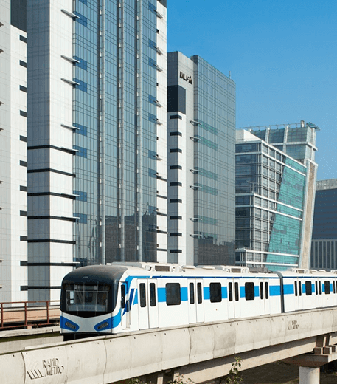
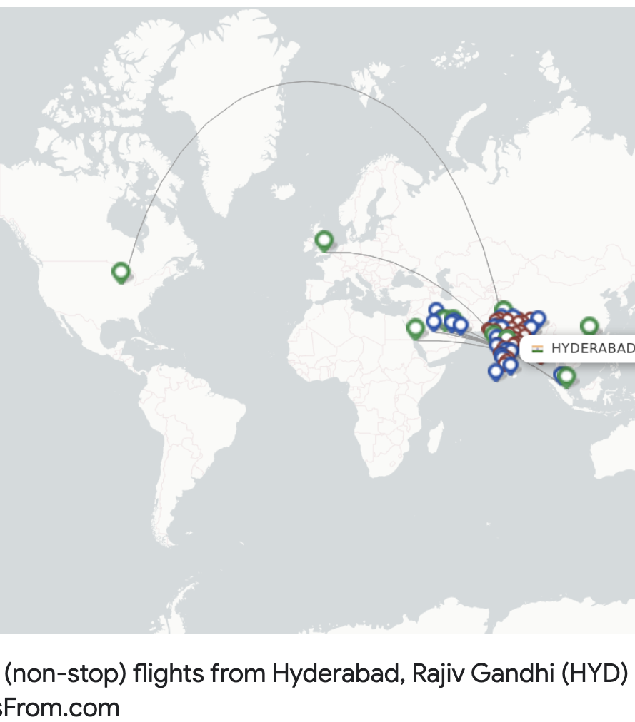
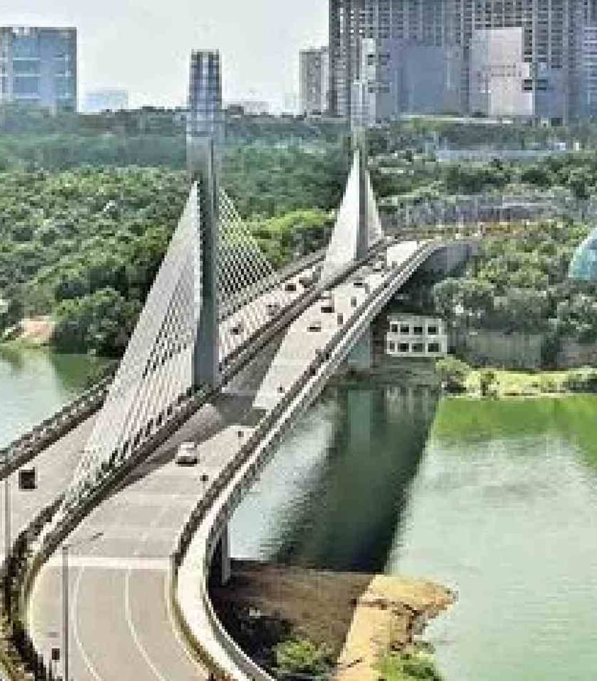
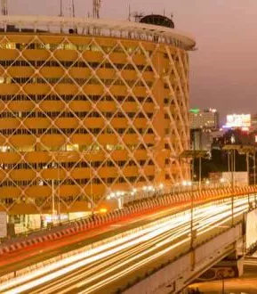
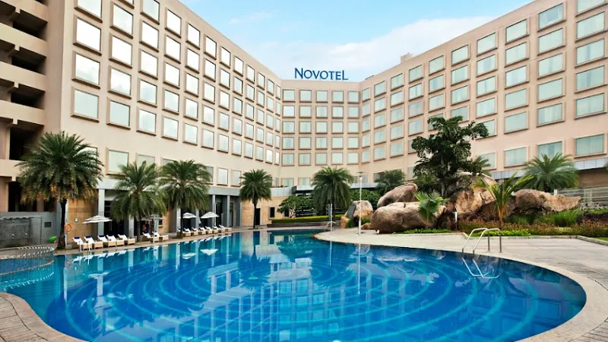
Location: Hyderabad, India
Home to several scientific institutions, IT Majors (Cyberabad) and Historical Tourist Attractions
Major hub for international flights and has direct connections to several major cities around the world
Excellent infrastructure, including world-class convention centers, hotels, and transportation facilities
Well-organized public transportation system of metro, buses, taxis, and auto-rickshaws, making it easy move around
Cost of accommodation, venue rentals, and other logistics is generally more affordable, making it an attractive choice
Pleasant Weather most of the year.

Slide 7
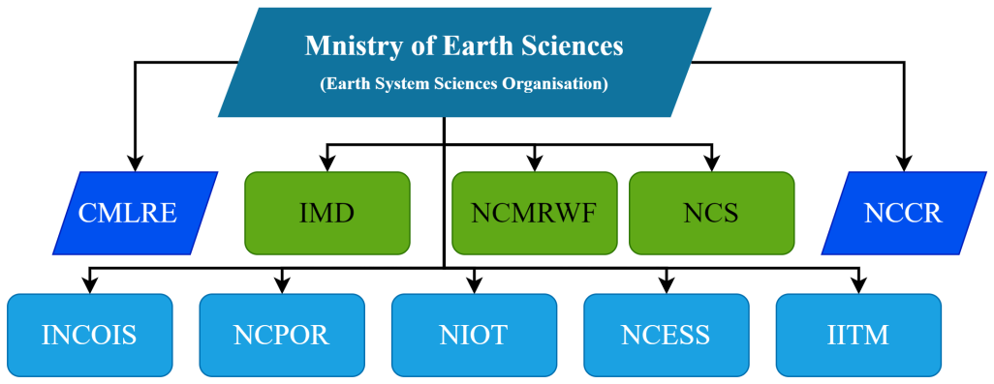
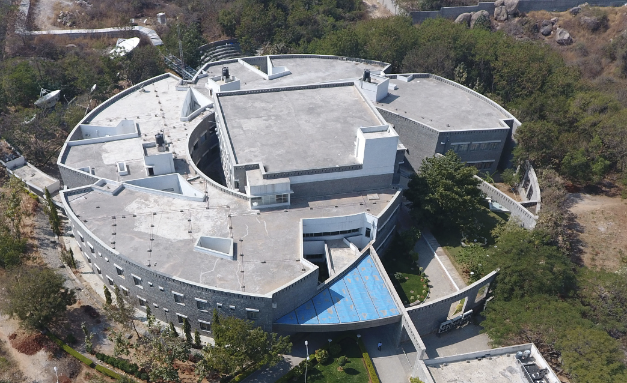
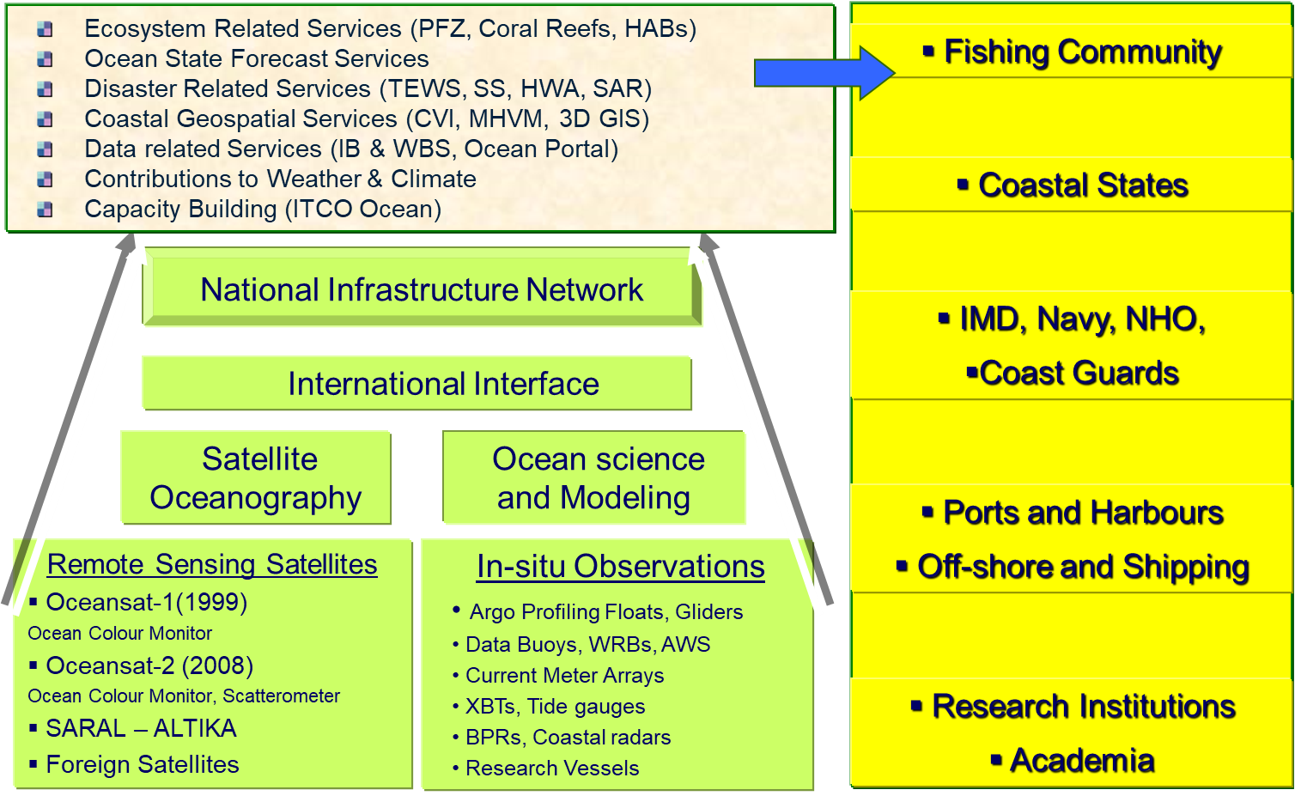
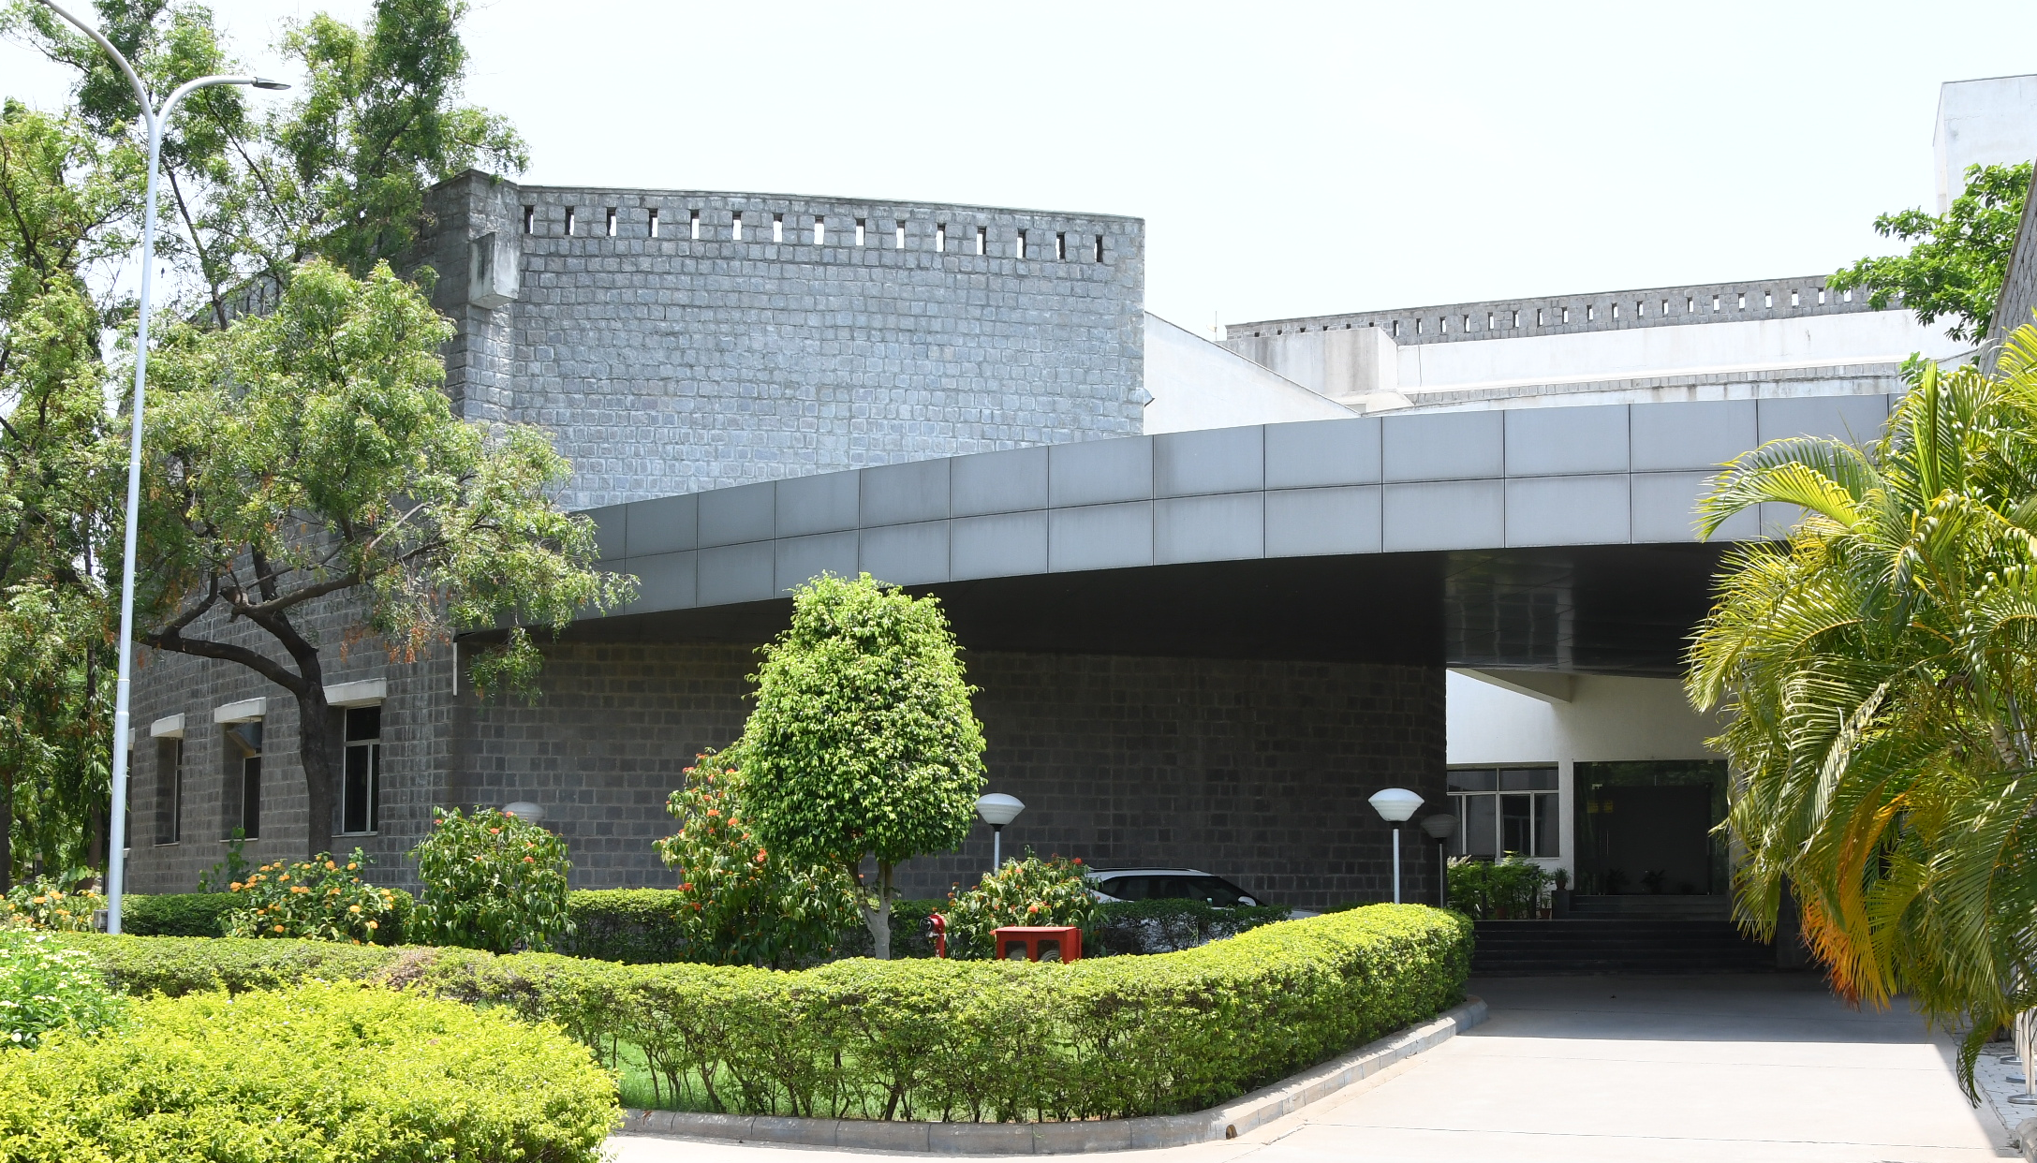
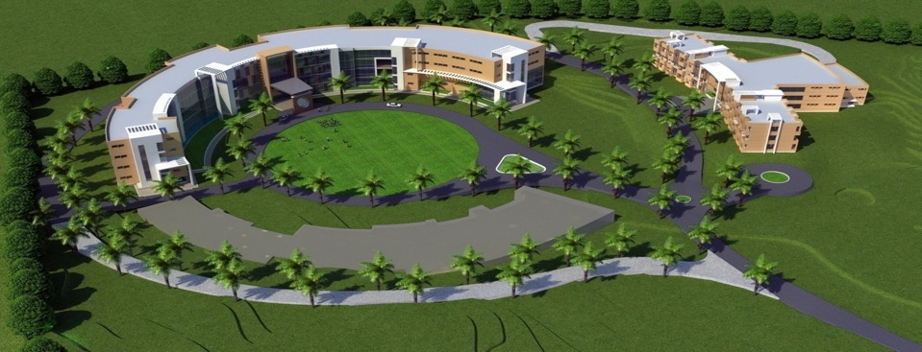
Venue: INCOIS, MoES, India
INCOIS Mission: To provide the Ocean Information and Advisory Services to Society, Industry, Government Agencies and Scientific Community through Sustained Ocean Observations and Constant improvements through Systematic and Focussed Research

Slide 8
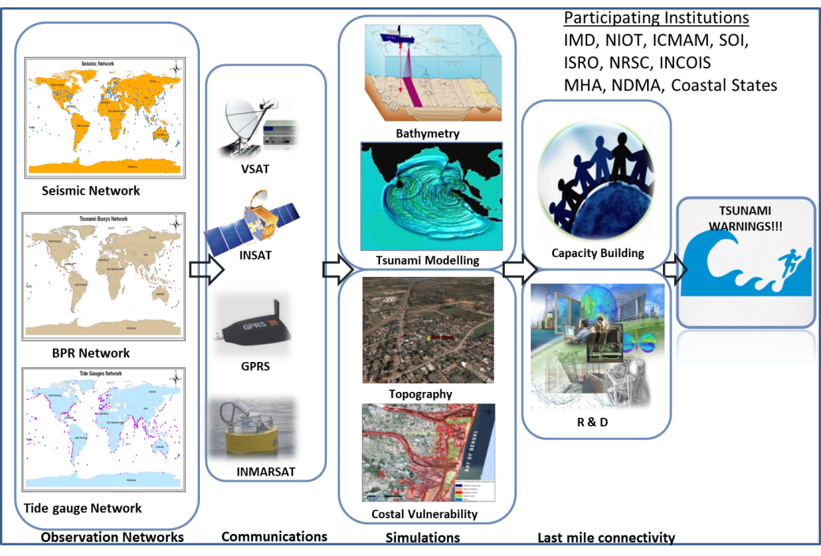
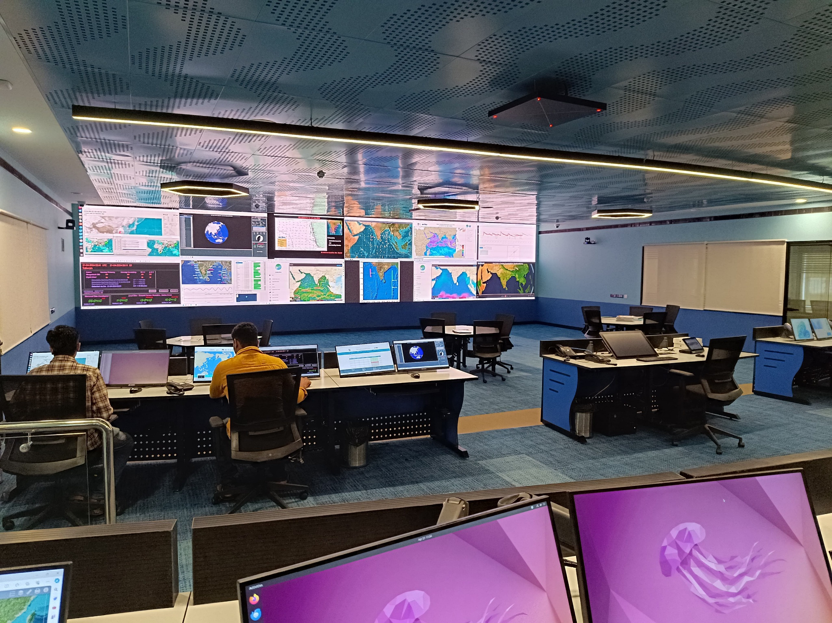
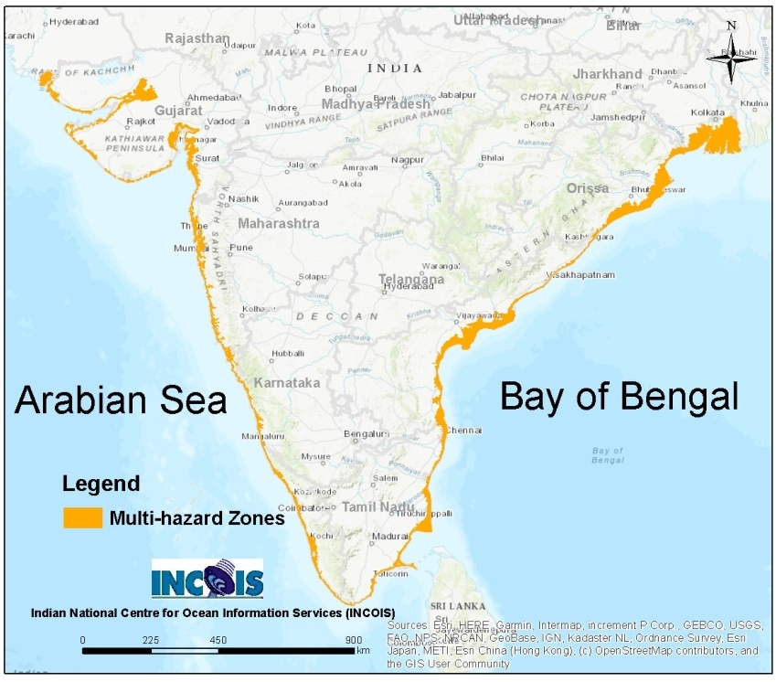
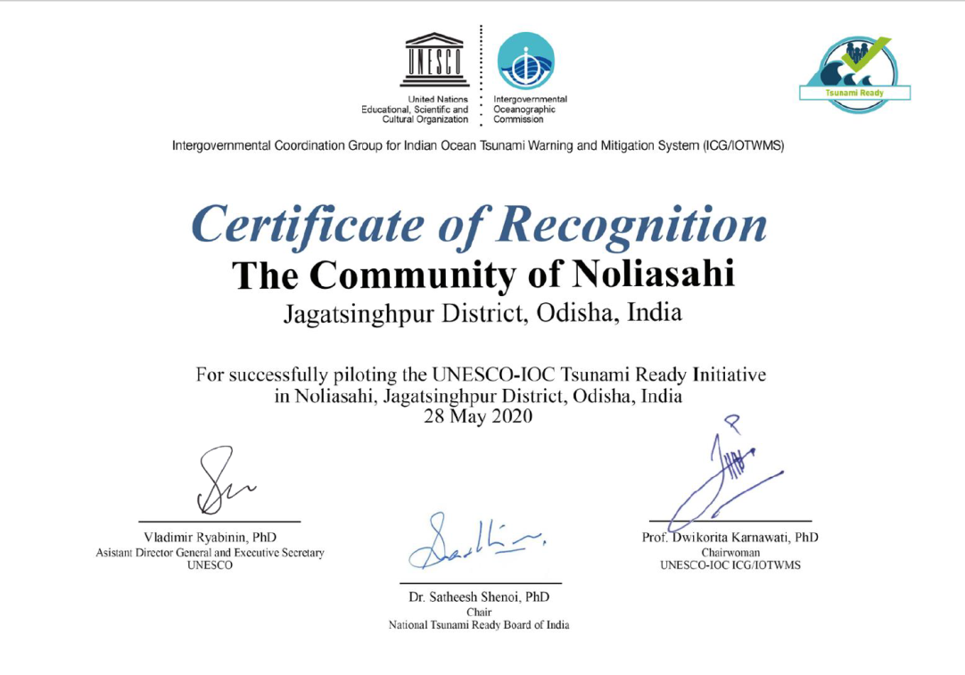
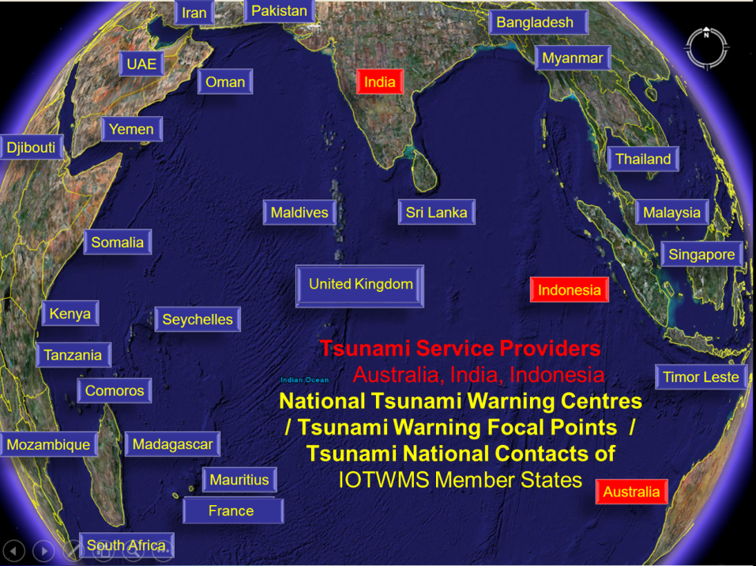
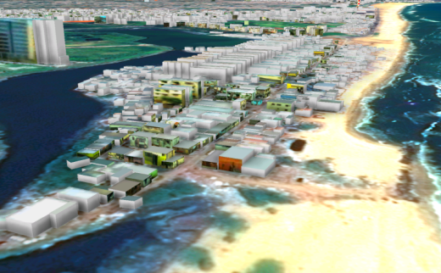
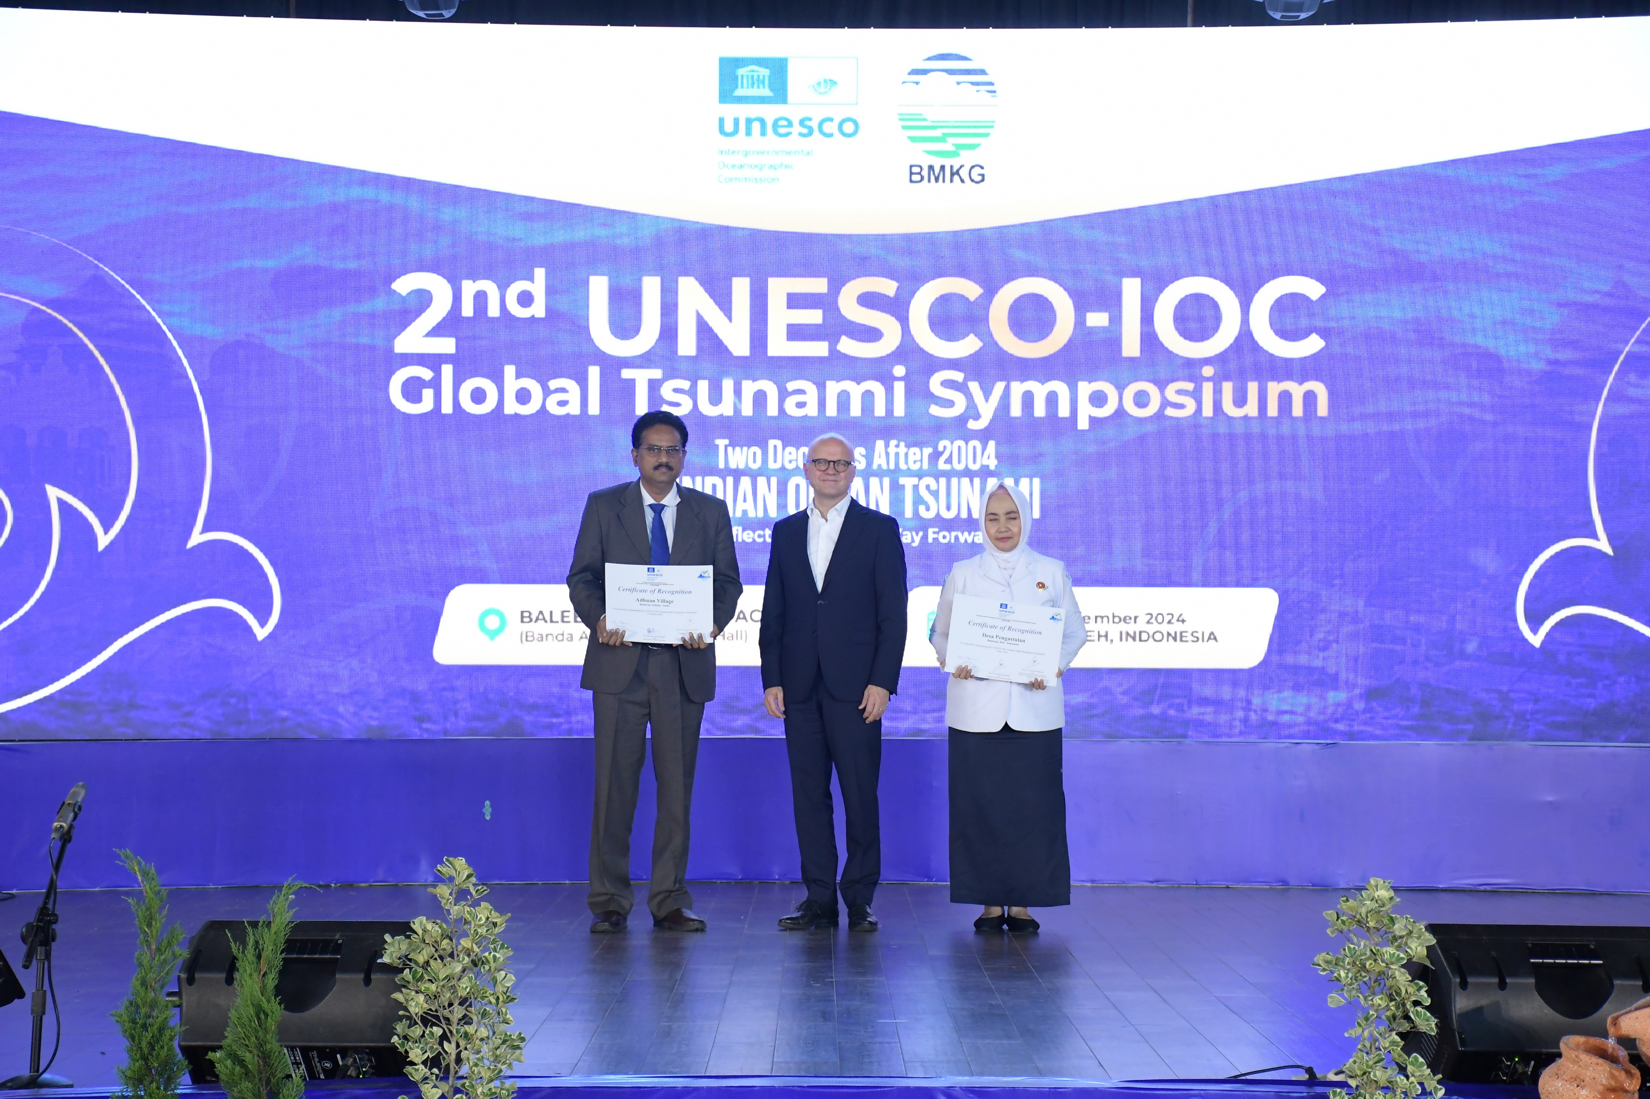
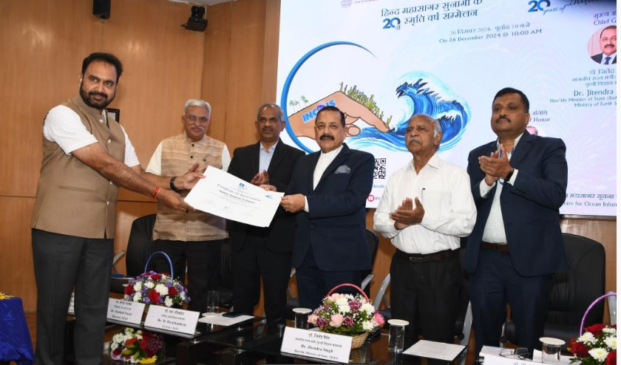
Tsunami & Coastal Multi-hazard Early Warning Services
Projected Coastal flooding due to Tsunami, Cyclone, Floods, Sea Level Rise and Erosion
SynOPS lab
Indian Tsunami Early Warning Centre
Tsunami Early Warning Services
Coastal Inundation – 3D Mapping

Slide 9
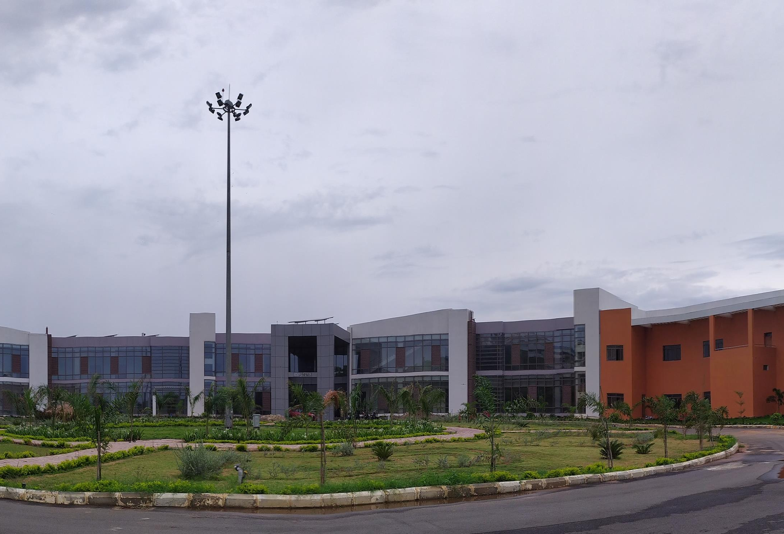
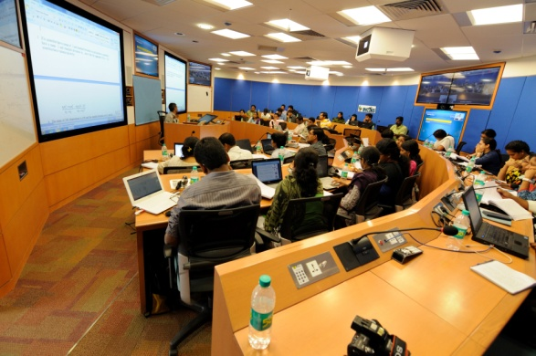
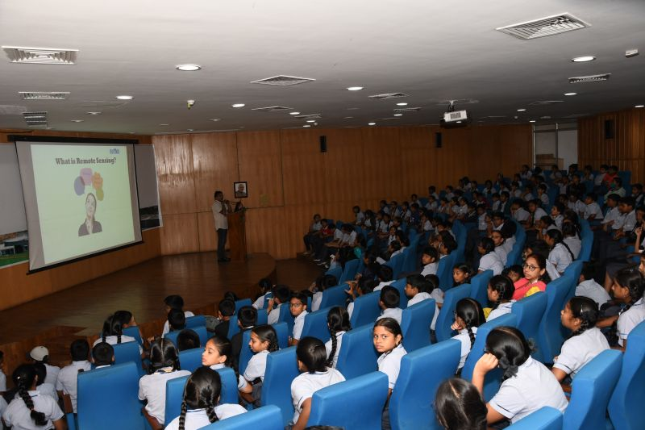
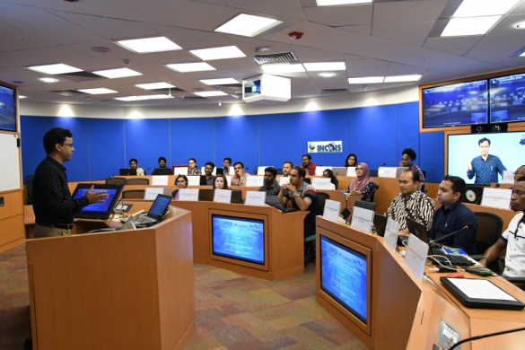
INCOIS On-Campus Conferencing / Training Facilities
  300 Capacity Open Plenary Hall
  172-Seater Auditorium
  72-Seater e-classroom
  48-Seater e-classroom
  30-Seater Board Room
  15-Seater Conference Rooms (x 4)
  Classrooms, Computer Labs
  Physical / Online / Hybrid capabilities

Slide 10
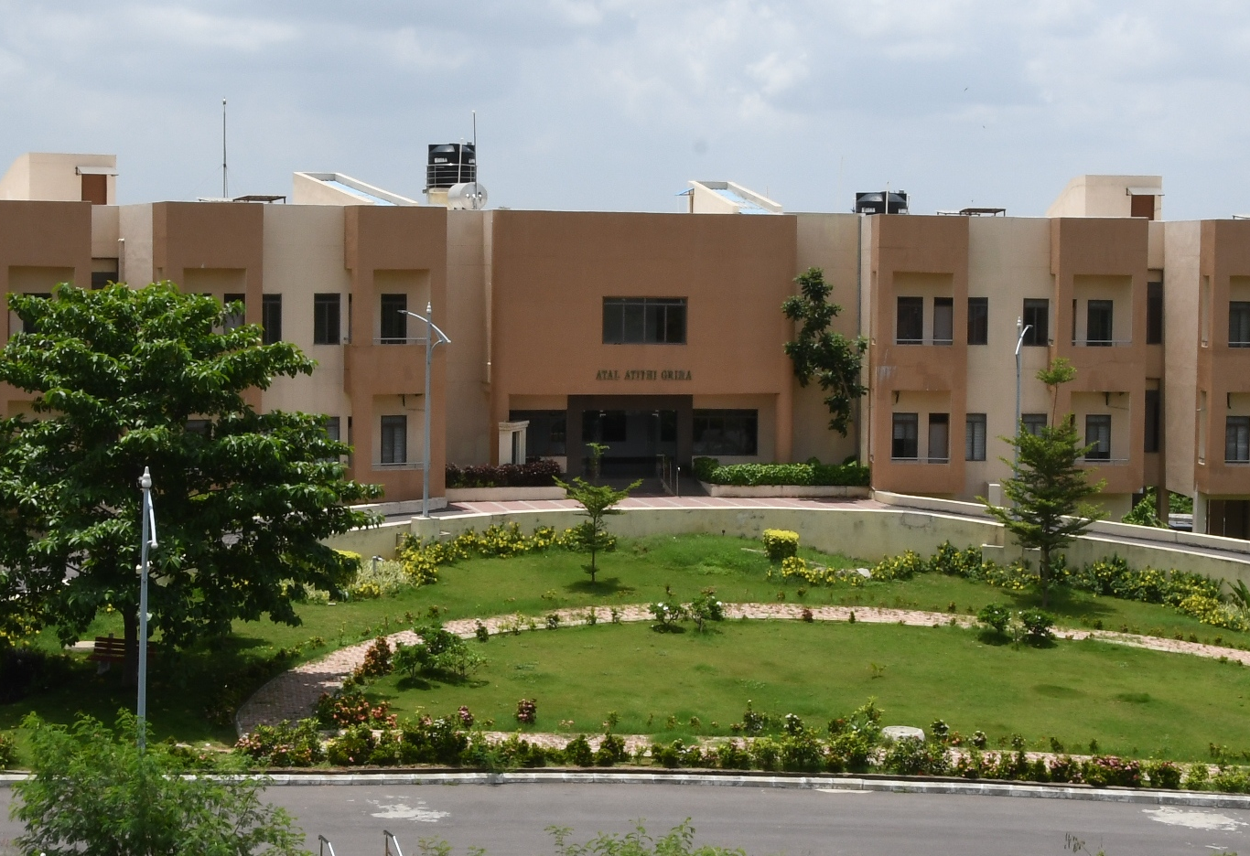
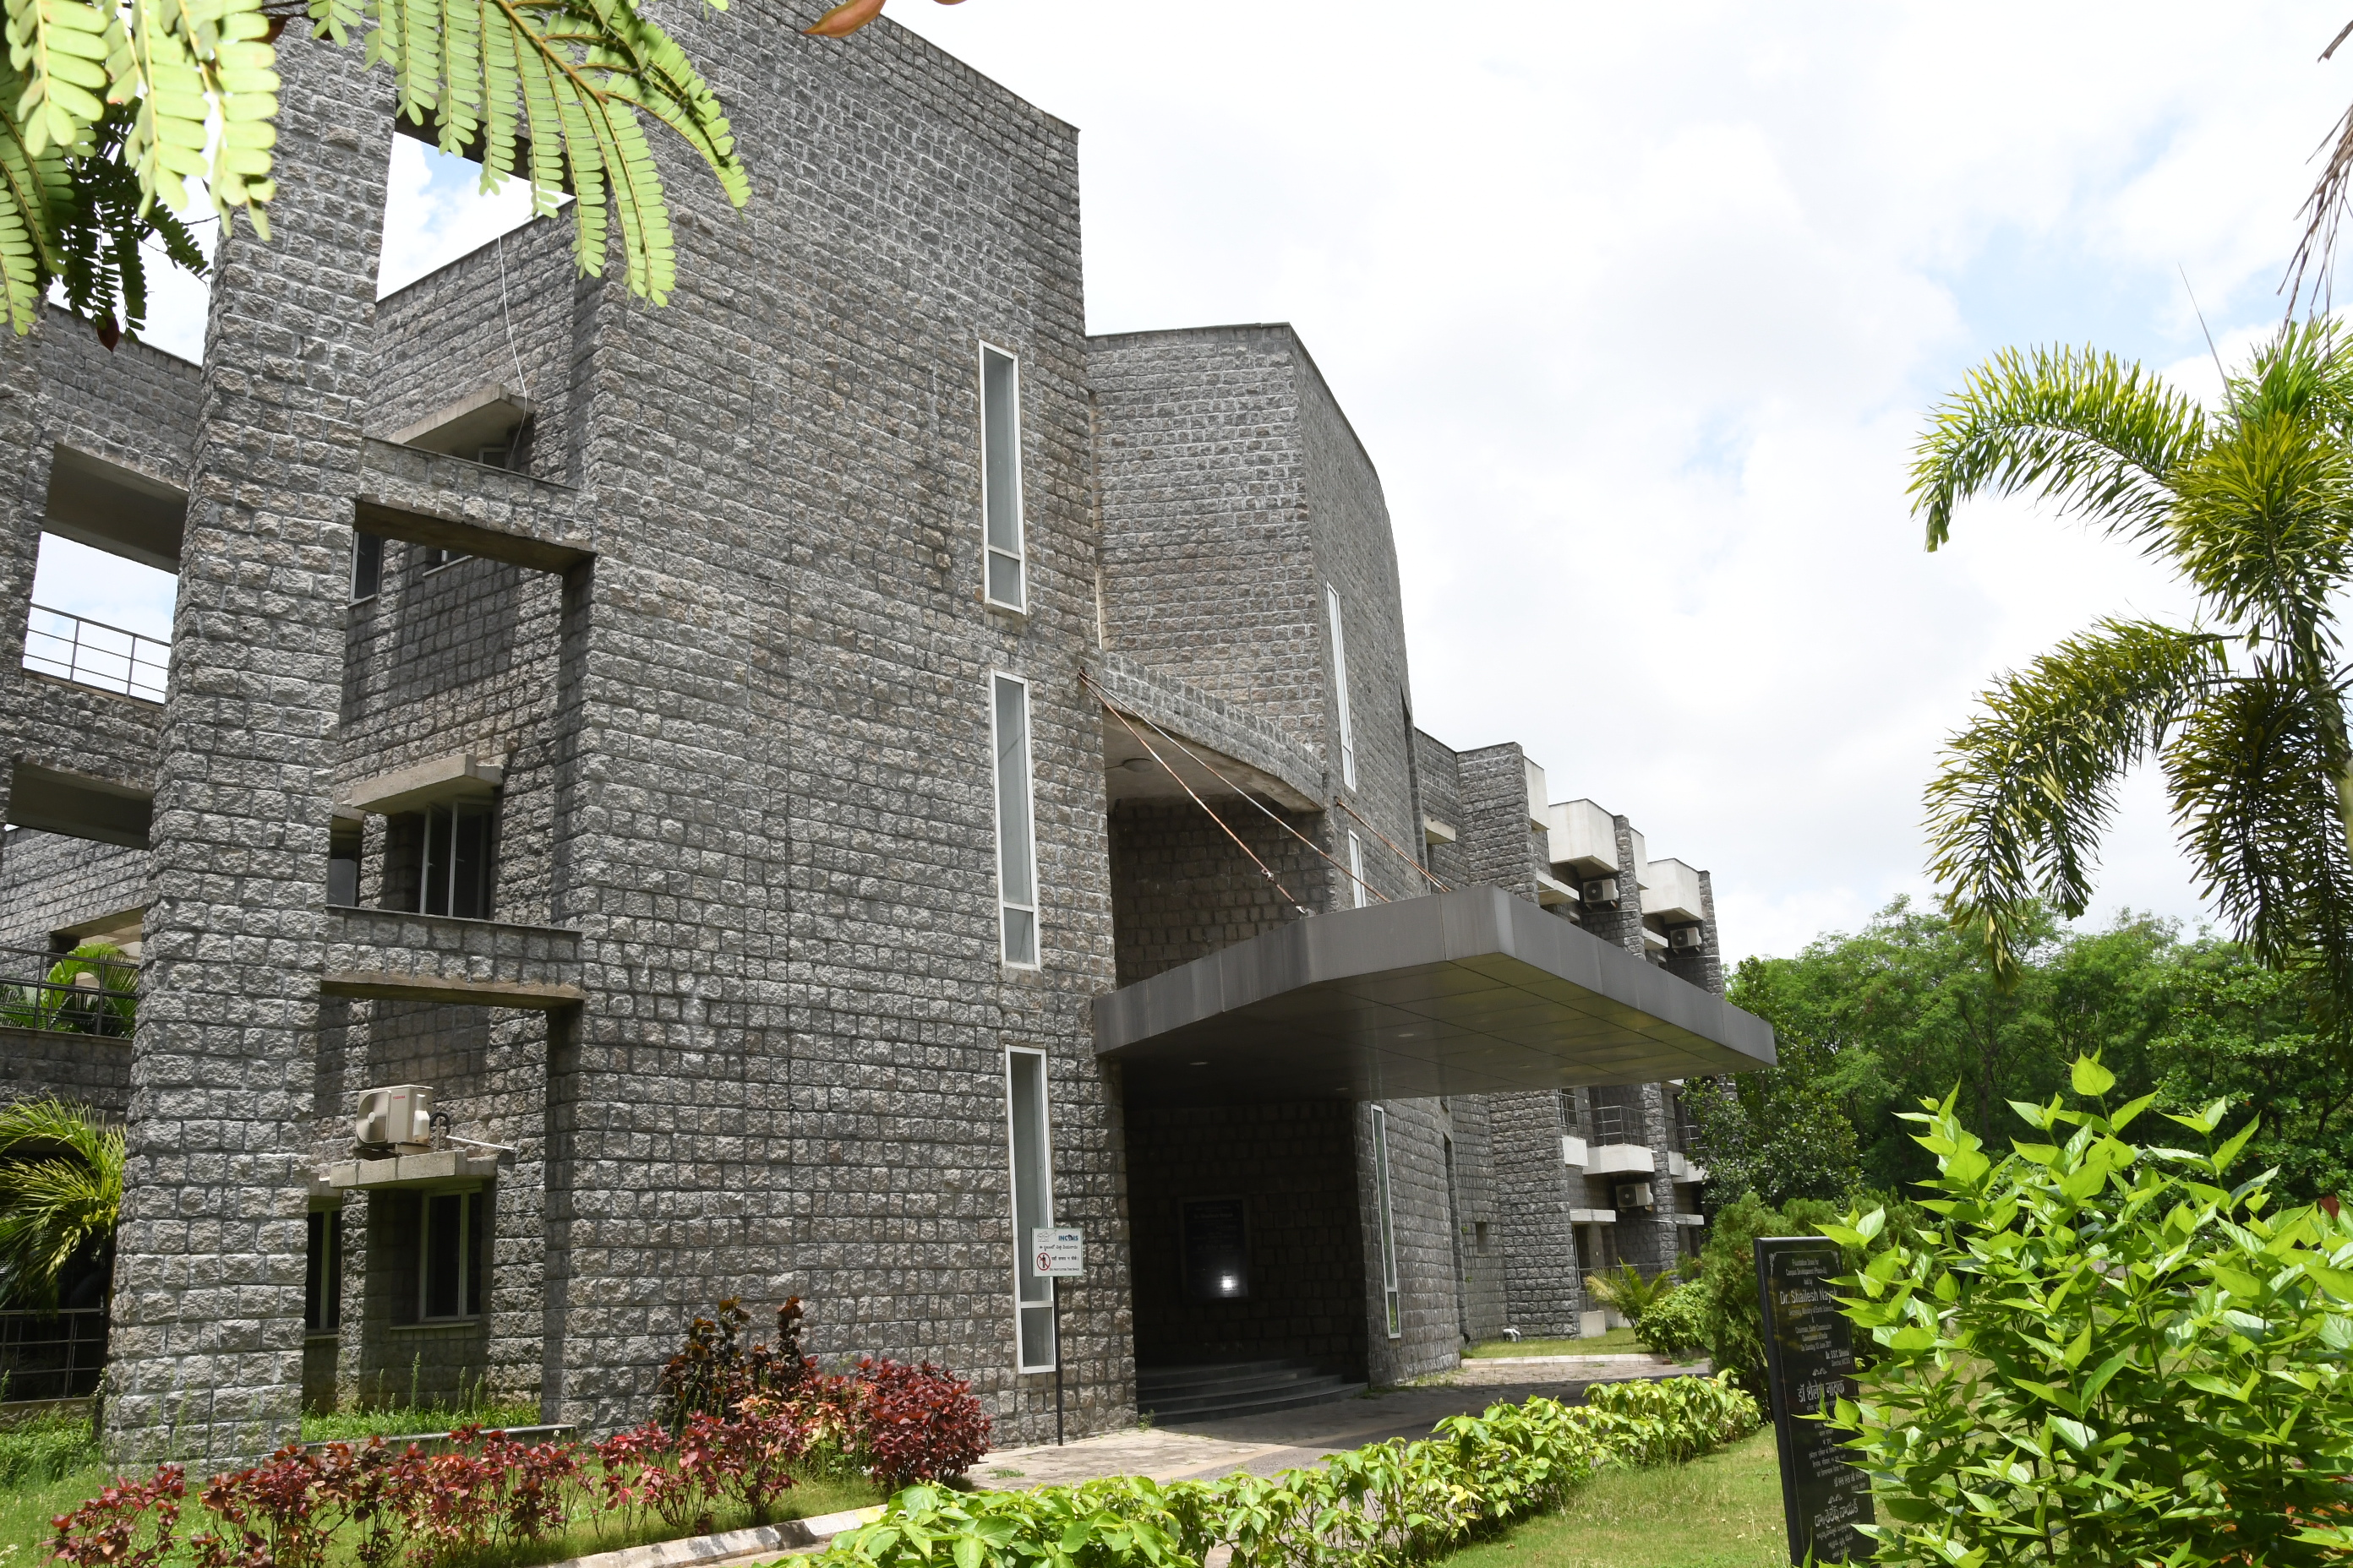
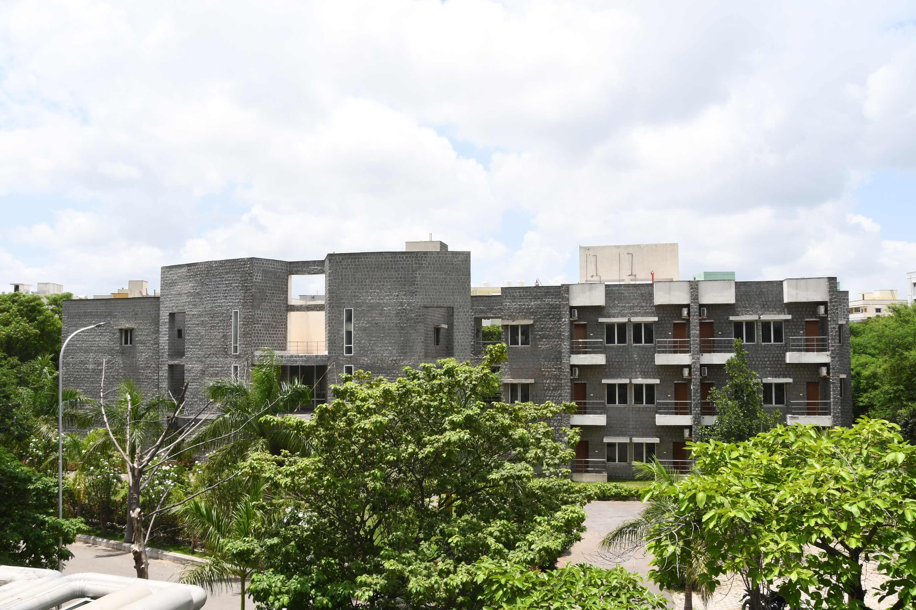
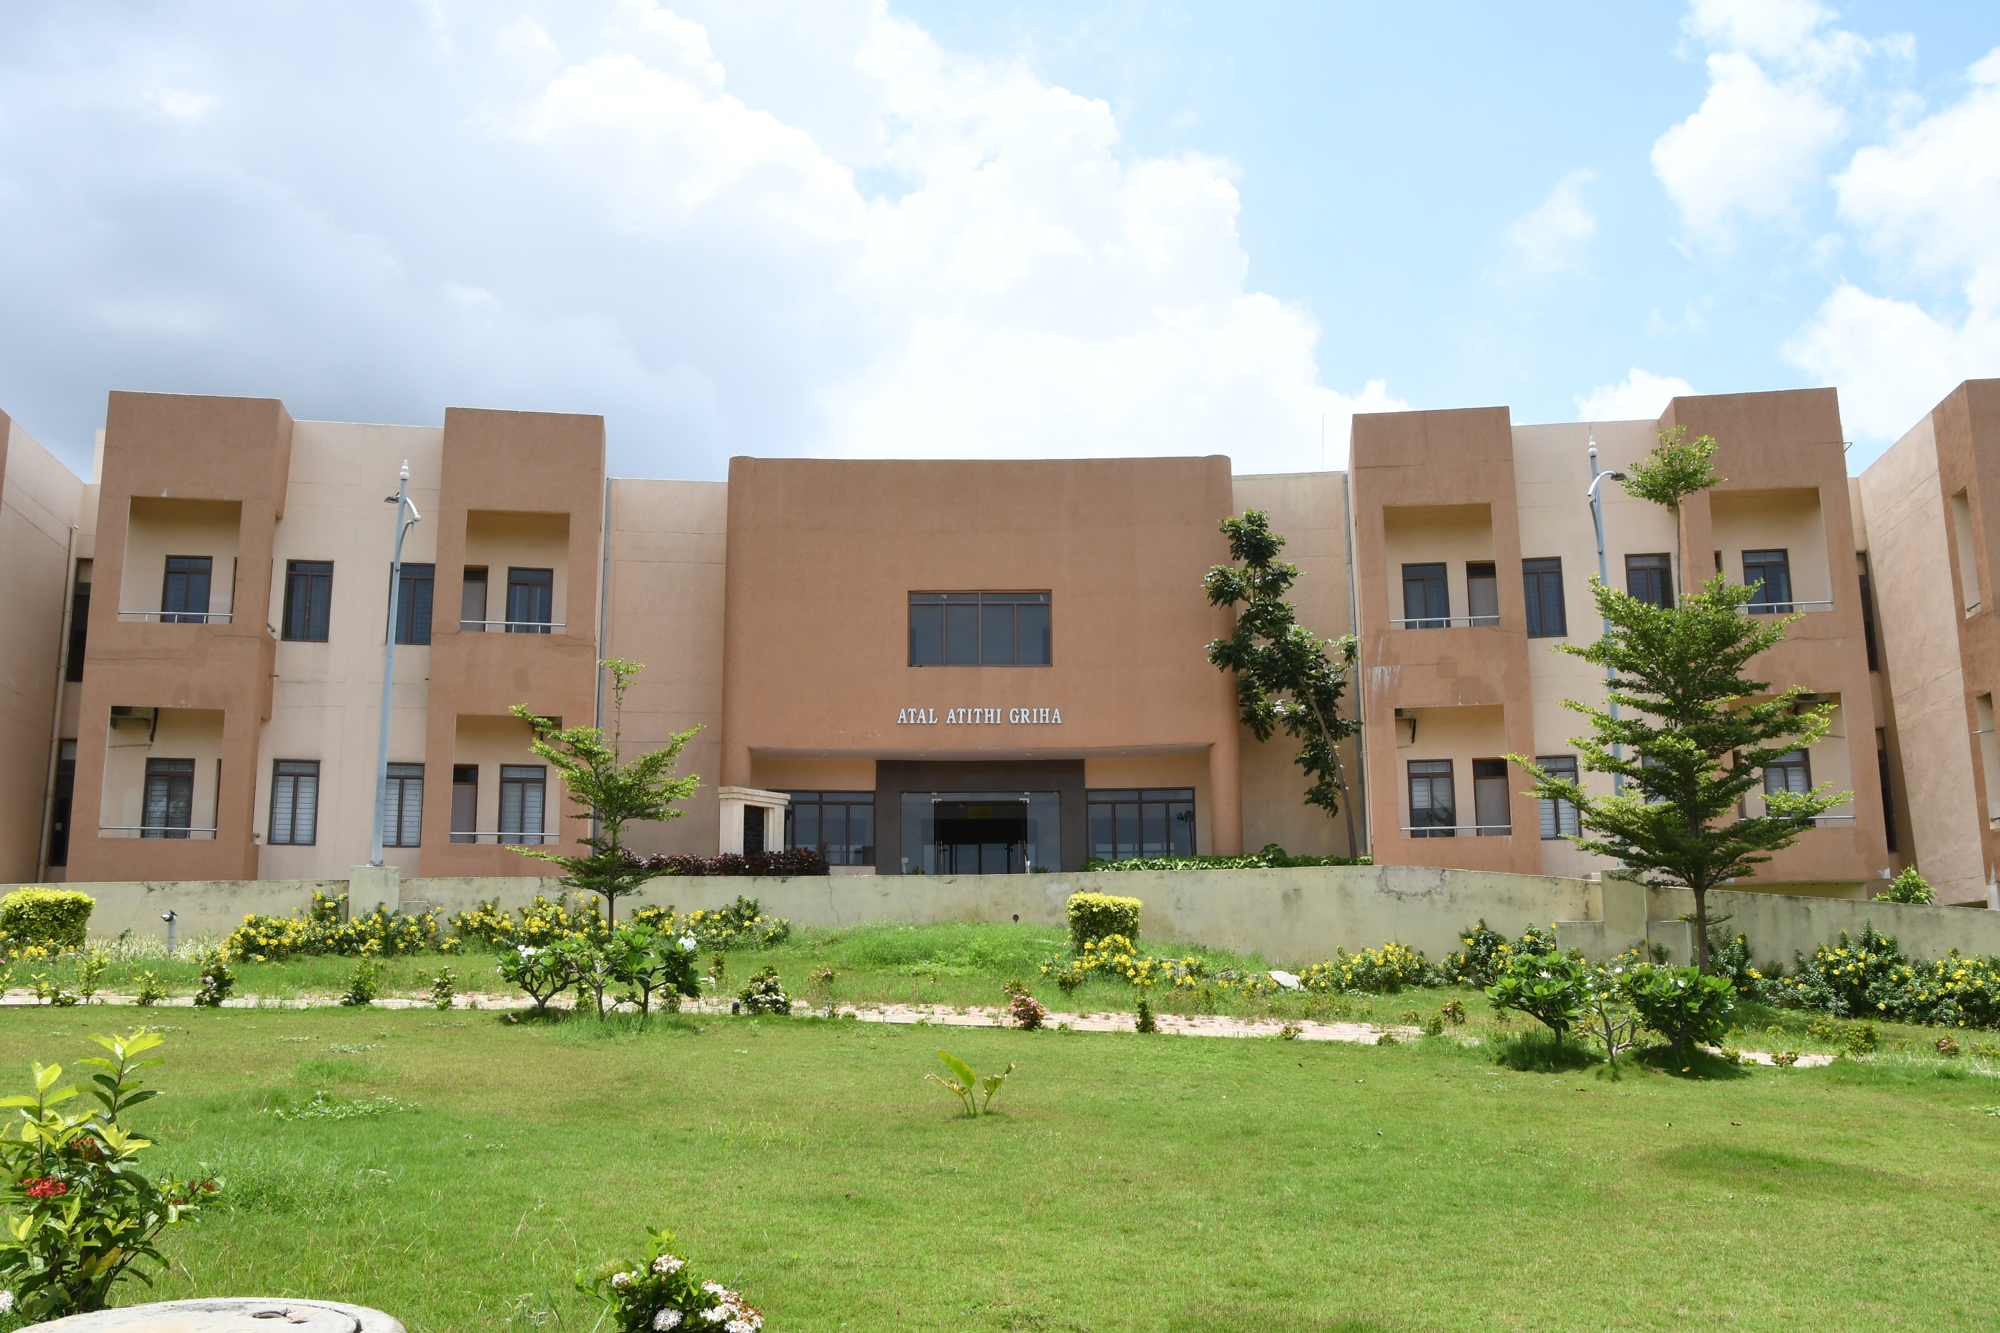
INCOIS On-Campus Accommodation
Hostel block - 3000 Sq M
  11 Faculty Suites
  24 Student Rooms
  Dining, Recreation area
  Gym
Guest House Block
  7 Suite rooms
  27 Single Rooms
  3 married accommodations
  Multipurpose Hall

Slide 11
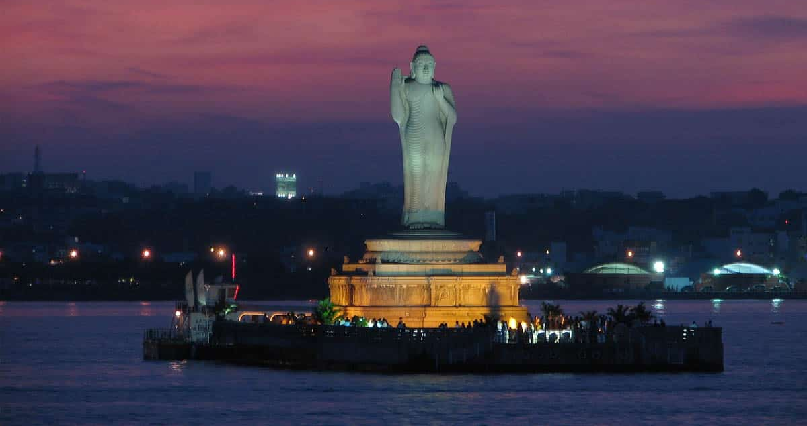
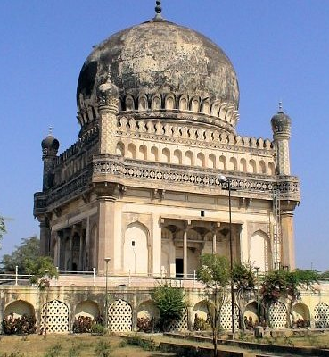
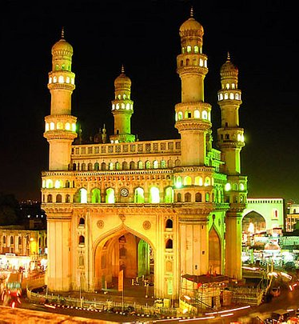
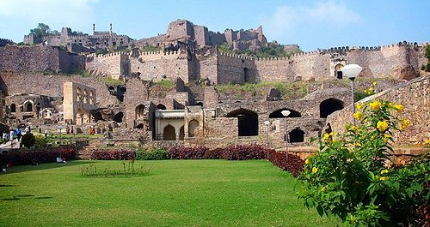
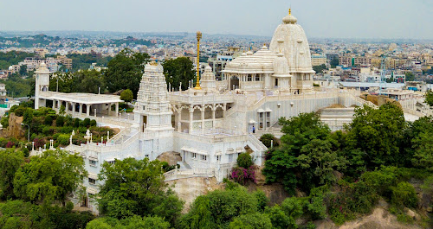
Thank you for your kind attention queries: sunanda@incois.gov.in
Tourist Attractions

