Slide 1
Tsunami Ready Coalition
Draft Implementation Plan
Dr. Laura Kong, TRC Chair
Director, ITIC
David Coetzee, UNOD TP SC
UN Ocean Decade Tsunami Programme, Scientific Committee
16-17 February 2025, Paris, France

Slide 2
Tsunami Ready Coalition (TRC)
IOC Decision EC-55/3.5.1 (July 2022) Warning and Mitigation Systems of Ocean Hazards. Part IV: Working Group on Tsunamis and Other Hazards related to Sea Level Warning and Mitigation Systems (TOWS-WG)
Approves the establishment of the UNESCO/IOC Tsunami Ready Recognition Programme (TRRP) as described in the working document “Tsunami Ready Programme – Proposal for endorsement by IOC” dated 21 February 2022;
Approves also
(ii) the Terms of Reference for the Tsunami Ready Coalition, as included under Annex 2 to this decision;
Annex 1. Revised Terms of Reference of the Working Group on Tsunamis and Other Hazards Related to Sea-Level Warning and Mitigation Systems (TOWS-WG)
The membership of the TOWS-WG will be constituted by:
a) The Chairpersons of the four ICG-TWSs, the Scientific Committee of the UN Ocean Decade Tsunami programme, the special Tsunami Ready Coalition, and representatives of the GOOS Steering Committee and IODE,
b) …

Slide 3
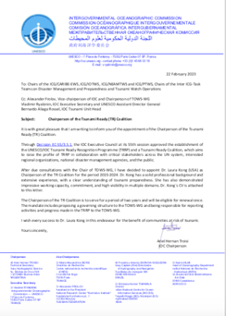
Annex 2. TRC Terms of Reference
Goal: Contribute to increasing the number of Tsunami Ready recognized
communities as part of the UN Ocean Decade.
Objectives:
The goal should be achieved through the following objectives:
Raise the profile of Tsunami Ready in collaboration with critical stakeholders across the UN system, interested regional organizations, national disaster management agencies and the public,
Increase funding resources for the implementation of Tsunami Ready,
Advise the TOWS-WG, TTDMP, and TTTWO on the implementation of Tsunami Ready, including on measures related to:
flexibility with regards to accomplishing the indicators to allow for circumstances where formal bureaucratic frameworks/requirements may pose barriers,
consideration of unique regional and/or local circumstances,
recognition of similar standards already in place in some countries

Slide 4
Annex 2. Terms of Reference – Membership
Membership could include, as appropriate, representatives from international, regional and national organizations, such as:
(up to 139 MS)
National:
AID National Agencies/Organizations
Emergency Management Agencies/EDMAs
French Inter- Ministerial for the Antilles Estate Major Zone (EMIZA)
IOC & Tsunami National Contacts (TNCs) & Tsunami Ready Focal Points (TRFPs)
National Commissions for UNESCO
National Youth organisations, and
relevant Members of the UN Ocean Decade Alliance with a focus on commitments towards Tsunami Ready actions;
(8+)
International:
IFRC
International Association of Emergency Managers (IEAM)
International Council for the Exploration of the Sea (ICES)
Relevant ICG Working Groups and Task Teams
Save the Children
Tsunami Information Centres
UNDP
UNDRR
(12+)
Regional:
Arab League Educational, Cultural and Scientific Organization (ALESCO)
ASEAN
Caribbean Disaster Emergency Management Agency (CDEMA)
CARIDIMA Youth Platform for DRM in the Caribbean.
Coordination Center for Disaster Prevention in Central America and the Dominican
Republic (CEPREDENAC)
Directorate-General for the European Civil Protection and Humanitarian Ais Operations of the EC (DG-ECHO-EC)
Islamic World Educational, Scientific and Cultural Organization (ICESCO) (Headquarters in Rabat, Morocco).
Joint Research Centre of the European Commission (JRC-EC)
Pacific Community (SPC)
U-INSPIRE Alliance (Asia and Pacific Alliance of Youth and Young Professionals in Science, Engineering, Technology, and Innovation for Disaster Risk Reduction and Resilience)
UNESCAP

Slide 5
Meeting TRC Goals and Objectives
Implementation Plan

Slide 6
ToR and Mandate – pg 5-6
Further clarification of high-level ToR
It is suggested that the ToR be interpreted to include the following:
Considering progress, providing strategic advice on the implementation of the TRRP (“how to”)
Creating opportunities for the global promotion of the TRRP.
Identifying, mobilizing, and coordinating ideas, solutions, initiatives, and resources in all its manifestations to support the implementation of, and the sustainability of the TRRP (“people, $$”)
Strengthening existing or creating new partnerships between organisations and across nations to advance the TRRP.
Mandate (IOC Decision A-31/3.4.1), TOWS WG XV, OCTP Implementation Plan (IOC TS 18) –(proposed)
The Tsunami Ready Coalition is a collaboration between global, regional, and national stakeholders to advance the UNESCO-IOC Tsunami Ready Recognition Programme (TRRP), with a specific view on the UN Ocean Decade Tsunami Programme aim of 100% of communities at risk of tsunami are prepared for and resilient to tsunamis by 2030. The Coalition will establish a network of critical stakeholders that will advocate for and facilitate support towards the implementation of Tsunami Ready through targeted promotion, resource mobilization, networking, influence, and advice. Reporting to the TOWS-WG, the Coalition will have a diverse, yet relatively small, membership by invitation of the UNESCO-IOC. Membership is primarily at the institutional level

Slide 7
Comments

Slide 8
Task 3. Objectives and key activities
Objective 1: Raising profile of TRRP in collaboration with critical stakeholders
Focus: Short-term (2 years) – 1st priority objective
As goal “100% of communities at risk of tsunami prepared for and resilient to tsunamis by 2030 through implementation of the UNESCO-IOC TRRP and other initiatives. Prominent profile needed to support participation and funding.
Objective 2: Increasing funding resources for implementation of TRRP
Focus: Medium-term (5 years); On-going
Given TRRP will be on-going beyond 2030, and UNESCO-IOC recognition renewed every 4 years, sustainable funding will be required on an on-going basis. Ideally, funding arrangements should therefore allow for at least one re-validation.
Objective 3: Conduct Tsunami Ready Indicators Workshops in the Regions
Focus: Medium-term (5 years); On-going
Via regional workshops, focus on targeted Indicators/topics in accordance with needs, sharing of practical experience and best practice from within the regions, and mayavoid language barriers. ICGs, and specifically TICs, to play key role
Objective 4: Advising TOWS-WG and TOWS Task Teams on implementation of TR
Focus: On-going. Advice will include (among others): TRRP progress, resources, and opportunities. Consideration of unique regional and/or local circumstances.

Slide 9
Objectives and Activities – pg 7-8
Objective 1: Raising profile of TRRP in collaboration with critical stakeholders
Focus: Short-term (2 years)
# | Raising the Profile: Sub-Objectives
1.1 | Advocate for TRRP in the UN system
1.2 | Advocate for TRRP in regional organisations
1.3 | Advocate for TRRP among other stakeholders (i.e. NGOs, Industry)
1.4 | Advocate for TRRP in countries (i.e. Aid Organisations)
1.5 | Raising the Public profile
1.6 | Supporting countries with the TRRP process

Slide 10
Objective 1 - Activities pg 7-8
Activity # | Sub-Obj # | Activity | Who | When / by when
1 | 1.1 - 1.4 | Utilise 2nd UNESCO-IOC Global Tsu Symposium Nov 2024 (Banda Aceh) to promote TRRP | Coalition Chair | Nov 2024
2 | 1.1 - 1.4 | Finalise the list of targeted stakeholders to compose the Coalition from: - The list of potential stakeholders identified by the TOWS TTDMP in 2021, - The stakeholder analysis in this Draft Implementation Plan, and - Expressions of Interest received | TOWS TTDMP | Feb 2025
3 | 1.1 - 1.3 | Endorse list of targeted stakeholders and request letters of invitation from IOC Executive Secretary. Letter to include Coalition mandate & ToR | TOWS-WG | March 2025
4 | 1.4 | Request letter from IOC Executive Secretary to IOC Member States to promote the TRRP and invite participation/implementation | TOWS-WG (Drafting- TTDMP) | March 2025
5 | 1.2; 1.4 | Invite respective ICGs to support promotion of TRRP among their member states | TOWS-WG | March 2025
6 | 1.5 | Letter to UNDRR under Activity # 3 above, to also request inclusion of a TRRP focus in World Tsunami Awareness Day in 2025, and every subsequent year up to 2030 | TOWS-WG (Drafting- TTDMP) | March 2025
7 | 1.1-1.4 | Confirm make-up of Coalition via letter from IOC Executive Secretary and TRRP website. Also advise Decade Coordination Unit (IOC) | TRS | May 2025
8 | 1.1 – 1.5 | Identify key international and regional meetings & conferences to target | TTDMP, Coalition SG | 2025-2028
9 | 1.1 – 1.5 | ‘Lobby’ for inclusion in targeted meeting & conference agendas of non- Coalition members | TTDMP; Coalition Steering Group | 2025-2028
10 | 1.6 | Hold regional Tsunami Ready Workshops to promote TTRP and determine needs (see Objective 3 below). | TICs | 2025

Slide 11
Raising the Profile – Relevant Institutions for Advocacy and Implementation - p. 16-21
Mechanisms | Activity {Engagement Point}
Ocean Decade | Barcelona Statement {Decade Coordination Unit, DCU} Ocean Decade Coordination Unit (DCU); Decade Collaborative Centres (DCCs); Decade Coordination Offices (DCOs) {DCU} Ocean Decade Projects and Programmes: CoastWAVE 2.0 Project {NEAMTWS} CoastPredict Programme {CoastPredict Secretariat} Integrated Multiple Coastal Hazard Early Warning System and Services for the Tropical Americas and Caribbean (iCHEWS TAC) {IOCARIBE}
Other Global | Early Warnings for All {IFRC, UNDRR, WMO} International Federation of Red Cross and Red Crescent Societies (IFRC) {Programme and Operations Division} International Union of Geodesy and Geophysics (IUGG) {IUGG Joint Tsunami Commission}, The Ocean&Climate Village {UNESCO-IOC} UN Office for Disaster Risk Reduction (UNDRR) {Intergovernmental Processes, Inter-agency Cooperation and Partnerships Branch; UNDRR Stakeholder Engagement Mechanism (UNDRR-SEM). (The latter may advise more than one engagement point)}. World Bank Group {See Chapter 3 World Bank’s International Development Association (IDA)}. World Meteorological Organization (WMO) {Services Department}
Meetings 2025 | First Ocean Decade International Coastal Cities Conference, 26-27 February 2025 in Qingdao, China: {Decade Coordination Centre, China} 8th Session of the Global Platform for Disaster Risk Reduction (GP2025), 2-6 June 2025 in Geneva, Switzerland {UNDRR} UN Ocean Conference, 9-13 June 2025 in Nice, France {UN Department of Economic and Social Affairs} 3rd UN Ocean Decade Conference, 2027 {Decade Coordination Unit}
Regional – Asia-Pacific | ASEAN {ASEAN Committee on Disaster Management (ACDM)} ESCAP {Chapter 3 (Potential Sources of Funding) for detail with regards to the ESCAP Trust Fund for Tsunami, Disaster, and Climate Preparedness}, Pacific Community (SPC){Partnerships, Integration, and Resource Mobilisation Division; Geoscience, Energy and Maritime (GEM) Division}, UNDP {See Chapter 3 (Potential Sources of Funding) for detail with regards to the UNDP Strategic Plan 2022-2025, as well as its Tsunami Project}
Regional – Europe | European Union { ECHO (for DIPECHO)}
Regional – Americas, Caribbean | Coordination Centre for the Prevention of Natural Disasters in Central America and the Dominican Republic (CEPREDENAC) {Executive Secretary}, Caribbean Disaster Emergency Management Agency (CDEMA) {CDEMA Coordinating Unit}

Slide 12
Objectives and Activities – pg 8-9
Objective 2: Increasing funding resources for implementation of TRRP
Focus: Medium-term (5 years), On-going
# | Increasing Funding Resources: Sub-Objectives
2.1 | Determine targeted funding sources
2.2 | Approach/encourage targeted funding sources
Activity # (cont) | Sub-Obj # | Activity | Who | When / by when
11 | 2.1 | Test the desktop research output and approaches in the Draft TRRP Implementation Plan through expert consultation | TTDMP; TOWS-WG; Coalition SG | 2025
12 | 2.1; 2.2 | Identify and catalyse existing projects and programmes for engagement and inclusion of TR elements. | TICs | 2025
13 | 2.1; 2.2 | Identify and catalyse new funding sources and in-kind support mechanisms | Coalition SG | 2025, On-going
14 | 2.2 | Implement/action other identified approaches (from Activity # 11) | Tbd | 2025
15 | 2.2 | Invite potential funding institutions to regional Tsunami Ready Workshops (see Objective 3) | TICs | 2025

Slide 13
Objectives and Activities – pg 9
Objective 3: Conduct Tsunami Ready Workshops in the Regions
Focus: Medium-term (5 years), On-going
# | Regional Tsunami Ready Indicators Workshops
3.1 | Support the implementation of TRRP in the regions through targeted workshops
Activity # (cont) | Sub-Obj # | Activity | Who | When / by when
16 | 3.1 | Determine the geographic target areas or sub-regions for regional workshops | ICGs | 2025
17 | 3.1 | Establish resources to conduct regional workshops | ICGs | 2025
18 | 3.1 | Coordinate regional workshops | TICs | On-going

Slide 14
Objectives and Activities – pg 10
Objective 4: Effective Organization of the Tsunami Ready Coalition
Focus: On-going
# | Effective Organization: Sub-Objectives
4.1 | Endorsement of the Coalition Implementation Plan by the TOWS-WG
4.2 | Appointment of Co-chair
4.3 | Opportunities for fruitful participation are created
4.4 | Reports to TOWS-WG result in outcomes
Activity # (cont) | Sub-Obj # | Activity | Who | When / by when
19 | 4.1 | Present the Plan to SC-ODTP for comment, TTDMP for validation, & TOWS-WG for endorsement | Coalition Chair | Jan, Feb 2025
20 | 4.2 | Identify, recommend, and appoint a Coalition Co-chair | Coalition Chair; TOWS-WG; Executive Council | 2025
21 | 4.3 | Hold meetings, workshops/summits as covered in Objective 3 (above) and in Chapter 5 | Coalition Chair; Secretariat | On-going
22 | 4.4 | Reports to TOWS-WG include recommendations aimed at enhancing the Coalition and TRRP | Coalition Chair | Annually

Slide 15
Comments

Slide 16
Governance – Minimum Structure – pg 13-15
Considered IODE Ocean Best Practices, GOOS, CoastPredict Programme.
Basic, relatively small structure to facilitate its management and coordination
1. Co-chairs: 1 appointed (Dr Laura Kong, ITIC). Propose 2nd appointed from Partners
2. Steering Group: Key Partners comprise Steering Group. Up to 20 stakeholders
 | Steering Group Terms of Reference
1 | Steering the TRRP to achieve the aim of making 100% of communities at risk of tsunami prepared for and resilient to tsunamis by 2030.
2 | Keep an overall view on the implementation of the TTRP
3 | Identify and channel synergies and opportunities among Steering Group Partners to advance TRRP objectives.
4 | Negotiate the mobilizing of resources to advance the TRRP objectives.
5 | Invite and draw on other relevant stakeholders, such as the Decade Coordination Unit (DCU), Decade Collaborative Centres (DCCs), Decade Coordination Offices (DCOs) to support relevant discussions.
6 | Create enduring partnerships to support sustaining Tsunami Ready globally
7 | Develop strategic advice and reporting to the TOWS-WG.

Slide 17
Governance – Minimum Structure – pg 13-15
3. TRRP Ambassadors complement Coalition:
May not have policy mandate or capacity to offer substantive support but keen to collaborate through sharing of experience and serving as examples of implementing best practices
 | Ambassadors Terms of Reference
1 | Acting as TRRP representatives in their organizations or countries
2 | Raising awareness through advocating for TRRP in their areas of influence.
3 | Sharing of expertise with aspiring countries/communities.
4 | Sharing of TRRP best practice among Ambassadors.
5 | Advising the Coalition Steering Group about TRRP implementation.
6 | Participating in special task teams identified by the Steering Group as required.
4. Task Teams
Task Teams, reporting to Steering Group may be established to support Work Plan
5. Secretariat
Secretarial and logistical support by UNESCO-IOC Tsunami Resilience Section

Slide 18
Governance: Partners (members) – p. 10-13
Propose stakeholders referred to as “Coalition Partners” considering Coalition mandate, objectives, and collaboration intent
To be efficient, target institutions with best ability or potential to support implementation:
For broad and diverse representation, recruit Strategic / Operational Partners (institutions)
Level | Implementation Role
Global | for mobilizing international support though promotion / funding, over next 5 yrs
Regional | for strengthening regional coordination and collaboration around TRRP.
National | for building bilateral and national momentum for implementation of TRRP.
Focus | Implementation Role
Strategic | aims at reinforcing existing or establishing new partnerships from an influence and decisions perspective
Regional | aims at exploring creative ways of leveraging on global and regional programmes, projects, and events.

Slide 19
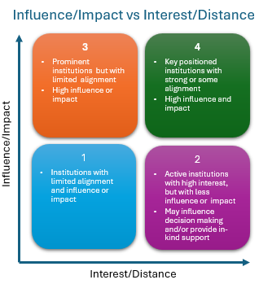
Analysis of Potential Partners, Ambassadors
Annex 2 (original) identified 8+ intl, 12+ regional, 139+ natl candidates for TRC membership.
While important not to leave any relevant stakeholder behind, the more participants involved, the more complex its coordination and management will be. Thus, the Annex 2 list may be too broad, and institutions had not been analysed for potential.
Partners reviewed for potential funding and promotional support, and that will ensure TRRP and/or relevant TR Indicators recognised in their Programmes
Global: multilateral development aid organisations and programmes.
Regional: regional development/aid organisations and programmes
National: national AID agencies and/or NDMO from each region, specifically with a view on bilateral and national support.

Slide 20
Governance: Partners, Ambassadors – potential p. 12-13
Type
Global Partners | IFRC, Islamic Development Bank, UNDRR (WTAD; EW4All), UNDP (Tsunami Project), WMO (Weather Ready; EW4All), World Bank Group (IDA; GFDRR)
Regional Partners | High value regional institutions that are also involved in sub-regional programmes Asian Development Bank (Pacific Disaster Resilience Programme; Strengthening Cooperation on Disaster Risk Management within the Association of Southeast Asian Nations), Caribbean Development Bank, CEPREDENAC, ESCAP (Trust Fund for Tsunami, Disaster and Climate Preparedness), EU Civil Protection and Humanitarian Aid Operations department – DG-ECHO (DIPECHO Programme; CoastWAVE), 4 x ICG-TICs (as key regional TRRP coordinators and representing the 4 ICGs), SPC (DCRP)
National Partners | High value national institutions that also support programmes on bilateral/international level Germany (GIZ – funded EWS in Indonesia; climate change initiatives in Pacific Island countries) Norway (Norad – strong engagement with the Decade), Japan (JICA; MEXT - funding UNDP Tsunami Project; CATAC), Switzerland (Agency for Development and Cooperation - funded Tsunami Capacity Assessment Validation Workshop for Indian and Pacific Oceans), USA (USAID – funding TRRP in Pacific Island countries)
Ambassadors | Government institutions that are implementing TRRP; best practice exemplars; may support via regional advice Note: For some countries, regional/provincial government institutions active in Tsunami Ready space may also serve as Ambassadors with endorsement of relevant national institution. For instance, the Odisha State Disaster Management Authority (OSDMA) in India Barbados , Costa Rica, Fiji, India, Indonesia

Slide 21
Comments

Slide 22
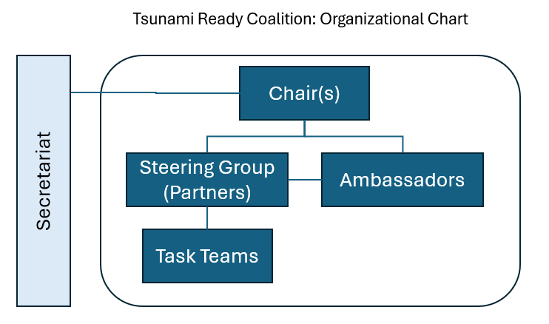
TRC Organizational Chart – meetings
Chair and Co-chair
Steering Group (meet 2X year, at least 1 in person, scheduled alongside TOWS-WG and/or coincide with global event conferences)
Notional Agenda
TRRP implementation status per region).
Countries requiring support.
Common implementation barriers (discussion with a view on solutions).
Promotion opportunities.
Future meetings and workshops (how can Partners assist?).
Reporting to TOWS-WG.
Ambassadors (primarily operational focus, participation in Steering Group meetings by invitation in advisory role, or as optional observers)
Task Teams (as required)
Secretariat (TRS)

Slide 23
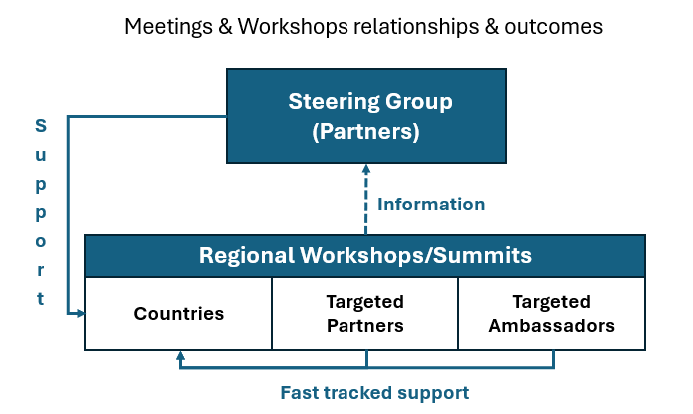
TRC Regional, Sub-regional Workshops
Relationship between workshops/summit and meetings of Steering Group, and their outcomes
After 2025 workshops and summits, at least one follow-up workshop or summit should be organized before 2030.
Expected that TICs will play a lead role in coordinating these events.
Notional objectives of regional and sub-regional workshops/summits are to:
Encourage countries in the regions to adopt or extend the implementation of TRRP.
Identify barriers and solutions to the implementation of TRRP.
Solicit resources to support the implementation of TRRP.
Share experience regarding implementation of TRRP.
Discuss alternative pathways to achieving Tsunami Ready communities where appropriate.

Slide 24
TRC Communication Plan – Annex 5 – pg 80-77
To maintain engagement of Tsunami Ready Coalition Partners and Ambassadors.
Document approach for connecting with other important stakeholders and audiences in international fora to register and to sustain prominence of Tsunami Ready, and the aim of 100% communities at risk are prepared and resilient to tsunamis by 2030.
Format consistent with communications practice
Covers:
Background and environmental factors,
An analysis of stakeholders and audiences,
An outreach and communication approach,
Consistent messages,
An Outreach and Communication Action Plan, and
Monitoring/measurement.

Slide 25
TOWS WG Recommendations (2025)
TOWS-WG in February 2025 crucial for advancing Coalition.
Key recommendations for TOWS-WG (to be reviewed by TOWS-TT-DMP, and included in Coalition Chair’s report to TOWS-WG)
The TOWS WG:
Notes the Tsunami Ready Coalition Implementation Plan, and
Endorses:
The Coalition mandate and terms of reference,
The Coalition structure, and
The identified key Coalition Partners.
Requests the IOC Executive Secretary to extend invitations to the proposed Coalition Partners and Ambassadors, and a Coalition Co-chair.
Requests ICGs to prioritize regional Tsunami Ready workshops or summits in 2025 and conduct further workshops or summits before 2030.
Noting resource and capacity constraints that will stymie progress the TRC Coalition Implementation Plan, requests the IOC Executive Secretary to urgently address

Slide 26
Tsunami Ready Coalition
Draft Implementation Plan
Dr. Laura Kong, TRC Chair
Director, ITIC
UN Ocean Decade Tsunami Programme, Scientific Committee
16-17 February 2025, Paris, France

