Slide 1


Meeting of Scientific Committee for the UN Ocean Decade Tsunami Programme
16-17 January 2025, UNESCO HQs. Paris, France
Meeting Room VIII
DISCUSS ICG INITIATIVES/COORDINATION WITH RESPECT TO ODTP
ICG-NEAMTWS
Denis Chang Seng , Maria Ana Baptista and Helene Hebert

Slide 2

The ICG/NEAMTWS Activities/Advancements 2023-2024
Key messages from ICG Chair, ICG/NEAMTWS XIX (A. Amato):
Recalling the NEAMTWS Strategic plan and goals
Continued operations (monitoring, warning, meetings, etc.) by 5 TSPs
6 recognized Tsunami Ready communities (and others coming soon)
Improved response in the NEAMWave23 (+ local exercises)
Closing of CoastWave project (2022-2024), Phase-2 started July 2024 (DG-ECHO)
Other projects on tsunami science and hazard - risk mitigation (+ EPOS, GTM, etc.)
New Task Team on Non-seismic tsunami sources (Stromboli test case, etc.)
New developments and technologies:
  New tide gauges in several MS coastal areas (20 in Marmara Sea, Türkiye)
  First cabled deep-ocean sensors connected to TSPs
  Two DART-like buoys coming in the Ionian sea (2025) + 1 near Stromboli
  Probabilistic Tsunami Forecasting - PTF implementation

Slide 3
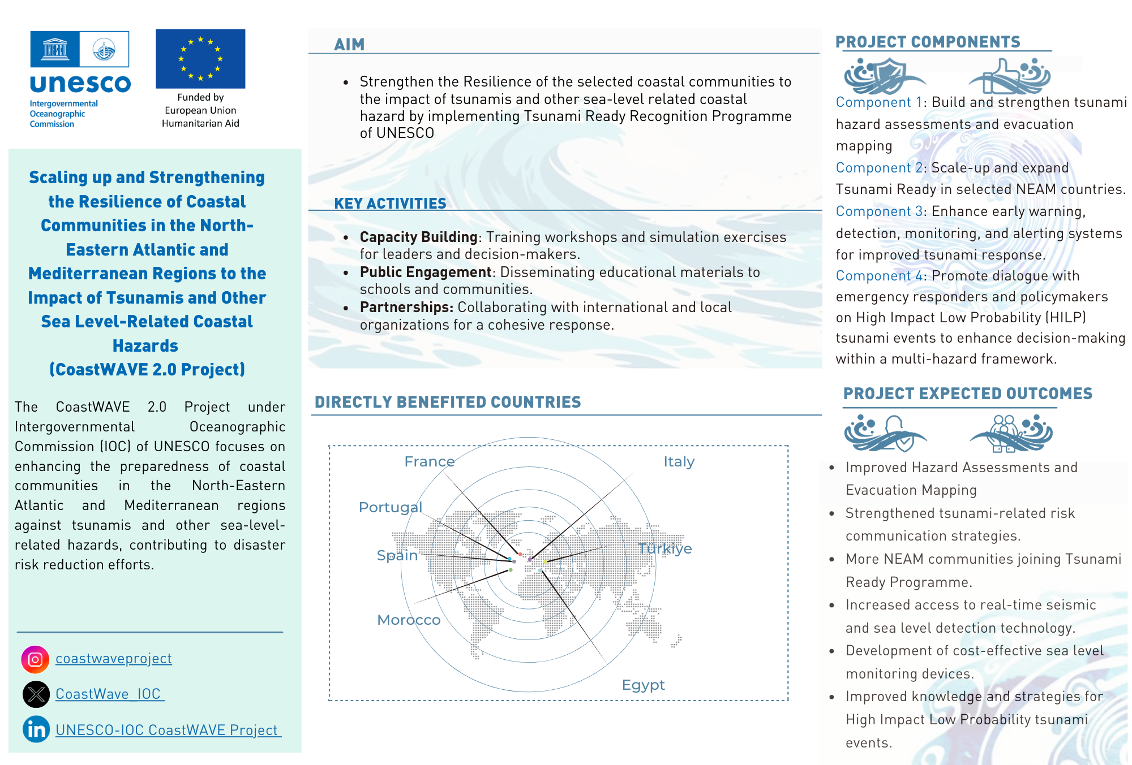
Key Projects
CoastWAVE 2.0, IOC

Slide 4
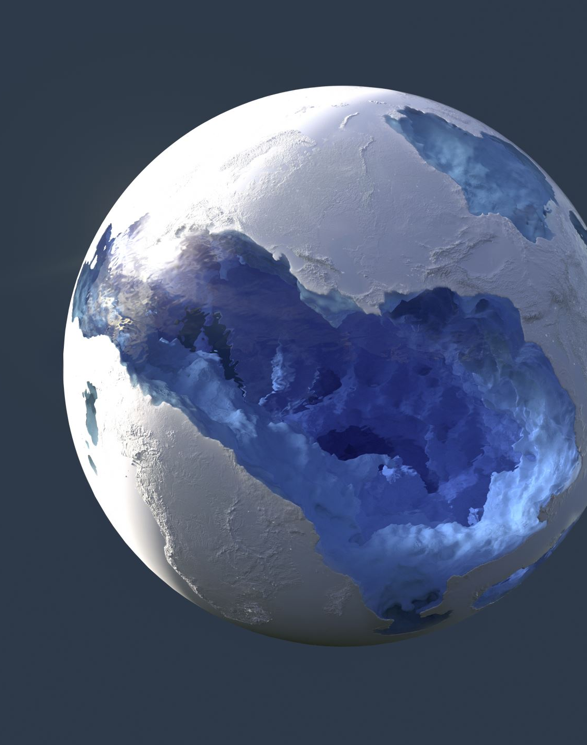
Other Projects
EPOS THEMATIC CORE SERVICES TSUNAMI,GFZ German Research Centre for Geosciences
In February 2024, 18 European institutions from 11 countries signed a Consortium Agreement to establish Thematic Core Services under the auspices of EPOS-ERIC (European Plate Observing System, https://epos-eu.org).
Mission of TCS-TSUNAMI
Promote tsunami research and its practical applications by providing open access to high-quality and FAIR data, services, and scientific products for a broad range of stakeholders, including researchers, disaster risk management and early warning practitioners, private sector, etc.
The products and services (currently over 40) are defined in four categories:
  Pillar 1 – Support to Tsunami Service Providers;
  Pillar 2 – Tsunami-related datasets and observations;
  Pillar 3 – Numerical tools and workflows for tsunami simulations;
  Pillar 4 – Hazard and risk products
Invited as a member of the EPOS ON project Advisory Board(Optimisation and EvolutionN) project, funded by the European Commission (Grant Agreement ID: 101131592) under the INFRA-2023-DEV-01 call, “Developing, consolidating and optimising the European research infrastructures landscape, maintaining global leadership”.

Slide 5
Key Projects
SUSTAINING AGITHAR TOWARDS A GLOBAL TSUNAMI MODEL, Universität Hamburg, Dept. of Mathematics, Hamburg, Germany
The COST Action AGITHAR (running from 2019 through 2023) developed community standards and best practices for PTHA & PTRA.
Basis for the Global Tsunami Model (GTM) network of experts, organized in an association with a sustained business model,
Advice to public entities and decision makers, insurance and reinsurance industry, port authorities, and other diverse stakeholders.
GTM Association was inaugurated in our Rome meeting in September last year.
formal registration as a legal entity (an e.V. under German legislation) is pending.
Membership
Planning the first General Assembly of the Association co-located with EGU 2025 in Vienna end of April 2025.

Slide 6
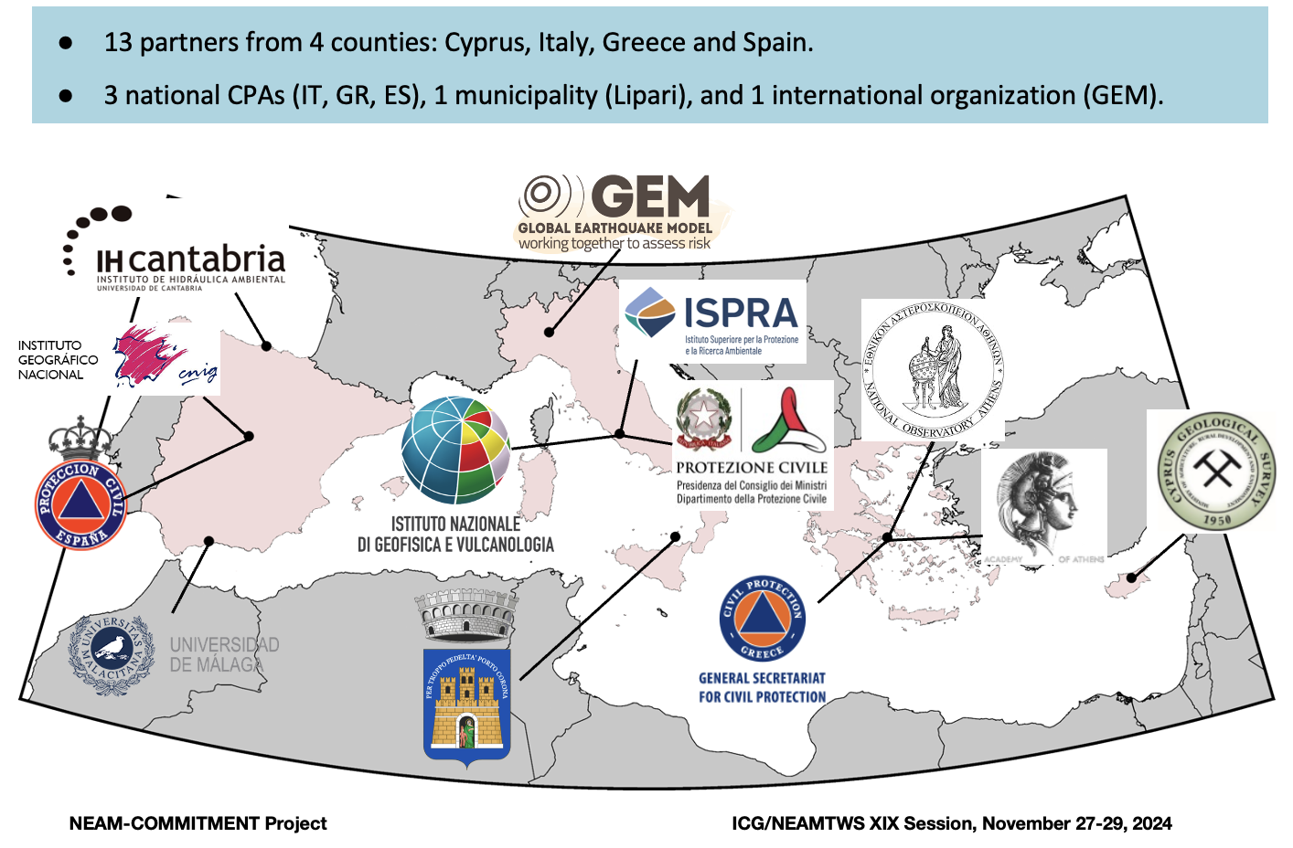
Key Projects
ΝEAM Collaboration fOr iMproved tsunaMi rIsk miTigation and management (NEAM-COMMITMENT), Coordinated by NOA Greece, Starting Feb 2025, 2 yrs

Slide 7

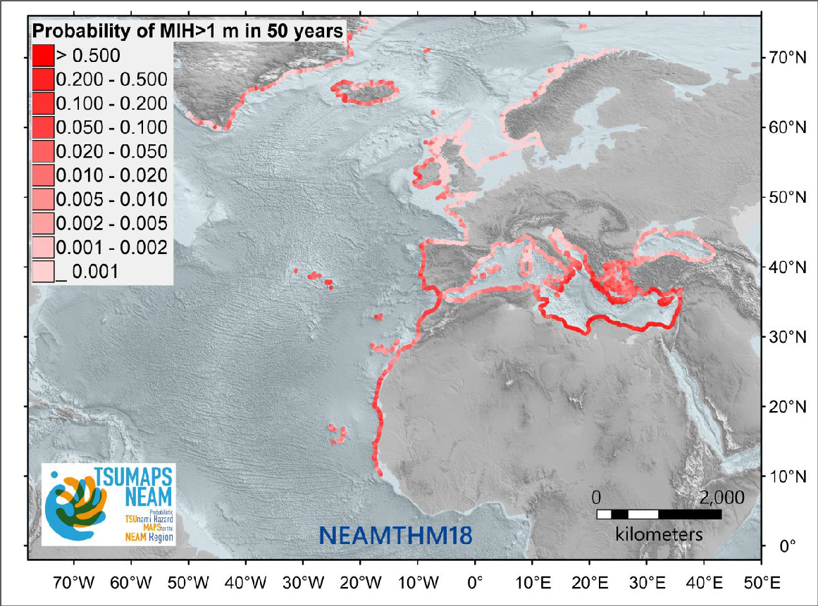


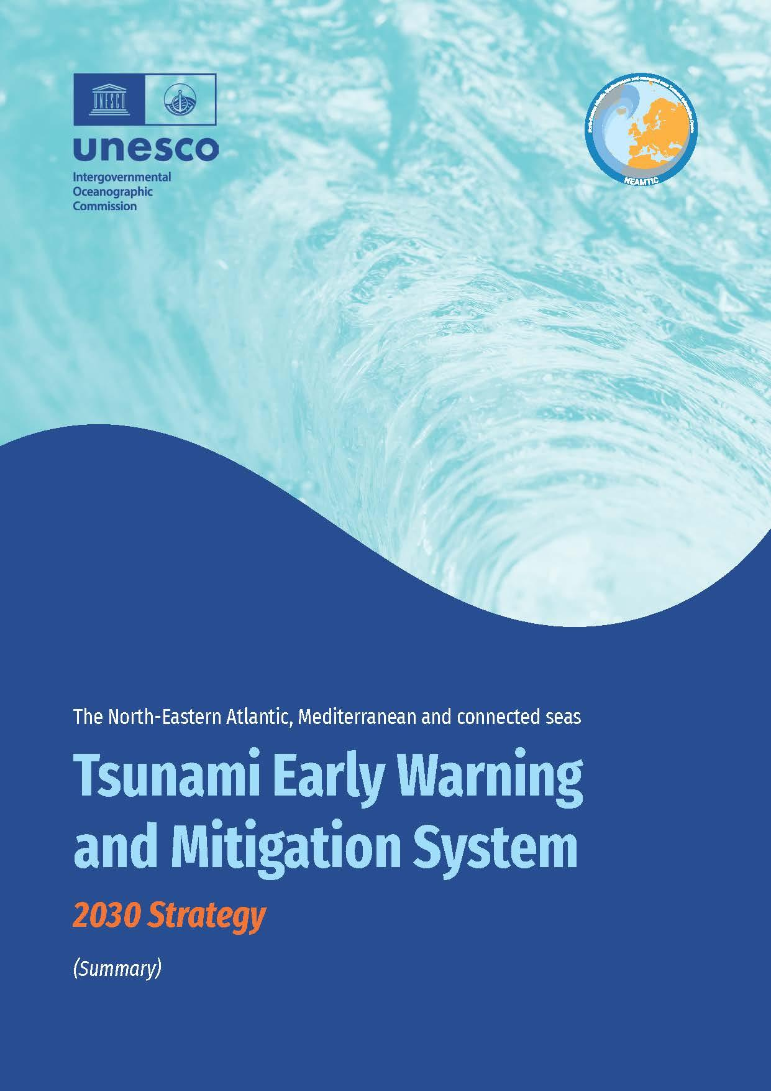



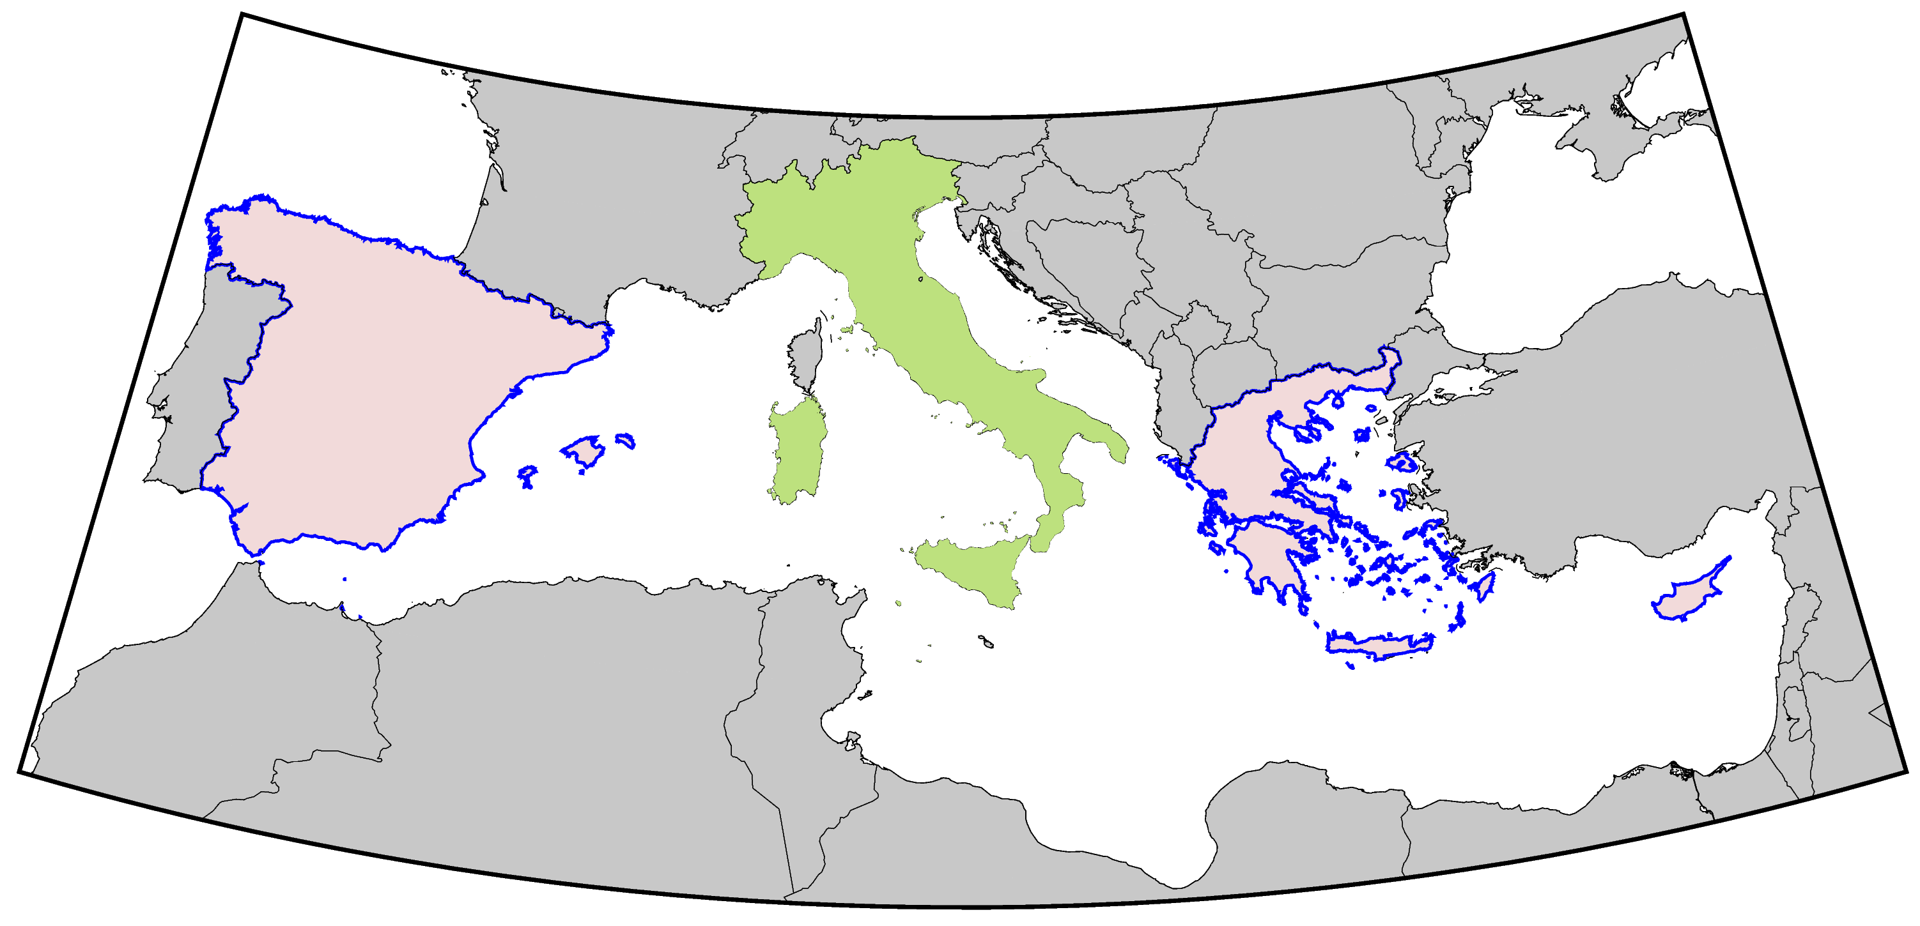
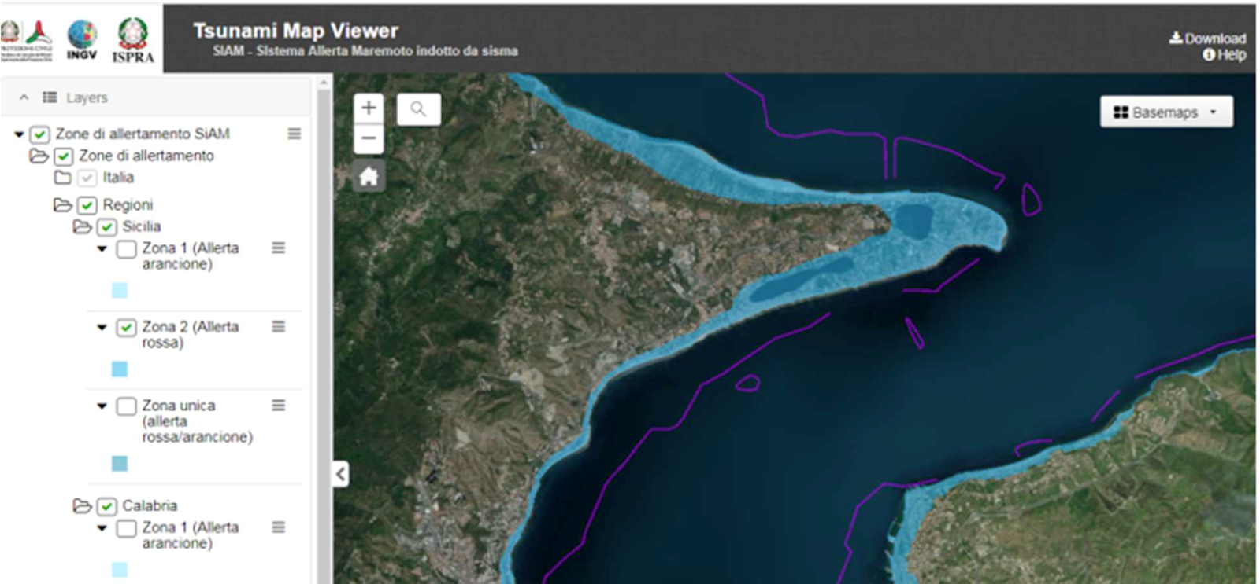
Objective 1 – common national maps across NEAM countries
project funded by DG-ECHO
National inundation maps
Outputs: national tsunami inundation maps (CY, GR, ES); guidelines and tools.

Slide 8
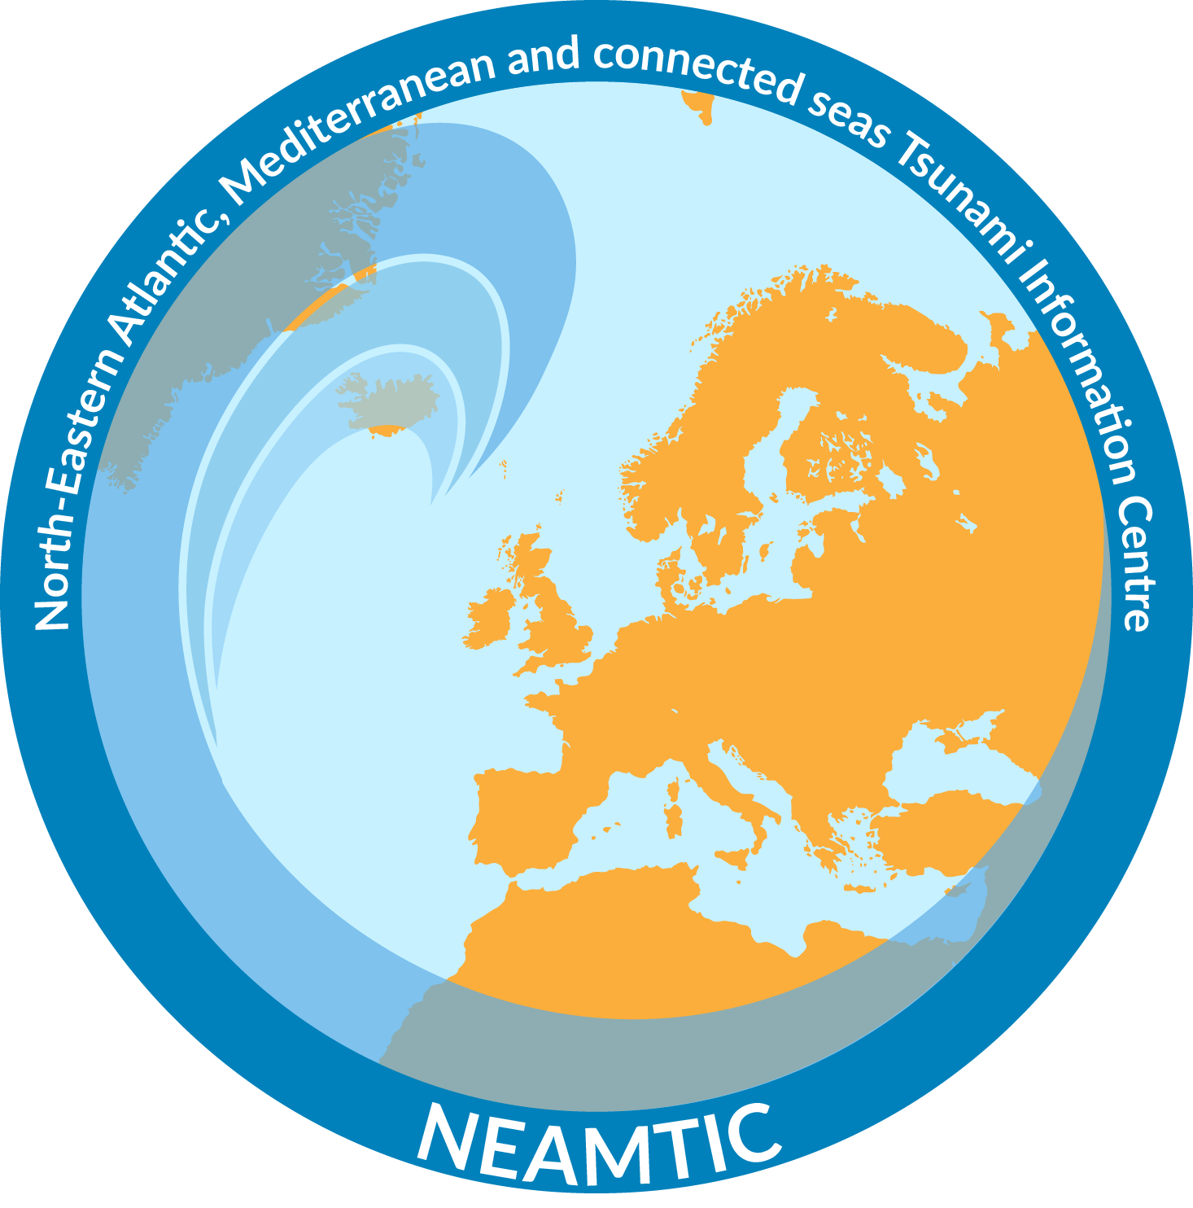

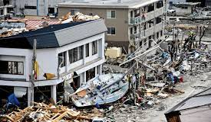
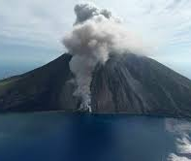
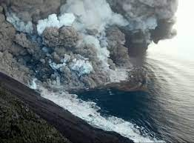
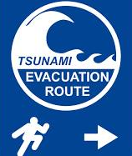
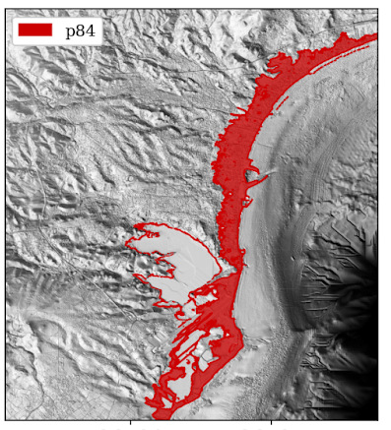
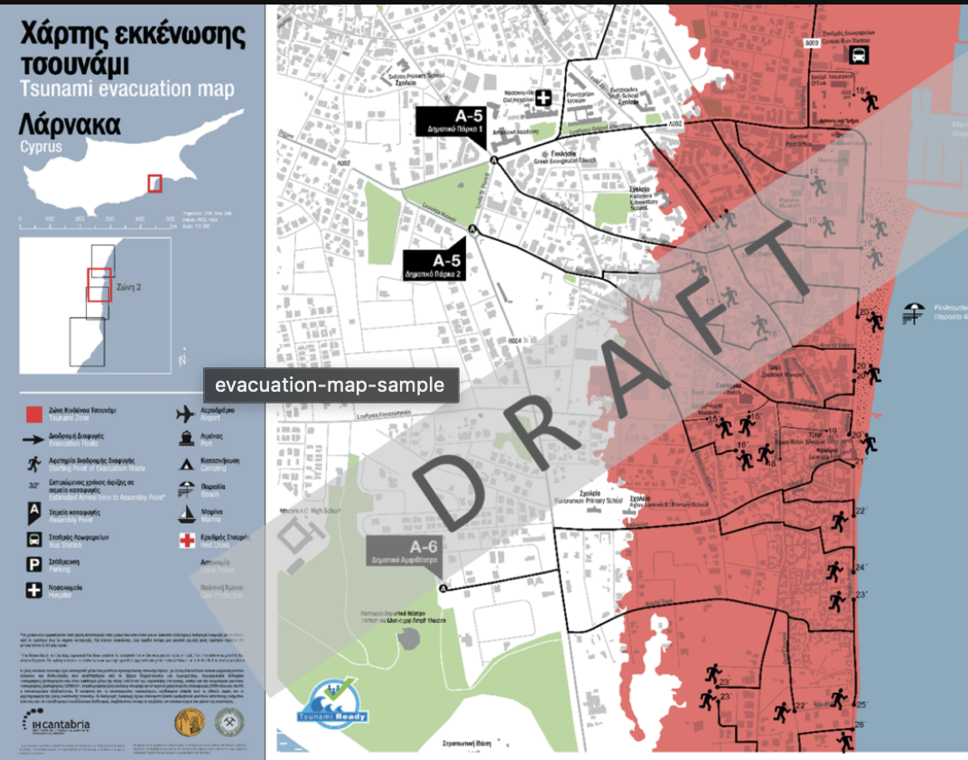
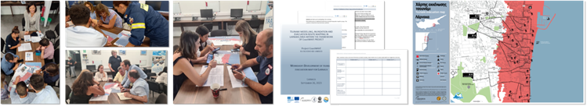
Objective 2 – Location-Specific Multi-Hazard Risk Management
Earthquake + tsunami
Volcanic activity + tsunami
Outputs: combined scientific-technical and participatory multi-hazard approach for tsunami evacuation planning and management; application to pilot sites in Greece and Italy; drafting of guidelines.

Slide 9
HAZARD RISK KNOWLEDGE
Further appreciates the organization of the international workshop organized by the National Institute of Geophysics and Volcanology (INGV), Italy on Stromboli: Observations, Modeling, Hazard Assessment, and Forecasting with the participation of eighty international experts from 5-7 October 2024 as a contribution to the topic on non-seismic tsunami sources;
Welcomes the recommendations to further advance Stromboli volcano tsunami early warning, and interest to publish a White Paper, as well as a UNESCO-IOC Technical Series document in that order;
Recommendations
To organise workshops and/or webinars as applicable on non-seismic tsunami with a focus on volcanic processes as a preliminary step.
To develop future bulletin formats including tsunami from non-seismic sources.
:

Slide 10
MONITORING AND DETECTION
AND WARNING
Helene Hebert

Slide 11

Updates in ICG/NEAMTWS
Ocean Decade Tsunami Programme
Objective 1
First objective: to develop the warning systems’ capability to issue actionable and timely tsunami warnings for tsunamis from all identified sources to 100 percent of coasts at risk.
  Most urgently, the ODTP will endeavour to provide tsunami confirmation within 10 minutes or less of origin for the most at-risk coastlines.
  This is challenging, as current warning systems depend upon quick detection and characterization of tsunamigenic earthquakes using only seismic sensors.
  This objective would require expanding existing monitoring systems and implementing further scientific and technological advances, and to also include non-seismic and complex tsunami sources.

Slide 12
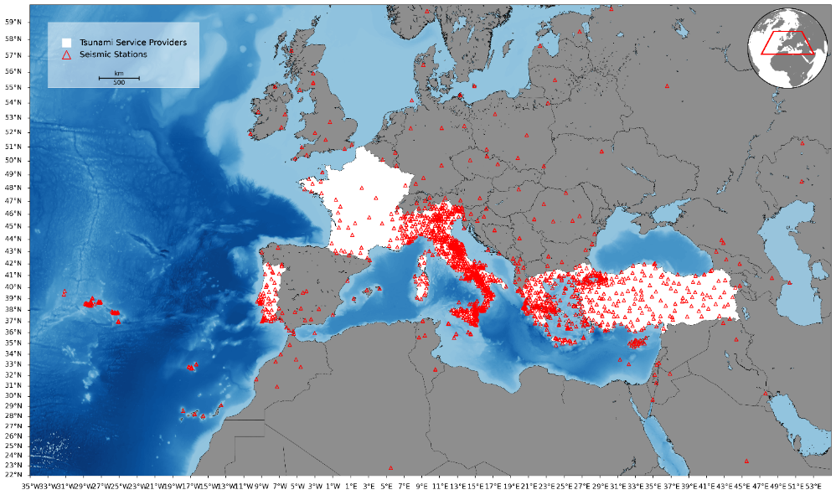
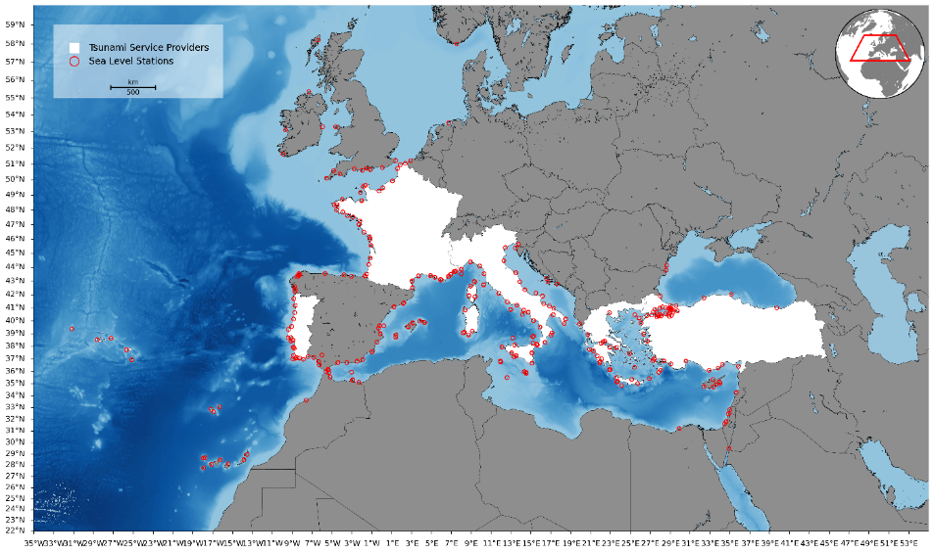
Seismic, Geophysical and Sea Level Measurements
Seismic and Sea Level Data Base in NEAM REGION (2024)
Seismic Stations Monitored by TSP
Sea-Level Stations Monitored by TSP
WG2&WG3 – Seismic, Geophysical & Sea Level Measurements IOC-UNESCO ICG/NEAMTWS, 27-29 November 2024, Paris, France

Slide 13
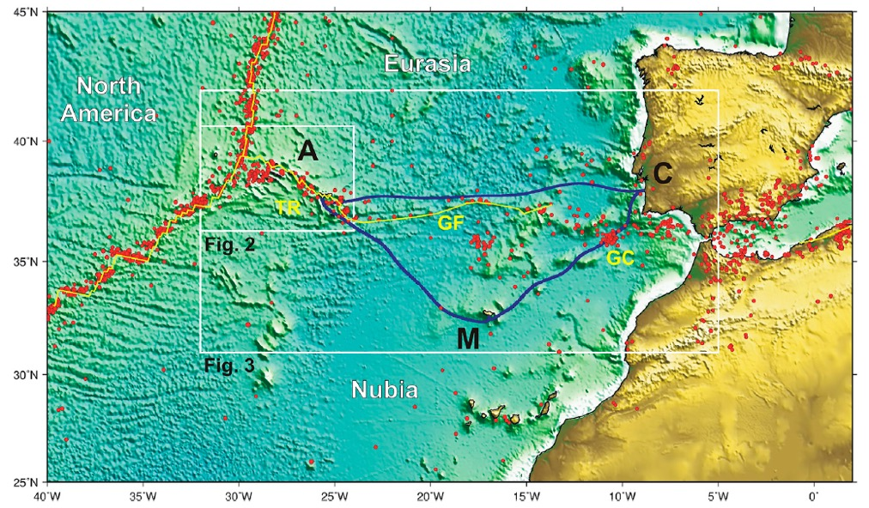
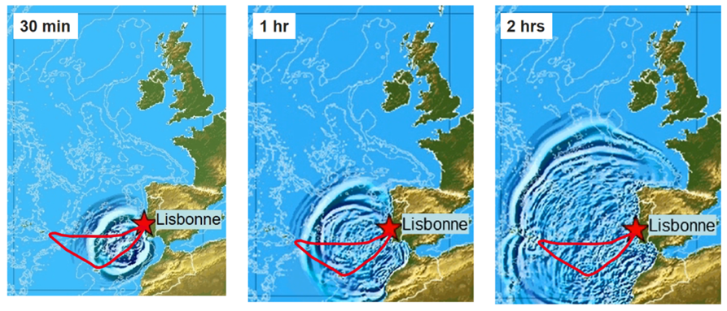
ONGOING ACTIVITIES: SMART CABLES IN THE ATLANTIC
New Submarine Cable Ring connecting Portugal Mainland-Azores-Madeira
Opportunity for a SMART system (SMART CAM) supported by Portugal
Operational in 2025-2026
Timeline of 1755-like tsunami propagation in NE Atlantic
(courtesy of IPMA and Cenalt)

Slide 14
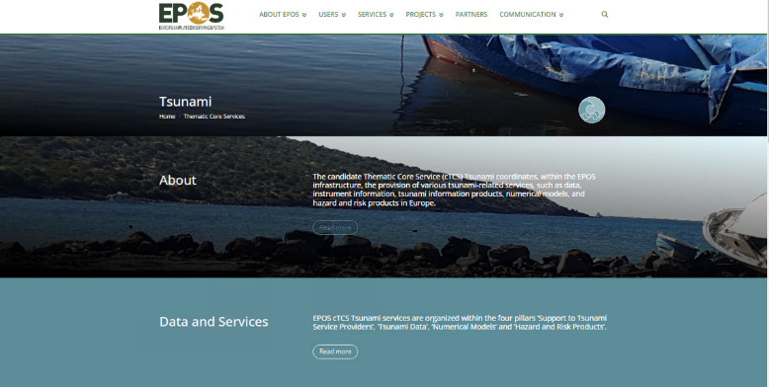
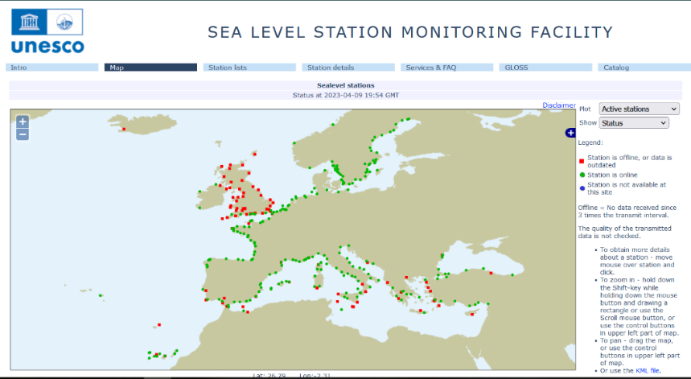
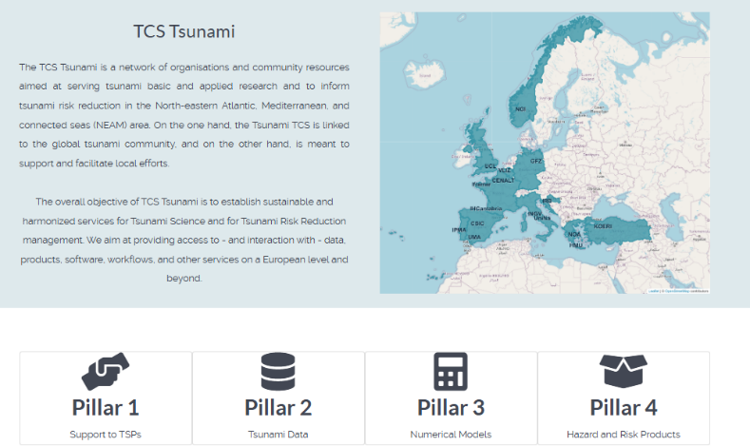
EPOS Research Infrastructure
Tsunami products: catalogues, historical data, data portal, empirical Tsunami Risk Products, Submarine Landslide Database..

Slide 15
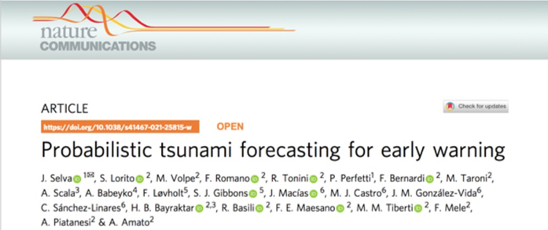
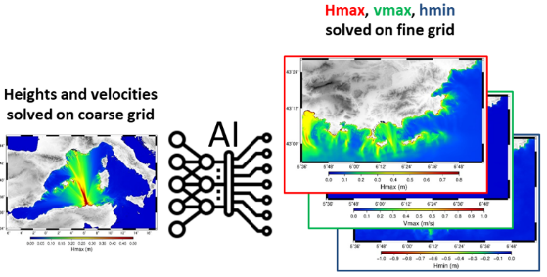
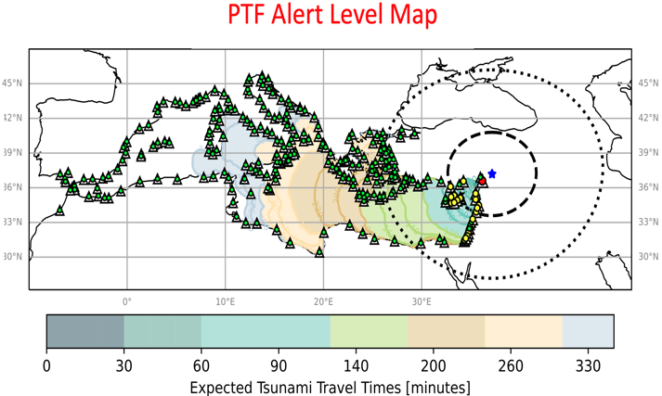
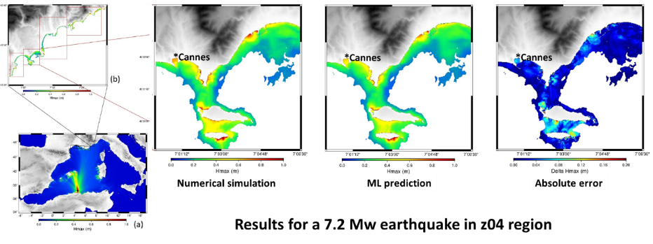
New Developments
Tsunami forecast products: probabilistic approach / AI approach
TSPs meeting (Lisbon), March 2025
>45’
<1’

Slide 16
Key ICG-NEAMTWS XIX D & R
Welcomes the continued progress of the investigation and the possibility to adopt tsunami forecasting methods by TSPs which represent an improvement over the Decision Matrices presently in use with a view to reducing uncertainty and false alarms, particularly the forecasting methods which consider tsunami numerical modeling and uncertainty quantification (e.g., the Probabilistic Tsunami Forecasting (PTF), pre-calculated scenario databases, etc.);
Notes CAT-INGV (Centro Allerta Tsunami - Istituto Nazionale di Geofisica e Vulcanologia, Italy) TSP ongoing progress towards implementing a PTF based Decision Matrix, and requires that the methodology implemented is documented in the updated NEAMTWS Operational User Guide and that TSP subscribers are informed accordingly;

Slide 17
PREPAREDNESS AND RESPONSE
Ocean Decade Tsunami Programme
Objective 2
Prof Maria Ana Baptista

Slide 18
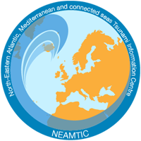

  TSUNAMI READY NEAMTWS
ICG NEAMTWS
Task Team on Tsunami Ready
Co-chairs
Elena Daskalaki (Greece)
Maria Ana Baptista
ODTP SC
16-17 February 2025. Paris, France
Notes:
The presentation contains quite a lot of information and the time for it is rather limited, therefore it will have to be done relatively fast. However, if there is anyone interested in further information, please do not hesitate to ask myself and Elena Daskalaki.

Slide 19
ICG-NEAMTWS-WGs / TTs
24-26 Nov. 2020 (link)
ICG/NEAMTWS
XVII Session
24 - 26 Nov. 2021
(online)
ICG/NEAMTWS
XVII Session
Establishment of intersessional WGs and TTs
ICG/NEAMTWS
Steering Committee
8-12 April 2022
(online)
Nov. 2020
Nov. 2021
Jan. 2022
April 2022
WG4 proposed to set up a dedicated Group on Tsunami Ready within WG4 to start coordinating and implementing Tsunami Ready
The ICG/NEAMTWS decides to formally establish a Task Team on Tsunami Ready with Terms of Reference in Appendix 5
Establishment of the NEAMTWS TT on TR
and appointment of new cochairs
Establishment of First TT-TR Plan of Action (PoA) (requested during ICG/NEAMTWS XVII 2021
IOC Circular Letter No 2821
7 Dec. 2020
ICG-NEAMTWS XVII Decisions and recommendations
(Working Document 23 Nov 2021)
ICG-NEAMTWS XVII Session Report.
Approved TT-TR Plan of Action 2022
Draft Plan of Action
Notes:
Say: there is no time to show the ToR and the POA, but that they are available for anyone who wants to read them.

Slide 20
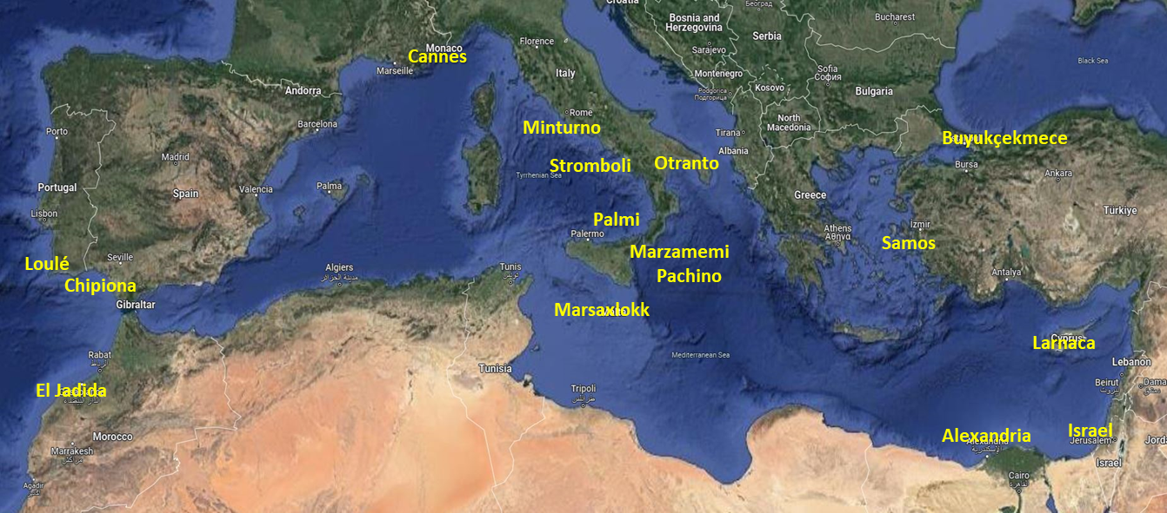
11 Countries and 15 communities (7 countries under IOC-UNESCO EU DG-ECHO CoastWAVE Project)
  Atlantic: El Jadida (Morocco); Chipiona (Spain).
  Central/Western Mediterranean: Cannes (France); Marzamemi-Pachino, Minturno, Palmi, Stromboli volcano, Otranto (Italy); Marsaxlokk (Malta).
  Eastern Mediterranean: Buyukçekmece (Turkey), Samos (Greece), Larnaca (Cyprus), Israel, Alexandria (Egypt).

Slide 21
Recognized Communities | Applications Received | Communities that are expected to apply soon (Coast Wave phase II)
Cannes, France January 2024 | Israel | Loulé, Portugal - all indicators fulfilled (waits nomination TNRB)
Buyukçekmece, Turkey |  | Cascais, Portugal - all indicators fulfilled(waits nomination of TNRB)
Alexandria, Egypt May 2024 |  | El Jadida, Morocco
Chipiona, Spain June 2024 |  | Marsaxlokk, Malta
Minturno, Italy , October 2024 |  | Marzamemi/Pachino, Italy
 |  | Palmi, Italy
Samos, Greece, June 2024

Slide 22
GENERAL BARRIERS
Some stakeholders difficult to involve, afraid that acknowledge of tsunami hazard may harm their business, due to international and sectoral competition.
Difficulties to get local officials to accept the signage because it materializes the tsunami risk (especially for municipalities oriented towards the tourism economy).
Reluctance from local authorities to officially endorse the evacuation plan because they are worried about legal liabilities in case of human losses during the evacuation.
General populations’ lack of knowledge and education about coastal hazards and especially tsunamis. Some coastal communities may underestimate the tsunami risk. Distress and fear among exposed population may also contribute to this underestimation.
Difficulties in public awareness due to special conditions (summer time, temporary population etc.).

Slide 23
INSTITUTIONAL, ORGANIZATIONAL, TECHNOLOGICAL BARRIERS
Establishment of NTRB/ establishment of the TRLC.
Institutional Coordination between different organizations at all spatial scales and administrative divisions.
Existing national Governance structures imply the integration of local tsunami emergency plans (slow down the process, depending on the political will of each community etc.).
Dependency on only one mean of dissemination for alerting the population.
International signage is not always easily acceptable by local decision makers - Need for adapting the tsunami signage and facilitating its integrations into the urban environment (fear…..).
Sustainability of TRRR. Continuous support by scientific and distaster/emergency experts.

Slide 24
Key ICG-NEAMTWS XIX D & R
Encourages other countries, in particular Cyprus (Larnaca), Israel (entire coast), Malta (Marsaxlokk) and Morocco (El Jadida) to finalize their efforts to complete the TRR process and application;
Encourages the continued progress made towards establishing UNESCO-IOC Tsunami Ready communities ongoing communities in Italy (Palmi, Marzamemi, Otranto and Stromboli), and in Portugal (Loule );
Reaffirms the target to have a total of 25 UNESCO-IOC Tsunami Ready Recognized communities in NEAM countries by the end of 2026, further contributing to making 100% of communities at risk of tsunami prepared for and resilient to tsunami by 2030 through the implementation of the UNESCO/IOC Tsunami Ready Programme and other initiatives, as stated by the Ocean Decade Tsunami Programme;

