Slide 1
Ocean Decade Endorsed Actions - ICG/CARIBE-EWS
Ocean Decade Tsunami Programme (Programme)
The Nippon Foundation-GEBCO Seabed 2030 Project (Programme)
Global Real-time Early Alarm for Tsunami (GREAT) (Project)
Open Access to GTS Project (Project)
Sea Level Station Monitoring Facility (Project)
SMART Subsea Cables (Project)
Decade Collaborative Centre for Coastal Resilience (Contribution)
Promote Seabed 2030 and Ocean Mapping (Contribution)
US Tsunami Contributions to IOC Tsunami PT 1 (Contribution)
US Tsunami Contributions to IOC Tsunami PT2 (Contribution)
Integrating Coastal Hazard Warning Systems for Tropical Americas and Caribbean (TAC) (Project)
Tsunami & Climatic Risk Reduction at Protected Areas in Costa Rica (Project)

Slide 2
ICG/CARIBE-EWS Decisions/Actions related to ODTP
    Decisions of ICG/CARIBE-EWS XVII (May 2024, Managua - Nicaragua)
Decided to establish an ICG/CARIBE-EWS Steering Committee which will, among others, guide the work and direction of the CARIBE-EWS to help deliver the goals of the UN Ocean Decade Tsunami Programme (ODTP) in support of its 10-year Scientific Research Implementation and Development Plan (RDIP) (7)
Decided to establish Tsunami Ready Task Team (TT-TR) (5,7/Objective 2)
Requested WG1 (Risk Knowledge), WG2 (Tsunami Detection, Analysis and Forecasting), WG3 (Tsunami Warning Dissemination and Communication), WG4 (Preparedness and Response Capabilities) and Tsunami Ready Task Team (TT-TR) to Present a progress report based on the Key Performance Indicators related to the United Nations (UN) Ocean Decade Tsunami Programme (ODTP) (2-7/Objective 1 and 2)
Decided the formation of a sub-group under Working Group 2 to specifically address the implementation of SMART Cable technology in the CARIBE-EWS (3/Objective 1)
Requested the Steering Committee to revamp the initiative of the Group of Experts (GoE) on work and implementation plan to enhance the warning system by including other coastal hazards within the framework of MHEWS and EW4All, and further noted that one of the priority areas of IOCARIBE is early warning systems for regional hazards and the need and benefit to strengthen cooperation between IOCARIBE and ICG/CARIBE-EWS (2-7/Objective 1 and 2)
Decided to organizing the 2nd Tsunami Ready Summit to review the benefits and lessons learned and establish a road map towards 100% communities prepared for and resilient to tsunamis through efforts like Tsunami Ready (5/Objective 2)
2. Risk Knowledge 3. Detection, Analysis and Forecasting of Tsunamis and Associated Hazardous Consequences
4. Warning, Dissemination and Communication 5. Preparedness and Response Capabilities 6. Capacity Development 7. Governance

Slide 3
ICG/CARIBE-EWS Decisions/Actions related to ODTP
    Decisions of ICG/CARIBE-EWS XVII (May 2024, Managua - Nicaragua)
Underlined the need to conduct a regional Digital Elevation Model (DEM) Training, identification of its venue, experts, and the tools to be used for this training (open-source software vs license-based software) (6)
Encouraged the Secretariat with Working Group 2 to organize sea level training courses in English and Spanish languages in alternating years with the support of NOAA and the Secretariat, and in close collaboration with the International Hydrographic Organization (IHO) and the International Maritime Organization (IMO) (6)
Recommended Working Group 3 to finalize and submit the Inventory of Tsunami Warning Dissemination and Communication Methods for the Caribbean and Adjacent Regions (4)
Requested Working Group 3 to review and revise Technical, Logistical and Administrative Requirements of a Regional Tsunami Service Provider for CARIBE-EWS and present at its XVIII session at the latest (3,4)
Recommended CATAC to explore and inform at ICG/CARIBE-EWS XVIII the integration of EEW applications for disseminating its tsunami services and products to its TWFP and NTWCs (3,4)
2. Risk Knowledge 3. Detection, Analysis and Forecasting of Tsunamis and Associated Hazardous Consequences
4. Warning, Dissemination and Communication 5. Preparedness and Response Capabilities 6. Capacity Development 7. Governance

Slide 4
ICG/CARIBE-EWS Decisions/Actions related to ODTP
    Decisions of ICG/CARIBE-EWS XVII (May 2024, Managua - Nicaragua)
Recommended CTIC and ITIC-CAR in coordination with Working Group 4 and CARIBE WAVE Task Team to organize a joint training on Manuals and Guides 86 and CARIBE WAVE Task Team meeting in Antigua and Barbuda during the following intersessional period (5,6)
Noted the successful conduct of the CARIBE WAVE 24 Exercise with the participation of 100% of the Member States and over 475,000 people registered (5,6)
Decided that the CARIBE WAVE 25 exercise will take place on Thursday, March 20, 2025 using 1) 1692 Jamaica scenario, and 2) the 1755 Lisbon scenario (5,6)
Additionally noted that CATAC will provide the updated users guide by March 2025 for the consideration of ICG/CARIBE EWS XVIII, recommended that CATAC continues full functionality in an interim manner (3,4,7)
Noting that the CARIBE EWS XI in 2016 approved Technical, Logistical and Administrative Requirements of a Regional Tsunami Service Provider for CARIBE-EWS which defines TSPs as centres that provide services to the whole CARIBE-EWS region, and further noting the update to the Tsunami Watch Operations Global Service Definition Document (2016, TS 130) is in its final stages, recommended the consideration of CATAC as a TSP in its XVIII Session in 2025 to enable the IOC Assembly to consider the final admission of CATAC as TSP in June 2025 (3,4,7)
2. Risk Knowledge 3. Detection, Analysis and Forecasting of Tsunamis and Associated Hazardous Consequences
4. Warning, Dissemination and Communication 5. Preparedness and Response Capabilities 6. Capacity Development 7. Governance

Slide 5
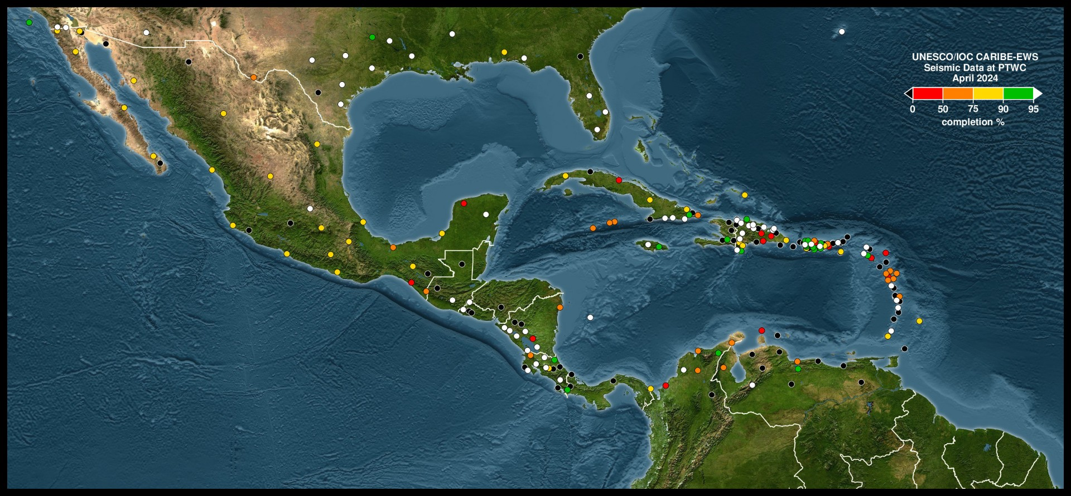
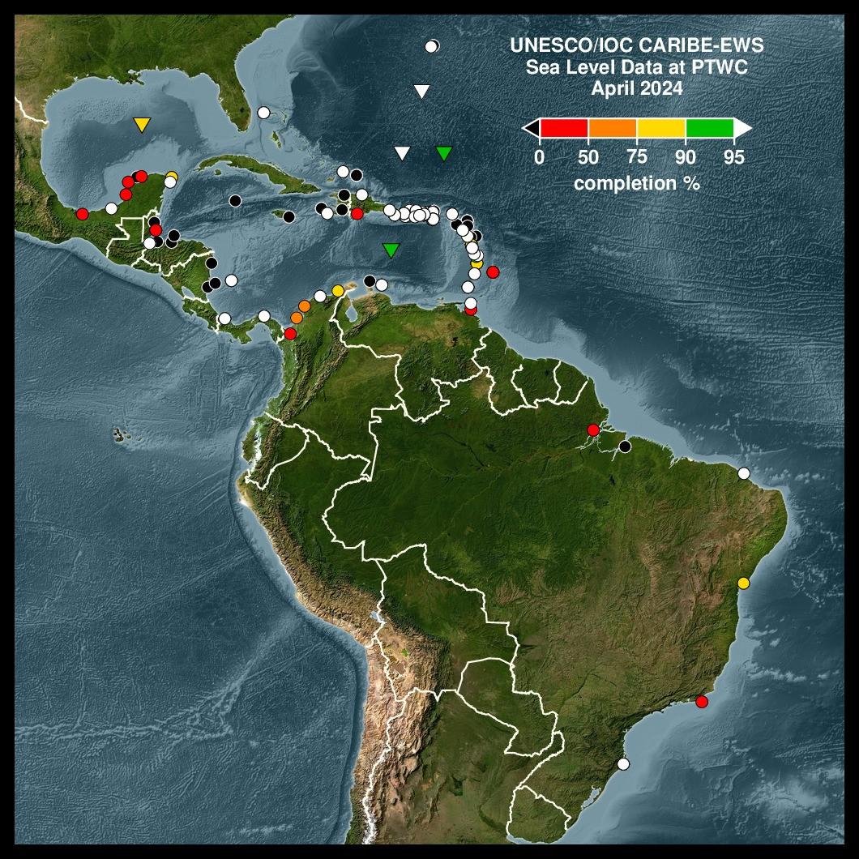
ICG/CARIBE-EWS Seismic & Sea-Level Network

Slide 6
ICG/CARIBE-EWS Decisions/Actions related to ODTP
    Tsunami Evacuation Workshop (22-24 April 2024, Heredia – Costa Rica)
The Workshop on Tsunami Evacuation held under the the leadership by Florida International University, the funding provided by USAID-BHA and ICG/CARIBE-EWS Secretariat, and the support of National University Costa Rica, ITIC-CAR and PRSN, with the participation of seven ICG/CARIBE-EWS Member States (Dominican Republic, Mexico, Guatemala, Nicaragua, Costa Rica, Panama, Colombia and USA-Puerto Rico) (5,6/Objective 2)
    Expert Meeting on seismic and non-seismic source (2-6 December 2024, Heredia – Costa Rica)
An expert meeting organized by the UNESCO-IOC Tsunami Resilience Section and hosted by the Sistema Nacional de Monitoreo de Tsunamis (SINAMOT) of Costa Rica brought together 16 in-person and 4 remote experts from Costa Rica, France, Spain, Trinidad and Tobago, and USA to discuss the source properties of earthquakes in the Northwest Caribbean and non-seismic sources of tsunamis for the Caribbean and Adjacent Regions. 3 experts from Italy and Norway as representatives of the Global Tsunami Model also attended the Expert Meeting specifically to contribute to the discussion on the use of probabilistic methodologies in tsunami risk assessment of both seismic and non-seismic origin. As a result of intense discussions in a laboratory type of setting, source parameters for volcanic and earthquake origin tsunamis in the respective regions were identified and preliminary modelling results were cross-examined during the joint session on the last day of the Expert Meeting. Experts will continue with the tsunami modelling of the sources defined with the aim of providing the results available within the first half of 2025 to be included in the report of the Expert Meeting.
2. Risk Knowledge 3. Detection, Analysis and Forecasting of Tsunamis and Associated Hazardous Consequences
4. Warning, Dissemination and Communication 5. Preparedness and Response Capabilities 6. Capacity Development 7. Governance

Slide 7
ICG/CARIBE-EWS Progress in TRRP
The communities of Cahuita (Costa Rica), St. James Central (Barbados), Portsmouth (Dominica), and Laborie, (Saint Lucia) convened their Tsunami Ready Ceremonies in 2024 after successfully fulfilling the 12 Indicators of the TRRP.
Ten Tsunami Ready initiatives are currently being undertaken in the communities of Anguilla (renewal), Barbuda (Antigua and Barbuda), Shermans to Mullins (Barbados, renewal), Belize City (Belize), Choiseul (Saint Lucia), Sabana Grande de Palenque (Dominican Republic), St. George's (Grenada), Omoa (Honduras, renewal) Tela and Tornabe (Honduras, renewal), Port Maria (Jamaica), and Mayora (Trinidad and Tobago). An additional two (2) communities – one each in Dominica and Grenada are proposed to initiate Tsunami Ready implementation or tsunami preparedness education and outreach activities in 2025.
The Tsunami Ready Evaluation Survey was revised and implemented with the support of the CARIBE EWS Tsunami Ready Task Team, ITIC-CAR and the Caribbean Tsunami Information Centre (CTIC) and efforts are underway for the implementation of key recommendations by the Task Team and ITIC-CAR.
The CTIC Getting Ready for Tsunamis Brochure and the Tsunami Flyer are being revised with the support of the International Tsunami Information Center-Caribbean Office (ITIC-CAR) to provide enhanced materials in Braille and Large print to better support the visually impaired. More formal efforts are being pursued by CTIC and ITIC-CAR to educate people living with disabilities through engagement with the World Institute on Disability among other organisations, and incorporation of their feedback into the development of public education and outreach materials as well as TRRP implementation.

Slide 8
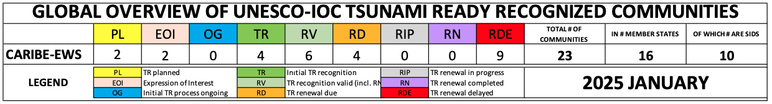
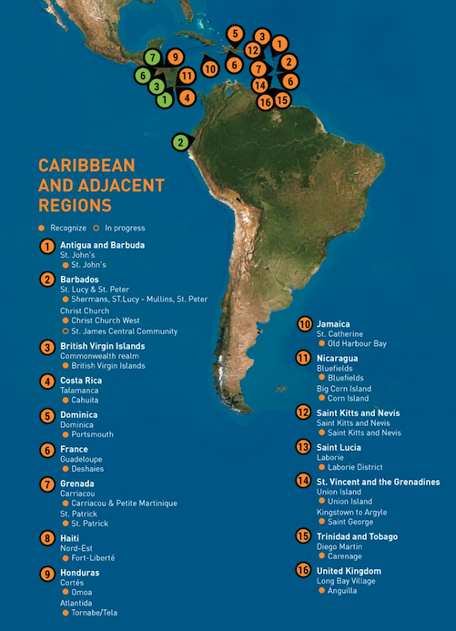
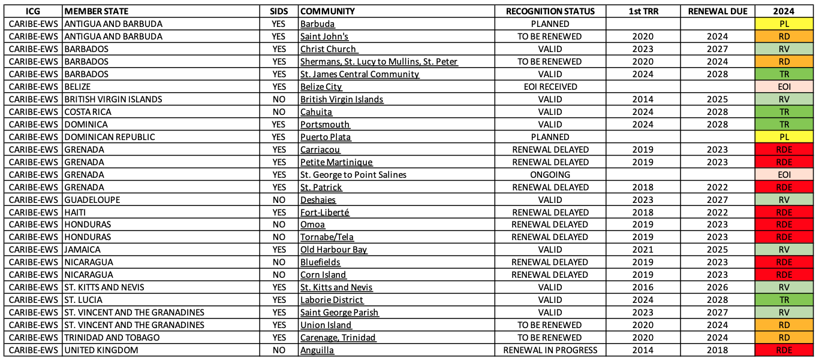
ICG/CARIBE-EWS Progress in TRRP
Antigua and Barbuda (1)
Barbados (3)
British Virgin Islands (1)
Costa Rica (1)
Dominica (1)
France-Guadaloupe (1)
Grenada (3)
Haiti (1)
Honduras (2)
Jamaica (1)
Nicaragua (2)
Saint Kitts and Nevis (1)
Saint Lucia (1)
St. Vincent and Grenadines (2)
Trinidad and Tobago (1)
United Kingdom – Anguilla (1)

