Slide 1






Resp-3: Redundant and reliable means to timely receive 24-hour official tsunami alerts are in place
Alessandro Amato
National Institute of Geophysics and Volcanology (INGV)
ICG / NEAMTWS
UNESCO-IOC EU DG ECHO CoastWAVE 2.0 Project
UNESCO-IOC Regional Tsunami Ready Recognition Programme (TRRP) Training
Online, January 14-15, 2025

Slide 2
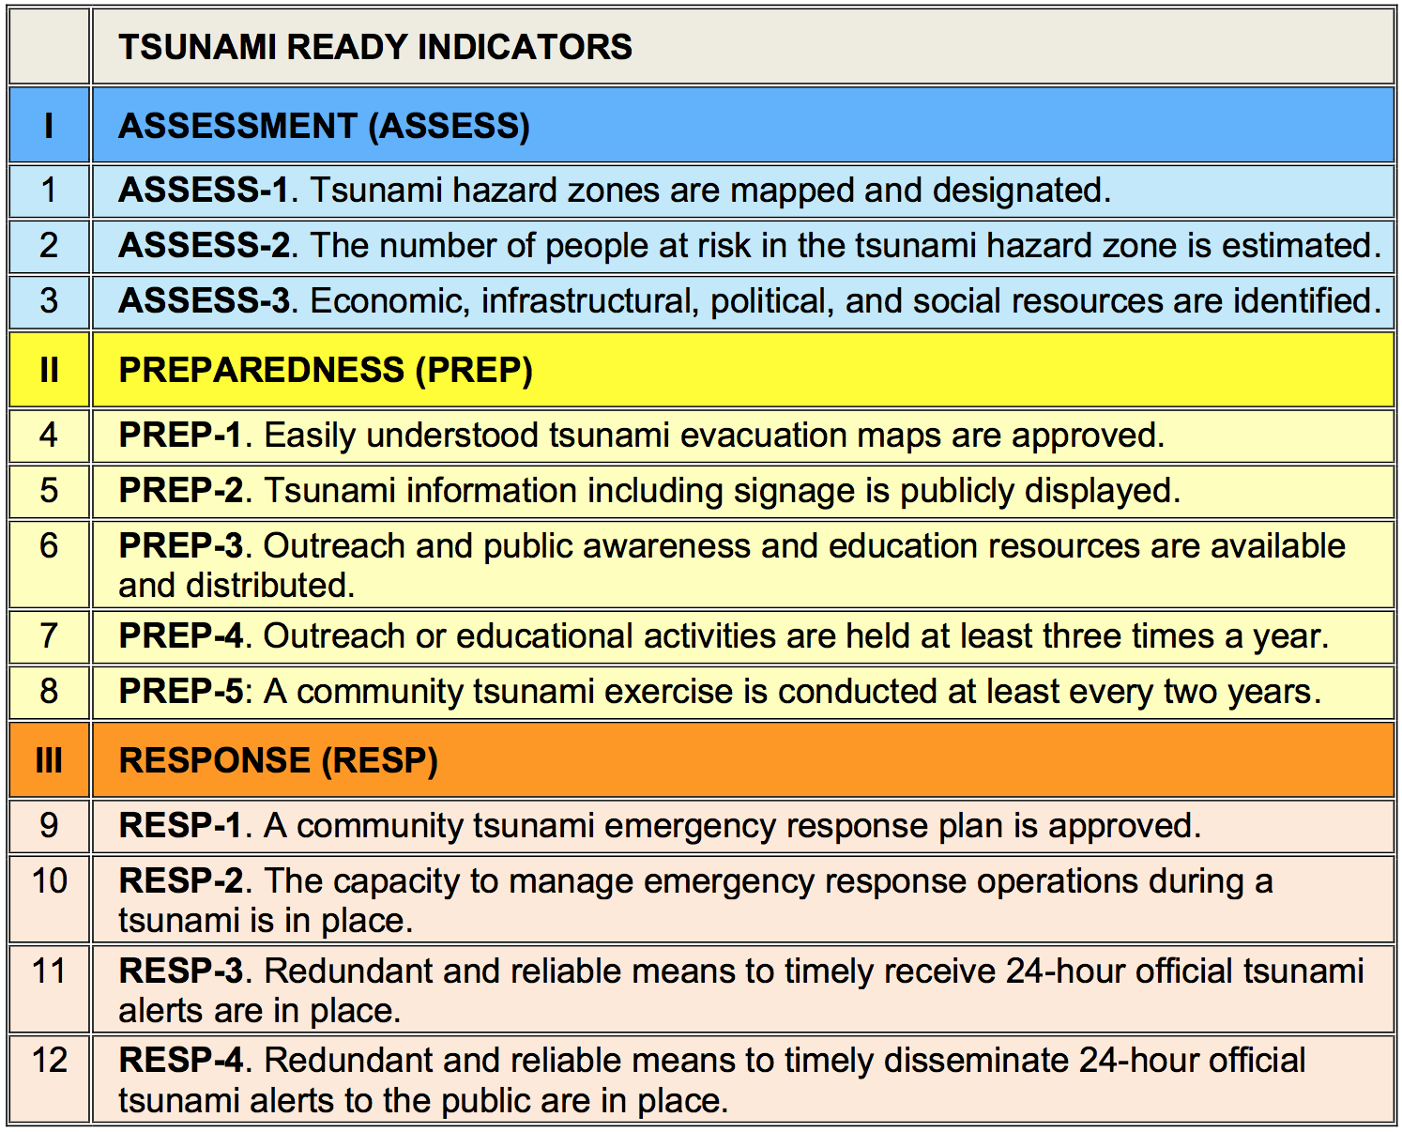
UNESCO-IOC Regional Tsunami Ready Recognition Programme (TRRP) Training
LAST
BUT
NOT
LEAST
!!!

Slide 3
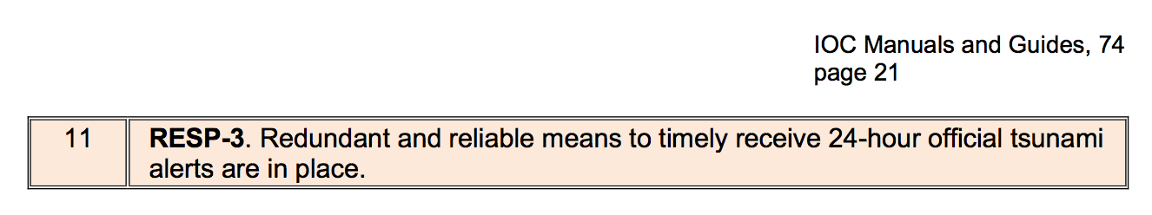
UNESCO-IOC Regional Tsunami Ready Recognition Programme (TRRP) Training
The community should be able to receive tsunami threat notifications at any time (24-hour) from the NTWCs and/or the Emergency or Disaster Management Office, or other officially recognized alerting authorities such as local emergency management agencies. Notifications must be able to reach the 24-hour receipt point by at least three of the following methods:

Slide 4
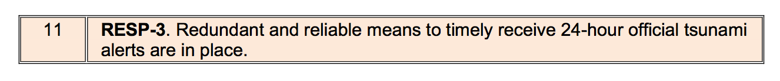
UNESCO-IOC Regional Tsunami Ready Recognition Programme (TRRP) Training
Public Alert Radio Systems, like Radio Digital Signals (RDS).
National/Territorial warning call-out tree system (documented in writing with backup indicated).
Instant messaging programmes available via the Internet used by operational personnel to share critical warning decision expertise and other significant information.

Slide 5
UNESCO-IOC Regional Tsunami Ready Recognition Programme (TRRP) Training
Amateur Radio transceiver: Potential communications directly to NTWC or TWFP or Emergency or Disaster Management Office or other official alerting authority.
Through a third-party provider: Typically received via phone, email and/or a texting service to a smartphone, tablet, or computer.
Local Radio: Emergency Alert System (EAS).
Active Internet monitoring capability, including social media such as Facebook, Twitter, WhatsApp, Viber, Signal, others.

Slide 6
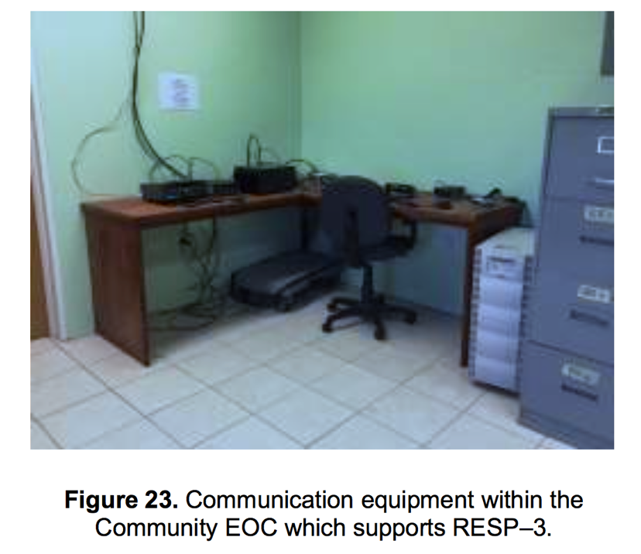
UNESCO-IOC Regional Tsunami Ready Recognition Programme (TRRP) Training
Example from IOC Manuals and Guides, 74. Paris, April 2022 (not very clear…)

Slide 7
UNESCO-IOC Regional Tsunami Ready Recognition Programme (TRRP) Training
Direct email from NTWC, TWFP and/or Disaster Management Office.
Direct fax from NTWC, TWFP and/or Disaster Management Office (in the process of being abandoned).
Text message, direct pager or social media message from NTWC, TWFP and/or Disaster Management Office.
Coast Guard (CG) or other maritime agency official broadcasts: warning point monitoring of CG marine channels.

Slide 8
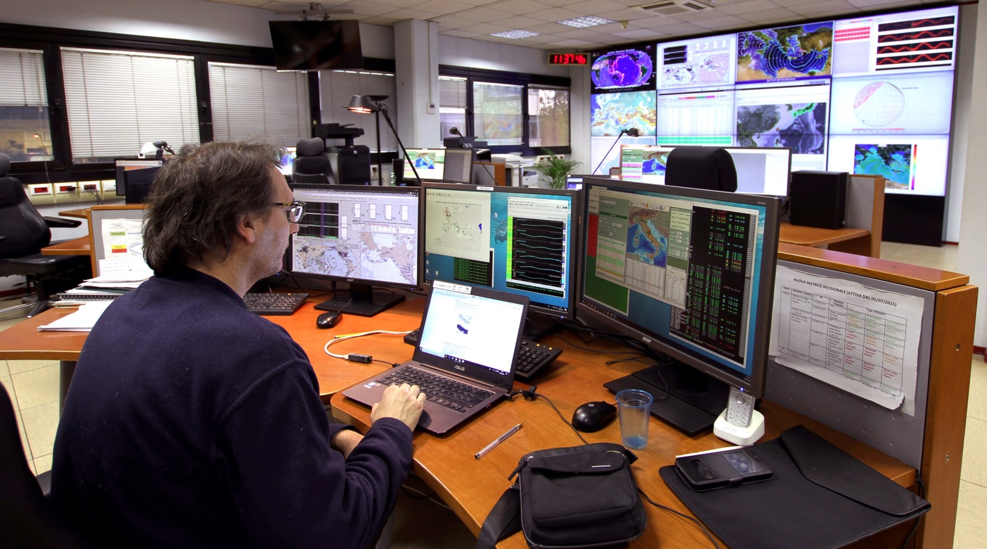
UNESCO-IOC Regional Tsunami Ready Recognition Programme (TRRP) Training

Slide 9
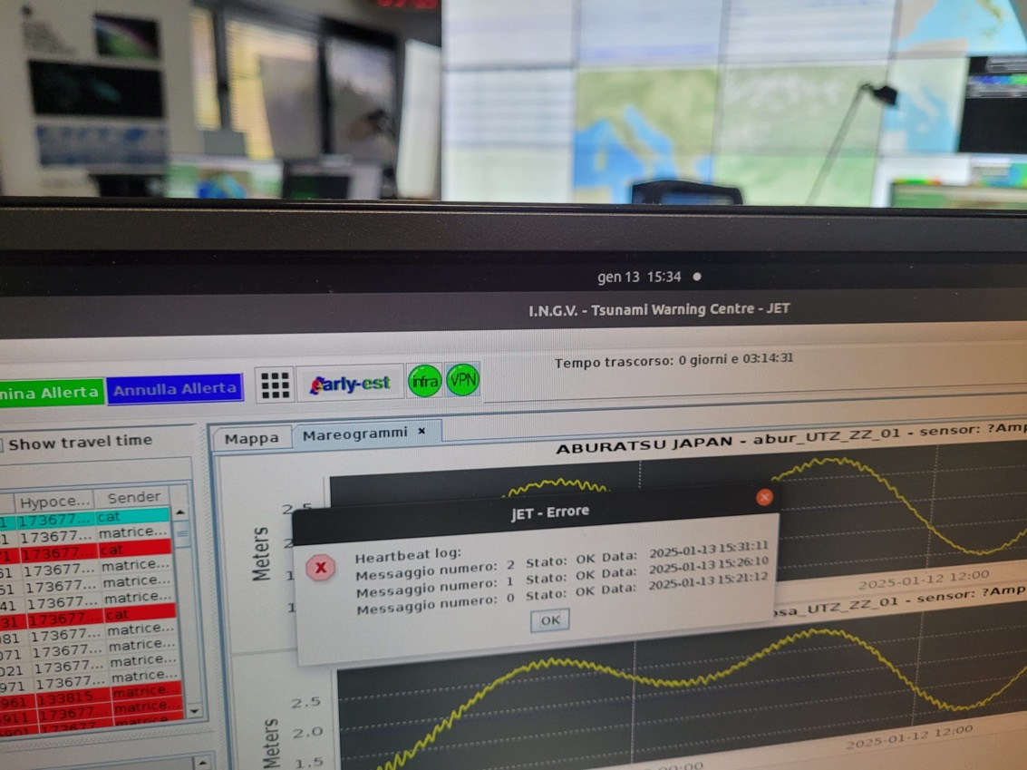
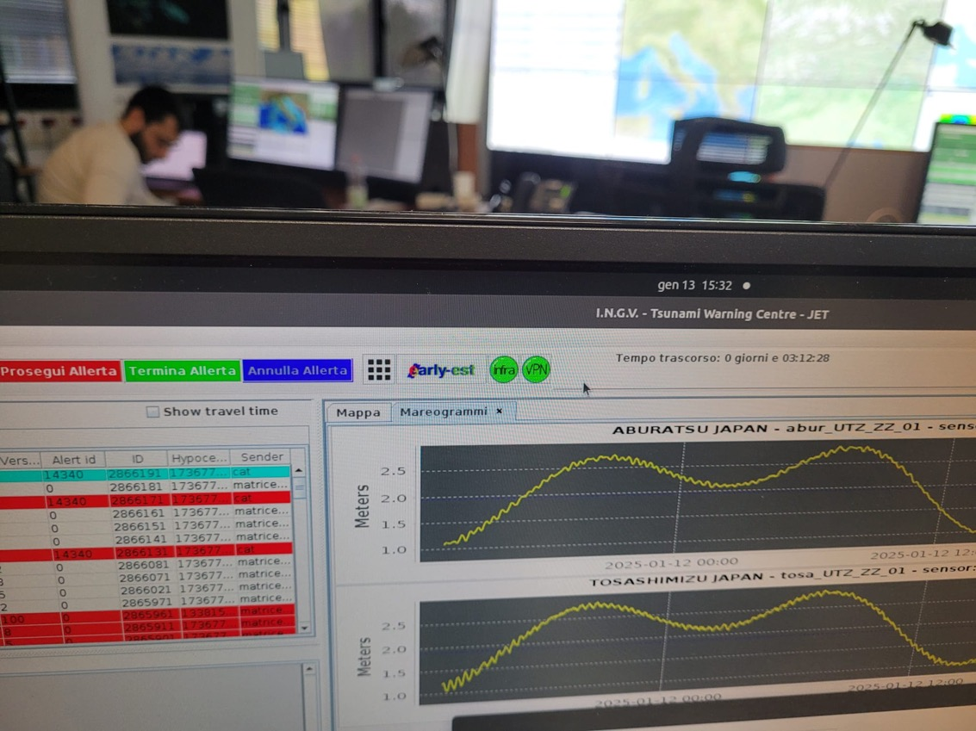
UNESCO-IOC Regional Tsunami Ready Recognition Programme (TRRP) Training
Warning (and test) messages are sent from the INGV TSP to the DPC using several channels.
The most rapid and safer are two parallel private connections (infranet and VPN, green/red buttons).
Every 5 minutes the two connections are tested and a message delivered (heartbit). If there is a failure the GREEN button turns to RED.
Operators on duty call the DPC monitoring room and the IT people on-call for checking and repair.

Slide 10
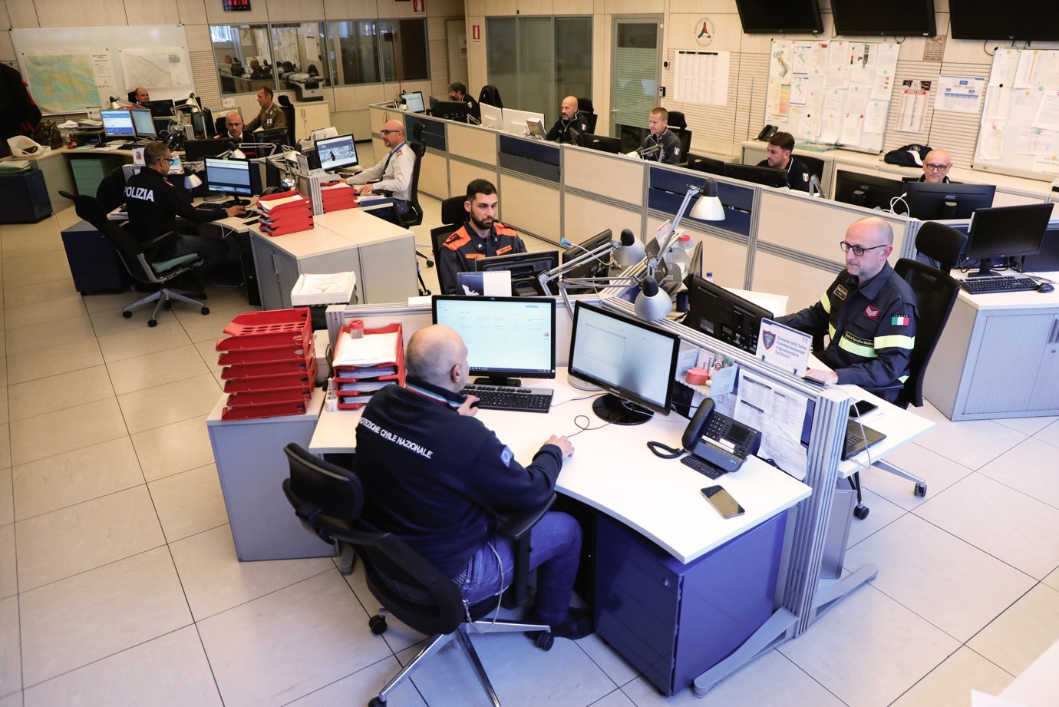
UNESCO-IOC Regional Tsunami Ready Recognition Programme (TRRP) Training
DPC Italy Situation Room

Slide 11
UNESCO-IOC Regional Tsunami Ready Recognition Programme (TRRP) Training
Alert message distribution in Italy
Given the limited time frame for the propagation of a tsunami wave in the Mediterranean Sea, alert issuing requires the use of a centralized system, linked with CAT-INGV, capable of simultaneously activating all those involved.
▪ For this purpose, a specific Technology Platform for Alert distribution was developed to send tsunami alert messages using two channels: email, SMS. It distributes them to the SNPC articulations (Annex 2-Indications) to the addresses of the centralized registry (ANCE) updated by the contact person of each institution.
▪ The entities receiving the message, through their activities and responsibilities, complete the warning chain by fielding all actions within their competence to reach the territorial level closest to the potentially affected coast.
▪ Citizen alert carried out by the coastal municipality through appropriate tools and channels also redonant (e.g. sirens, panels, emails, SMS, apps...).

Slide 12
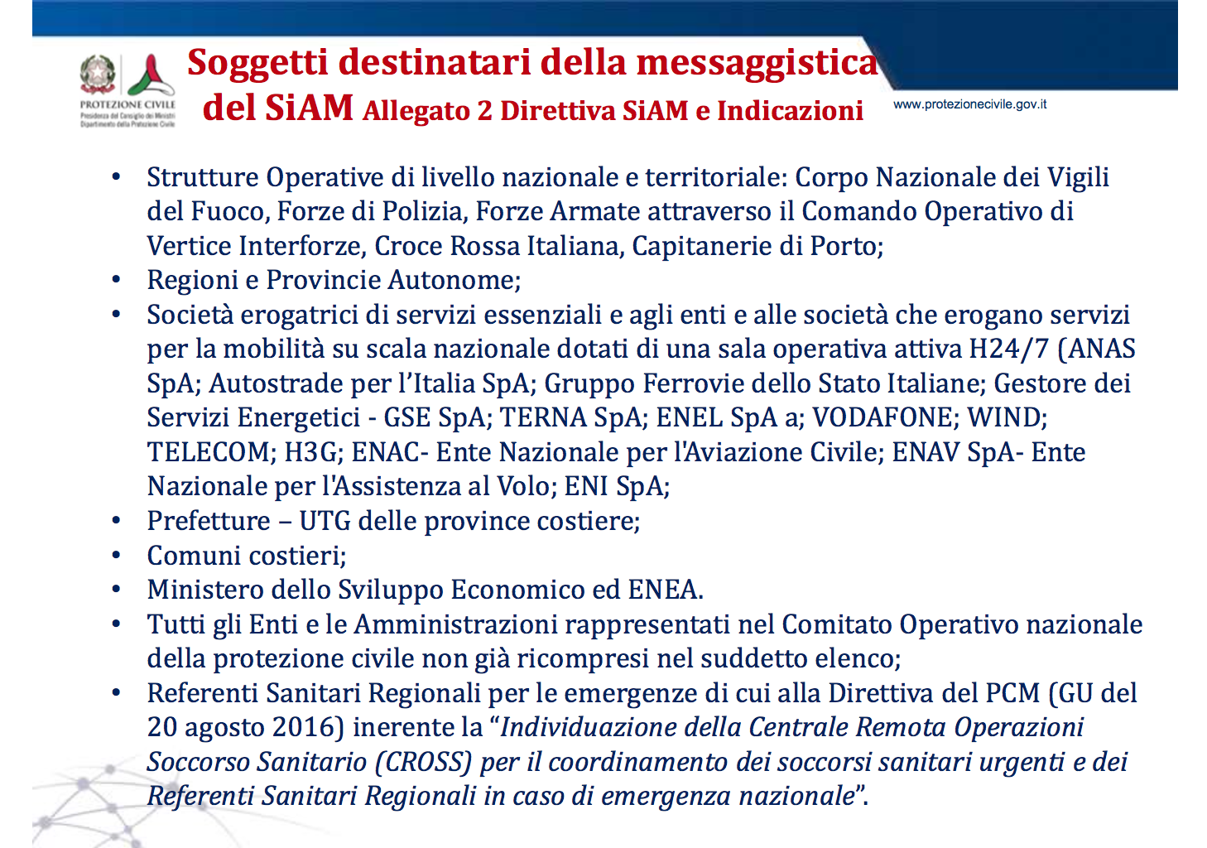
UNESCO-IOC Regional Tsunami Ready Recognition Programme (TRRP) Training
Messages are sent by DPC to all authorities at regional and local level, including about 1,600 coastal municipalities, etc.

Slide 13
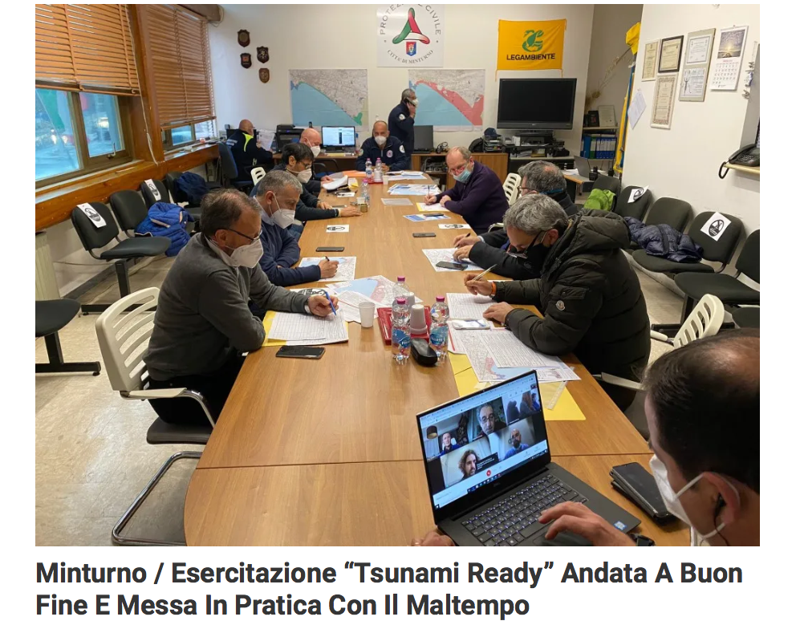
UNESCO-IOC Regional Tsunami Ready Recognition Programme (TRRP) Training
Monitoring Room of the Minturno municipality
during a NEAMWave exercise
Receiving (test) messages through different channels
Situation awareness
Connecting with national/regional CP authorities and experts
Decision making
IMPORTANCE OF EXERCISES

Slide 14
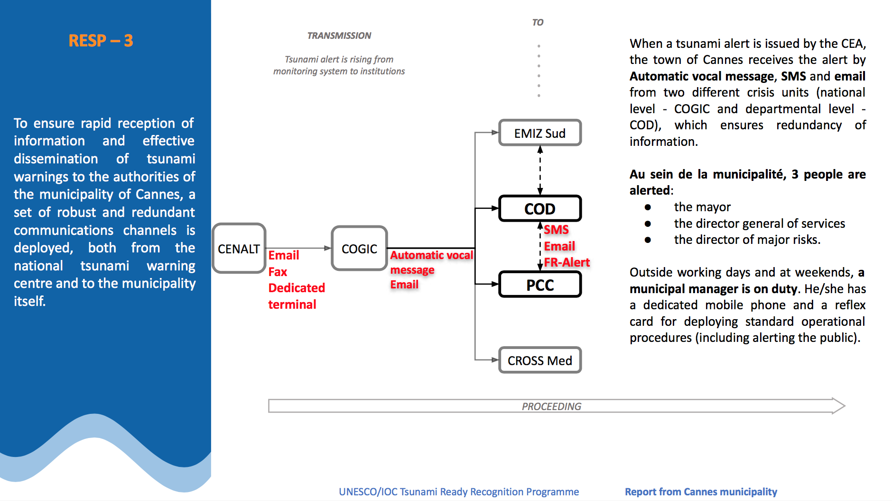
UNESCO-IOC Regional Tsunami Ready Recognition Programme (TRRP) Training
Cannes (France)
TRRP
2024
https://tsunami.ioc.unesco.org/en/tsunami-ready/fr/cannes

Slide 15
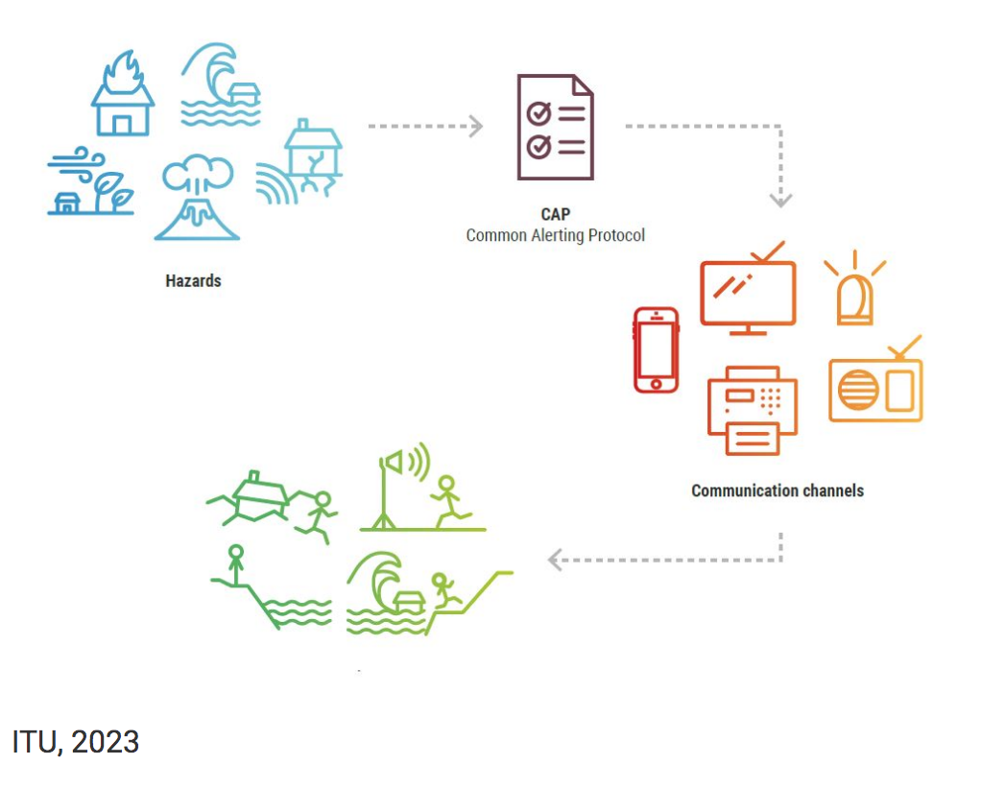
UNESCO-IOC Regional Tsunami Ready Recognition Programme (TRRP) Training
The Common Alerting Protocol (CAP) The international standard format for emergency alerting
What is the CAP?
Alerting authorities use numerous standards and protocols to transmit warnings.
The Common Alerting Protocol (CAP) is the international standard format for emergency alerting and public warning. It has been developed by the Organization for the Advancement of Structures Information Standards and adopted by the International Telecommunication Union (ITU).
It is designed for all hazards – weather events, earthquakes, tsunamis, volcanoes, public health crises, power outages and other types of emergencies.
ITU, 2023

Slide 16
UNESCO-IOC Regional Tsunami Ready Recognition Programme (TRRP) Training
What are the benefits of a CAP?
When an emergency is extensive, it is common to have overlapping jurisdictions, and different authorities might issue more alerts as the emergency evolves. The use of CAP by all alerting authorities to communicate key facts as the emergency unfolds helps to ensure key facts are communicated coherently. This applies to private communications among alerting authorities and affiliates, as well as public messaging.
“Sending the same alerting message over multiple platforms increases coverage and impact and enhances trust in alerting services”
Another benefit of CAP is that the process of issuing warnings is quicker and easier than some other methods. Alerting authorities without CAP issue alerts by, for example, making phone calls, sending emails and posting on online media. Those activities consume valuable time, distracting from the mission of composing accurate and actionable alerts. With CAP, a single message disseminates quickly over multiple alerting methods. For reaching people in harm’s way, CAP is the fastest and least error-prone way to disseminate emergency alerts.

Slide 17
UNESCO-IOC Regional Tsunami Ready Recognition Programme (TRRP) Training
In conclusion:
Redundancy in exchanging messages is fundamental
Most used channels are EMAIL, SMS, FAX (no longer), PHONE CALLS, AUTOMATIC VOCAL MESSAGES, DIRECT CONNECTIONS
Automatic procedures allow more rapidity
CAP (Common Alerting Protocol) is suggested for its characteristics (rapidity, multiple delivery, etc.)

Slide 18
Resp-4: Redundant and reliable means to timely disseminate 24-hour official tsunami alerts to the public are in place
Luigi D’Angelo
National Civil Protection Department, Italy (DPC)
UNESCO-IOC EU DG ECHO CoastWAVE 2.0 Project
UNESCO-IOC Regional Tsunami Ready Recognition Programme (TRRP) Training
Online, January 14-15, 2025

Slide 19
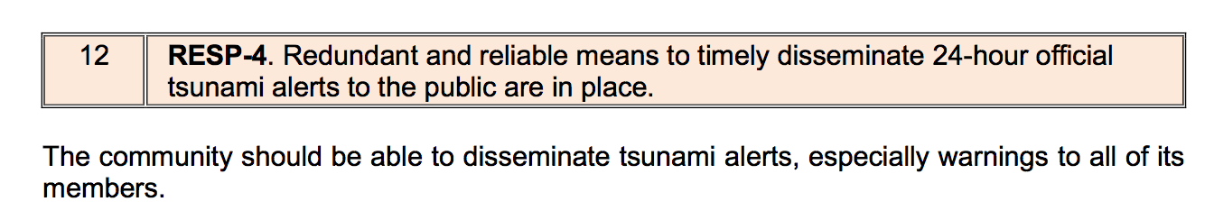
UNESCO-IOC Regional Tsunami Ready Recognition Programme (TRRP) Training
Alerts must be able to be disseminated at any time of the day from the warning point (24-hour) and/or EOC through at least three of the following methods:

Slide 20
UNESCO-IOC Regional Tsunami Ready Recognition Programme (TRRP) Training
Country EAS message initiation and broadcast.
Public/private television and audio/video overrides (broadcast of ‘breaking news’).
Local flood warning systems ideally with no single point of failure.

Slide 21
UNESCO-IOC Regional Tsunami Ready Recognition Programme (TRRP) Training
Audible alerts, such as outdoor warning sirens, siren/megaphone mounted on emergency vehicles, school or church bells or mosque loudspeakers, village ‘bells’ (old propane tank hung from tree hit with metal rod).
Visual alerts, such as roadway signs (electronic billboards), flags or banners (colour-coded or with specific symbology).
Local pager/texting system.
Other local alert broadcast system.

Slide 22
UNESCO-IOC Regional Tsunami Ready Recognition Programme (TRRP) Training
Amateur radio operator network.
Telephone mass notification system (automatic dialing).
Call out tree.
Coordinated jurisdiction-wide radio network.
For counties, parishes, islands and boroughs, a countywide communications network that ensures the flow of information between all cities and towns within its borders, including acting as the surrogate warning point and/or EOC for communities without those capabilities.

Slide 23
UNESCO-IOC Regional Tsunami Ready Recognition Programme (TRRP) Training
Social media usage (Twitter, Facebook, WhatsApp, Viber, Signal, others.).
Water safety officials, such as lifeguards on beaches and on patrol.
Airborne notification, such as by low-flying airplanes equipped with speakers, and/or flags/banners flying pre-planned routes along coastlines.

Slide 24
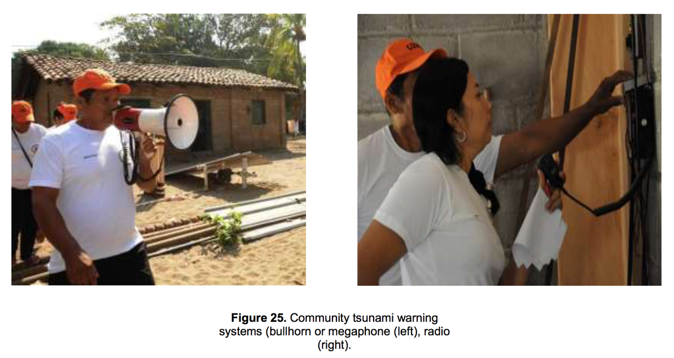
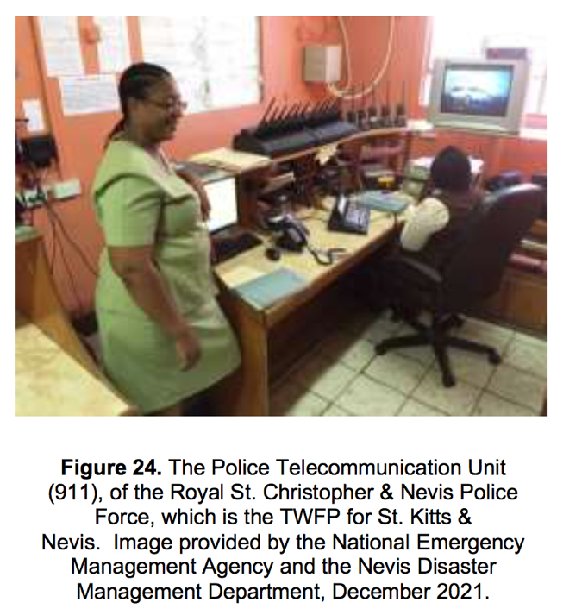
UNESCO-IOC Regional Tsunami Ready Recognition Programme (TRRP) Training

Slide 25
UNESCO-IOC Regional Tsunami Ready Recognition Programme (TRRP) Training
Samos-Greece
Tsunami Warning Messages distributed through email and 112, as part of the National SOP.

Slide 26
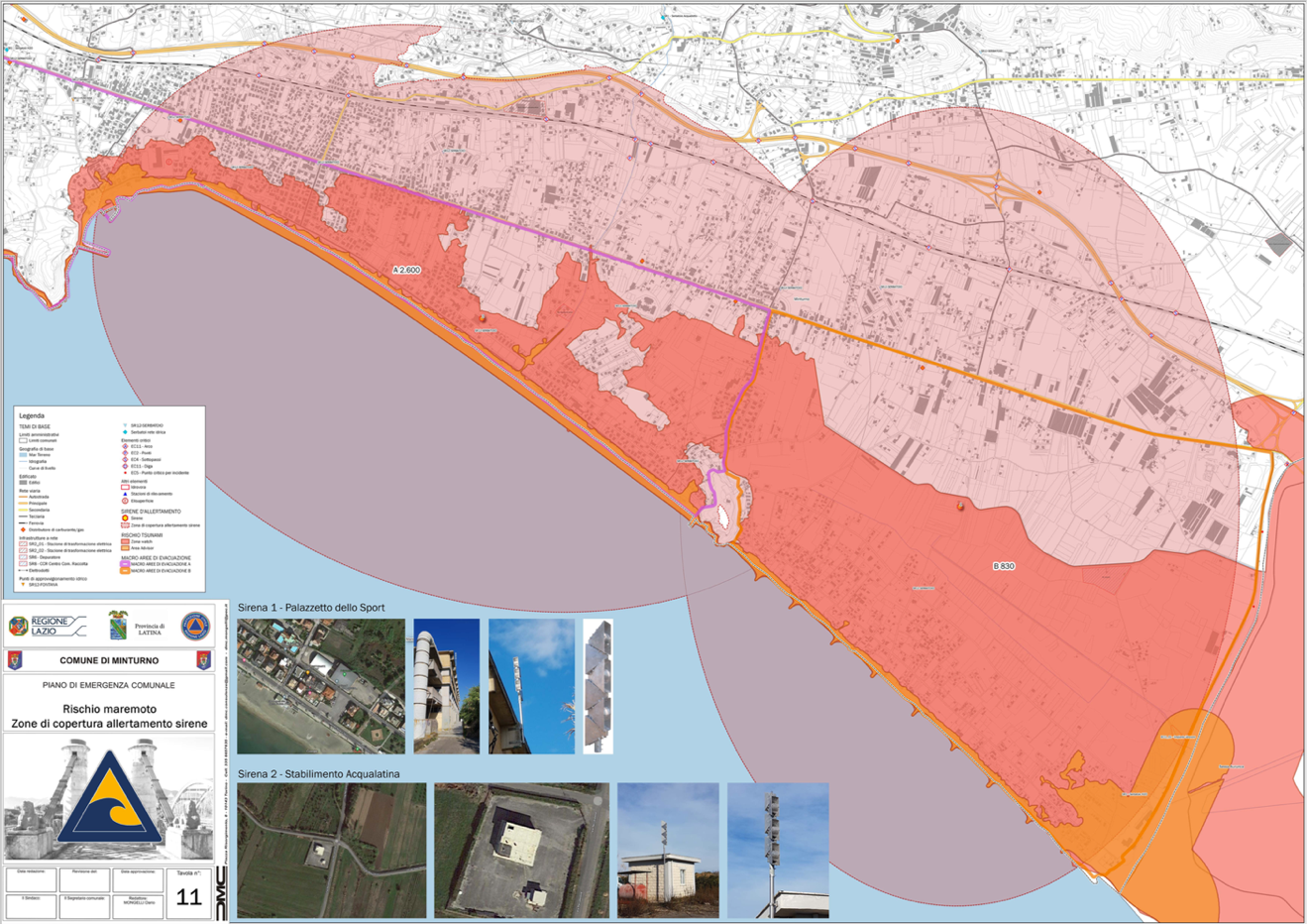
UNESCO-IOC Regional Tsunami Ready Recognition Programme (TRRP) Training
Some examples from Italy: Minturno (TR-2024) and Palmi (TR-candidate)

Slide 27
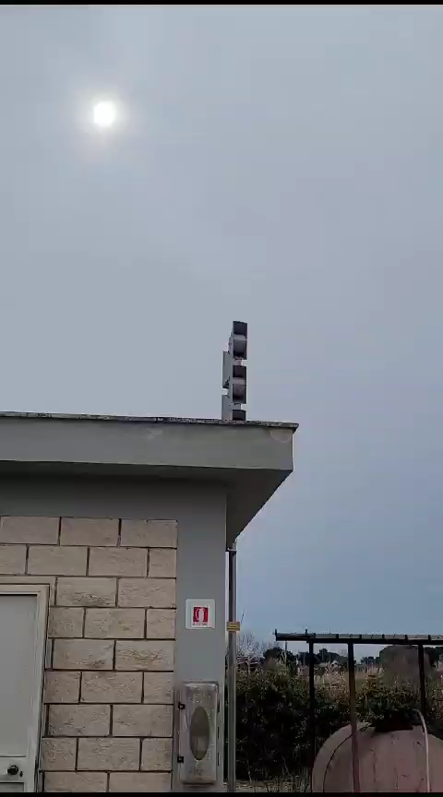
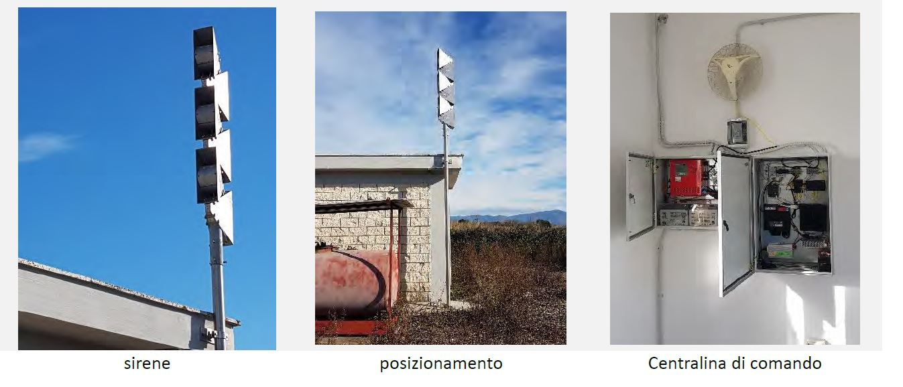
UNESCO-IOC Regional Tsunami Ready Recognition Programme (TRRP) Training
Minturno / Siren n. 1 /Acqualatina
The sirens can be activated either automatically or manually.
They can transmit both sounds and voice messages.

Slide 28
UNESCO-IOC Regional Tsunami Ready Recognition Programme (TRRP) Training
Palmi (Southern Calabria)
Moreover, the Palmi municipality has equipped itself with two variable message panels with traffic lights.

Slide 29
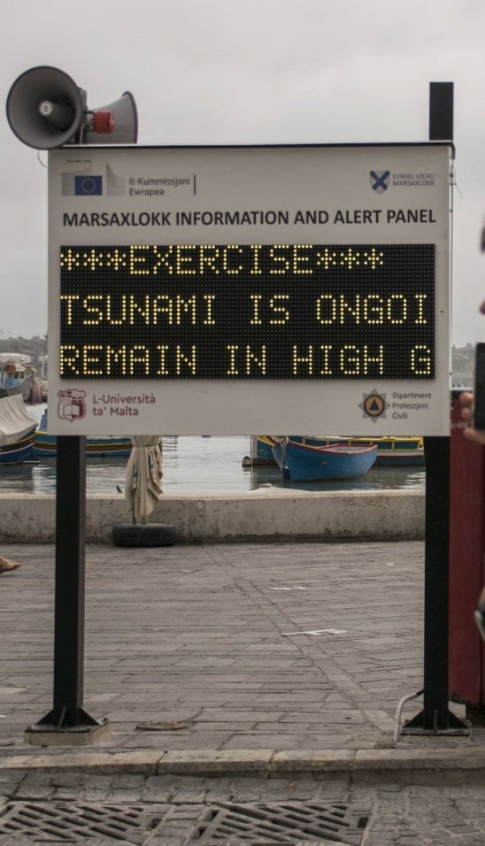
UNESCO-IOC Regional Tsunami Ready Recognition Programme (TRRP) Training
Marsaxlokk - Malta
A tsunami alert device comprises a panel equipped with data receivers, a display, a siren and a loudspeaker.

Slide 30
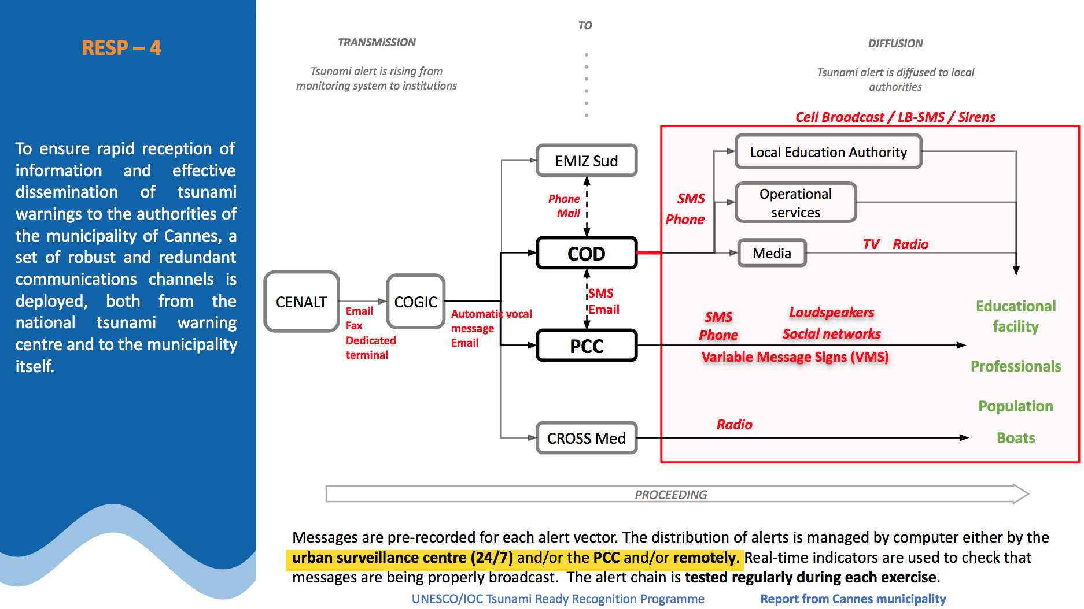
UNESCO-IOC Regional Tsunami Ready Recognition Programme (TRRP) Training
https://tsunami.ioc.unesco.org/en/tsunami-ready/fr/cannes

Slide 31
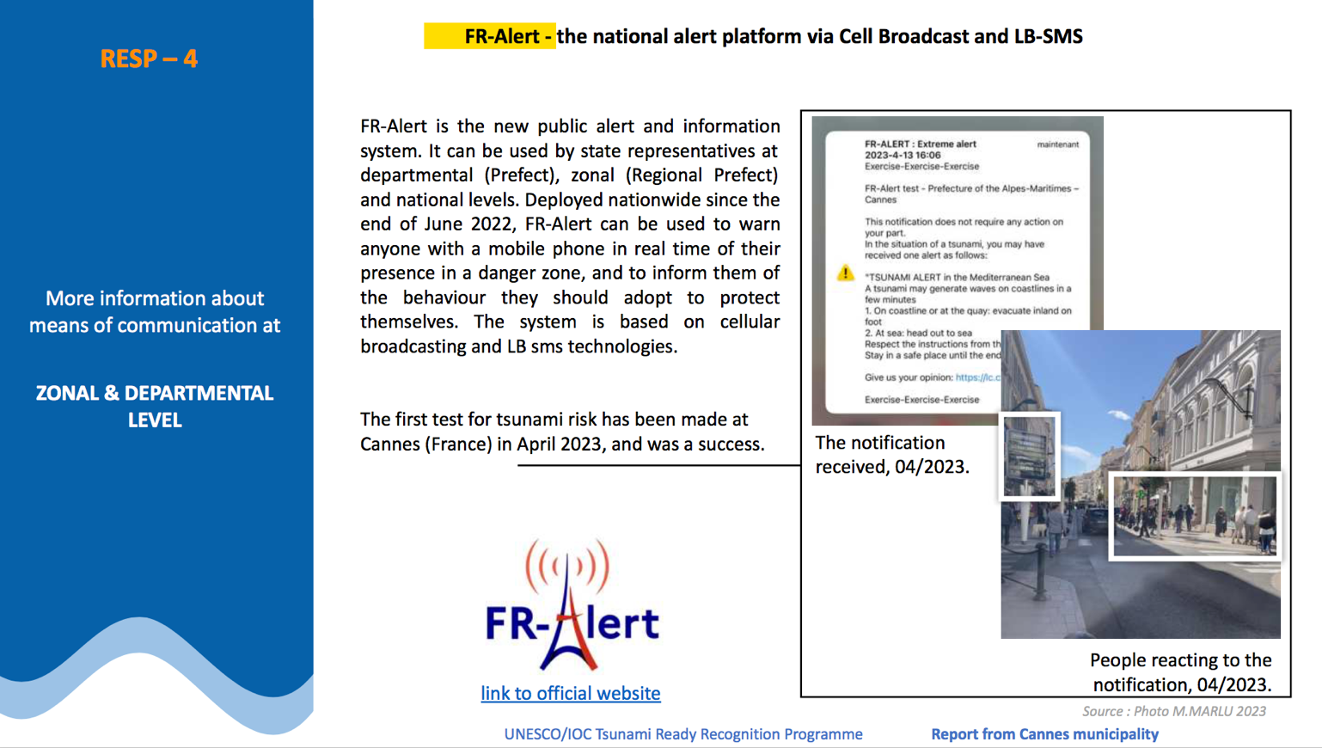
UNESCO-IOC Regional Tsunami Ready Recognition Programme (TRRP) Training
https://tsunami.ioc.unesco.org/en/tsunami-ready/fr/cannes

Slide 32
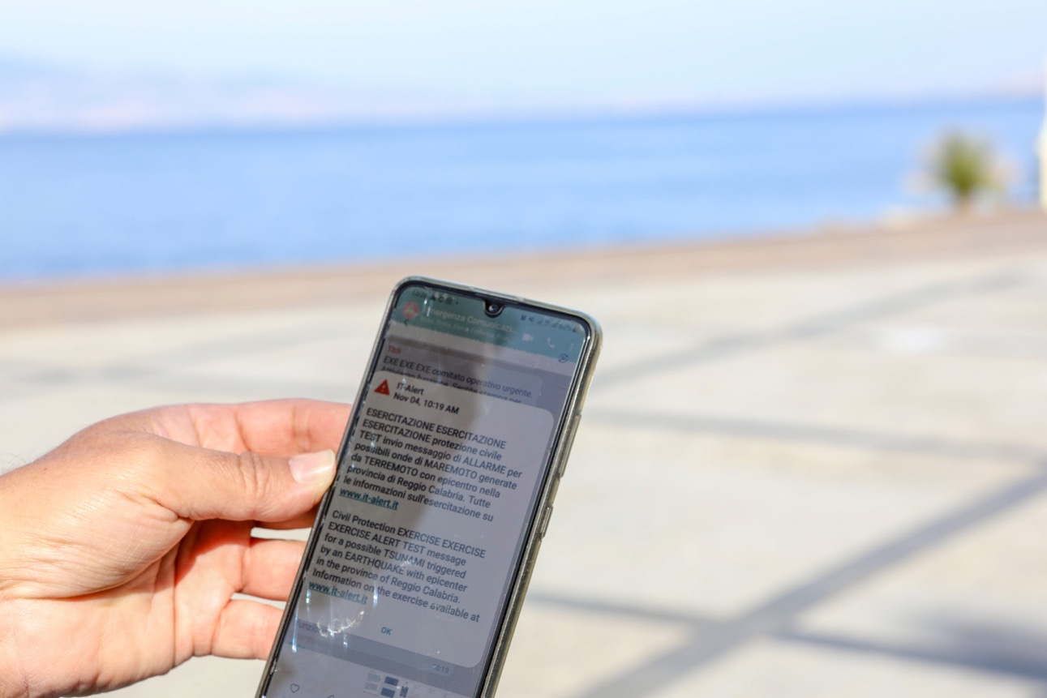
UNESCO-IOC Regional Tsunami Ready Recognition Programme (TRRP) Training
IT-Alert Cell. Broadcast system
Under test for tsunami risk
Other NEAM Member States have implemented or are testing the tool
ETSI TS 102 900 V1.2.1 (2012-01) “European Public Warning System (EU-Alert)

Slide 33
UNESCO
Intergovernmental Oceanographic Commission (IOC)
UNESCO-IOC DG ECHO CoastWAVE 2.0 project Tsunami Resilience Section

