Slide 1
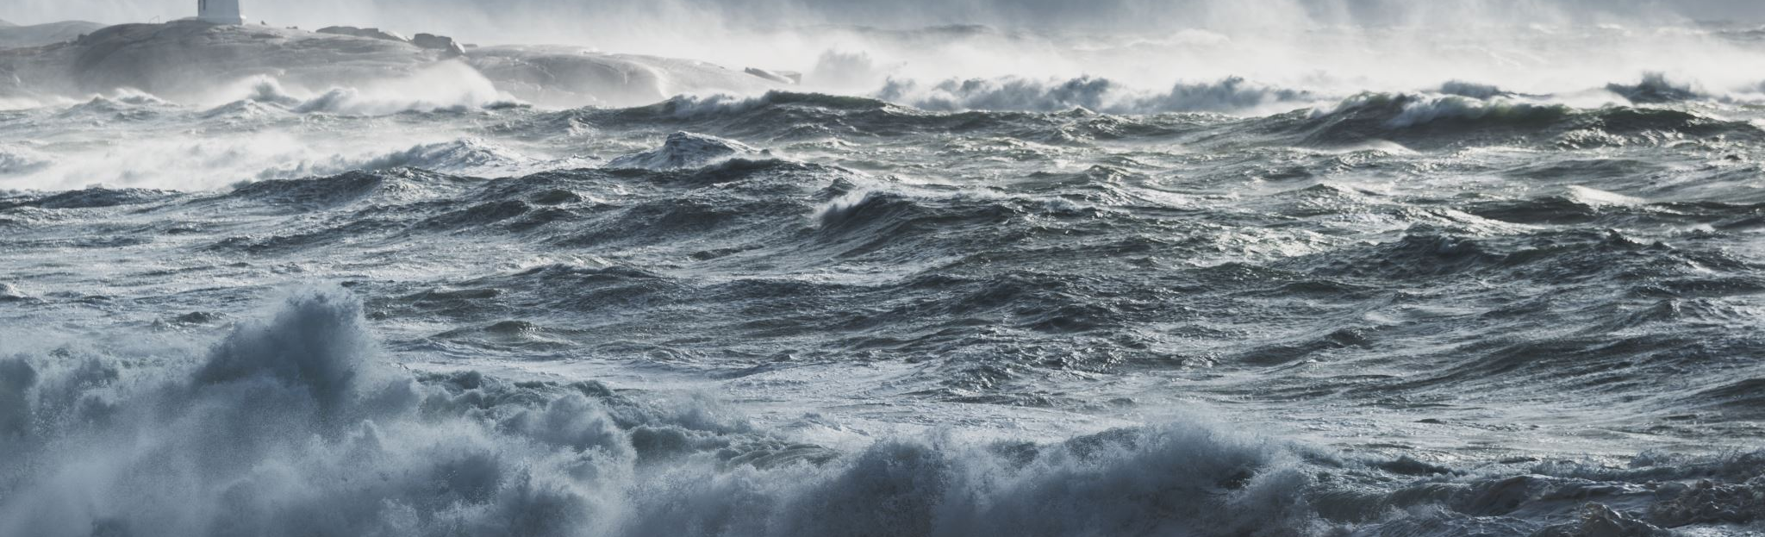

5th Meeting of the Ocean Decade Tsunami Programme Scientific Committee
16-17 January 2025
Ocean Decade Tsunami Programme (ODTP)
Monitoring and Tracking Tool
Tsunami Performance Monitoring & Tracking Tool?
Denis Chang Seng, PhD
Programme Specialist
Technical Secretary (ICG-NEAMTWS and TOWS TT DMP)
Focal Point TSR ODTP-ODTP-SC-OD
CoastWAVE Project
UNESCO -IOC

Slide 2
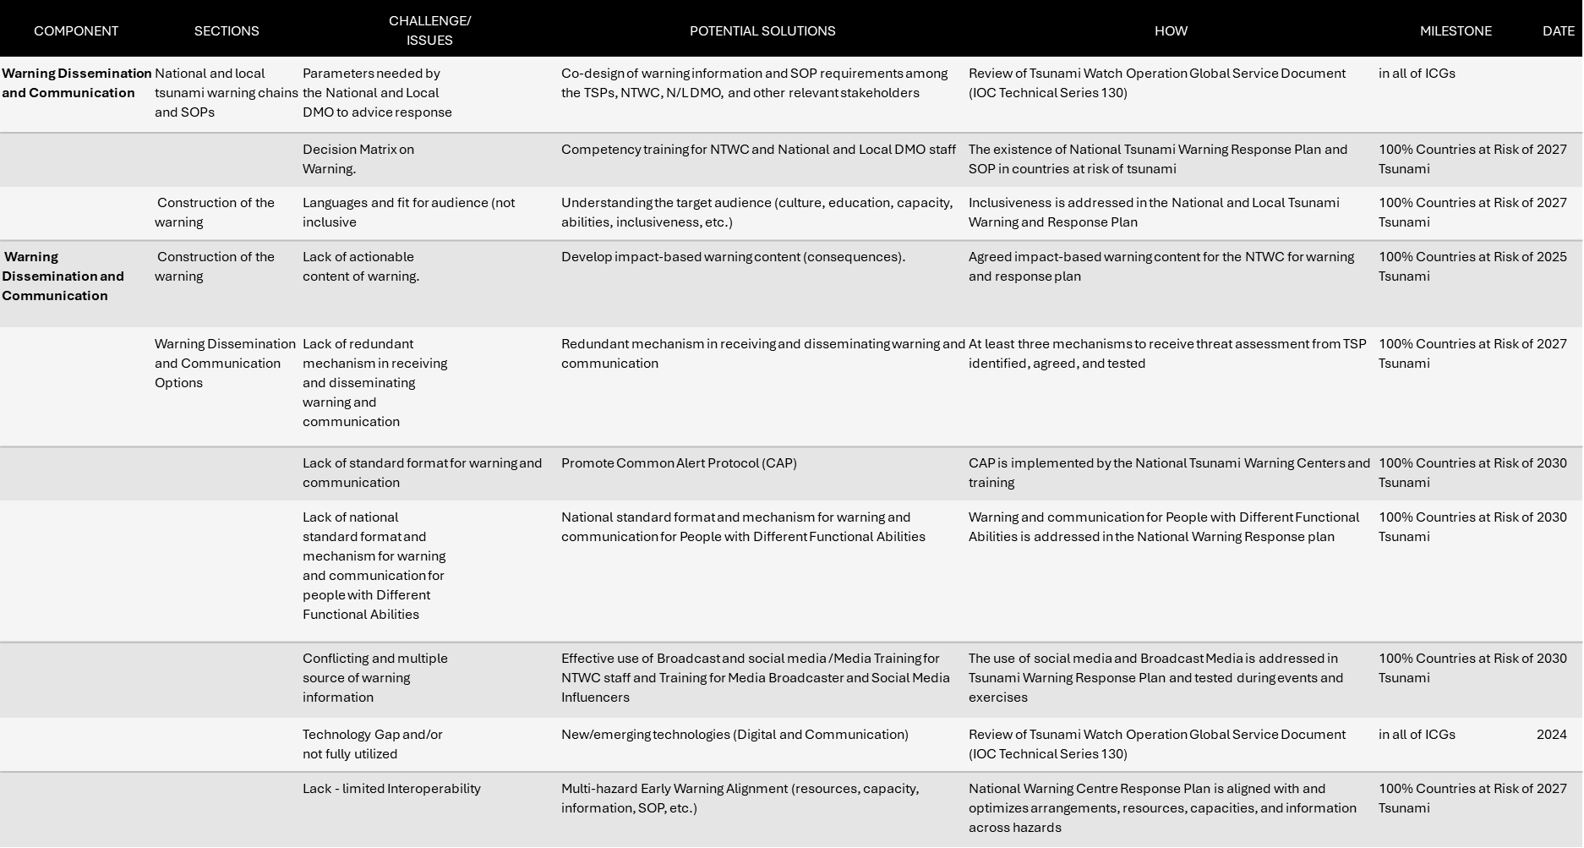
Ocean Decade Tsunami Programme (ODTP) Monitoring and Tracking Tool
Current situation?
Recalls that the appendices (Appendix 1-4, Pages 60-80) in the ODTP RDI (Aug 2023) was developed to guide the measurement/assessment of progress actions (ODTP-RDI).
Notes that no progress achieved to date in its implementation.
Further notes the TOWS TT DMP recommendation in Sendai, Japan, 19 - 20 February 2024
  Requests the TT TWO and TT DMP to develop KPIs for the relevant sections of the ODTP Research & Development Implementation Plan (RDIP) to monitor progress.
  Requests the Secretariat develop a reporting mechanism to allow ICGs to report progress on related projects within the Ocean Decade and against the ODTP RDIP KPIs, aligning this with the proposed Global KPI Framework for the UNESCO-IOC Tsunami Programme.

Slide 3

THINKING …
A closer analysis clearly indicated the need to further improve the ODTP RDI KPI to successfully report on the progress of the ODTP related actions.
There are other related KPI assessments e.g. Global Tsunami Performance Monitoring Framework - KPI, Vision 2030 White Paper etc.
How to bring new ideas and clarity to the methodology and process?

Slide 4


Key Issues & Challenges
SMART indicators( Specific, Measurable, Achievable, Relevant:
  Are they SMART indicators? Very technical in details designed by technical experts.
Level of detail/ granularity:
  Are there too many indicators and too granular?
Strategic fit /efficiency/seamless challenges:
  How can KPIs from one assessment framework be used efficiently and seamlessly, avoiding duplication in assessments and reporting efforts, especially important in a resource and staff constraint environment?

Slide 5
Ocean Decade Tsunami Programme
Monitoring and Tracking Tool
WHAT IT IS AND WHAT IT IS NOT ?
ODTP-RDI KPI (Two High Level Objectives)
Tsunami Programme (ICG/GTKPI)
The ODTP Monitoring and Tracking Tool to be applied only to endorsed Ocean Decade Actions relevant to the ODTP while the ICG/GTKPI is designed for the entire Tsunami Programme

Slide 6
Way Forward?
The TRS inspires to develop an Ocean Decade Tsunami Programme –Monitoring and Tracking Tool to better support implementation, tracking and monitoring of the ODTP. ODTP-Monitoring and Tracking Tool aligns
  Clear SMART (Specific, Measurable, Achievable, Relevant, and Time-bound) Actions
  Aligns with:
    future Global Key Performance Indicator (KPI) Framework spearheaded by the Pacific Tsunami Warning System with the aim of reporting to the Sendai Framework for Disaster Risk Reduction
    and facilitates the implementation of the Monitoring and Evaluation Framework of the United Nations Decade of Ocean Science for Sustainable Development 2021-2030

Slide 7

Way Forward (Con’t)
UNESCO-IOC/TSR invited written proposals from Individual Consultants to Support the Tsunami Resilience Section (TSR) to develop the Ocean Decade Tsunami Programme (ODTP) Monitoring and Tracking Tool
Only one application was received after extension and readvertising.
Evaluation found the application is not only unaffordable, but also focused on disaster response technological tools/platforms. Perhaps more useful for developing the ODTP RDI KPI survey platform at the final stages. Not a simple task?
TRS decided to develop the new ODTP-RDI KPI in house based on work already started.
A first meeting was organized with the participation of key TRS staff mid-December 2024

Slide 8

Way Forward (Con’t)
AIM: To develop Single Tsunami Performance M &T Tool. From this tool, users can choose ICG-KPIs and or ODTP-KPIs depending on application and use.
Proposed Approach
  ICG-KPI: The foundation to build the new Tsunami Performance Monitoring & Tracking Tool.
  ODTP-RDI-KPI: Align/mapping of ODTP-RDI Indicators onto the ICG-KPI.
  Others: Align/mapping other KPIs (e.g. Vision 2030 White Paper
Seamless connections- granular (ICG) operational technical level to macro-policy making level (OD/ Sendai, SDG) , ensuring efficiency while avoiding duplication in assessments and reporting.
STEP 2
STEP 1
Original ODTP-RDI-KPI
ICG-KPI
STEP 3
Other KPI Vision 2030
ICG-KPI
SFDRR-KPI
ODTP -KPI
OD-KPI
New ODTP RDI KPI for M & T

Slide 9
Ongoing Work
First proposal was shared with secretariat team (Technical Secretaries and Head of Section, Associate Project Officer) before Christmas
Main tasks : Align and mapping of indicators. Eliminate duplication of indicators, add any missing indicators
Feedbacks have been received and under consideration/ implementation.
One to one online meeting.

Slide 10
Work Plan
16–17 Jan 2025
Feedbacks/inputs from 5th ODTP-SC
20–22 Feb 2025
Feedbacks/inputs from TOWS-WG TTs meetings
Mar–Apr. 2025
First final draft + supporting documentation
Aug–Sep. 2025
Online Feedbacks/ inputs
Oct 2025
Develop online platform tool(Consultant)
Nov 2025
Test

Slide 11
Key Questions
Operational/Practical
Who to complete the surveys (ICG and ODTP), noting that ODTP actions may also be the addressed under ICG-KPI [TNCs, Action Leads?].
Information meetings required before rolling out tool?
What is the expected time frame to operationalize the M & T Tool (Jan 2026?). NB:-The OD M &T takes place every year in the first semester.
ODTP-RDI KPI (Two High Level Objectives)
Tsunami Programme (ICG/GTKPI)

Slide 12
Questions (Con’t)
Strategic
How can TSR effectively and sustainably manage such a tool to ensure standardization/alignment with best practices for KPIs and performance measures ( data collection, analysis, knowledge information, dissemination, review, and continuous adaptation?
What strategies and resource planning approaches can be employed to coordinate and manage additional layers of performance monitoring and tracking, considering the current heavy workload of TRRP and its increasing demands?

Slide 13
Contributions and Thanks
  Srinivas Kumar, Ocal Necmioglu, Bernardo Aliaga & Derya Vennin
END

