Slide 1



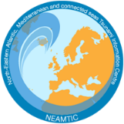
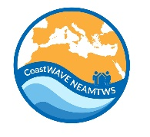

Prep-3: Outreach and public awareness and education resources are available and distributed.
Raluca Partheniu
National Institute for Earth Physics (INFP)
UNESCO-IOC EU DG ECHO CoastWAVE 2.0 Project
UNESCO-IOC Regional Tsunami Ready Training for North-eastern, Atlantic and connected Seas Region Online, January 14-15, 2024

Slide 2
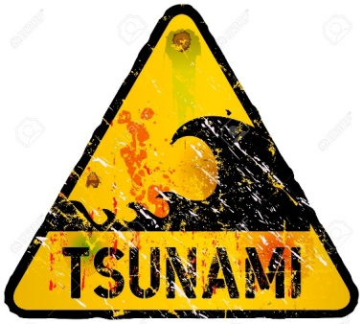
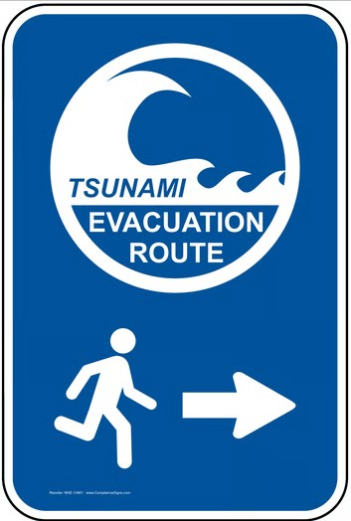
UNESCO-IOC Regional Tsunami Ready Training for North-eastern, Atlantic and connected Seas Region
The Tsunami Ready (TR) Recognition Program includes three indicators: ASSESSMENT (ASSESS), PREPAREDNESS (PREP) and RESPONSE (RESP).
The PREPAREDNESS Section has to follow 5 indicators, among which the 3rd one is OUTREACH AND PUBLIC AWARENESS AND EDUCATION RESOURCES ARE AVAILABLE AND DISTRIBUTED.
Tsunami materials include different types of information, in order to fulfill all necessities of the wide public, as follows: TSUNAMI EVACUATION MAPS, EVACUATION ROUTES, SAFETY TIPS and information regarding WARNINGS - WHEN AND HOW TO RESPOND, being structured to meet local needs, based on particular tsunami threats.
Tsunami Materials are structured as:
Tsunami Evacuation Maps -> Comprehensive mapping tailored to local needs.
Evacuation Routes -> Clearly marked and easy-to-follow pathways.
Safety Tips -> Practical advice for staying safe during a tsunami.
Warnings: When and How to Respond -> Structured guidance based on location-specific tsunami threats.
Outreach d public awareness and education

Slide 3
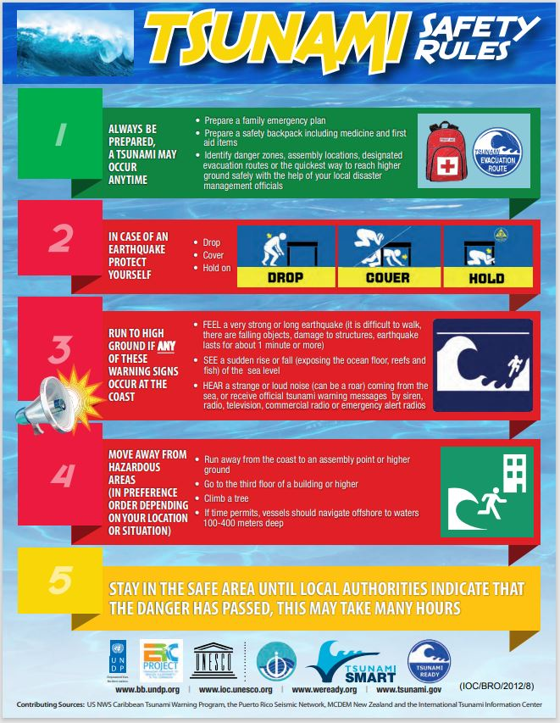
UNESCO-IOC Regional Tsunami Ready Training for North-eastern, Atlantic and connected Seas Region
Outreach d public awareness and education
Schools within the community requesting recognition of TR should receive copies of
all materials.
Materials distribution through three or more wide-reaching methods:
Brochures / flyers at public venues and/or bulk mailed to local residents and
businesses
Newspaper, local radio and television
Public utility/service industry bill safety notices
Historical markers and interpretative signs
Billboard, roadside, highway or educational signs
Local faith-based and civic organization bulletins/mailings
Informational or safety videos and public service announcements (voice, video)
Websites/social media and bulk email.

Slide 4
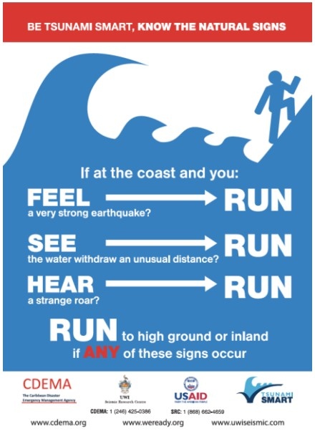
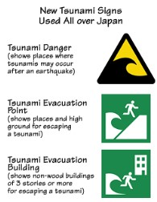
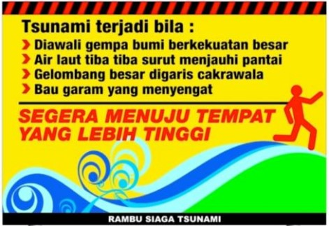
UNESCO-IOC Regional Tsunami Ready Training for North-eastern, Atlantic and connected Seas Region
Different locations for materials distribution:
Visitor Centers, local tourist businesses (e.g. restaurants, bars)
Schools
Hotels, motels and campgrounds
Public libraries
Community and recreation Centers
Banks and Utility companies
Childcare and health Centers
Kiosks or information Centers (e.g. malls, stores, etc.)
Transportation Centers (bus, train, transit stops or central stations)
Ports of entry (airports, harbors).
Tsunami sign in Bali, Indonesia
Tsunami signs in Japan
Tsunami Natural Warning signs (as flyers,
magnets, beverage coasters or others)

Slide 5
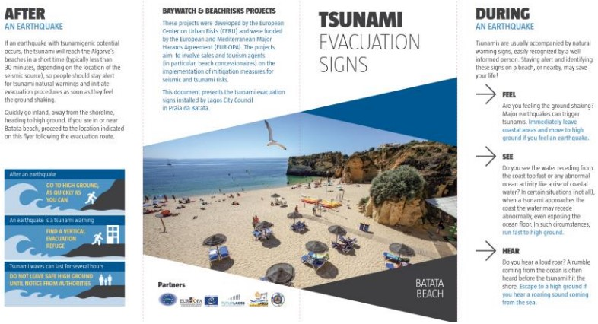
UNESCO-IOC Regional Tsunami Ready Training for North-eastern, Atlantic and connected Seas Region
Tsunami Leaflet Lagos, Portugal

Slide 6
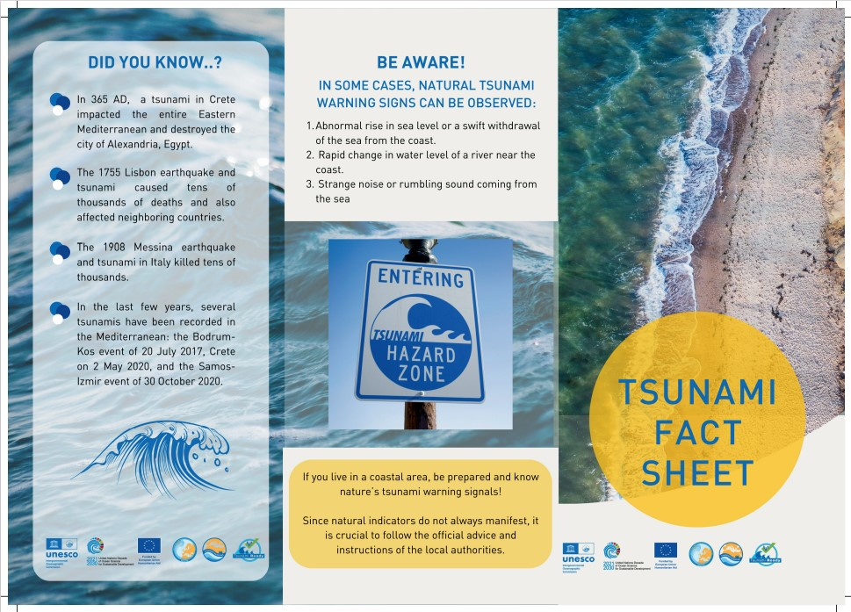
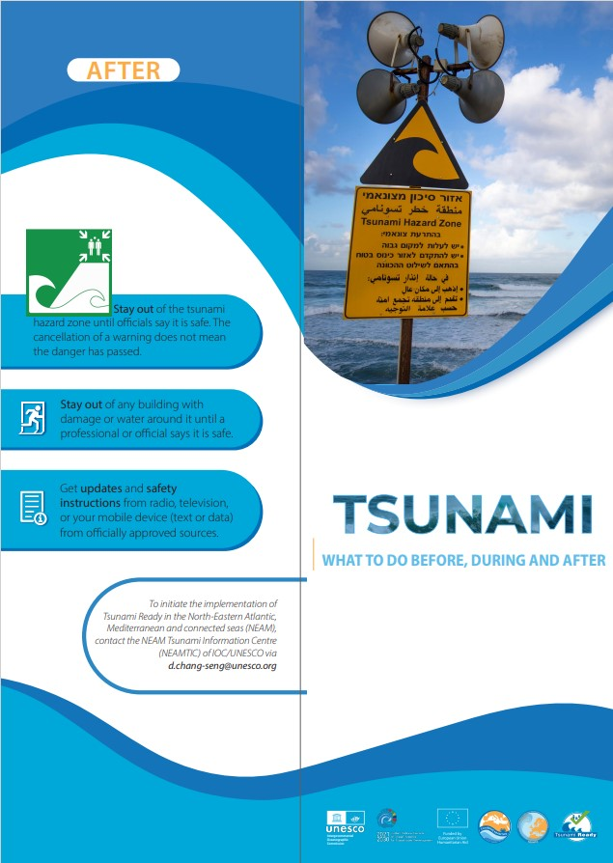
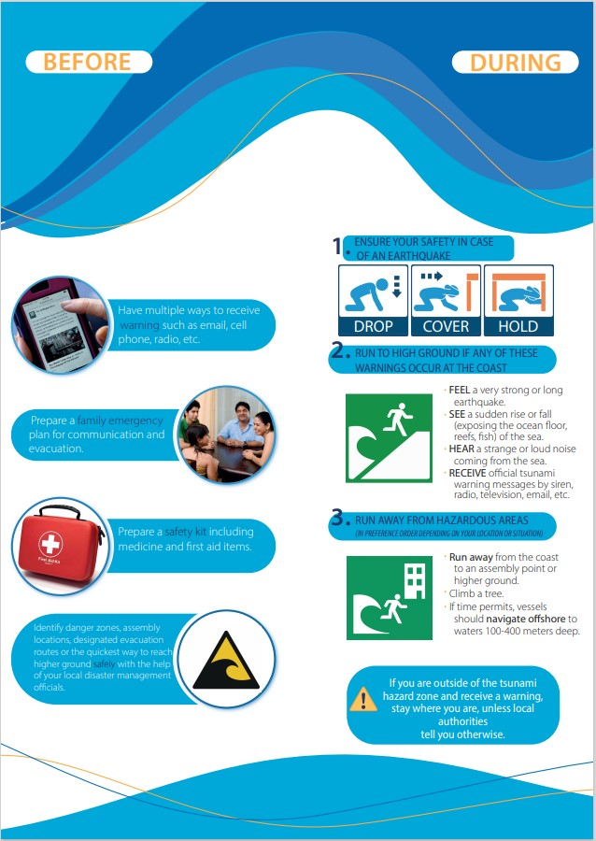
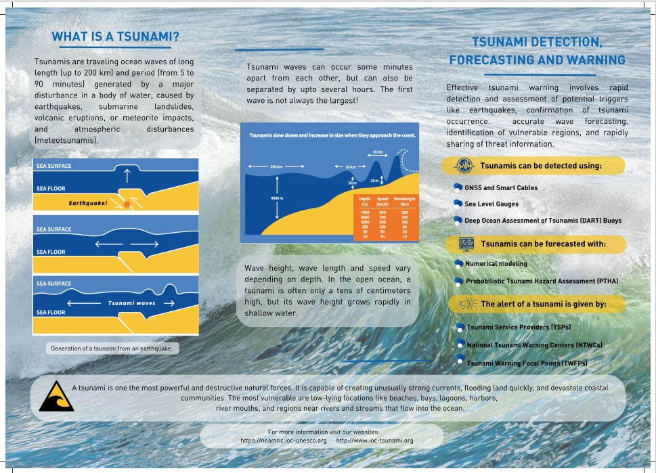
UNESCO-IOC Regional Tsunami Ready Training for North-eastern, Atlantic and connected Seas Region
Tsunami information flyers (left: tsunami fact sheet, right: what to do…)

Slide 7
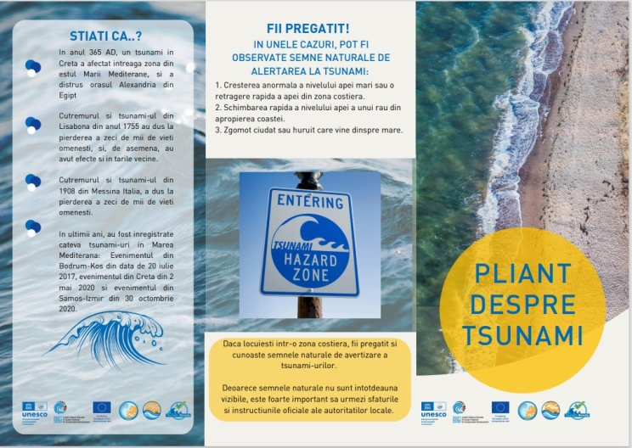
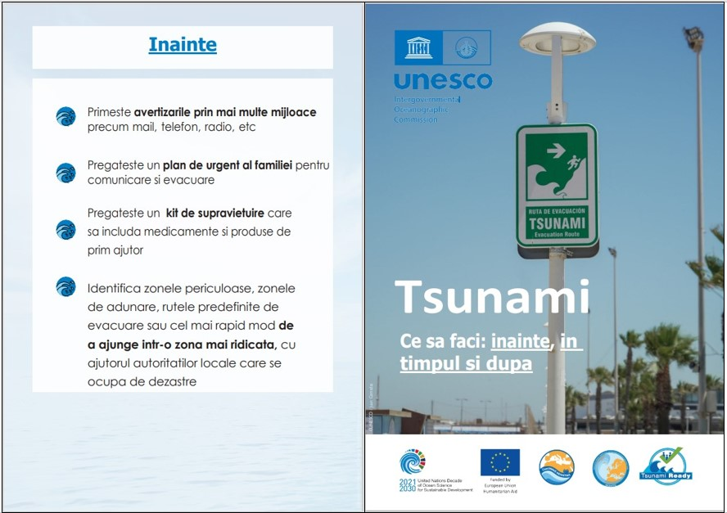
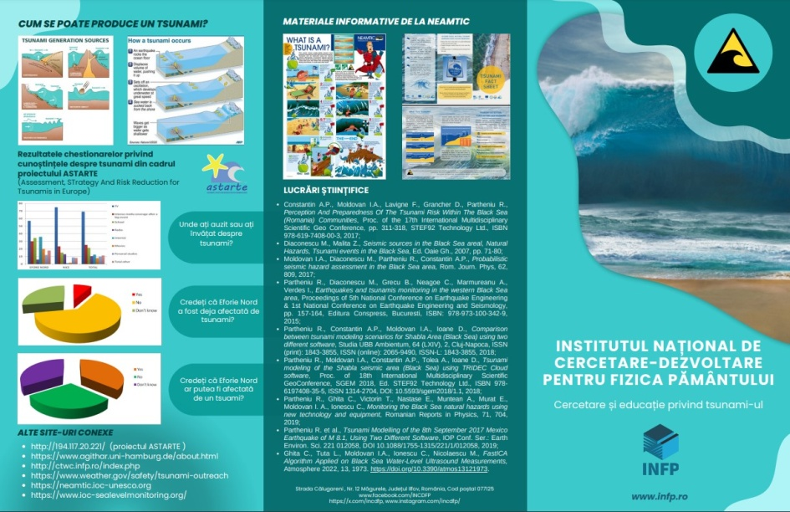
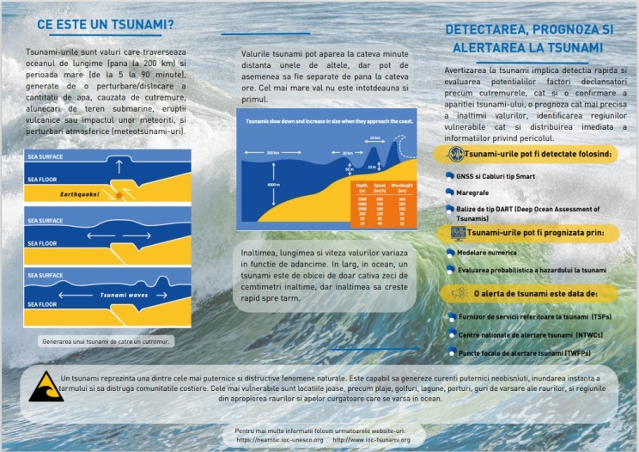
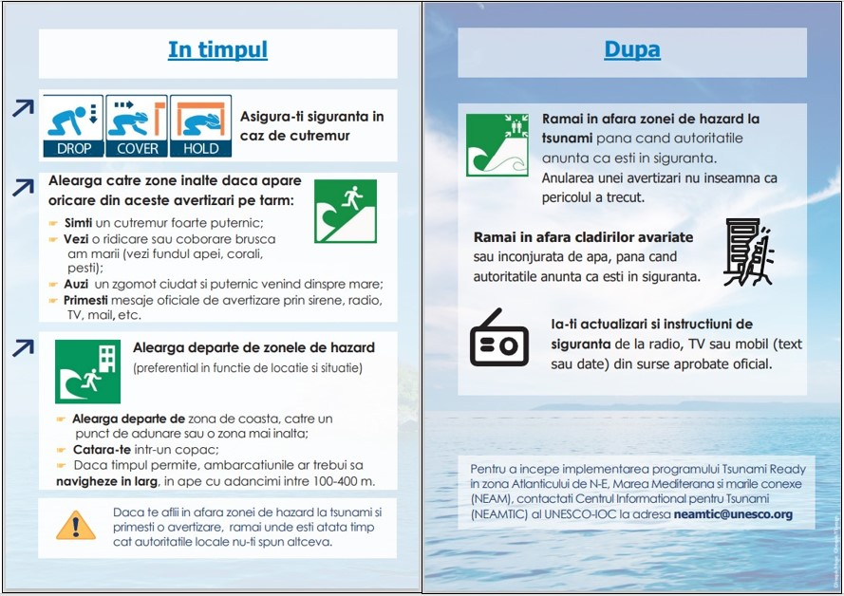
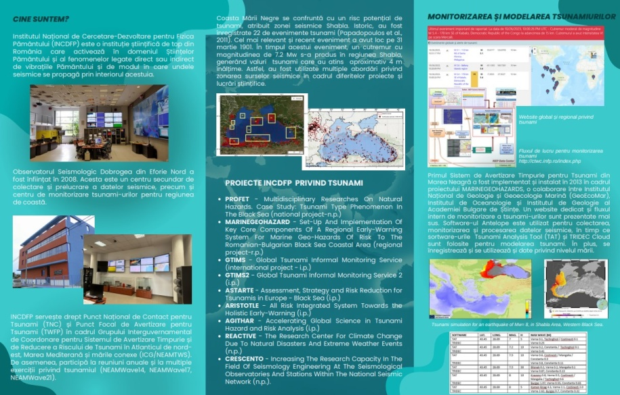
UNESCO-IOC Regional Tsunami Ready Training for North-eastern, Atlantic and connected Seas Region
PARTICULAR CASE : Black Sea region
We give herein an example from Romania, where the National Institute for Earth Physics (NIEP) uses multiple ways for public outreach, awareness and education, at local and regional level for the Black Sea area through: educational materials (displayed below) and scientific articles and presentations at different meetings and conferences.

Slide 8
UNESCO
Intergovernmental Oceanographic Commission (IOC)
UNESCO-IOC DG ECHO CoastWAVE 2.0 project Tsunami Resilience Section

