Slide 1
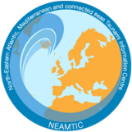
Assess-3: Economic, Infrastructural, Political, and Social Resources
Dr. Derya Vennin
UNESCO-IOC Tsunami Resilience Section
UNESCO-IOC EU DG ECHO CoastWAVE 2.0 Project
UNESCO-IOC Regional Tsunami Ready Training
Online, January 14-15, 2025

Slide 2
UNESCO-IOC Tsunami Ready Training for NEAM Region
Purpose of Assess-3:
Enhance the community's capacity to prepare for and recover from tsunamis.
Identify critical resources to support effective disaster management.
Notes:
I’m honored to present on the critical topic of identifying economic, infrastructural, political, and social resources, which is a key indicator under the Tsunami Ready Recognition Programme. Today, we’ll explore how understanding these resources can significantly enhance community resilience against tsunami hazards. “Identifying these resources is essential to building robust tsunami preparedness and recovery strategies. Assess-3 ensures that communities have a clear understanding of their strengths and gaps in disaster management.

Slide 3
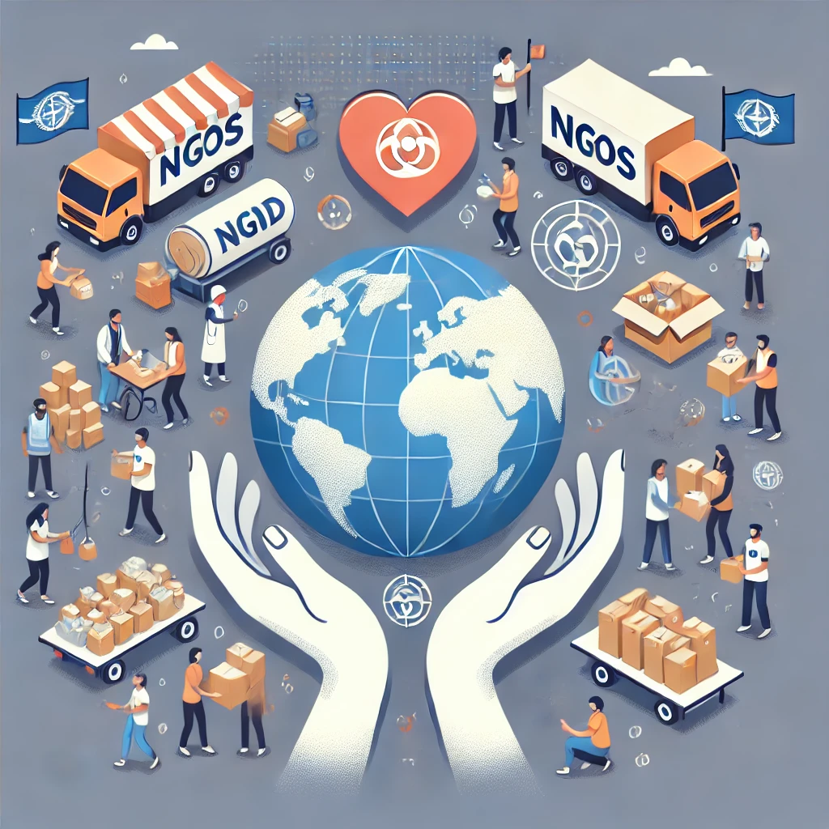
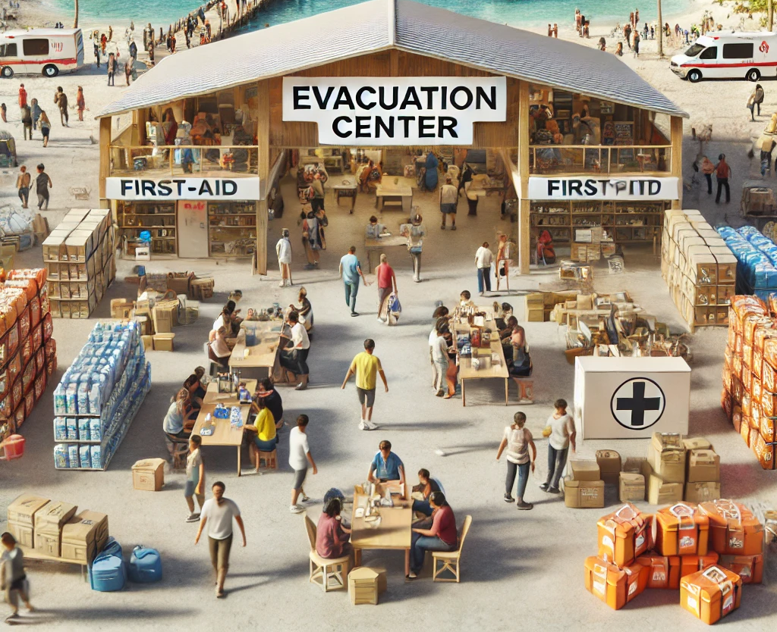
UNESCO-IOC Tsunami Ready Training for NEAM Region
Economic Resources
Definition: Financial systems, budgets, and economic support for disaster risk reduction.
Examples:
Government funding for evacuation
centers and warning systems.
Key Benefits:
Ensures the availability of resources for preparedness and recovery efforts.
Insurance systems
for disaster recovery.
Support from NGOs and
international donors.
Notes:
Economic resources form the backbone of tsunami preparedness. They include government funding, disaster relief budgets, and financial contributions from NGOs or international organizations. For example, communities with established disaster insurance systems or contingency funds are better positioned to recover quickly after a tsunami. Prioritizing economic planning is vital to sustaining disaster resilience efforts.

Slide 4
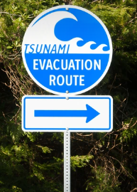
UNESCO-IOC Tsunami Ready Training for NEAM Region
Infrastructural Resources
Definition: Physical facilities and structures critical for tsunami response.
Examples:
Roads, bridges, and evacuation routes.
Emergency shelters
and healthcare facilities.
Communication networks
(e.g., sirens, radios).
Importance:
Enables effective evacuation and response operations.
Supports the community in quickly recovering post-disaster.
Notes:
"Infrastructure plays a pivotal role during a tsunami event. Key facilities such as evacuation routes, shelters, and communication networks can mean the difference between safety and vulnerability. For example, communities with well-maintained evacuation routes and strategically placed shelters are more likely to protect lives during emergencies. Mapping and evaluating these resources is a priority for effective disaster planning."

Slide 5
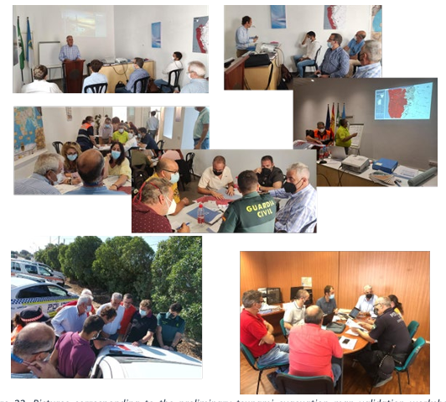
UNESCO-IOC Tsunami Ready Training for NEAM Region
Political Resources
Definition: Leadership, governance, and policies for disaster risk reduction.
Examples:
National and local disaster management policies.
Tsunami awareness campaigns led by authorities.
Intergovernmental agreements for regional cooperation.
Key Considerations:
Leadership fosters a culture of preparedness.
Policy-driven funding and resource allocation.
Notes:
"Political leadership and governance are integral to disaster preparedness. Strong disaster management policies, such as those mandating regular evacuation drills or public awareness campaigns, demonstrate the importance of political commitment. Collaboration between local, national, and international bodies ensures that resources are effectively allocated and utilized for tsunami preparedness."

Slide 6
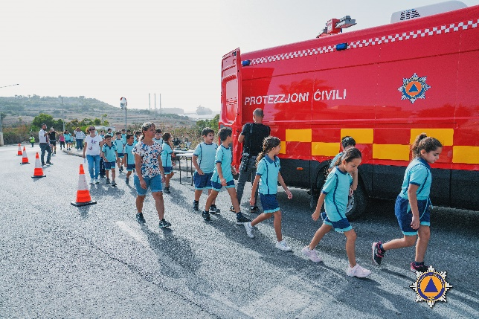
UNESCO-IOC Tsunami Ready Training for NEAM Region
Social Resources
Definition: Community networks, relationships, and capacities.
Examples:
Community-led initiatives for disaster awareness.
Local volunteer groups supporting evacuation drills.
Educational programs in schools.
Significance:
Strengthens social cohesion and collective resilience.
Encourages active participation in preparedness efforts.
Notes:
"Social resources emphasize the power of community networks and relationships. Local groups and educational programs can drive tsunami awareness and preparedness initiatives. For example, volunteer networks trained in evacuation procedures can significantly enhance community response times. Investing in social groups fosters a collective resilience that strengthens overall preparedness."

Slide 7
UNESCO-IOC Tsunami Ready Training for NEAM Region
Importance of Assess-3
Integration Across Resources:
Economic, infrastructural, political, and social elements must work together for effective tsunami readiness.
Notes:
"Assess-3 integrates economic, infrastructural, political, and social resources into a unified approach. This holistic perspective ensures that communities address all aspects of tsunami preparedness.

Slide 8
UNESCO-IOC Tsunami Ready Training for NEAM Region
Steps to Identify Resources
1. Assessment: Conduct baseline studies to identify available resources.
2. Mapping: Geographically map key infrastructure and assets.
3. Engagement: Collaborate with stakeholders (government, NGOs, and communities).
5. Documentation: Create a comprehensive resource database.
4. Prioritization: Focus on areas most critical for tsunami response.
Notes:
"Identifying resources involves a systematic approach. First, conducting baseline assessments helps communities understand their current capabilities. Next, mapping these resources geographically highlights accessibility and gaps. Engaging stakeholders ensures that diverse perspectives are included, and prioritizing critical areas allows for efficient use of resources. Finally, comprehensive documentation ensures that knowledge is preserved for future planning."

Slide 9
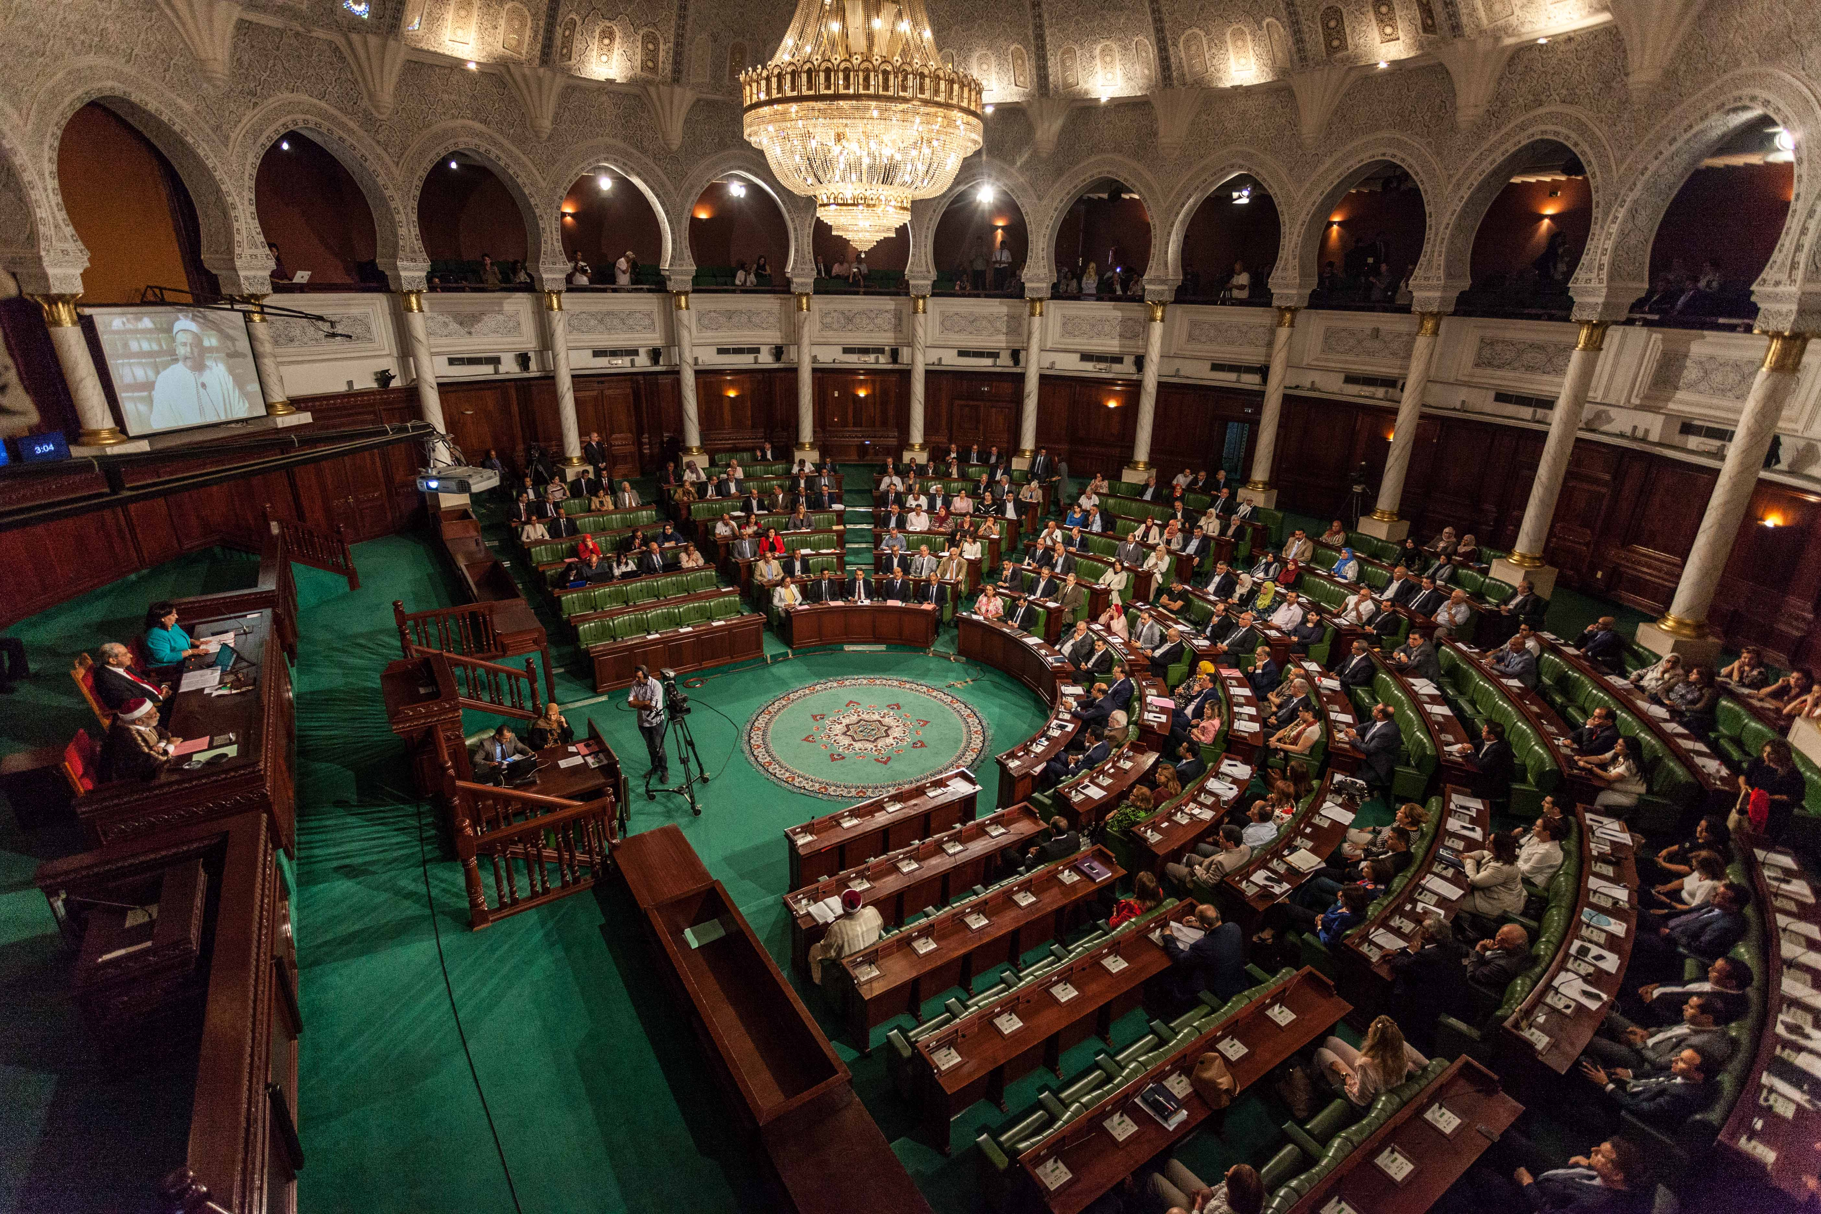
UNESCO-IOC Tsunami Ready Training for NEAM Region
Challenges and Solutions
Challenges:
Limited funding and resources.
Lack of community awareness or engagement.
Political instability.
Solutions:
Establish partnerships with international organizations.
Promote community-based risk management programs.
Advocate for policy changes at national and regional levels.
Notes:
While communities face challenges like limited funding, political instability, or lack of awareness, there are solutions. Establishing partnerships with international organizations, promoting community-led initiatives, and advocating for stronger policies can overcome these barriers. For example, a collaboration between local governments and NGOs has successfully improved evacuation infrastructure in several coastal communities."

Slide 10
UNESCO-IOC Tsunami Ready Training for NEAM Region
Summary:
Identifying and mobilizing economic, infrastructural, political, and social resources is critical for tsunami readiness.
Collaborative efforts ensure sustainability and resilience.
Engage stakeholders to address gaps in resources.
Promote a culture of preparedness in your communities.
What resources do you think are most critical for your community’s tsunami preparedness?
Notes:
"In conclusion, identifying and mobilizing economic, infrastructural, political, and social resources is a cornerstone of tsunami preparedness. These resources work together to create a resilient and sustainable response system. I urge you to engage your stakeholders, address resource gaps, and promote a culture of readiness within your communities.

Slide 11
UNESCO
Intergovernmental Oceanographic Commission (IOC)
UNESCO-IOC DG ECHO CoastWAVE 2.0 project Tsunami Resilience Section

