Slide 1




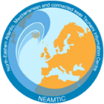

Assess-2: The number of people at risk in the tsunami hazard zone is estimated.
Prof. Maria Ana Baptista
Instituto Dom Luiz (UL)
UNESCO-IOC EU DG ECHO CoastWAVE 2.0 Project
UNESCO-IOC Regional Tsunami Ready Recognition Programme (TRRP) Training
Online, January 14-15, 2025

Slide 2



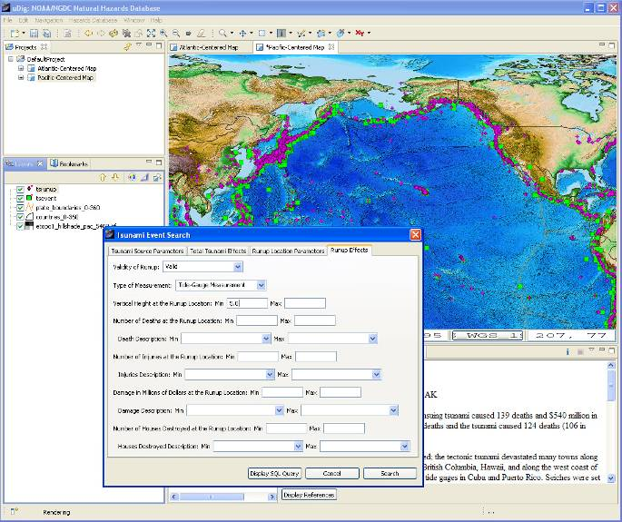

UNESCO-IOC Tsunami Ready Training for NEAM Region
Historic records
News papers
Event data observations
Indigenous and Local knowledge
Written eyewitness accounts
Wave height, Flooding extent, damage and impact, etc…
Seismic and tsunami catalogues databases
1. Tsunami hazard in your region

Slide 3
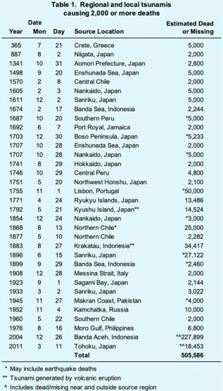
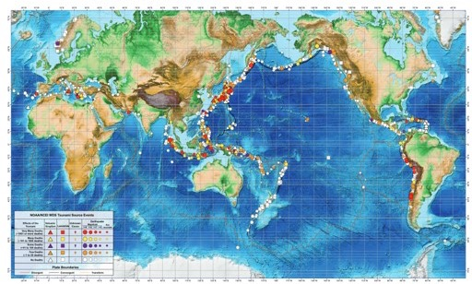
UNESCO-IOC Tsunami Ready Training for NEAM Region
Tsunami Sources 1610 B.C. to A.D. 2017
From Earthquakes, Volcanic Eruptions, Landslides, and Other Causes
The use of numerical models to predict the impact of a tsunami requires knowledge of probable tsunami sources (such as earthquakes, landslides, and volcanic eruptions);
Tsunami catalogues and historical descriptions can help to estimate their likelihood of occurrence impacts along the coasts.
The information on sources comes from geology, and scientists use the “worst yet possible scenario” in a conservative approach to simulate the impact.
1. Tsunami hazard in your region

Slide 4
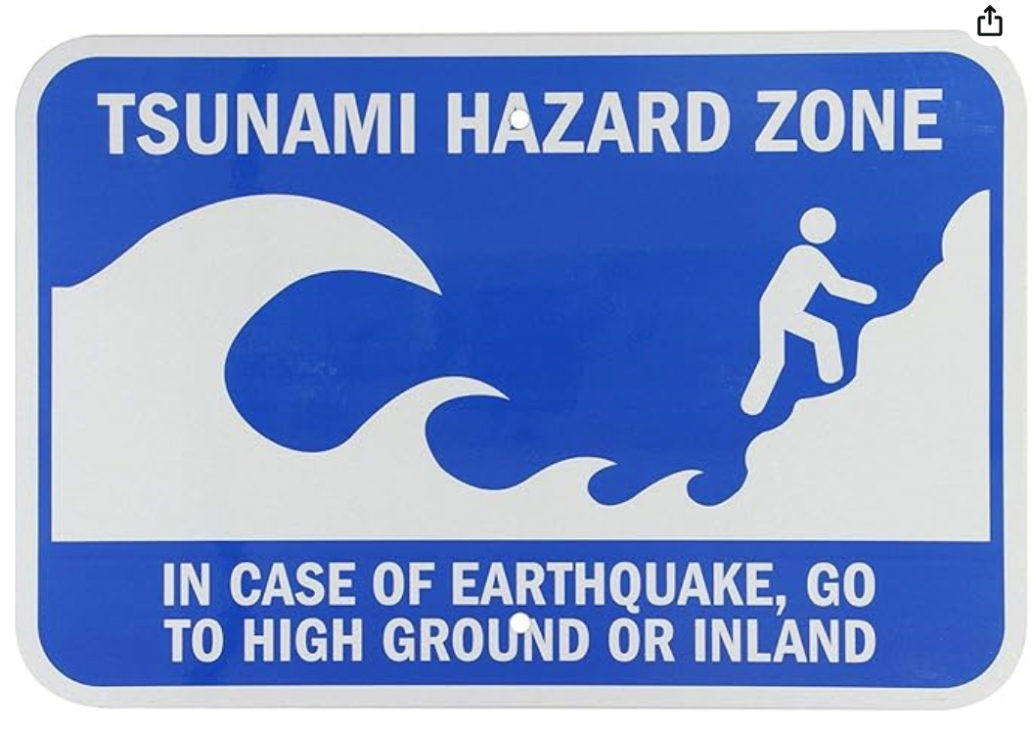
UNESCO-IOC Tsunami Ready Training for NEAM Region
Use tsunami hazard maps created by geospatial and modeling experts. These maps show the expected extent of inundation based on historical data, seismic activity, and topographic features.
Tools like GIS (Geographic Information Systems) or simulation software such as Tsunami Inundation Modeling (TIM) can help determine the boundaries of the inundation area.
1. Tsunami hazard in your region

Slide 5
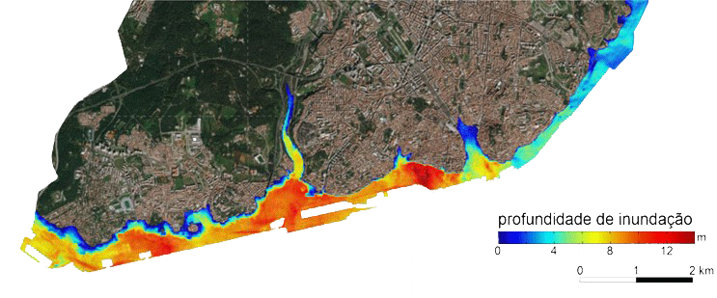
UNESCO-IOC Tsunami Ready Training for NEAM Region
Inundation depth
Tsunami Inundation Maps depict the areas that may be flooded by a tsunami usually based on a worst-yet-credible scenario (the worst tsunami that can impact the area)
Safer areas are those outside the inundation zone -
Safer areas are not Safe areas (we can not guarantee that people will not be impacted)
2. Local Tsunami Inundation Maps (in your area area)

Slide 6
UNESCO-IOC Tsunami Ready Training for NEAM Region
People at Risk
Knowing the number of people in the hazard zone is necessary for estimating the response effort and for planning to build evacuation shelters and define evacuation routes.
The assessment should include local residents, vulnerable populations (people with disabilities, elderly, young, etc.) and the approximate number of temporary workers and tourists (non-residents) that are at risk.
Both daytime and nighttime population in the hazard zone should be estimated as well as population during summer and winter seasons and mass gatherings.
The local census, the emergency operations plan, municipal data or information from the Disaster Management Office can be good references to obtain this initial estimate
3. People at Risk

Slide 7

UNESCO-IOC Tsunami Ready Training for NEAM Region
2. Assessing People at Risk
Use population density maps from sources like : Census data
Open data platforms like WorldPop, Gridded Population of the World (GPW), or LandScan
Satellite imagery combined with machine learning for estimating population in less-surveyed areas
Obtain real-time population data, if possible, for estimating the transient population (e.g., tourists or seasonal workers).
http://ec2-3-223-105-100.compute-1.amazonaws.com/how-to-use-2020-census-data-in-predictive-analytics/
3. People at Risk

Slide 8
UNESCO-IOC Tsunami Ready Training for NEAM Region
Sources of Information:
Depends on size of community and availability of existing data
Census data is a good starting point, if available (population distribution, socio-economic status, statistics such as age, occupation, disability and education)
Other sources include provincial or municipal data or information from the DMO for existing Emergency Operation Plans
For smaller communities or where official data is not available, on-the-ground surveys and questionnaires will be required to obtain information on population distribution. Satellite imagery and apps such as Google Maps are also useful for planning such surveys
Even when using official information such as census data it is advisable to conduct ground-truthing surveys to check the accuracy of the data, as populations can be dynamic and change over time in response to a range of socio-economic factors
3. People at Risk

Slide 9
UNESCO-IOC Tsunami Ready Training for NEAM Region
Consider variations in population based on the time of day: Residential areas will have higher populations at night.
Commercial and recreational areas may have more people during the day.
Use mobility data or human activity models to adjust for this variability.
4. Adjust for Time of Day

Slide 10
UNESCO-IOC Tsunami Ready Training for NEAM Region
Classification of land use within the inundation area on different categories
Urban areas
Permanent residence
Non permanent residences
Beaches and open areas
5. Consider type of areas

Slide 11



UNESCO-IOC Tsunami Ready Training for NEAM Region
Urban areas
Permanent Housing
Census data
Non Permanent
Hospitals, industrial buildings, schools,other:
5. Consider type of areas - Urban

Slide 12
UNESCO-IOC Tsunami Ready Training for NEAM Region
Beaches and open areas
Non-permanent population
  Seasonal (winter time/summer vacation time
  Daily (day/night)
Number of people should be obtained through the responsible organization;
Schools and industry: number of people at risk different in day time or night time
5. Consider type of areas – Non Urban

Slide 13
UNESCO-IOC Tsunami Ready Training for NEAM Region
Final Considerations
Take into account all activities, not just residential accommodation. e.g.. schools, community centres, offices, markets, beaches, hotels, places of worship (religious buildings)
Pay particular attention to identifying vulnerable people who will require assistance during evacuation. For example, elderly people, people with disabilities.
Hospitals in the hazard zone will require specific measures to protect the safety of patients and staff
Also take into consideration differences between daytime and night-time populations, and seasonal variations in workers and tourists
6. Final Considerations -1

Slide 14
UNESCO-IOC Tsunami Ready Training for NEAM Region
It is necessary to know the number of people in the tsunami hazard zone for estimating the response effort, planning evacuation shelters and defining evacuation routes
All community activities should be considered including schools, community centres, offices, markets, beaches, hotels, mosques and churches as well as residential areas
Particular attention should be paid to identifying vulnerable people who will require special assistance during evacuation. Any hospitals in the hazard zone will require specific measures to ensure the safety of patients and staff
Differences in daytime and nighttime populations and seasonal variations in workers and tourists should also be accounted for
Official census data, if available, is a good starting point for obtaining information on population distribution and demography. For smaller communities or where official data is not available, on-the-ground surveys will be required to obtain estimates of the number of people in the tsunami hazard zone
6. Final Considerations - 2

Slide 15
UNESCO
Intergovernmental Oceanographic Commission (IOC)
UNESCO-IOC DG ECHO CoastWAVE 2.0 project
Tsunami Resilience Section

