Slide 1

The ΝEAM Collaboration fOr iMproved tsunaMi rIsk miTigation and management
(NEAM-COMMITMENT) project

Slide 2

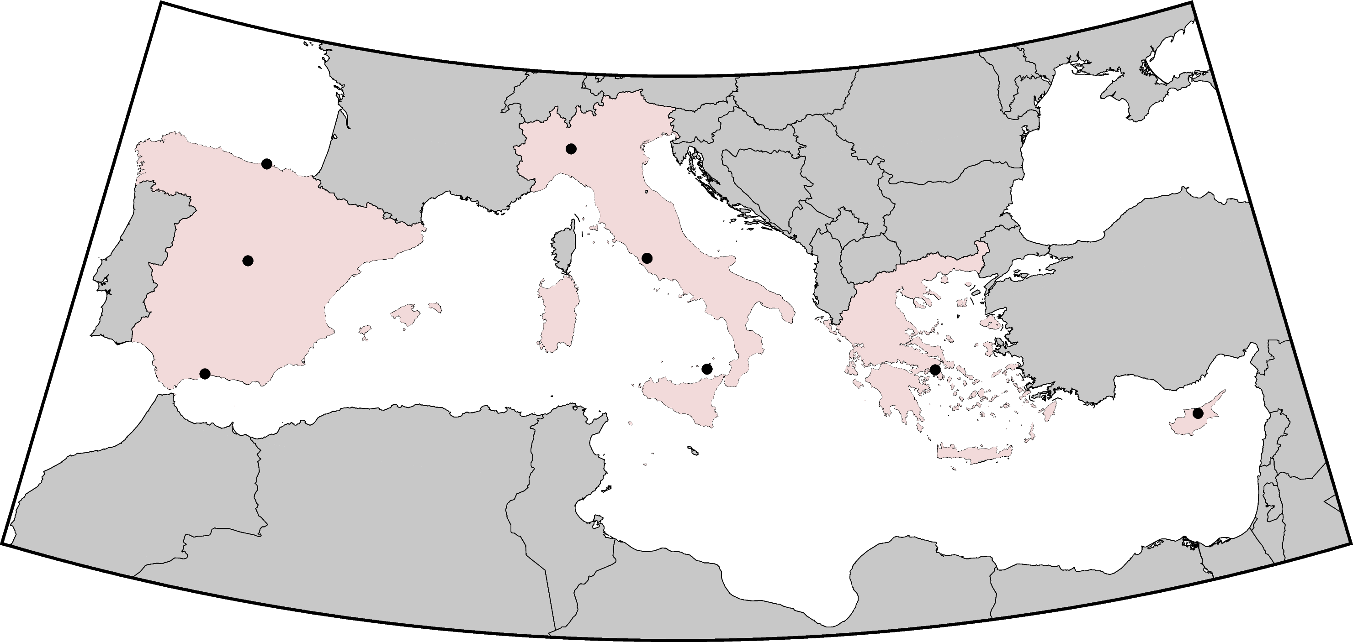












NEAM-COMMITMENT project partners
13 partners from 4 counties: Cyprus, Italy, Greece and Spain.
3 national CPAs (IT, GR, ES), 1 municipality (Lipari), and 1 international organization (GEM).

Slide 3

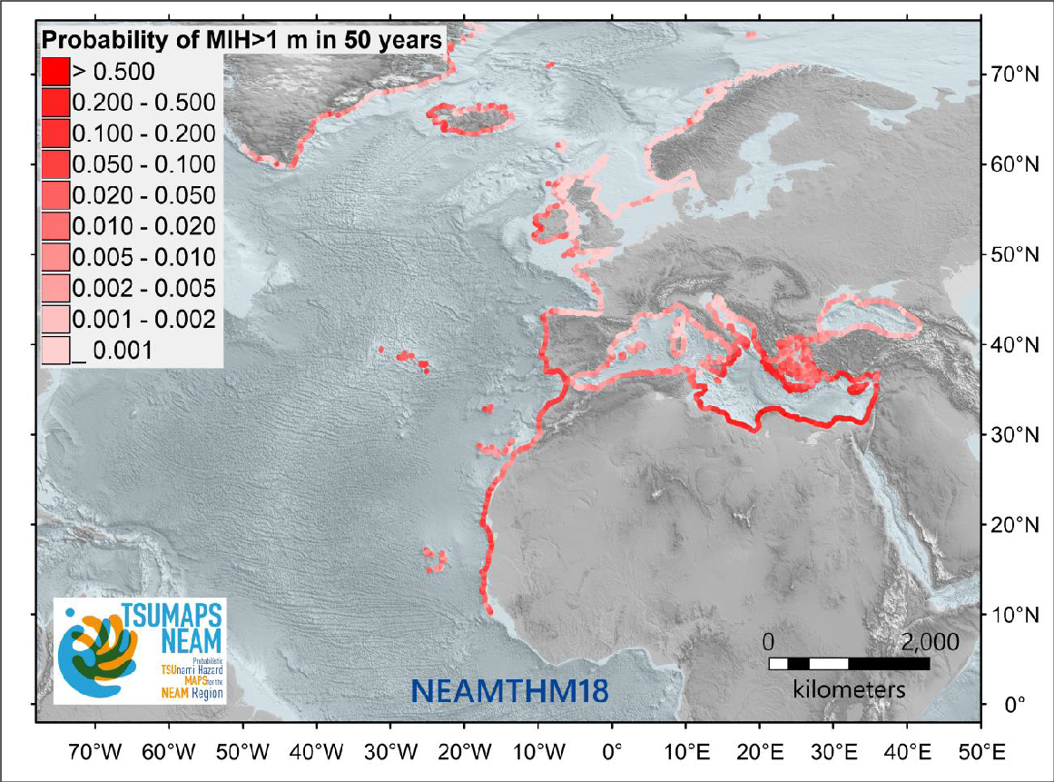





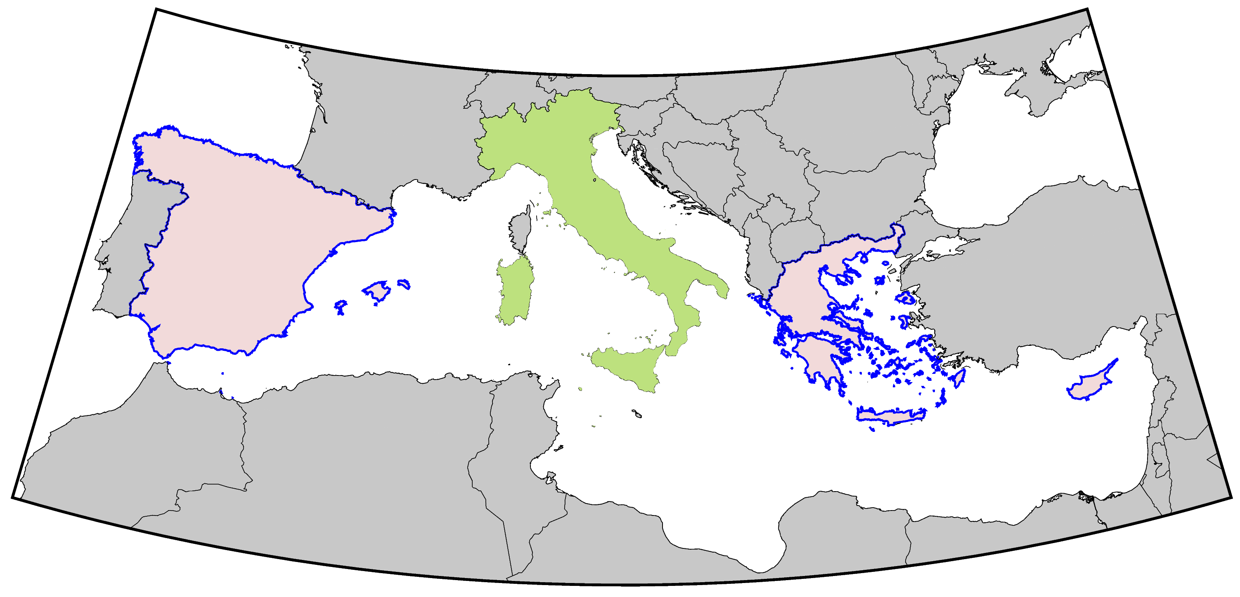
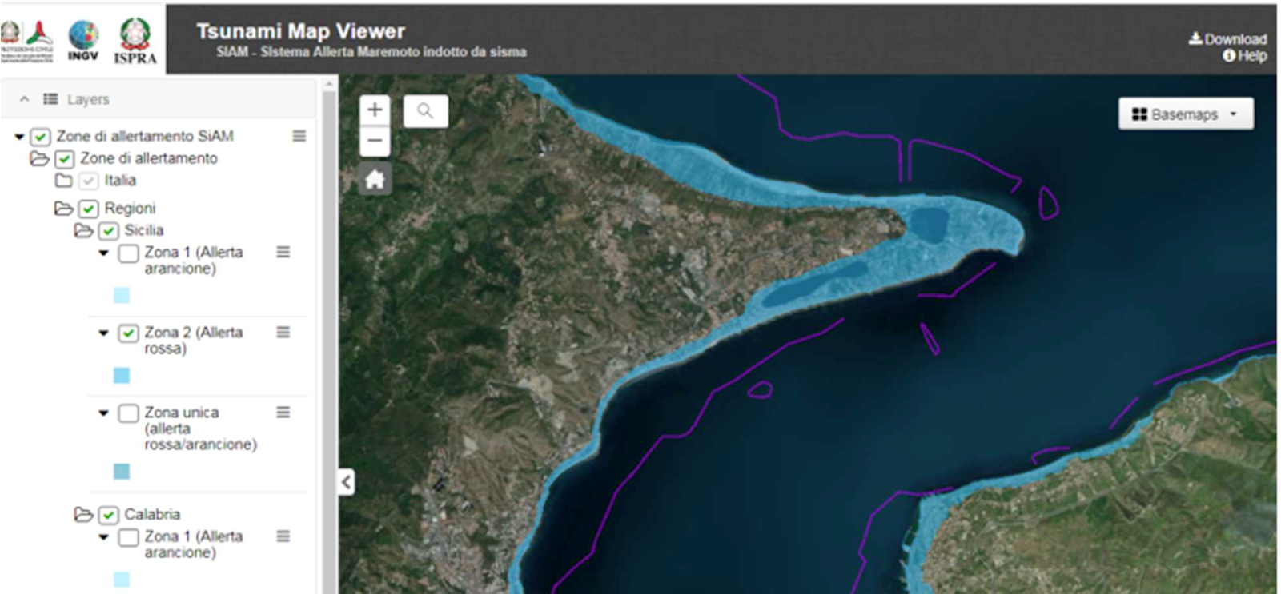
Objective 1 – common national maps across NEAM countries
project funded by DG-ECHO
National inundation maps
Outputs: national tsunami inundation maps (CY, GR, ES); guidelines and tools.

Slide 4
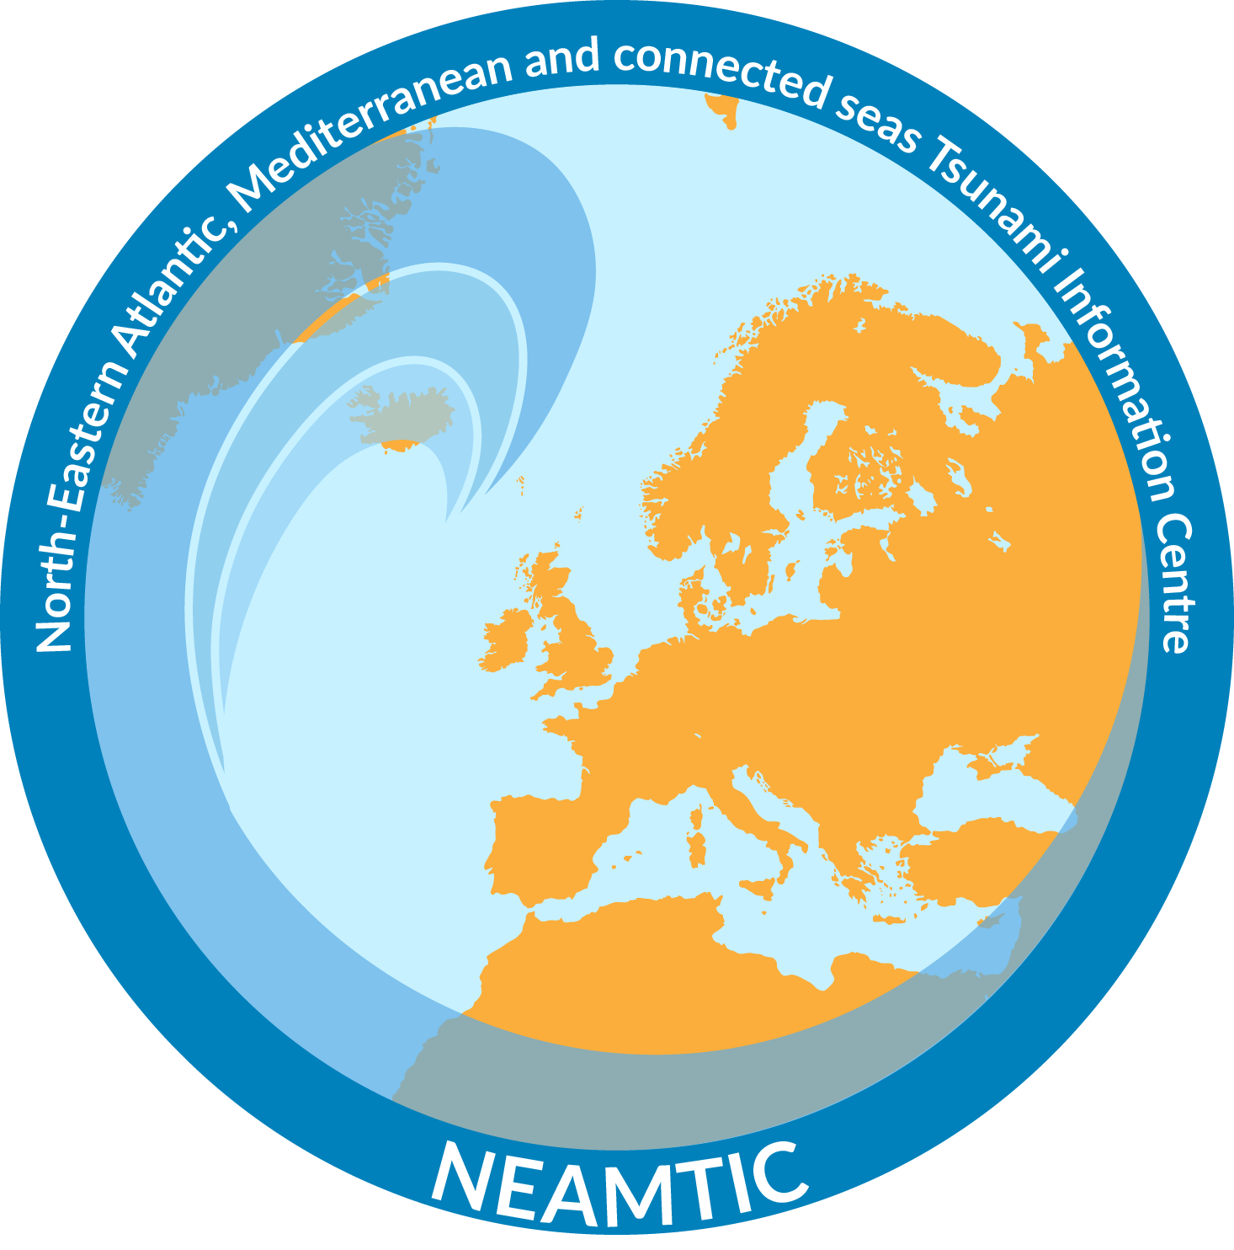

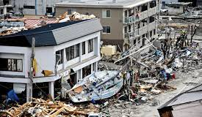
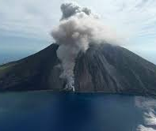
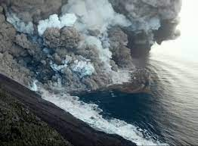

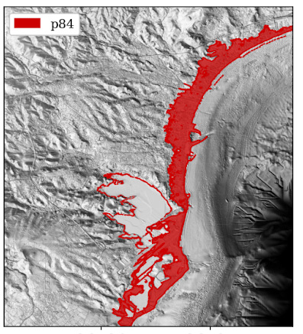
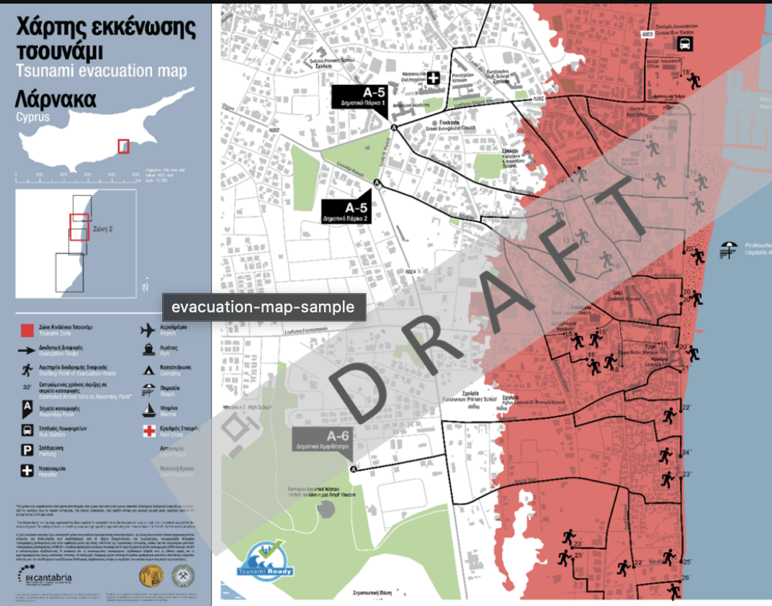
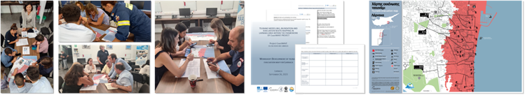
Objective 2 – location-specific multi-hazard risk management
Earthquake + tsunami
Volcanic activity + tsunami
Outputs: combined scientific-technical and participatory multi-hazard approach for tsunami evacuation planning and management; application to pilot sites in Greece and Italy; drafting of guidelines.

Slide 5
Communication and Dissemination
Provide guidelines and perform capacity building to expand the nation-wide planning approach across the NEAM region, in harmony with the NEAMTWS Strategy and with the UNESCO-IOC Tsunami Ready Recognition Program;
Disseminate the nation-wide planning results across the relevant national stakeholders;
Disseminate further the planning results within the local communities for a broad acceptance and a better understanding and preparation for adverse events;
Raise tsunami awareness of local population at local pilot sites.
Further project information
Expected starting date: February 2025;
Project duration: 2 years.

