Slide 1

Community initiatives in the NEAMTWS
S. Lorito, INGV
XIX ICG-NEAMTWS, Paris, UNESCO HQ, November 27-29, 2024

Slide 2

Status of Community Initiatives
The GTM Global Tsunami Model:
  eV associaton founded (~20 members) + > 30 Letters of Interest globally
  global S-PTHA in preparation within the ChEESE project
  Support to UNESCAP Makran S-PTHA project
  Collaboration with GEM for source/results interoperability (e.g. OpenQuake) and planning for pilot Seismic+Tsunami Probabilistic Hazard and Risk Assessment for South America
  Will submit request for endorsement to UNODTP
GTM’s vision
“Saving lives, reducing losses, and enhancing resilience”
“Advancement of tsunami science, provision of expert information, promoting dialog about tsunami hazard and risk”

Slide 3


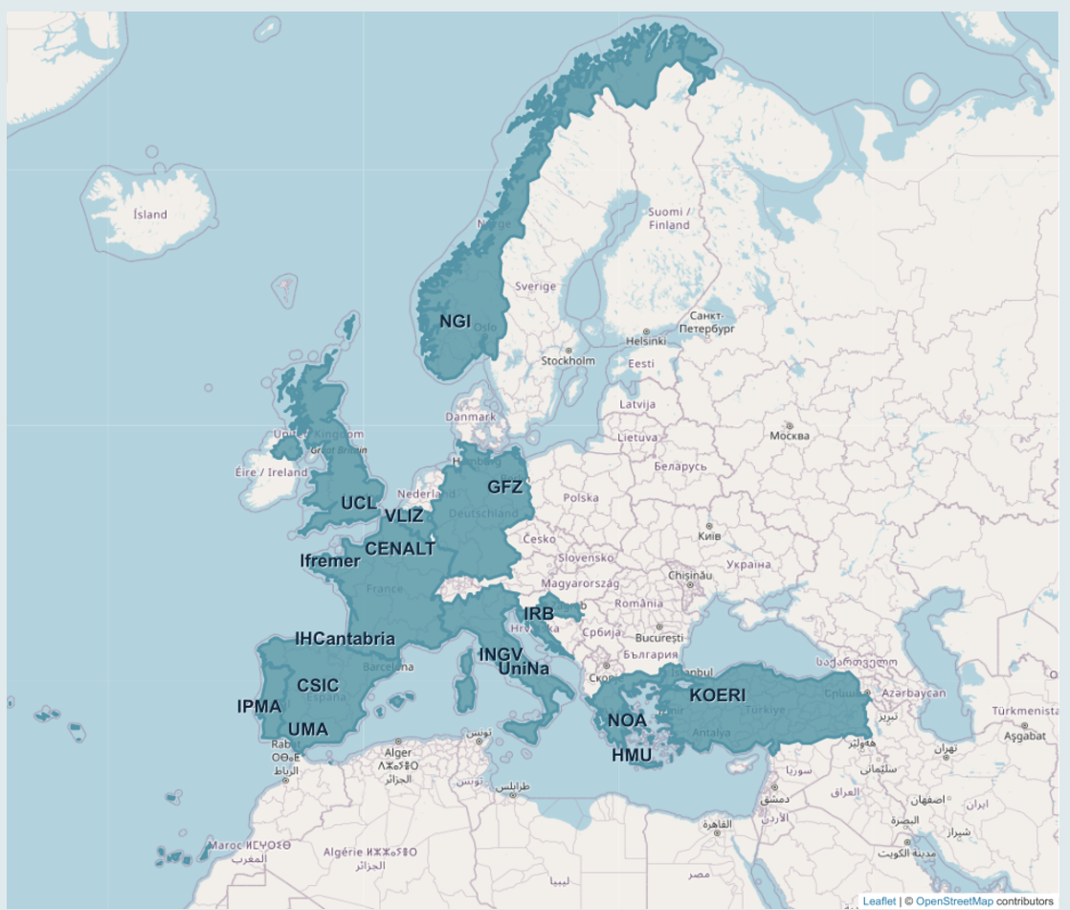

Status of Community Initiatives
Tsunami TCS in EPOS
  Consortium of ~ 20 Universities and Institutions in EU (incl. VLIZ, 4/5 TSPs + CENALT TSP and CINECA Supercomputing Centre expected in 2025)
  FAIR Distribution of DDSS (data, hazard and risk models, software, computational resources)
  Financial support by the EU Member States via EU and National funding, and in cooperation with EU projects
    EPOS-ON EU Project to support the finalization of the TSP-IOT (INGV, NOA, KOERI, IPMA as advisor)
    Geo-INQUIRE to support Virtual and TransNational Access to the services (include local PTHA support for Spain - Cadiz, Morocco, Chile, Pakistan, Iran)
  Request submitted for endorsement by UNODTP
TCS Tsunami
ics-c.epos-eu.org

Slide 4
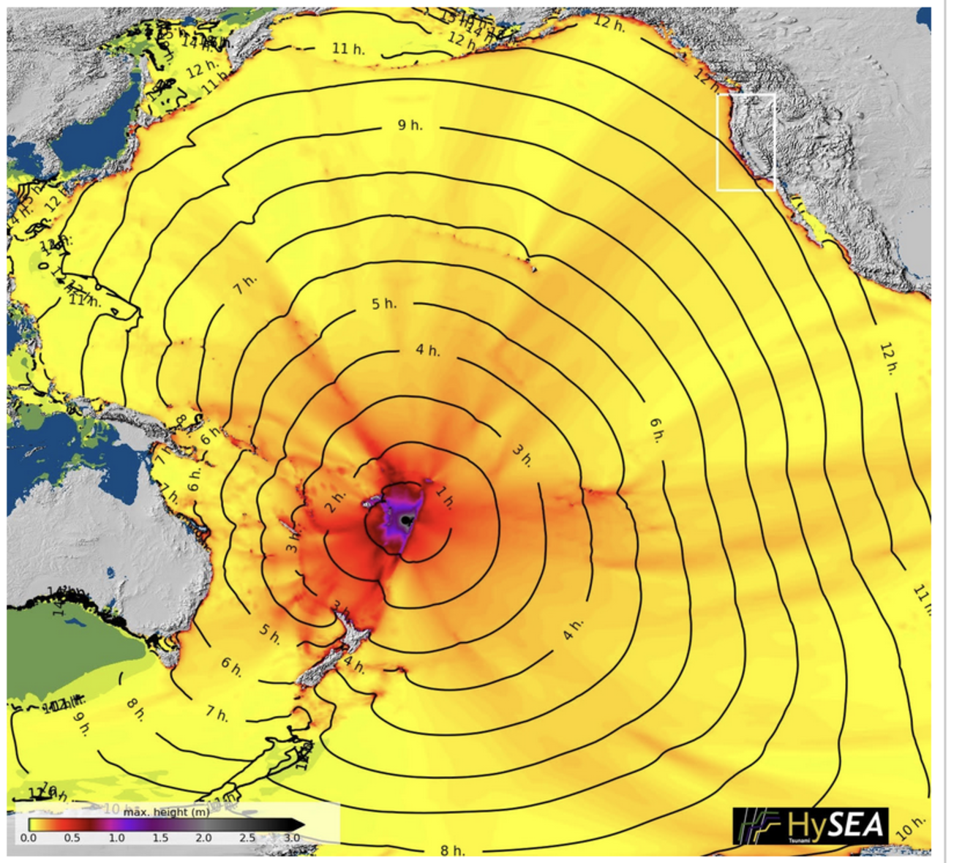

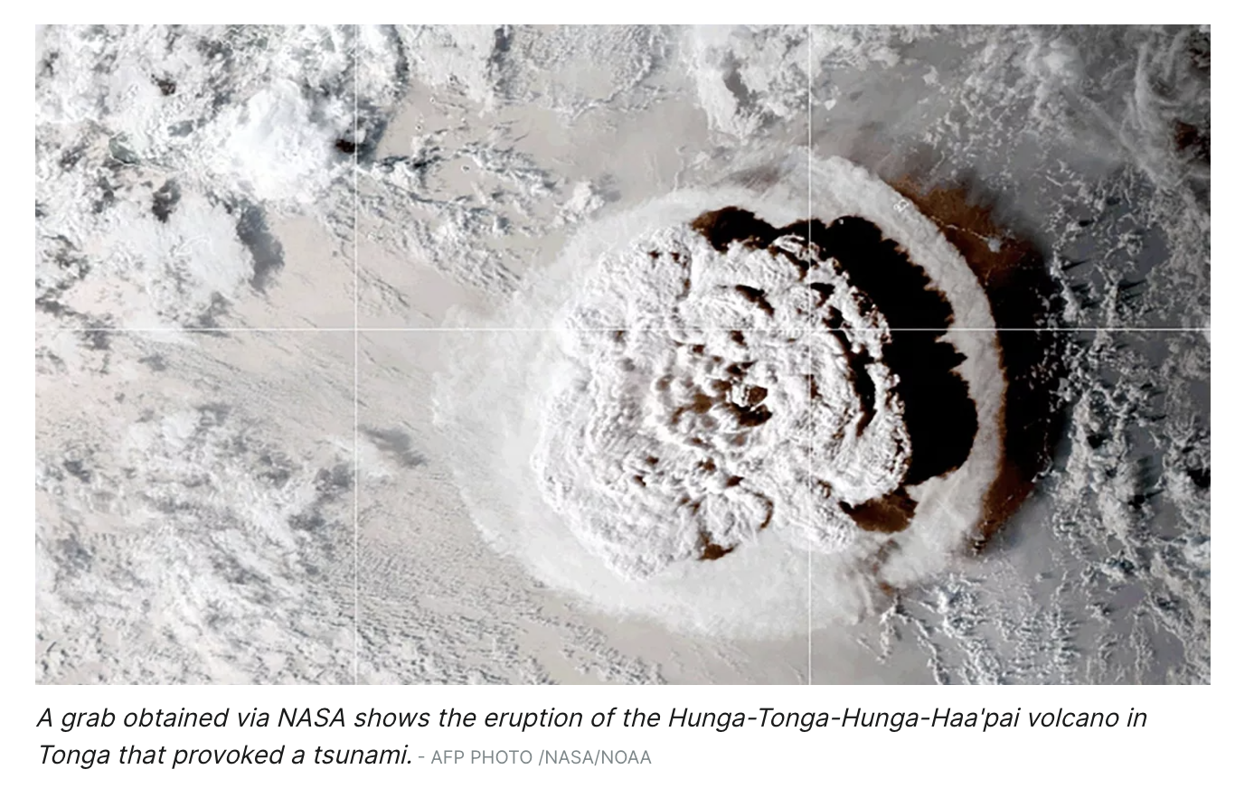
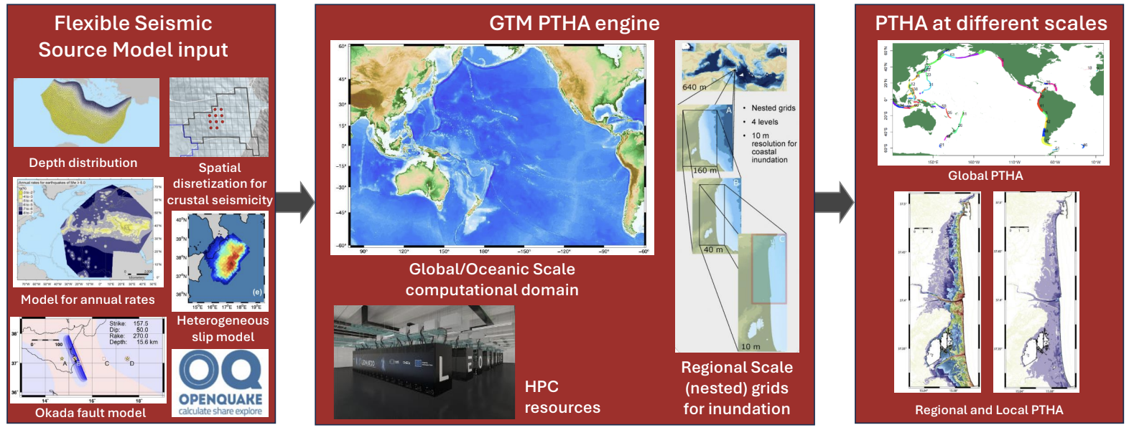


Other EU projects relevant for ICG-NEAMTWS
The ChEESE project:
  Global Urgent Computing type simulation of the HTHH tsunami on the Leonardo supercomputer @CINECA
    Near-field source with SeisSol+L-HySEA
    Global source with M-HySEASupport to UNESCAP Makran S-PTHA project
  Realization of the Global GTM S-PTHA (update of Davies, 2018 global PTHA)
    Heterogeneous earthquake slip
    Inclusion of small islands globally
    Inclusion of tides, long-term sea-level rise

Slide 5

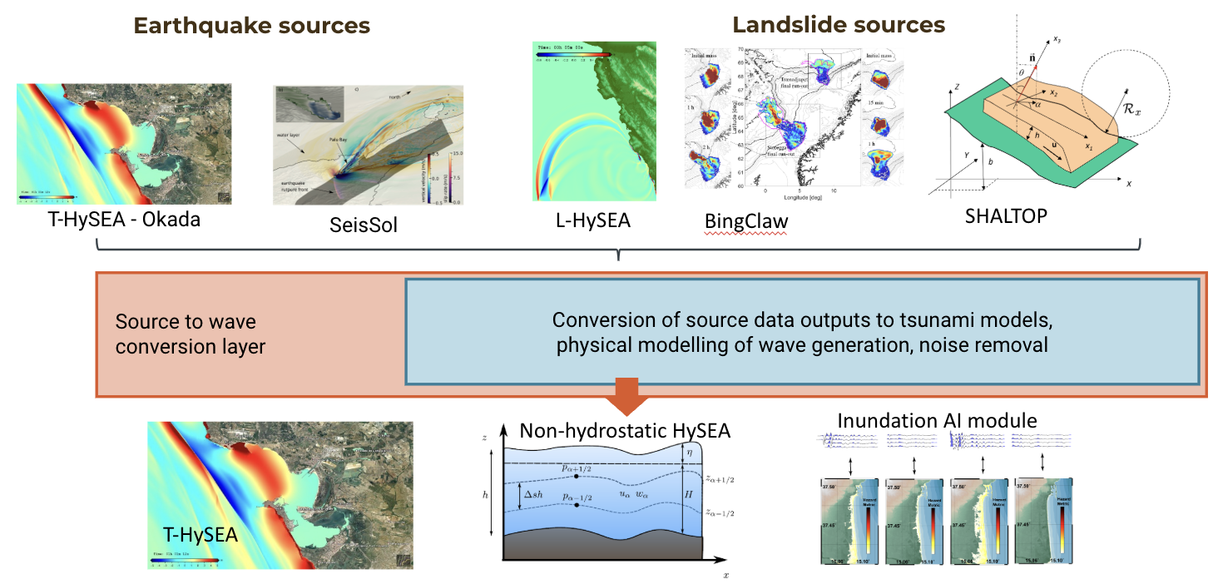
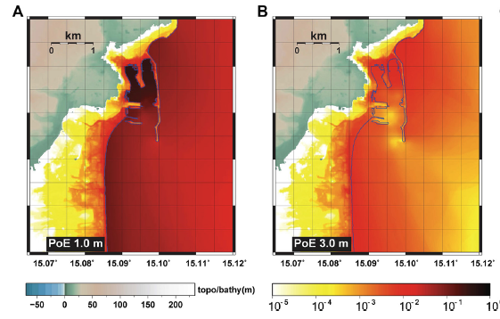

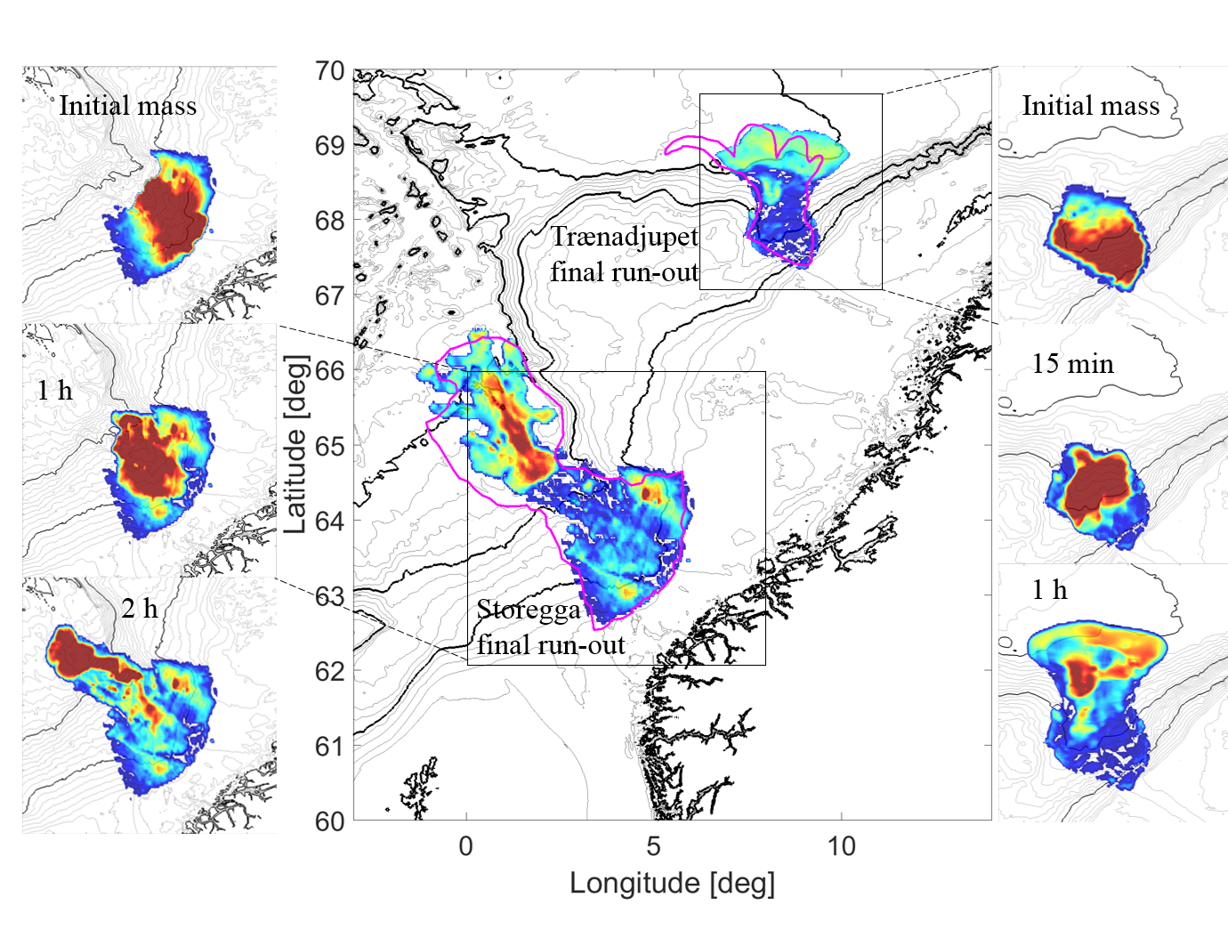
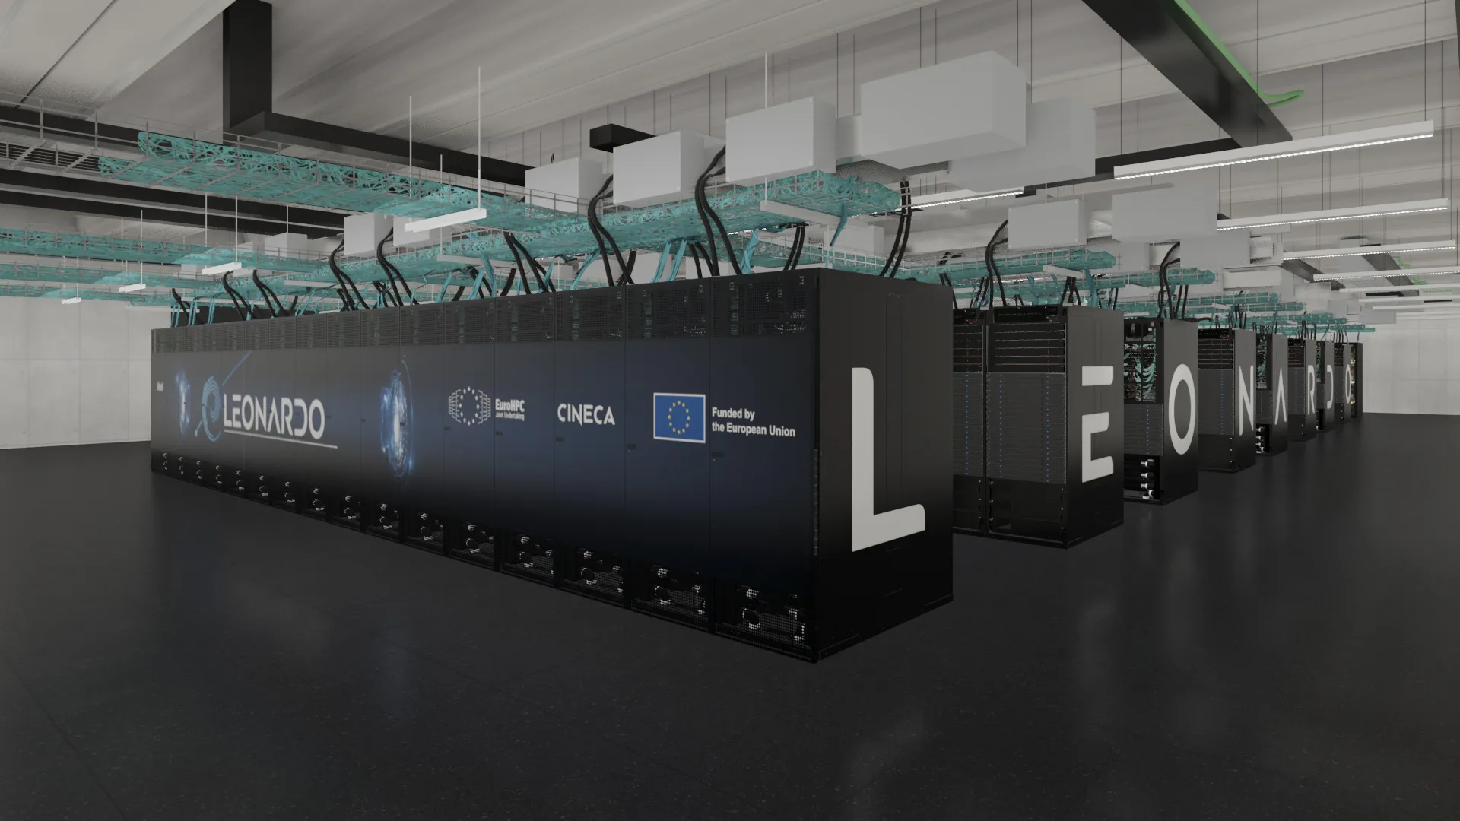
Other EU projects relevant for ICG-NEAMTWS
The DT-GEO project:
  Urgent computing version of the PTF with experimental:
    Real-time tsunami simulations on the Leonardo supercomputer @CINECA
    GNSS and Tsunami data assimilation
    Seismically-induced tsunamigenic landslides
The Geo-INQUIRE project
  Virtual and TransNational Access to tsunami services (hazard and risk models, data, software, HPC resources)

Slide 6

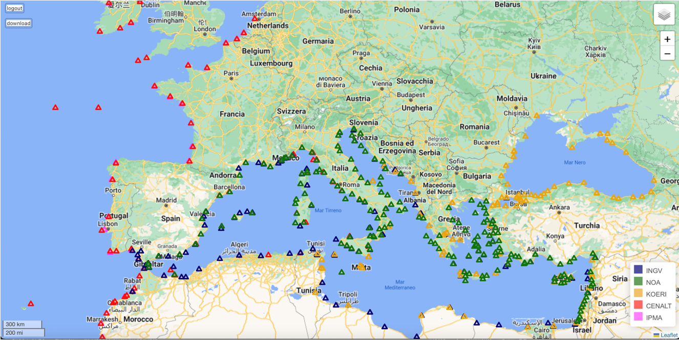
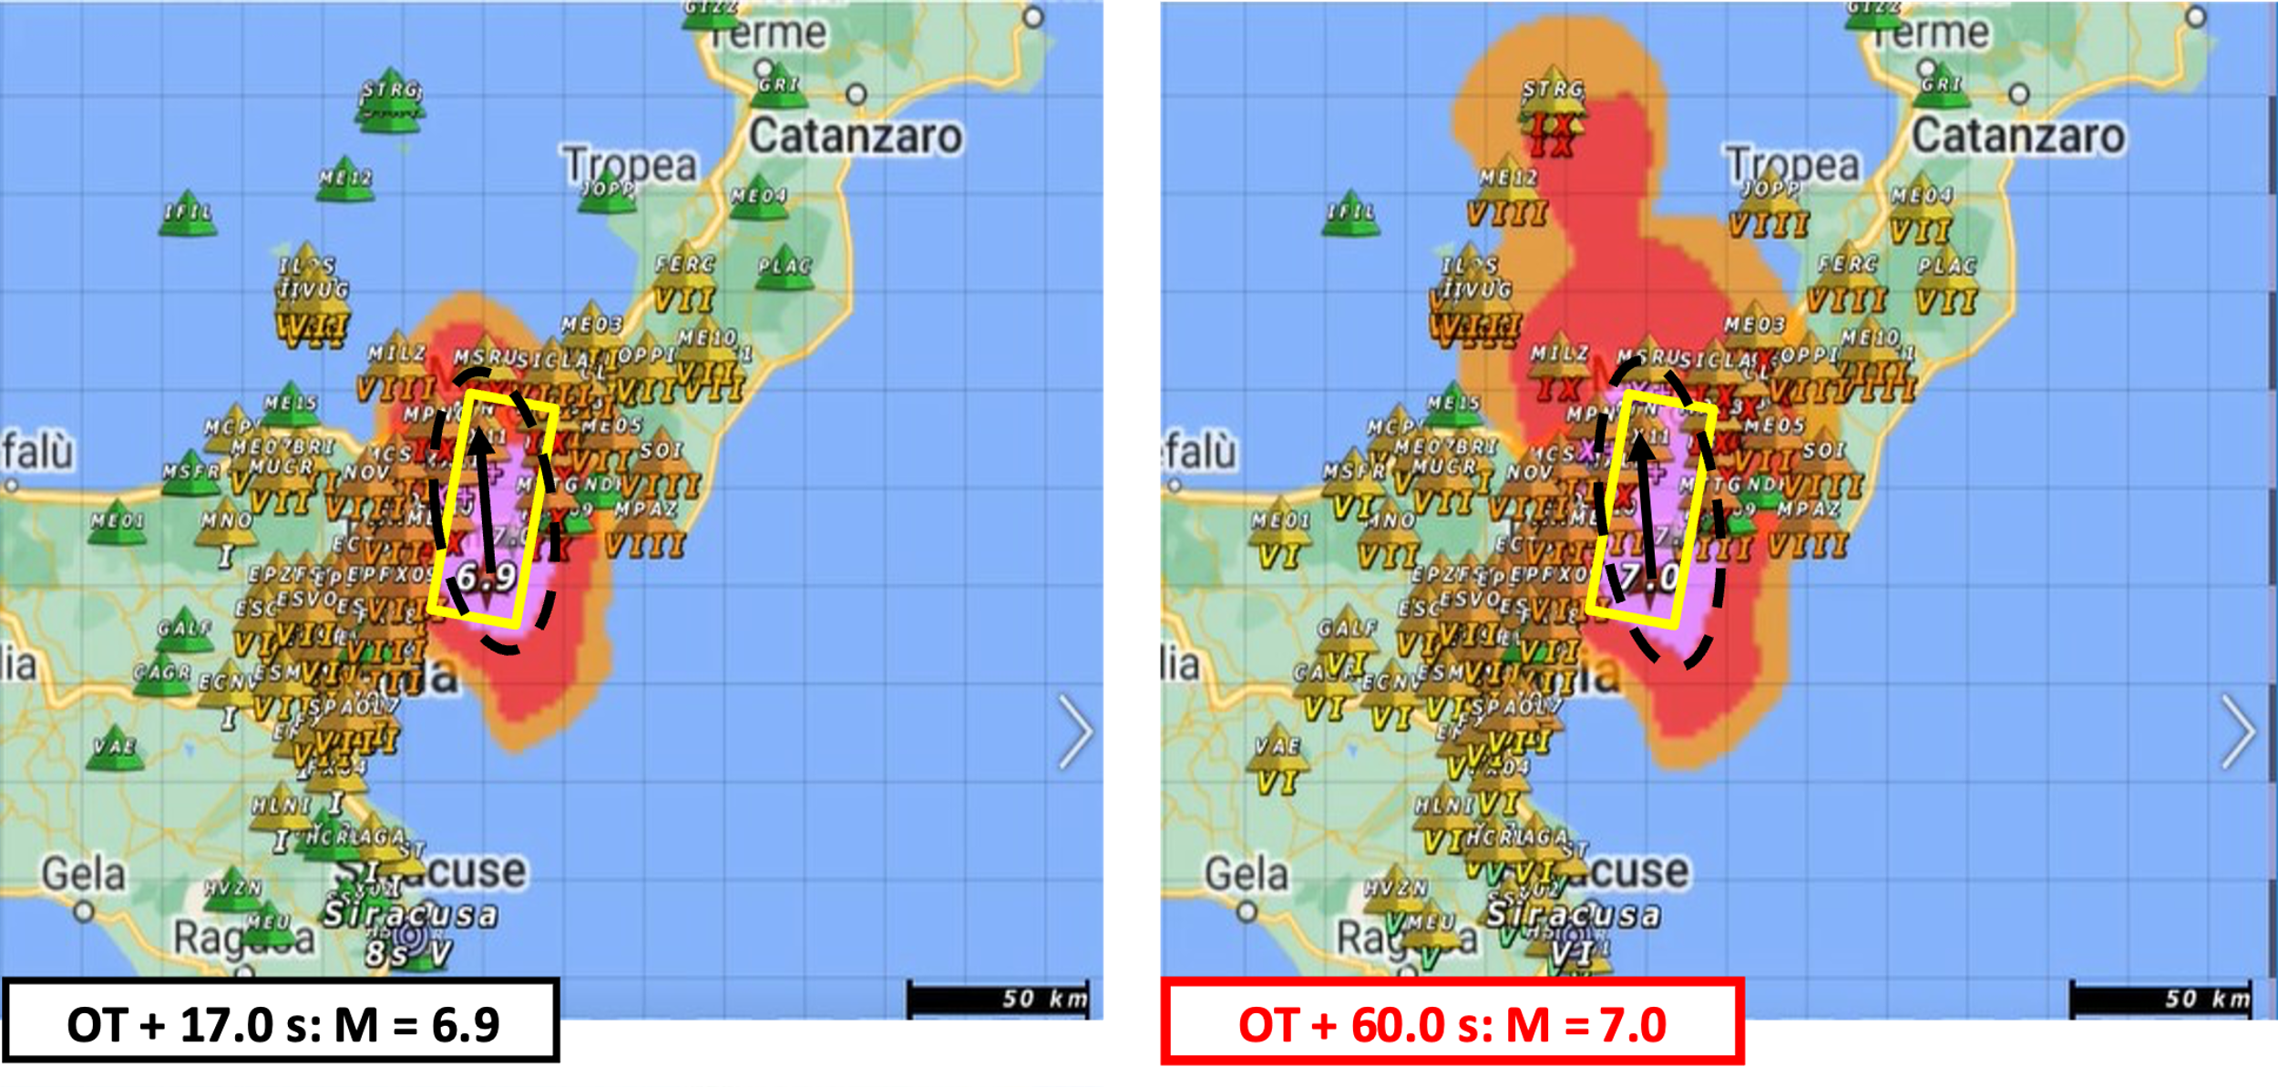
Other EU projects relevant for ICG-NEAMTWS
The EPOS-ON project
  Support to the development of the TSP-IOT
    “Certified” Data and Tools make the TSP functions/information interoperable and potentially consistent
    Redundancy of data/information for-and-among TSPs and TSP operations is fostered
    Data/Products (Repository) accessible to TSPs via a webservice
  Pilot cases for integration with EEW

Slide 7
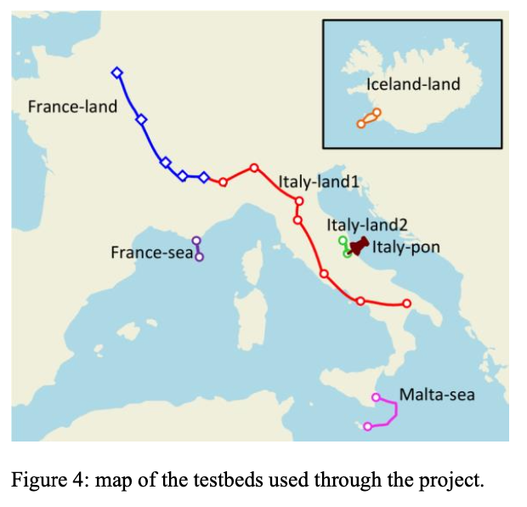
Other EU projects relevant for ICG-NEAMTWS
SENSEI - SMART EUROPEAN NETWORKS FOR SENSING THE ENVIRONMENT AND INTERNET QUALITY
One task dedicated to assessing the capability of subsea fibers to detect tsunami waves
Testbeds for it: France-sea, Malta-sea

Slide 8
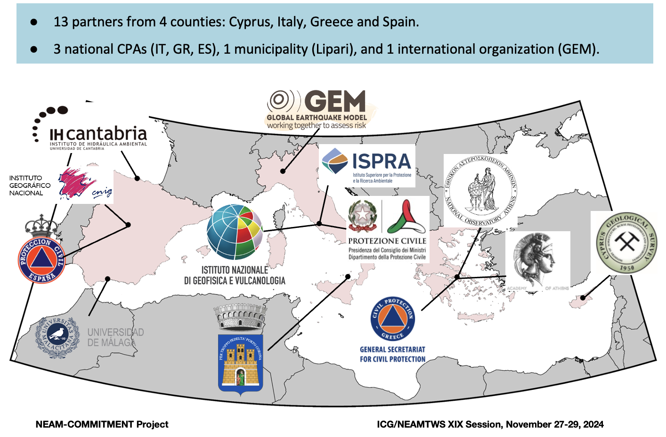
Other EU projects relevant for ICG-NEAMTWS
ΝEAM Collaboration fOr iMproved tsunaMi rIsk miTigation and management (NEAM-COMMITMENT)
- Coordinated by NOA, Greece
supported by the TR IOC-UNESCO Section
uses science-informed participatory approach to decision-making

Slide 9
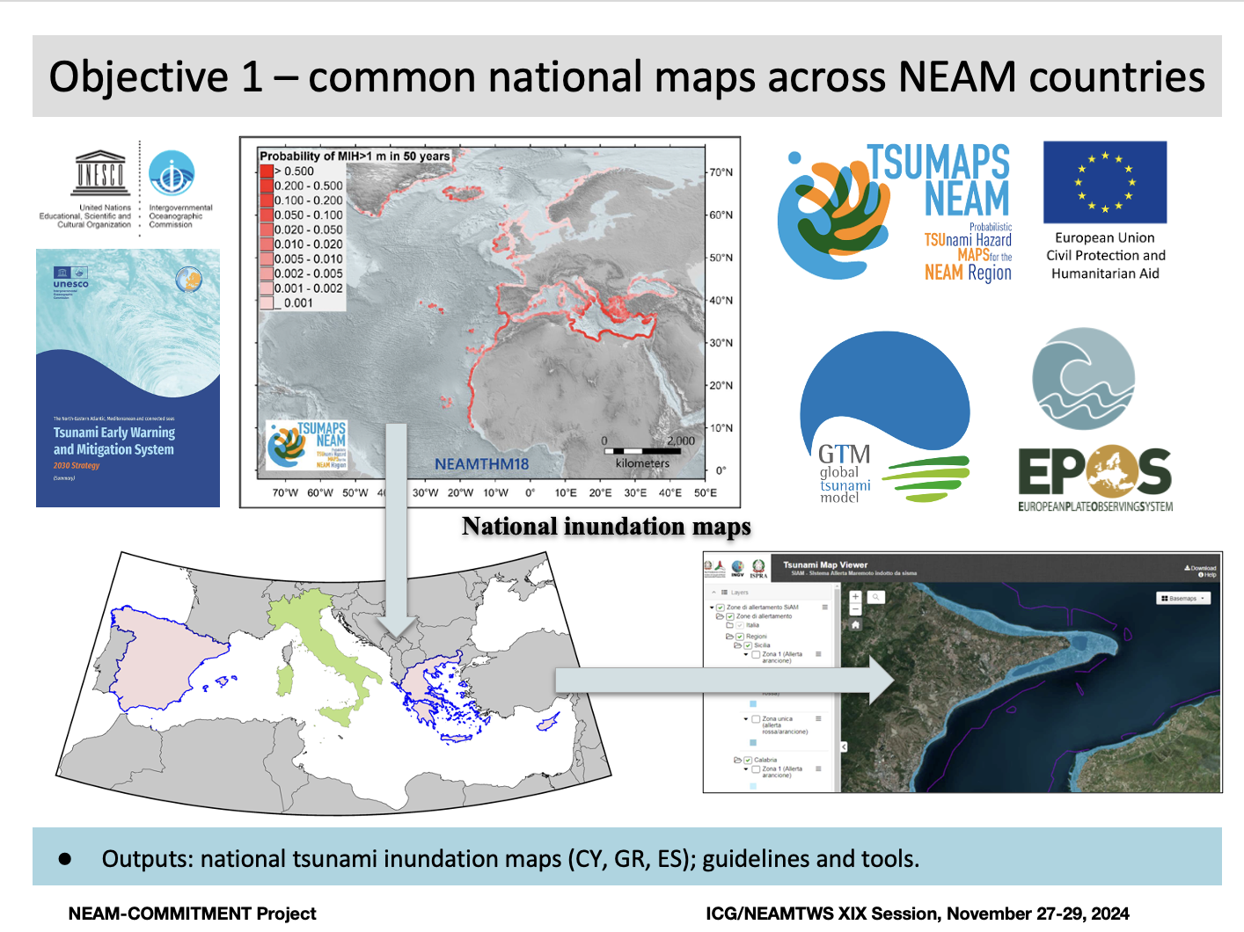
Other EU projects relevant for ICG-NEAMTWS
  Nation-wide evacuation planning based on NEAMTHM18 for Cyprus, Greece, Spain
  complementary to CoastWAVE 2.0

Slide 10
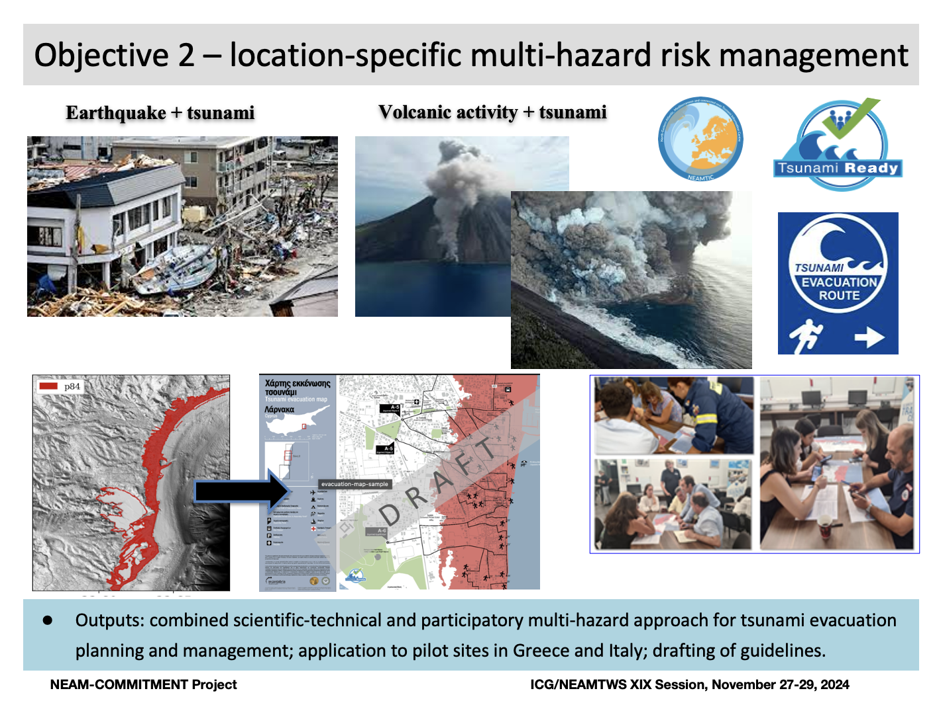
Other EU projects relevant for ICG-NEAMTWS
  Local multi-hazard evacuation planning in Stromboli, Italy (seismic and volcano tsunami + volcanic hazard)
  Local planning in Gytheio, Greece, with consideration of building resistance for vertical evacuation planning and potential damage/collapses affecting evacuation routes
  complementary to CoastWAVE 2.0

Slide 11
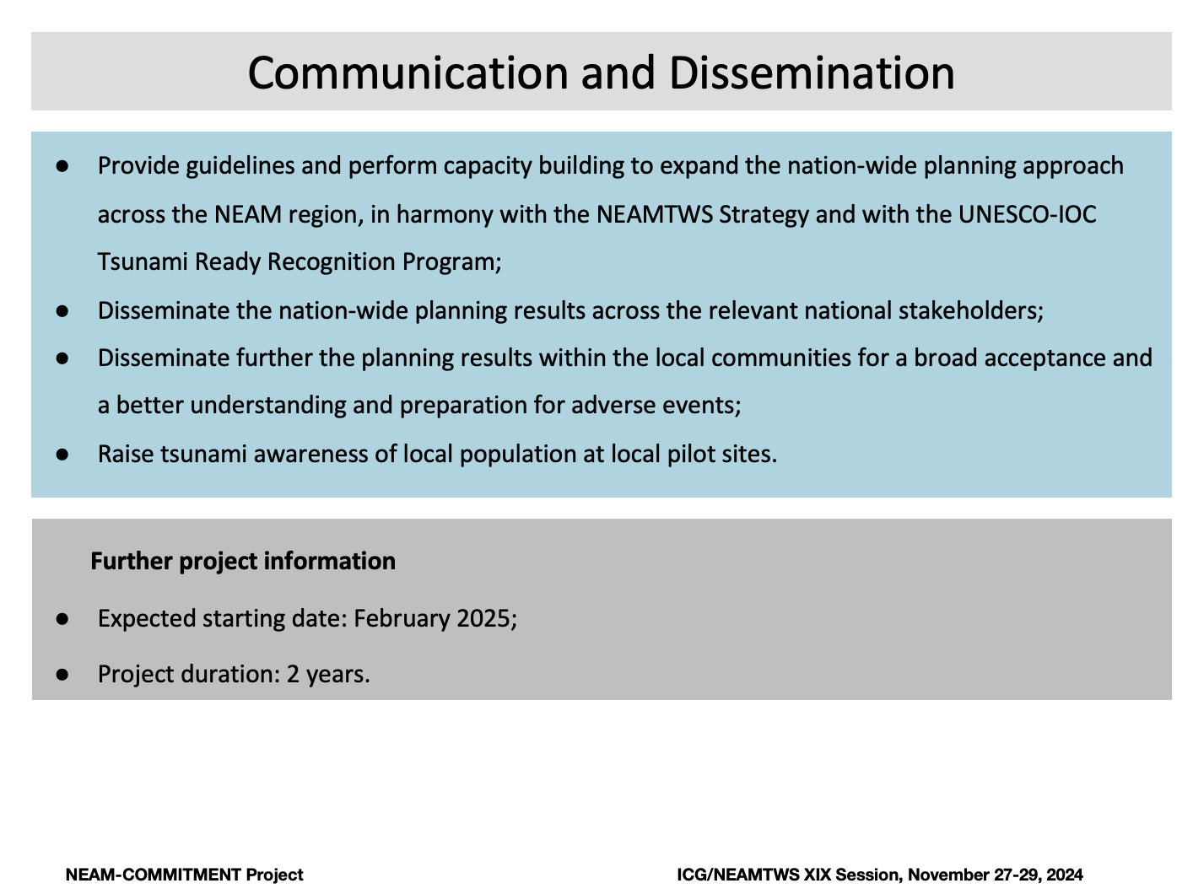
Other EU projects relevant for ICG-NEAMTWS
  Leave a legacy for further implementation of the multi-scale participatory planning approach and awareness raising to contribute to the Tsunami Ready Program

