Slide 1



Tsunami Service Provider
Hellenic National
Tsunami Warning Centre
Institute of Geodynamics
National Observatory Athens
19th session of the ICG/NEAMTWS
Paris, 27 - 29 November 2024

Slide 2
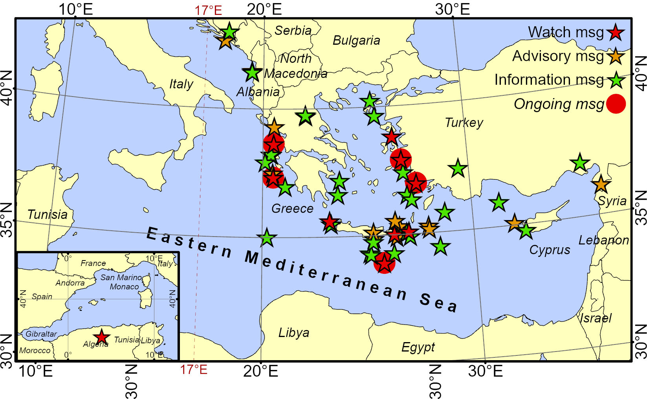
Operational activities
    1 Tsunami Warning Message in 2024
no | Date | Time (UTC) | Region | Lat | Lon | Magnitude | Alert Level
53 | 29-Mar-24 | 07:12:47 | Strofades Island, Southern GR | 36.99 | 21.09 | 5.8 | Information

Slide 3
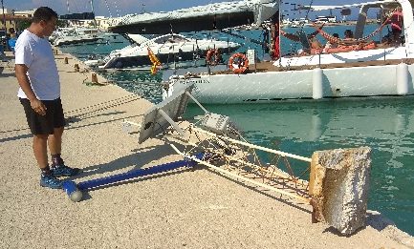
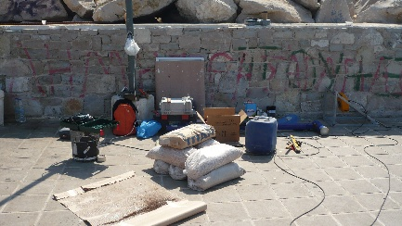
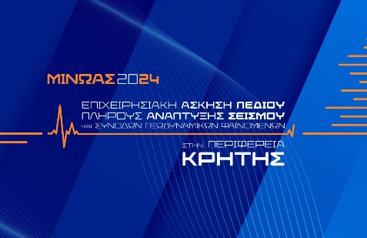
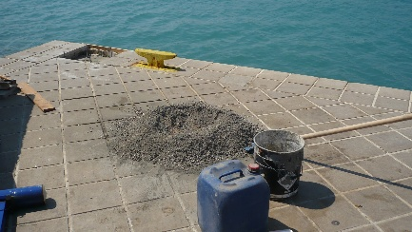
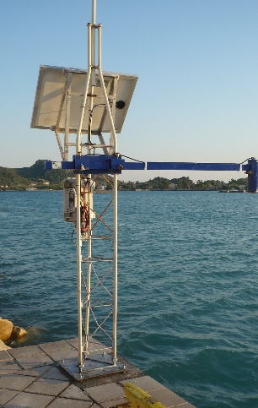
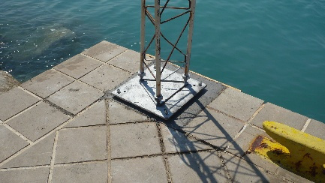
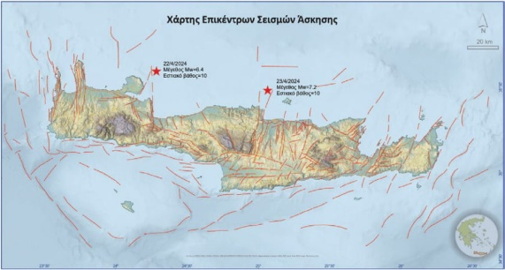
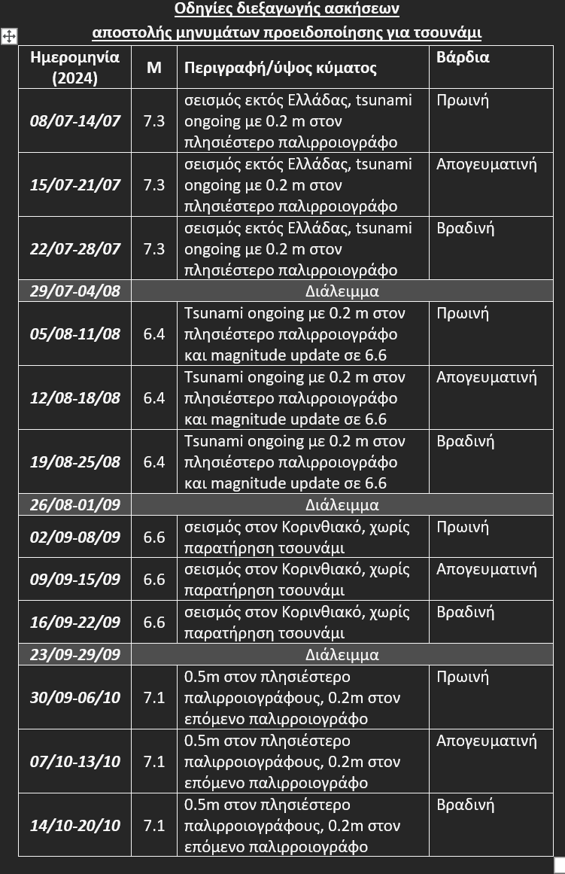
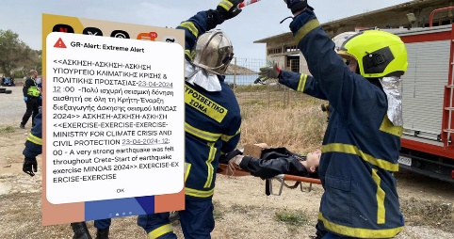
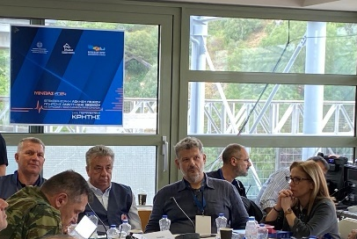
Operational activities
    Tide Gauge maintenance
    on a need-to and can-do basis
    FSX MINOAS
    Co-organizing and participating in a national earthquake and tsunami exercise for the whole island of Crete.
    Daily scenario-based tsunami drills
    for internal training
    of the duty officers in HL-NTWC

Slide 4
Scientific / Research activities
    HL-NTWC is participating in the following projects and initiatives:
    • Aristotle-eENHSP (2020 - …)
    • EPOS Tsunami TCS (2021 - …)
    • CoastWAVE (2022 - 2024)
    • MINOAS National earthquake and tsunami Full-Scale Exercise in Crete (2024)
    • SUBMERSE (2023 - 2025)
    • Geo-INQUIRE (2022 - 2026)
    • DEMONAX earthquake and tsunami Full-Scale Exercise in Cyprus (2024 – 2026)
    • EPOS-ON (2024 - 2027)
    • TRANSFORM2 (2024 - 2027)
    • NEAM-COMMITMENT (2025 - 2027)
Notes:
Geoscience use cases / existing telecommunication DAS and SOPs / Preveza

Slide 5
Participation in workshops and meetings
    GTM foundation meeting in Rome.
    In person (Athens and Rome) and online NEAMTWS inter-TSP meetings, co-organized between TT-OP and TT-DOC.
    Project-related meetings (e.g., CoastWAVE progress meetings, EPOS-ON kick off meeting, etc.).
    EPOS TSUNAMI TCS meetings (in person and online).
    17th Meeting of the Working Group on Tsunamis and Other Hazards related to Sea Level Warning and Mitigation Systems (TOWS-WG-XVII), in Sendai, Japan.
    2nd Global Tsunami Symposium, in Banda Aceh, Indonesia, with two invited speakers.
    INGV Workshop on Tsunami warning @Stromboli: Observations, Modelling, Hazard, Forecasting. -> Approaches/methodologies relevant to the Kolumbo submarine volcano in the Aegean Sea.

Slide 6
Ongoing developments
    • A tender for the purchase of 12 new tide gauges and new server for the pilot implementation of PTF will be issued before the end of 2024.
    • Signing an agreement with INGV for the collaborative installation and operation of 2 new tide gauge stations, in the Ionian Sea.
    • Development of a national tsunami warning page to publish information related to tsunami
    events for the public.
    • Development of a new platform for acquisition, storage and presentation of raw real-time and quality-controlled sea level data from NOA’s tide gauge network.

Slide 7
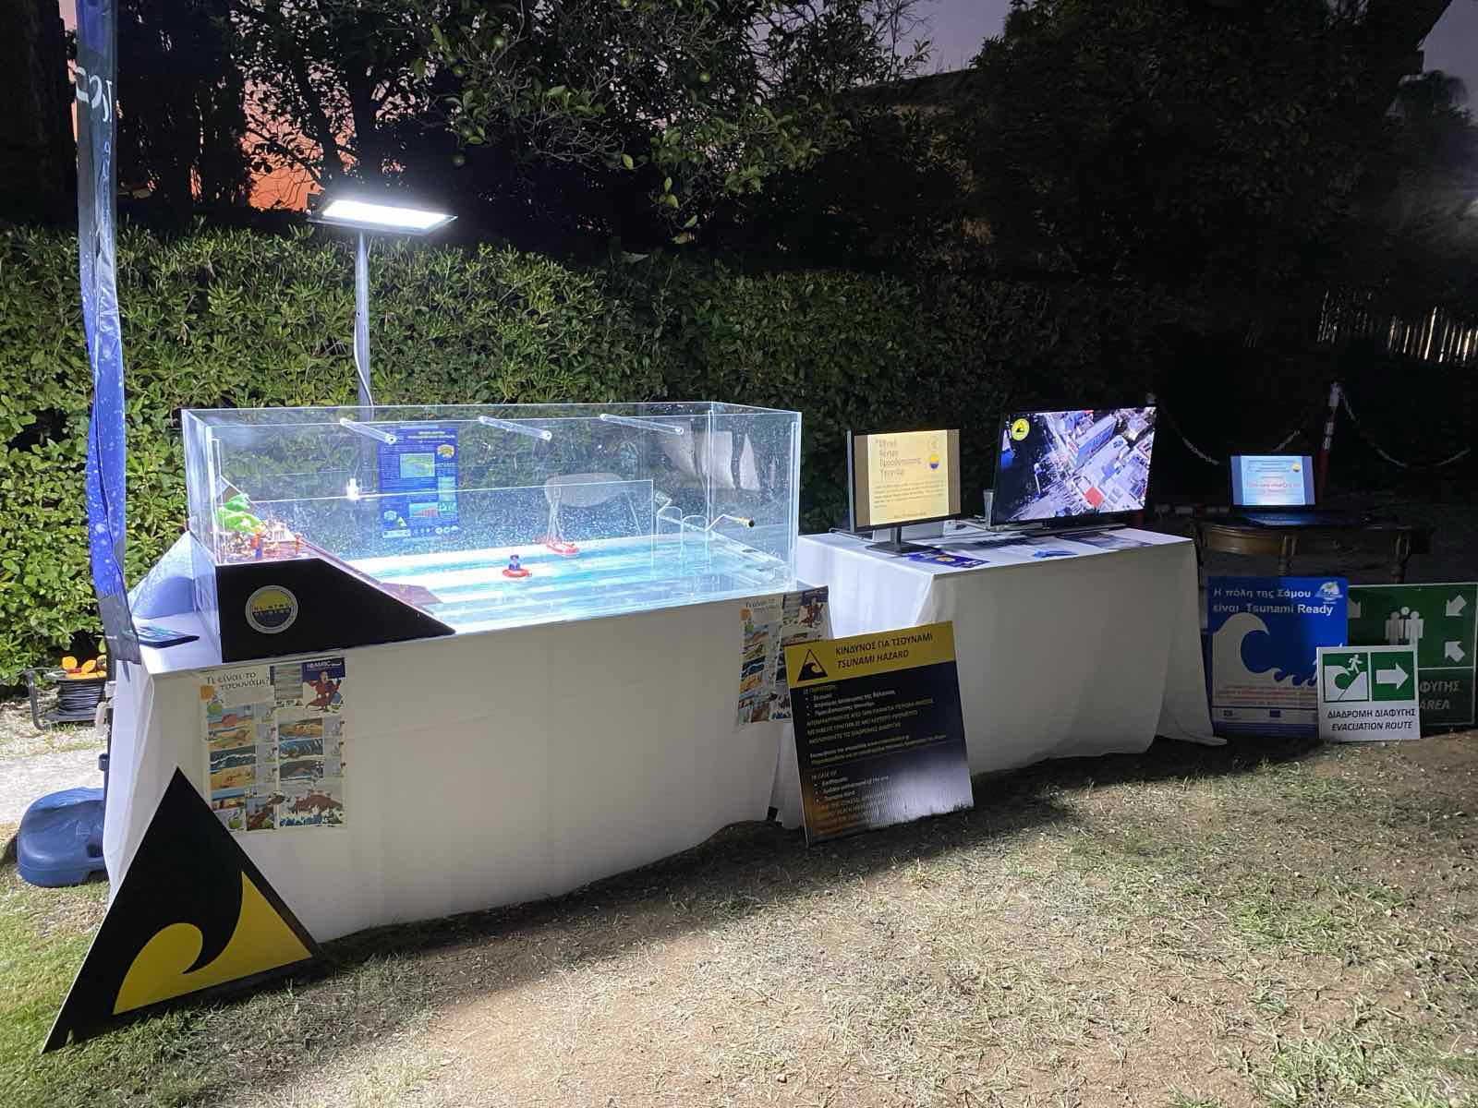
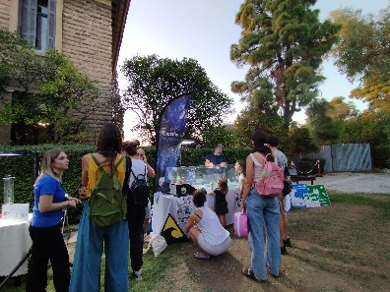
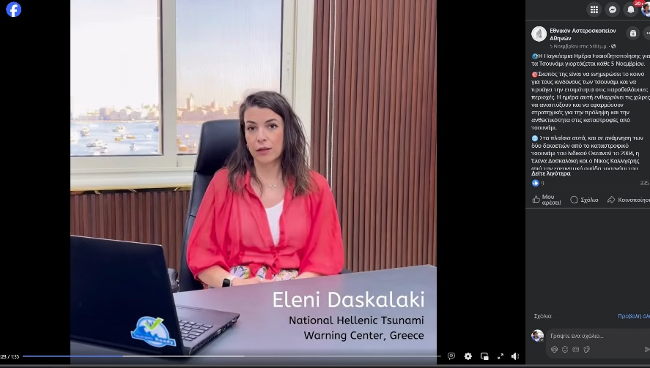
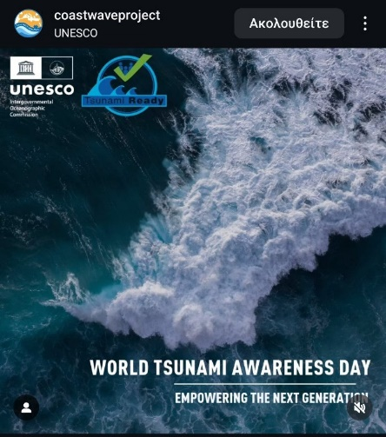
Awareness activities
  Researchers' night – September 2024
  Tsunami awareness activity for the public
  WTAD - NOA’s official channel
  Social media reposts

Slide 8
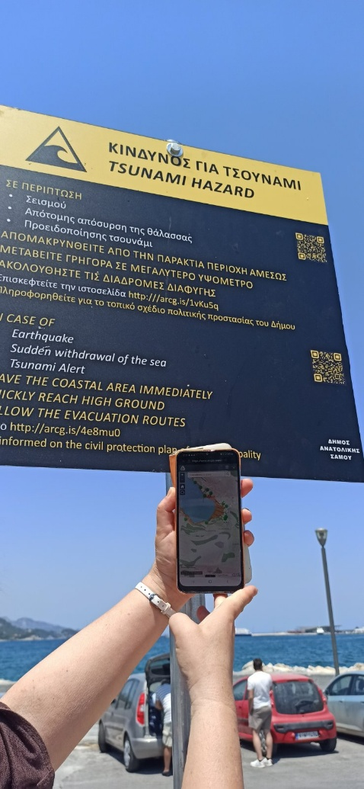
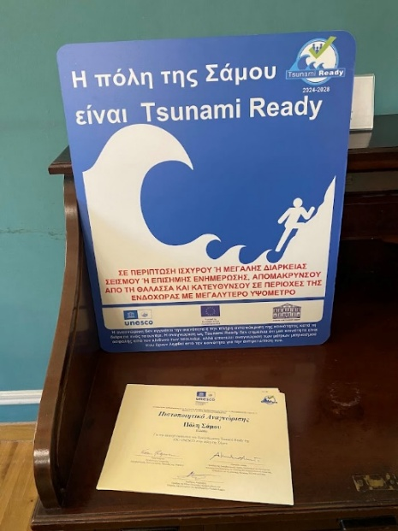
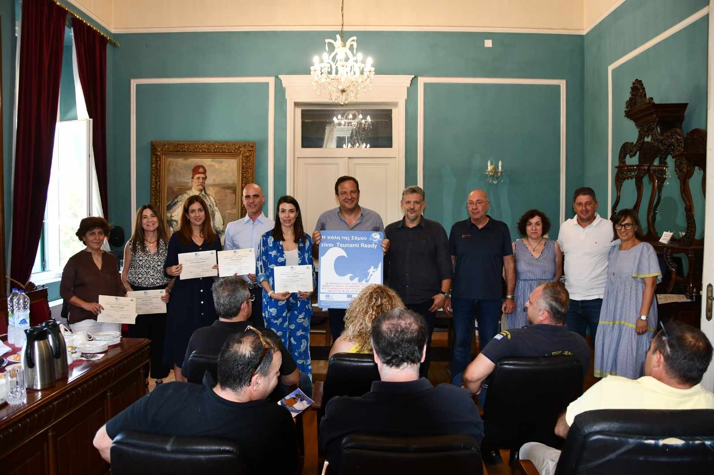
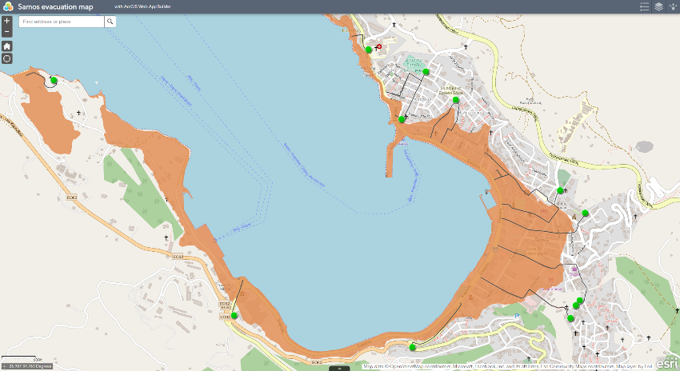
TSUNAMI READY
  Samos
  1st community in Greece
  Recognized as Tsunami Ready

Slide 9




*
19th session of the ICG/NEAMTWS
Paris, 27 - 29 November 2024

