Slide 1
National Report of Egypt
Activities of Tsunami in Egypt
During 2024
Prof. Mohamed Said

Slide 2
Workshop on:
The Alexandria tsunami between reality and illusion.
Will Alexandria sink?
31 July 2024

Slide 3
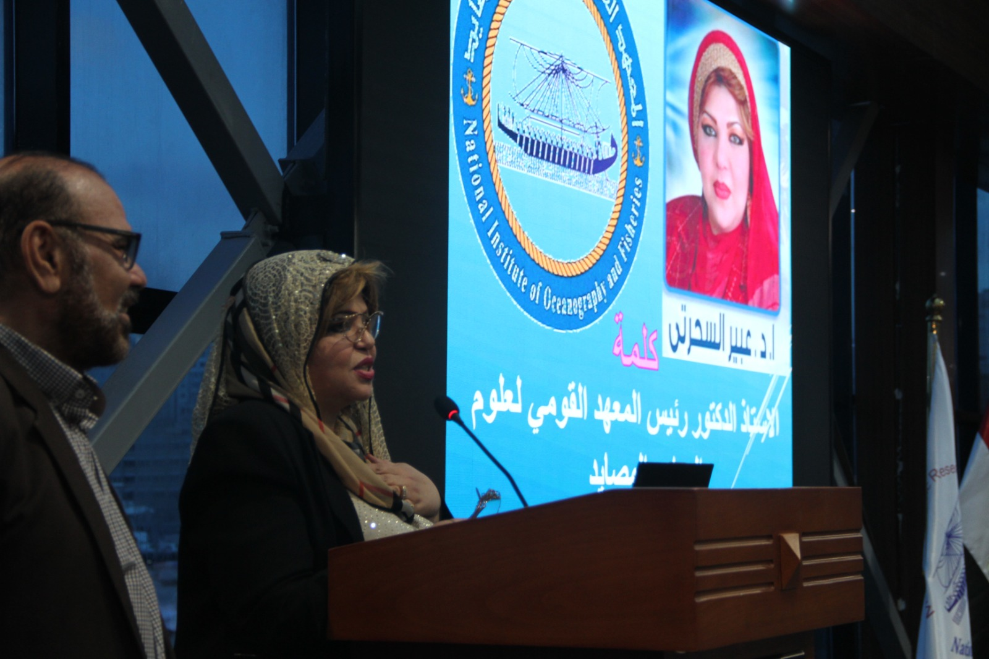
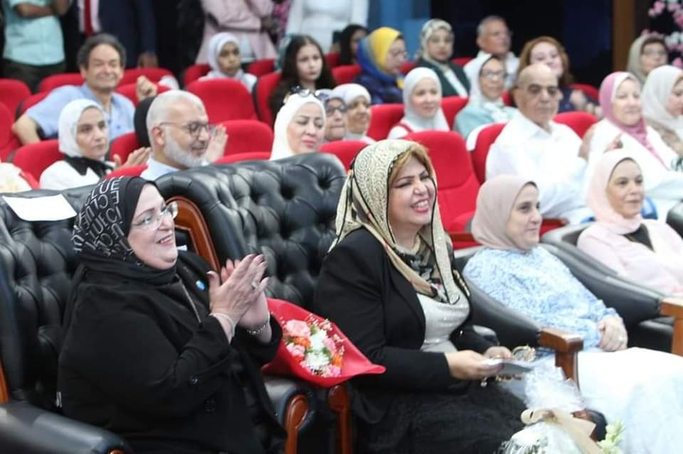
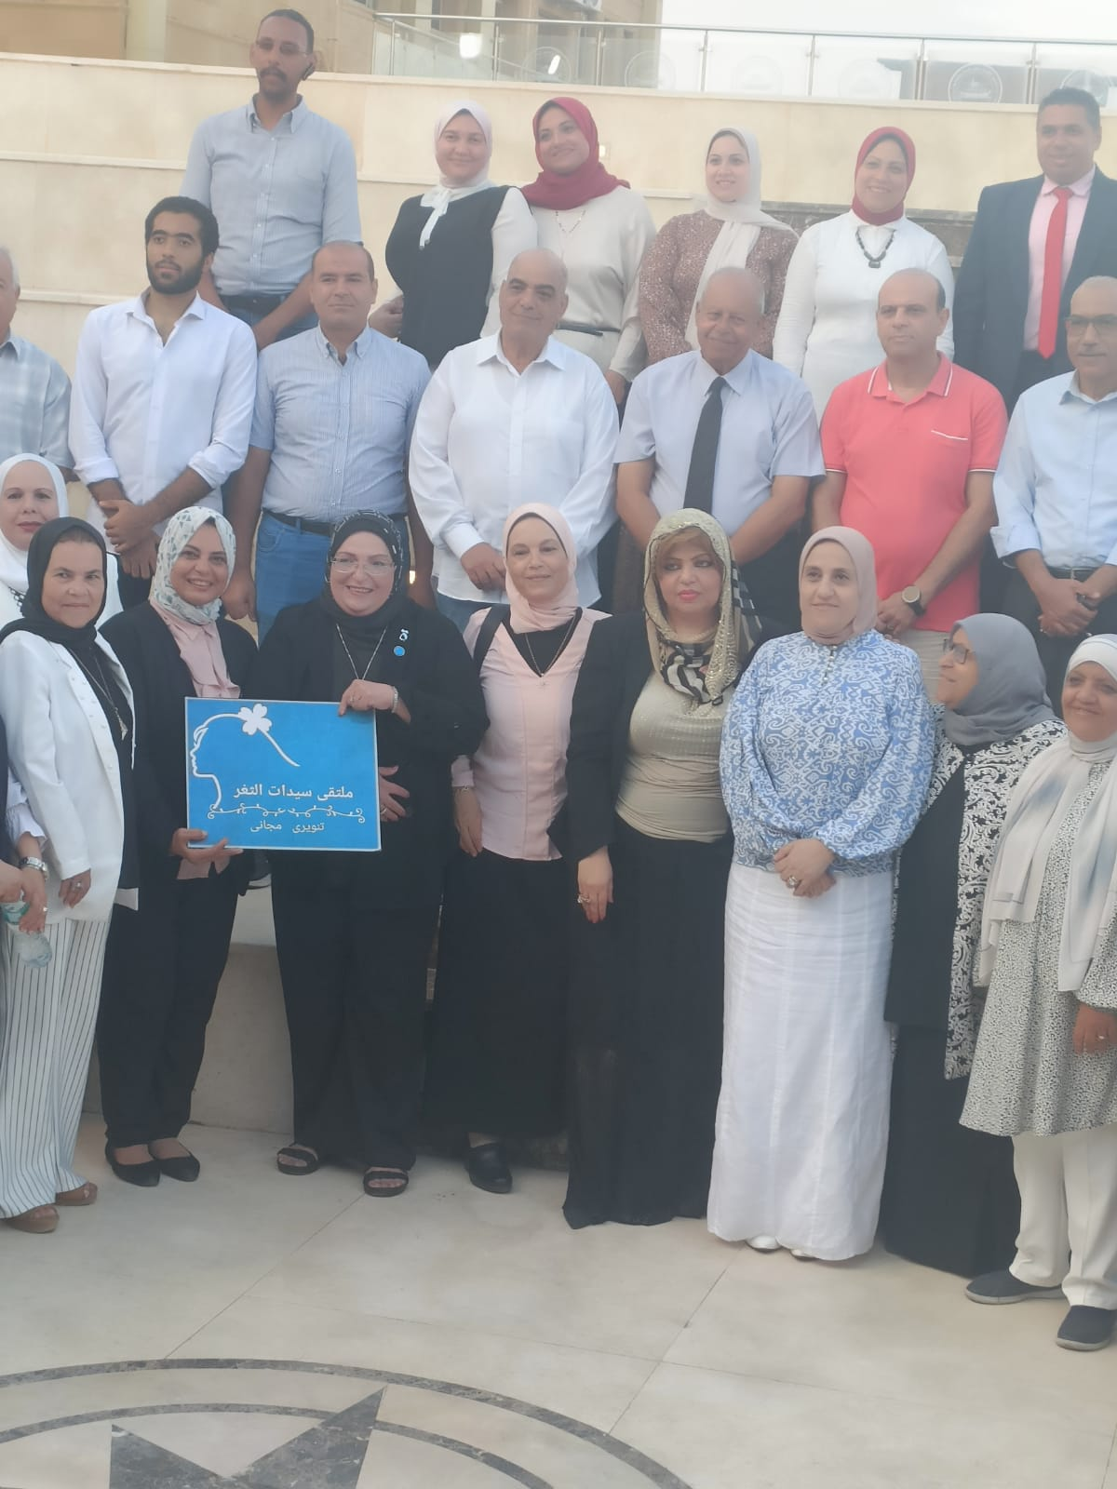
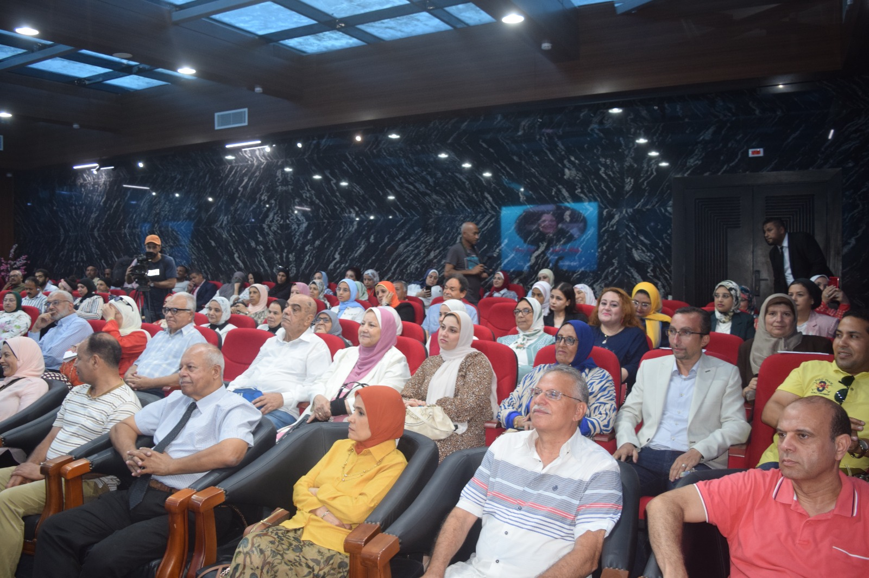
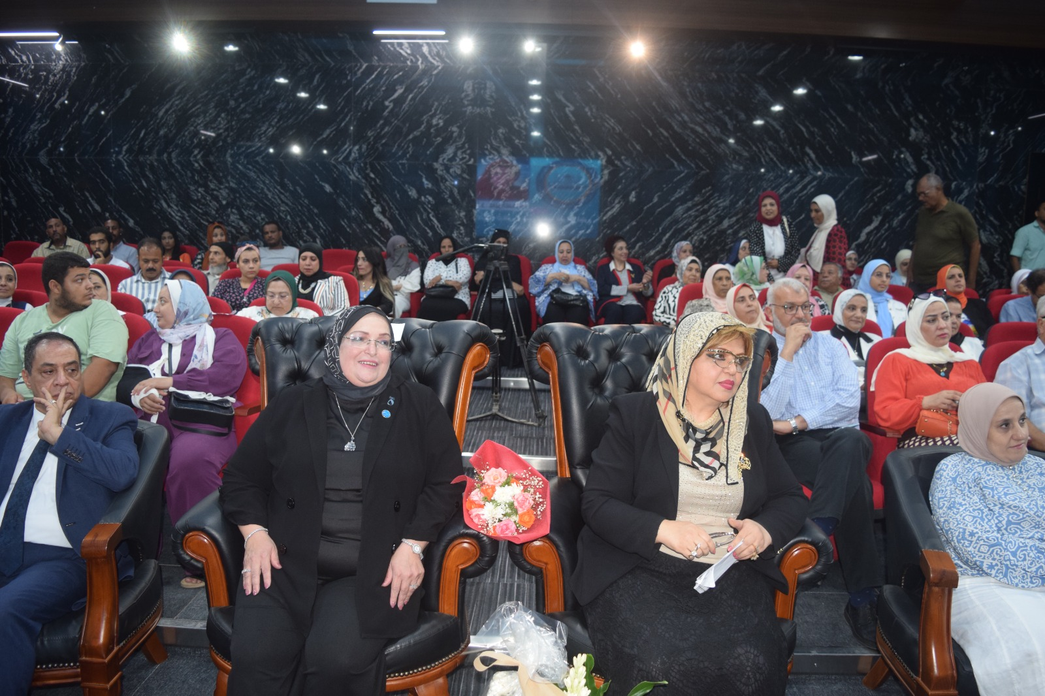
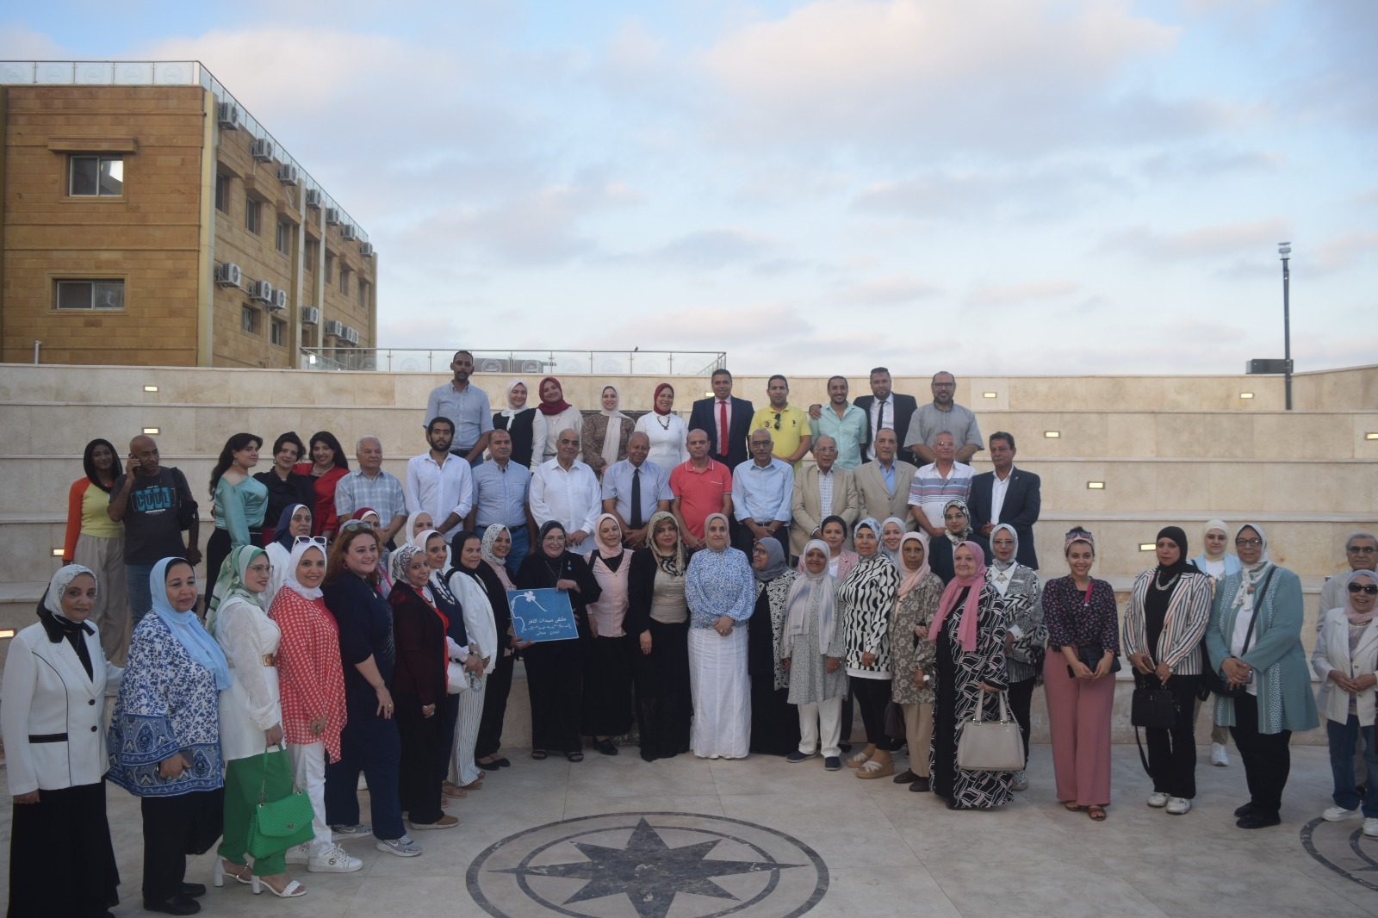
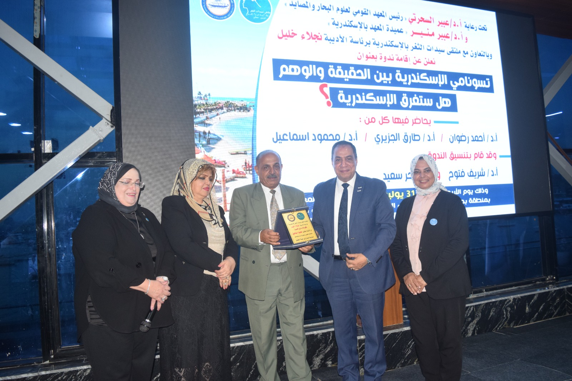
Workshop on Tsunami
31 July 2024

Slide 4
Workshop on Climate Change risk management in coastal cities –preparation workshop ahead of the United Nations Ocean Conference
Alexandria, Egypt, 17 October 2024
NIOF with a cooperation of Avitem (France) organized a Workshop on Climate Change risk management in coastal cities –preparation workshop ahead of the United Nations Ocean Conference (UNOC3) which will be held in Nice (France) in June 2025. The Workshop focused on coastal risks and resilience processes including tsunami in all dimensions: knowledge, strategy and operational solutions, governance and financing.
The title of my presentation was: Coastal sea level monitoring in the Egyptian Mediterranean waters. Case Study: Alexandria facing the risks of submersion, erosion and tsunami.

Slide 5
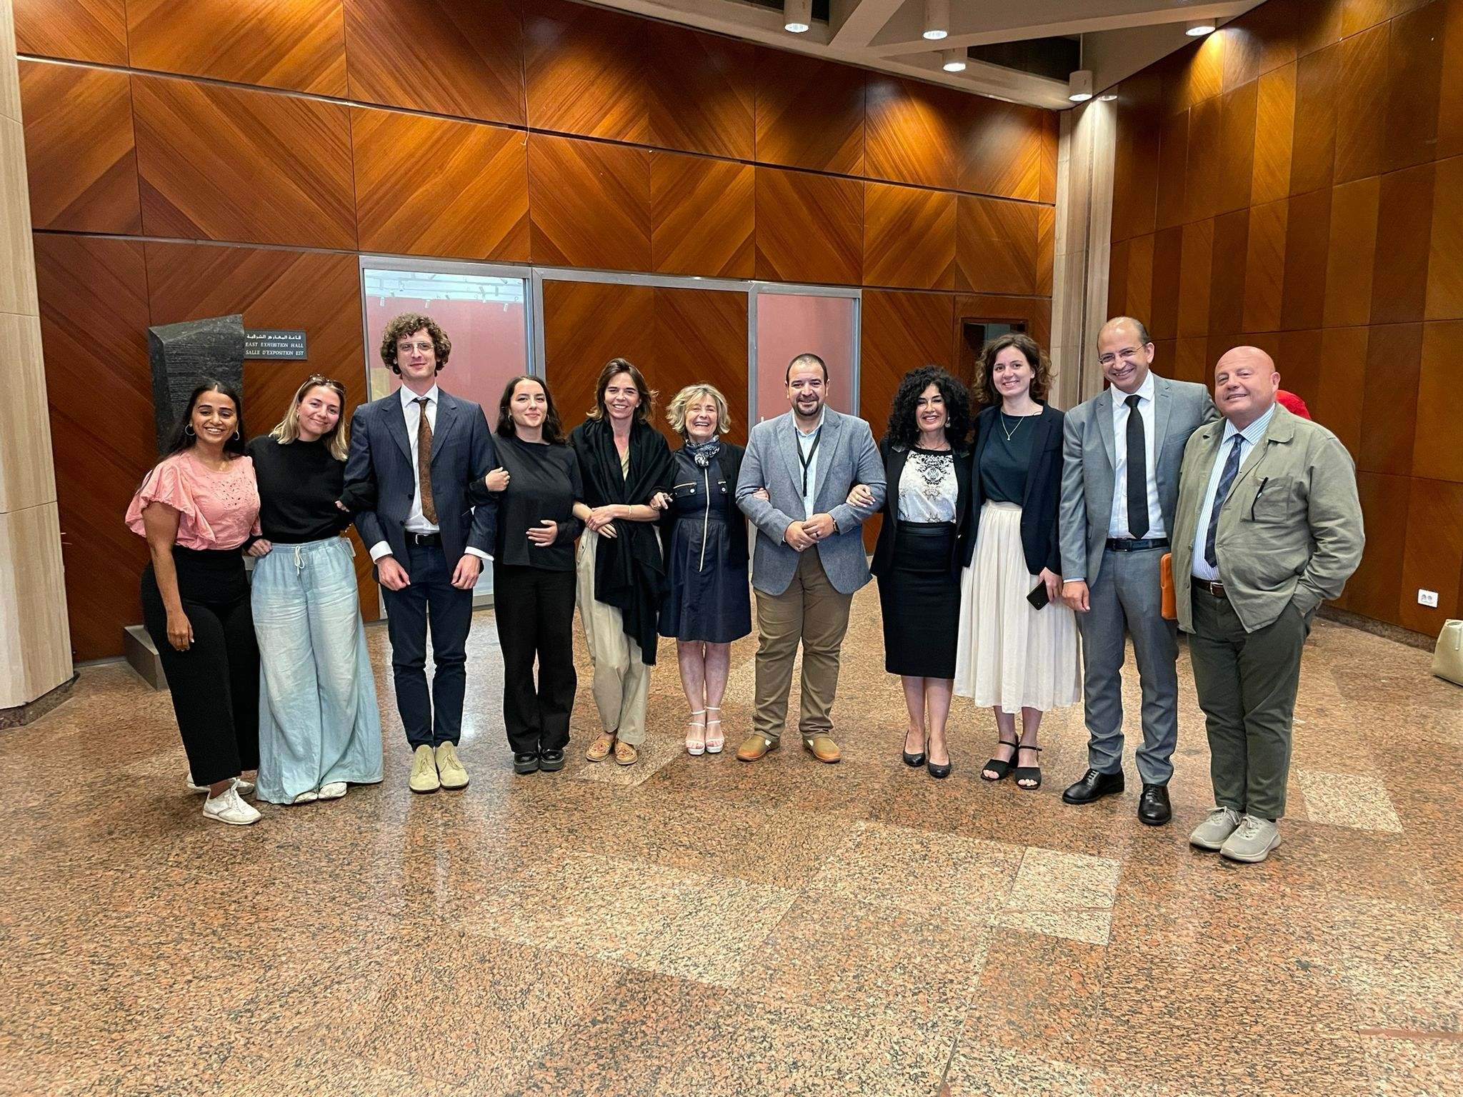
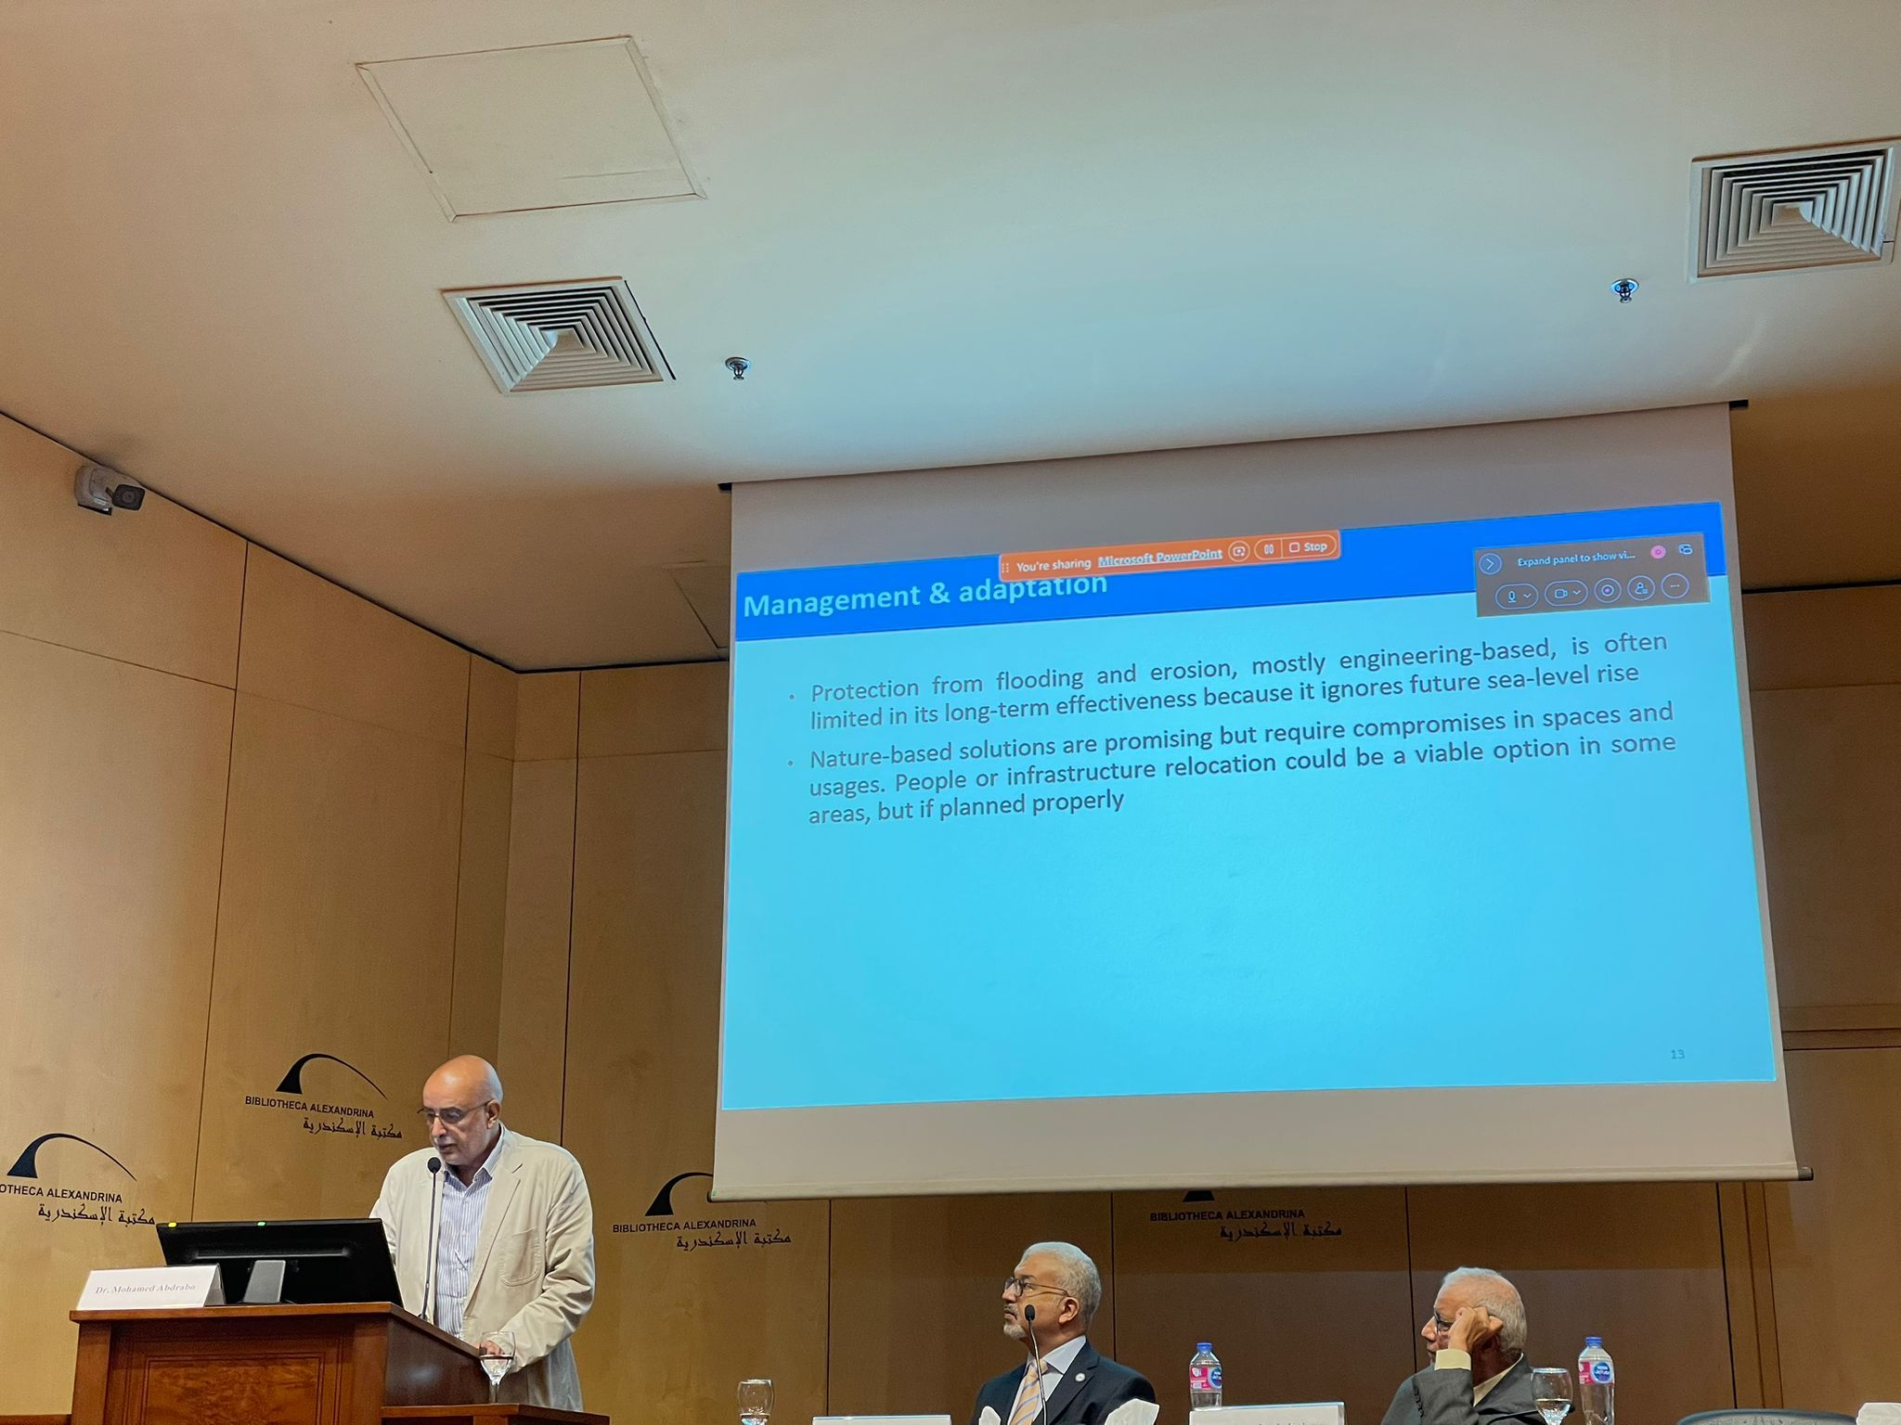
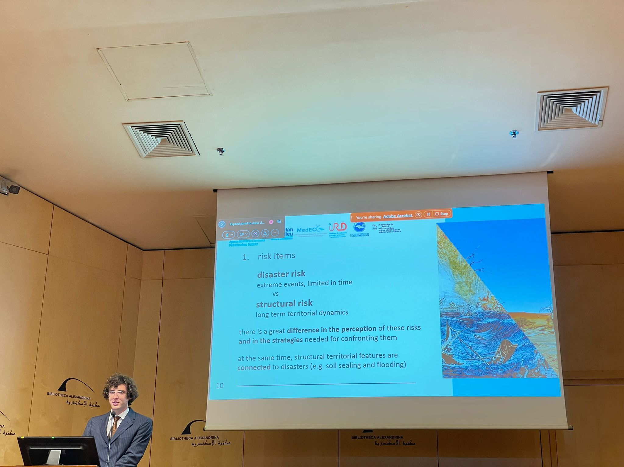
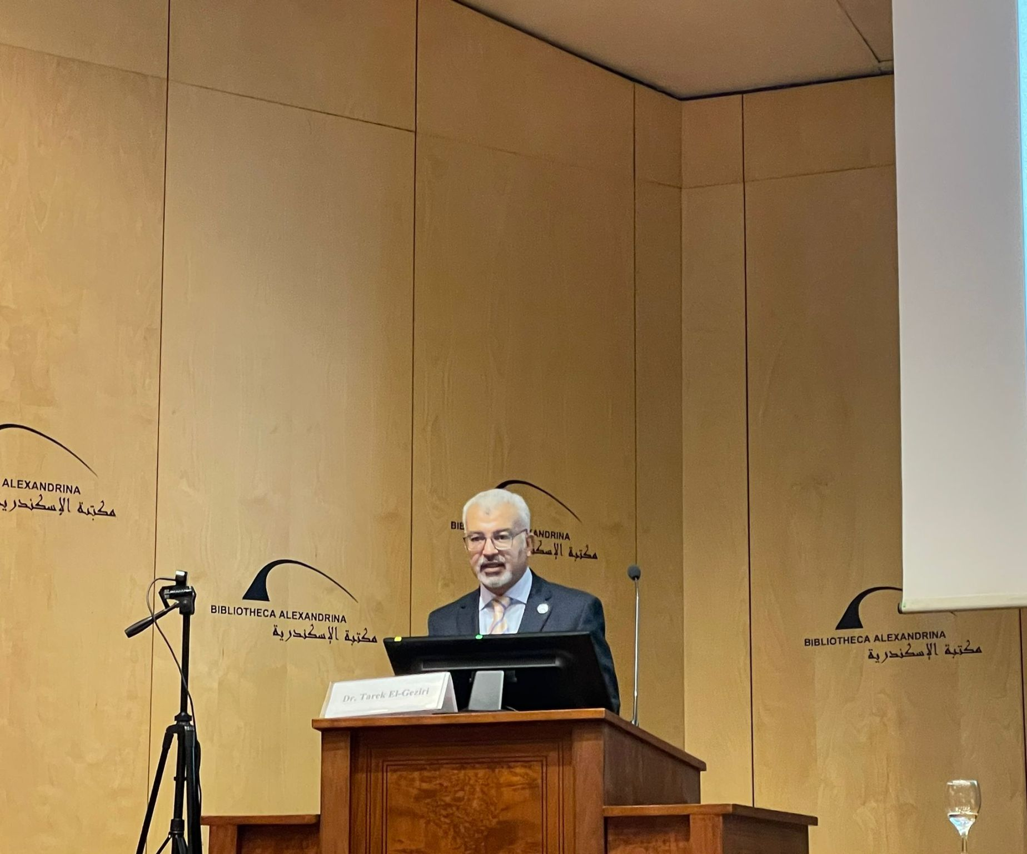
17 October 2024

Slide 6
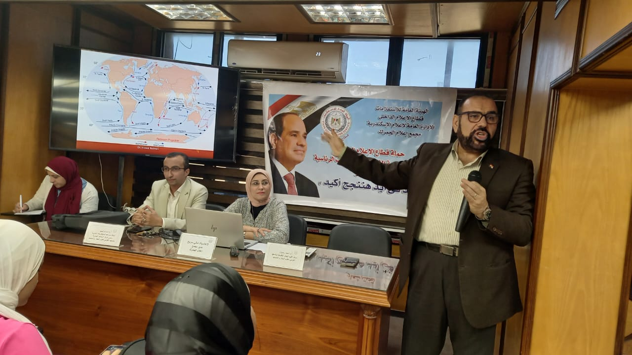
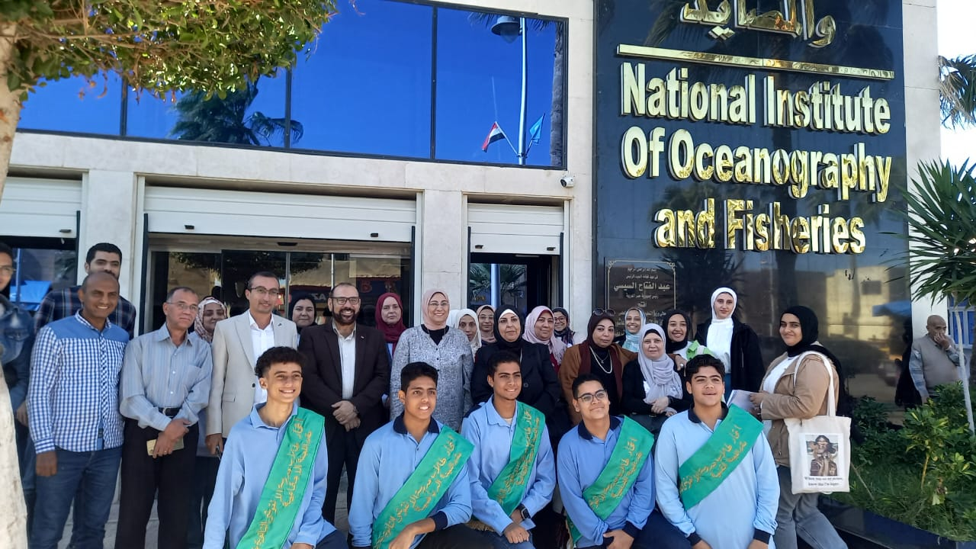
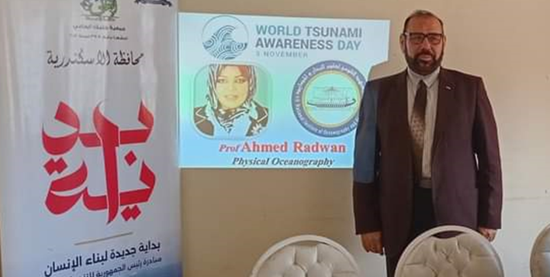
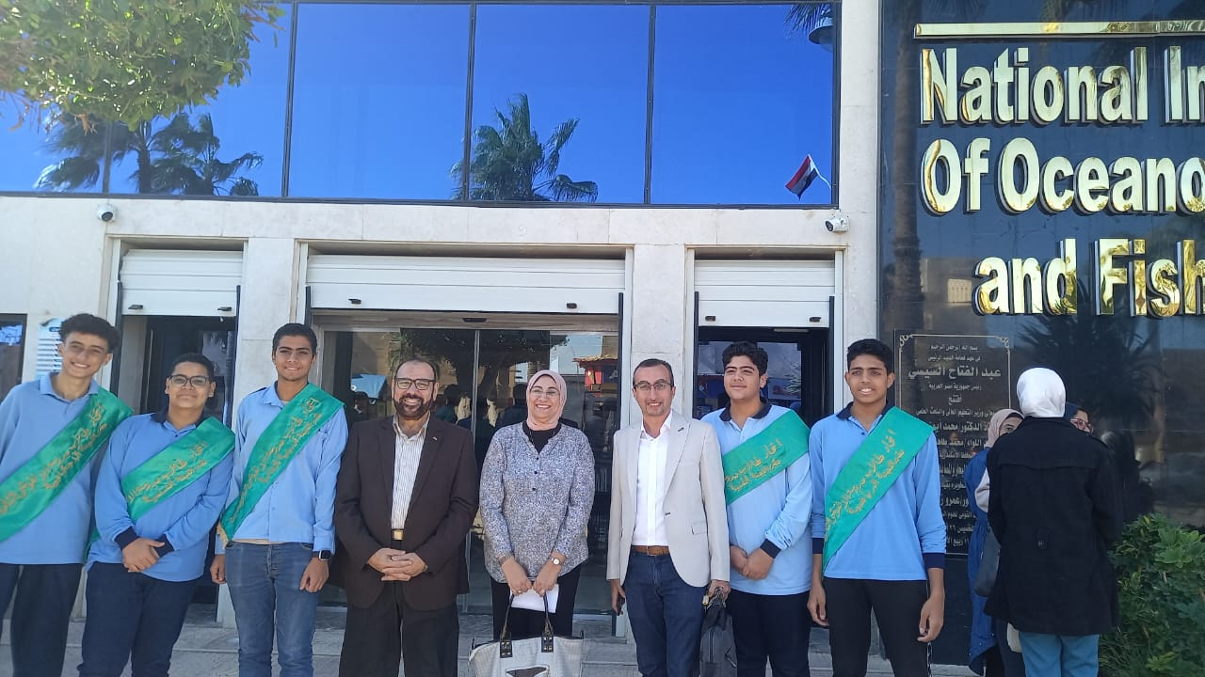
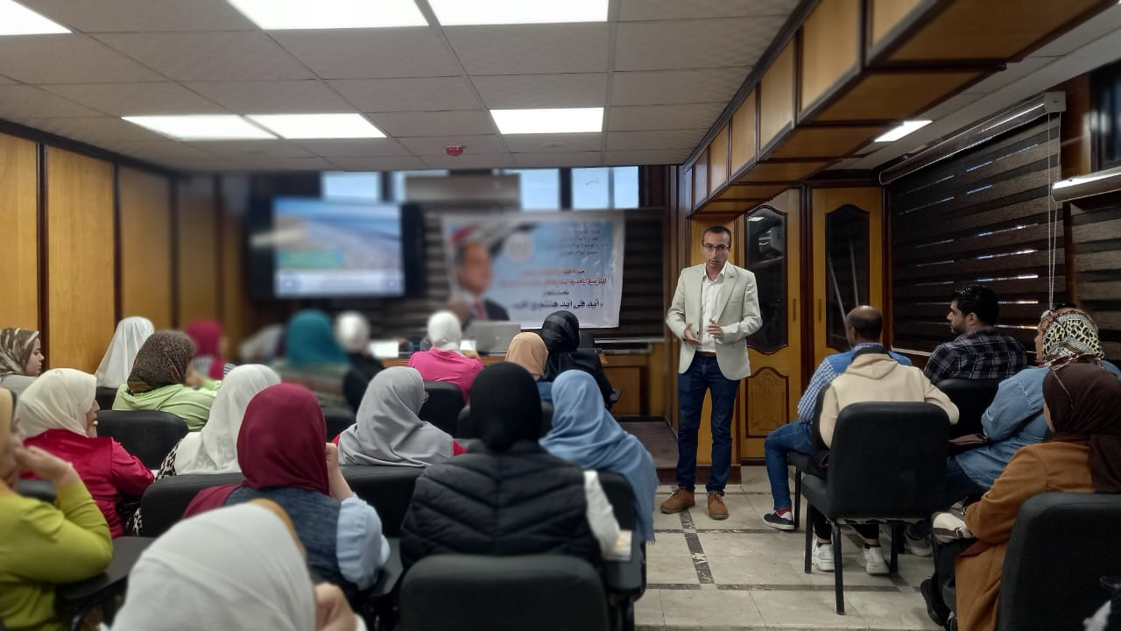
13
November
2024

Slide 7
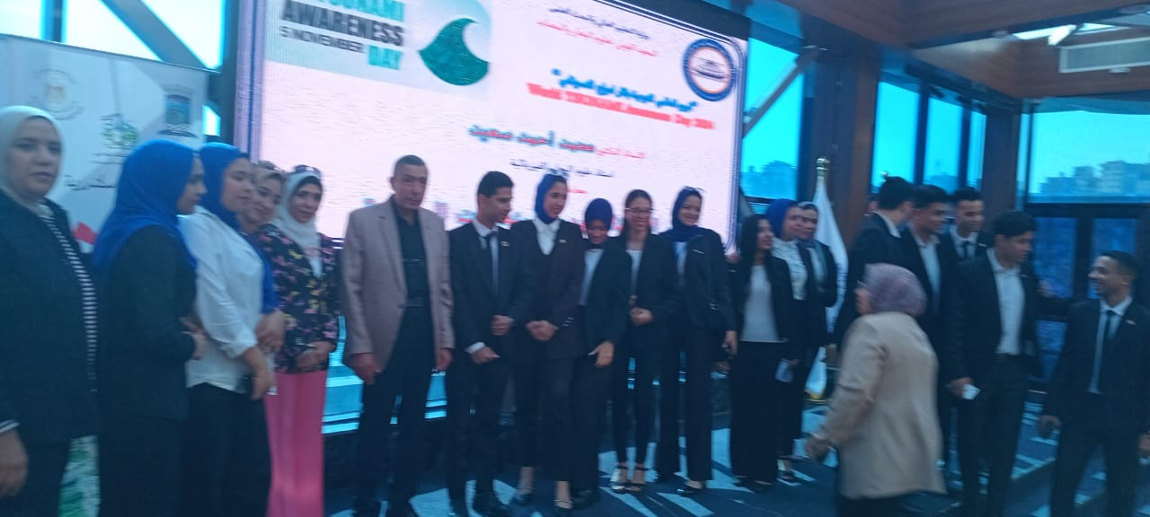
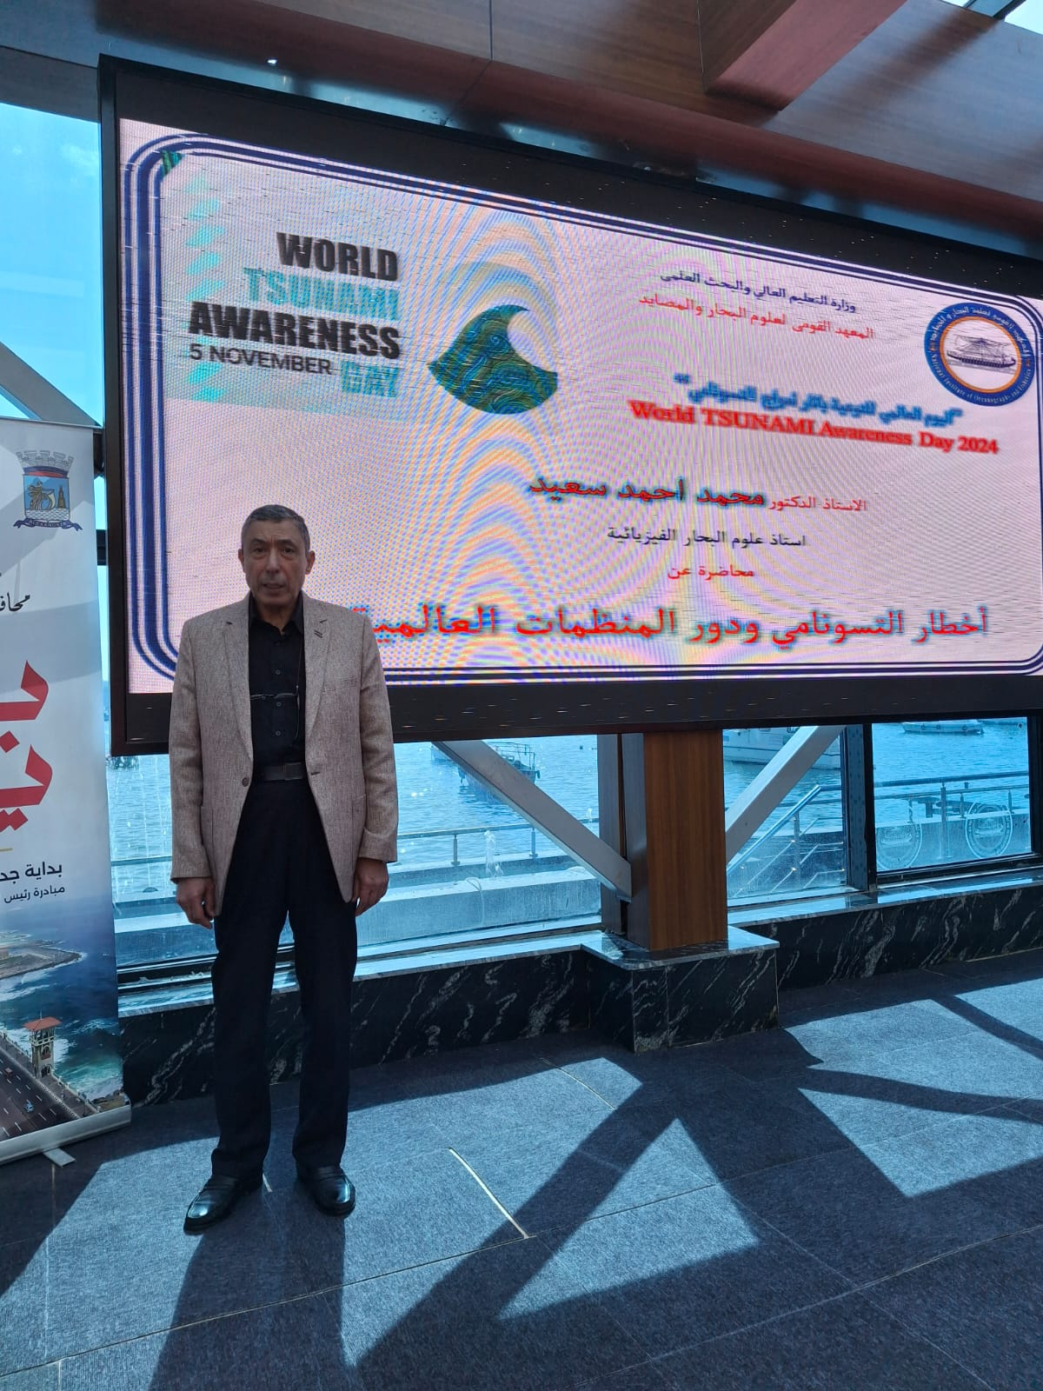
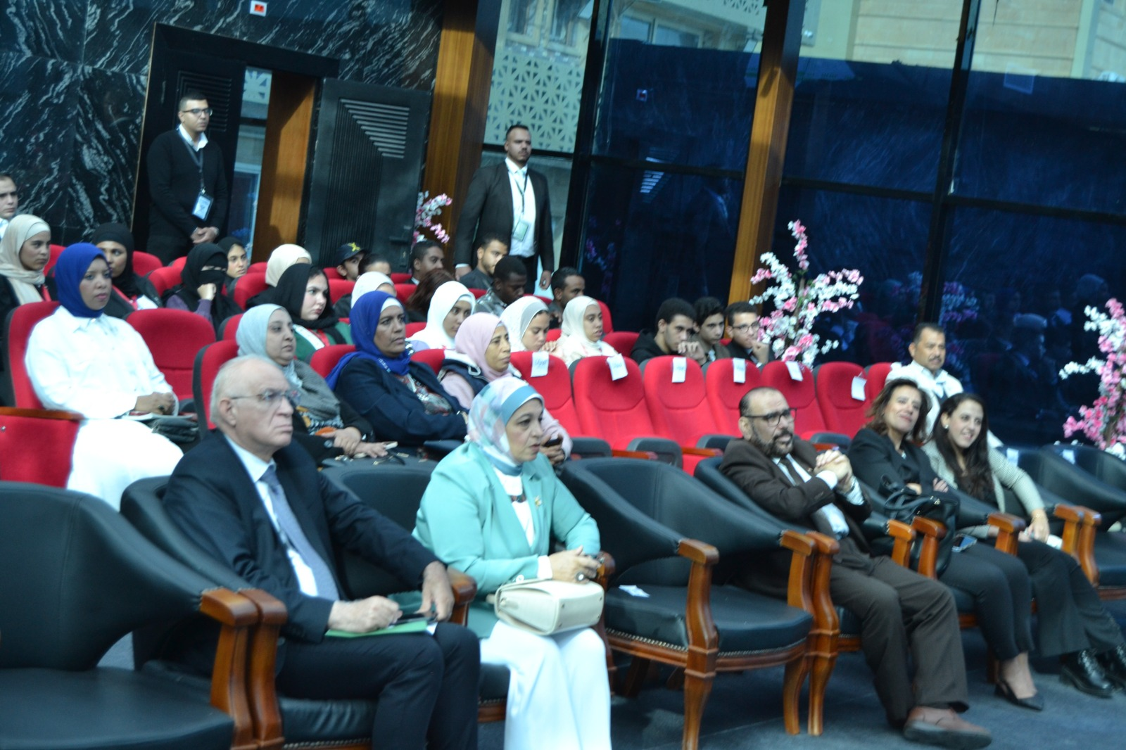
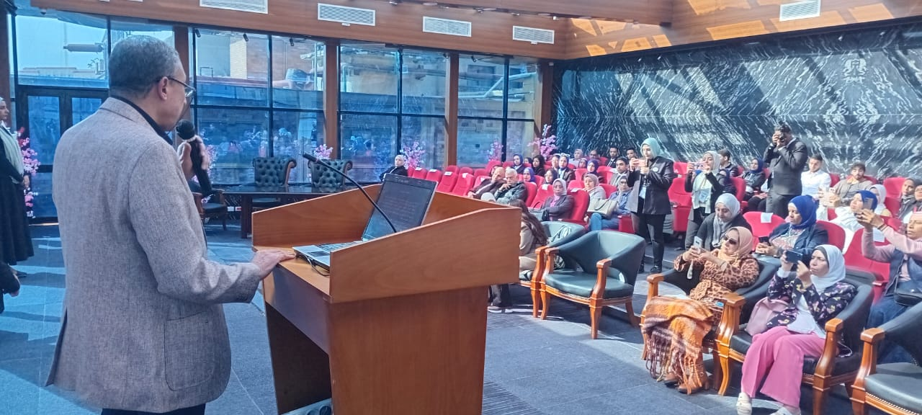
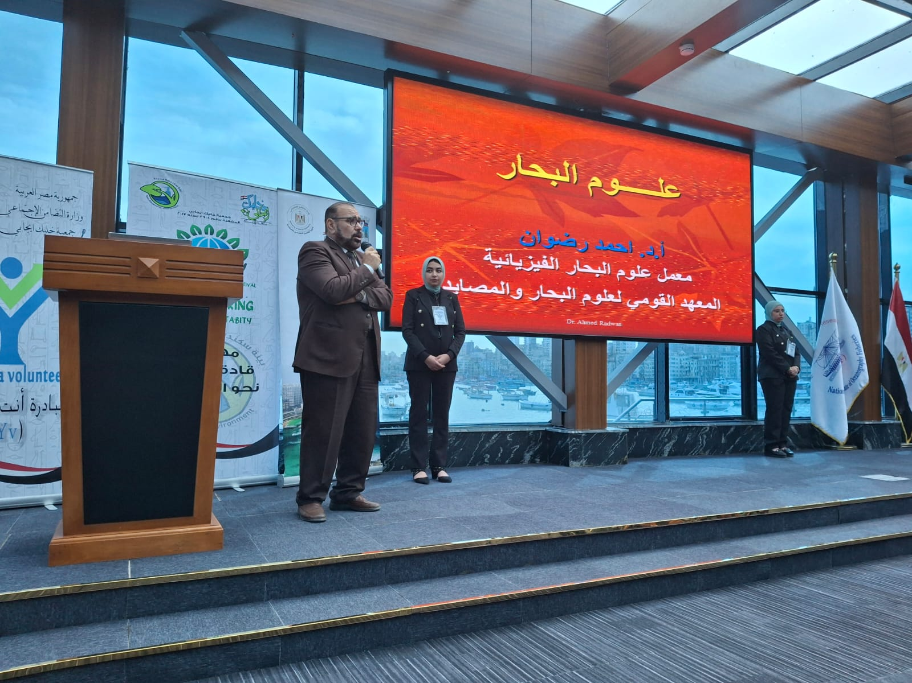
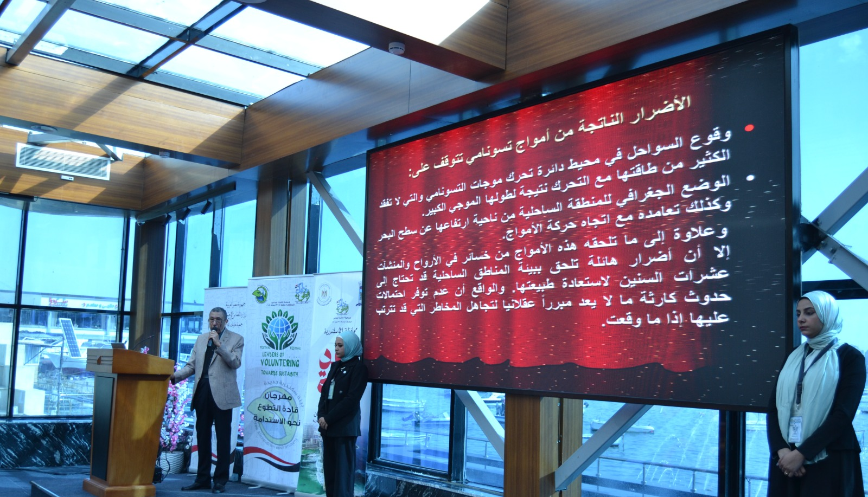
Tsunami Awareness Day 21 November
2024

Slide 8
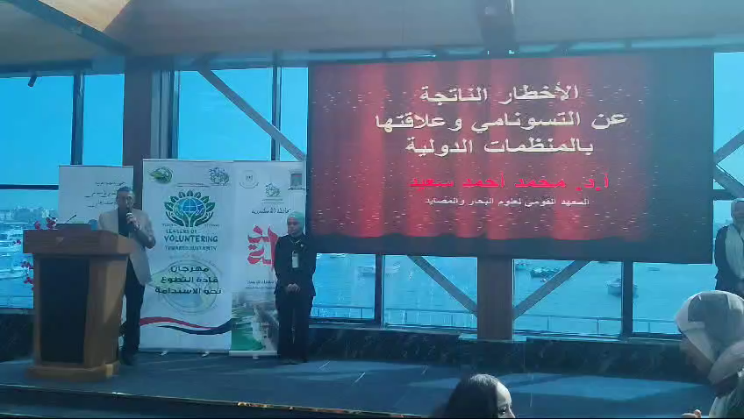

Slide 9
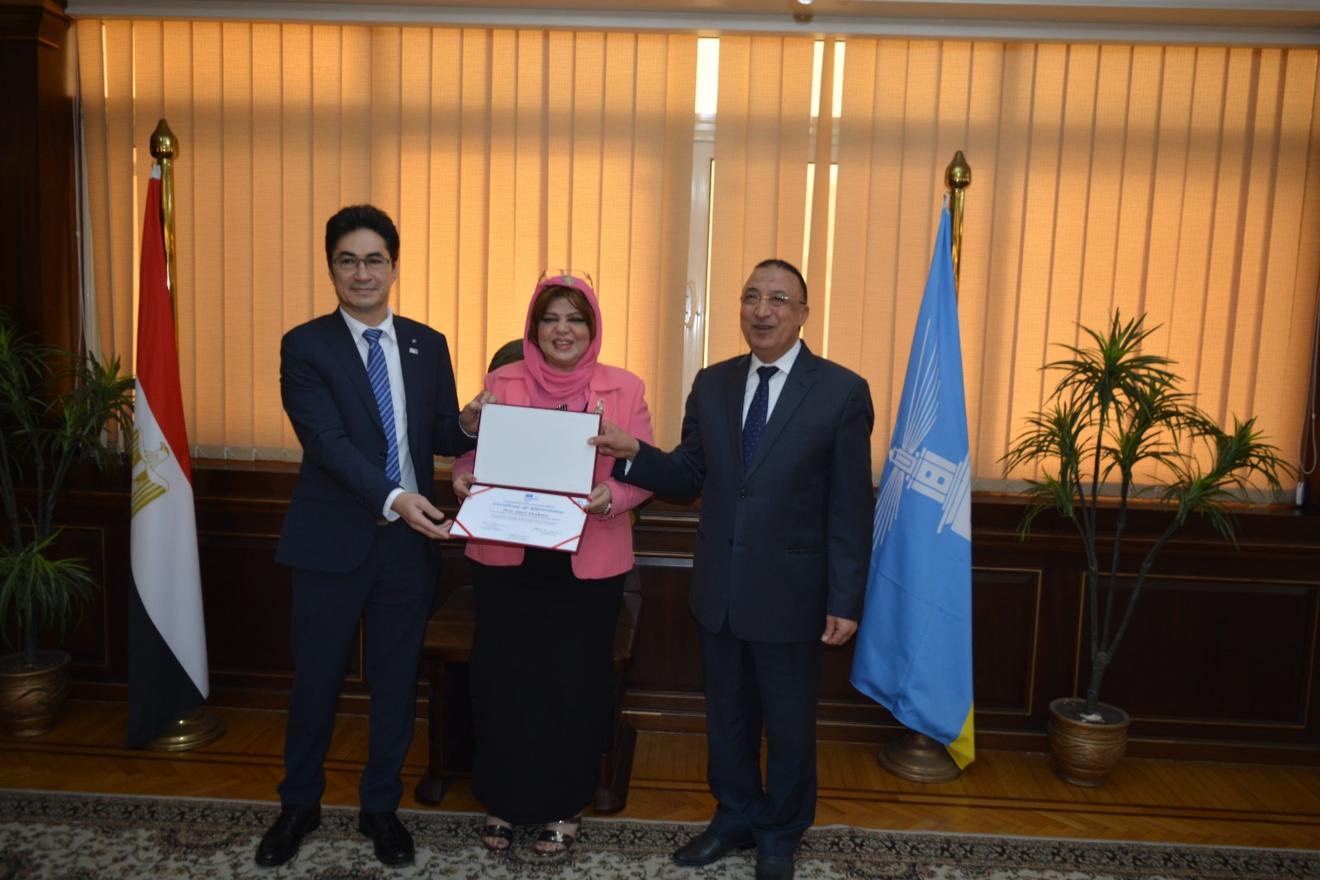
Alexandria City Ready for Tsunami

