Slide 1
ICG/NEAMTWS-XVIII
6–8 February 2024
UNESCO Headquarters
Paris, France
OPENING SEGMENT
BERNARDO ALIAGA ROSSEL

Slide 2
Indian Ocean Tsunami
20 years anniversary
WTAD 2024
5 Nov. 2024
11-14 Nov. 2024
26 Dec. 2024
Core WTAD event at UNESCO
(previously only at UN HQs in New York)
2nd GTS, Aceh, Indonesia
June 2024
IOC EC 57th
Roger Revelle Lecture – Prof E. Okal
Side events with UNDRR, UNDP,
Exhibition “I survived a tsunami”
Social Media
Jan-June 2024
In crescendo phased
Social Media, interviews
Regional events
5 Nov. 2023
WTAD 2023
WTAD Event at HQs connected with shootings and recording of Tsunami Survivors
March-August 2023 – planning phase

Slide 3
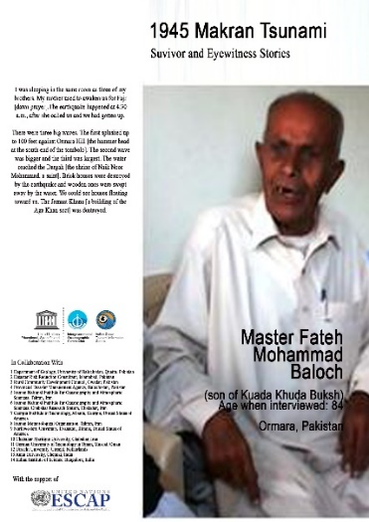




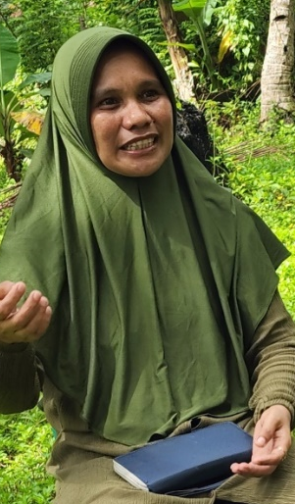
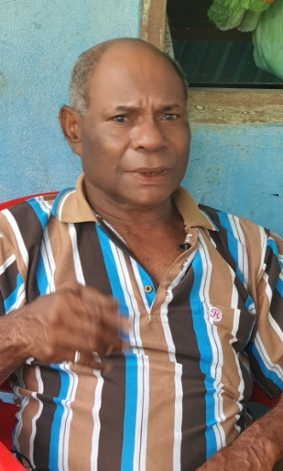
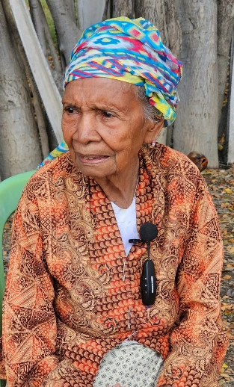

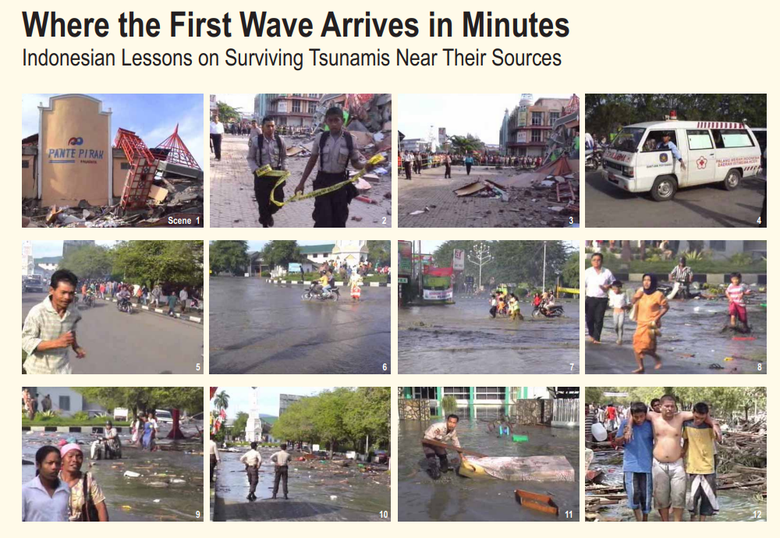




IOTIC – BMKG: Preserving Past Tsunami Information for Future Preparedness
2015
2016
2018
2019
2020
2021
2022
2023
1945 Makran Tsunami
38 videos
1950 Ambon Tsunami
28 videos
1992 Flores Tsunami
45 videos
1994 Banyuwangi Tsunami
46 videos
Central Sulawesi Tsunamis (1927, 1938, 1968, 1996, 2018)
30 videos
1996 Biak Tsunami
60 Videos
2000 Banggai Tsunami
72 Videos
1995 Dili Tsunami
East Timor
37 Videos
356 Stories of Eyewitness and Survivors of Past Tsunamis
(222 in YouTube IOTIC 134 in Process)
6 Booklet Publication

Slide 4
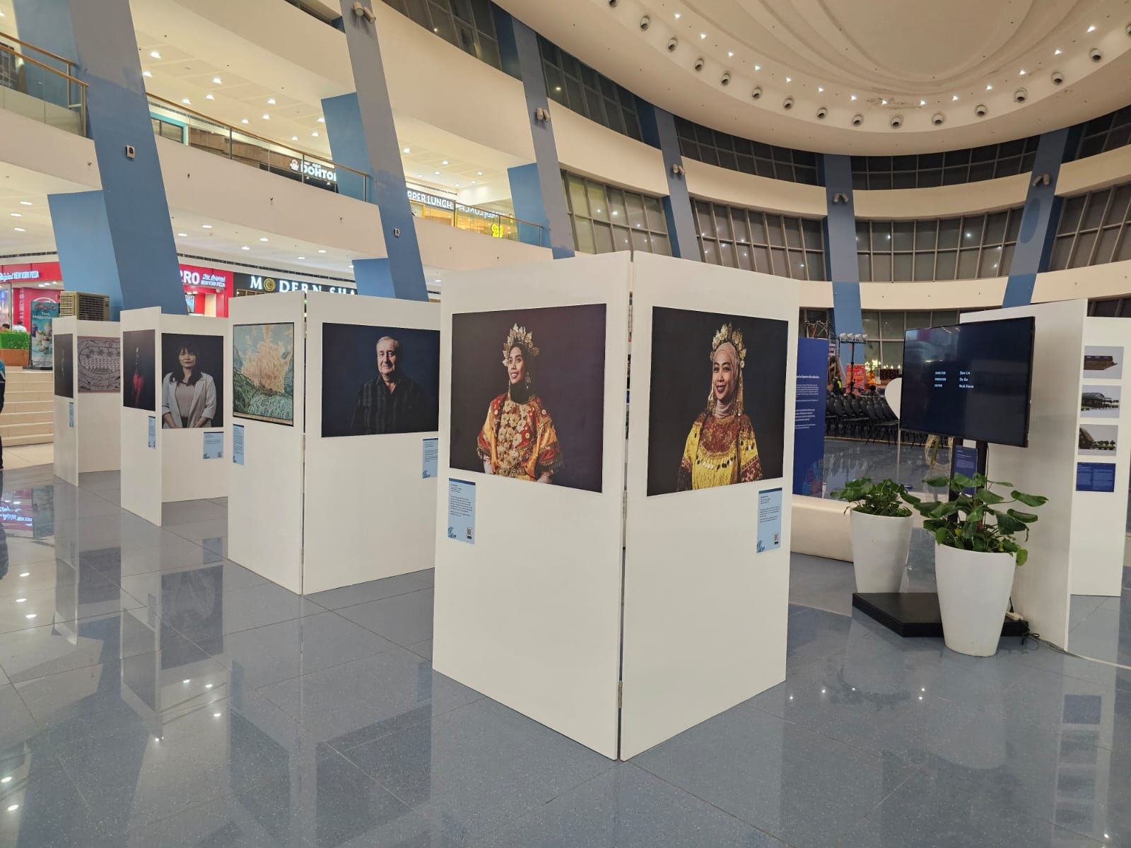
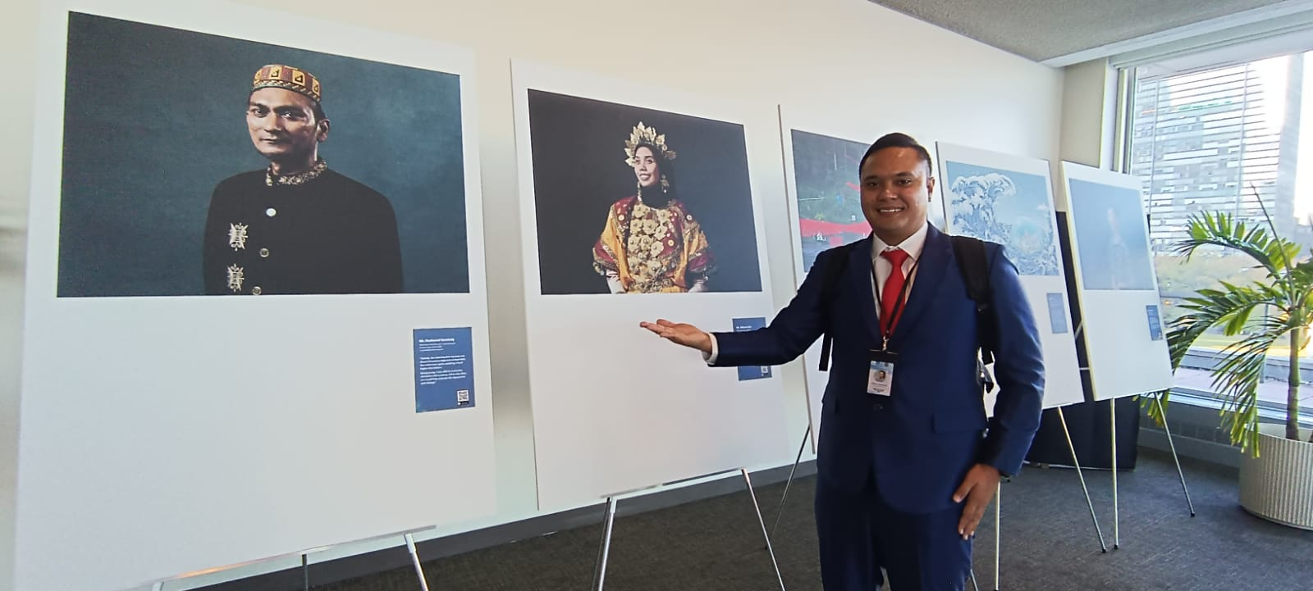

Slide 5
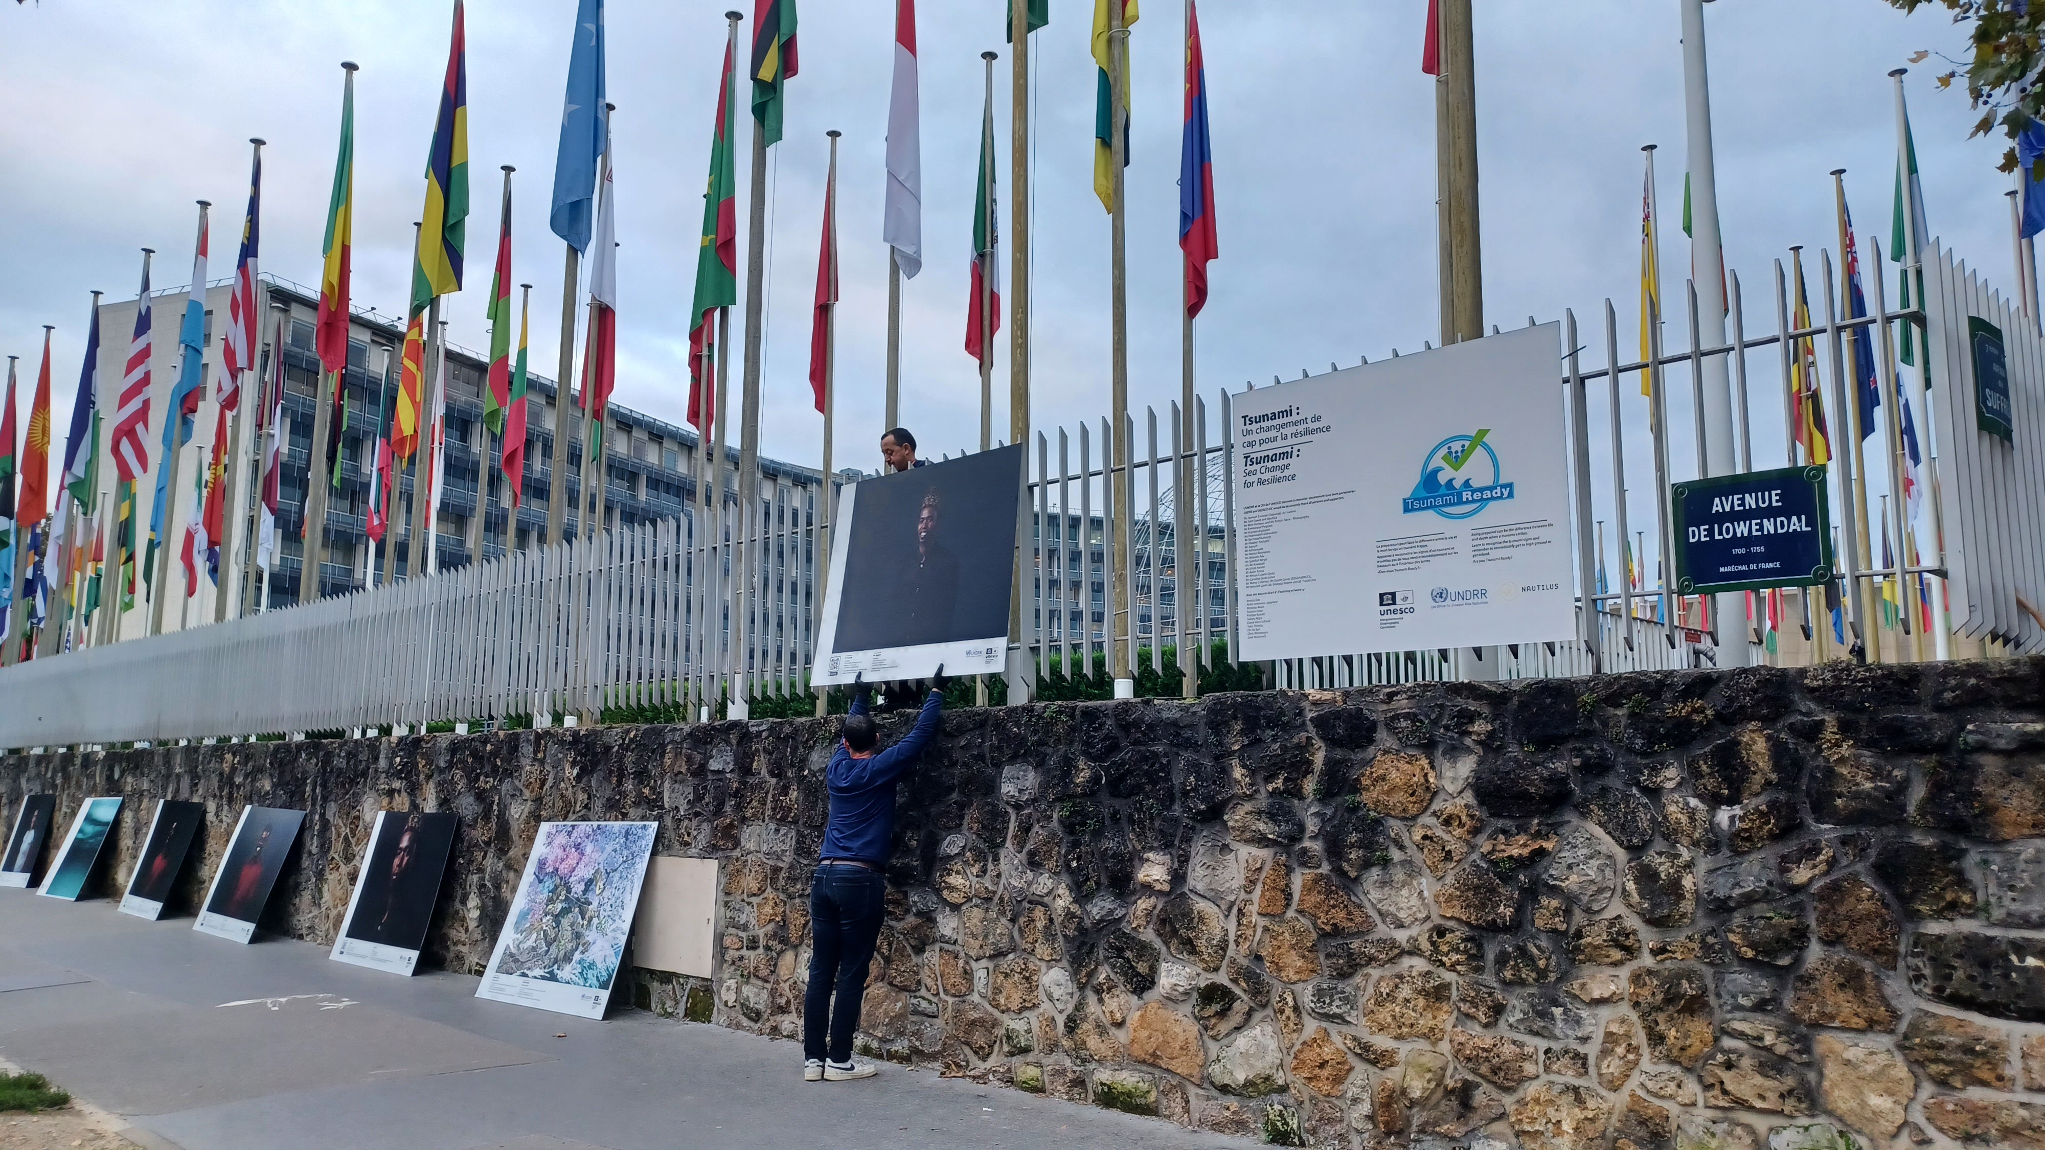

Slide 6
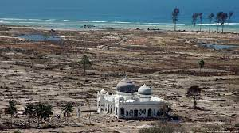
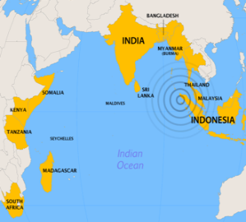
2nd UNESCO-IOC Global Tsunami Symposium
“Two Decades After 2004 Indian Ocean Tsunami: Reflection and the Way Forward”
Monday 11th - Thursday 14th November 2024
in BANDA ACEH, INDONESIA

Slide 7
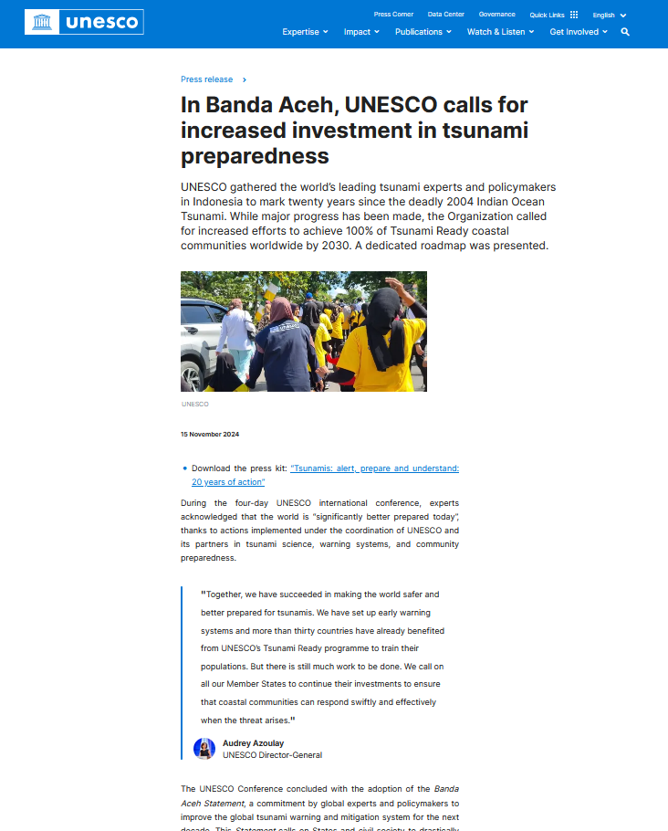
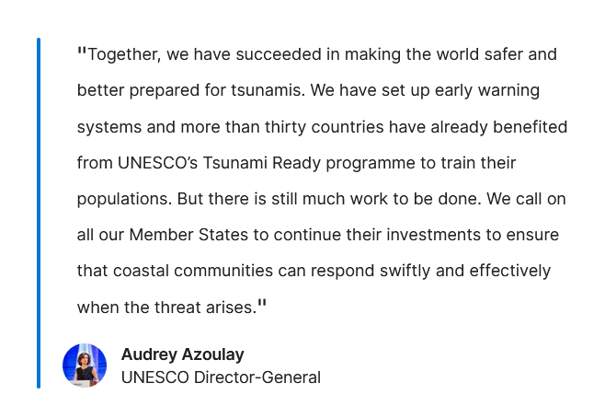

Slide 8
What is next?
ODTP targets
WTAD 2025
5 Nov. 2025
Dec. 2025
With UNDRR – focus on TR
1st ODTP Conference?
June 2025
IOC Assembly
All ICGs reporting
TOWS-WG
Feb 2025
Tsunami Ready Coalition
Meteotsunami
WTAD 2025
Jan 2025
ODTP SC
Check-review ODTP submissions
Plan 2025-2027
Suggested: 3 conferences 2025-2026-2027
Dec-2024 – take a rest?

