Slide 1
ICG/CARIBE-EWS XVII
Gérard Métayer
ICG/CARIBE-EWS Chair
November 27th, 2024
Presenting on behalf of Chair
Marie-Noëlle RAVEAU
ICG/CARIBE-EWS Vice Chair

Slide 2
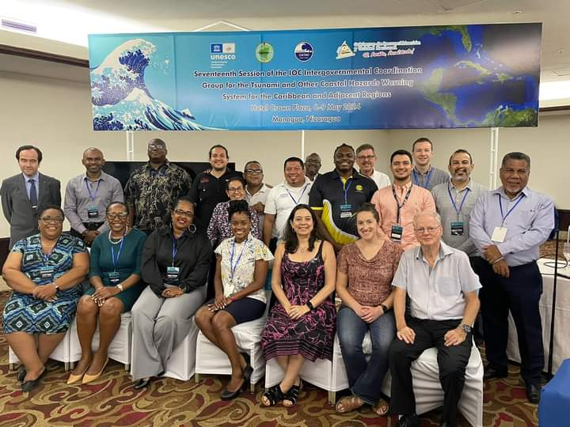
ICG/CARIBE-EWS-XVII meeting
Nicaragua, 6-9 May, 2024
15/48 MS and Territories
3 Observers
85 in-person & virtual participants
Next Meeting
  May 5-9, 2025: France (tentatively) – Pending host agreement

Slide 3
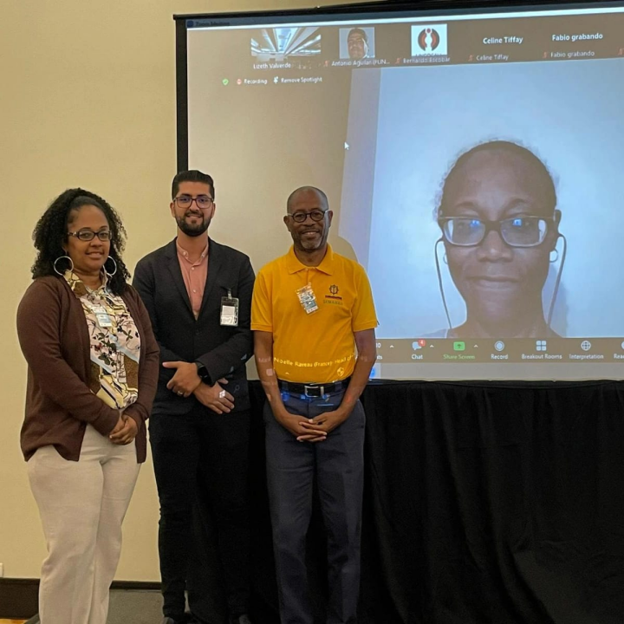
officers elected in 2023
Chair
Gérard Métayer
(Haiti)
Vice Chairs
Regina Browne
(USVI)
  Marie-Noëlle Raveau
  (France-Martinique)
  Anthony Murillo
  (Costa Rica)

Slide 4

ICG/CARIBE-EWS XVII Nicaragua May, 6-9, 2024
Reports and Recommendations
Reports from some Member States and Territories
Barbados, British Virgin Islands, Colombia, Costa Rica, France, Guatemala, UK Antigua and Barbuda, USA, and Venezuela.
Reports from UN and non-UN Organizations
Recommendations to IOC on Governance, Working Groups & Task Teams, CTIC, and CATAC
Ocean Decade Tsunami Program. Smart cable. IOCARIBE. PTWC
Caribe Wave exercises. Implementation Plan.

Slide 5
Intergovernmental Coordination Group for the Tsunami and Other Coastal Hazards Warning System for the Caribbean and Adjacent Regions (ICG/CARIBE-EWS)
ORGANISATIONAL STRUCTURE
2024 - 2025
Chair: Mr. Gerard Metayer (Haiti)
Vice-Chairs: Mr. Anthony Murillo Gutierrez (Costa Rica), Ms. Marie-Noëlle Raveau (France/Martinique), Ms. Regina Browne (USA/Virgin Islands)
Caribbean Tsunami Information Center (CTIC): Ms. Alison Brome (Barbados)
Technical Secretary: Mr. Öcal Necmioğlu (Türkiye)
Working Group 1:
Risk Knowledge
Chair:
Mr. Frederic Dondin (FR)
Vice-Chair:
Mr. Raphaël Paris (FR)
Working Group 2:
Tsunami Detection, Analysis and Forecasting
Chair:
Ms. Elizabeth Vanacore (USA/PR)
Vice Chairs for Subgroups:
Tsunami Source Identification and Characterization
Mr. Dan McNamara (USA)
Tsunami Detection
Ms. Gloria Romero (VE)
Tsunami Forecasting:
Mr. Chris Moore (USA)
SMART Cables:
TBD
Working Group 3:
Tsunami Warning Dissemination and Communication
Chair:
Ms. Christa von Hillebrandt-Andrade (USA/PR)
Vice-Chair:
Ms. Susan Hodge (UK/AI)
Working Group 4:
Preparedness and Response Capabilities
Chair:
Ms. Silvia Chacon Barrantes (CR)
Vice Chairs for Subgroups:
Preparedness and Response capabilities:
Mr. Jacob Ngumbah (KN)
Mitigation:
Ms. Stacey Edwards (TT)
Task Team on CARIBE WAVE
Chair:
Mr. Antonio Aguilar (VE)
Vice Chair:
Ms. Gisela Baez Sanchez (USA/PR)
Task Team on Tsunami Ready
Chair:
Mr. Fabian Hinds (BB)
Vice Chair:
Mr. Matthieu Péroche (FR)
Notes:
DESIGN-1

Slide 6
Establishment of the ICG/CARIBE-EWS Steering Committee
Maintain the ICG/CARIBE-EWS Organizational Structure and Governance
Monitor, maintain and update the CARIBE-EWS Implementation Plan
Oversee the execution of the Decisions and Recommendations of the ICG
Develop a Strategy for funding CARIBE-EWS activities
Monitor performance and examine continuing compliance of Tsunami Service Providers (TSPs)
Guide the work and direction of the CARIBE-EWS to help deliver the goals of the UN Ocean Decade Tsunami Programme (ODTP)
Report, develop strategy for effective coordination, revamp the Group of Experts (GoE) work and implementation plan to enhance the warning system by including other coastal hazards

Slide 7
XXth Anniversaries of ICG/CARIBE-EWS
ICG/CARIBE-EWS will participate at the 2nd Global Tsunami Symposium to celebrate the Two Decades Post 2004 Indian Ocean Tsunami
ICG/CARIBE-EWS notes that 2025 will be the 20th anniversary of the establishment of the ICG/CARIBE-EWS, 2026 will be the 20th anniversary of the first ICG/CARIBE-EWS and 2027 will be the 20th Session of the ICG/CARIBE-EWS
The ICG further noted that these anniversaries had already been noted as an important opportunity for raising awareness, ensuring tsunami resilience in the Caribbean and its Adjacent regions
CARIBE-EWS Steering Committee will organize events and other actions and activities associated with the occasion of the 20th anniversaries of the ICG/CARIBE-EWS

Slide 8
Recommends CATAC to continue with the implementation of Earthquake Early Warning (EEW) methods for the acceleration and improvement of the tsunami warning for Central America.
Recommends the use of additional methods for the transmission of CATAC’s products to its users.
Recommends that CATAC continues full functionality in an interim manner to be able to support the National Tsunami Warning Centers (NTWCs), Tsunami Warning Focal Points
Further recommends the consideration of CATAC as a TSP in its XVIII Session in 2025 to enable the IOC Assembly to consider the final admission of CATAC as TSP in June 2025.
Tsunami Service Providers
Central AmericaTsunami Advisory Center (CATAC)

Slide 9
Caribbean Tsunami Information Center
(CTIC)
Recommends a strategic review of the staffing resources needed to ensure adequate capacity at the CTIC to effectively execute and implement the programmatic and project activities to support the ICG/CARIBE EWS and EW4All frameworks
Recommends that CTIC continues to work with the Secretariat, Steering Committee, CARIBE EWS Member States and partners to develop a strategic plan to guide the resource mobilization and staffing efforts of the CTIC,
Recommends a strategic review by the CARIBE EWS Steering Committee of the CTIC Governance structure
Further recommends the integration of the work and role of the CTIC and the CTIC Governance Structure review process, the integration of other coastal hazards
Need to expand support for Tsunami Ready Recognition Program
Requests the Member States to provide greater support through financial
and human resources

Slide 10

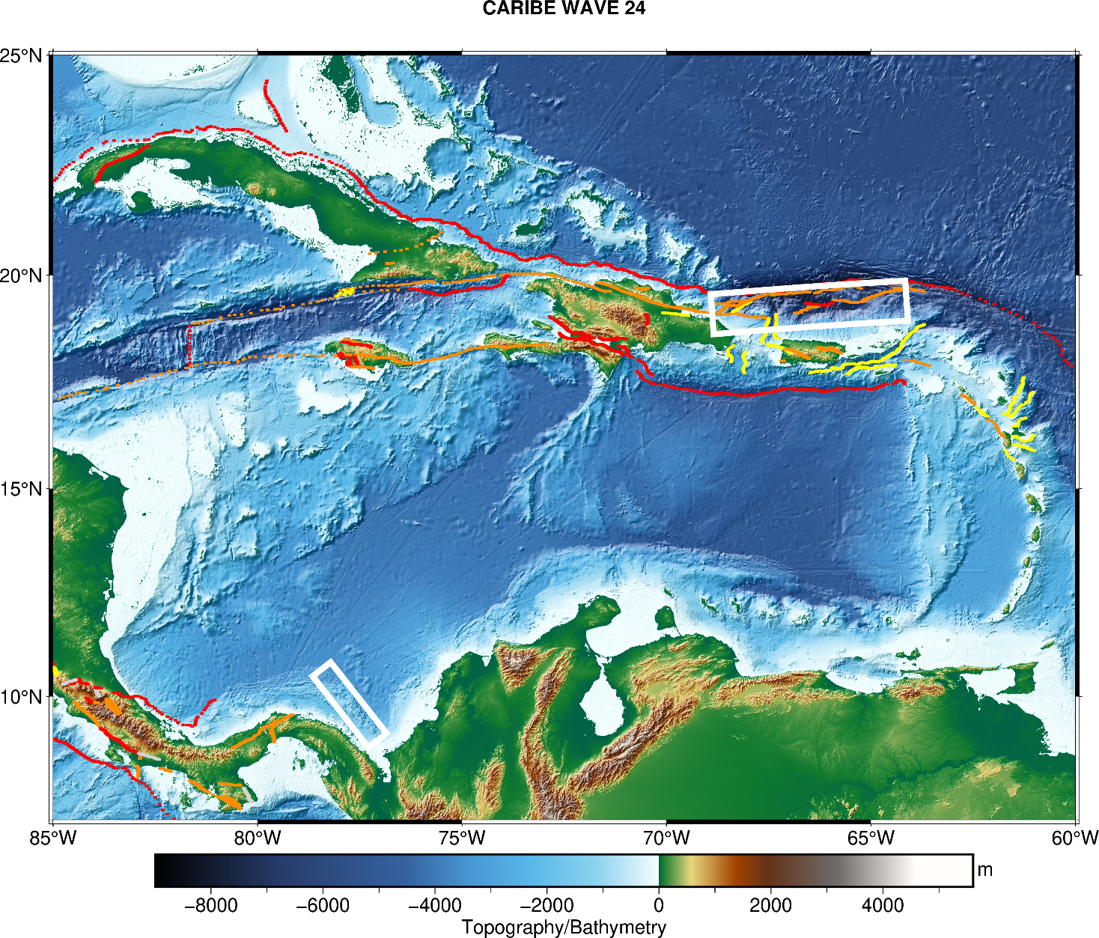
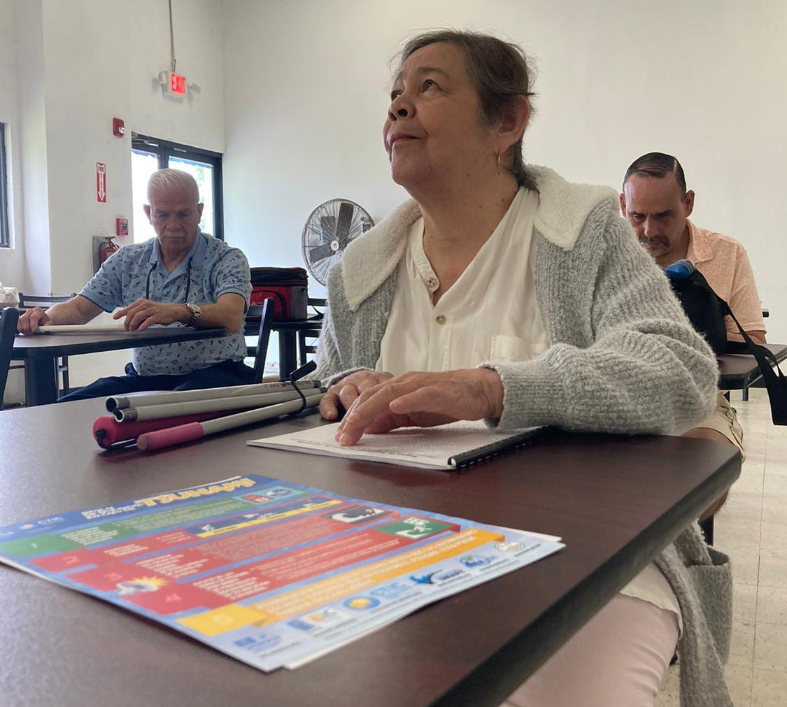
CARIBE WAVE 24
Ivette Lopez, sewing machine operator of Industries for the Blind Corporation in Cabo Rojo, Puerto Rico, a textile industry, whose majority of employees are with a visual impairment. As part of CARIBE WAVE 24 exercise, employees like Ms. Lopez were given an orientation on Tsunamis and received the Safety Rules flyer in Braille (credit: Glorymar Gomez Perez, Contractor of the International Tsunami Information Center Caribbean Office).
March 21, 2024 15:00 UTC
2 scenarios
  Puerto Rico Trench
  1882 North Defomed Panama Belt
457,000 people registered
NPDB

Slide 11
CARIBE WAVE 25
CARIBE WAVE 26
March 20, 2025, 15:00 UTC
2 possible scenarios
  1692 Jamaica scenario
  1755 Lisbon scenarioo
2 Possible Scenarios
1 EQ Scenario
1 Volcano Scenario

Slide 12
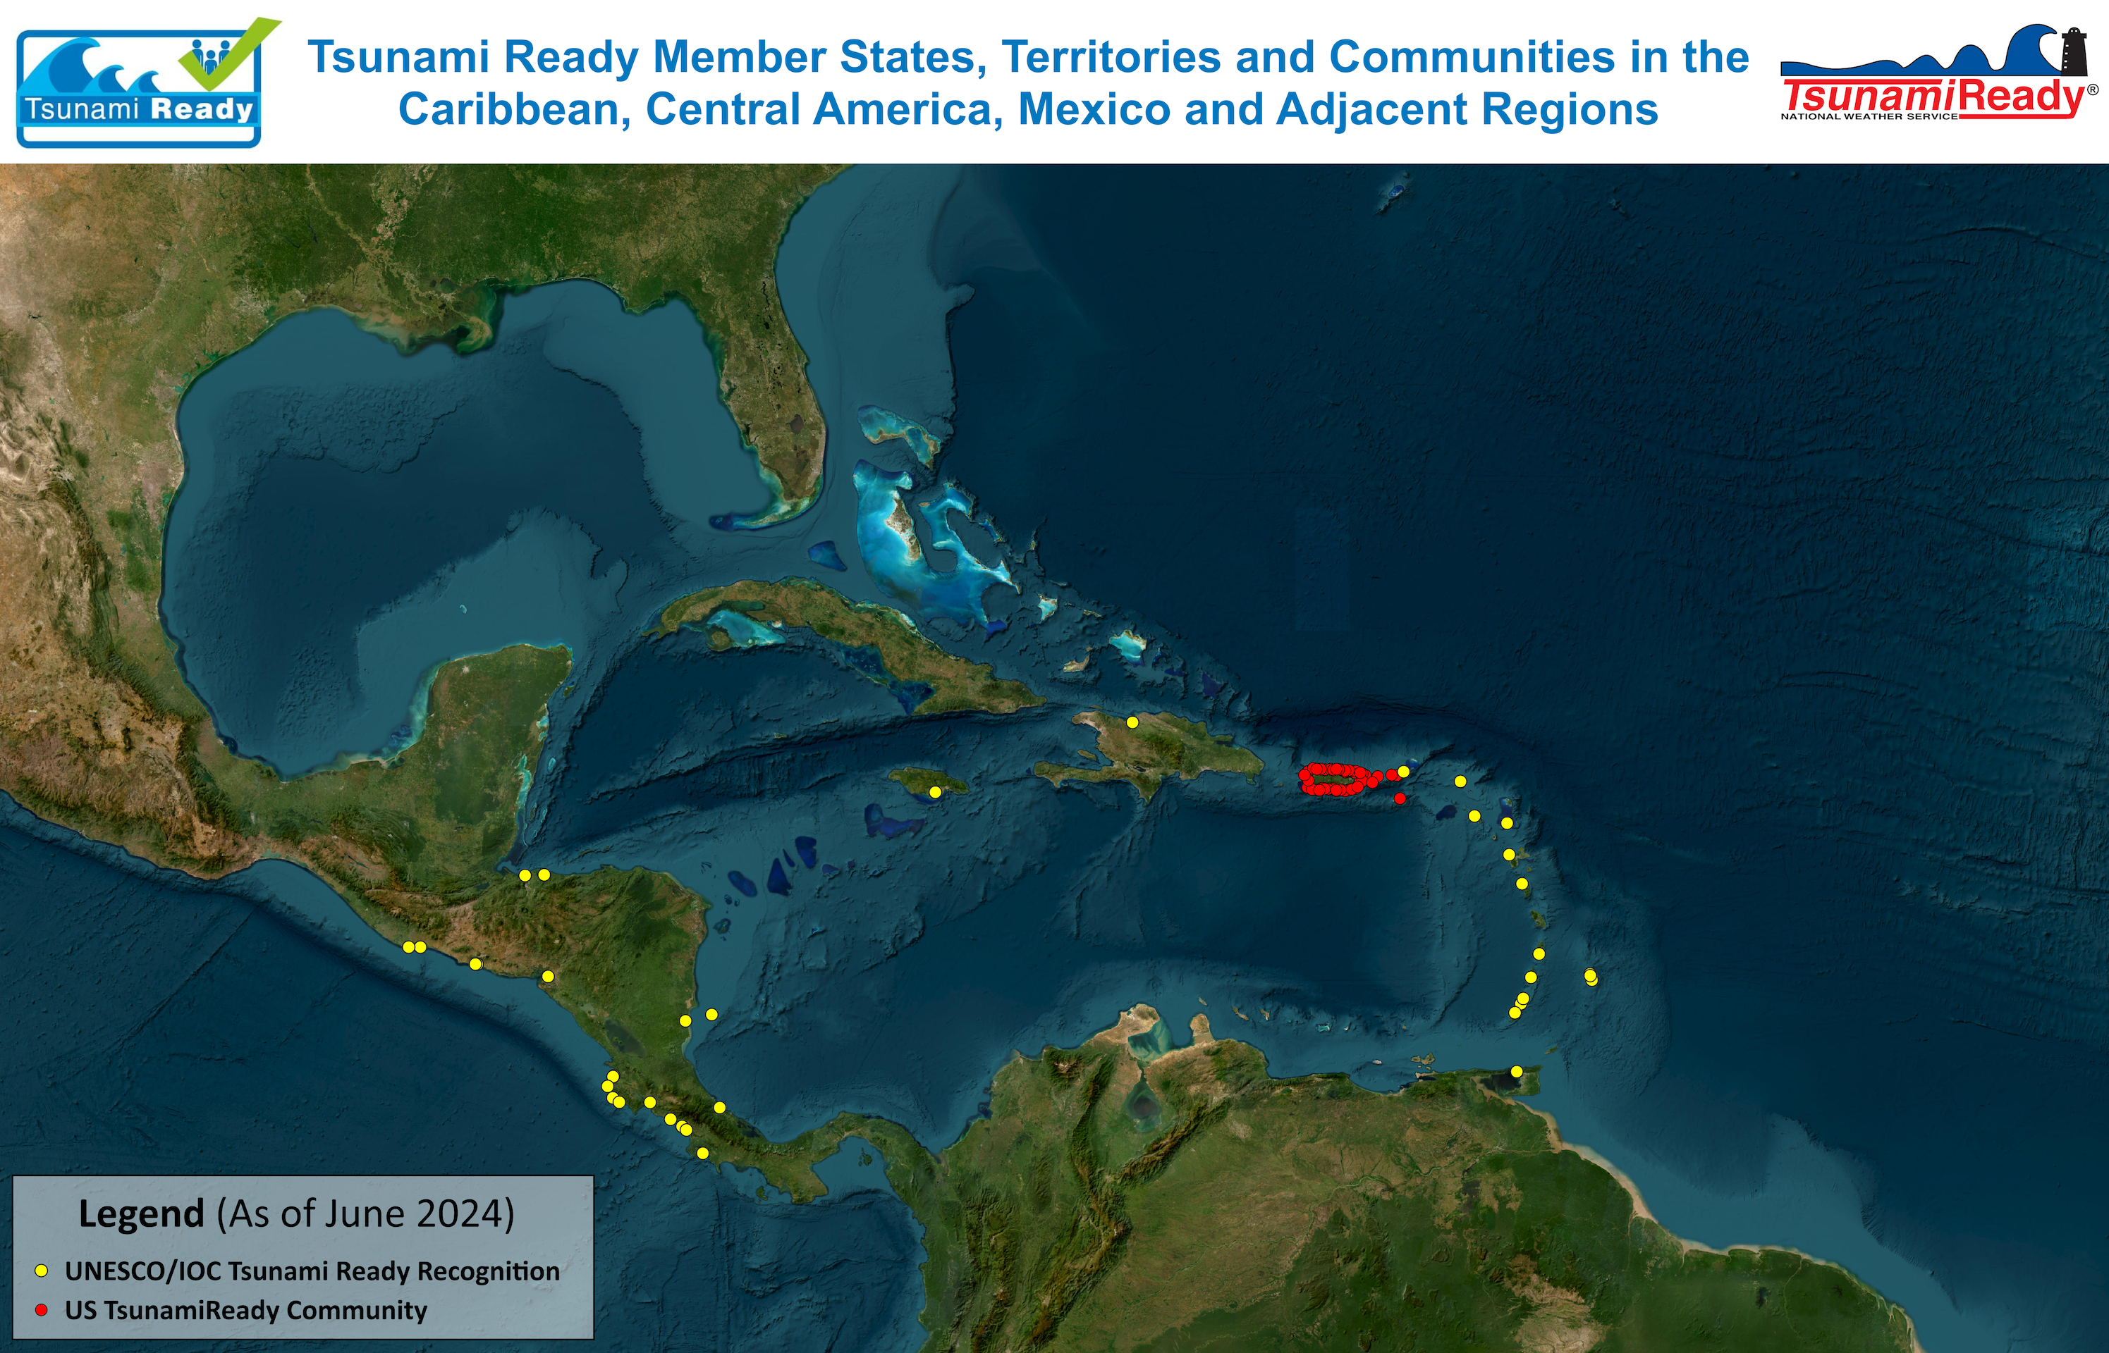
25+ countries and territories have/implementing Tsunami Ready
21 UNESCO/IOC Tsunami Ready Communities/Countries/Territories
3 Renewal
49 US TsunamiReady communities in Puerto Rico and USVI

Slide 13

OCEAN DECADE TSUNAMI PROGRAMME:
THE MAIN SOCIAL OUTCOME
BY
2030
TO MAKE
100%
OF COMMUNITIES AT RISK OF TSUNAMI PREPARED FOR AND RESILIENT TO TSUNAMIS

