Slide 1
3. REPORTS ON ICG/NEAMTWS INTERSESSIONAL ACTIVITIES
3.3 Reports by Other ICGs
- Report from ICG/PTWS -
ICG/NEAMTWS-XIX, Paris, France
27 - 29 November 2024
NISHIMAE Yuji
Chair, ICG/PTWS

Slide 2
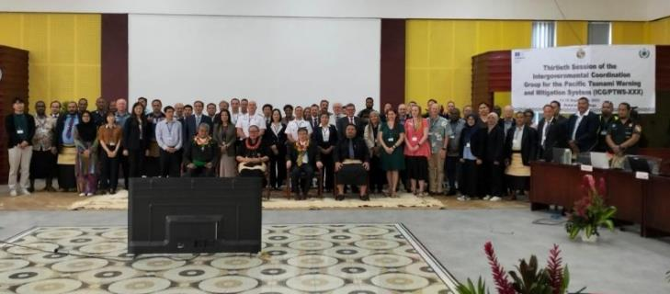
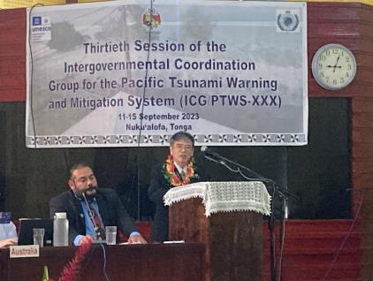
The Thirtieth Session of the ICG/PTWS (ICG/PTWS-XXX)
Venue: Nuku’alofa in Kingdom of Tonga
Date：12th - 15th September, 2023
62 delegates from 17 Member States (Australia, Canada, Chile, China, Ecuador, Fiji, France, Indonesia, Japan, Malaysia, New Zealand, Nicaragua, Republic of Korea, Solomon Islands, Tokelau, Tonga, and United States of America)
11th September, 2023: 8th JOINT ICG/PTWS– IUGG JOINT TSUNAMI COMMISSION TECHNICAL WORKSHOP

Slide 3
Recommendations adopted in the ICG/PTWS-XXX
Recommendation ICG/PTWS-XXX.1: ICG/PTWS Governance
Recommendation ICG/PTWS-XXX.2: Understanding Tsunami Risk
Recommendation ICG/PTWS-XXX.3: Tsunami Detection, Warning and Dissemination
Recommendation ICG/PTWS-XXX.4: TSP Messages for the Maritime Community
Recommendation ICG/PTWS-XXX.5: Disaster Risk Management and Preparedness
Recommendation ICG/PTWS-XXX.6: Start of Operation of Central America Tsunami Advisory Center (CATAC)
Recommendation ICG/PTWS-XXX.7: Minimum competency levels for National Tsunami Warning Center (NTWC) operations staff
Recommendation ICG/PTWS-XXX.8: UN Decade of Ocean Science for Sustainable Development (2021 – 2030)

Slide 4
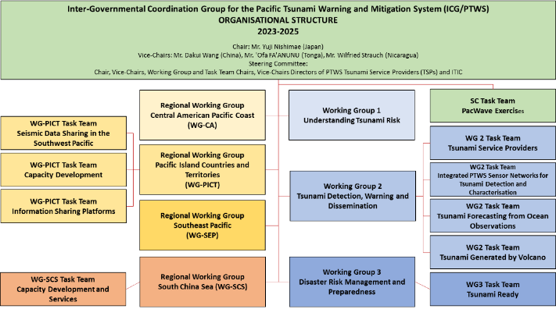
ICG/PTWS Organizational Structure (Recommendation ICG/PTWS-XXX.1)
Chair: Mr. Yuji Nishimae (Japan)
Vice-Chairs: Dr. Dakui Wang (China)
Dr. Wilfreid Strauch (Nicaragua)
Mr. ‘Ofa Fa’anunu (Tonga)
Dissolved Task Teams;
Task Team on UN Ocean Decade,
Task Team on Future Goals and Performance Monitoring,
WG2 Task Team on the Minimum Competency Levels for National Tsunami Warning Centre (NTWC) Operations Staff
Established Task Teams;
WG2 Task Team on Tsunami Generated by Volcanoes (TGV)
WG2 Task Team on Forecasting from Ocean Observations (TT-FOO)
WG3 Task Team on Tsunami Ready
Pacific Island Countries and Territories Working Group Task Team on Information Sharing Platforms

Slide 5
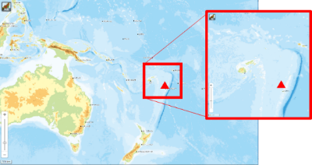
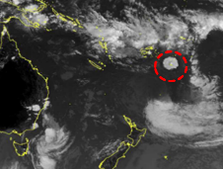
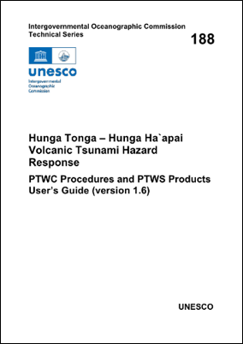
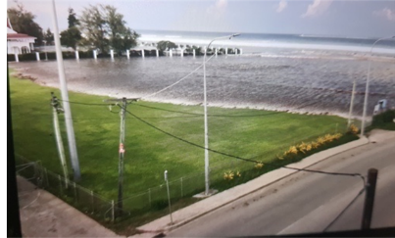
15 Jan 2022 – Hunga Tonga – Hunga Ha’apai Event
Unprecedented – massive eruption and tsunami Tsunami waves were observed at not only near tide gauges but also distant tide gauges.- Larger than 1 meter in California of USA, Chile, Japan.
3 PTWS Briefs (20 Jan, 3 Feb, 10 Feb 2022)
Post-Event Assessment (PAE)
ITIC expert/facilitate support to Tonga (ensure best technical effort with minimum duplication), 1st call 25 Jan => April (30+ virtual meetings, IOC hosted) – (Situational EQ/Volcano activity, HTHH interim procedures, equipment install / repair and post-tsunami survey (NZ, AU, US, SPC)
PTWS HTHH Interim Products and Procedures
Post-Tsunami Field Survey (runup, inundations)
Hunga Tonga Hunga Ha’apai’ Volcano Permanent Monitoring and Warning Procedures of the Pacific Tsunami Warning Center was published (IOC CL-2984 dated on 19 January, 2024) as IOC TS 188.
Location of Hunga-Tonga Hunga-Ha'apai volcano

Slide 6
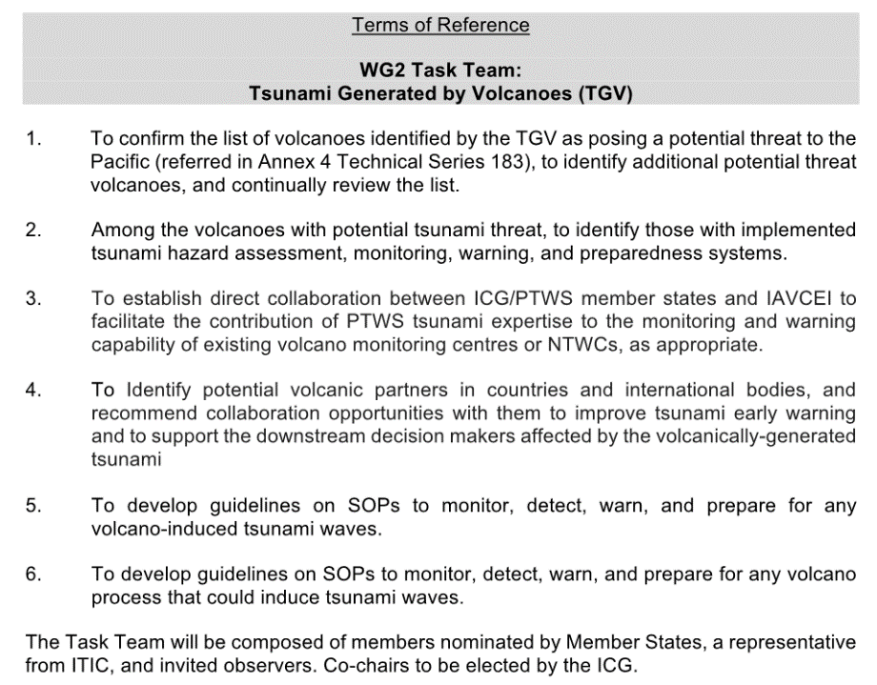
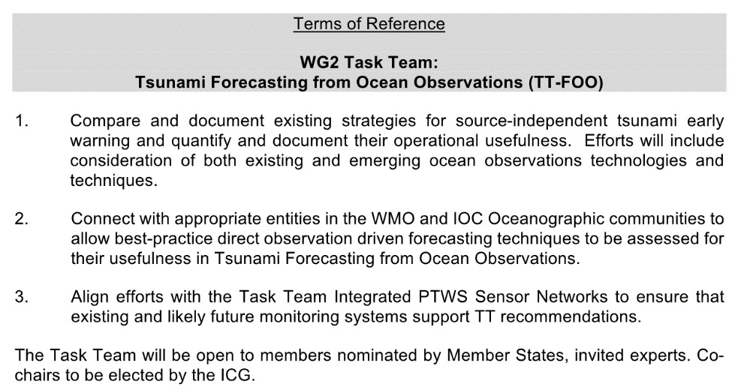
Establishment of Task Teams for Tsunami Forecasting under the WG2 (Recommendation ICG/PTWS-XXX.1 and ICG/PTWS-XXX.3)
The first objective of the Ocean Decade Tsunami Programme is to develop the warning systems’ capability to issue actionable and timely tsunami warnings for tsunamis from all identified sources to 100 percent of coasts at risk.
WG2 Task Team on Tsunami Generated by Volcanoes (TGV)
WG2 Task Team on Forecasting from Ocean Observations
(TT-FOO)

Slide 7
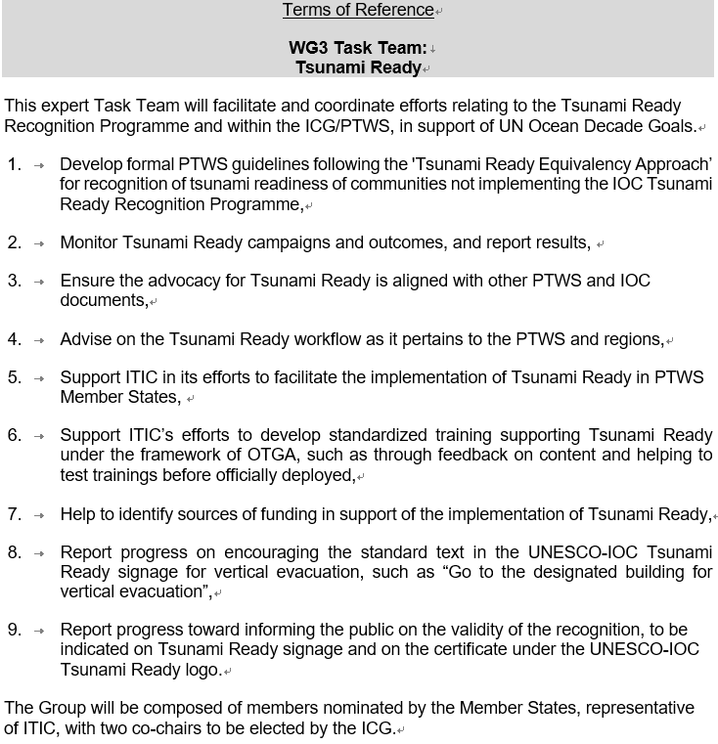
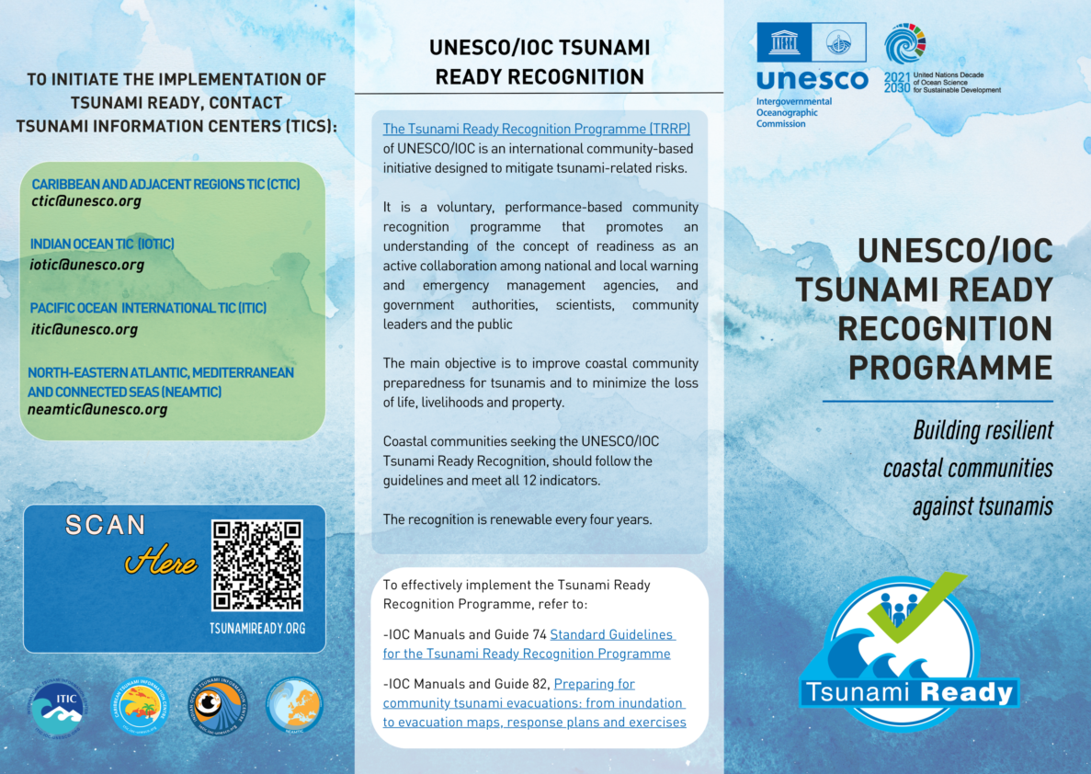
IOC/UNESCO Tsunami Ready Recognition Program
(Recommendation ICG/PTWS-XXX.1 and ICG/PTWS-XXX.5)
Establishment of Task Teams for Tsunami Ready under the WG3
The second objective of the Ocean Decade Tsunami Programme is that 100 percent of communities at risk to be prepared and resilient to tsunamis by 2030 through efforts like the IOC-UNESCO Tsunami Ready Recognition Programme.
The intent of the equivalency guidance isn't to gain formal TR recognition, but instead to monitor progress towards the UNOD goal of '100% of at risk communities prepared for and resilient to tsunami' in a common language / framework.
The term 'equivalency' is under discussion, and will likely change.

Slide 8
Minimum competency levels for National Tsunami Warning Centre (NTWC) operations staff (Recommendation ICG/PTWS-XXX.7)
Recommends the approval of the PTWS National Tsunami Warning Centre competencies, framework, and training requirements, as described in IOC ICG/PTWS-XXX Working Document (Agenda 4.5) Report from the Task Team on the Minimum Competency Levels for National Tsunami Warning Centre (NTWC) Operational Staff.
Framework -2 Tiers (1. TSP Products, 2. TSP + National analyses)
NTWC Staffing Role 1: Tsunami incident controller (or manager)
This tier 1 role requires a comprehensive understanding of tsunami causes and impacts, expert interpretation of TSP products, and competent performance of all key national warning procedures.
NTWC Staffing Role 2: Tsunami incident assistant
This tier 2 role requires a basic understanding of tsunami causes and impacts, simple interpretation of TSP products, and ability to perform some tasks of the national warning procedures.
Minimum Competencies
Core science knowledge
Advanced science knowledge
Core operational competency
Advance agency competency
Training Requirements
An NTWC Competency Programme should
Include a NTWC Staffing Profile, including positions, qualifications, and capabilities,
Establish standardized training modules, covering science, operational, and agency competencies, that have measureable assessments, performance criteria, and/or tests.

Slide 9
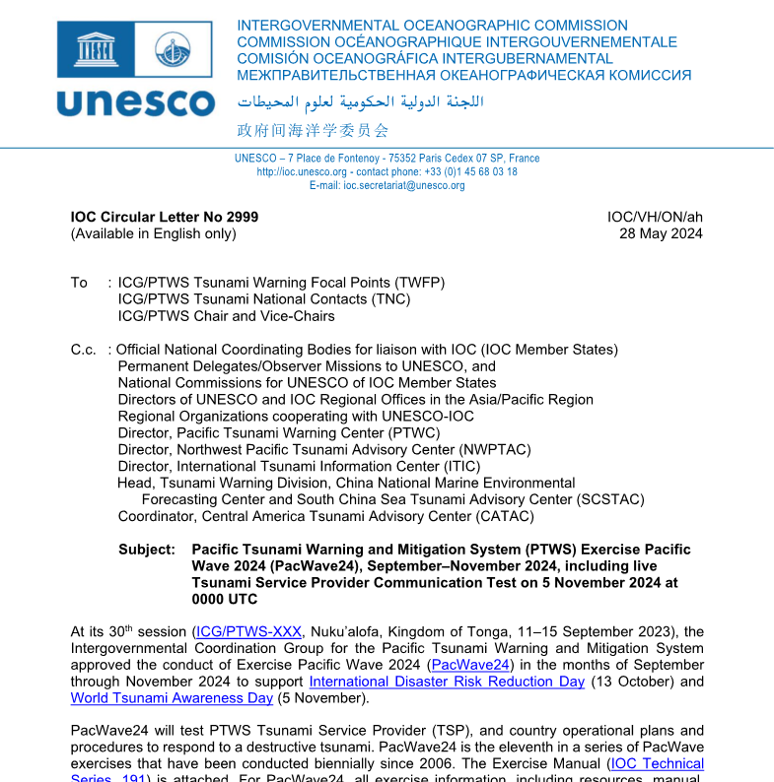
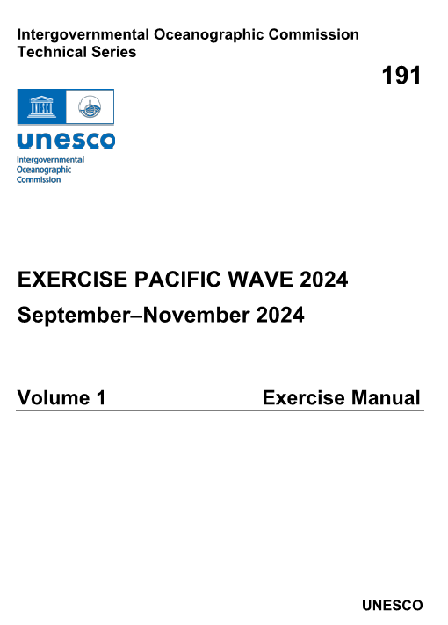
Exercise Pacific Wave 24
  September to November, 2024 to support IDDRR (13 Oct. 2024) and WTAD (5 Nov. 2024)
  Regional Exercise and National Exercise
  Live Communications Test from the PTWS TSPs on 5 November
  Trial Transmission of the dummy message from PTWC to the NAVAREA coordinators through the NTWC on 5 November.
  IOC-CL 2999 dated 28 May 2024 has been issued with the Exercise Manual (IOC TS-191) as an attachment.

Slide 10
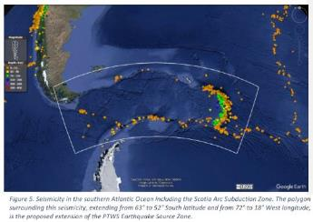
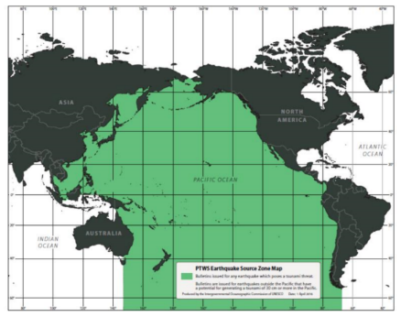
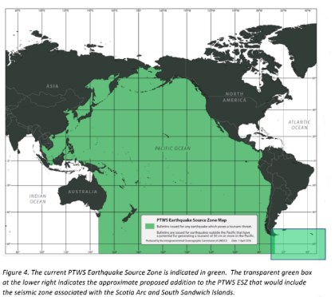
Expansion of the ICG/PTWS Earthquake Source Zone
(Recommendation ICG/PTWS-XXX.3)
Decision in the ICG/PTWS-XXX session
Decides to expand the PTWS Earthquake Source Zone to include an area from 63º to 52º south latitude and from 72º to 18º west longitude to include the Scotia Arc and its adjacent seismic zones.

Slide 11
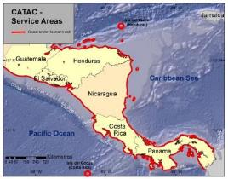
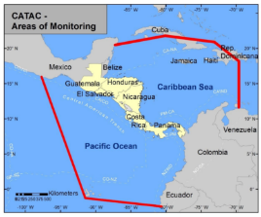
Start of Operation of Central America Tsunami Advisory Center (CATAC)
(Recommendation ICG/PTWS-XXX.6)
Recommendation ICG/PTWS-XXX-6
Decides to admit the start of the official full functional operations of CATAC, starting after the IOC governing body meeting in 2024, with the specific starting date to be decided after the coordination with the ICG/CARIBE-EWS

Slide 12
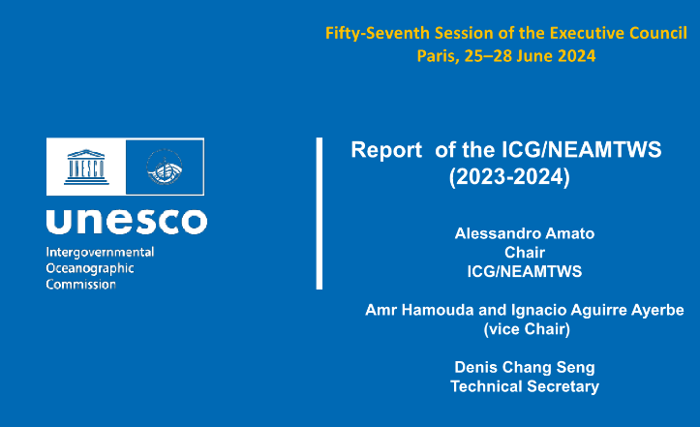

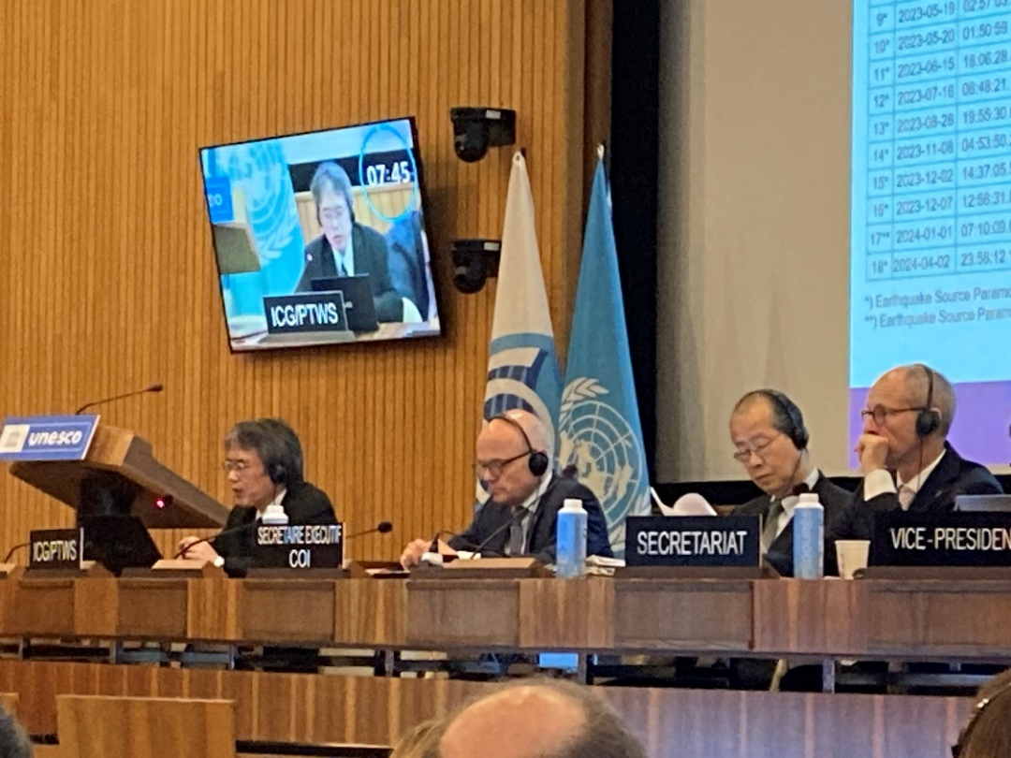

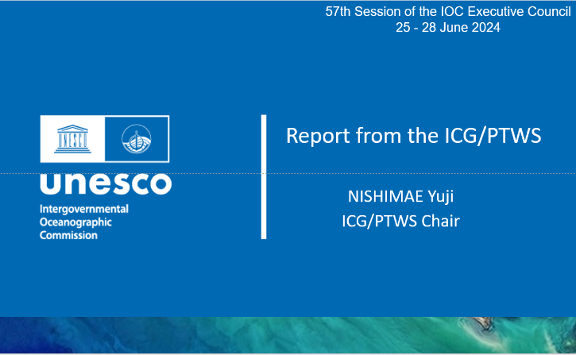
IOC EC 57th Session (25 June to 28 June 2024)
ICG and | Session | Reporter
ICG/CARIBE-EWS | XVII Session | Dr. Regina Browne on behalf the Chair
ICG/NEAMTWS | XVIII Session | Dr. Alessandro Amato
ICG/PTWS | XXX Session | Mr. Yuji Nishimae
TOWS-WG | XVII Session | Dr. Srinivasa Kumar Tummala

Slide 13
Start of the official full functional operation of the Central America Tsunami Advisory Center (CATAC)
Recommendation ICG/PTWS-XXX-6
Decides to admit the start of the official full functional operations of CATAC, starting after the IOC governing body meeting in 2024, with the specific starting date to be decided after the coordination with the ICG/CARIBE-EWS
Recommendation ICG/CARIBE-EWS-XVII.8
Recommends CATAC to continue with the implementation of EEW methods for the acceleration and improvement of the tsunami warning for Central America.
Recommends the use of additional methods for the transmission of CATAC’s products to its users.
Recommends that CATAC continues full functionality in an interim manner to be able to support the National Tsunami Warning Centers (NTWCs), Tsunami Warning Focal Points 18 (TWFPs), and emergency management authorities of Central America in addressing those challenges,
Further recommends the consideration of CATAC as a TSP in its XVIII Session in 2025 to enable the IOC Assembly to consider the final admission of CATAC as TSP in June 2025

Slide 14
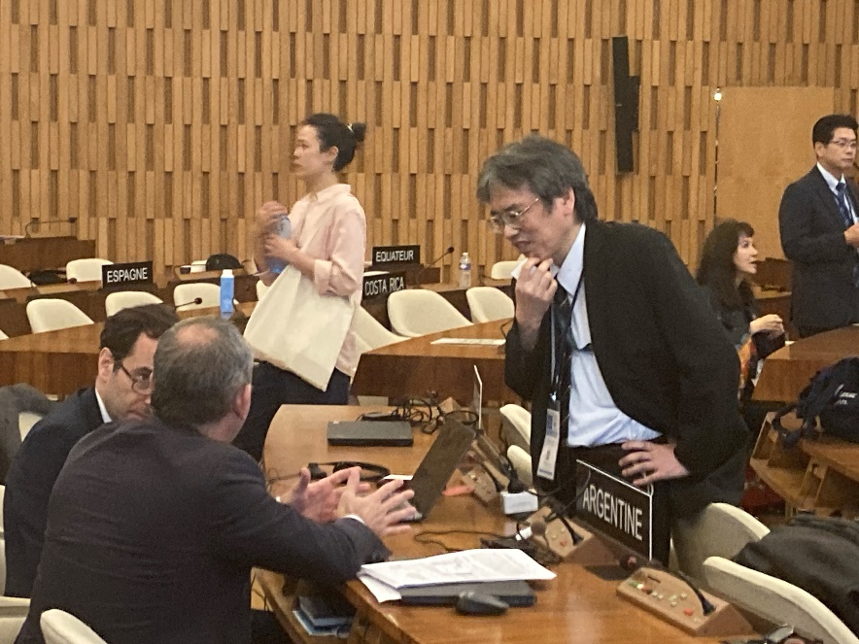
Expansion of the ICG/PTWS Earthquake Source Zone
Recommendation ICG/PTWS-XXX.3
Decides to expand the PTWS Earthquake Source Zone to include an area from 63º to 52º south latitude and from 72º to 18º west longitude to include the Scotia Arc and its adjacent seismic zones.
Adopted decision about the ESZ
The related paragraph to the Recommendation ICG/PTWS-XXX.3 was deleted.
Notes:
(i) the concerns of ICG/PTWS regarding the seismic activity in the Scotia Arc region as reflected in the Executive Summary of the ICG/PTWS-XXX (IOC/ICG/PTWS-XXX/3s);
(ii) that tsunami bulletins are issued by the PTWC for the ICG/CARIBE-EWS and ICG/PTWS for earthquakes in the Scotia Arc and its adjacent seismic zones for events fulfilling certain criteria as reflected in the IOC Technical Series, 130, ‘Tsunami Watch Operations-Global Service Definition Document’;
(iii) the need for the active engagement of Argentina with the ICG/CARIBE-EWS and ICG/PTWS regarding Argentinian Search and Rescue (SAR) and NAVAREA VI coordination responsibilities;

