Slide 1
ICG/NEAMTWS-XVIII Session
27-29 November 2024, Paris, France
Report of the ICG/NEAMTWS
Technical Secretary
(2024)
Denis Chang Seng, PhD
Programme Specialist and
ICG/NEAMTWS Technical Secretary
CoastWAVE Project Responsible Officer
Tsunami Resilience Section
UNESCO IOC

Slide 2
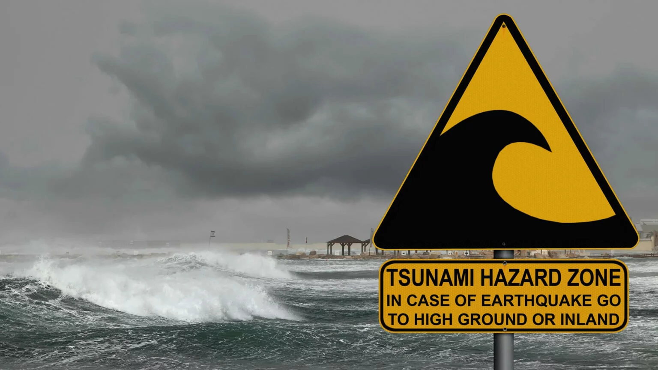
1
3
4
COMM & IMPACTN
5
5
Future Activities
2
Main Activities
4
5
MEETINGS
Documents
CW 2.0

Slide 3
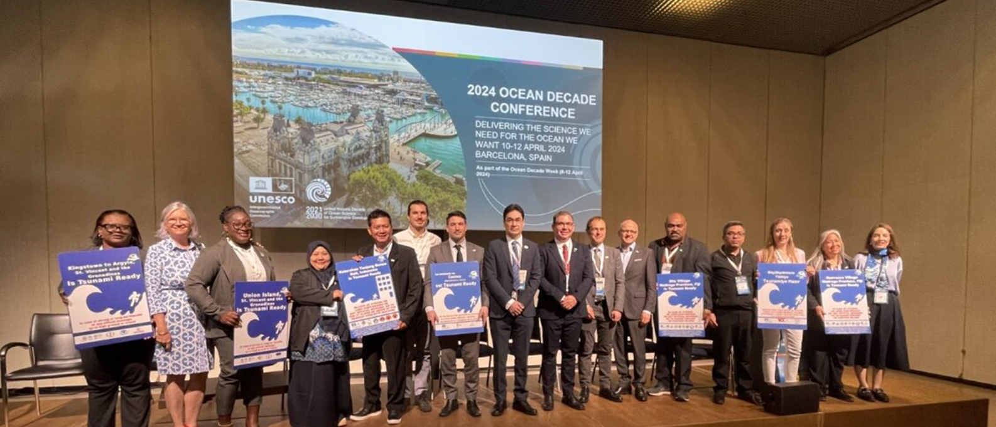
Major International Event
Coastal Cities and Communities Joining Tsunami Ready, 2024 Ocean Conference, Barcelona, 11 April 2024,
Strengthening Coastal Resilience: UNESCO-IOC Initiative Gathers Momentum. Coastal communities worldwide are uniting to bolster their resilience to ocean hazards.

Slide 4
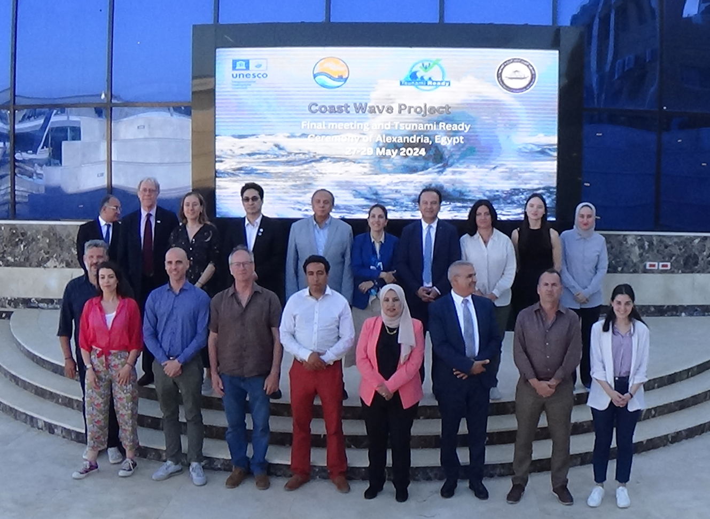
Major Workshop
Partners and Stakeholders Convened in Alexandria, Egypt, 24-25 May 2024 to showcase CoastWAVE Project- Phase 1 at Closure Meeting

Slide 5
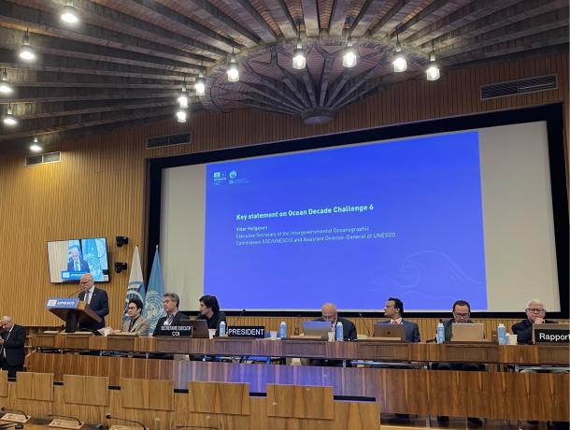
Side Event at
IOC 57 EC
Coastal Horizons: Pathways and Actions to Strengthen Resilience to Coastal Hazards, 57 IOC Executive Council, June 2024
Advancing Ocean Decade Actions for Enhanced Coastal Hazard Resilience
Highlighted critical strategies and actions necessary to bolster coastal resilience globally as part of ODTP

Slide 6
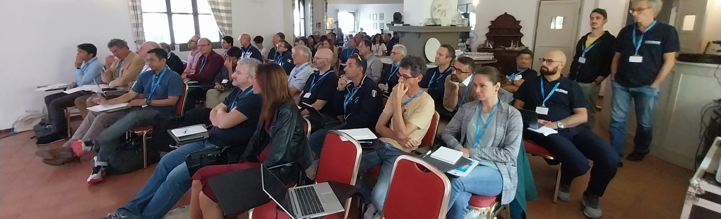
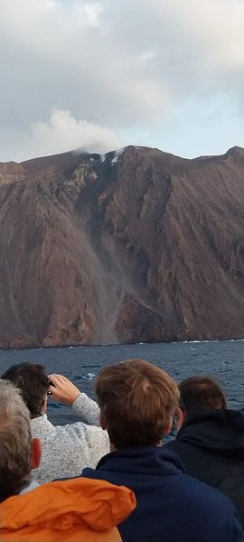
Major International Workshop
80 International Experts Participated
Stromboli Workshop, Organized by INGV, Italy 5-7 October 2024
The event will focused on observations, modeling, hazard assessment, and forecasting

Slide 7
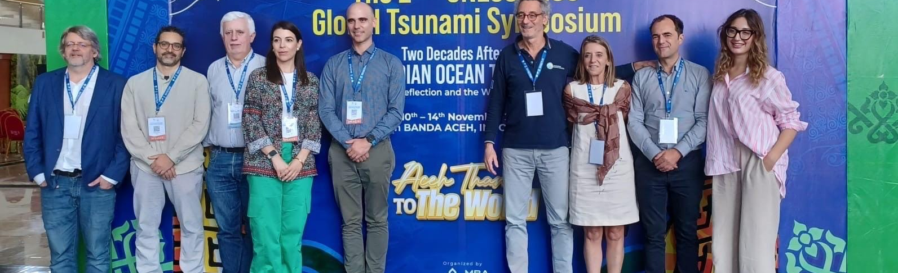
2nd UNESCO-IOC Tsunami Global Symposium, Banda Aceh, Indonesia, 11-14 Nov 2024

Slide 8
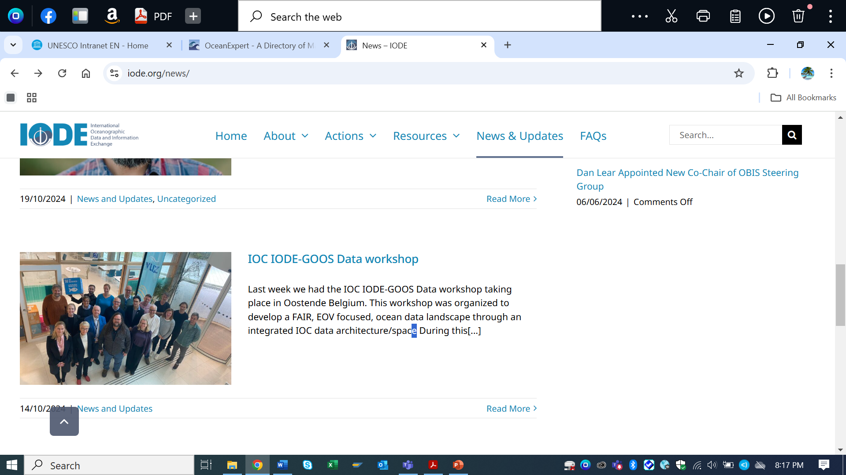
Other Meetings
First IODE/GOOS Data Workshop, 30 September - 02 October 2024
Aim: to develop a FAIR, EOV focused, ocean data landscape through an integrated IOC data architecture/space
CoastWAVE 2.0 Information Meeting, 25 April 2024 (online)
ICG-NEAMTWS SC , 13 May 2024 (online)
CoastWAVE 2.0 Kick–Off Workshop, 6/7 November 2024

Slide 9

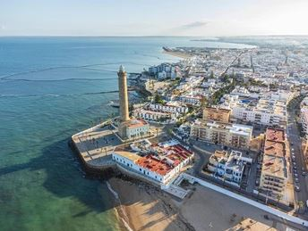
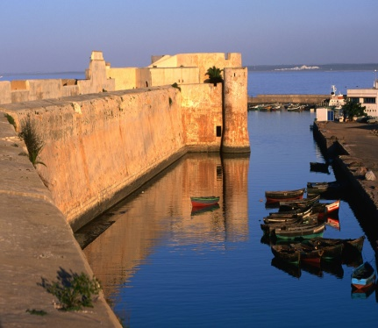
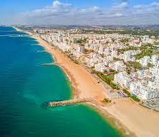
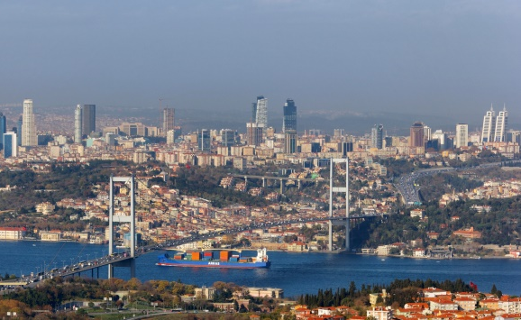
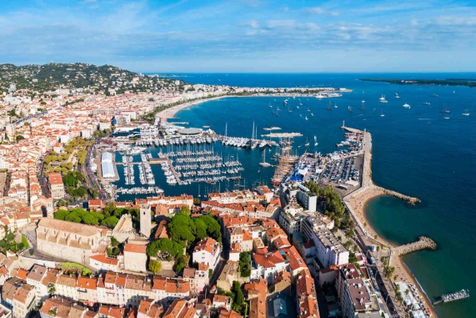
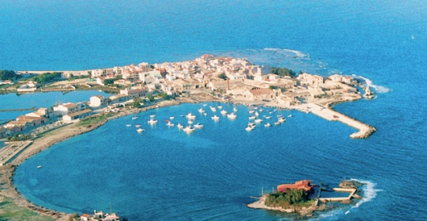
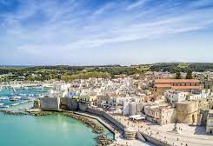
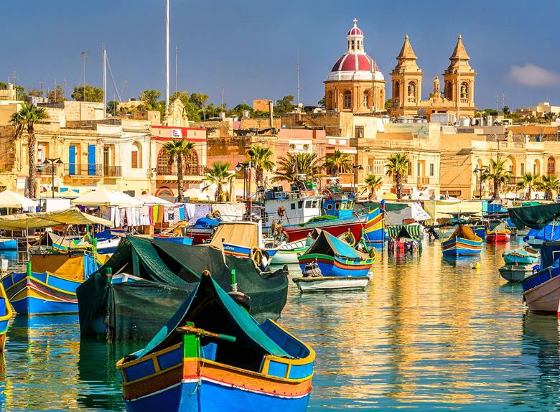
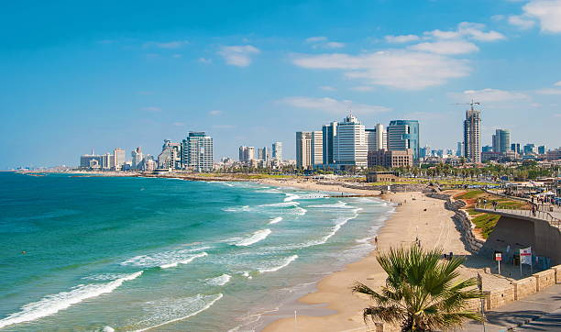
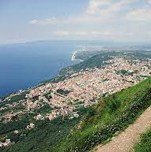
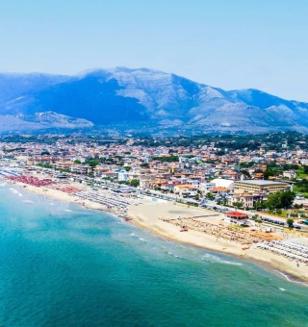
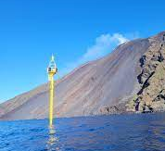
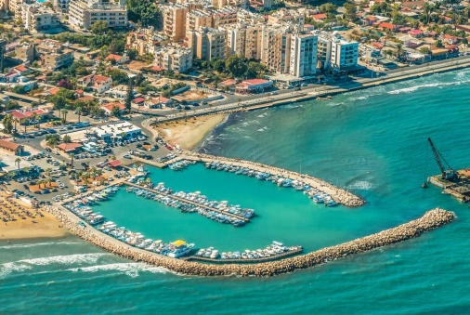
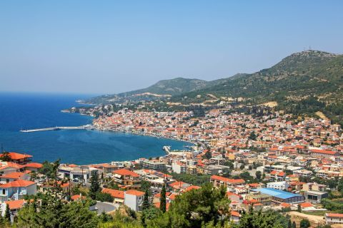
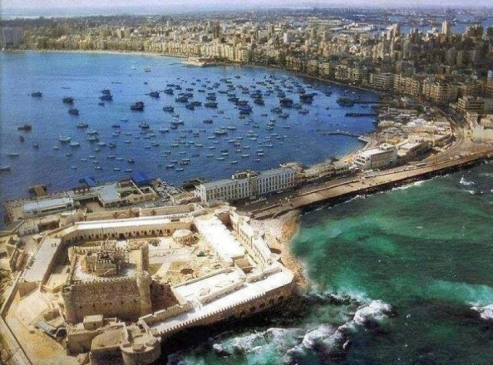
Tsunami Ready Implementation in NEAM REGION
11 Countries
15+ Communities
6 Recognized in 2024
…more coming!
Chipiona
El Jadida
Loulé
Büyükçekmece
Cannes
Marzamemi
Otranto
Marsaxlokk
Israel
TRS/Chang
Seng /Amato 2024
Palmi
Minturno
Stromboli
Larnaca
Samos
Alexandria

Slide 10
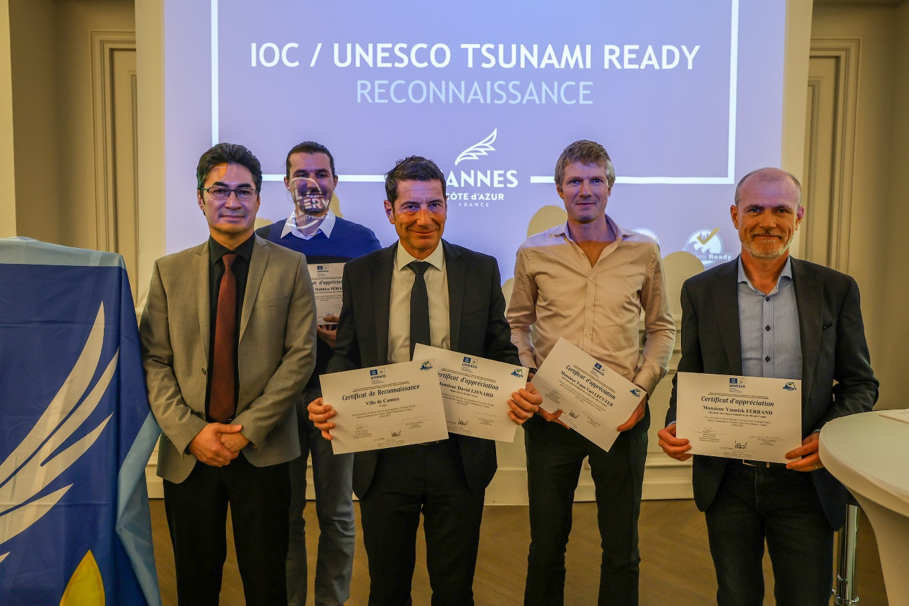
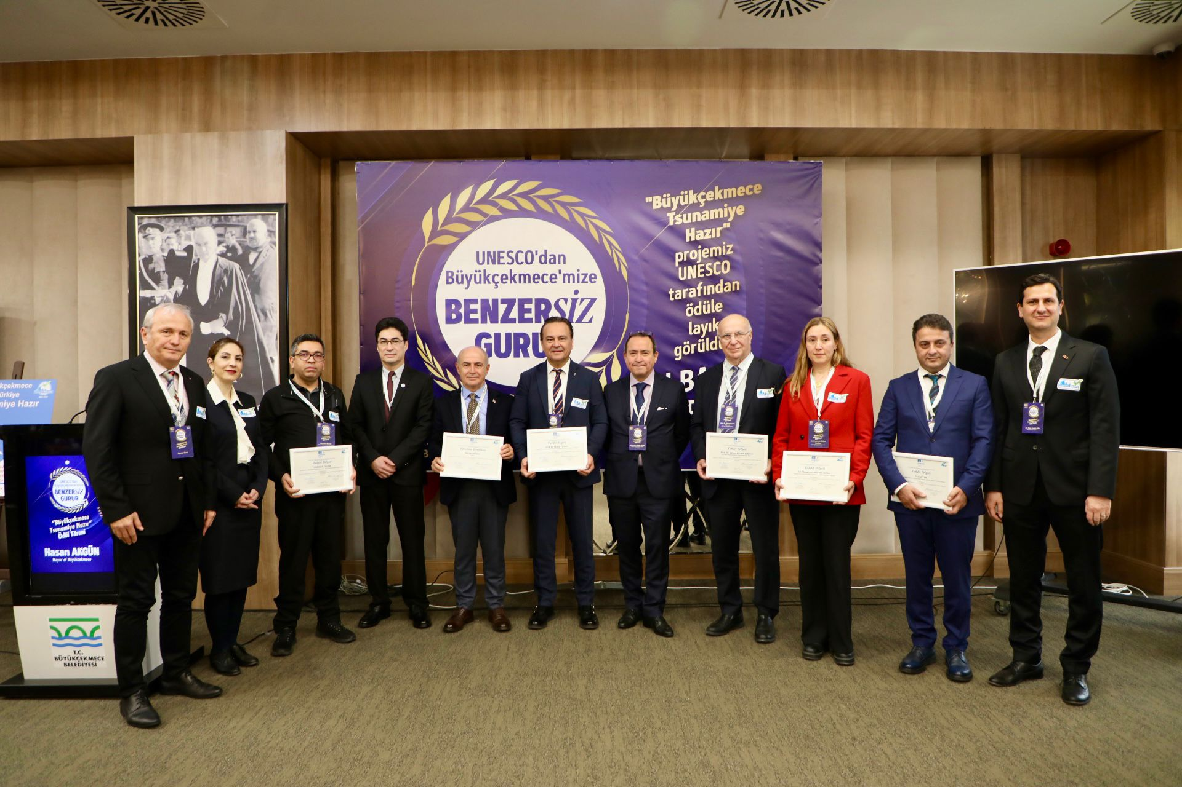
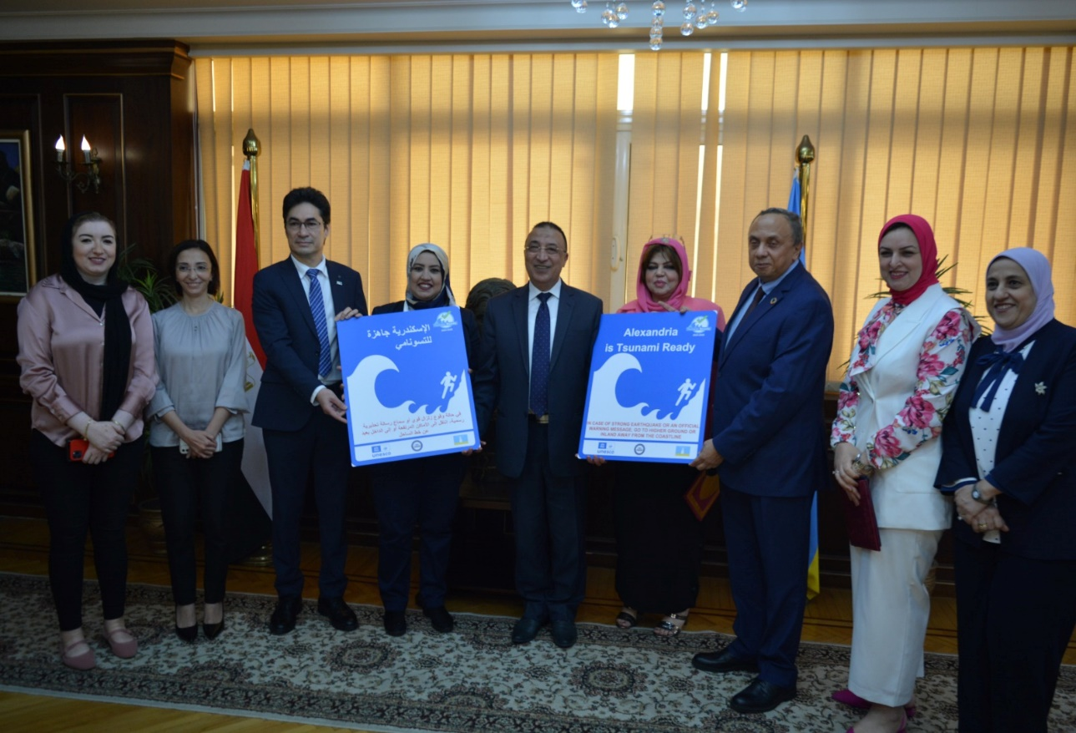
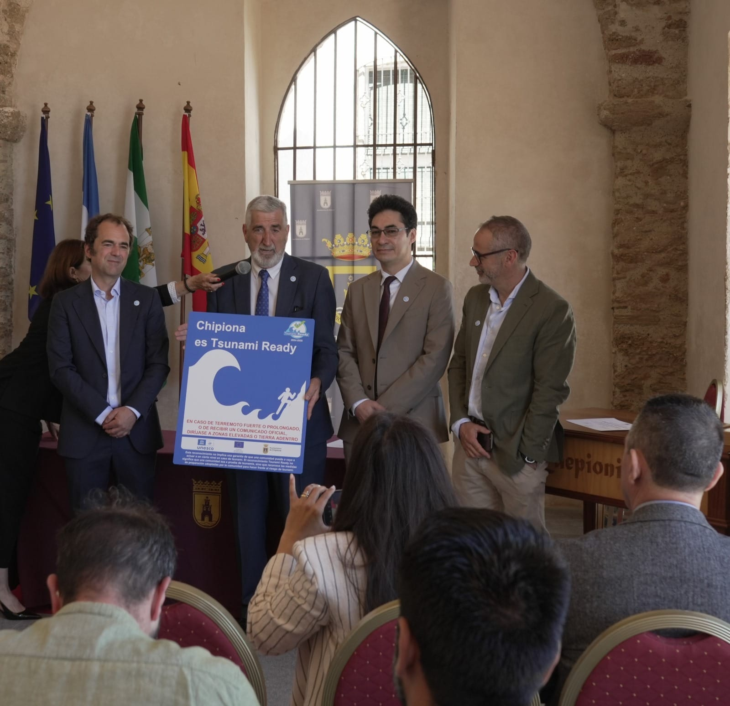
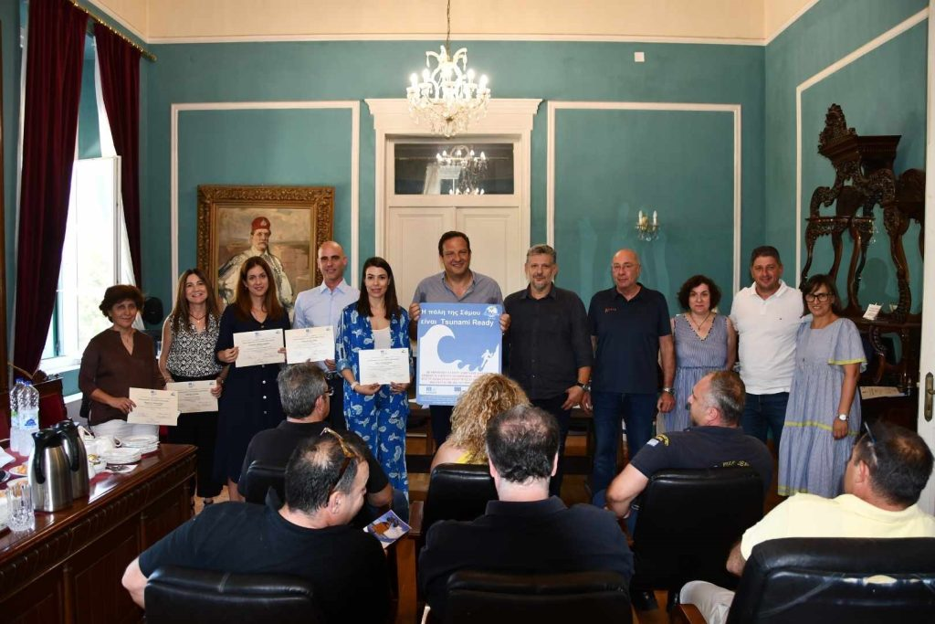
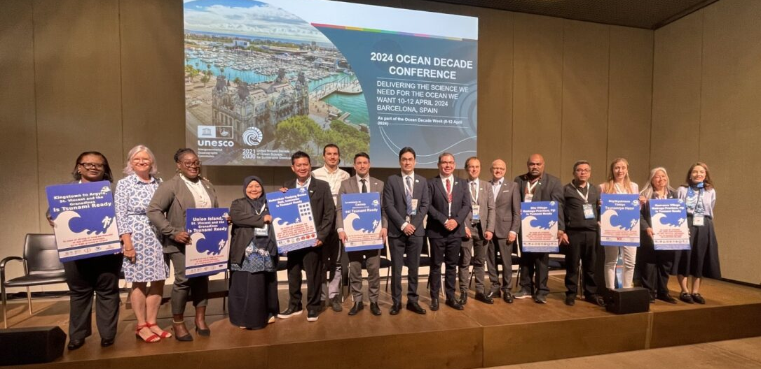
International, National, Local Engagements
City Mayors and Governor
Cannes, France
Büyükçekmece, Itanbul, Turkeye
Alexandria, Egypt
Chipiona, Spain
Samos, Greece
2024 Ocean Conference, Barcelona 11 April 2024

Slide 11
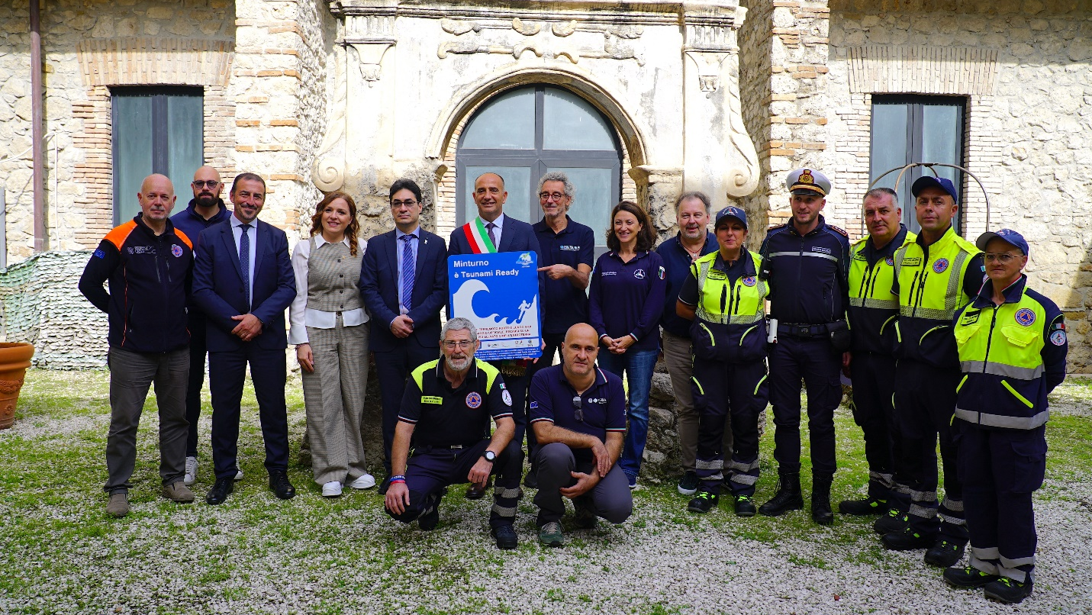
Minturno, Italy joins the UNESCO-IOCTsunami Ready Programme

Slide 12
Documents
6 Technical Documents
ICG/NEAMTWS -XVIII Summary Report
Evaluation of IDSL
IDSL Manual, User Guides and Maintenance Plan
Sea Level Related Coastal Multi-Hazard Risk Perceptions of the Communities in Alexandria, Büyükçekmece, Chipiona, El Jadida, Larnaca, Marsaxlokk, and Samos, IOC. Technical series and BRO/2024/
Final CoastWAVE Project Report
Final Project Evaluation Report
3 in Progress
NEAMWave 23 Evaluation report
OUG in progress?
Best Practices, Guidance, Challenges, Lessons Learned in Implementing UNESCO IOC Tsunami Ready .
  Invite Task Team Tsunami Ready to contribute to the drafting and /finalization of document

Slide 13
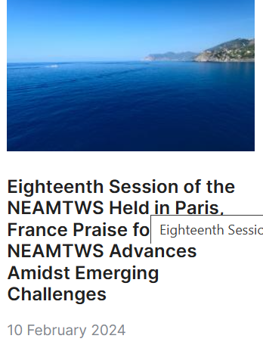
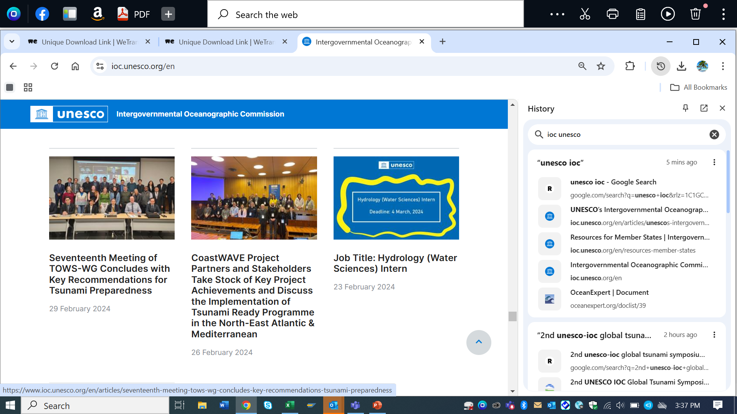
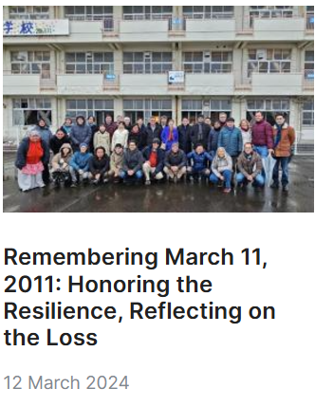
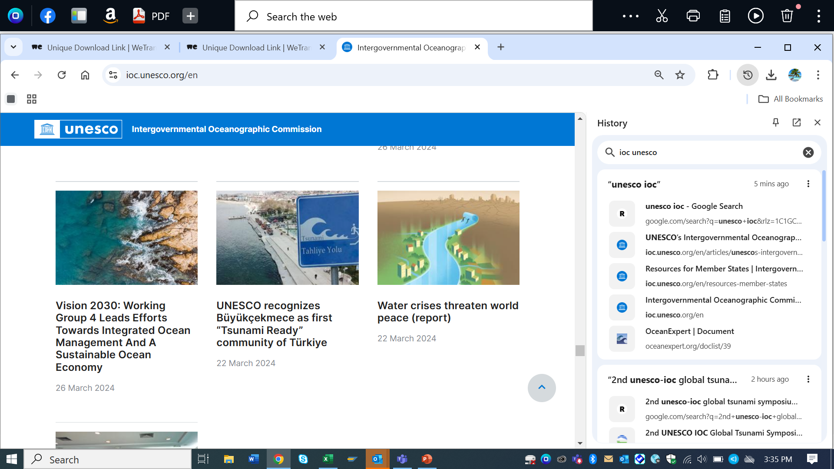
Communication and Outreach
(Feb –Nov 2024)
13 Articles

Slide 14
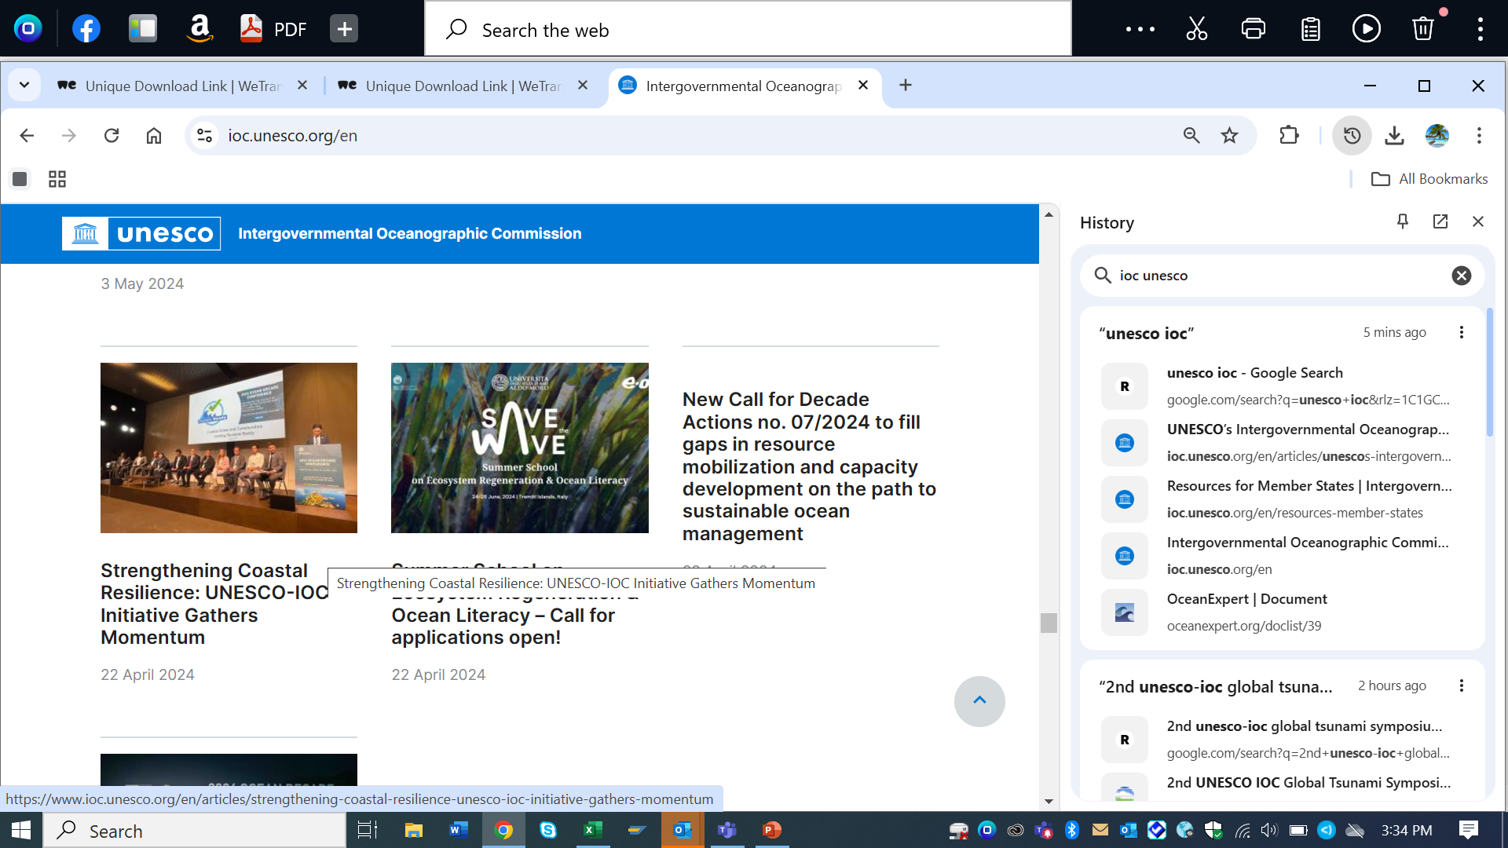
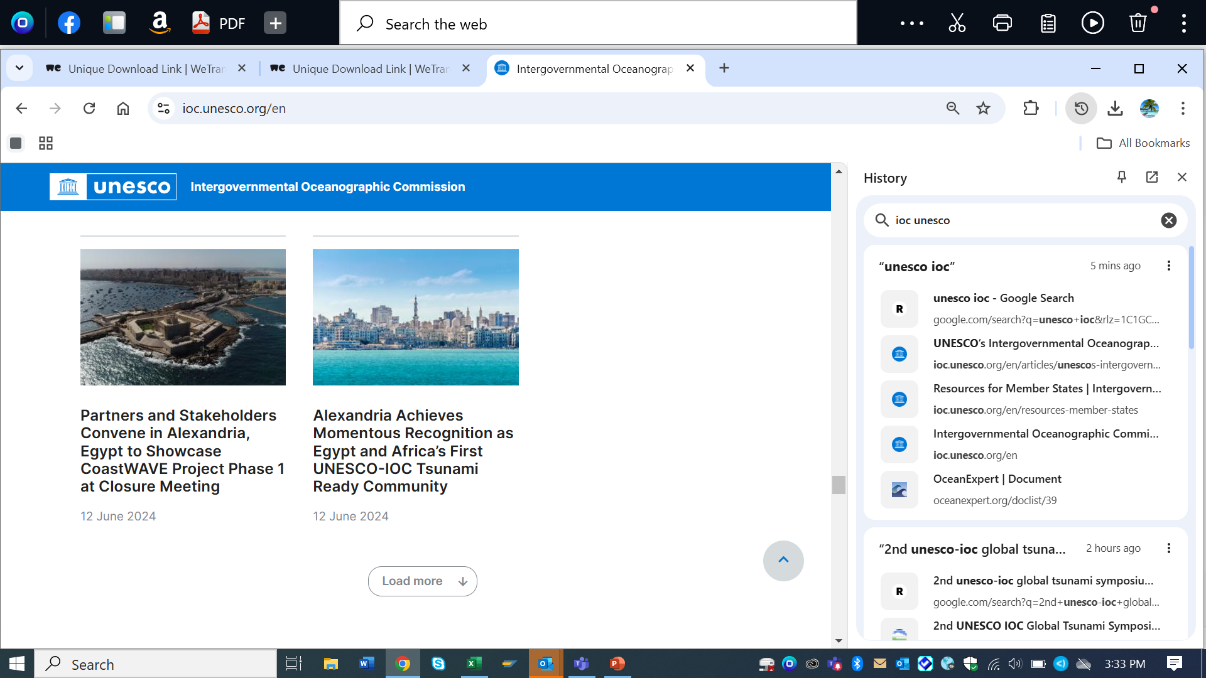
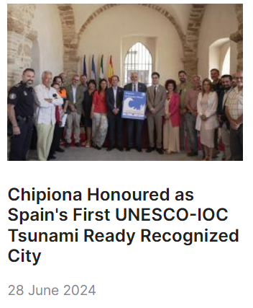
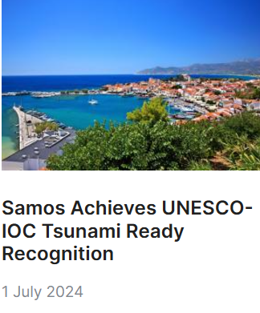
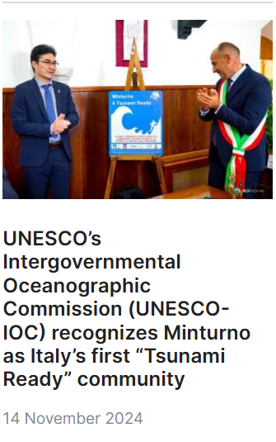
Communication and Outreach

Slide 15
New IOC DG-ECHO Funded
CoastWAVE 2.0 Project (1.2 M Euros)
Phase -II project ( 1 July 2024 -1 July 2026 (2 yrs)
Initiating, planning and negotiation phase.
Key Thrust of CW 2.0
Enhancing detection, monitoring and dissemination systems
Scaling up of TRR communities and integration/alignment with other coastal resilience initiatives.
Creating dialogues on HILP within a MHEW context
Diversify partnerships and direct engagement with Civil Protection Agencies
Strengthening connections with other projects
“Scaling-Up and Strengthening the Resilience of Coastal Communities in the North-Eastern Atlantic and Mediterranean Regions to the Impact of Tsunamis and Other Sea Level-Related Coastal Hazards”;
External Evaluation of CoastWAVE 1.0
UNESCO should facilitate:
pairing partnering institutions to conduct research collaboration, share and analyze scientific data, and conduct tours to understudy other countries with advanced observatory systems and models.
twinning cities and municipalities between regions or countries to replicate and scale up successful projects.

Slide 16
Interesting Development
Upcoming Events
UNESCO Press Office want to offer a more local angle to French journalists who plan to cover the 20 yr anniversary of 2004 tsunami.
The risk of tsunamis in the Mediterranean has been of great interest to the French press in the past.
France, Cannes
Spain, Chipiona
Greece , Samos
Türkiye, Büyükçekmece Tsunami Ready Community,
14-15 January 2024: Tsunami Ready Workshop (CW 2.0), Online?
Feb 2025: Tsunami Sources Workshop (CW 2.0)?
16-17 January 2025 :ODTP –SC. Paris, HQ
Mid Feb 2025: TOWS and TTs, Paris, HQ
2- 4 June 2025: EW4ALL GSF,
2-6 June 2025: 8th GPDRR 2025, Geneva
4-6 June 2025: One Ocean Science Congress, Nice, France
25 June-2 July 2025: IOC Assembly , Paris. HQ
Target: Total of 25 UNESCO-IOC Tsunami Ready Recognized Communities in NEAM region by end of 2025 (25/2025)

Slide 17
Nominations of ICG-NEAMTWS
WGs and TTs Members
Email-Google document
IOC CL
In session
END

