Slide 1


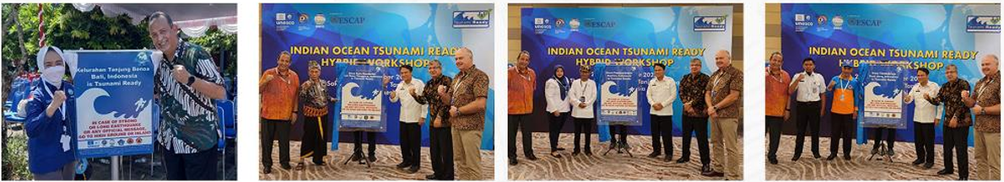
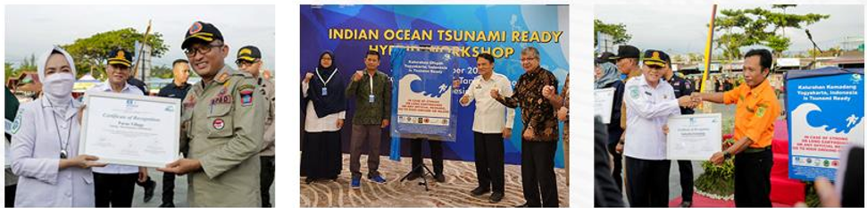
BMKG
Plan on the Implementation of Tsunami Ready
Programme in the South China Sea Region
South China Sea Meeting XII
Jakarta, 7 – 8 November 2024
Abdul Rosid - BMKG

Slide 2
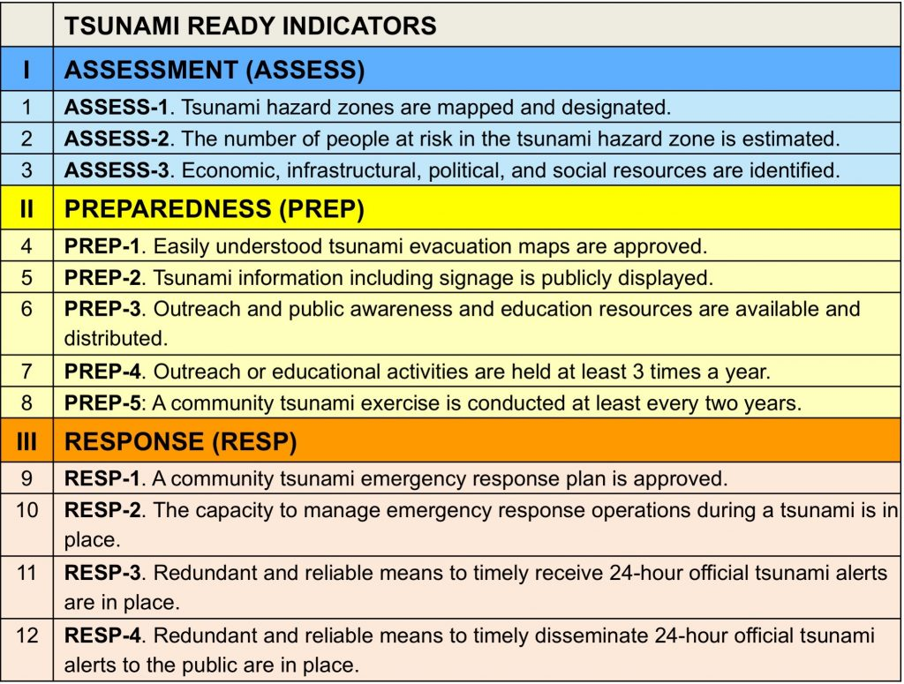
Background of Tsunami Ready Programme
Tsunami Ready Recognition Programme is a community performance-based programme that facilitates tsunami preparedness as an active collaboration of the community, community leaders, and national and local emergency management agencies.
The main goal of the programme is to improve coastal community preparedness for tsunami emergencies, to minimise the loss of life, livelihoods and property, and to ensure a structural and systematic approach in building community preparedness.
Tsunami Ready consists of 12 key indicators designed to strengthen local tsunami risk reduction capacity. The indicators are grouped into three categories:

Slide 3
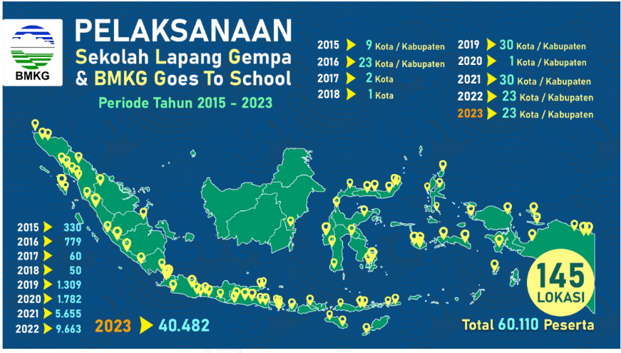
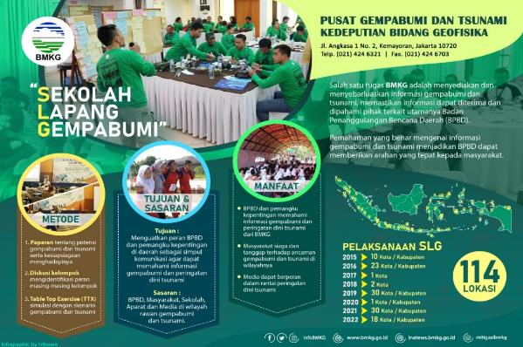
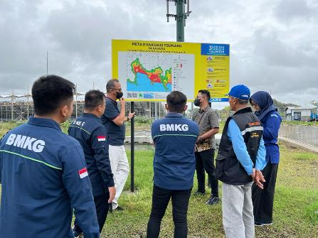
THE COMMUNITY EDUCATION ACTIVITIES OF SEKOLAH LAPANG GEMPA (SLG) ON CONTRIBUTING TO THE DEVELOPMENT OF TSUNAMI READY COMMUNITY
The SLG (Earthquake Field School) is a capacity building activity to enhance local government and community awareness and response
Create Champions from LDMO, Community, Army, stakeholders related to the disaster management and response, School, community, private sector are involved.
The scope of the SLG:
Field Survey and advocating the implementation of the 12 indicators
TOT Workshop of the SLG
School Exercise
145

Slide 4
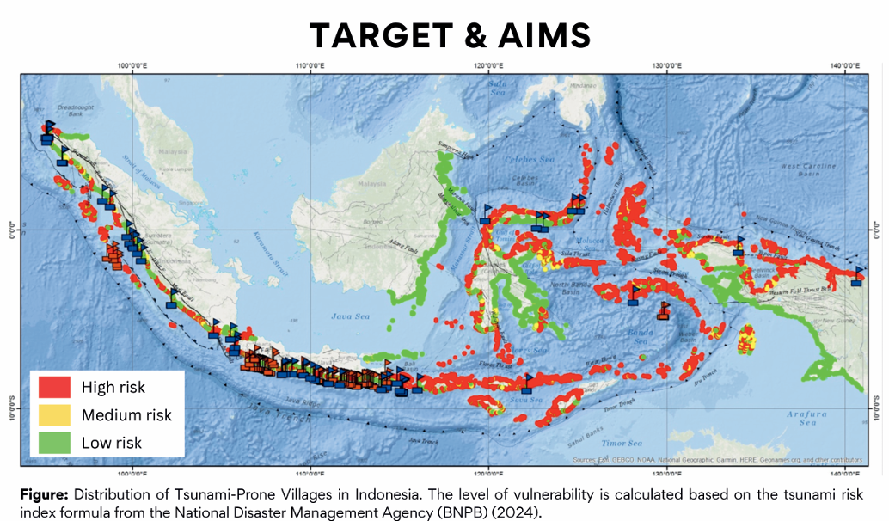
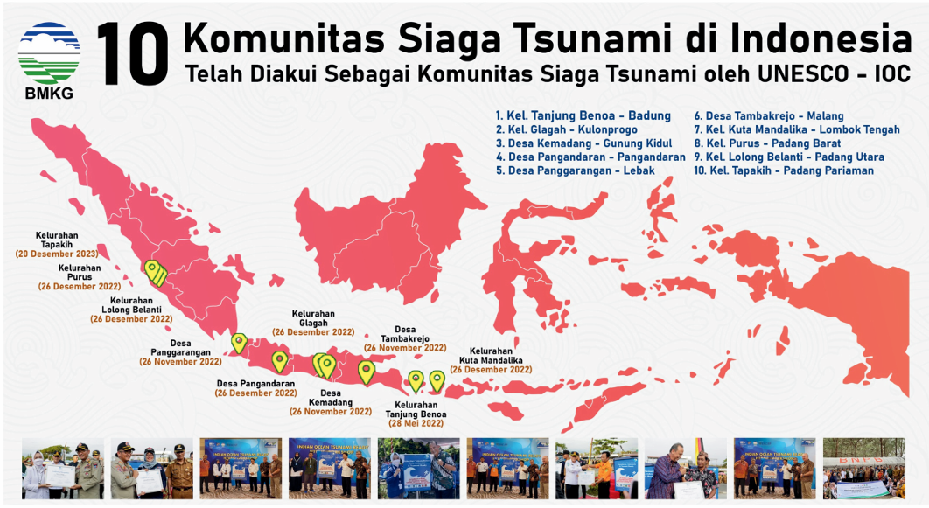
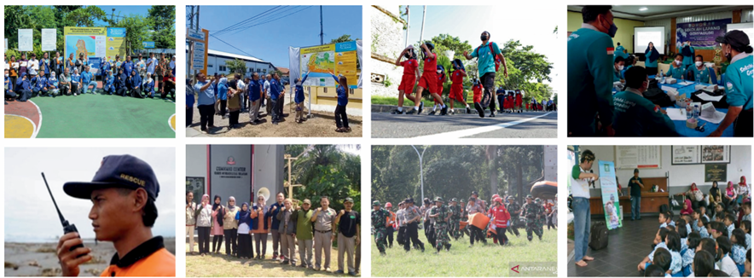
Implementation in Indonesia
The Implementation of the Tsunami Ready Program targets 5,732 tsunami-risk villages/communities across Indonesia, consisting of 1,013 communities with a high-risk index and 4,719 communities with a medium-risk index.
As of 2024, BMKG has successfully facilitated 10 communities in 10 cities/regencies to receive international recognition from UNESCO as Tsunami Ready Communities.
Additionally, BMKG has helpoed 11 communities in 5 cities/regencies achieve national-level recognition as Tsunami Prepared Communities, with plans to continue working toward international recognition by the end of 2024 including 4 villages in Aceh.
Tsunami Ready Community in Indonesia
Has been recognized as TRC by UNESCO-IOC

Slide 5
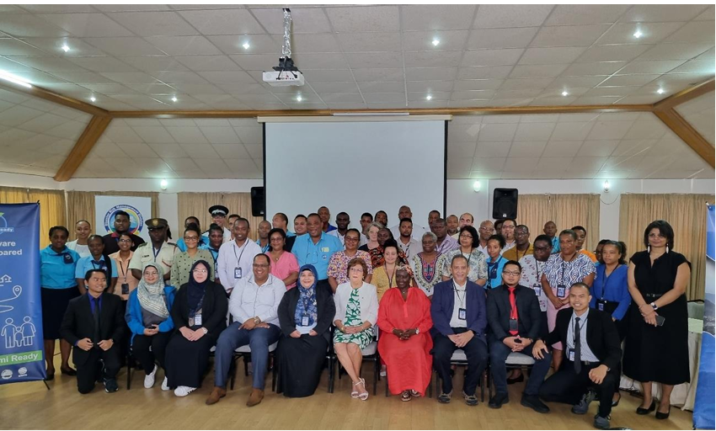
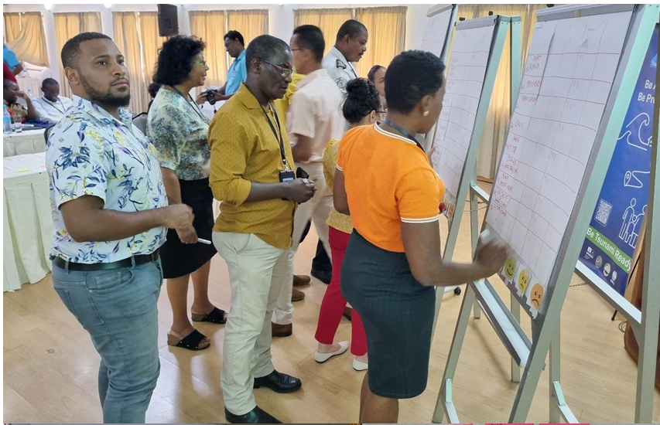
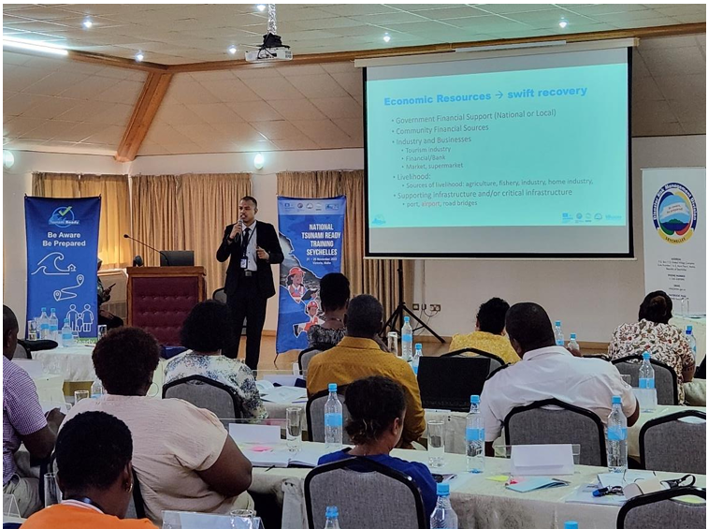
Training of Tsunami Ready Trainer in Seychelles
Training of Trainer Tsunami Ready, National Tsunami Ready Training - Seychelles aims to invite, encourage, and support communities and stakeholders in Seychelles to implement the UNESCO-IOC Tsunami Ready Recognition Programme (TRRP), contributing to the UN Ocean Decade goal of preparing 100% of tsunami-prone communities to be aware and ready for tsunamis by 2030.
It was held on 21-24 November 2023
52 participants:

Slide 6
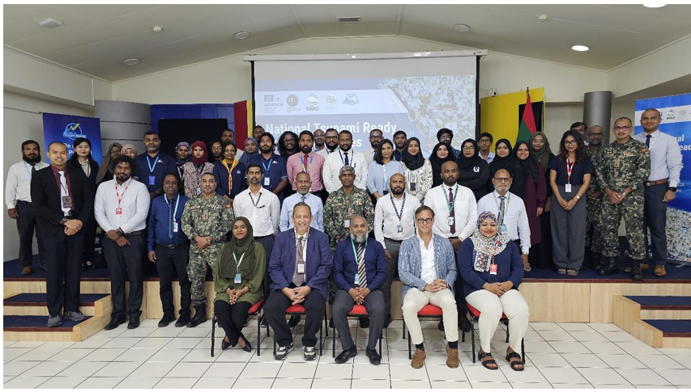
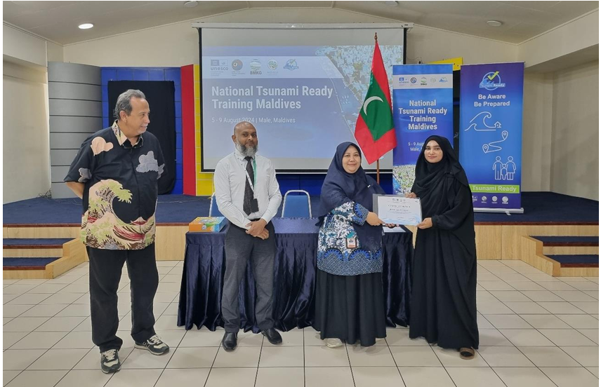
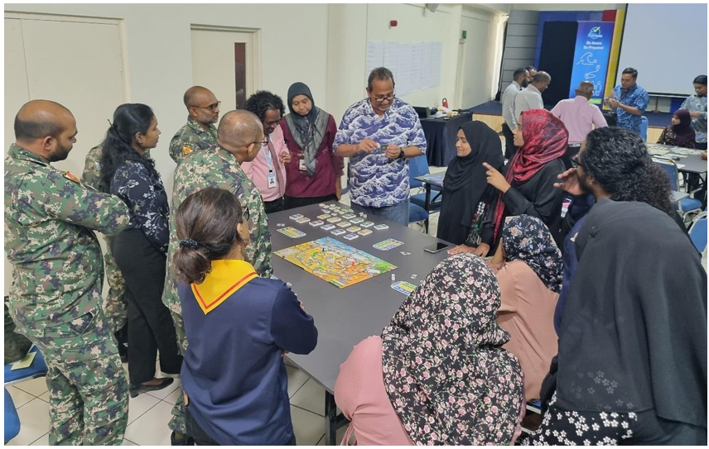
Training of Tsunami Ready Trainer in Maldives
5th – 7th August 2024
54 participants; Maldives Meteorological Service, Ministry of Tourism, Maldives National Defence Force, Maldives Police Service, Maldives Transport and Contracting Agency, Maldives Airport Company, Maldives Port Limited, Maldives Water and Sewerage Company and etc.
Introduction of 12 UNESCO-IOC Tsunami Ready Indicators
Sharing of good examples and experiences in the implementation of UNESCO-IOC TRRP :
- Indonesian communities of Tanjung Benoa, Tambakrejo, Kemandang, Glagah, Panggarangan, Pangandaran and Kuta Mandalika
- Other Tsunami Ready stakeholders and collaborators

Slide 7
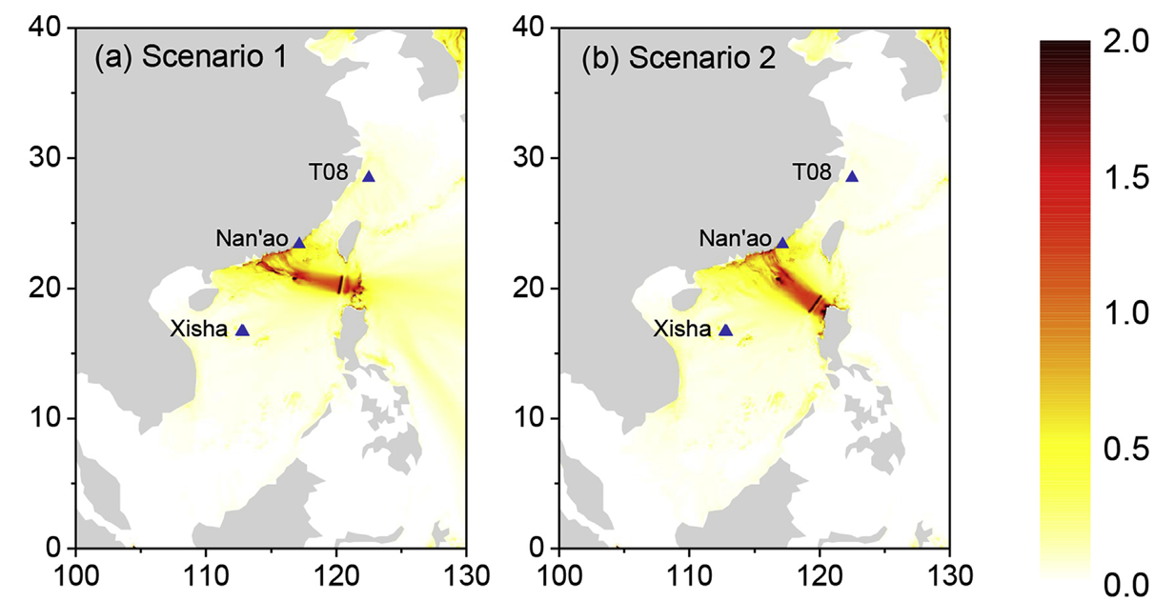
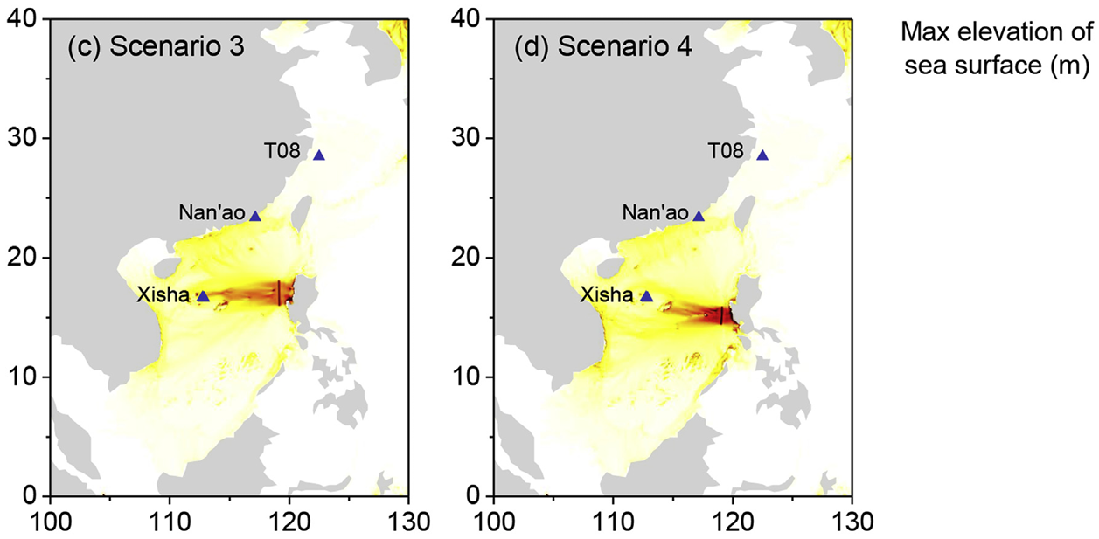
Plan for South China Sea Region
(Yang et al., 2016)
BMKG is planning to implement TRC Program in South China Sea Region in incoming years.
As we do in Seychelles and the Maldives, BMKG will seek its own financing for the provision of trainers.
Furthermore, to realize this activity, we need the help of countries in the South China Sea Region, including:
- Further coordination to the training participants ranging from the local government, NDMO, LDMO, and the community.
- Provide a location for training

Slide 8
THANK YOU

