Slide 1


Summary agreed elements
Session 11 & 12: Defining Steps to integration for an IOC data architecture
Emma Heslop, Joanna Post, Peter Pissierssens IOC/UNESCO
IOC IODE/GOOS Data Workshop
30 September - 02 October 2024, IODE Project Office/VLIZ, Ostende, Belgium

Slide 2
Strengths (internal)
General alignment to modern distributed data practices (ODIS,WIS2,ERDAP)
We are all Looking outward to see how to deliver services
All invested - all been working together for some time - skilled people FAIR principles / Common implementation approach
Long history / sustained commitment from Member States
Success stories on how to share data (Emodnet, GDAC, OBIS…and working across nations)
Part of UN - Critical awareness of international focus
IOC Statutes (informing MS on actions)
Working towards same goal
Can GRAs help get all data shared… Can NFP help
ODIS has matchmaking capability
work with existing strengths
Weaknesses
Underused / ignored significance of IOC being UN
not enough skilled people
data
liaison to user groups
GOOS /IODE/ IOC weak in the UN System - underappreciated
Our strengths are not recognised - unique value of IOC in running this
Data sharing not a cross cutting priority in IOC
Data management and sharing not recognized as essential in all IOC communities of practice and relevant DM practices are insufficiently known and used
Shared visión and an ongoing governance system to support implementation
Fragmentation geographically and politically
difficult to create products
several entities doing the same thing
multiple submissions by one agency
different versions out of one data set
inefficiencies
different time horizons for users
some still not share data - whole MS
Collective access and benefits sharing regime (funding mechanism) - enable our competitors to a degree that we are outcompeted
we do not have own awareness of licencing and restrictive usages
insufficient linkage between what we do at technical level and top level of governance where decisions on data sharing are made
lack of capacity in global south / under-resourced countries / communities
everyone working in niches
SWOT - current situation across IOC data landscape

Slide 3
Opportunities (external)
engagement with private sector
recognised need for more ocean data - from UN / private sector / governments
Ocean decade
Agree a coordinated approach
use the WMO Unified Policy and other mechanism more
Communicate much better what we are doing…
Be an exemplar to a wider community to influence other communities than the ocean (e.g. ?NASA heliophysics, CDIF… )
Opportunity to demonstrate mechanisms to balance protection and openness (appetite for data sharing with products and building trust)
Creating a “marketplace” to enable trading/sharing/negotiating data (preposition ourselves in emerging digital economy)
optimise green computing- sharing metadata not data -= data mesh architecture
Private sector could create products
Private sector design the technology we need
Provision of and refining of Indicators
use decade and UNGA to raise awareness of top level government for data sharing and also to avoid data colonialism
work with diversity of partners to build a system for global community
Need a plan - staged approach - guidelines…
Roll out feature (“ocean in a box”)
Threats
Non support for multilateralism
Others can step up and do it
Being part of UN can make slow to innovate…
Too slow and others will do it (with our innovation)!
unique role of IOC is not recognised
HL engineering takes over good ideas of the system
need to ‘police’ nodes -
Geopolitics and emerging regulatory frameworks
Access and benefit sharing - digital equity
Fear by different countries of asymmetries in benefits from sharing data - digital colonialism.
involving over-capacity nations so that they invest in us
lack of resources and
lack of optimised allocation of resources
lack of redundancy in data systems
no clear identification of ownership of separate parts of system
Ensure we identify manageable list of tasks
SWOT - current situation across IOC data landscape

Slide 4
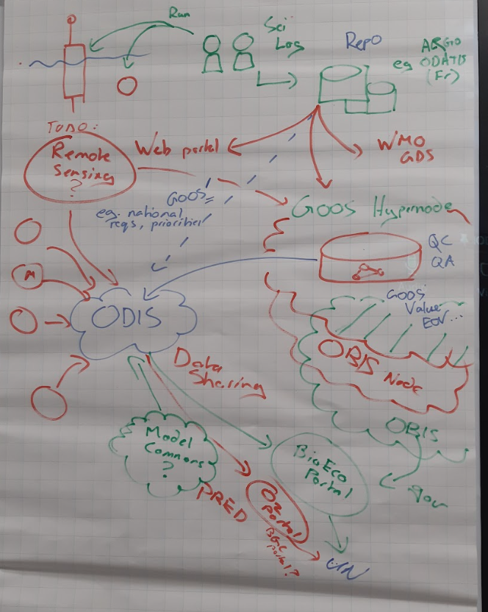
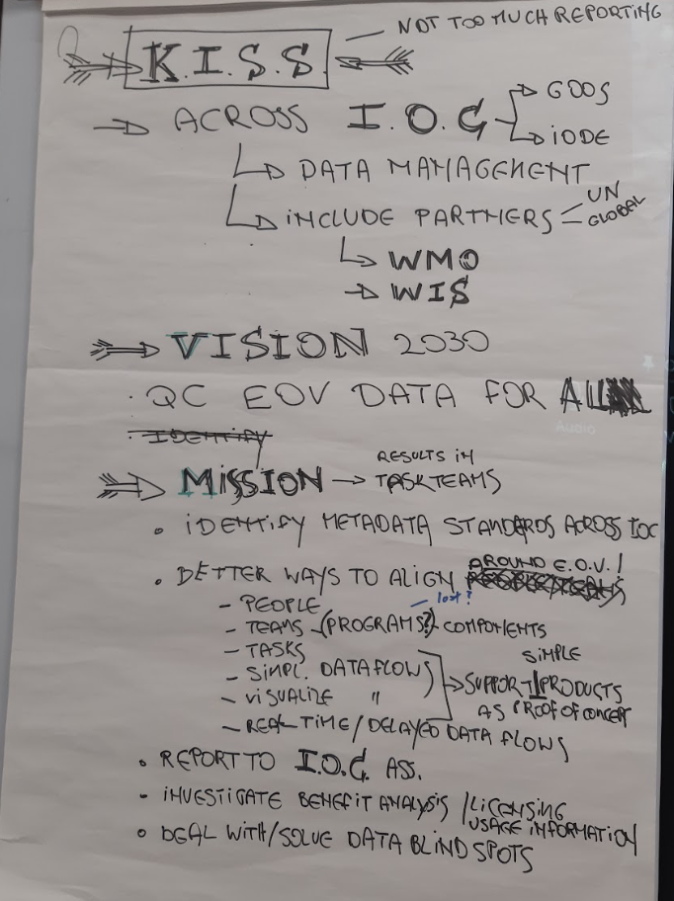
Coordination structure
Create a cross IODE-GOOS-IOC Working Group (see later actions for its work) w. UN partners(?)
ODIS architecture holds the technical governance structure for the relationships between nodes/components, agree standards for exchange, verify GOOS ‘brand’ data
UN connection is unique and brings value
Vision - QC EOV Data FAIR All
Joint Session/agenda item at IOC Assembly

Slide 5
products/services
Annual Reports / tracking services
EOV products
Metadata
OceanOPS
BioEco Portal
WMO OSCAR?
Interoperability and discoverability layer
ODIS
Data access
ERDDAP
OBIS
WOD, others
GRAs
WIS2.0???
Observations
GOOS OCG networks / GDACs
GOOS BioEco EOV programs
Data held
Metadata held
Notes:
Green is data; orange is metadata

Slide 6
What do we want?
Wherever you are in the world - you want to be able to access EOV data - free and unrestricted
IOC has defined and clear niche in digital ecosystem which is unique to us and highly investable
Start with Minimum Viable Product (MVP) - clear deliverable / GOALS - key outcomes/products
Promoting/proving the benefits of improving access to global data sets
New Partners
IOC Technical integration
Clear link/role for each member of the value chain / data ecosystem
Joint vision
Collaborative buy-in by all in process and its outcomes
Implementation plan
focus on how we make it happen
clear timeline
identify resource requirements
working with success stories
Phased approach
New Partners
Buy-in from IOC regions / Decade regional coordinating committees…
applicable KPI for regions (e.g. has ‘someone’ collected data within your domain of interest)
use system to find and integrate products that not used before

Slide 7
Actions / Timeline
SEPT 2024
Define plan
WG formed
JAN/FEB 2025
GOOS SC
IODE Committee (3/25)
IOC Officers
Draft proposal
JUNE 2025
IOC Assembly
Joint session
Proposal
Decision
4 months
4 months
Short term - proposal creation/initiate collaborative structure
Create a cross IOC Working group to devise the proposal for a cross IOC data architecture/space - Vision, Governance, Technical, Unique offer, Advocacy, Capacity, Diversity, Initial deliverables, Resource need, Risk
GOOS/IODE jointly hire to support proposal development process
Map the data flows - what to govern and what to implement - look at optimisation/eliminating redundancy
Create ‘rules’ of coordination, responsibilities - ODIS broker, services, data flows
Select showcase pilots that demonstrate data flows and broker service test assumptions are robust
How would plan address capacity (training session or ODIS in a box, tools, SOPs…)
Develop joint IODE/GOOS/IOC budget strategy, extra-budgetary accelerates services, what required beyond and how we are advocating to get it
Communicae on the proposed IOC data architecture/space - create visuals - reference meeting Decade recommendations - gain feedback - came up again today

Slide 8
Actions / Timeline
SEPT 2024
Define plan
WG formed
JAN/FEB 2025
GOOS SC
IODE Committee (3/25)
IOC Officers
Draft proposal
JUNE 2025
IOC Assembly
Joint session
Proposal
Decision
4 months
4 months
Short term - proposal creation/initiate collaborative structure - plus LAST Session
Ingestion (sketch idea) - corporate data other data (sharing costs), certainly of listening to lower risk
Resources -computing power
Model data - consider IOC system and signalling
Digital equity - data avail - (there s diversity but strengthen…) - UNEP…

Slide 9
Actions / Timeline
SEPT 2024
Define plan
WG formed
JAN/FEB 2025
GOOS SC
IODE Committee (3/25)
IOC Officers
Draft proposal
JUNE 2025
IOC Assembly
Joint session
Proposal
Decision
4 months
4 months
Longer term - post proposal making collaborative structure real (out to 2030)
Through IOC Assembly gain view of what MS are asking for - that this plan answers
Prioritisation of what needs to be done - Minimal Viable Product to support initial deliverable products and services
Advocate - create communications - came up again today
Ensure cross-walk between the views of the system by EOVs and between elements providing services - OceanOPS, BioEco Portal, BGC Portal
Portals are filters on ODIS - ensuring the system is functioning - they are also early deliverables
Assess collective access and benefits sharing regime (funding mechanism) and make clear the decisions that are being made, consider licencing and restrictive usages
Consult and implement operational GOOS EOV metadata tag system - certification/checking
TODAY - map structure - and how its evolving, and efficiency

Slide 10
Missing longer term - out to 2030
TODAY - develop a IOC digital culture for practitioners, training through OTGA, SOPs/practices are documented
Detailed Implementation plan that states phases and identifies goals and roles of different agencies, w. Timelines, with clear regional relevance, including SIDs (structure for engagement)
Data systems redundancy arrangements
Articulate key deliverables
Dedicated assessment as to how far we have come to reduce digital divide
Regular consultation with regional hubs, ad hoc other consultations on use and on product output - possibly higher level consultation with government ministers for digital transformation etc. to ensure plans meet their needs (e.g. data and digital infrastructure minister)
Gather cost and value information, cost of value chains, and including environmental cost (are we green….)
Review 2030 - check that we are now providing a big chunk of the information needed for key global initiatives WOA, is IOC recognised for this work as a trusted source, reinvigorate NODCs, successfully entrained new ocean data (e.g. public sector)
Be careful - a) need a phased plan, b) with each phase a resource plan, and c) success markers important to sell the dream, but also to be realistic about cost as capacity is developed. Iterative nature of the project, do get feedback, move onto the next step (MVP concepts)

Slide 11
Discussion - need to make this real
What partners do we need to work with early to ensure this is supported and successful in and beyond IOC?
What are the biggest barriers to implementation in the short term and medium term that we would really need to focus on?
Actions agreed short term - we need to go back and define in detail - who and what - are we ready to start next week?
Actions agreed long term - looks a bit short compared to what we have discussed - do we need to enrich this?

Slide 12
Missing short term
MVP 1 - GOOS ERDAAP, OceanOPS, BioEco Portal, ODIS bridge - before IOC Assembly proof of concept - already proof the technical solution
Communication - make sure we have a map off the scheme - hyper-nodes etc…
Prototype for metadata semantics for identifying EOvs
Clear implementation plan oxygen (others) EOV/SDG data flow to show Assembly
Articulate as useful to the MS - ahead of the Assembly, doing more with what we have, providing clear guidance. IOC information webinar in late April (or go to each Officers Working Group - after and take advice from Officers Meeting….
Timeline:
IODE deadline end January 2025 for draft proposal and Officers Mtg - GOOS SC to sign off on the structure
Assembly Working document submitted - bit of delay - start of May need
Intention that this is a decision

Slide 13
Partners
DCC Ocean Prediction (ETOOFS GOOS) model data in the planning - in second MVP…
WMO WIS2
UNEP digital equity plus…
Space agencies - CEOS, CGMS, ESA, NASA, ISRO, etc.

Slide 14
WG focal points
Informal WG
ODIS- Lucy/Pier Luigi
OBIS/BioEco - Ward/Pieter
OCG/OceanOPS - Kevin/Mathieu
GOOS general - Emma/Joanna
SDG 14.3.1/Science - Katherina/Kirsten
GOOS BGC/IOCCP - Veronique/Nico
IODE general - Peter/Lotta
DCC/DCOs Infrastructure 3 - Terry, Enrique, Jan Bart
Punctual review
IOC: MSP, Tsunami, DCU, Capacity development, IOC regions
GRAs virtual meeting - GOOS SC

Slide 15
Barriers
Document architecture straight away?!
Identifying who takes charge? Anchor are IODE/GOOS. For proposal sign off is both IODE and GOOS technical and management levels
Users, reach out and ensure production is useful for key MVPs - co-design - ensure…
Effective communication - who what how and how we resource - different phases, multi level
Insufficient technical input - solved through (partially) communication within our system on some questions - engaging with many more across nations etc, GOOS OCG Data TT, GRAs, IODE/OBIS nodes. Draw on networks for internal review. Engage with outside? With other groups, dialogue with industry, Corporate data group potential.

Slide 16
Vision - agreed north star (Vision and KO’s)
IOC as the gateway all ocean data - with core GOOS certified EOV data clearly identified
Wherever you are in the world you want to be able to appropriately access EOV data
EOV Data of documented quality, following FAIR & CARE principals, available for All
Harnessing all parts of the IOC value chain (or all IOC assets and capacities) to deliver trusted information to as many users as possible
High value products that get delivery of the EOV data into the hands of the global assessments and multilateral processes, that can be traced back to the point of truth (i.e. observations)
IOC has defined and clear niche in digital ecosystem which is unique to us and highly investable, that is aligned with other architectures and built on existing infrastructure.
IOC data architecture and associated products and services will bridge the digital divide and help mature digital ecosystems globally
Ref: IOC Data Policy, WMO Unified Data Policy, and GOOS data is free and unrestricted
Define Ocean Data: be it from in situ, modelling, analytics, public and private sector
Define the IOC Value Chain - IOC Medium Term Strategy page 16)
(Global ocean data and data flows clearly mapped - KPI?)

