Slide 1



Session 9 : Ocean Decade work on private/industry ocean science data
IOC IODE-GOOS Data Workshop | Ostend, Belgium | 3 October 2024

Slide 2

2
Ocean Decade – Data Strategy and Industry Data
Data Coordination Group
Develop a data & information strategy
Corporate Data Group
Unlock privately held data
Strategic Vision & Objectives
Data Strategy Implementation Group
Implementation Plan
Frameworks, Strategies, Recommendations
To enable private companies to share their privately held ocean data for the benefit of ocean science
2
Vision 2030 Process
White papers setting ambitions & outcomes
Notes:
In the Ocean Decade there is a decentralized coordination, with multiple entities helping to coordinate activity in a particular domain. This allows a bottom-up approach, bringing in outside expertise.
The Data Coordination Group was convened in Nov 2022 to develop an overarching data and information strategy for the Deacde that would endure beyond 2030. Then in 2023, a sub-group was convened to work o the implementation plan for this strategy. Both of these groups include data experts from around the world, brought together through a public call for candidates.
With eh Corporate data Group – focused on unlocking privately owned ocean data - and the outcomes of the Vision 2030 process, we must set the priosities for data sharing, capacity development, etc.

Slide 3
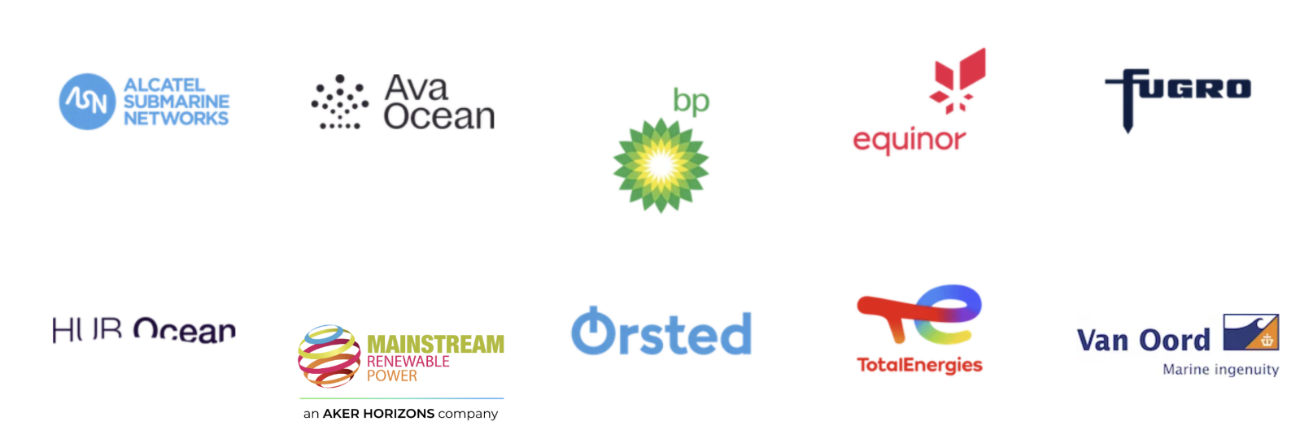


Corporate Data Group
Unlocking privately held ocean data for science
Develop strategies to provide public access to privately held ocean data
Engage with Ocean Decade stakeholders and actions
Actively promote the Ocean Decade and seek collaborations

Slide 4

Corporate Data Group
Learnings
Industry top 3 barriers to data sharing:
Legal/contractual - data ownership not always clear, or split between multiple organisations
Technical - knowledge of where and how to share data, not always easily accessible
Incentives - lack of incentives, risk/reward not clear, resources required, etc.
Others: commercial sensitivity, liability risk
Notes:
What have we learned?
Here are the top 3 barriers that came ou of a workshop in the early days of the

Slide 5
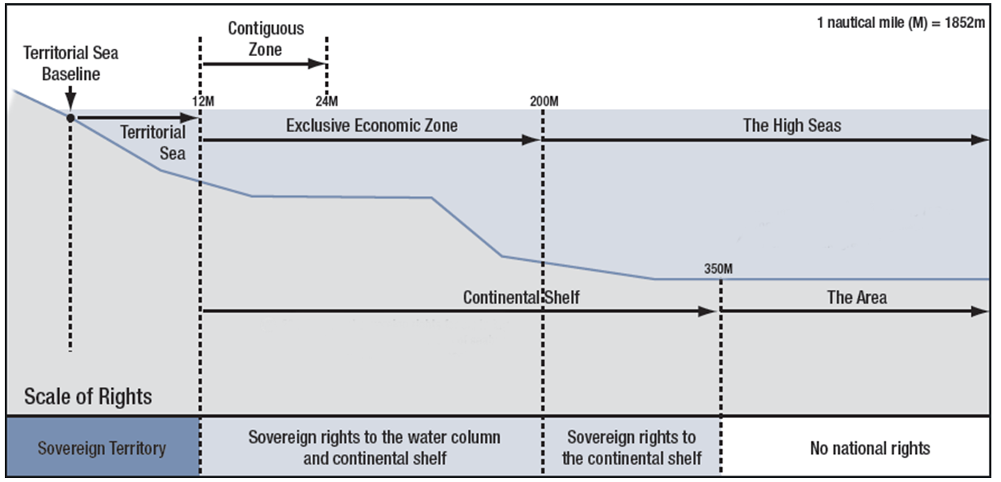
Bathymetry data use case
Learnings
Authorisation from the organisation that conducted or contracted the data
Authorisation from national jurisdictions
Notes:
Each jurisdiction has its own set of rights, responsibilities, and limitations, and they are established and governed by international law, including UNCLOS. Understanding these jurisdictions is crucial for regulating activities in the ocean, ensuring sustainable resource management, and resolving disputes between states. Companies must understand and abide by the national jurisdiction legislation with respect to data collection and data sharing.
In highly simplified terms:
EEZ – need government authorization
High seas – in a nutshell, data is owned by the flag state of the vessel, or by the 3rd party that
In each case we need to find the right stakeholders, the right contacts, the champion in the national government that will help you obtain this approval
Detailed explanation:
Authorisation required to share ocean data collected within national jurisdictions, i.e. within the state’s Exclusive Economic Zone (items 1-3 above), can vary depending on the country's legal framework and regulations governing ocean data. In many cases, the government of the respective nation may claim ownership of the data collected within its territorial waters, as the data pertains to land and water columns which are owned by the coastal state. This ownership is often justified by the government's responsibility for managing and protecting marine resources, ensuring national security, and supporting scientific research and public interests.
Organisations collecting ocean data in territorial waters for projects such as building offshore energy infrastructure need special permission and licences to do so from the coastal state. With this permission, organisations have specific rights to access the data for their own use. However, they are in most cases not authorised to share the collected data with the public. The procedure on how to share collected ocean data with the public differs between coastal states, but in most cases special permission will need to be acquired before sharing of ocean data is allowed.
As of September 2023, the Data Governance Act became applicable in the European Union (EU). The Data Governance Act is intended to address barriers to data sharing while ensuring the protection of individuals' rights and promoting innovation and economic growth within the European Union. The act aims to create a framework for data sharing across sectors, including public and private entities, by establishing mechanisms for data intermediaries to facilitate secure and transparent data sharing. Under this act, governments are mandated to release data, including ocean data collected within national jurisdictions. This data is accessible to companies through platforms provided by data intermediaries.
For data collected outside of territorial waters, i.e. in the High Seas, authorisation must be obtained from the organisation that conducted or contracted the data collection.

Slide 6

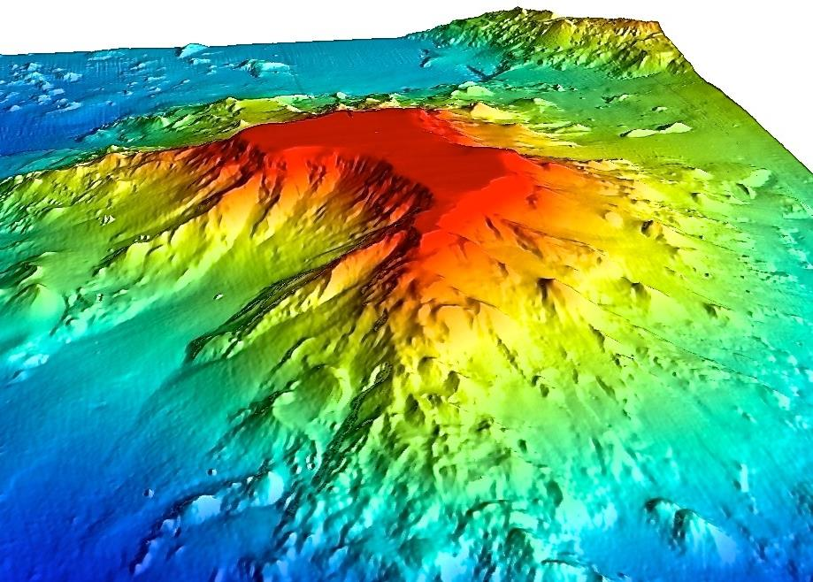
Corporate Data Group
Work on use cases
Establish guidelines for sharing, demonstrate impact:
Bathymetry data
Biodiversity data
Marine Mammal Observations
MetOcean Data
CTD data or ADCP (TBD)?
Image courtesy of Christopher Kelley/HURL.
Notes:
When we started working with the CDG, we quickly realised that different types of ocean data presented different types of obstacles.
This is why we decide to focus on specific data types in each use cases.
So why did we choose bathymetry? Well, for a number of reasons…

Slide 7
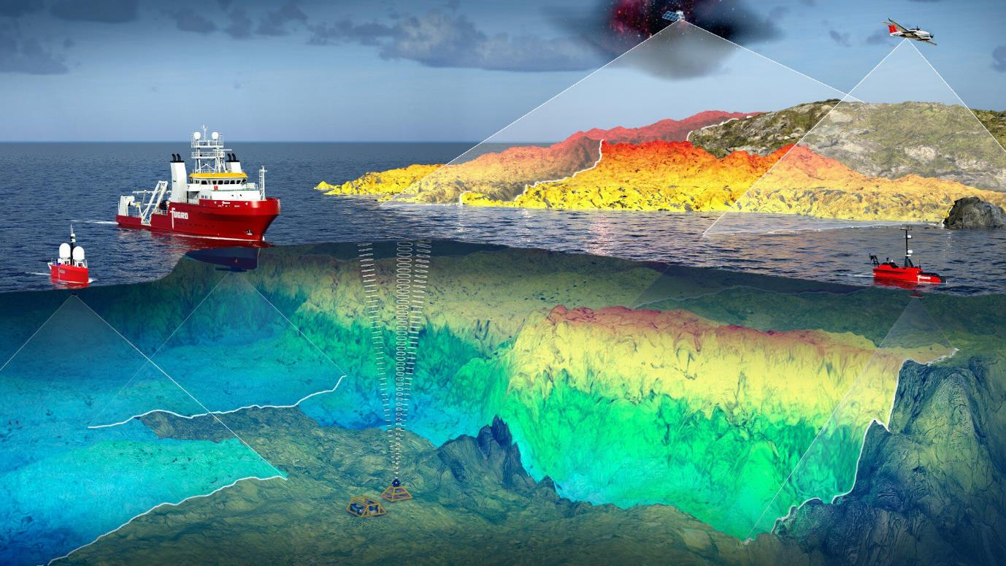
Corporate Data Group
Many sources of bathymetry data produced by industry
Digitized nautical charts
Satellite-derived
Airborne LiDAR
Echosounders - single and multibeam
3D seismic data
Notes:
…First of all, companies that work offshore usually always collect some form of bathymetry data, whether its for fisheries, energy infrastructure, submarine cables, etc.
There are many technologies available today to capture bathymetry, including digitized charts, satellite-derived bathymetry, airborne lidar, etc.
Hydrographic surveys using single- or multi-beam echosounders from vessel, USVs,
There is also in-transit, or crowd-sourced bathymetry
And 3D seismic data collected also provides a source of bathymetric data.

Slide 8
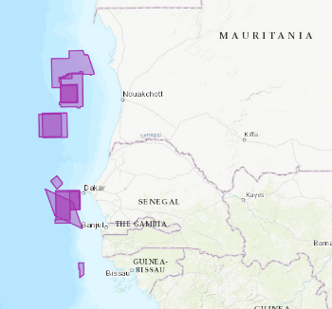
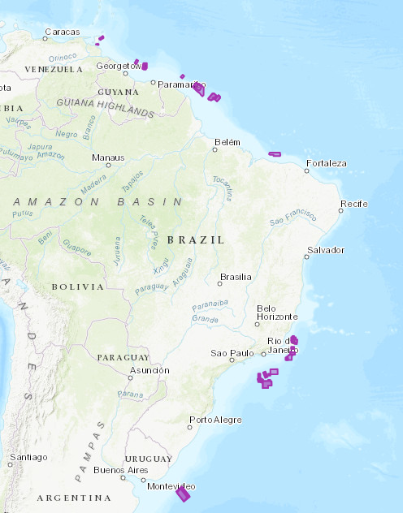
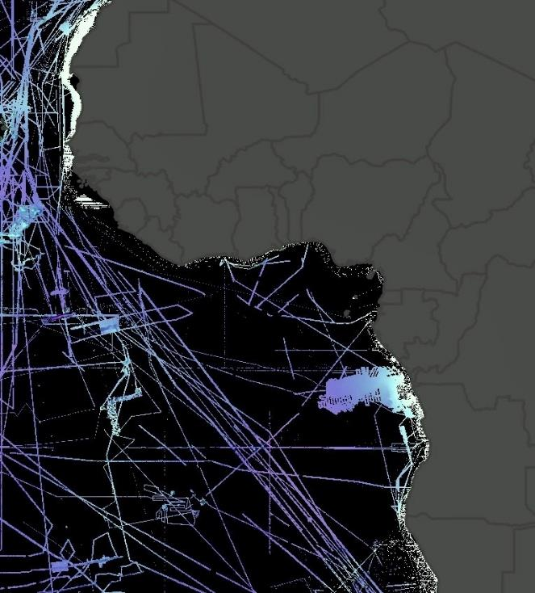

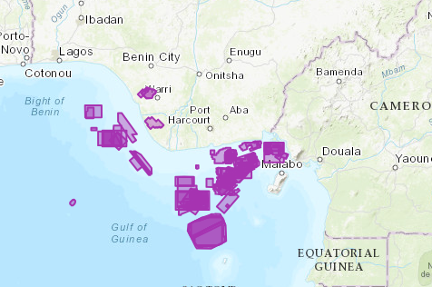
Corporate Data Group
Filling Gaps with Industry Data
Existing 3D seismic data coverage
Notes:
Industry data has the potential to fill data gaps.
Here are the 3D seismic data holdings owned by just one energy company
We decided to look for areas where we knew that the CDG members had data, but also where there were holes in the Seabed 2030 data…identify pilot areas.
Five pilot countries:
Brazil
Mauritania
Nigeria
Senegal
Uruguay

Slide 9
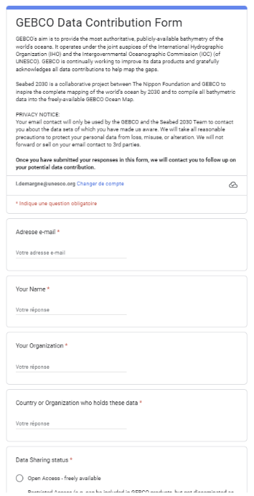
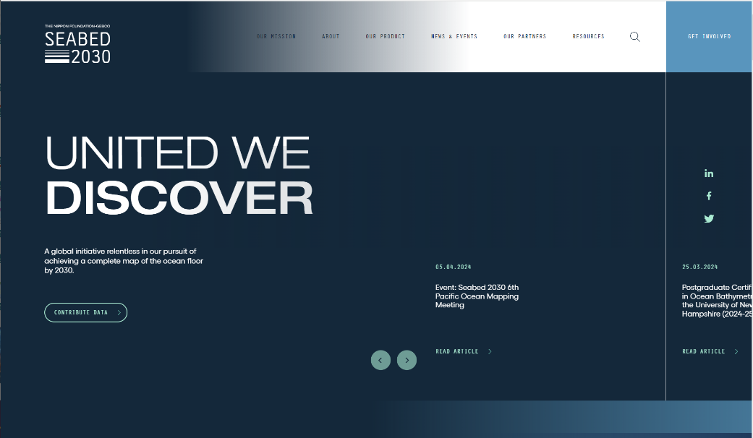

11
Bathymetry data use case
Where to share bathymetry data?
Raw: native sensor format
Processed data: gsf, BAG, NetCDF, tiff, xyz, sd, asc, etc.
Metadata: XML or text
No cost for curating data
Resolution: 10m x 100m grid
Notes:
The good news is that there is an existing platform where we can upload bathymetry data and metada, and that is the Seabed 2030 programme, managed by GEBCO and funded by the Nippon Foundation.
When you go to the website you there is a simple tool and process to go through to provide data.
They can work with a broad variety of formats and have resources to work with other formats if needed.

Slide 10
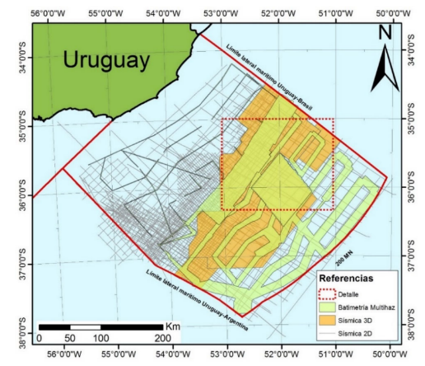
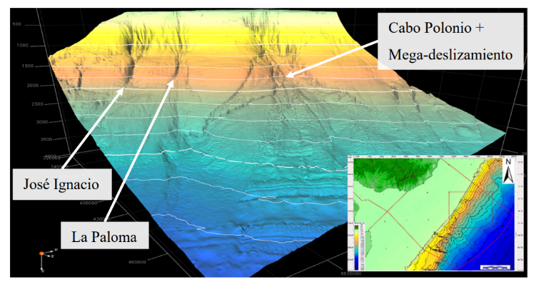
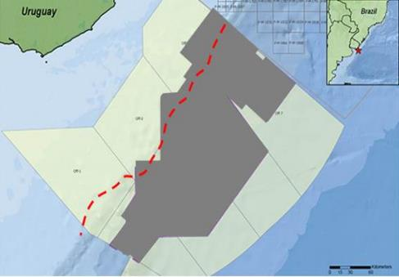
Bathymetry data use case
Success story - Uruguay
ANCAP own 3D seismic data collected in their EEZ
Bathymetry data extracted - made publicly available (250m grid)
Now connected with GEBCO Seabed 2030
Notes:
I want to highlight a first success story of the work of the Corporate Data Group! URUGUAY
[explain Uruguay]
However, our work so far also highlight a key issue, which is that how do we scale this up? Going country by country and company by company will be time and resource intensive.
So on the industry side, we have started to talk to industry associations to help us promote this data sharing as good industry practice, highlighting not just the process to share data, but also the benefits.
And we must also urge national countries to clarify and facilitate the process for releasing bathymetry data, and we will come back to this in our Call to Action.

Slide 11
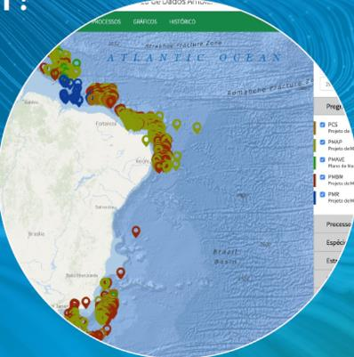
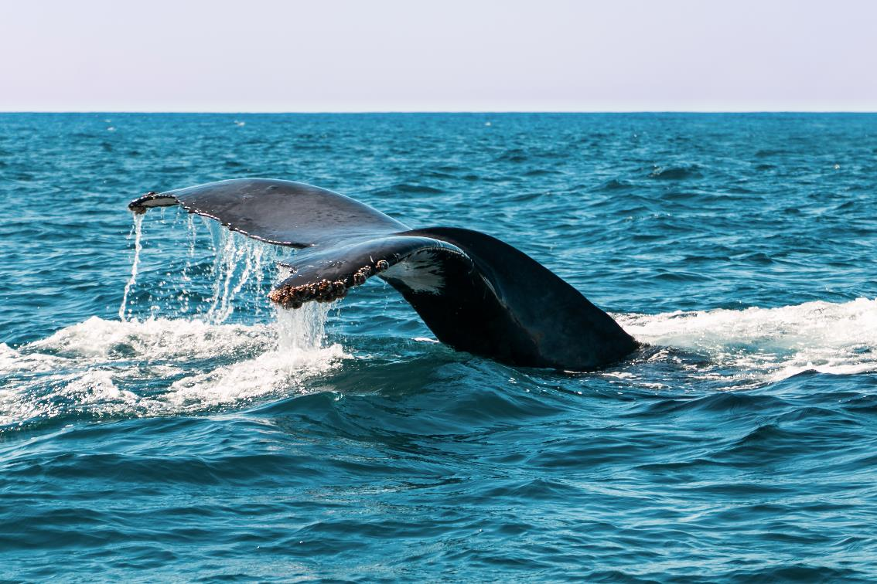
Corporate Data Group
Biodiversity Use Case - Marine Mammal Observations
Driver: compliance with regulations, avoid downtime
Fragmented, uncoordinated – observations not always recorded!
Global repositories, anecdotal use: GBIF, OBIS, EcoTaxa
Use of regional platforms/projects: EMODnet, Netuno, Mareano
Industry-wide standard: JNCC recording forms

Slide 12
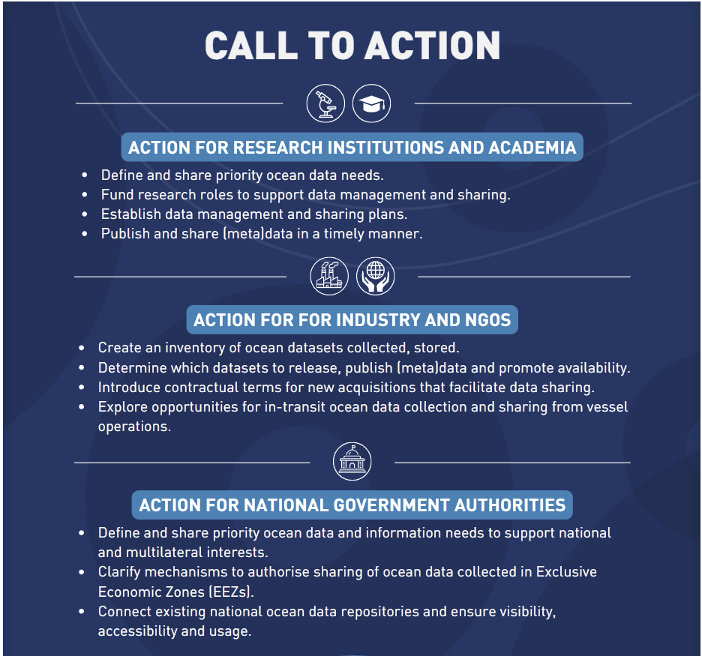
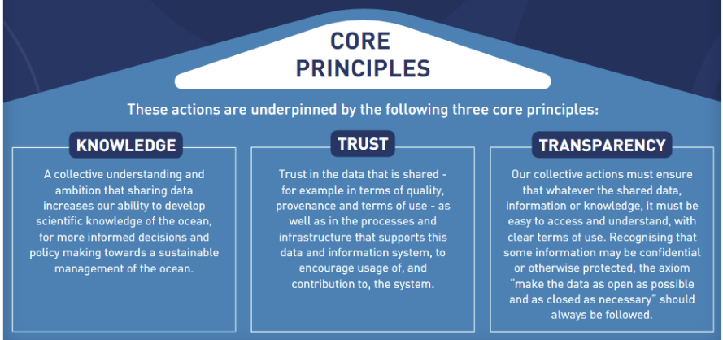
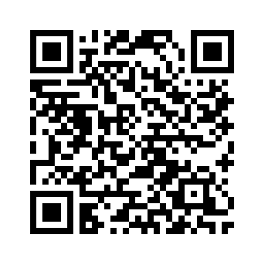
Corporate Data Group
Call to Action – April 2024

Slide 13

Corporate Data Group
Conclusion
Identify priority datasets and make them visible
Demystify data sharing
Make data sharing as simple as possible
Demonstrate how benefits/impact outweigh perceived risks and effort
Increase visibility, acknowledgement
Industry and governments must work together – policy ask
Image source: arnaudjerald.com
Notes:
A first tasks is to prioritise those datasets that will have the biggest immediate impact. The Ocean Decade provides a good framework to determine where we should focus our efforts. The Vision 2030 process, in particular, identified the information products we must develop by 2030, which will inform the underlying data needed.
Once these datasets are identified, we must make them discoverable and accessible. HUB Ocean and the Ocean Decade’s Corporate Data Group are working towards this goal with industry and UNESCO’s ODIS programme led by IODE is also setting the foundations for a federated data ecosystem accessible to all users.
[Demystify data sharing]
We should also demystify data sharing. We can do this first by demonstrating how the benefits and impact of sharing data outweigh the perceived risks and the efforts required to share.
Secondly, we must find ways to make data sharing as simple as possible, providing clear guidelines and automating the process as much as possible, aligning data producers and users around a common set of standards.
Finally, once the data is shared, increased visibility and acknowledgement of how and where the shared data is being used would also encourage further engagement.
[Industry and governments working together]
Yet the incentives for industry to share data are not always understood. At the same time, national governments can be reluctant to share ocean data, given the geopolitical context.
Therefore, I believe industry and governments must work together to establish pathways that facilitate data sharing and benefit both stakeholders equally. For example, governments could require data sharing as a mandatory step of the permitting processes for offshore operations, as is the case already in the UK.

Slide 14
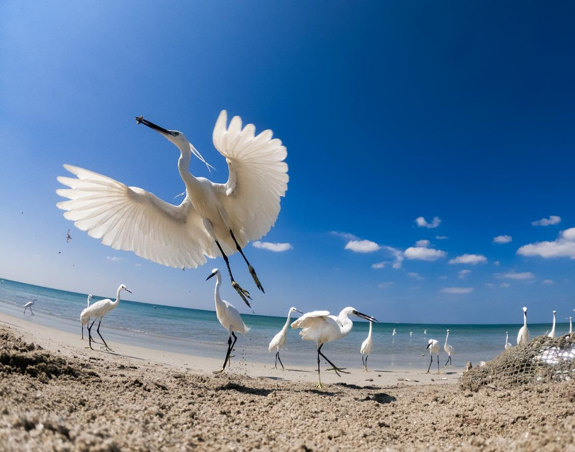


Thank you !
Contact : Louis Demargne
l.demargne@unesco.org
Ocean Image Bank / Kaveesha Madhubhashana

Slide 15
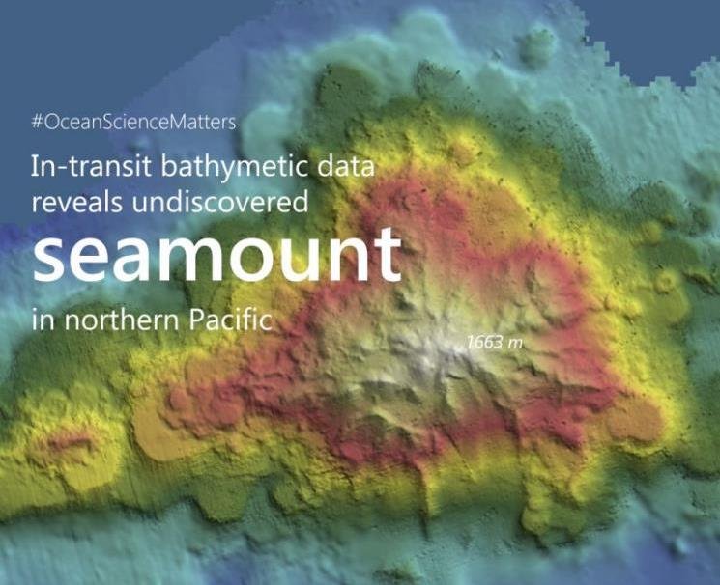
Bathymetry data use case
Why is bathymetry important?
Establish safer and more efficient shipping routes
Identify and sustainably manage valuable resources
Monitor and preserve vulnerable marine habitats and ecosystems.
Better understand natural hazards for better disaster preparedness and response.
Improved ocean modelling and forecasting…
…leading to optimised offshore operations
Notes:
Secondly…
Because bathymetry is one of the core layers of our digital representation of the ocean and is critical for many types of application.
Imagine trying to conduct any type of scientific study of our terrestrial envirinment without a topographic map or a DTm…just with an assumed flat surface…its unthinkable rigth? First thing we would do is a topo survey.
Same with the seafloor.

