Slide 1


VISION 2030 WHITE PAPER 8 –
CREATING A DIGITAL REPRESENTATION OF THE OCEAN
& PERSPECTIVES FROM DCO’S ODS-OO/DCC-OP ON THE DIGITAL ECOSYSTEM
IODE-GOOS COORDINATION MEETING 30/09-2/10 2024
VISION 2030 CHALLENGE 8 WORKING GROUP
JAN-BART CALEWAERT & ENRIQUE ALVAREZ

Slide 2
PART 1 - VISION 2030 DECADE CHALLENGE 8

Slide 3


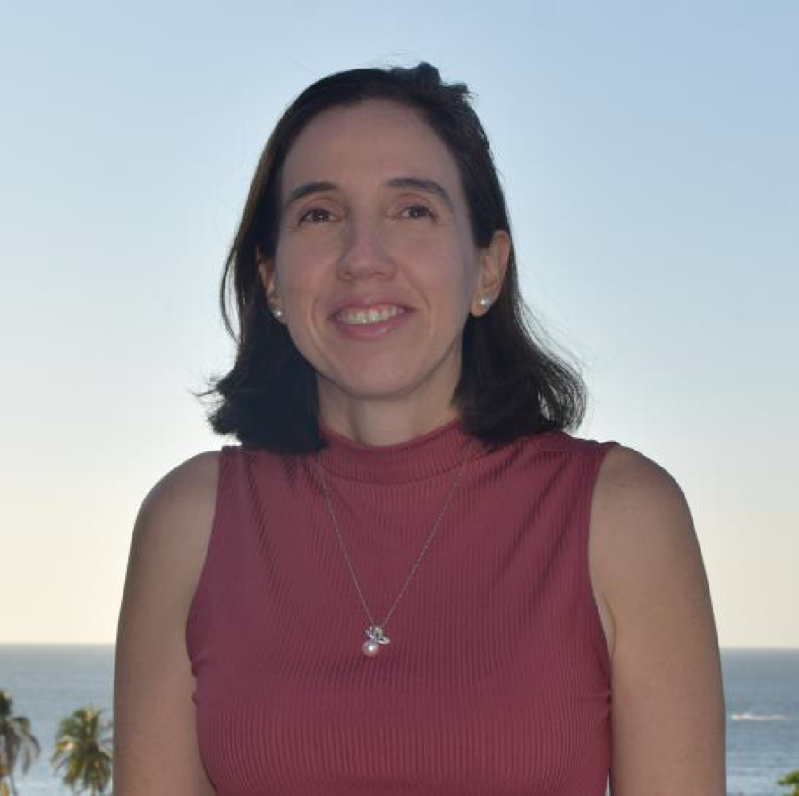

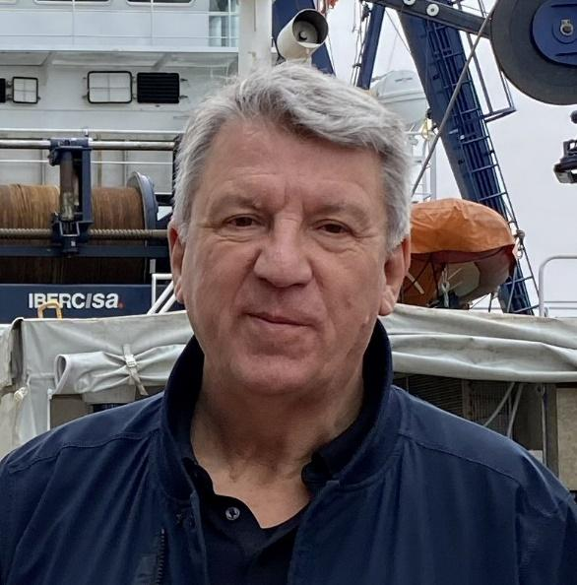




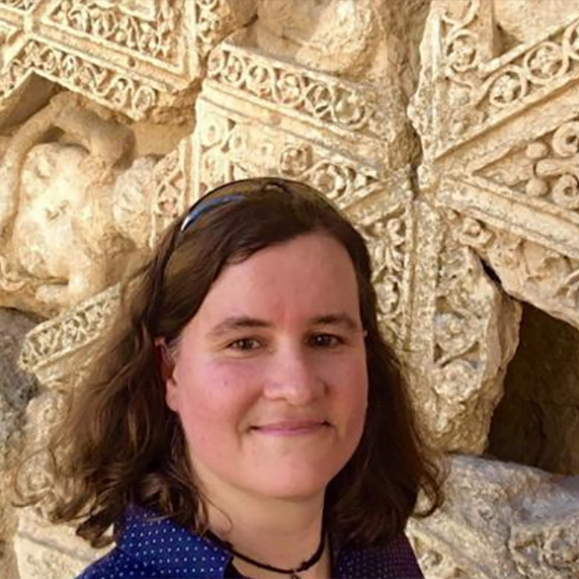

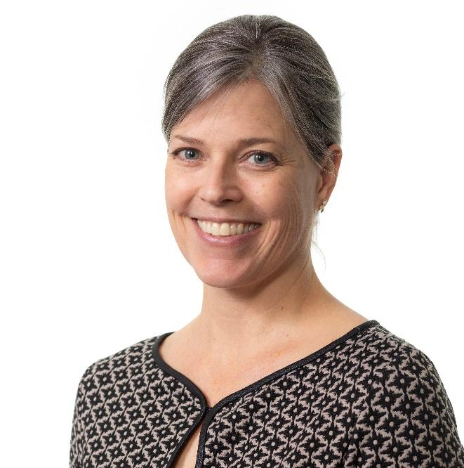
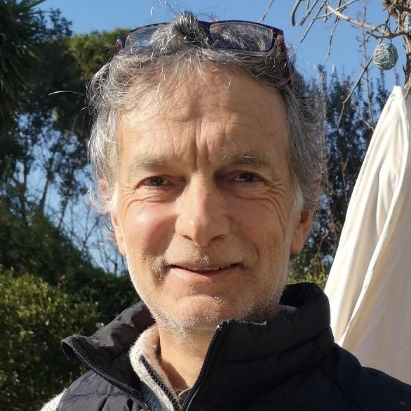
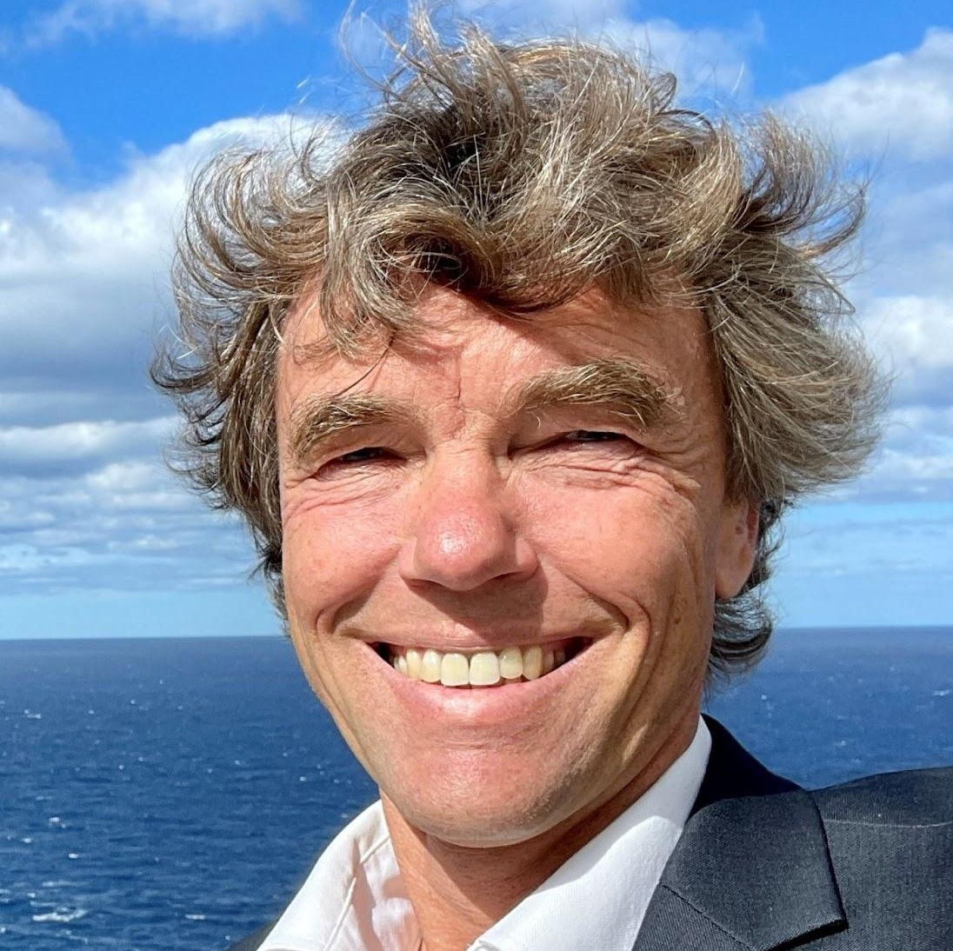
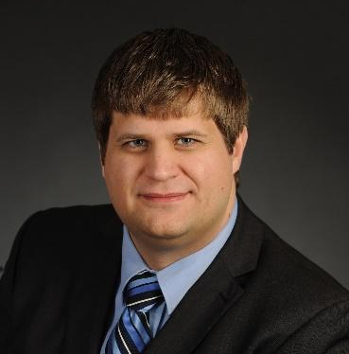


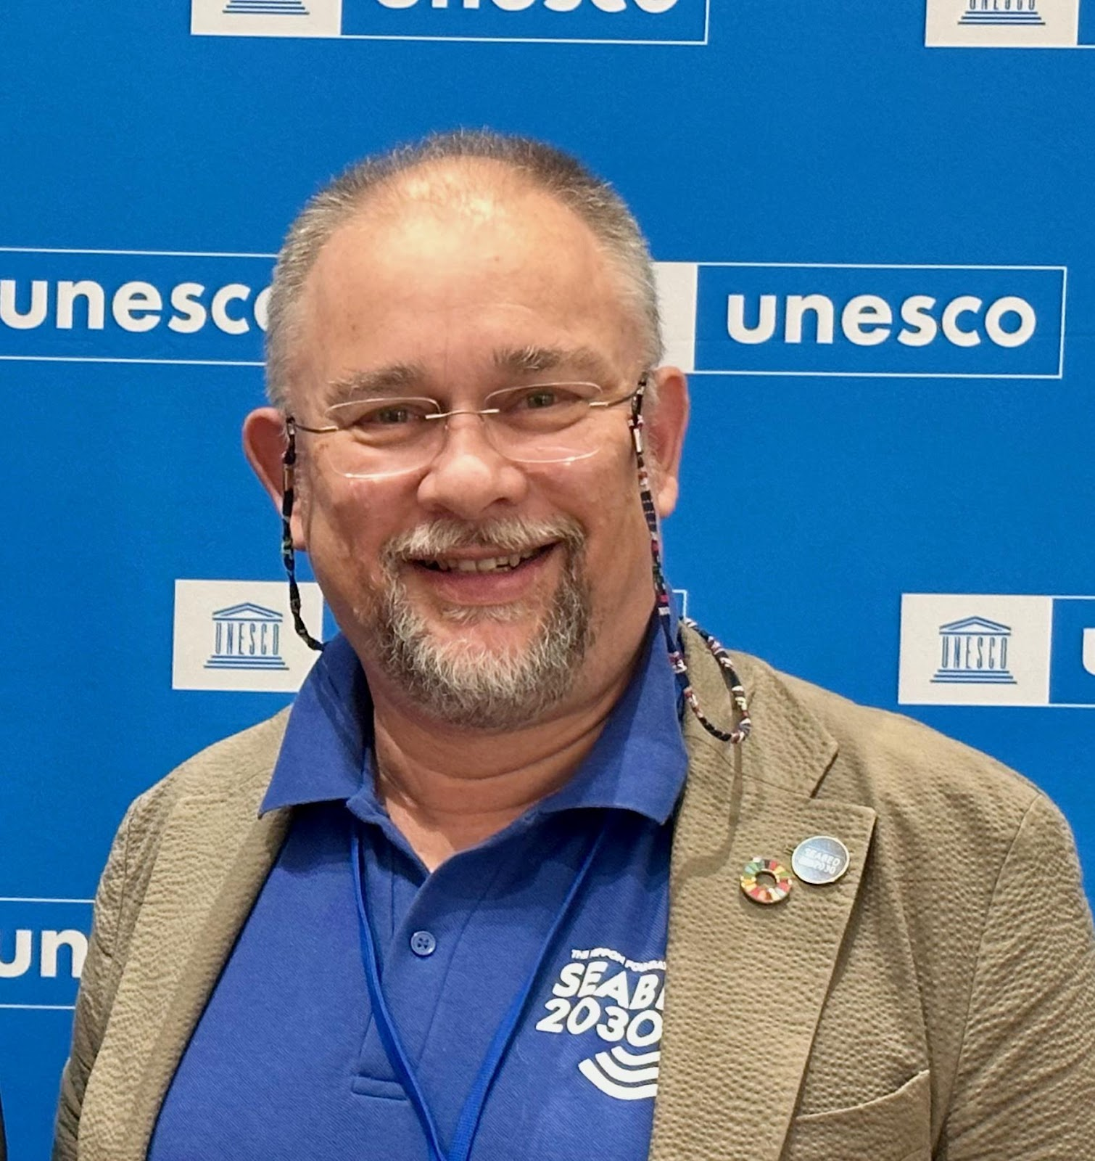
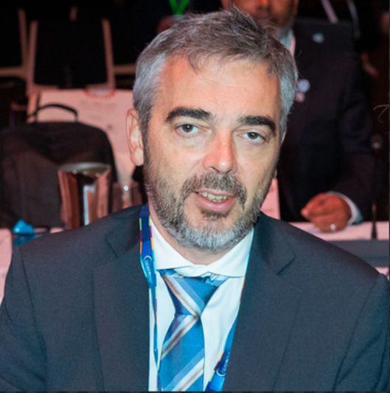

UN Ocean Decade Vision 2030 Working Group 8
Challenge 8: Create a digital representation of the Ocean
THE CO-CHAIRS
Through multi-stakeholder collaboration, develop a comprehensive digital representation of the ocean, including a dynamic ocean map, which provides free and open access to explore, discover and visualize data and information on the past, current, and future state of the ocean.
Jan-Bart
Calewaert
Paula Cristina
Sierra-Correa
THE EXPERT MEMBERS
Ann-Christine Zinkann
Dick M.A.
Schaap
Gerben J.
de Boer
Toru
Suzuki
Gustav
Kågesten
Iain
Shepherd
Tanya
Haddad
Véronique
Jégat
YOUR LOGO HERE
Kate
Crosman
Marc
Taconet
Martin
Visbeck
Mike
Smit
Xingyuan
Ren
Peter Teye Busumprah
Steve
Hall
Alain
Arnaud

Slide 4

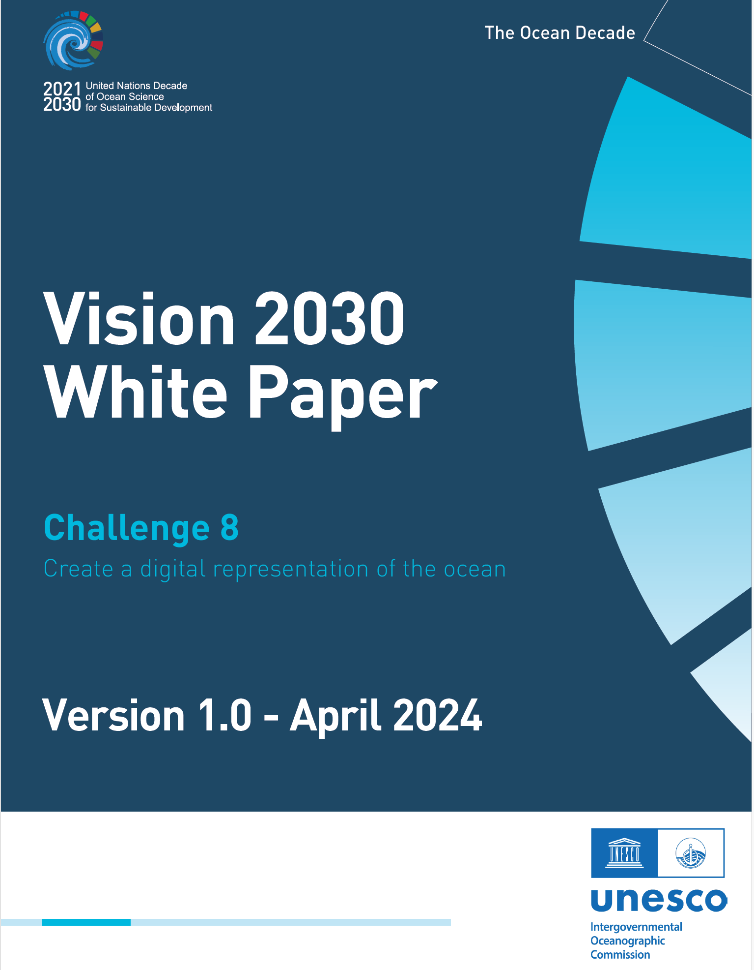
Delivering the Strategic Ambition – Challenge 8
The Strategic Ambition for Ocean Decade Challenge 8 is to have in place by 2030:
The enabling environment [Infrastructures, Tools, Services and Content], for the creation of and access to an increasing number of digital representations and (twin) applications of the Ocean
All observations, datasets, data products, information and knowledge outputs generated by Decade Actions should be shared and easily available to all.
A global Digital Atlas with at minimum 10 societally relevant global base-layers & minimum 10 local use cases (prioritizing SIDS and LDCs).
The following tools, systems and services to be developed and in place by 2030:
A federated global Ocean Data Discovery & Access Service (DDAS) with map viewer + Ocean Data Helpdesk and distributed Data Ingestion Service;
A global Technical and Organizational Structure for Ocean Forecasting;
A user-friendly reference global Digital Atlas of the Ocean;
Set of platforms & mechanisms to easily store & exchange ocean information & knowledge;
Enhanced Capacity Development & Training resources/facilities tailored to user-needs;
Vision 2030 White Paper - Challenge 8

Slide 5
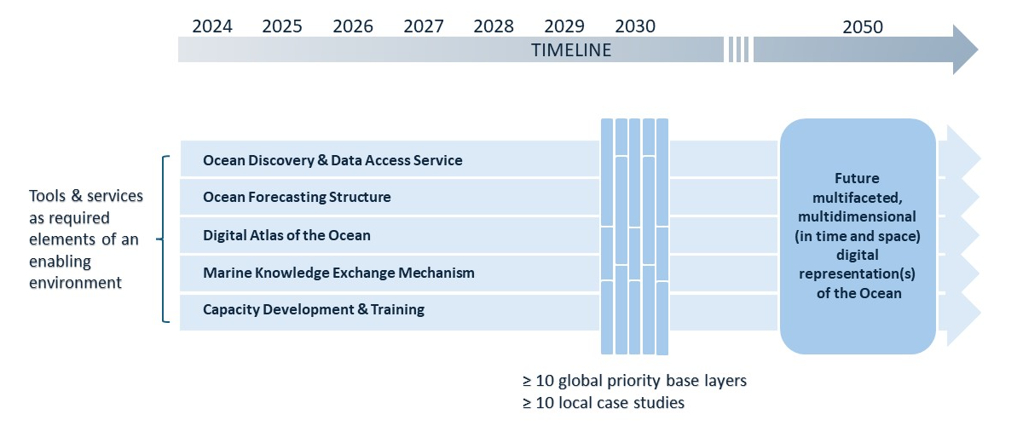
Delivering the Strategic Ambition – Challenge 8
Creating The Enabling Environment
Ensure interoperability and compatibility of proposed data and information-sharing systems & services with other core ocean knowledge systems and/or decision support tools/applications existing or currently under development – connecting and building on what exists already.

Slide 6
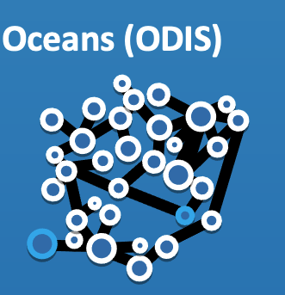
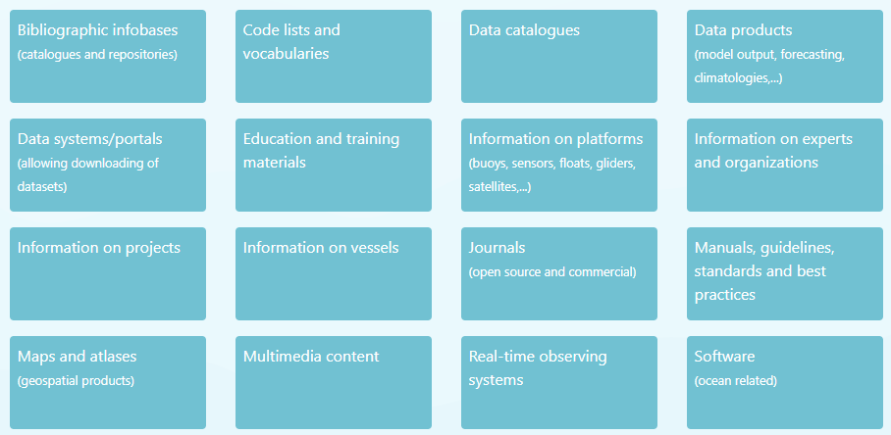
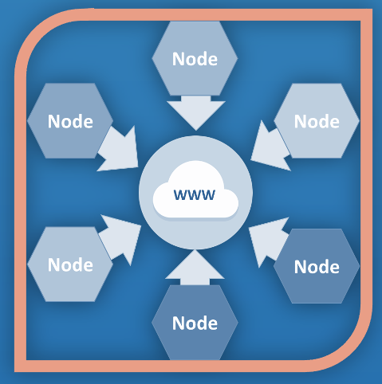




OceanData2030
The Decade programme ‘An Ocean Data and Information System supporting the UN Decade of Ocean Science for Sustainable development’ (OCEANDATA 2030) is led by IODE of the Intergovernmental Oceanographic Commission (IOC).
Development of an open-source data and information system that will link existing ocean information systems around the world, and enable more efficient discovery of data, information and knowledge products.
The Ocean Data and Information System (ODIS) and Ocean InfoHub are central elements of the OceanData2030 Programme.
Hosting Ocean Decade projects:
  Marine Regions / From global gazetteer to global community
  Portuguese National Oceanographic Data Centre
  World Ocean Database Cloud
Vision 2030 White Paper - Challenge 8

Slide 7


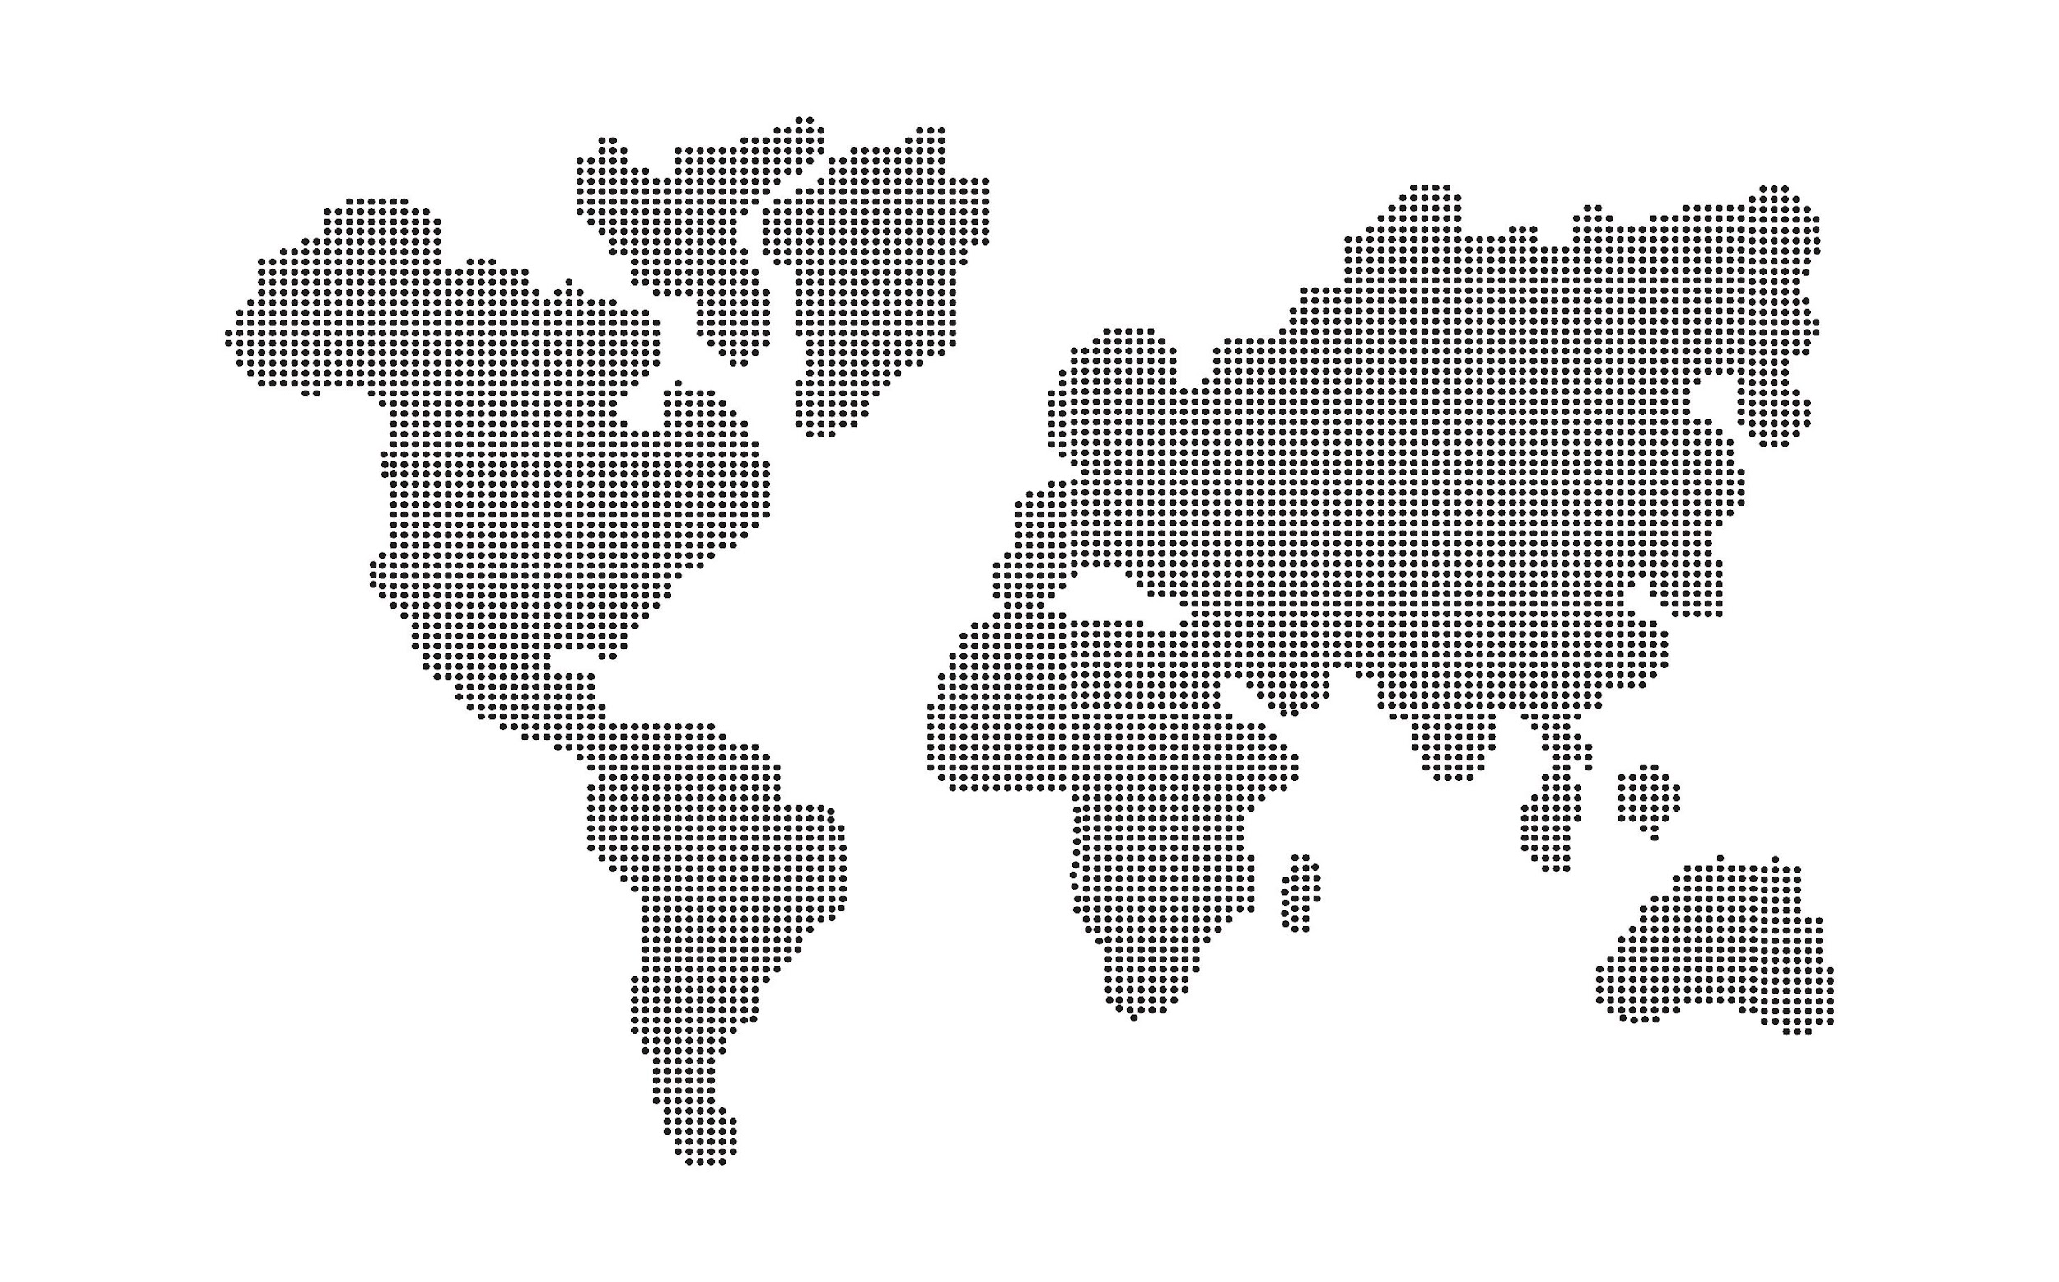

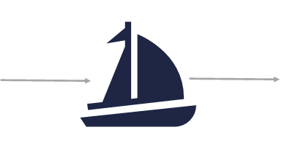

2020: THE OCEAN FORECAST WE HAVE
2030: THE OCEAN FORECAST WE WANT
OceanPrediction DCC VESSEL
Captain: UN Ocean Decade
Chief engineer: Decade actions and DTO
Crew: OceanPrediction DCC community
Navigator: OceanPrediction DCC
Useful but partially disconnected services
Poor presence in developing countries
Connected community and services
Many robust systems worldwide

Slide 8

Working Group 8 – Digital Ocean
Process towards a Strategic Ambition Setting for Challenge 8 White Paper
WHO ARE OUR USERS
Everyone - diverse in expertise & area, leave no one behind
professional (hands on)
professional (not hands on)
non-professional/public
other 9 challenges are proxy users defining data & info needs (both content & services)
DIGITAL CONTENT NEEDS
All data types relevant
Focus on priority data products & underpinning data
Data-layers as drivers to pull in data
Address data-gaps, agree on standards & improve interoperability
Leverage existing communities
Must be societally relevant (other challenges)
Must be co-developed in a transparent process
Global layers must be complemented with local case studies (priority: global south)
DIGITAL SERVICES NEEDS
Global Ocean Data Discovery and Access Service
Online user-friendly Digital Atlas of the Ocean
Marine Knowledge exchange mechanisms
Help Desk Service
Capacity Development / Sharing and Training facility
NEXT STEPS
Agree on set of priority global data layers: e.g., seabed2030 seafloor map, marine litter/pollution, MPAs, blue carbon, …)
Elaborate service ideas (e.g. atlas/ODIS, …), building on what exists / identify existing best practices
Identify and develop synergies with implementation of other Challenges
Mobilise key Decade Actions (and promote new ones required)
Align and coordinate with Data Strategy implementation and DCC/DCOs towards Ocean Decade Digital Ecosystem
WHAT DO THEY NEED?
easy access to ocean data & information (multidisciplinary)
tools/services for accessing and sharing data, information and knowledge
Vision 2030 White Paper - Challenge 8

Slide 9
PART 2 – THE DCO-DCC’S OCEAN OBSERVING, DATA SHARING, AND PREDICTION

Slide 10
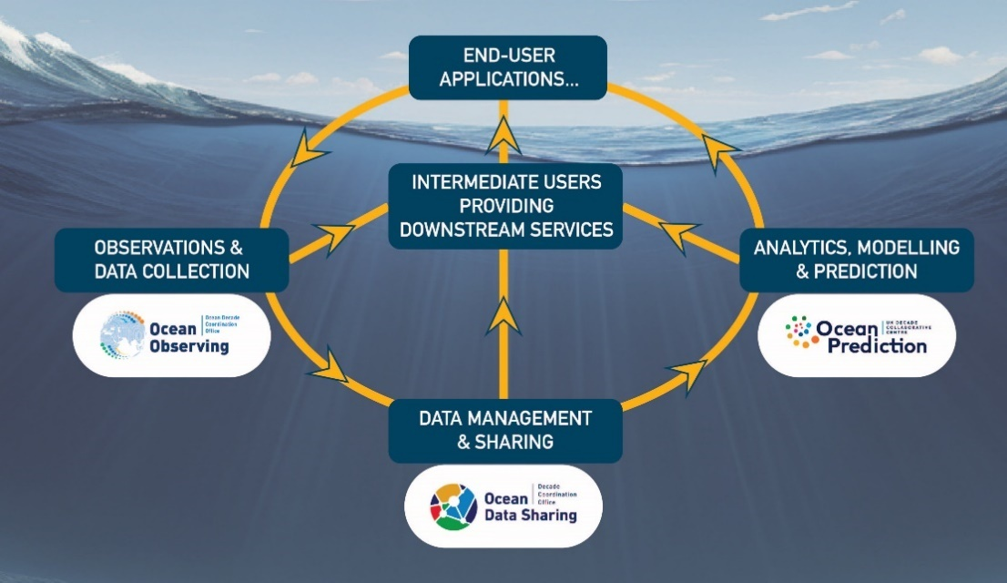
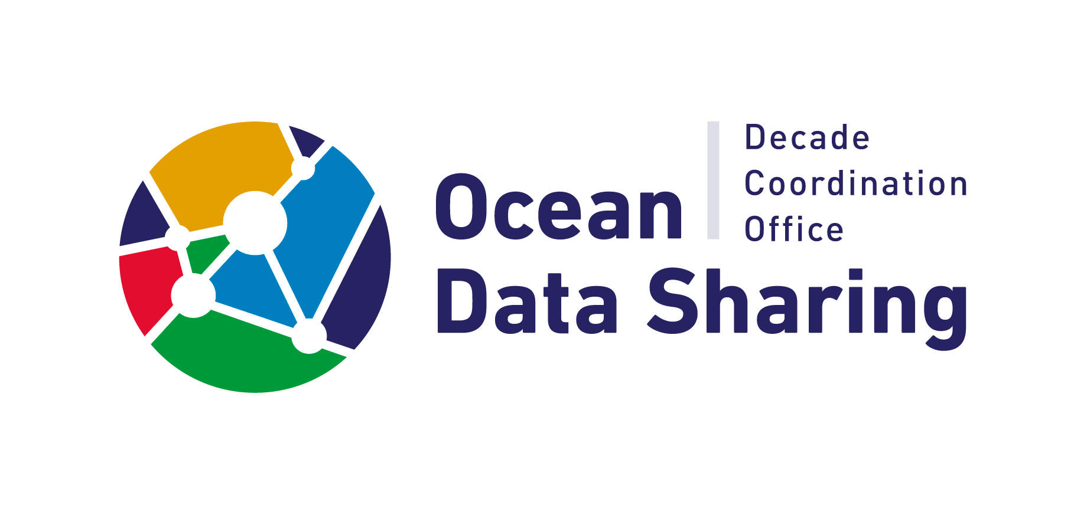

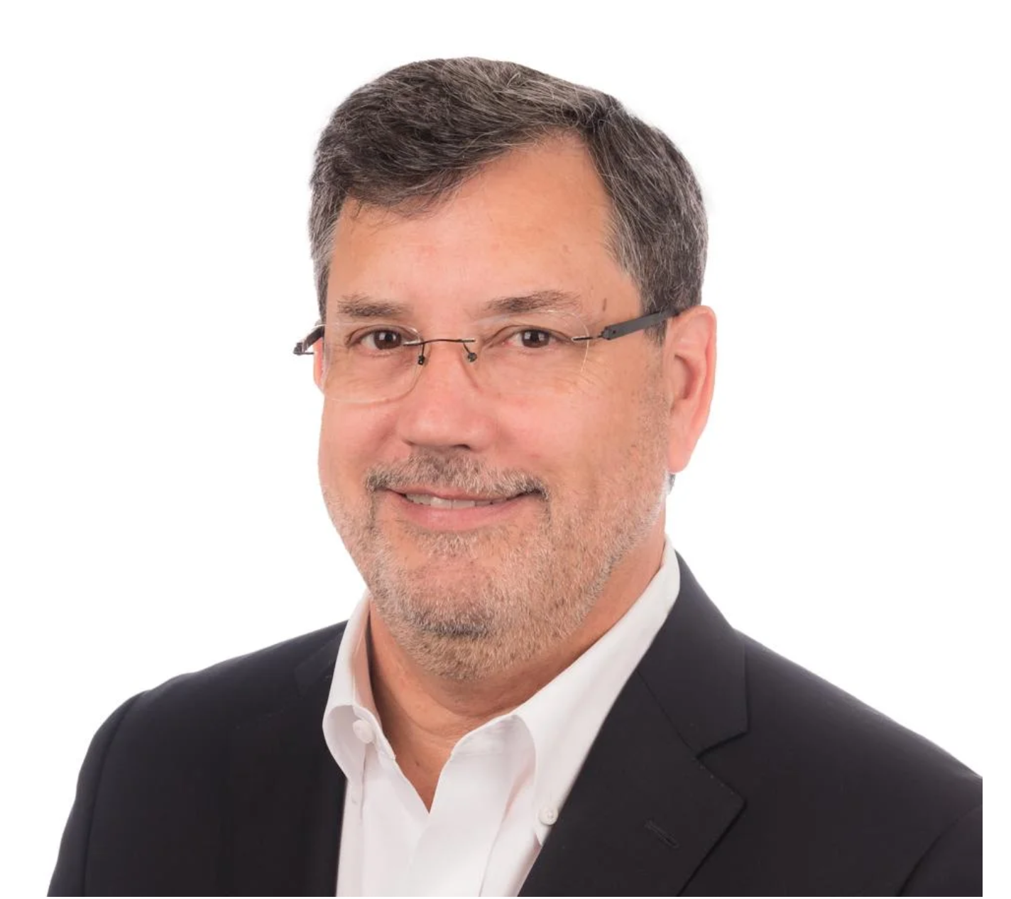
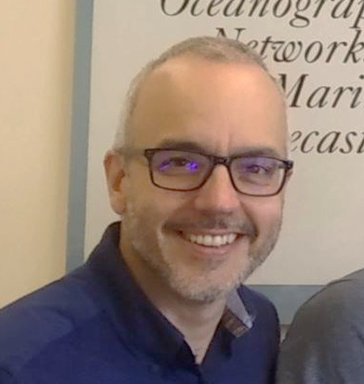

Key Components of a globally distributed, trusted, inclusive, and interconnected ocean data and information ecosystem
DCO for Ocean Data Sharing aims to establish, promote and coordinate the data management and sharing component of the digital ecosystem needed for the Ocean Decade to be successful.
Assist Decade Actions with data sharing guidance to adhere to FAIR and CARE principles.
Website with Data Resource Toolkit & Online Data Help Desk
https://oceandatasharing-dco.org/

Slide 11
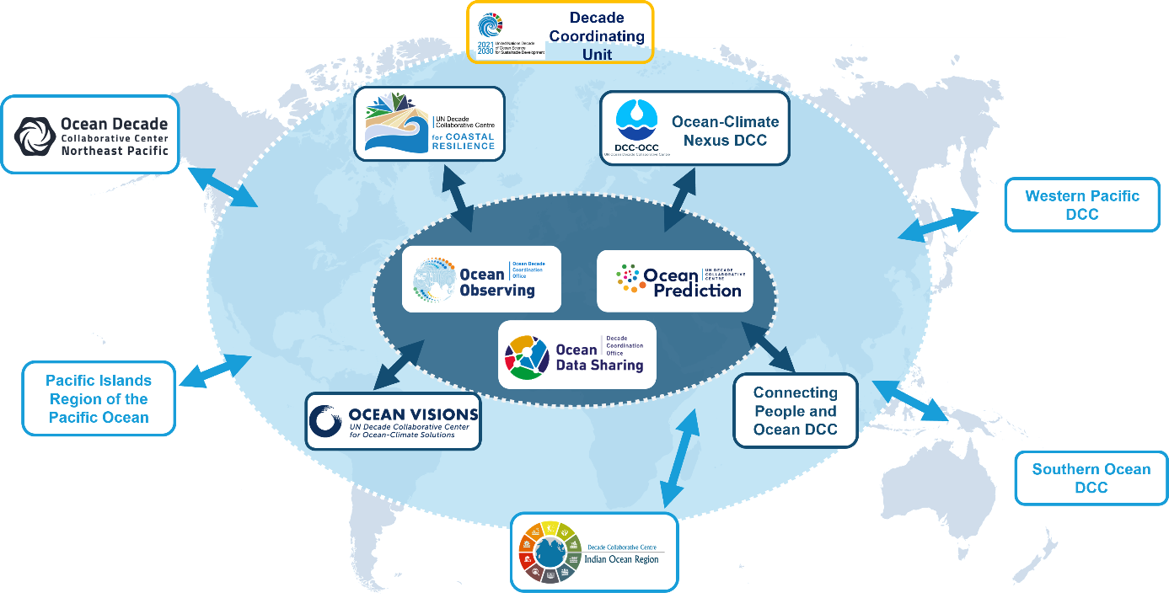
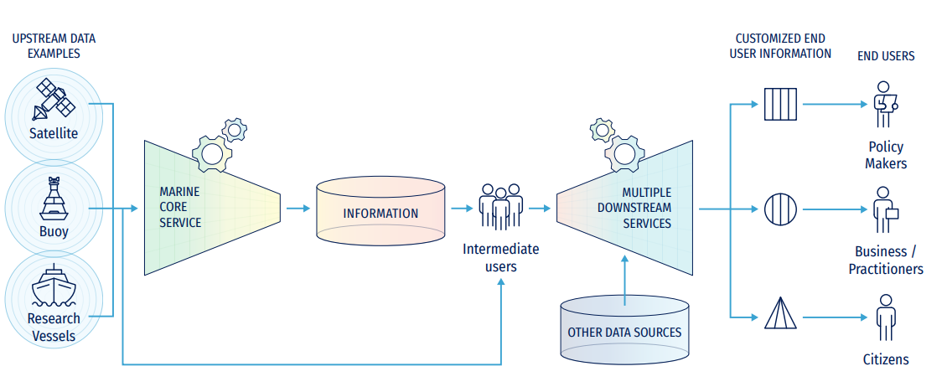
ADVANCING THE OCEAN DECADE’S DIGITAL ECOSYSTEM
A collaborative network of UN Ocean Decade DCCs,
fostering the development of the Ocean data value chain worldwide - from observations to end user services

Slide 12
PART 3 – PERSPECTIVES & RECOMMENDATIONS
TOWARDS AN END-TO-END OCEAN DIGITAL ECOSYSTEM SUPPORTING DECISION MAKING

Slide 13
PERSPECTIVES FROM THE DCO-ODS
Main aim of DCO-ODS envisaged next steps are to “scale up and manage/coordinate the Ocean Data Sharing component of the Decade and to roll out the activities required to achieve the objectives of the Data and Information Strategy & WP8”.
Core objectives:
Coordinate Ocean Decade Actions on data/information aspects, as well as the associated Community of Practice;
Support implementation of the Data and Information Strategy and the recommendations of Vision 2030 white paper 8;
Support the development of a data-literate global community within the Ocean Decade.
Horizons for future development of the DCO-ODS
Horizon 1: Incremental change: respond to the needs of Decade Actors (cf DCO-ODS Data Survey), providing data management guidance/resources & signpost data archives for the Decade Actions.
Horizon 2: New innovation: promote development of operational data and information system (ODIS) via Ocean Data 2030 and global digital reference Atlas for use by all. Facilitate creation of key value-added digital content / data products.
Horizon 3: Disruptive innovation: fostering new ambitious public-private collaborations with major technology companies, to change the pace of development of technology solutions that would allow for the Decade's ambitions.

Slide 14


Advancing the Ocean Decade’s Digital Ecosystem
Existing gaps:
  Significant differences across geographical regions
  Limited integration of the components
  Inefficient Practices
  Redundant Developments
  Lack of shared tools
  Limited Interoperability
Way forward
(max. impact with limited resources)
Development of officially endorsed recommendations for:
  Best practices
  Data standards
  Systems architecture
  Ready to use tools

Slide 15

Improving the different steps of the Value Chain
Best practices
Data standards
Systems architecture
Ready to use tools

Slide 16

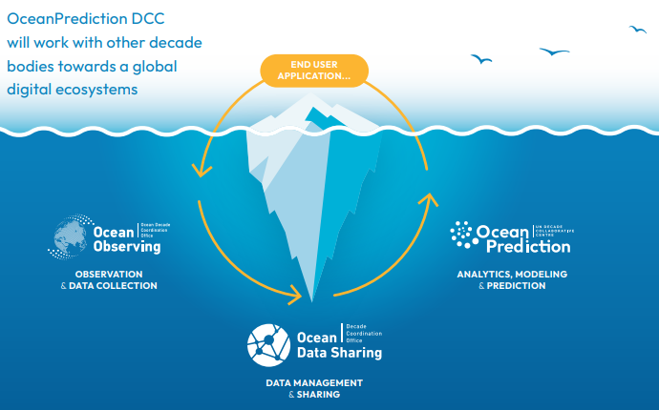




Improving the different steps of the Value Chain
A multi-actor Decade endeavour
GEMS
OCEAN
…

Slide 17
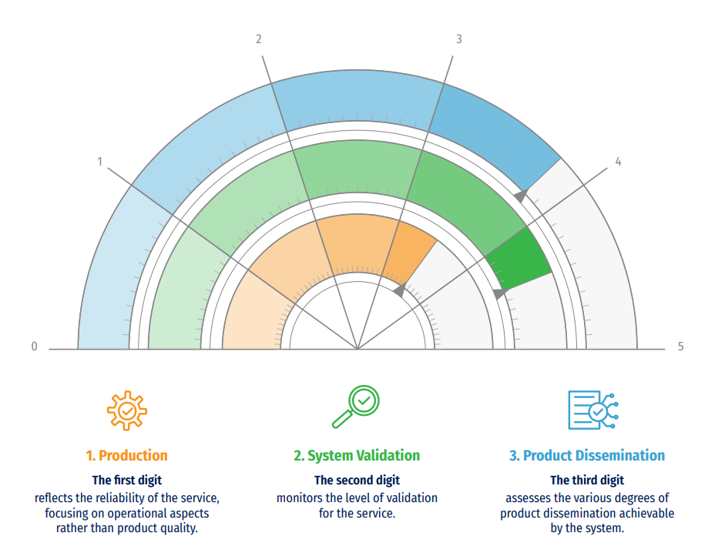
Example 1: The Operational Readiness Level for Ocean Forecasting
Best practices
Data standards
Systems architecture
Ready to use tools
Best practices collection and a tool to check its application
    A mechanism to introduce Best Practices
    A way to promote the evolution of Ocean forecasting
    A mechanism to endorse services to join common frameworks

Slide 18
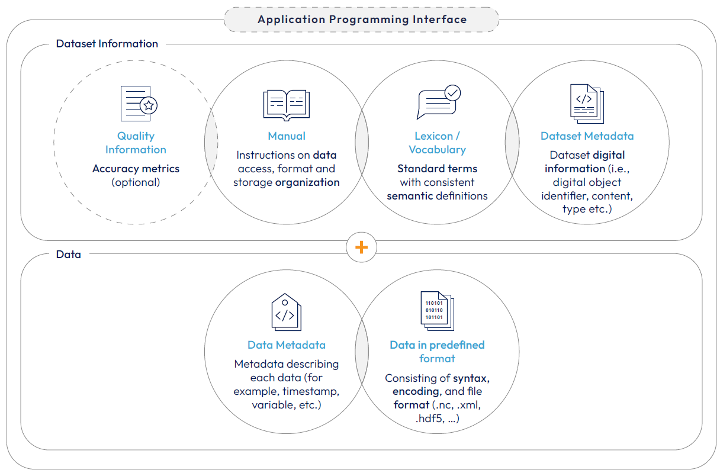
Example 2: Data standards for Ocean Forecasting (under development)
Best practices
Data standards
Systems architecture
Ready to use tools
Data standards are documented agreements on the representation, format, definition, structuring, tagging, transmission, manipulation, use, and management of data (not just “a NetDCF”)

Slide 19
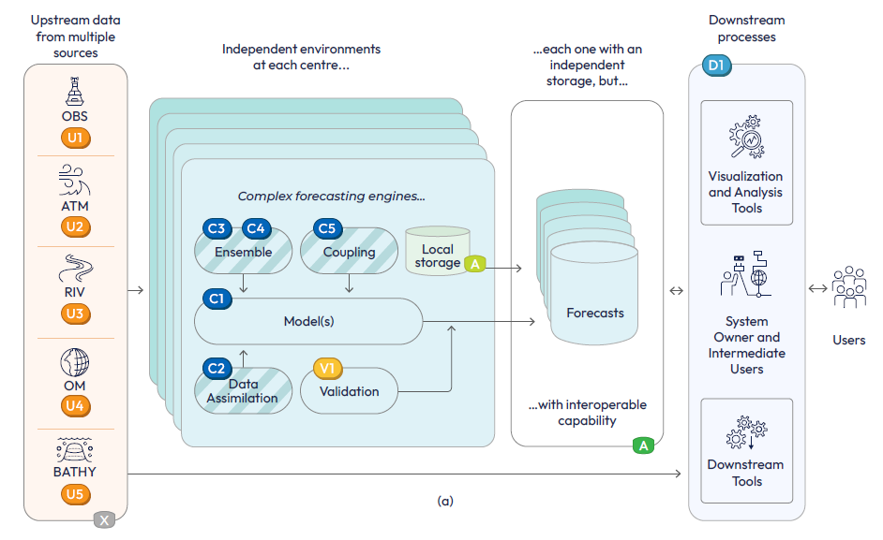
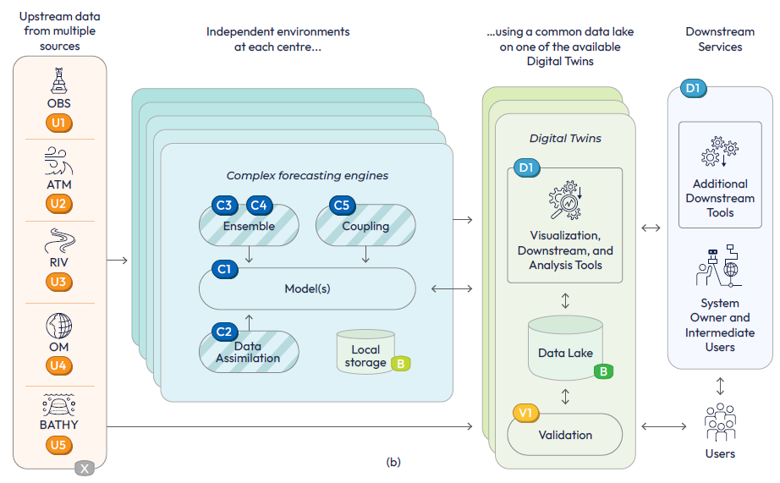
Example 3: The OceanPrediction DCC architecture
Best practices
Data standards
Systems architecture
Ready to use tools
Wiring diagrams to build a system
    Including connection with DTO
    Bases on tools and data standards
    Actual software to be developed

Slide 20


THE END…
So much time and so little to do. Wait a minute. Strike that. Reverse it.
…OF THE BEGINNING

