Slide 1



The Ocean Decade Data & Information Strategy
Implementation Plan
October 2024
P.L.Buttigieg & K. O’Brien
Notes:
This presentation provides an overview of the data and information strategy for the Ocean Decade and how with your support we can transform the way data is produce, managed, used and shared to unlock greater potential from the Ocean Decade.
Why the ocean? Simply put, it is our planet’s life support system and we know it’s under threat from the combined effects of overfishing, pollution and climate change. Yet very little is known about the ocean.

Slide 2
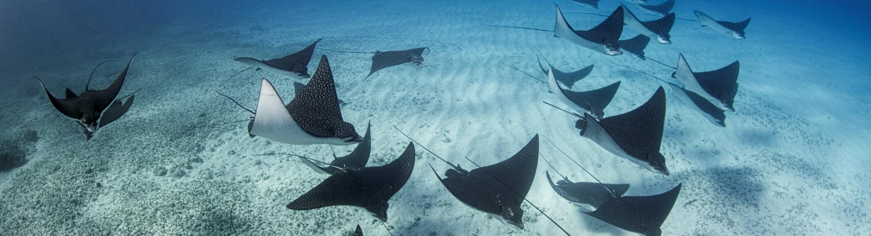


The Ocean Decade
Data & Information Strategy
1
Ocean Image Bank / Amanda Cotton

Slide 3
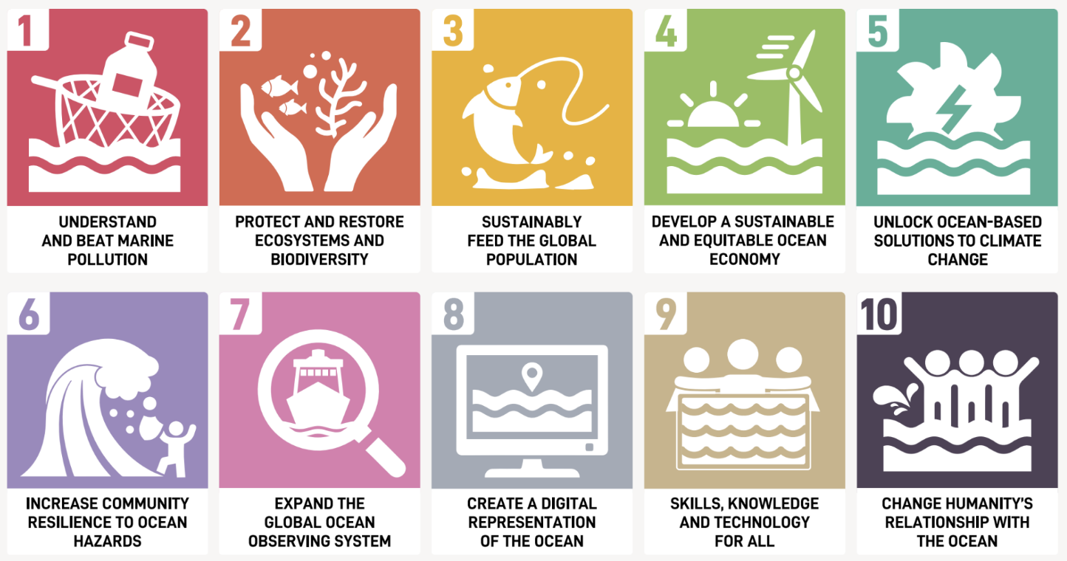


Data and Information are cornerstones of the Decade’s success
Notes:
As ou all know, the Ocean Decade aims to meet these 10 challenges, find solutions for the sustainable ocean management, and ensure we develop a truly sustainable ocean economy.
Challenges 7 and 8 – on collecting and sharing ocean observations and data, and developing a digital representation of the Ocean to assist with decision making are key challenges, because these underpin all other challenges.
Indeed, information and knowledge will be cornerstones of the success of the Ocean Decade. Achieving the vision and overcoming these Challenges requires an enabling environment for a distributed ocean digital ecosystem that connects across disciplines and geographic boundaries - including the frameworks, infrastructure, people, tools and resources.
One of the recurring issues is the difficulty in finding, accessing and using ocean data. Data sources are many, but they are scattered and uncoordinated, which is hindering our ability to drive scientific research effectively and finding solutions.
For this reason, the Ocean Decade coordination unit decide to develop a data and information strategy to address these critical issues…with the ambition of leaving a legacy behind that endures beyond 2030.

Slide 4
03
Ocean Decade Working Groups – Strategy and Priorities
Data Coordination Group
Develop a data & information strategy
Corporate Data Group
Unlock privately held data
Strategic Vision & Objectives
Data Strategy Implementation Group
Implementation Plan
Frameworks, Strategies, Recommendations
To enable private companies to share their privately held ocean data for the benefit of ocean science
4
Vision 2030 Process
White papers setting ambitions & outcomes
Notes:
In the Ocean Decade there is a decentralized coordination, with multiple entities helping to coordinate activity in a particular domain. This allows a bottom-up approach, bringing in outside expertise.
The Data Coordination Group was convened in Nov 2022 to develop an overarching data and information strategy for the Deacde that would endure beyond 2030. Then in 2023, a sub-group was convened to work o the implementation plan for this strategy. Both of these groups include data experts from around the world, brought together through a public call for candidates.
With eh Corporate data Group – focused on unlocking privately owned ocean data - and the outcomes of the Vision 2030 process, we must set the priosities for data sharing, capacity development, etc.

Slide 5
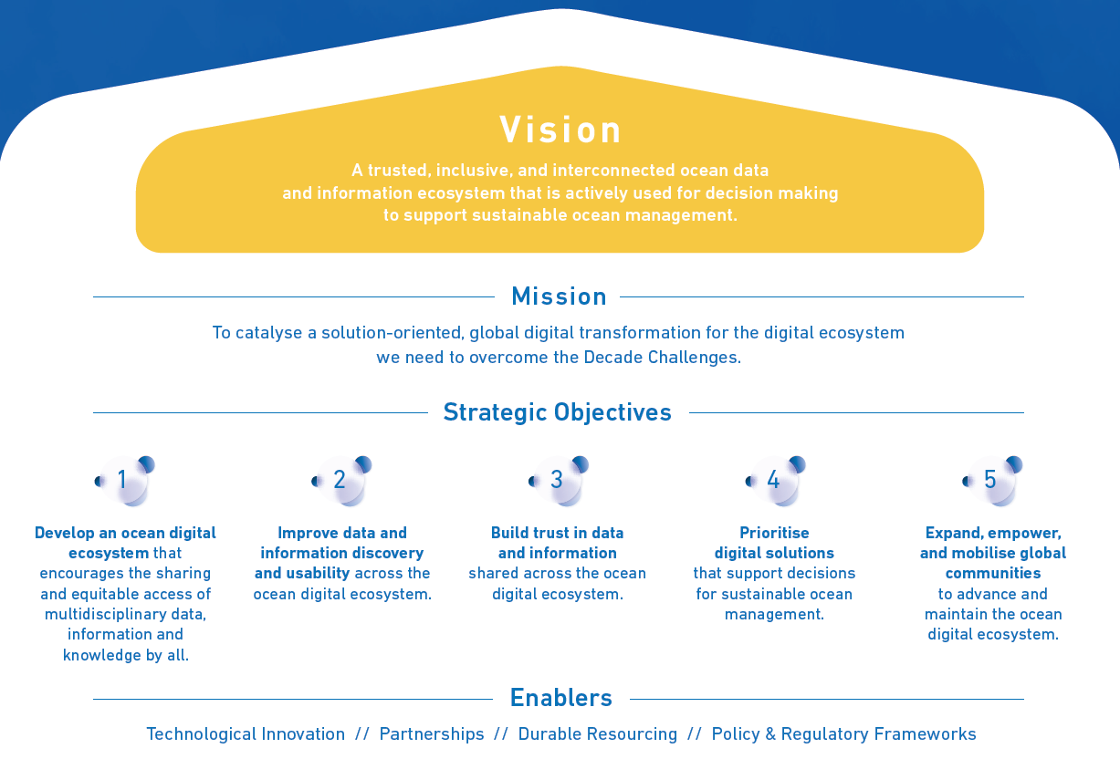
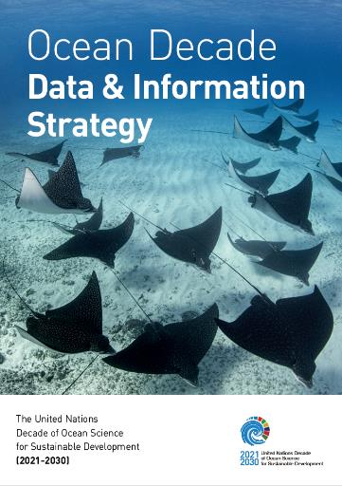



A globally distributed, trusted, inclusive, and interconnected ocean data and information ecosystem
Download here:
Notes:
During 2022, the DCG has been working on developing a Strategy and a mature draft was completed end of 2022. It has then gone into review by DCU, key decade actors/stakeholders and we are finalising the revisions based on the review which should be ready for publication later this month.
The main Strategic Objectives and aspects of the Strategy - which will likely not change anymore – to reach our Vision to put in place by 2030 “A trusted, inclusive, and interconnected ocean data and information ecosystem that is actively used for decision making to support sustainable ocean management.”
The QR code you can access the Executive Summary of the data strategy – it is published in 5 different languages.

Slide 6
Five Strategic objectives
Establish a globally distributed ocean digital ecosystem allowing sharing and equitable access of multidisciplinary data, information and knowledge by all
Improve data and information discovery and usability
Build trust in data and information shared across the digital ecosystem
Prioritize digital solutions that support decisions for sustainable ocean management
Expand, empower, and mobilize global communities to advance and maintain the ocean digital ecosystem
Notes:
Going in to a bit more detail on the objectives
---------
Objective #1 - this is about developing the specifications, implementing the standards and mobilizing the resources needed to establish a federated ocean data ecosystem that allows users to easily find, use, and contribute ocean data and information through interfaces tailored to their needs and capacities. It’s also about addressing major gaps in key ocean data types, variables and in spatial and temporal coverage.
Objective #2 addresses the need to ensure that digital resources under the Decade abide by the FAIR principles. Once data are available and accessible online, steps must be taken to make them easily discoverable (findable) and readily usable (accessible, interoperable, reusable). Prior to sharing ocean data, information, and knowledge, participants in the digital ecosystem should have clearly defined internal data management plans, policies, procedures, and architectures for their generation, management, licensing, and sharing.
Objective #3 - relates to the need Practices must be implemented to ensure the quality and provenance of the digital resources users rely upon are known, as well as mechanisms to ensure proper attribution. Similarly, systems and infrastructure to ensure the long-term and curated archival of data, information, software, digitised knowledge, or any other digital resource must be implemented, as well as clear data policies and Terms of Use.
Unless there is trust in the data and information they share, as well as trust in the entire data value chain and its related infrastructure, neither providers nor users will fully engage in any collective digital ecosystem.
Objective #4 - focusses on the need for the ocean data ecosystem to be developed to support digital solutions (including meta-data standards, software, models, analytics, artificial intelligence solutions, user experiences) that can be effectively used by decision makers at all levels. Through co-design of digital solutions, a core principle of the Ocean Decade, we increase the likelihood that valuable insights from data products and services reach those that need them in a form that they can understand and act upon.
The successful implementation of this strategy depends on a thriving human community that is digitally literate and committed to sharing data, information, and knowledge. The purpose of Objective #5 in the short term is to build awareness, skills, capacities and drive alignment with the strategy as we roll it out. The long-term ambition is to affect an enduring culture change towards a digitally fluent ocean community, who readily and openly share their data, insights and understandings.
The Data Strategy Implementation Group – a group 27 global ocean data experts convened by the Decade Coordination Unit- is currently working on a draft implementation plan which will be revealed at the Ocean Decade Conference in Barcelona in April 2024, and there will be eventually a global consultation process to review and provide feedback on the strategy.

Slide 7
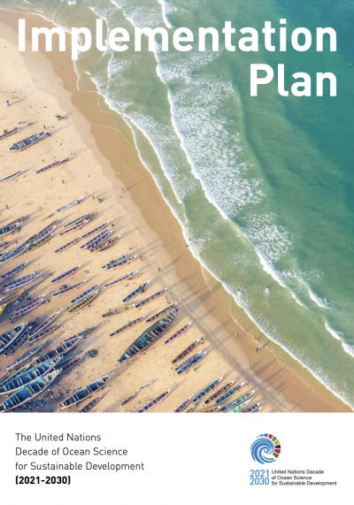
07
Strategy implementation plan – Why it matters to you
Aligning to a multilateral mission
The implementation plan will guide you and your data teams to concretely and meaningfully align your system to others contributing to the Ocean Decade
We’re better together
If our digital capacities are implemented using similar norms, they can robustly and sustainably work together – this will help the Ocean Decade’s partnership thrive well past 2030
Notes:
PLB

Slide 8
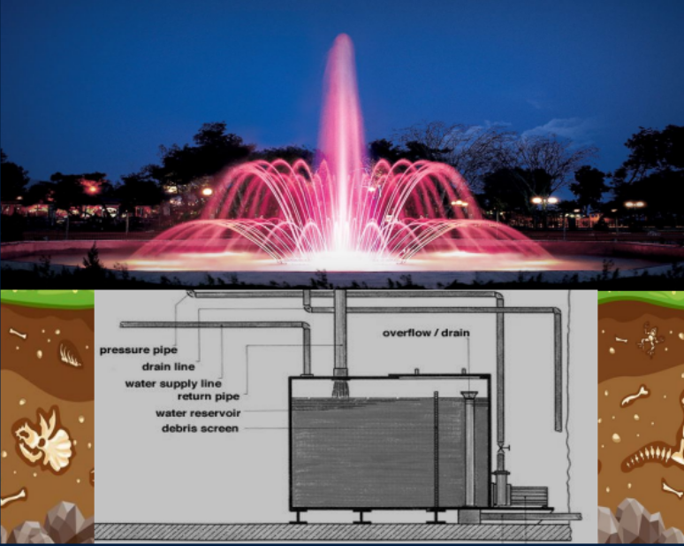
07
Strategy implementation plan – Why it matters to you
“Sparkly fountains need robust plumbing systems”
– Terry McConnell
G7 International Digital Twins of the Ocean Summit
Especially if you want to connect them
The Implementation Plan talks about this bit, where the real magic happens
Notes:
PLB

Slide 9
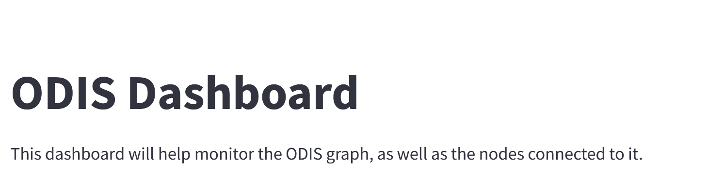
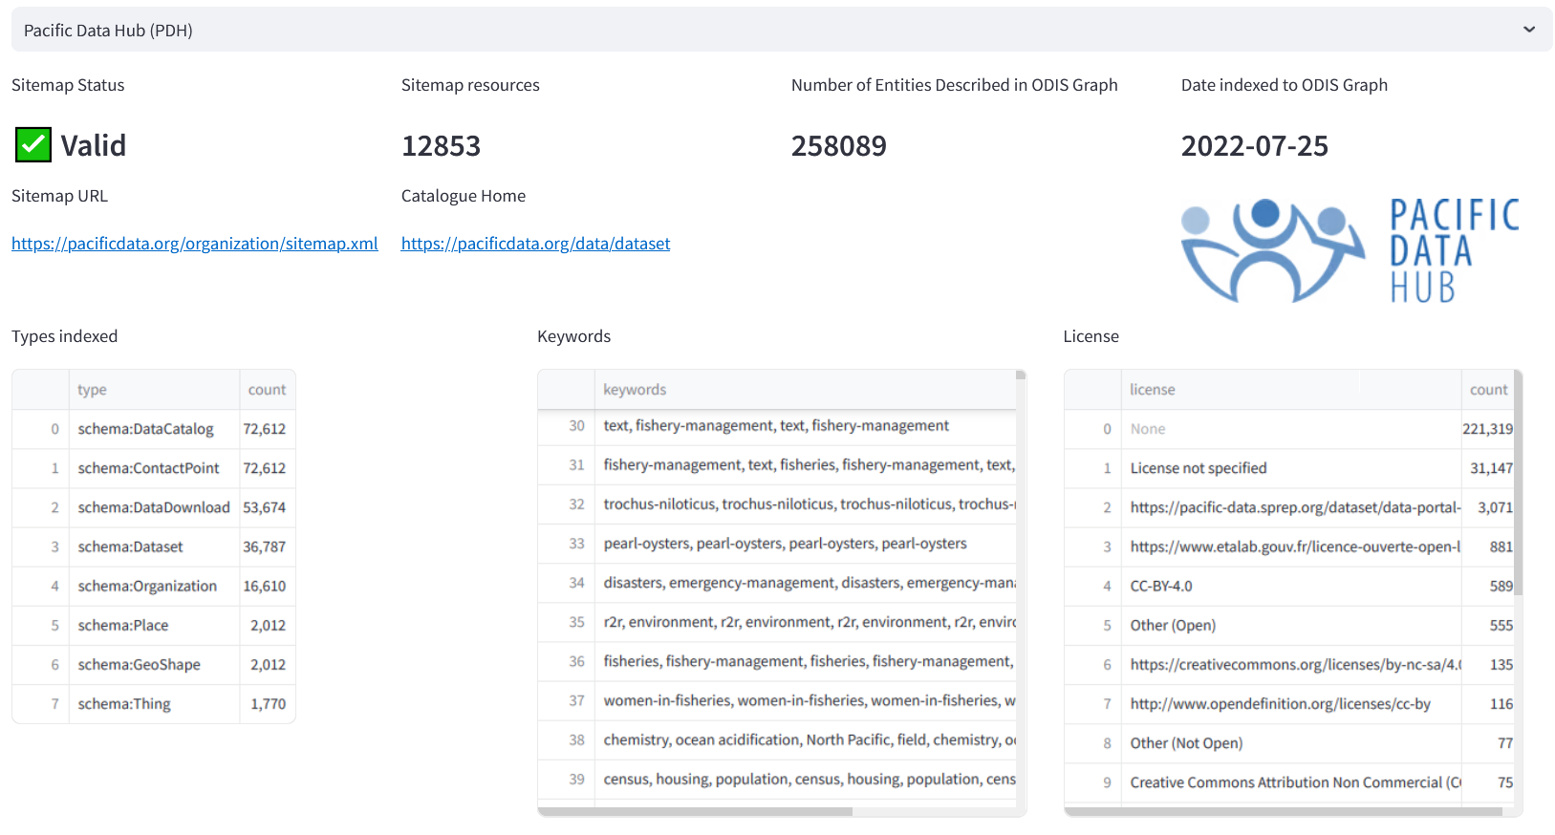
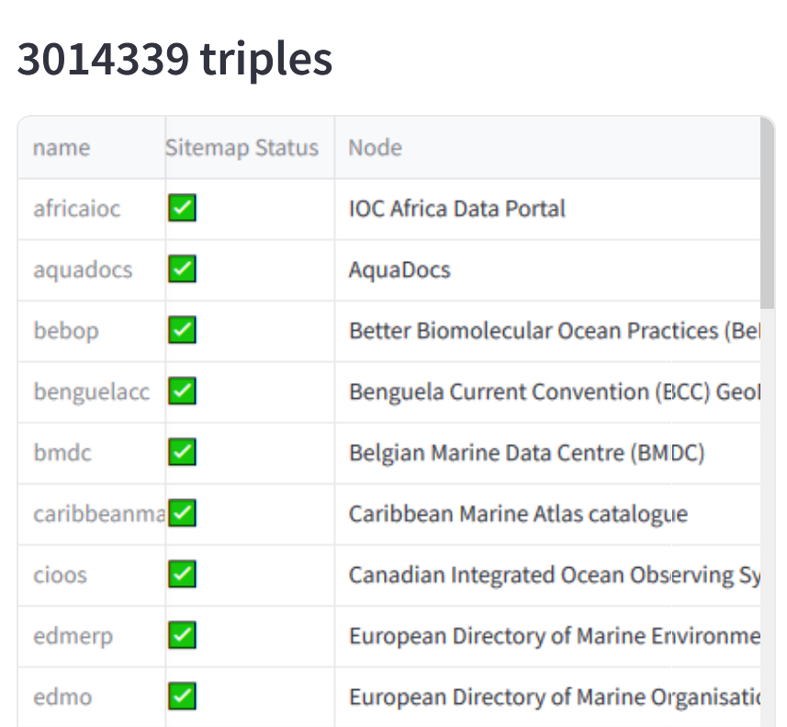
The world is watching
Claims that data, software, or other digital assets are
FAIR or CARE compliant
Useful to societal stakeholders and rights holders
Supporting SDG information flows
…
are testable – and more and more systems will continuously test them (and not in glossy reports), and we all should want this
We’re here pre-align implementation
The implementation plan is there to help systems save massive resources by aligning as early and as profoundly as possible, before expensive (and often infeasible) post-hoc alignment becomes a necessity

Slide 10
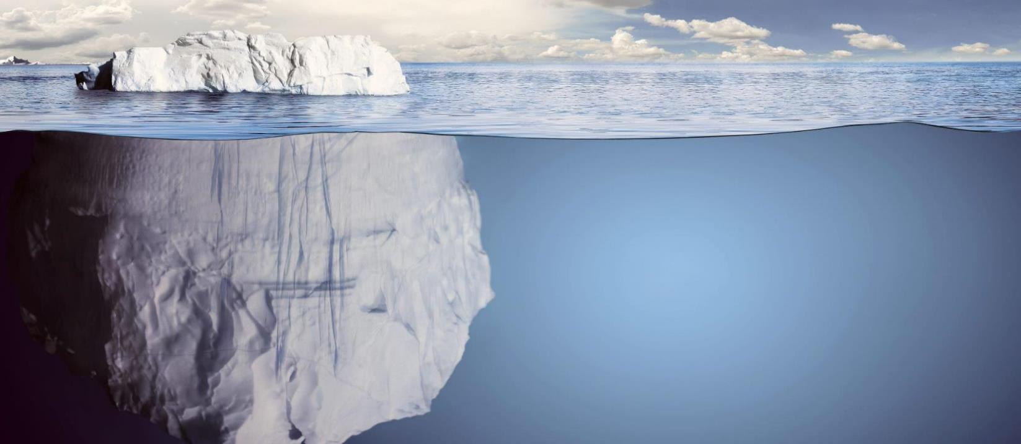







Coordinating the Strategy Implementation through the data value chain
END-USER NEEDS & APPLICATIONS (CO-DESIGN)
OBSERVATIONS
& DATA COLLECTION
ANALYTICS, MODELLING & PREDICTION
DATA MANAGEMENT & SHARING
Notes:
The goal of the Decade is to develop sustainable solutions to meet the 10 Decade Challenges.
Solutions involve delivering knowledged and information to decision makers/policy makers at the right time. And in a easily consumable way.
For these solutions to work, we need the necessary infrastructure behind to support the data and information colectiong, management, sharing and utilization; it to make it happen.
As we are developing such solutions, we need to make sure that we don’t end up with multiple such icebergs floating around…and this is also what the data and information strategy is a;l about.
This is important enough that we need a focused coordinated approach from observations (upstream) all the way along the value chain to the end-user and decision maker (downstream). That is what we have created with these coocrdinating offices that by coordinate the activities and actions, but also help us implement the strategy.

Slide 11
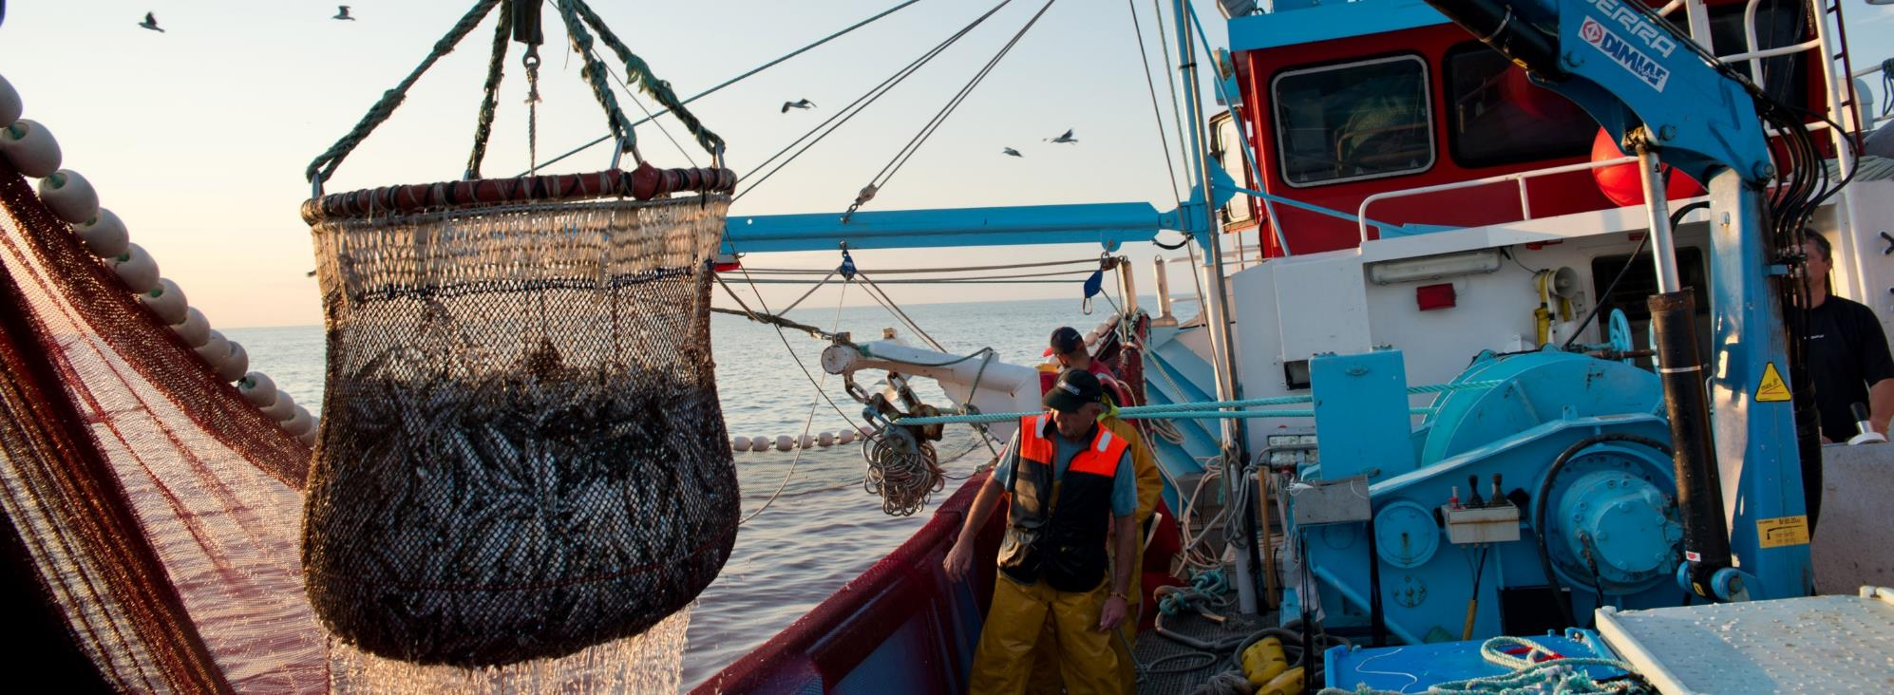
The Strategy Implementation Plan
2
Ocean Image Bank / Nicolas Job

Slide 12
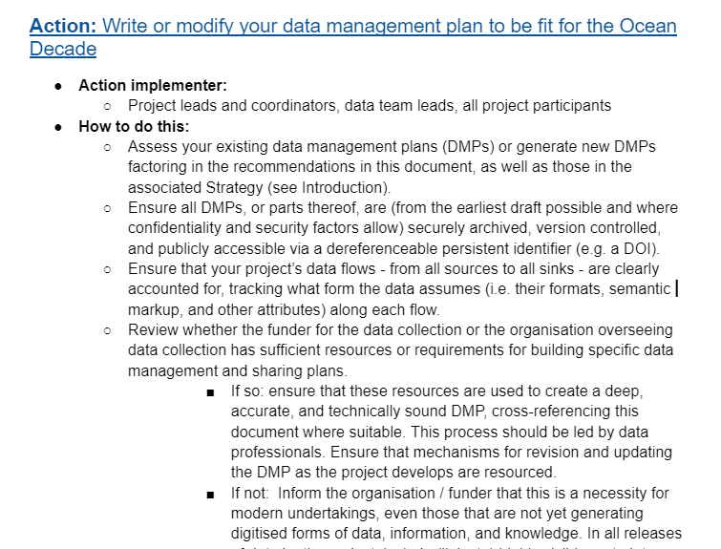
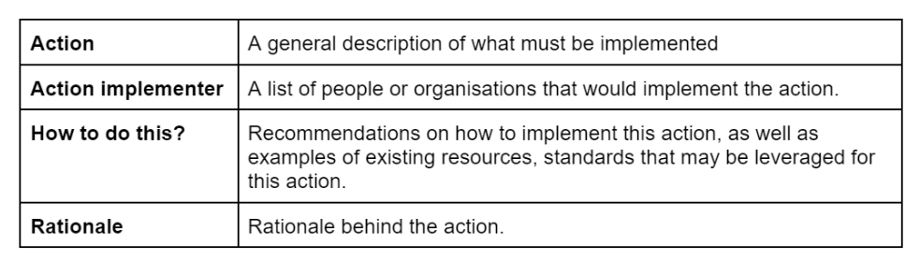
Strategy implementation plan – focus on actionable steps
Notes:
Decade-endorsed programme/project leads
Data originators/providers
IDOE National Oceanographic Data Centres (NODC) and Associate Data Units (ADU)
Global Data Assembly Centres (GDACs)
Ocean data centres / repositories
Data publishers
Data users

Slide 13
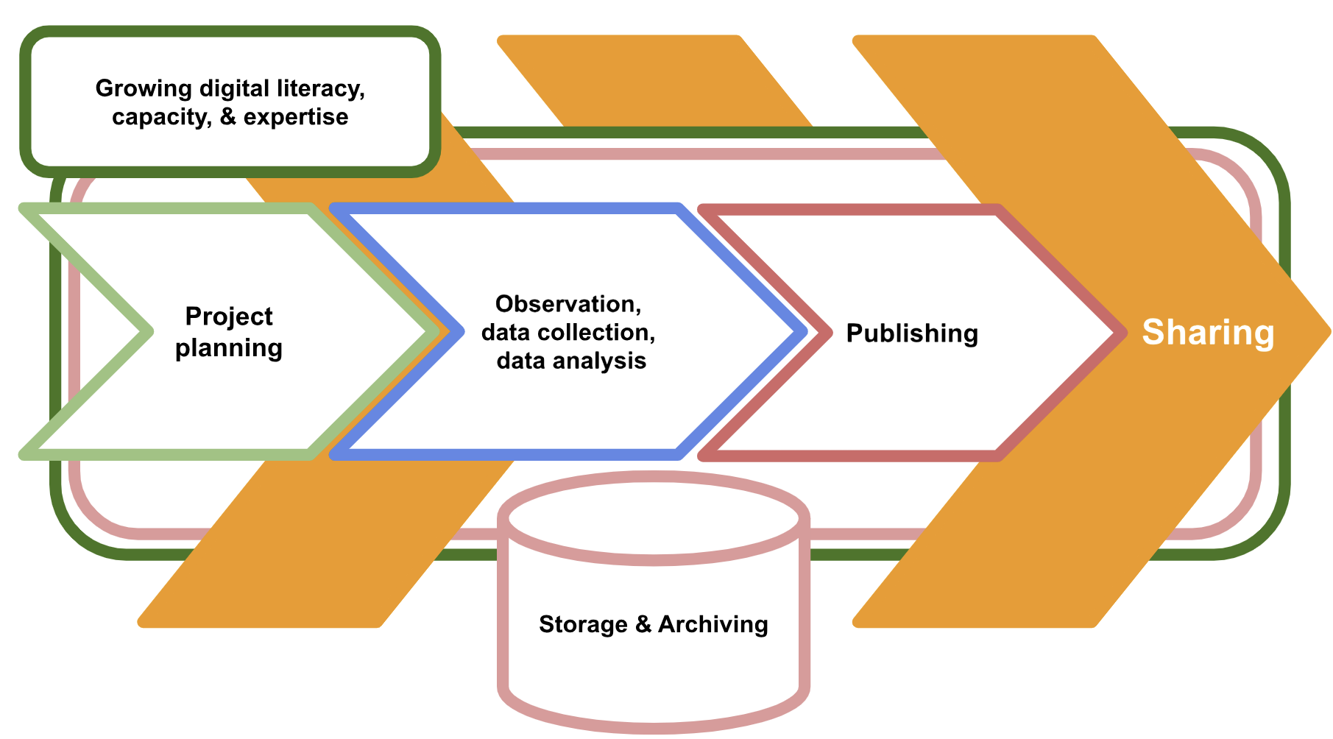
Strategy implementation plan – actions are organized according to project phases

Slide 14
Strategy implementation plan – who are the priority implementers?
Implementers | Planning | Data collection, observations, analysis | Data Sharing | Storage & Archiving | Grow digital literacy, capacity, expertise
Decade-endorsed programme/project leads | ● | ● | ● | ●
Data originators/providers |  | ● | ● | ●
IDOE National Oceanographic Data Centres (NODC) and Associate Data Units (ADU) |  | ● | ● | ● | ●
Global Data Assembly Centres (GDACs) |  | ● | ● | ● | ●
Ocean data centres / repositories |  | ● | ● | ●
Data publishers |  |  |  | ● | ●
Data users | ● |  |  |  | ●
…

Slide 15
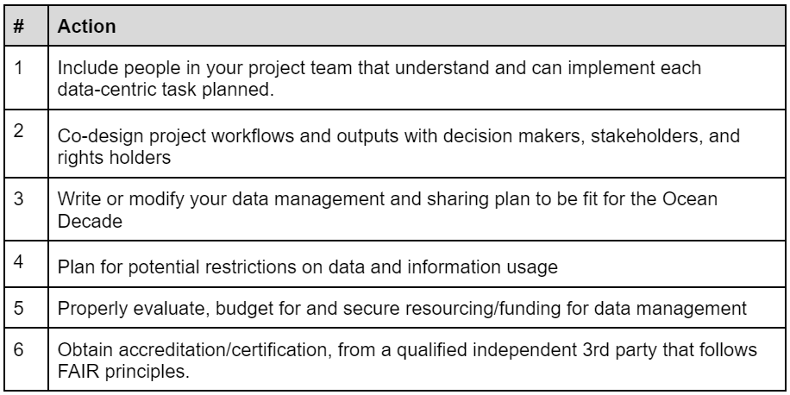
Strategy implementation plan – Required Actions per project phase
Draft
Project planning

Slide 16
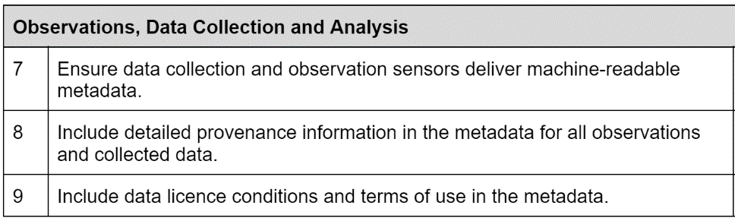
Strategy implementation plan – Required Actions per project phase
Observation, data collection,
&
data analysis
Draft
Notes:
Kevin

Slide 17
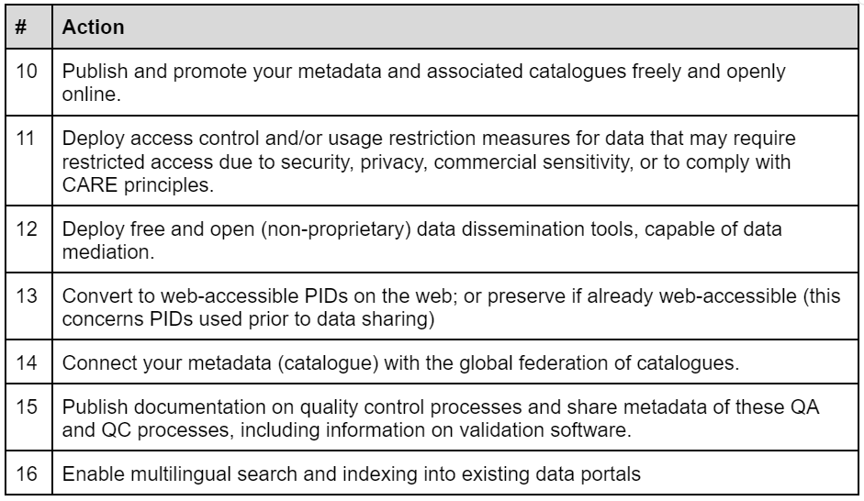
Strategy implementation plan – Required Actions per project phase
Draft
Sharing

Slide 18

17
Strategy implementation plan – Timeline
April
  Present Strategy Implementation Plan at Ocean Decade 2024 Conference
  Publish actions on GitHub as they are finalized
August-September
  Finalize draft data strategy implementation plan for review
  Launch review and consultation process
November
  Gather all reviews and comments, including GitHub feedback
  Compile and publish final version
Sign up here to participate in the review and consultation process:
https://www.surveymonkey.com/r/PMF3Q7Z
4
5-7
8-9
10
11
May-July
  Gather feedback from Ocean Decade participants
  Invite review of actions on GitHub from broader community
October
  Consultation and review period
Notes:
Going in to a bit more detail on the objectives
---------
Objective #1 - this is about developing the specifications, implementing the standards and mobilizing the resources needed to establish a federated ocean data ecosystem that allows users to easily find, use, and contribute ocean data and information through interfaces tailored to their needs and capacities. It’s also about addressing major gaps in key ocean data types, variables and in spatial and temporal coverage.
Objective #2 addresses the need to ensure that digital resources under the Decade abide by the FAIR principles. Once data are available and accessible online, steps must be taken to make them easily discoverable (findable) and readily usable (accessible, interoperable, reusable). Prior to sharing ocean data, information, and knowledge, participants in the digital ecosystem should have clearly defined internal data management plans, policies, procedures, and architectures for their generation, management, licensing, and sharing.
Objective #3 - relates to the need Practices must be implemented to ensure the quality and provenance of the digital resources users rely upon are known, as well as mechanisms to ensure proper attribution. Similarly, systems and infrastructure to ensure the long-term and curated archival of data, information, software, digitised knowledge, or any other digital resource must be implemented, as well as clear data policies and Terms of Use.
Unless there is trust in the data and information they share, as well as trust in the entire data value chain and its related infrastructure, neither providers nor users will fully engage in any collective digital ecosystem.
Objective #4 - focusses on the need for the ocean data ecosystem to be developed to support digital solutions (including meta-data standards, software, models, analytics, artificial intelligence solutions, user experiences) that can be effectively used by decision makers at all levels. Through co-design of digital solutions, a core principle of the Ocean Decade, we increase the likelihood that valuable insights from data products and services reach those that need them in a form that they can understand and act upon.
The successful implementation of this strategy depends on a thriving human community that is digitally literate and committed to sharing data, information, and knowledge. The purpose of Objective #5 in the short term is to build awareness, skills, capacities and drive alignment with the strategy as we roll it out. The long-term ambition is to affect an enduring culture change towards a digitally fluent ocean community, who readily and openly share their data, insights and understandings.
The Data Strategy Implementation Group – a group 27 global ocean data experts convened by the Decade Coordination Unit- is currently working on a draft implementation plan which will be revealed at the Ocean Decade Conference in Barcelona in April 2024, and there will be eventually a global consultation process to review and provide feedback on the strategy.

Slide 19
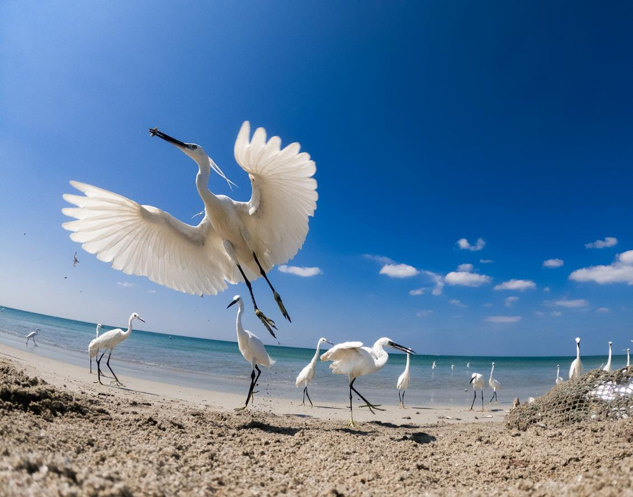


Thank you !
Contact : Louis Demargne
l.demargne@unesco.org
Ocean Image Bank / Kaveesha Madhubhashana

