Slide 1
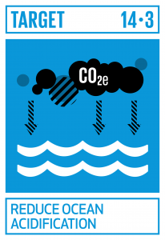
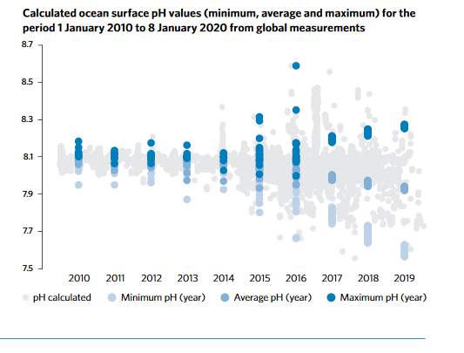

The global call to collect ocean acidification data
Target 14.3 Minimize and address the impacts of ocean acidification, incl. through enhanced scientific cooperation at all levels.
Goal 14. Conserve and sustainably use the oceans, seas and marine resources for sustainable development.
Indicator 14.3.1 Average marine acidity (pH) measured at agreed suite of representative sampling stations.

Slide 2
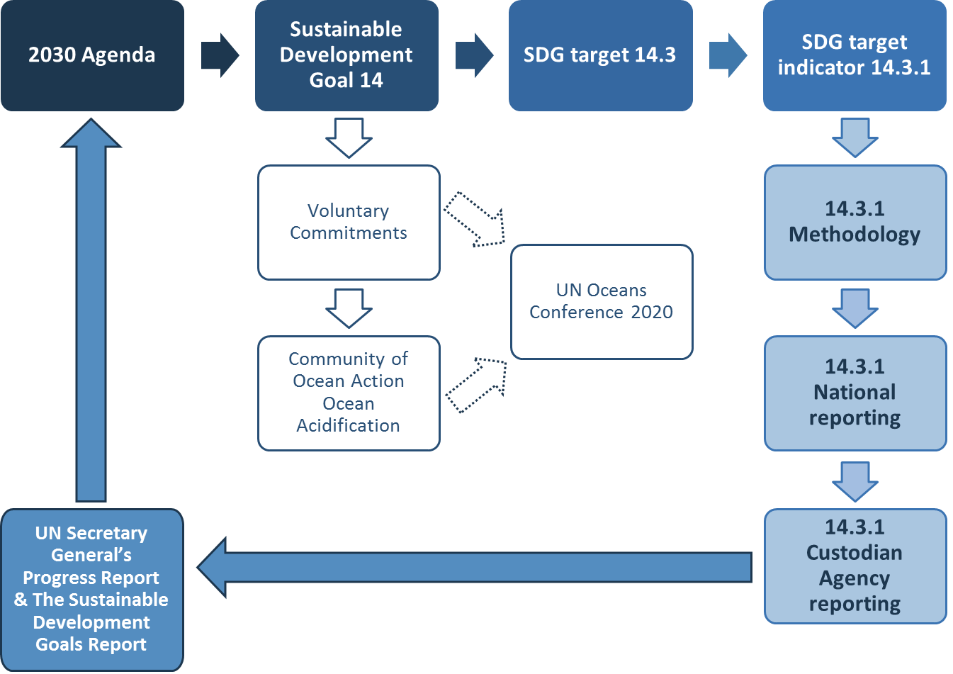


Slide 3
SDG 14.3.1 Indicator Methodology
Data template
14.3.1 trainings and workshops
‘Methodology’ explanations and definitions
14.3.1 data portal
Metadata template and instructions
14.3.1 not just a piece of paper

Slide 4
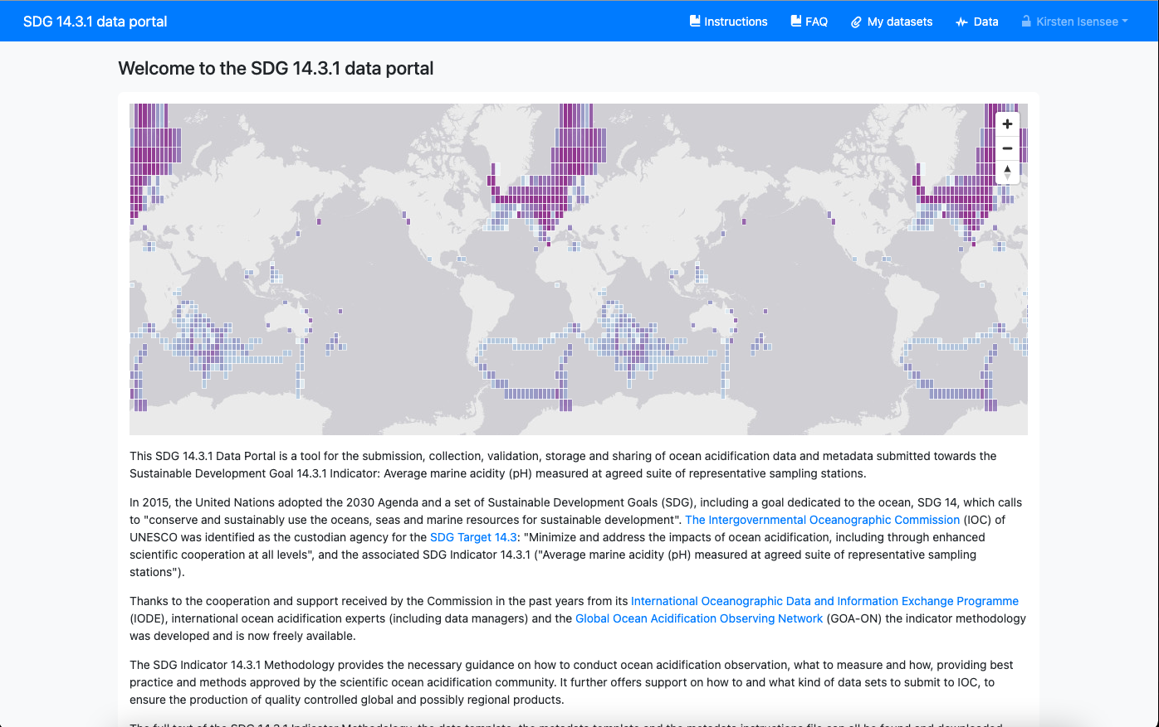

14.3.1 Data Portal
Title subtitle
https://oa.iode.org/

Slide 5
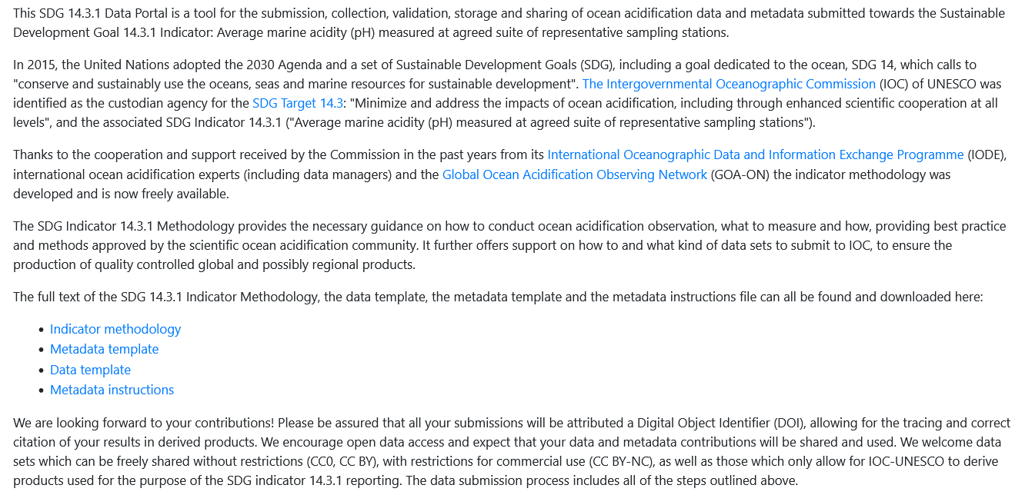
14.3.1 Data Portal
Title subtitle
https://oa.iode.org/

Slide 6
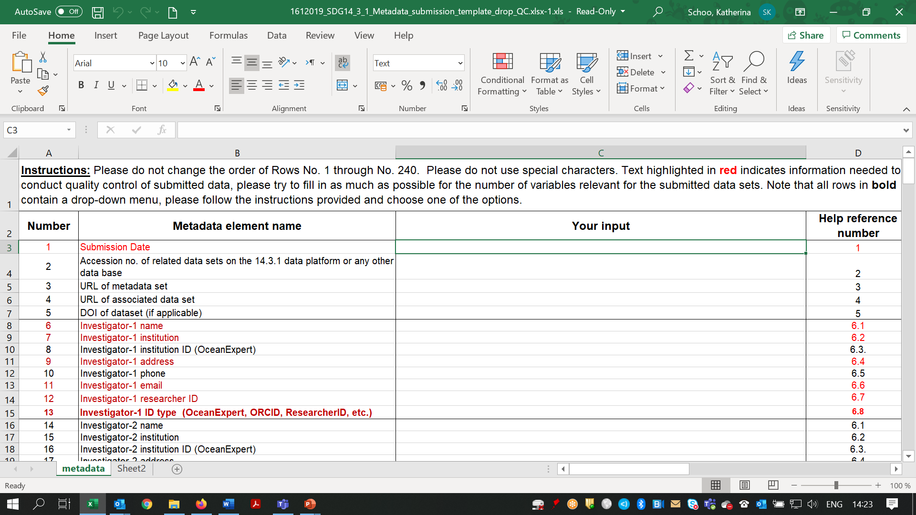
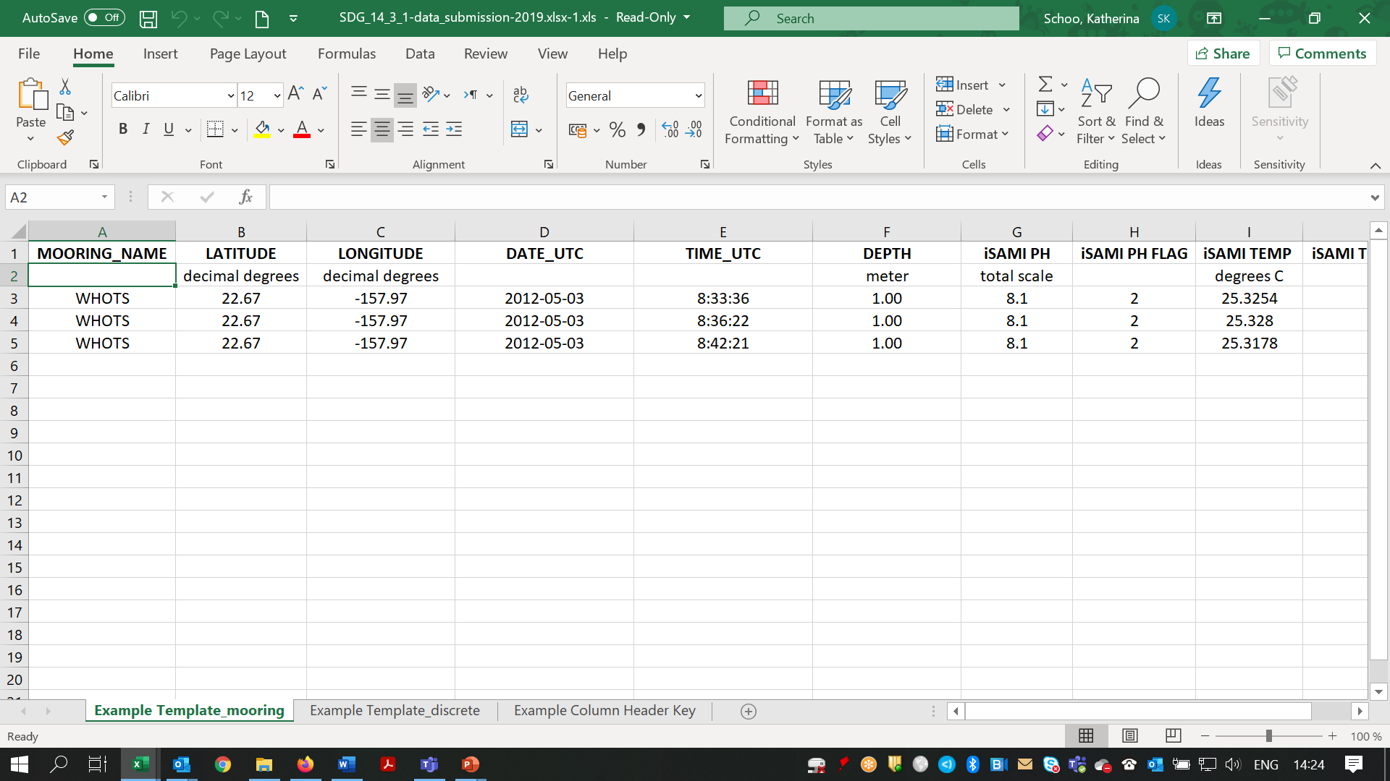
14.3.1 Data Portal
Title subtitle
https://oa.iode.org/

Slide 7
Data submission process
Data provider/ Researcher
NODC/ADU/ NSO
IOC
UN SDG Report
Notes:
National data submissions should ideally follow this pattern:
The data providers or researcher submits the data to the relevant National Agency
This Agency, the National Oceanographic Data Center, the Associate Data Unit or the National statistical Office will submit the data to the IOC
The IOC reports to the United Nations for the SDG Report

Slide 8
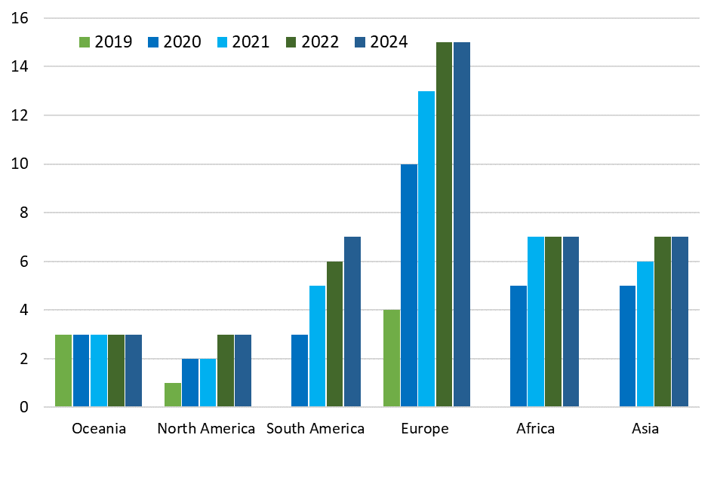
SDG 14.3.1 Reporting – progress
2020 – 8 countries submitted data and information
2021 – 28 countries submitted data and information
2022 – 37 countries submitted data and information
2023 – 41 countries submitted data and information
2024 – 42 countries submitted data and information

Slide 9
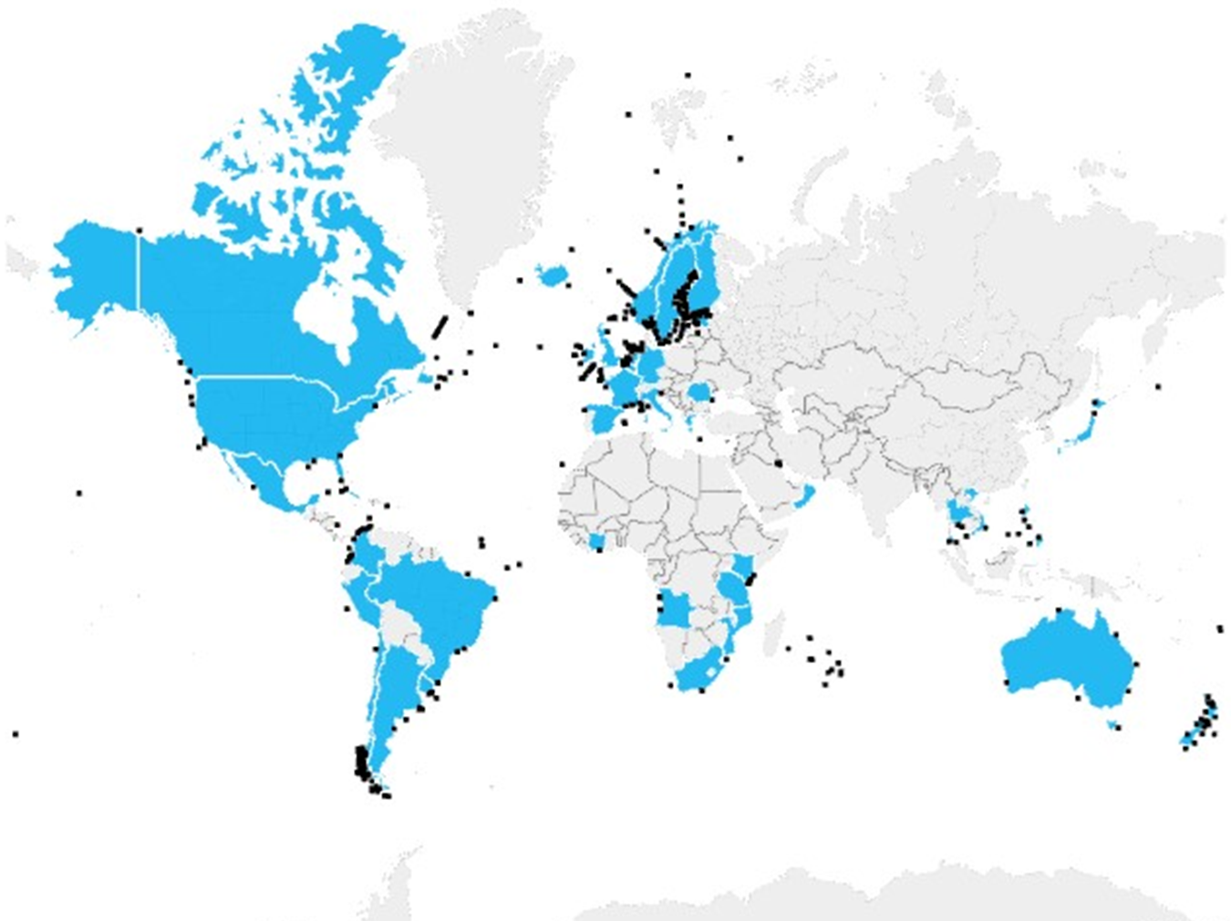
638 stations in 42 countries reported data in 2024
(308 stations in 35 countries reported in 2022, 539 stations in 2023)

Slide 10




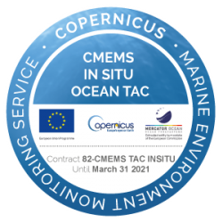


Next steps
NODCs
OCADS
To avoid duplication of efforts the aim is to develop a federated data system to automatically exchange data with other relevant databases on a regular basis using ERDDAP services.
Federated
Data
System
Notes:
To improve the data flow, not just for SDG 14.3.1 Indicator, but for a truly global ocean acidification data collection, the next steps are: Develop a federated data system that will connect existing data bases and allow the exchange of the relevant ocean acidification and ocean carbon data between the platforms. This way, data will only need to be submitted once, to one database, and will then automatically be available to other users.
In order to do this, there needs to be cooperation between the databases, and an alignment of the data and metadata requirements as well as the vocabularies. We are currently working on this, together with partners at national and international databases as well as some National Oceanographic Data Centres, NODCs.

Slide 11
Integrate data and metadata by enhancing the interoperability and establishing a federated data integration/ingestion system using ERDDAP services
Next steps
Machine-to-machine metadata exchange :
Mapping and implementation of standardised vocabularies
Integration of missing standardised vocabularies in the field of enriched metadata according to the SDG 14.3.1 Methodology
Controlling and aligning the metadata requirements in agreement with data generators and the scientific community to provide needed enriched metadata
Data exchange:
Data availability in a standardised form using standardised vocabularies.
With the development of the federated system the 14.3.1 portal would become one of the platforms to be harvested on a regular basis and could act as a mirror to support visualization/exchange and ensure long term availability of the data.

Slide 12
Metadata
Agreement on data and metadata requirements, and adoption of the metadata template by all data centres
Possible adaptations to facilitate the process:
  create data type specific metadata templates, allowing users to only enter metadata elements related to the specific type of data (e.g., mooring, underway);
  enable users to prepopulate all metadata elements based on previously published datasets of similar type, and modify them from there instead of starting from scratch;
  automatically generate some metadata elements, such as the bounding box longitude and latitude, start date, end date, and minimum and maximum sampling depths.

Slide 13
Vocabularies
Key requirements
The vocabulary(ies) adopted need to comply with the FAIR data principles and in particular enable cross-domain interoperability;
It needs to enable machine-access (i.e. compliant with web standards) as well as human readability;
If more than one vocabulary is used for the same concept then they will need to be mapped, and the mapping will need to be maintained;
Many variable-naming vocabularies exist, and we need to avoid creating new ones unless necessary;
Most variables needed by the OCA community, including e.g. Temperature of pH measurement, already have a vocabulary code in either the CF Standard Names or the BODC PUV;
Existing vocabularies should be reviewed by experts to ensure they are correct, and superfluous or ambiguous ones can be deprecated;

Slide 14
IODE support to
IOC
ODIS support
  Inclusion of SDG 14.3.1 in ODIS
Technical support for maintenance and upgrades of the SDG 14.3.1 Data Portal
  Improved search and download functions
  Integration into federated data system
  Visualization tools embedded in the federated system, according to the SDG 14.3.1 methodology, to include maps showing the origin of the datasets received, organised by data quality; maps depicting trends for long-term datasets (>5 years).
Support with the communication of SDG 14.3.1 Indicator data requirements to NODCs, ADUs and other relevant national agencies to improve data flow

Slide 15
IODE 27 and Management Team
IODE-27:
“The Committee welcomed the latest developments related to the SDG 14.3.1 data portal presented.
The Committee invited NODCs and ADUs, as well as relevant existing regional networks, to participate in the upcoming data collection calls.
The Committee expressed its support for the continued involvement of the IODE Secretariat in the further development of the SDG 14.3.1 data portal, which will be a crucial contribution to ODIS.”
Management Team meeting:
The Management Group instructed the OIH team to develop the specifications for exchanging SDG relevant metadata across the ODIS Federation and offer technical support to integrate SDG data streams into ODIS.
The Management Group instructed the Secretariat to continue supporting the communications with the NODCs and ADUs for the annual calls for data collection towards the SDG 14.3.1 Indicator.
Regarding the “integration of the SDG 14.3.1 Data Portal with other relevant ocean carbon databases through a federated system” the Management Group invited the SDG 14.3.1 team to discuss the requirements in more detail with OIH/ODIS.

Slide 16
The Clean and Healthy Ocean Integrated Program (CHO-IP)
Introduction to the Integrated Programme.

Slide 17
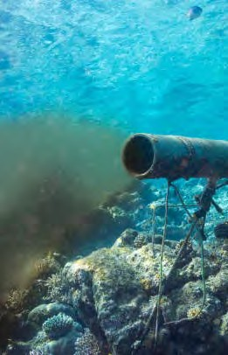
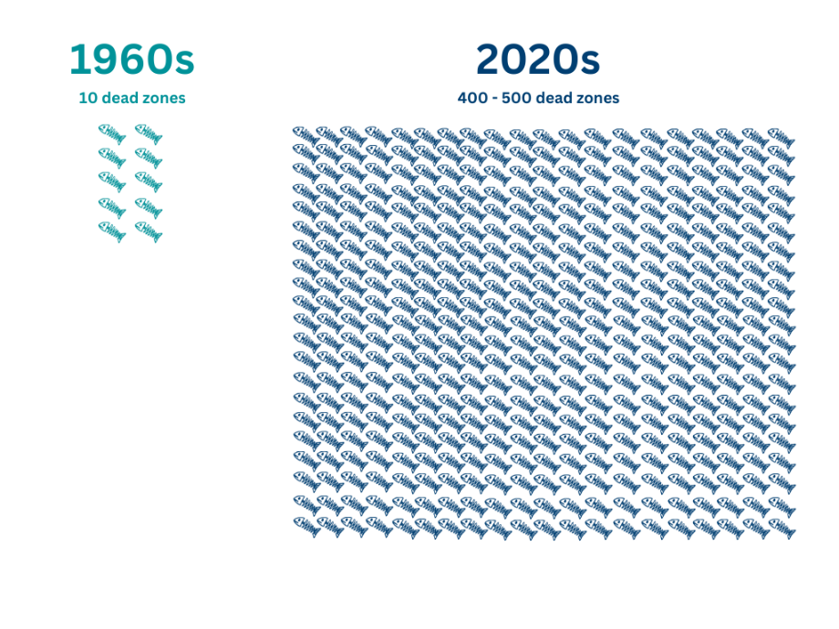

Pollution of the coastal zone is one of the most serious threats to the coastal ecosystems of the world.
70-80% of global wastewater is discharged untreated into the ocean
RATIONALE
Increasing levels of nutrients entering the oceans from urban and agricultural activities are a major threat to coastal waters.
More than 500 dead zones have been identified worldwide. They cover an area roughly the size of the EU.

Slide 18

Global, regional and national awareness and knowledge of hypoxia causes, effects and solutions are insufficient to motivate action.
BARRIERS
Science-based strategic and adaptive management critical to inform efficient and effective hypoxia solution packages.
Policies, regulations, strategic planning and investments to internalize the challenges and solutions of nutrient pollution and to provide incentives for the adoption of improved management practices.
Innovation and uptake of cost-effective nature-based and regenerative approaches.
Investment and innovative financing approaches required to stimulate, maintain and accelerate effective land-based pollution mitigation and coastal conservation measures

Slide 19


To address marine hypoxic zones by curbing coastal pollution from agriculture, industrial and municipal sources
OBJECT IVE

Slide 20


Through policy and regulatory measures and infrastructure investments combined with nature-based solutions.
HOW
foster the enabling environment to advance countries’ efforts toward sustainable blue economy goals.
LONG TERM

Slide 21
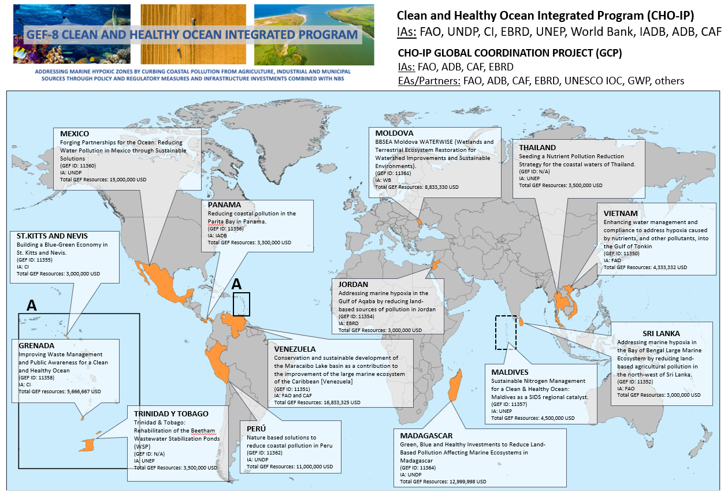

Fourteen (14) National Child Projects

Slide 22
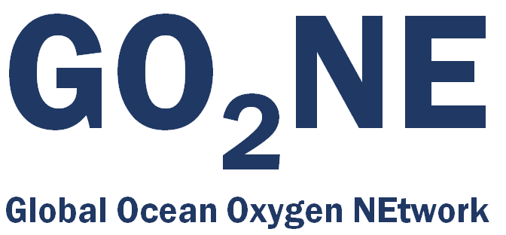

GO₂NE and GOOD
IOC working group - Led by a group of ocean oxygen scientists and researchers working from the coasts to the deep ocean
Collaborations on scientific papers, workshops, capacity development activities, conferences, policy documents and briefs, and public awareness initiatives
A programme under the UN Ocean Decade, led by the GEOMAR on behalf of the GO₂NE expert group
Provides an umbrella for other Ocean Decade Actions, focusing on different aspects of decreasing oxygen in the ocean
Both feature regular capacity building activities (webinars, workshops and summer schools); collaborations on best practice papers for ocean oxygen measurement, data analysis and data management; and knowledge sharing opportunities.
The expert working group, their colleagues and international connections, and members of the expanded GO₂NE will be key to IOC-UNESCO’s support to the GCP and the Country Projects.

Slide 23
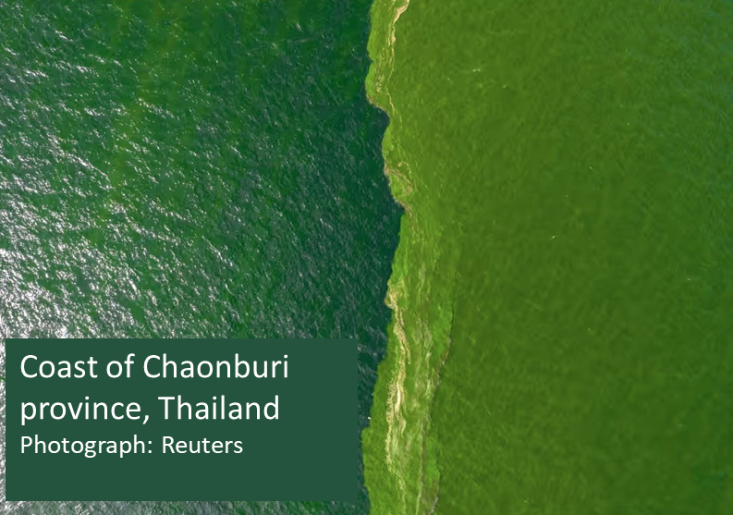
IOC-UNESCO led GCP Activities
Activities that welcome engagement, but are resourced almost entirely by the GCP and actioned by IOC-UNESCO and its network
Development of a free, open-access, ocean oxygen data portal and map tool – the Global Ocean Oxygen Database and Atlas (GO₂DAT), that will draw data from existing databases
Collecting, sharing, and advising on best practices for ocean oxygen measurement and long-term, sustainable, data management
Assessments of relevant (regional) Nature-based Solutions to mitigate and adapt to marine hypoxia and eutrophication
International capacity building initiatives, including the development of related training material and the organisation of international summer schools for Early Career Scientists on ocean deoxygenation and acidification
Scientific messaging and communications campaign in coordination with GCP partners

Slide 24
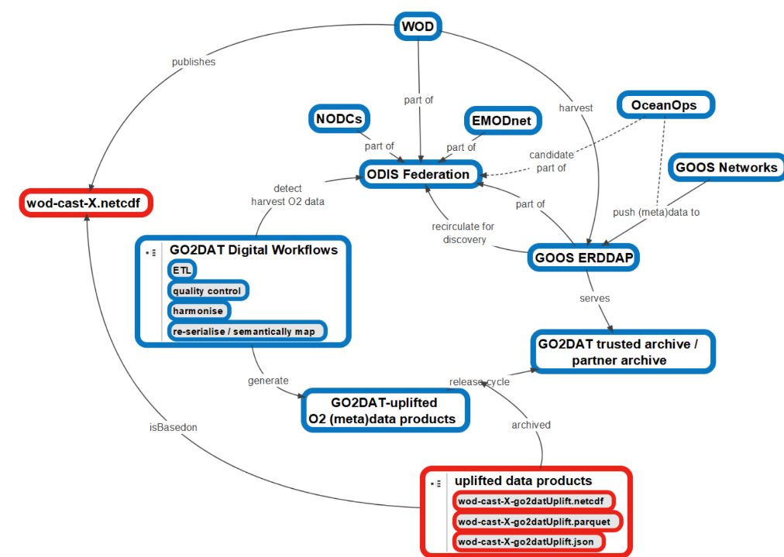
GO₂DAT Prototype
O2 highest ranked EOV in feasibility and impact
Builds upon existing structures and common structured metadata
Utilizes ODIS-federation for (meta)data harvesting
Automates data ETL
Utilizes ERDDAP as a service for flexible data extraction
Provides single access point for O2 data
Establishes feedback loops to original data sources
Roadmap: Grégoire et al., 2021 to be updated within GOOS digital ecosystem infrastructure framework

Slide 25
IODE 27 and Management Team
IODE-27:
“The Committee welcomed the development of GO2DAT, the cooperation with the IOC WG GO2NE and GO2DAT Steering Committee.
The Committee encouraged Member States, NODCs and ADUs to support the development of GO2DAT financially and in-kind.”
Management Team meeting:
The Management Group instructed the OIH technical team, before the end of the OIH project, to assist with the addition of the GO2DAT system in the ODIS Federation with the objective of increasing interoperability, detecting and remedying duplication, and harmonization with other IODE assets, in particular the World Ocean Database.

