Slide 1
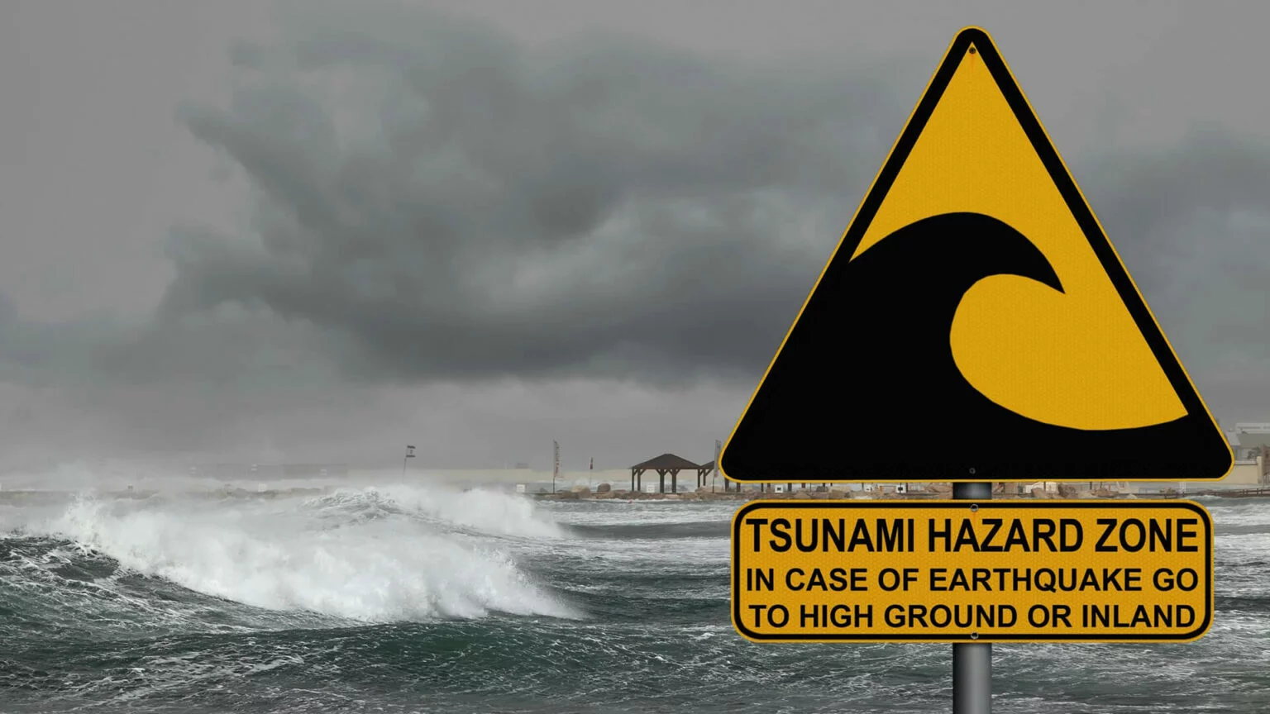
IOC IODE-GOOS Data Workshop
Timing: Monday 30 September - Wednesday 02 October
Location: VLIZ, InnovOcean Campus, Jacobsenstraat 1, 8400 Oostende
User and System Needs across IOC and Decade
Current State of TEWS
Future TEWS and Contributions to MHEWS: Focus on Data Exchange
Prepared by Denis Chang Seng and Bernardo Aliaga
Tsunami Resilience Section
UNESCO-IOC
Contributor: Bill Fry, Seismologist, New Zealand

Slide 2
Global TEWS
Global Tsunami Early Warning and Mitigation Programme
Coordinated by IOC-UNESCO, the Global Tsunami Warning System plays a critical role in protecting lives.
The IOC-UNESCO Tsunami Programme supports in coordination with the Tsunami Service Providers and Tsunami Information Centers, Member States in assessing tsunami risk, implementing TEWS and in educating and building capacities of communities at risk about preparedness measures (Three Strategic Pillars).

Slide 3
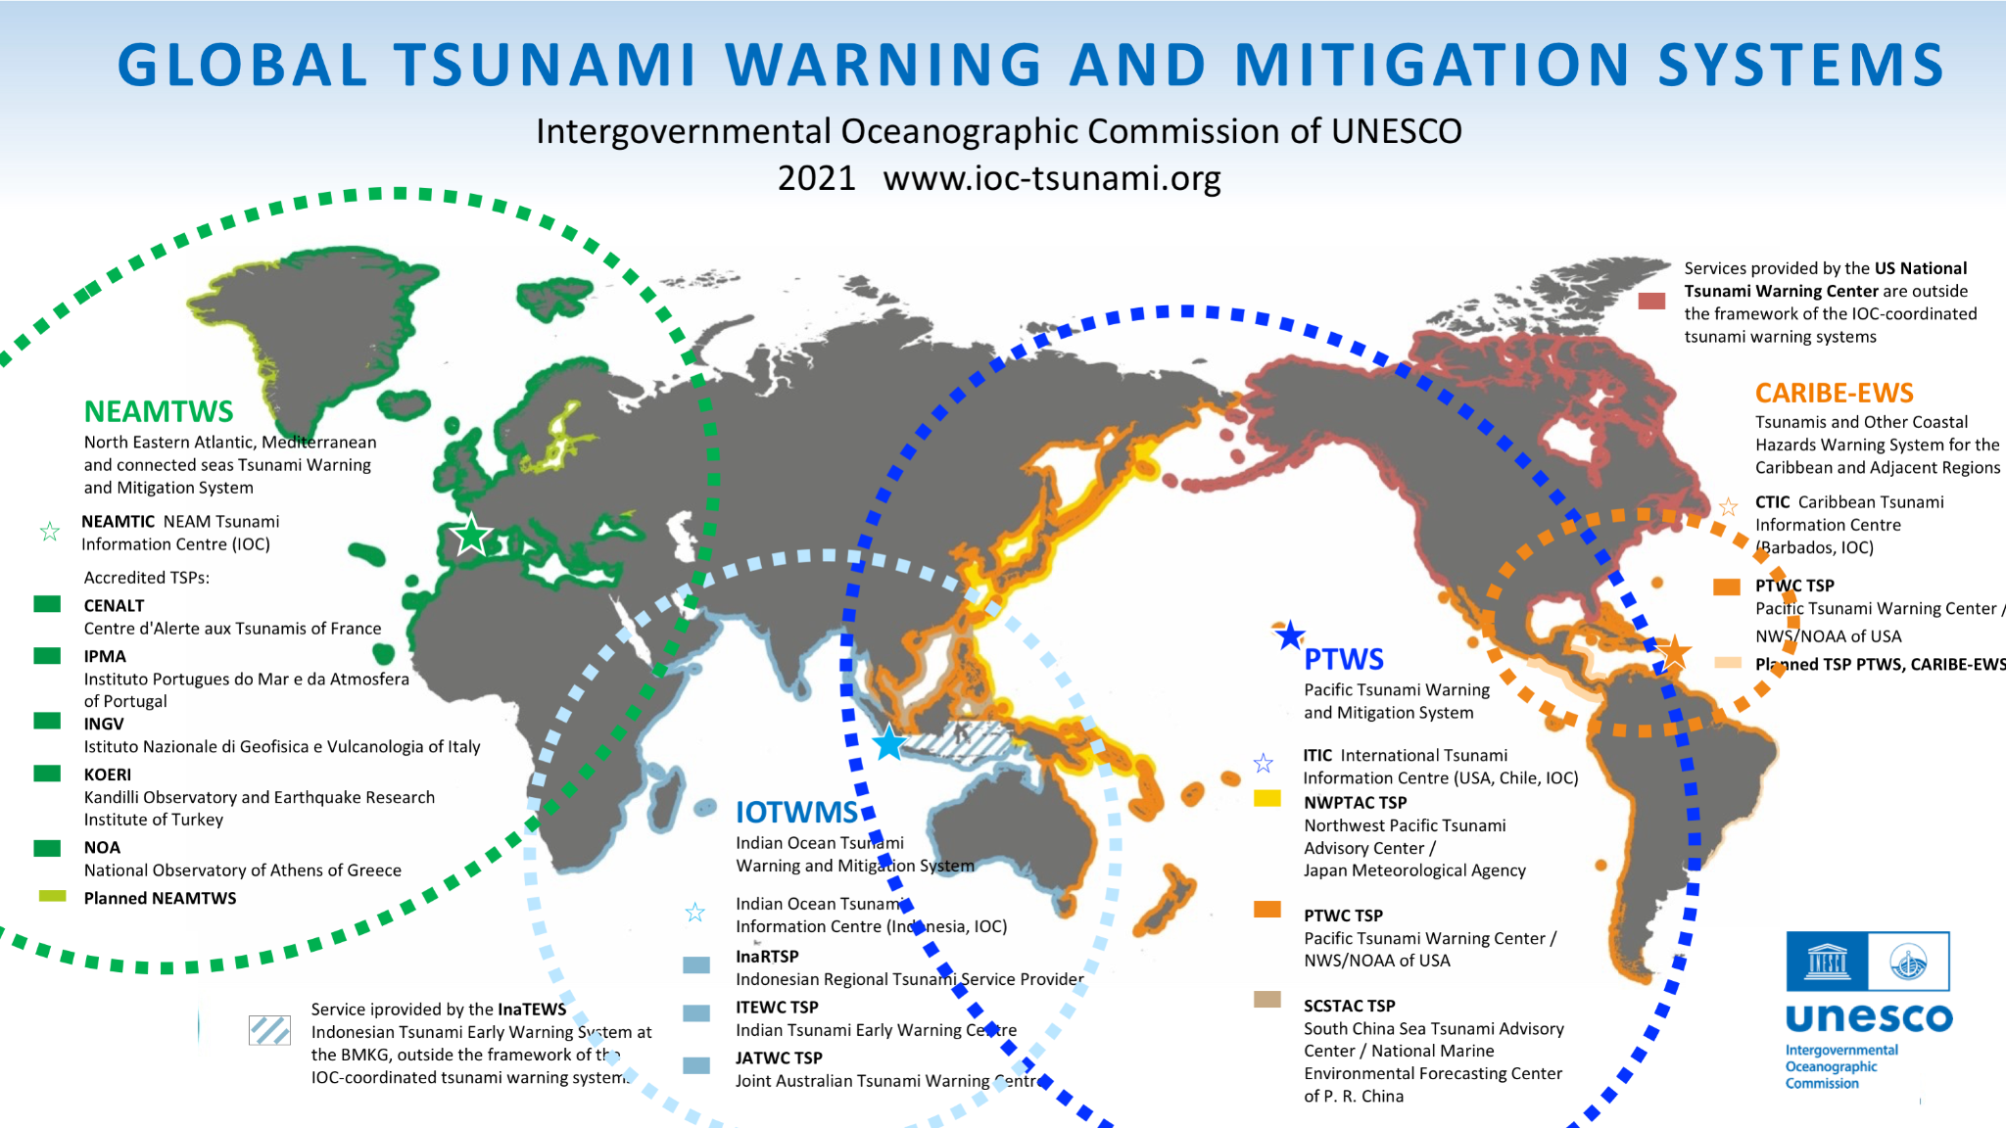
TSPs and NTWC
Critical Architectures / Infrastructures in TEWS (Data)
Tsunami Service Providers (TSPs)
Centre that monitors seismic and sea level activity and issues timely tsunami threat information within an ICG framework to National Tsunami Warning Centres/Tsunami Warning Focal Points and other TSPs operating within an ocean basin.
National Tsunami Warning Centres (NTWCs)
A centre officially designated by the government to monitor and issue tsunami warnings and other related statements within their country according to established national Standard Operating Procedures.

Slide 4
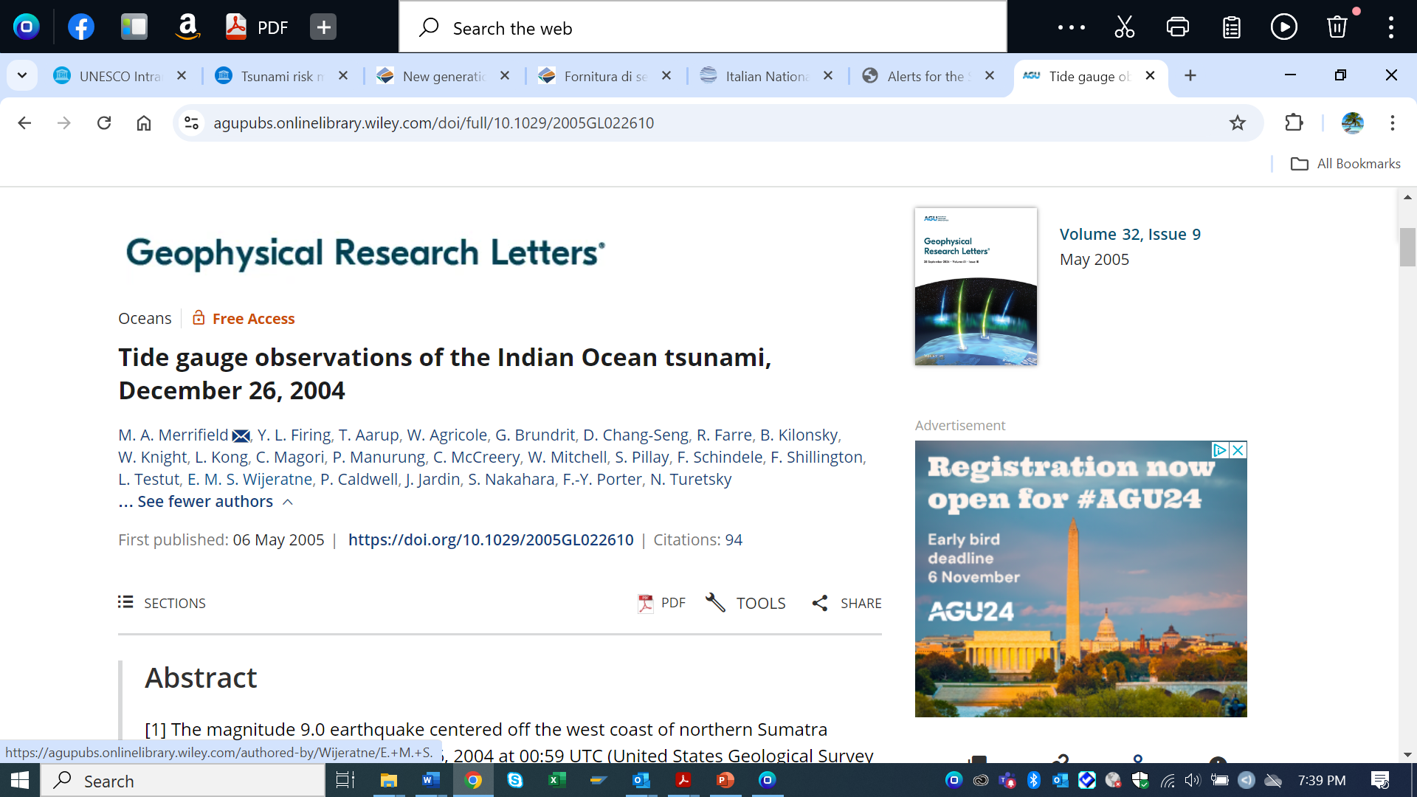
The Importance of Tide Gauge
Observations
Tide gauges operated on behalf of national and international organizations recorded the wave form at a number of island and continental locations.
Recommendation for the use of the basin-wide tide gauge network for future warnings.

Slide 5
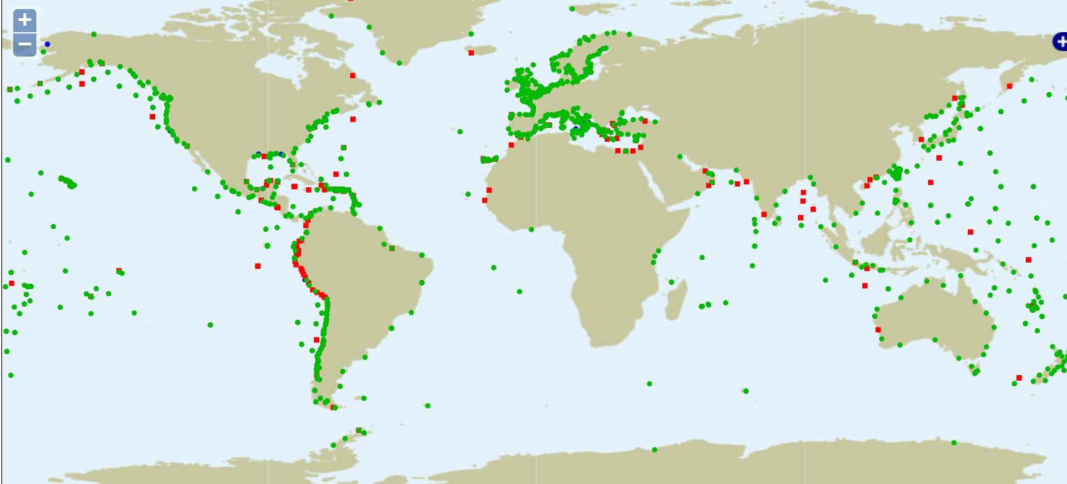
How They Get Data for TEWS
Sea Level Data
TSPs, NTWC get sea level data from
  National Hydrographic and Oceanographic Centers
  GLOSS Data Centers (mainly the IOC Sea Level Station Monitoring Facility
  1300 Stations Monitored (VLIZ) Flanders Marine Institute
  Other facilities (JRC / IDSL)WEBCRITECH
  NB:- For tsunami early warning sea level sampling rate (towards 1sampling per second) and to reduce the real time data latency to 1 minute or less;
  IOC Sea Level Station Monitoring Facility
Real-time sea level data can be delivered in an automated way via:
  Global Telecommunication System (GTS): requires you to have access to it
  HTTP POST: you upload the data to our website via a HTTP request. See BGAN for more info
  HTTP pull: you provide a web service that we can read
  FTP upload: you upload to our FTP server
  FTP pull: you provide an FTP server that we can read
  Socket connection: you provide a TCP port that we can read

Slide 6
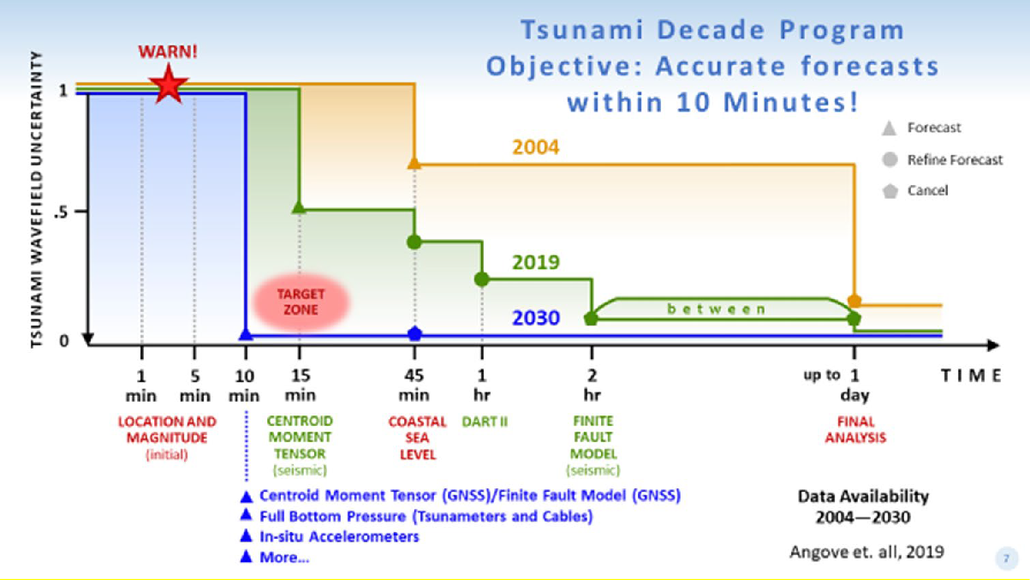
Sea Level Data in Current Tsunami Warning Systems
Sea level data are used to confirm or alert tsunami arrivals and to specify tsunami warnings for particular coastlines
Used to estimate tsunami impacts and height variations along coastlines.

Slide 7
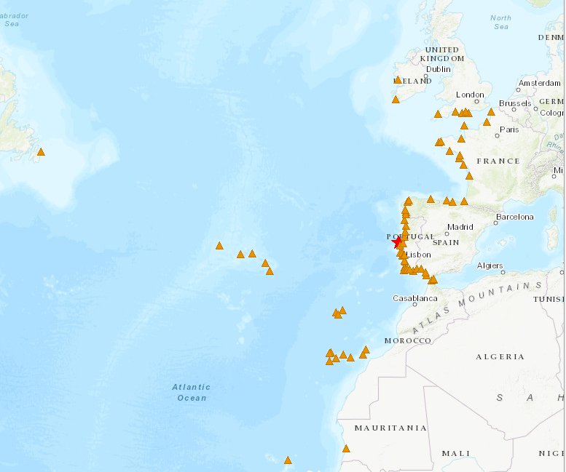
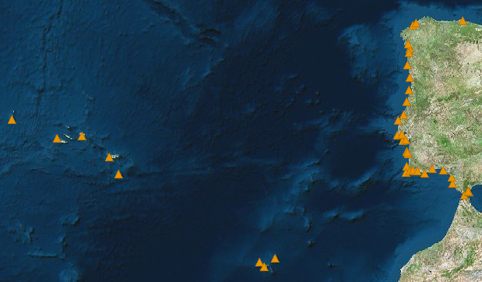

Tide-Gauge Network
Internet
MPLS
Internet
MPLS
El Jadida
71 stations for TEWS
Instituto Hidrográfico
Puertos Del Estado (via IOC & IGN)
Direção Geral do Território
CNRST (via CNRST & JRC)
JRC (ipma & ign support)
IOC

Slide 8
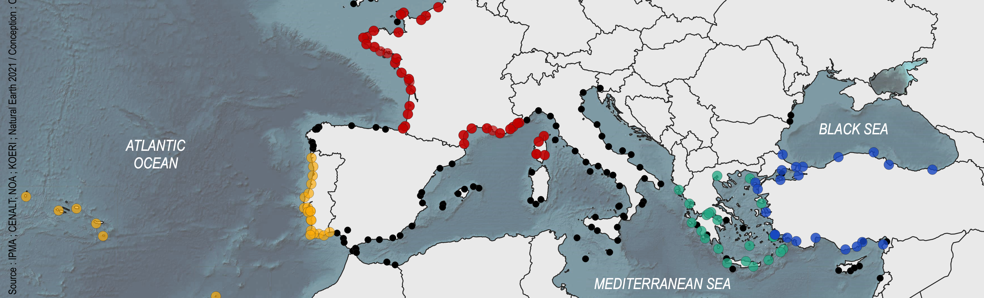
IPMA, Portugal
Tsunami Service Provider/NTWC Sea Level Data Sources
France, CENALT, seiscomp/MPLS (SHAUM stations)
Spain, IH, webservice/Internet (Instituto Hidrográfico)
JRC, webservice/Internet (IOC Sea Level Station Monitoring Facility)
EMSO (European Multidisciplinary Seafloor and Water Column Observatory) -PT/UBI/IPMA, webservice/Internet
IGN seiscomp/Internet (Puertos del Estado stations) (National Institute of Geography)

Slide 9
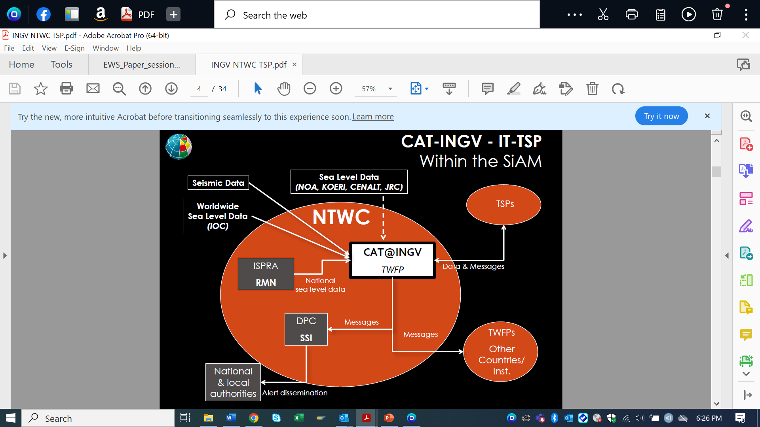
Sea Level Station Monitoring Facility

Slide 10
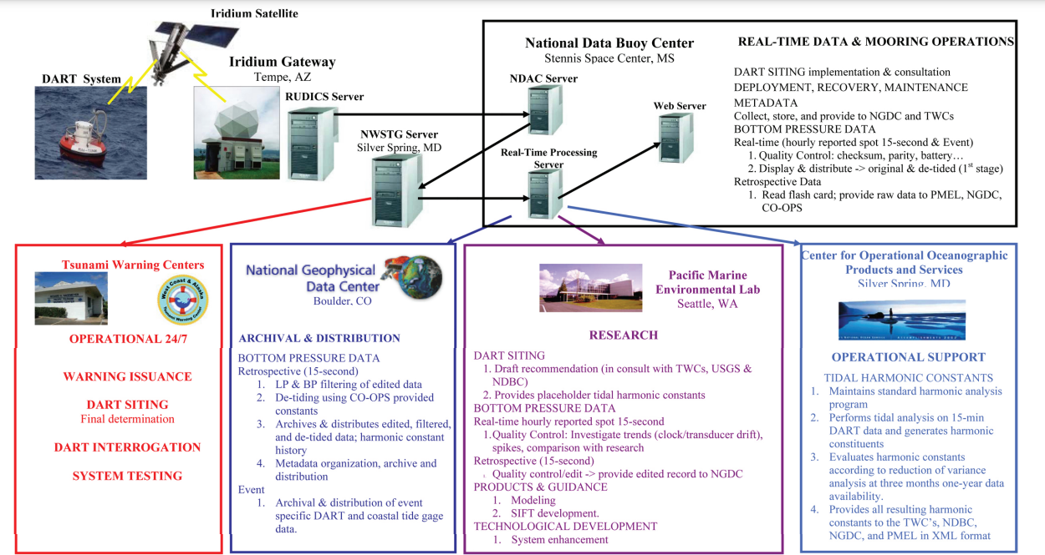
Tsunameters
Deep ocean pressure gauges (tsunameters) important for the TWS because they directly detect tsunami waves in the open ocean both close to the source region and across an ocean basin in near real time.
Flow of DARTTM data from buoy to archive. NOAA 2008

Slide 11
Future TEWS and
Contributions to MHEWS?

Slide 12
ODTP: Rapid Tsunami Detection, Measurement and Forecasting Capabilities
ODTP:
Objective 1: Progress actions is envisioned particularly in the fields of rapid tsunami detection, measurement and forecasting capabilities

Slide 13
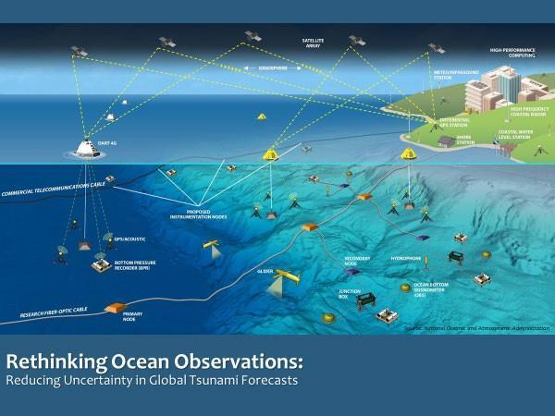
The Vision of the ODTP is to move beyond the seismic proxy relationship and detect and measure the tsunami source or resultant wavefield directly in order for reliable forecasts to be produced (agnostic source).
Many sensors will need to contribute (coastal sea level stations, tsunameters, GNSS ground stations, hydrophones, gliders, coastal radars and, in-situ seismographs) and many are low-cost or no-cost
Strategy:
Maximise, Expand, Apply, Innovate
It is a goal of the ODTP to provide opportunities for all at-risk MS to make meaningful contributions to this global detection and monitoring

Slide 14
Current Efforts to Experiment GNSS and Acoustic/Gravity SMART Data into Forecasting Systems

Slide 15
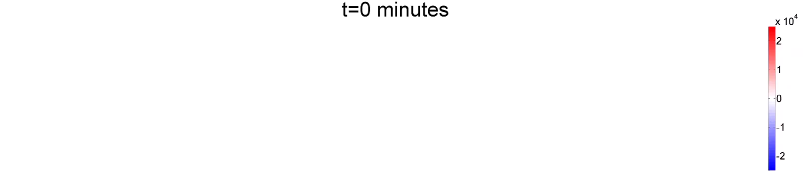
1. Current Efforts to Experiment Acoustic/ Gravity Data into Forecasting Systems
Real-time Tsunami Detection by Acoustic-Gravity Waves
Tsunami warning relies on seismic measurements causing false alarms.
Development of a real-time TEWS technology based on analyzing fast travelling sound signals that carry information on tsunamis.
Surface gravity wave (tsunami)
100 km
[Pa]
Hydrophone
Acoustic-gravity waves
(1500 m/s)
Submarine earthquake
Ocean
1,000 km
Sea-floor
Source: Usama Kadri, 2024

Slide 16
1. ODTP Endorsed Action Acoustic –Sound Signals
Project (4) : Global Real-time Early Alarm for Tsunami (GREAT)
Challenge 6: Coastal Resilience
Challenge 7: Ocean Observations
Institution: Cardiff University
Host: UN31. The Ocean Decade Tsunami Programme
Lead: Usama Kadri
Country: United Kingdom of Great Britain and Northern Ireland (UK)
Summary: Tsunami warning relies on seismic measurements causing false alarms. which result in financial loss due to evacuation and business shutdown. Moreover. people’s confidence reduces due to repeating false alarms leading to increased number of casualties in real tsunami. Reducing false alarms is an intergovernmental priority led by the UNESCO in accordance with SDG’s Goal 11 to make cities inclusive. safe. resilient and sustainable. Therefore. we developed a real-time early tsunami warning technology based on analysing fast travelling sound signals that carry information on tsunamis. The technology will be deployed in two NTWCs for operational validation. then it will be deployed in more centres to provide tsunami emergency response. The technology is built on years of research in the field bridging cutting-edge deep-sea observations to inverse modelling. AI and numerical modelling. Such a technology is complimentary and inclusive with the conventional tsunami detection techniques
Start and End: 09/01/2013 -31/12/2030
Basin: North Atlantic Ocean, South Atlantic Ocean, North Pacific Ocean, South Pacific Ocean, Indian Ocean, Southern Ocean, Mediterranean Sea

Slide 17
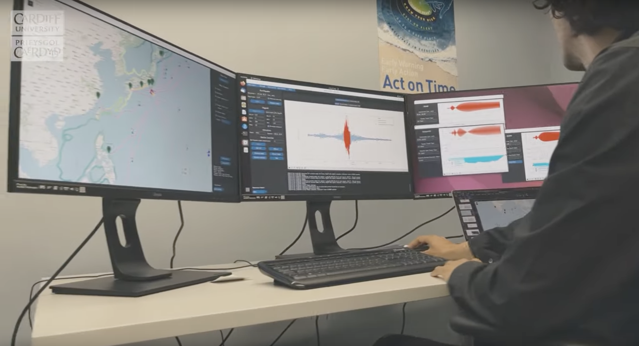
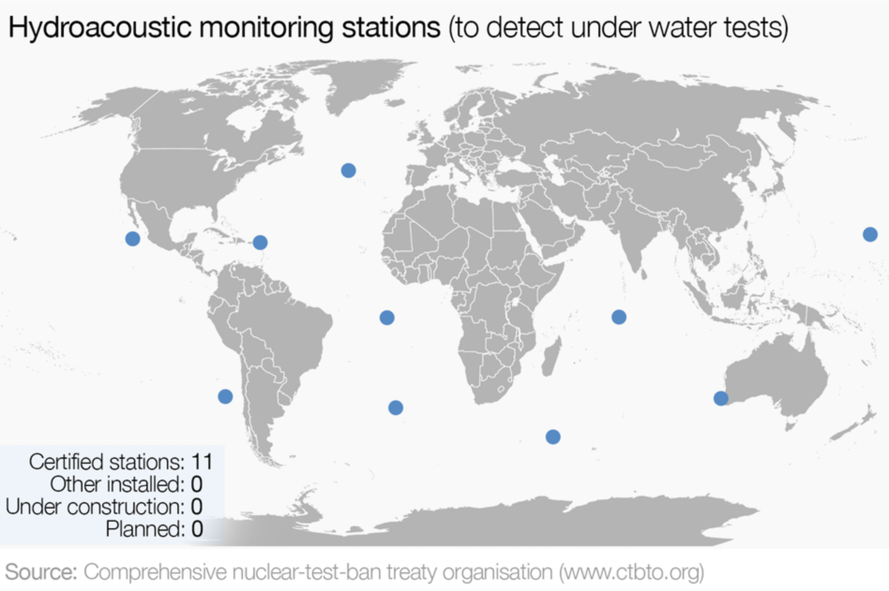
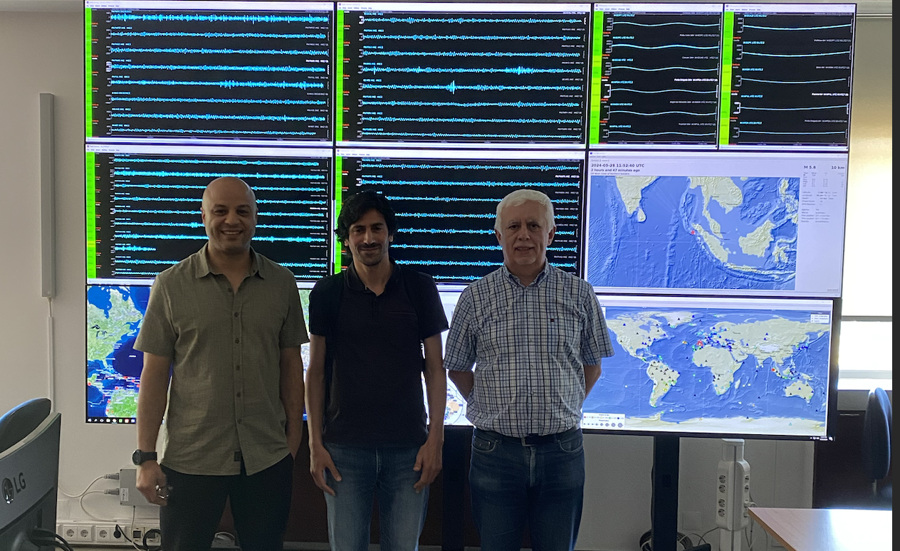
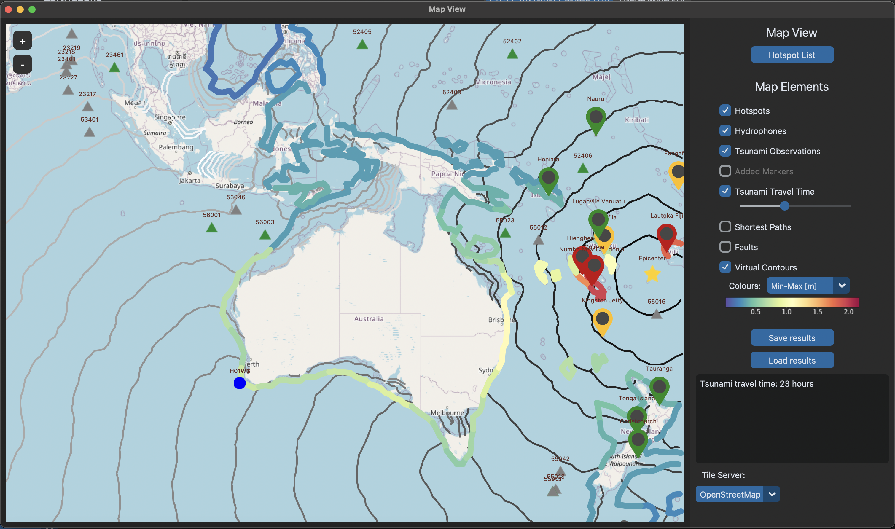
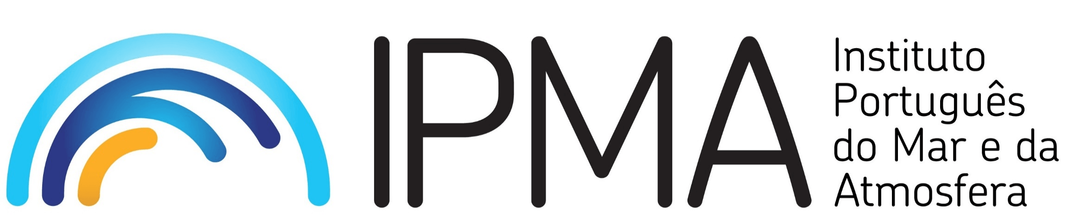
1. Access to IMS/CTBTO Real-Time Hydroacoustic Data
Real-time access (CTBTO)
Cardiff University Tsunami Centre, UK
MoU UNESCO –CTBTO 2010
Access to IMS
Software deployed at IPMA June 2024
Assess globally & benefits coastal communities, especially SIDS and LDCs
Source: Usama Kadri, 2024

Slide 18
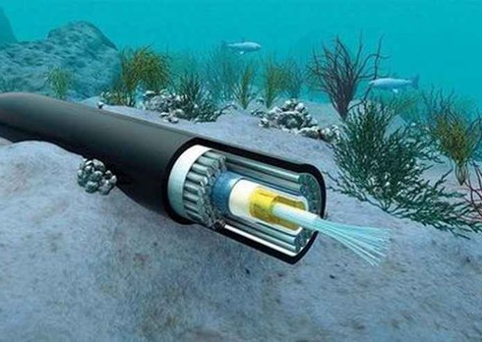
2. Current Efforts to Experiment SMART Data into Forecasting Systems
SMART Data
SMART cables are in transition from development to implementation/
Potential for global scale.

Slide 19
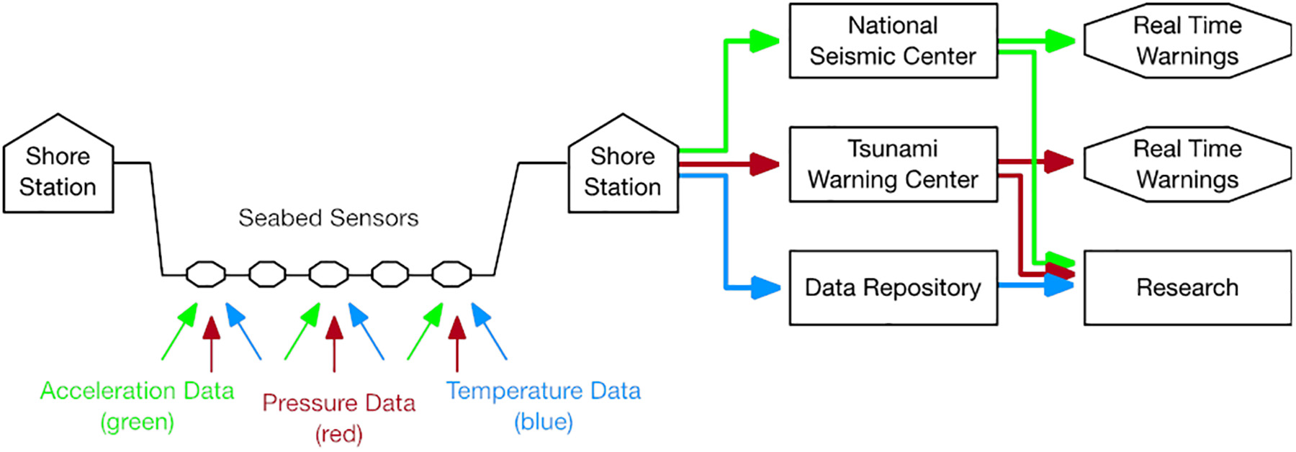
2. Current Efforts to Experiment SMART Data into Forecasting Systems (con’t)
Data from SMART cable sensors will be transmitted to a shore station
Stored in raw form, processed and transmitted to data repositories , national agencies, and academic institutions
Facilities and Users
Multinational facility like EarthScope Consortium (merger between IRIS and UNAVCO) facilitates access to time series
This facility allows SMART cable data products to have an immediate user base and wide range of other institutions.
Seismic and pressure sensor data to be sent immediately
Figure 1 Data flow from SMART cables to end users (Bruce et al., 2019)

Slide 20
3. Current Efforts to Experiment GNSS Data into Forecasting Systems

Slide 21
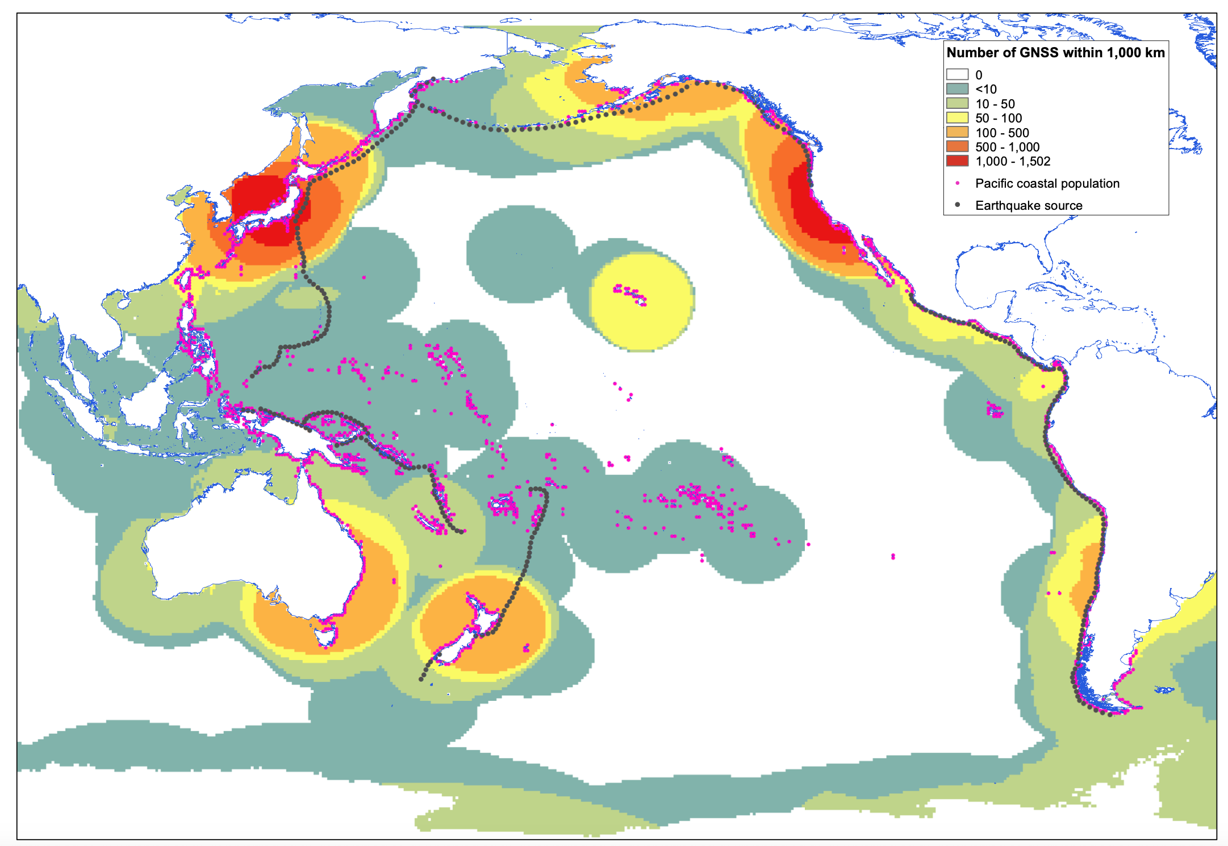
3. Current Efforts to Experiment GNSS Data into Forecasting Systems
Global Navigation Satellite System (GNSS) displacement data in the near-field has ability to track the motions of large earthquakes.
Research efforts aimed to forecast tsunami wave heights based only on Global Navigation Satellite System (GNSS) data, which is available within minutes from an extensive network of stations.
The model performs well even when only the initial 4 min of GNSS data is used.

Slide 22
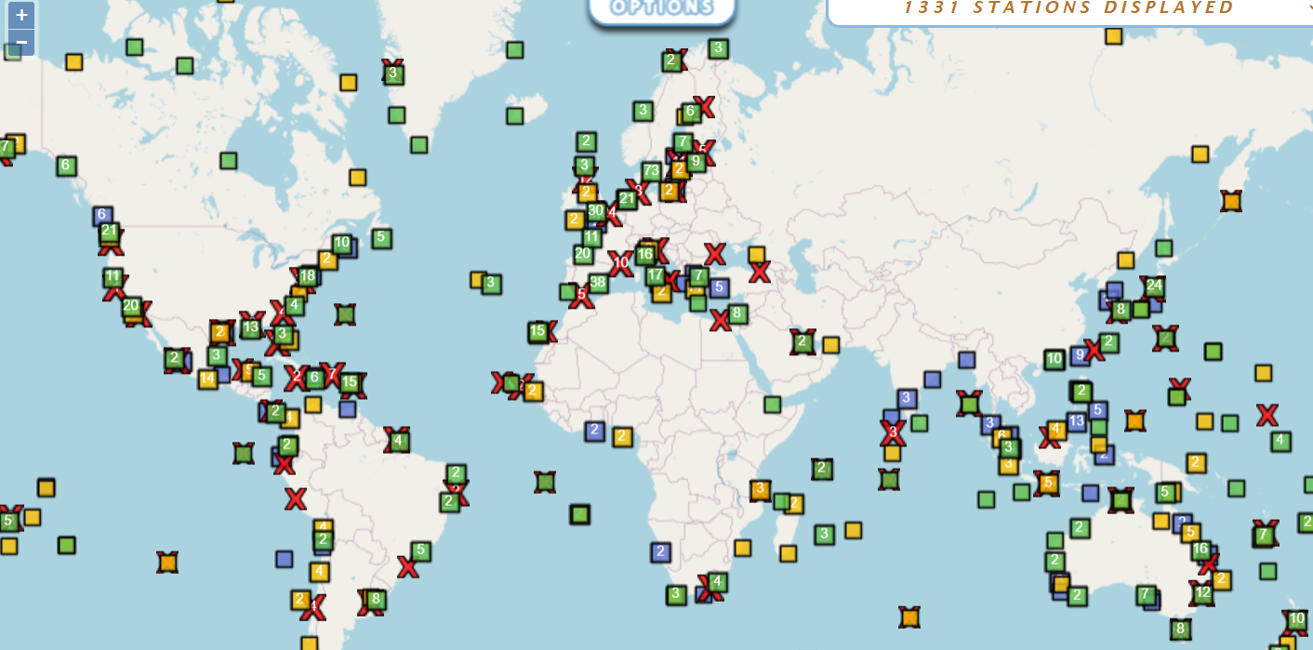
979 GNSS Stations in 62 countries, 201 PROVIDERS
SONEL
Several GNSS are currently available:
  Galileo (EU)
  GPS (USA)
  GLONASS (Russia)
  BeiDou (China)
SONEL serves as the GNSS data assembly centre for the Global Sea Level Observing System (GLOSS), which is developed under the auspices of the IOC/UNESCO.

Slide 23
Key Points
Rich, diverse real time data exchange - TEWS architectures/ infrastructures and users ( global to national level )
More diverse and novel data emerging to improve the effectiveness of TEWS : ODTP goals/objectives ( addressing also non-seismic tsunamis
NB:- Ocean Bottom Pressure (OBP) is now a GOOS Essential Ocean Variable (EOV).
Greater possibility to contribute to MHEWS (opportunity)

