Slide 1
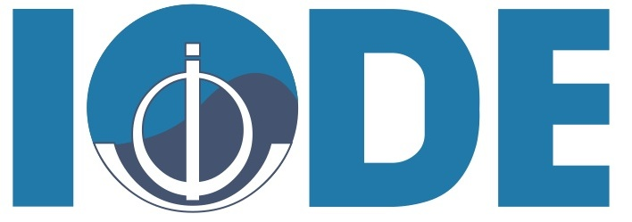
Draft structure
Session 7: Technical integration
Kevin O’Brien, Ward Appeltans, Pier Luigi Buttigieg, Emma Heslop
IOC IODE/GOOS Data Workshop
30 September - 02 October 2024, IODE Project Office, Ostende, Belgium

Slide 2
Contents
What is ODIS - important to understand some key points
Considerations across the data flows, a look through the known strategies, data flow maps and issues (GOOS SC-13 + discussions)
Draft technical sketch - two different ways to show how this adds up
Conclusions

Slide 3
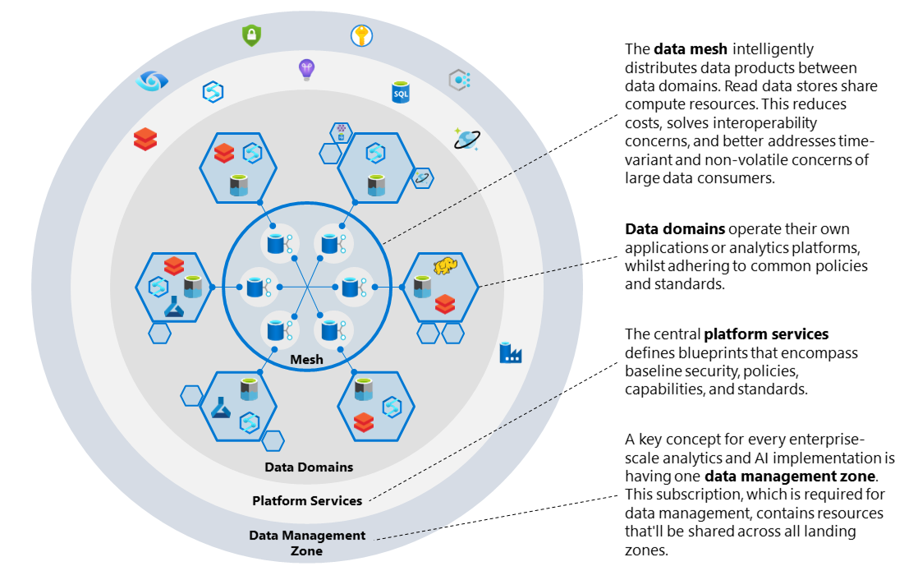
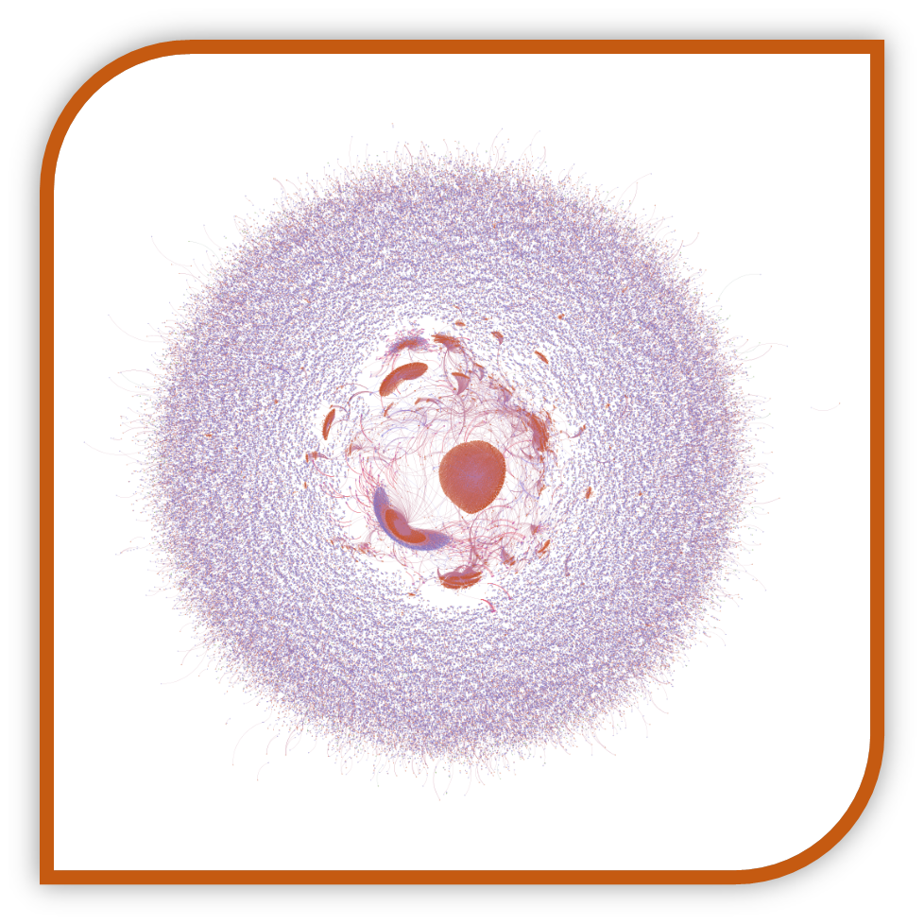
ODIS
https://learn.microsoft.com/en-us/azure/cloud-adoption-framework/scenarios/cloud-scale-analytics/images/data-mesh-plane.png

Slide 4
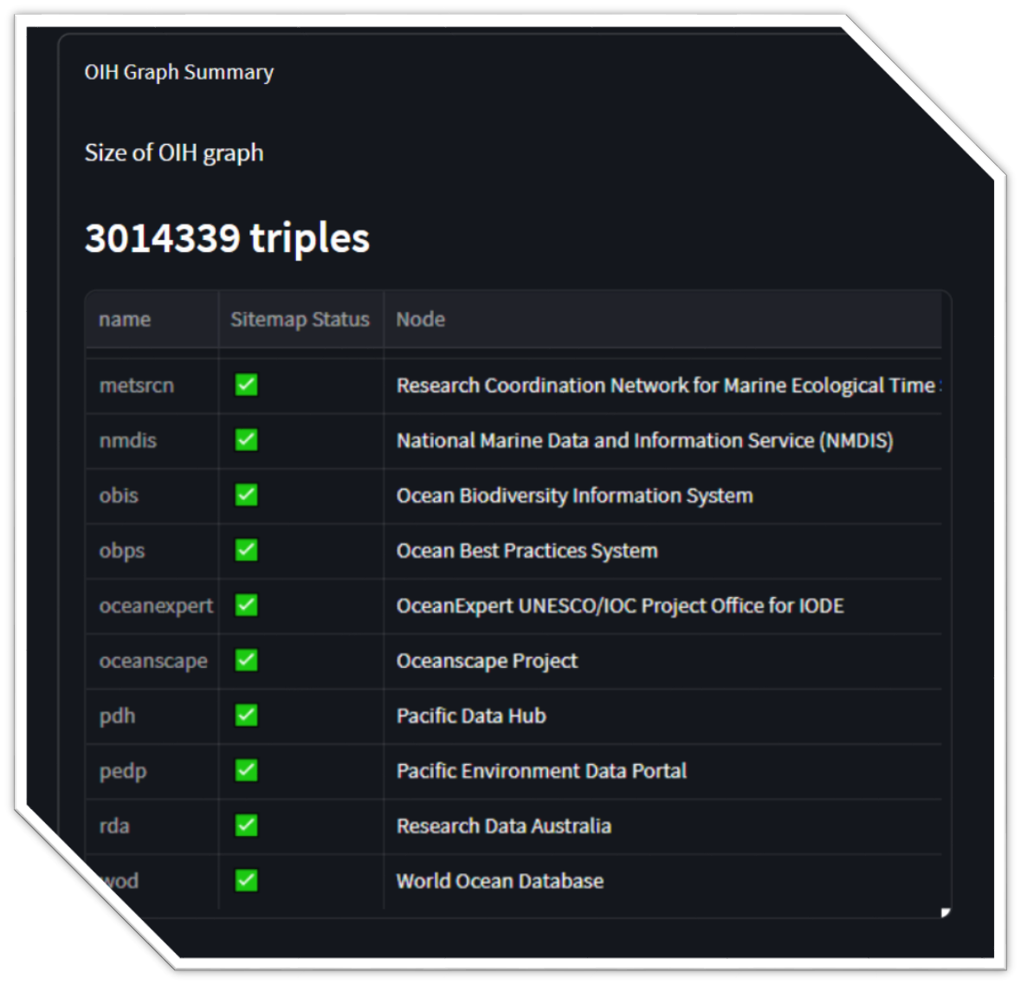
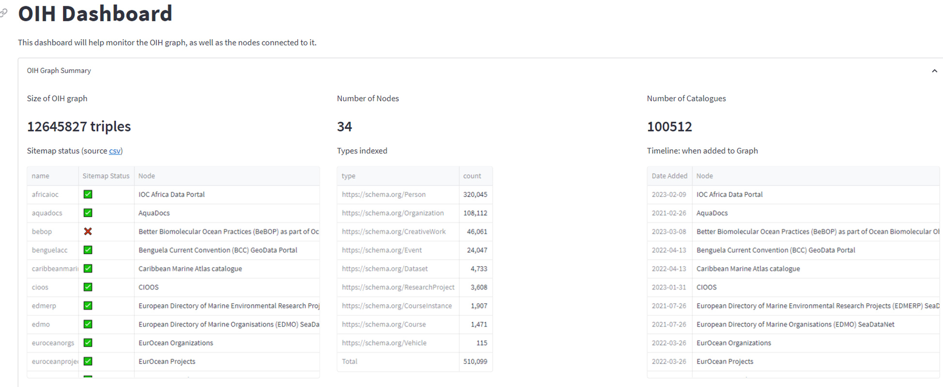
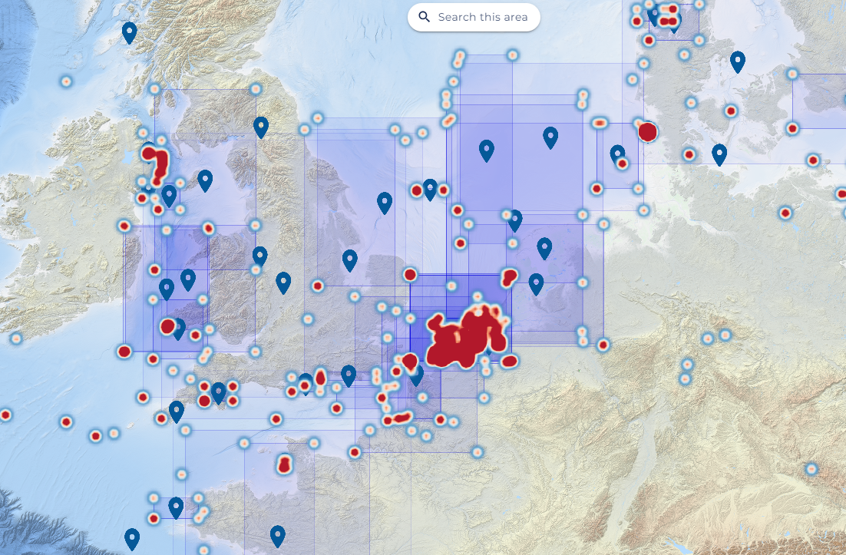
ODIS
Domain-agnostic architecture offering a robust integration point for (meta)data exchange
Mission is to ensure a healthy, transparent, exchange of (meta)data
Nodes are components of ODIS - nodes are single point sources of data, e.g. a NODC, a regional hub, a corporate actor.
Matchmake needs / requirements for data ingest with data product development and deployment

Slide 5
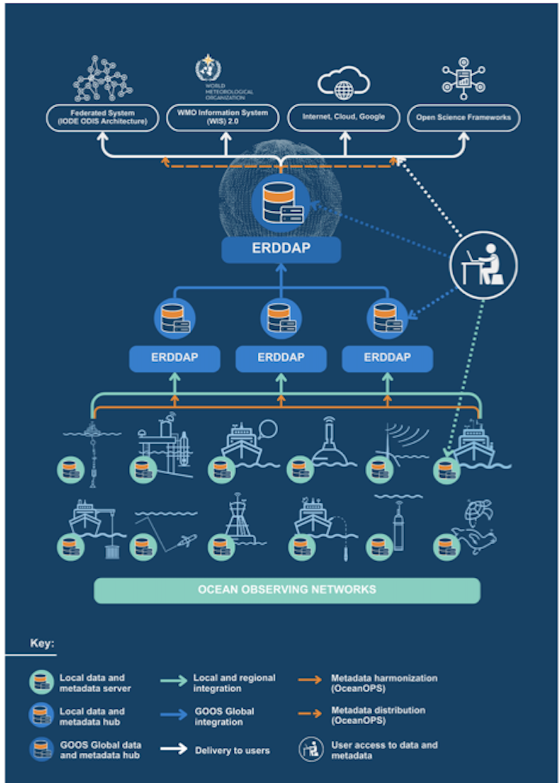
GOOS OCG Cross-Network Data Implementation Strategy
OCG data strategy is aligned with the ODIS architecture
OCG ERDDAP node is an ODIS Hyper Node (a self-organised multiple source node), it is also a potential node to other systems e.g. WIS2.0
OceanOPS placing a subset of its metadata in ERDDAP makes it available to ODIS and to complete metadata
OceanOPS provision of unique identifiers is important required
OceanOPS/OCG network/GDAC work on data and metadata quality is contributing to overall data quality
GRAs can also be ODIS and/or OCG nodes - OCG can track additional data

Slide 6
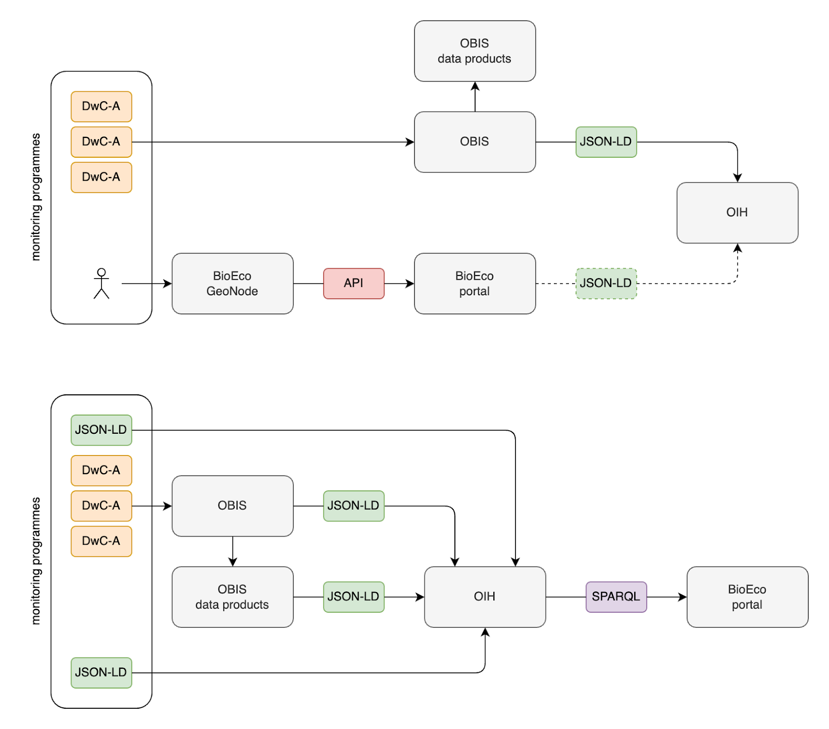
OBIS/BioEco data flow
BioEco data flow is already connected to ODIS, but need to a) recognise GOOS EOV networks b) consider/issue unique identifiers (like for OCG networks) for sustained obs
An ‘OceanOPS’ for the BioEco data flow? Options discussed:
a) extend OceanOPS,
b) create similar capability aligned to OBIS, however a solution may already exist
c) using ODIS Cat (issue IDs for data sources) and Ocean Expert (extended for EOV networks)
Solution c) offers advantages and allows BioEco portal to recognise network s etc…
There could also be the need for GDACs (some forming) for QC of EOVs - do we ended to define a more formal recognition for GDACs
The planned BioEco system

Slide 7
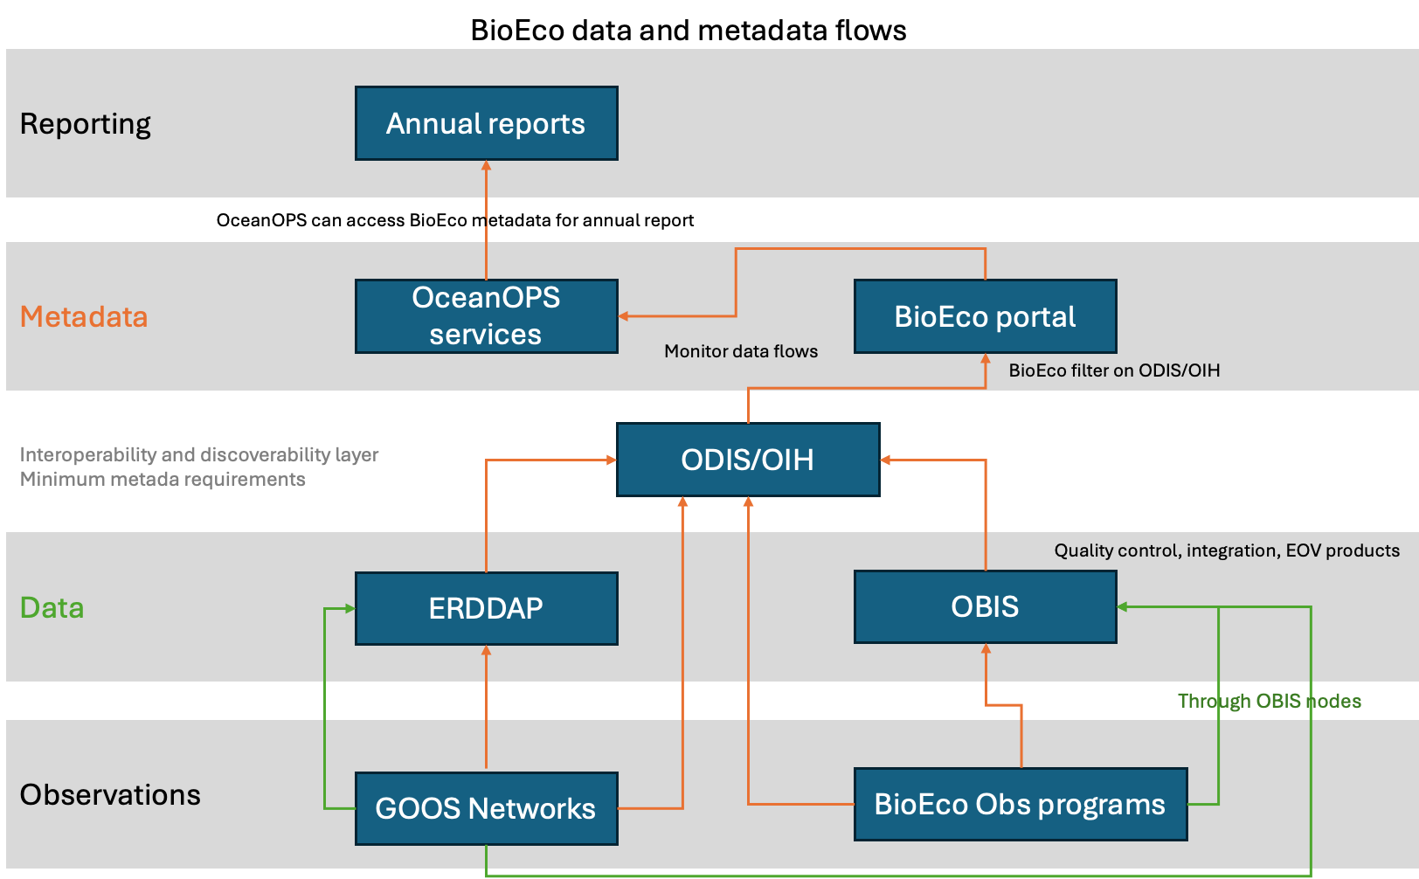
Connection of OBIS to ODIS planned
Currently in discussions of how to deliver information to OceanOPS for reporting
Initiating discussions on data discovery of biological observations from OCG networks
End goal: visibility/accessibility of biological observations across all GOOS components and external programmes
Notes:
Green is data; orange is metadata

Slide 8
BGC Data flow
Issues
Data collected by GOOS networks provided by
National and regional data centers (BSH, BCO-DMO, SeaDataNet)
Specific GDACs (Ifremer, CCHDO)
Data products (WOD, GLODAP, EMODnet)
Data collected outside of GOOS networks with limited impact on global products
Multiple synthesis products developed (terminated; living)
Cross-platform and/or cross-EOV, Specific scientific rationales in mind, Often underfunded (i.e., based upon substantial ‘volunteer work’)
ODIS solves many issues:
OCG ERDAAP and other data sources (WOD, CCHDO…) connect into ODIS, so all data can be combined
BGC Panel can define and promote metadata standard/s. ODIS has an outline (here) and work with OceanOPS/SOCONET will help. A BGC standard can be pushed across community networks, others. This will enable data to be harvested and combined
Value chains (e.g. SOCONET-SOCAT-SOCCOM) can run across the ODIS architecture, enabling harvesting of variables and creation of products without a designated single value chain

Slide 9
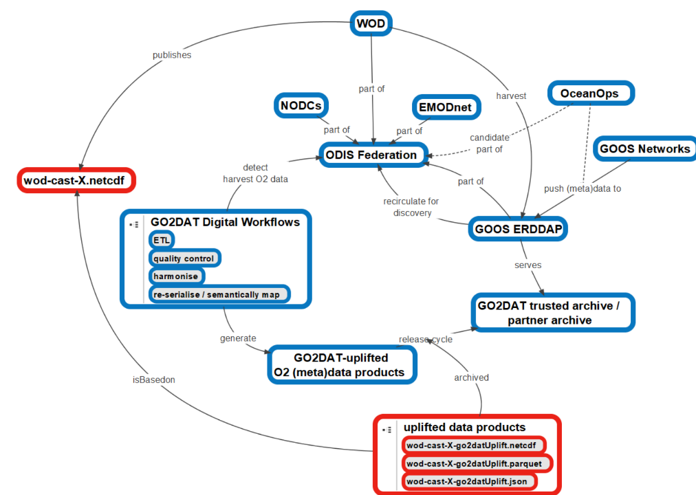
BGC needs
Builds upon existing structures and common structured metadata
Utilizes ODIS-federation for (meta)data harvesting
Establish automated links from NODCs to (partly developed) GDACs
Improve synergies with existing entities (OceanOPS, ODIS, etc.)
Implement “submit once – use many times”
Embrace FAIR principles
Develop consistent metadata across EOV's (and platforms)
Develop tools utilizing templates to enable more automated data flows
Support creation of multiple value chains for products
Establishes feedback loops to original data sources
Notes:
GO2DAT digital workflows is an overarching term for all work that GO2DAT is supposed to do

Slide 10
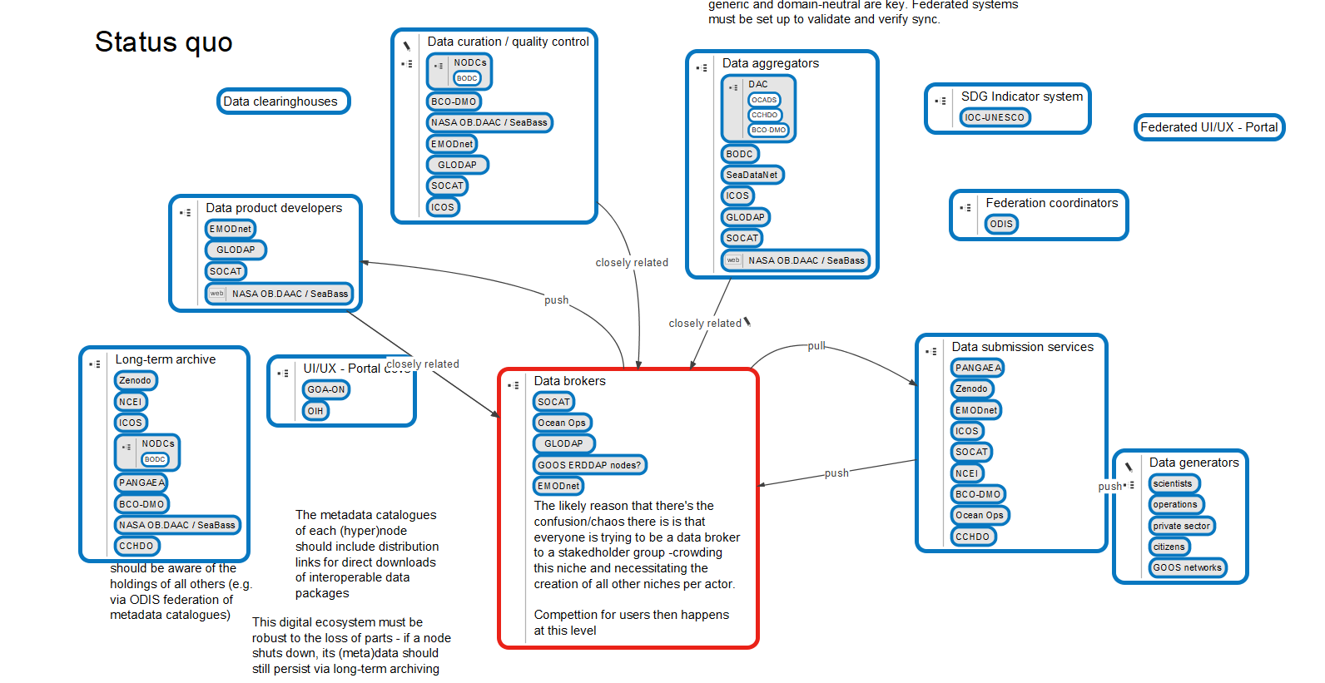
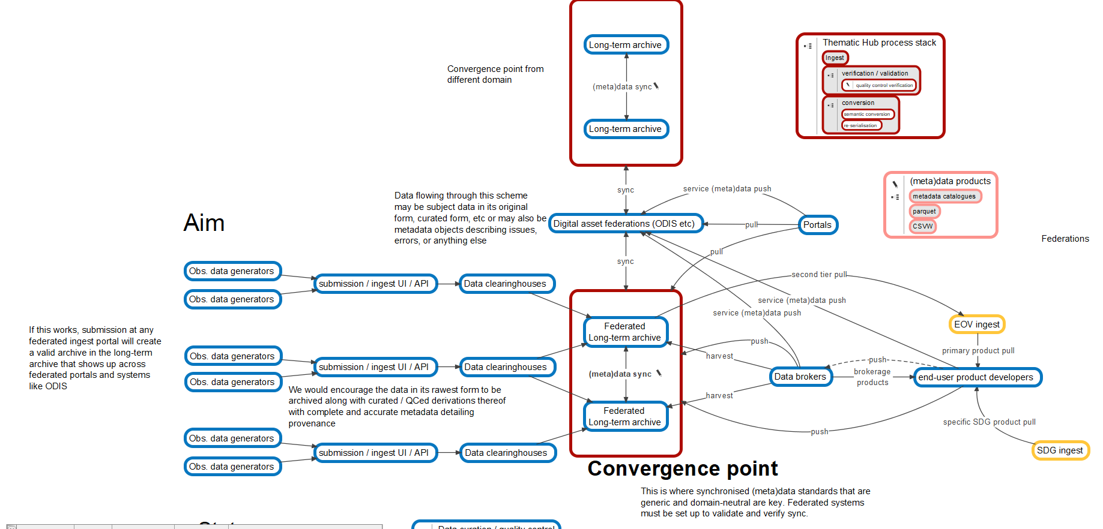

Slide 11
products/services
Annual Reports / tracking services
EOV products
Metadata
OceanOPS
BioEco Portal
WMO OSCAR?
Interoperability and discoverability layer
ODIS
Data access
ERDDAP
OBIS
WOD, others
GRAs
WIS2.0???
Observations
GOOS OCG networks / GDACs
GOOS BioEco EOV programs
Data held
Metadata held
Notes:
Green is data; orange is metadata

Slide 12
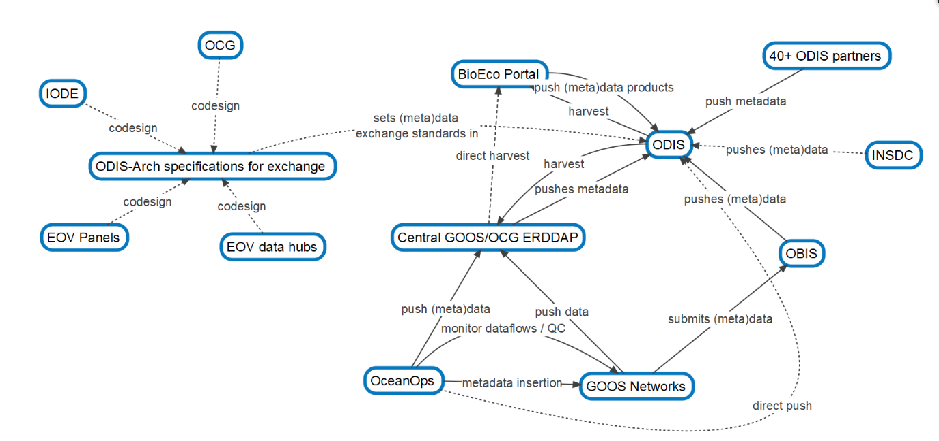
Different visualisation of digital infrastructure across GOOS-IODE (BioEco - OCG - BGC)
von Schuckmann et al., 2020

Slide 13
Advantages/issues solved
BioEco: identify GOOS EOV networks (using OBIS and Ocean Expert)
BioEco: develop BioEco unique identifiers
BioEco Portal: track BioEco networks
OBIS/BioEco Panel/BGC: set minimum metadata standards (with the community/OceanOPS/OCG) push standards and track metadata complete
BGC: use OBIS to assemble products across repositories and sources - OCG networks, WOD, etc. - with metadata standards and attributions
OceanOPS: can leverage ODIS to create advanced services, complete EOV views cross GOOS, completeness of metadata, other sources
OceanOPS/OCG ERDAAP/networks: self organised hyper node - vital quality control, unique identifiers and metadata continue and recognised
GDACS: create certification/standards, expand for BGC and BioEco - role recognised
>> are there other issues not included?
>> pilot functionality with specific data flows - BioEco/BGC/OCG - including OCG networks linking in BioEco data (AniBOS/BioEcoGO-SHIP). Oxygen data! Test services function across the architecture?
>>what is needed to effectively run this collaborative structure - resource/management?

Slide 14
For IODE and GOOS
Serves to connect the GOOS system, with networks (GDACs?), EOVs, metadata standards., and known services, GOOS can efficiently feed into AND run across this virtual architecture…
IODE enriches its data landscapes considerably, ODIS Cat has new key data
IODE and GOOS/OCG to work together to integrate GRAs and NODCs

