Slide 1


The Ocean Data and Information system (ODIS)
Session 4: Mapping the current situation
Lucy Scott
L.Scott@unesco.org
Pier Luigi Buttigieg
pier.buttigieg@awi.de
IOC IODE/GOOS Data Workshop
30 September - 02 October 2024, VLIZ, Oostende

Slide 2

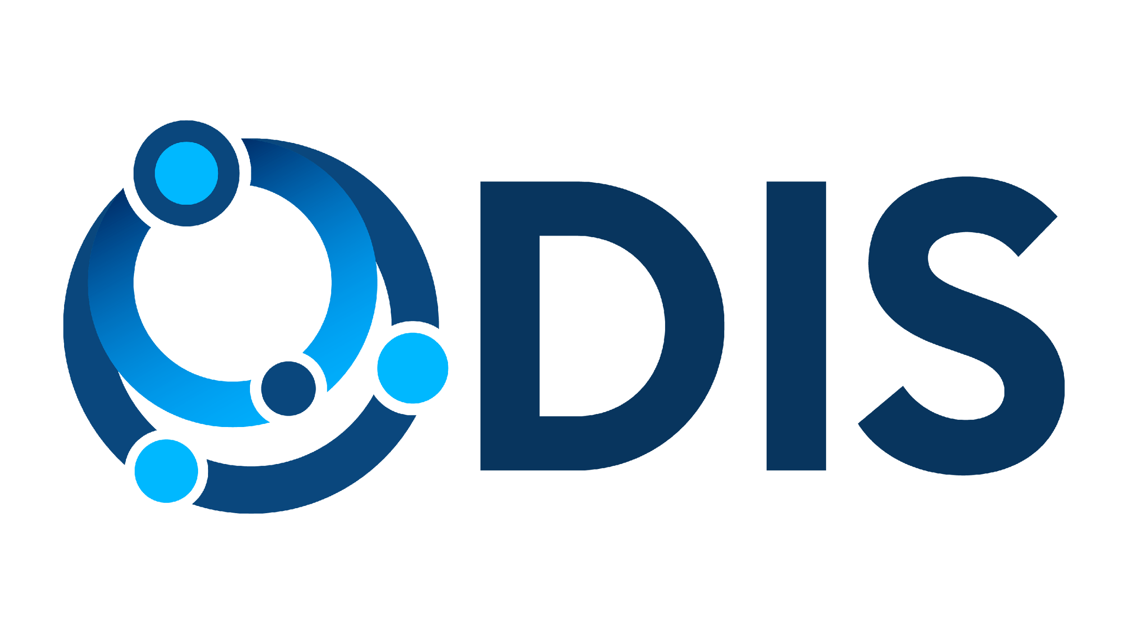

The Ocean Data & Information System (ODIS)
ODIS is a federation of independent systems that uses common conventions to share and exchange their (meta)data over the Web.
ODIS is a global initiative supported by the IOC/UNESCO to:
Improve access to marine and coastal data and information
Provide an openly accessible online platform to network stakeholders and facilitate the exchange of Ocean data and knowledge
Ocean InfoHub
ODIS
April 2020
ODIS architecture applied in 3 pilot regions
July 2024
ODIS architecture applied globally

Slide 3
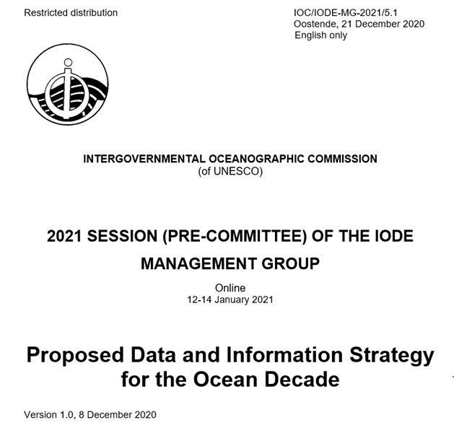
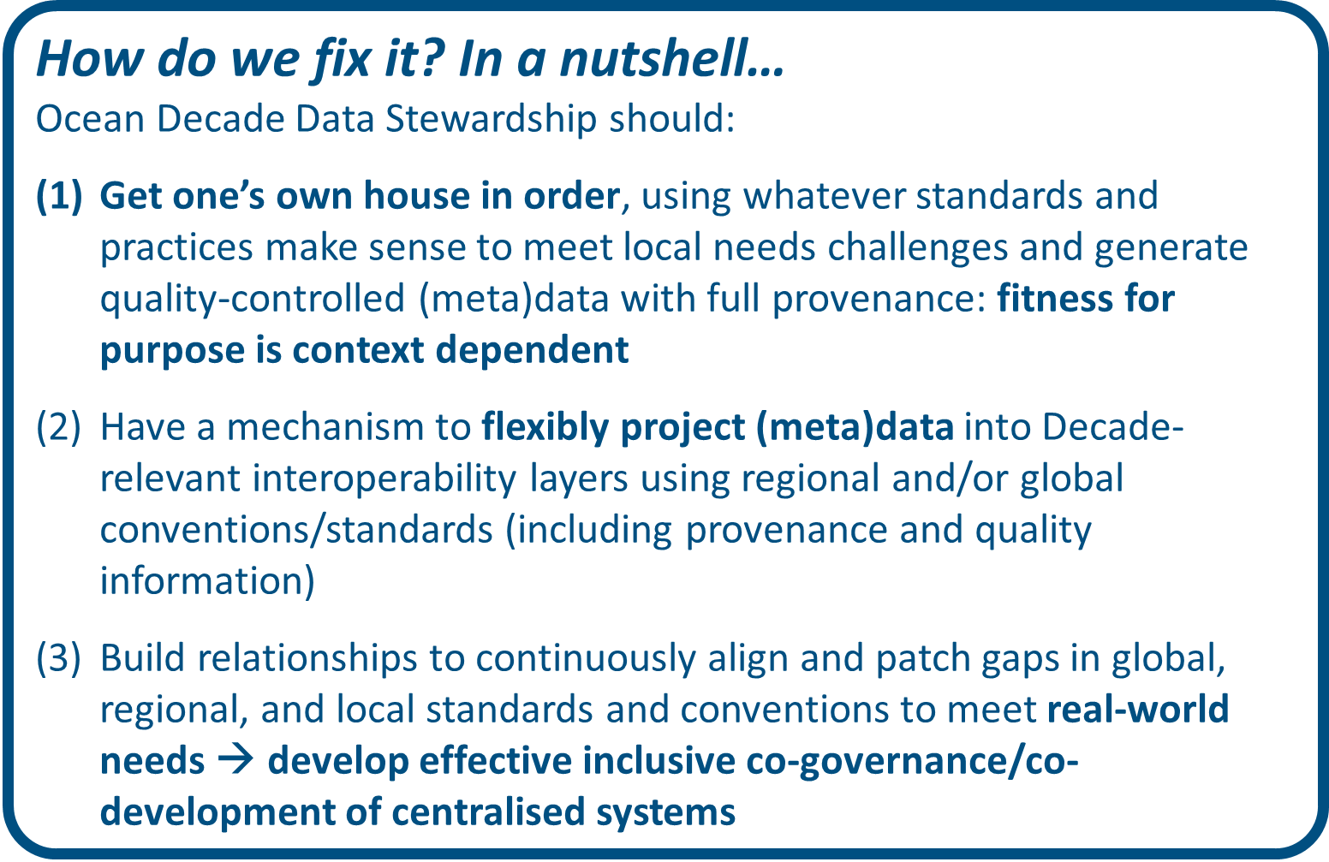

Slide 4
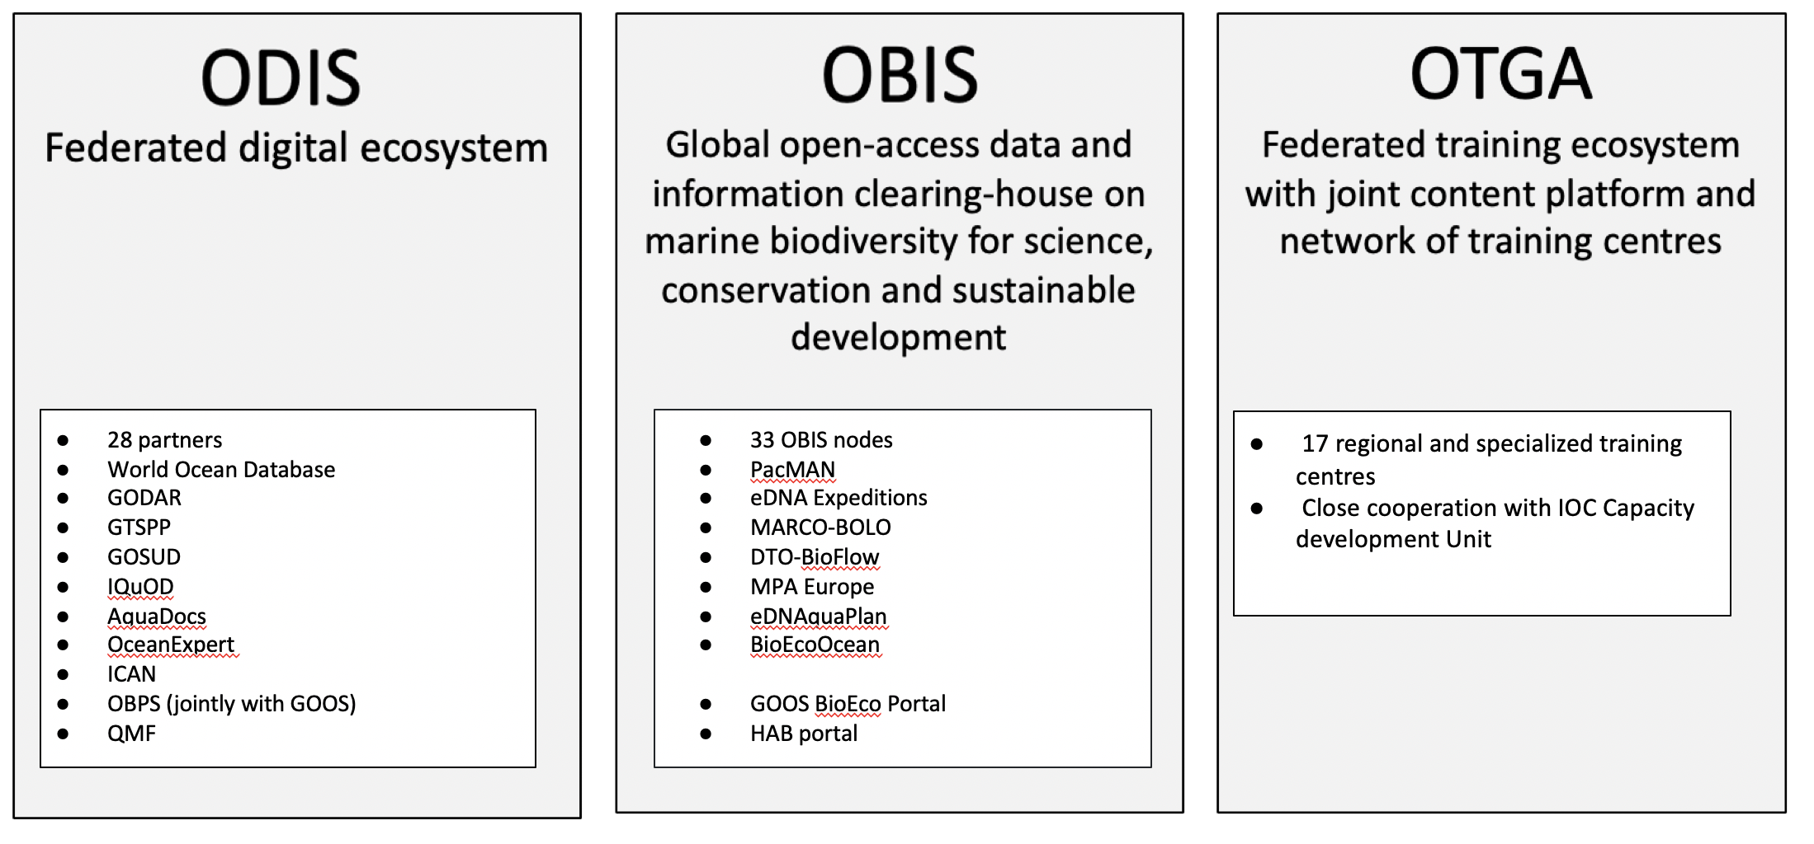
IODE Operational Structure
42 Partners

Slide 5
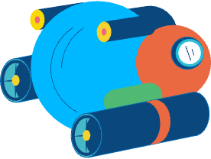
ODIS objectives
Harness the proliferation and diversity of Ocean data, online data systems and other digital resources;
Connect global and local digital systems and infrastructures using Web architecture;
Support IOC member states and institutions;
Raise awareness of global data and information resources among local users;
Overcome challenges of trust through socio-technical innovation in some regions and communities.

Slide 6
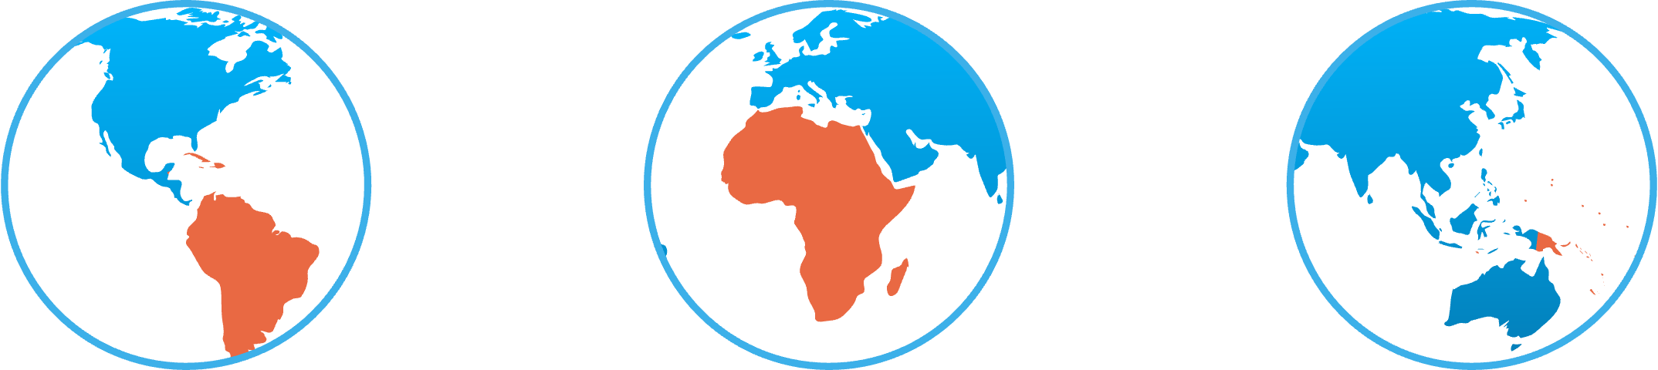
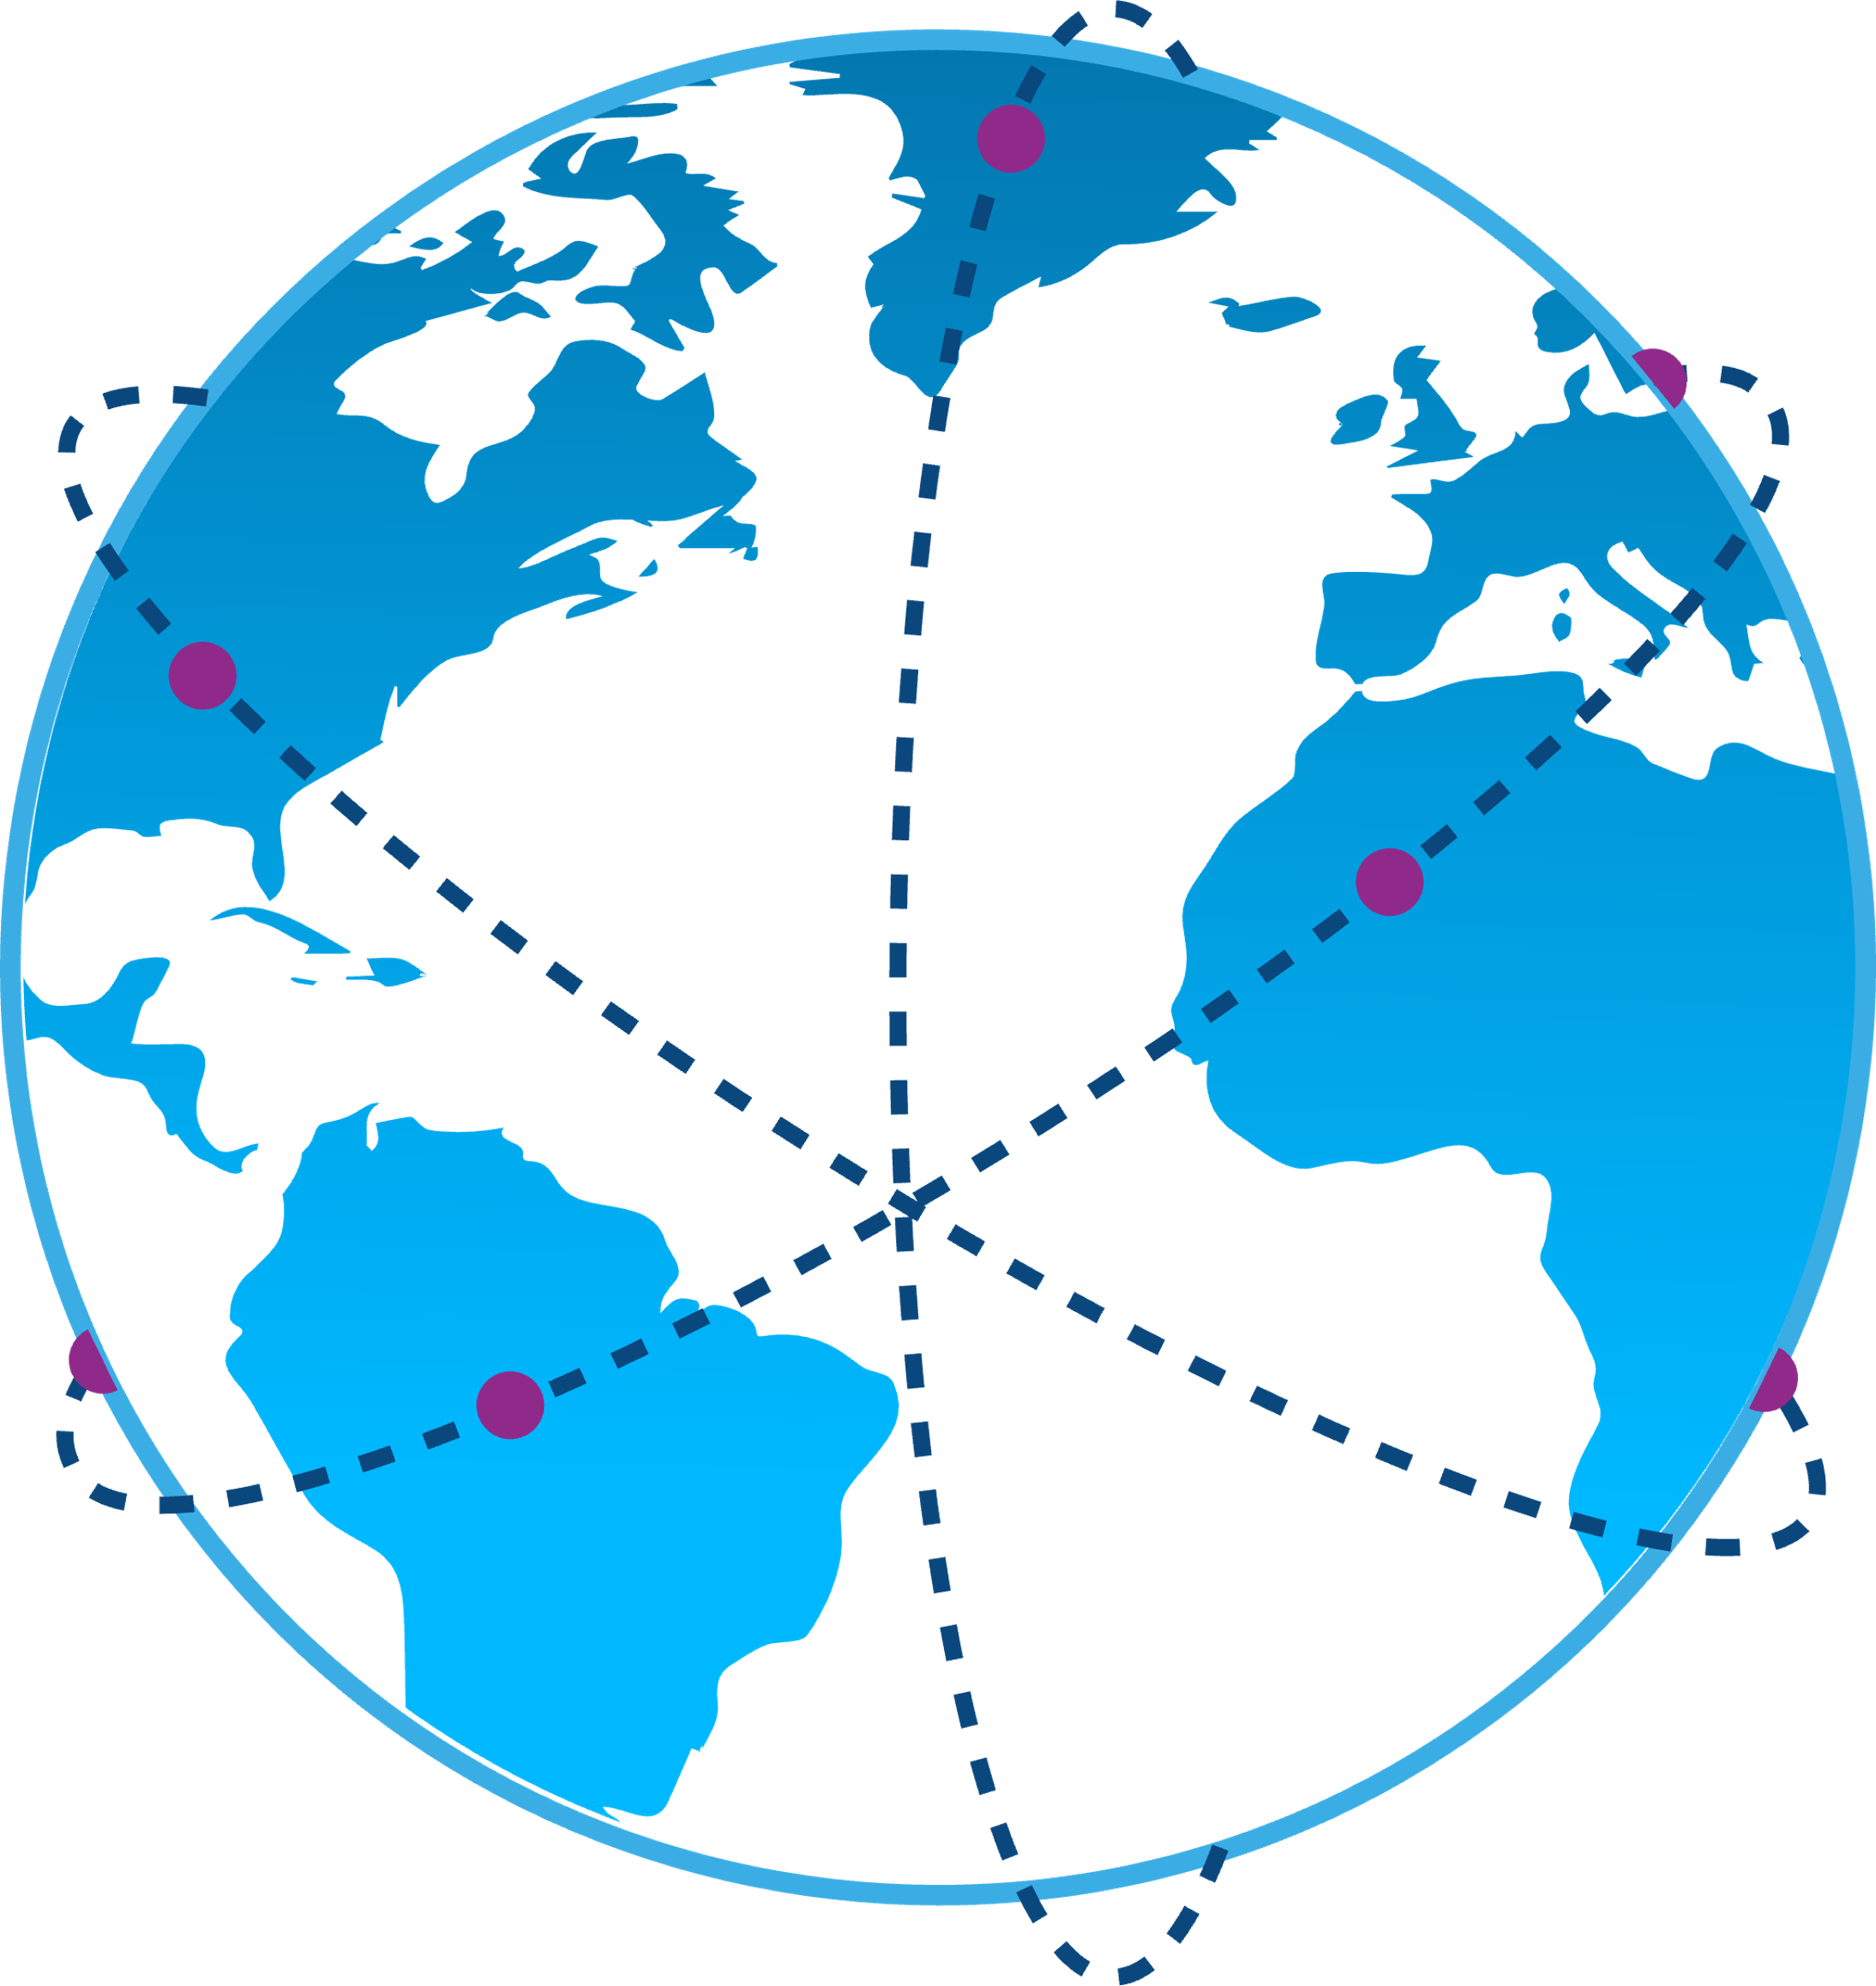
Three pilot regions to a global network
The Ocean Data & Information System (ODIS) is now a global infrastructure that can help any organisation or individual to share their ocean (meta) data with the Web, as well as to access a growing ecosystem of Ocean data.
Latin America and the Caribbean
Africa
Pacific Small Island Developing States

Slide 7
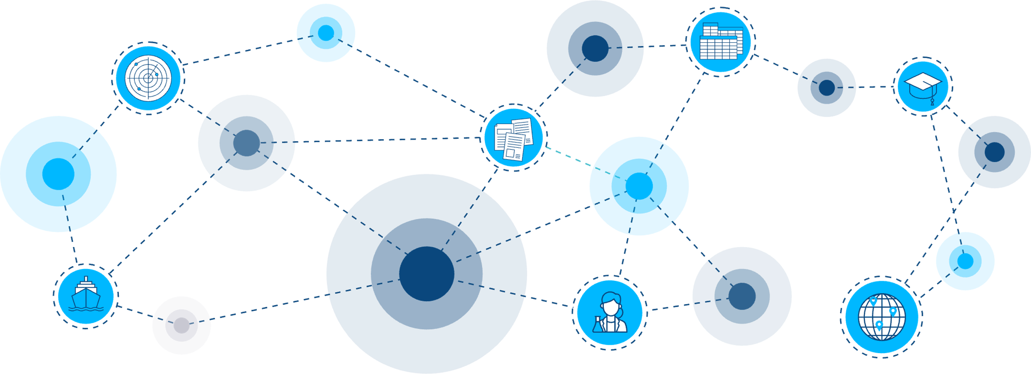
Partner network
Composed of ODIS Nodes, through which data providers and partners can communicate, discover and share data, and connect;
With high scalability: gains richness and efficiency with growing number of nodes.
Currently links 50 data sources from 42 partner organisations
National Marine Data and Information Service (NMDIS)
Ocean Biodiversity Information System (OBIS)
Ocean Best Practices System (OBPS)
OceanExpert UNESCO/IOC Project Office for IODE
Oceanscape Project
ODIS Catalogue (ODISCat)
Aquatic Sciences and Fisheries Abstracts (OpenASFA)
Observing System Monitoring Center (OSMC)
Pacific Data Hub (PDH)
Pacific Environment Data Portal (PEDP)
Rolling Deck to Repository (R2R)
Research Data Australia (RDA)
UNEP Data Catalogue
WIO (Western Indian Ocean) Symphony
World Ocean Database (WOD)
Leibniz Center for Tropical Marine Research (ZMT)
Latin America and the Caribbean Region (LAC) Geospatial
Latin America and the Caribbean Region (LAC) Institutions
Latin America and the Caribbean Region (LAC) Training
Latin America and the Caribbean Region (LAC) Vessels
MARine COastal BiOdiversity Long-term Observations (MARCO-BOLO)
Marine Institute Data Catalogue (Ireland)
Marine Training EU
Marine Spatial Atlas for the Western Indian Ocean (MASPAWIO)
Marine Environmental Data and Information Network (MEDIN)
Research Coordination Network for Marine Ecological Time Series (METS-RCN)
Marine Information Management System (MIMS)
NCEI Marine Microplastics Catalogue
Canadian Integrated Ocean Observing System (CIOOS)
European Directory of Marine Environmental Research Projects (EDMERP) SeaDataNet
European Directory of Marine Organisations (EDMO) SeaDataNet
European Marine Observation and Data Network (EMODnet)
EurOcean Organizations
EurOcean Projects
EurOcean Vessels
Global Biodiversity Information Facility (GBIF)
Indian National Centre for Ocean Information Services (INCOIS)
Latin America and the Caribbean Region (LAC) Documents
Latin America and the Caribbean Region (LAC) Experts
African Coastal and Marine Atlas catalogue (ACMA)
IOC Africa Data Portal
AquaDocs
Argovis ARGO Collection
Better Biomolecular Ocean Practices (BeBOP) as part of Ocean Biomolecular Observing Network (OBON)
Benguela Current Convention (BCC) GeoData Portal
Belgian Marine Data Centre (BMDC)
British Oceanographic Data Centre (BODC)
Caribbean Marine Atlas catalogue
CLIVAR and Carbon Hydrographic Data Office (CCHDO)
Canary Current Large Marine Ecosystem (CCLME)

Slide 8
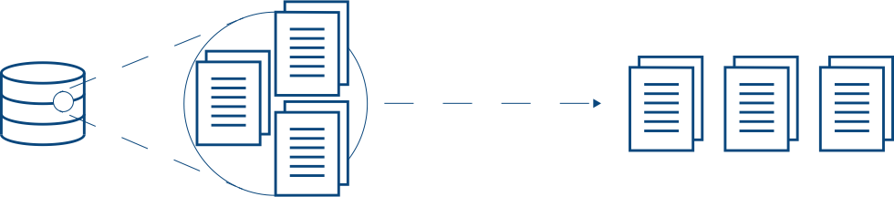
Data
source
Data labelled according
to different patterns
Experts and institutions/organizations
Documents
Training opportunities
Spatial data and maps
Projects
Research vessels
Indexed through
ODIS-Arch
specifications
Partners do not change internal workflows or existing (meta)data systems: A common Web interface through JSON-LD/schema.org and LOD paradigms is the key to common FAIR implementation
Specifications are lightweight, easy to implement, and resilient to gain/loss of parts. Partners aligned to ODIS are also discoverable by Google Dataset search and others.
Partners retain their own data and complete control over what they share through their node or nodes. Essential for CARE compliance and interfaces with sensitive data in corporate or other realms.
All documentation is online, free and open https://book.oceaninfohub.org/index.html

Slide 9
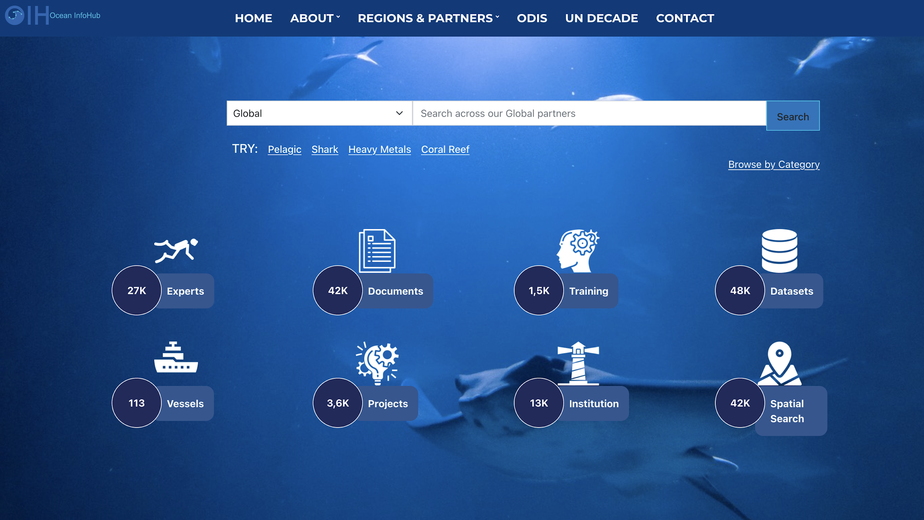
Global Search Portal
A Global Search portal has been developed as a demonstration of ODIS (https://oceaninfohub.org). The portal currently contains over 130,000 content items in seven content categories: (i) Experts (27,000); (ii) Institutions (13,000; (iii) Documents (42,000); (iv) Training (1,500); (v) Vessels (113); (vi) Projects (3,600); and (vii) Datasets (48,000).

Slide 10
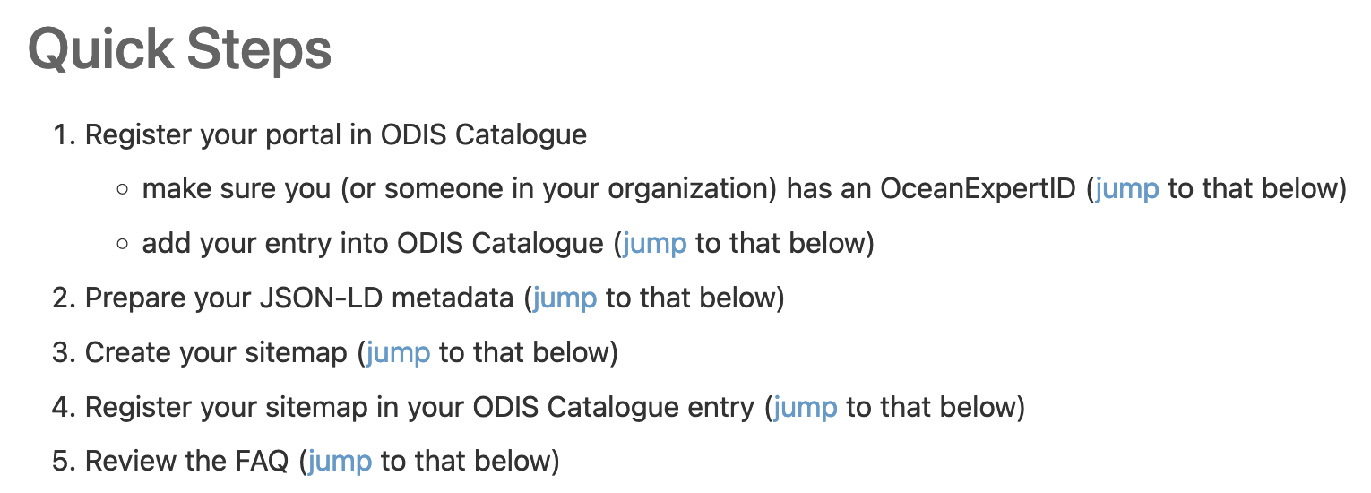
Linking to ODIS: Getting started
https://book.odis.org/gettingStarted.html

Slide 11
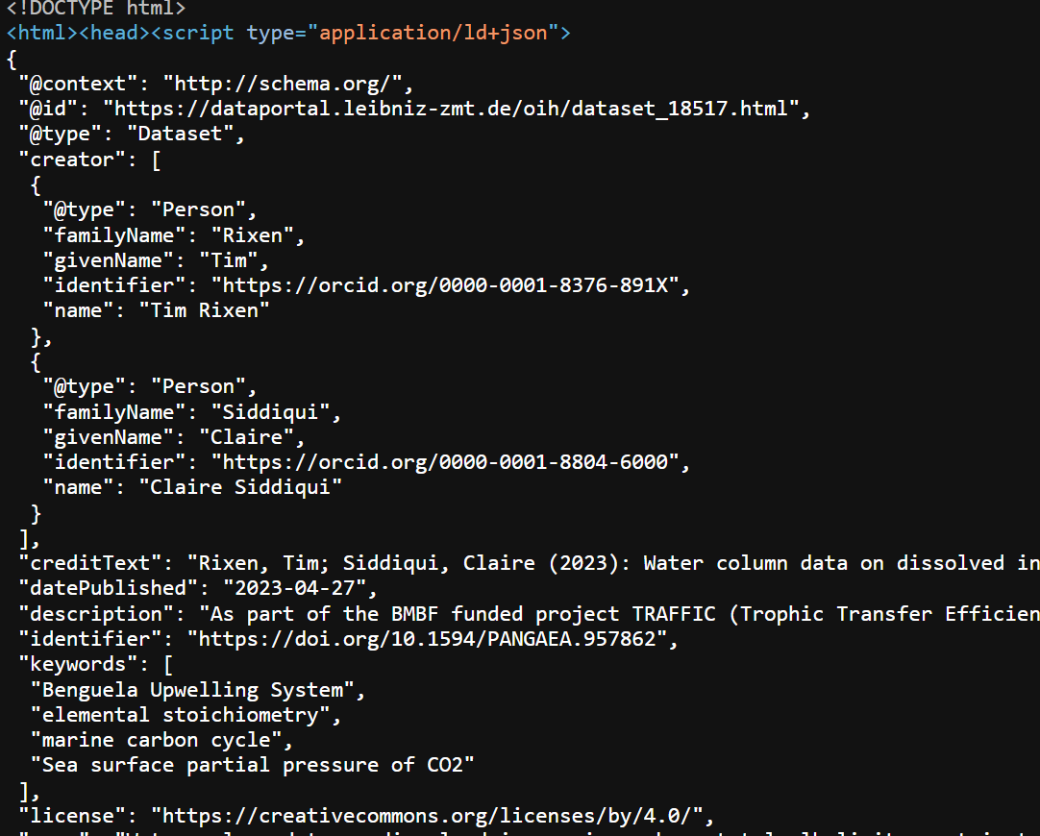

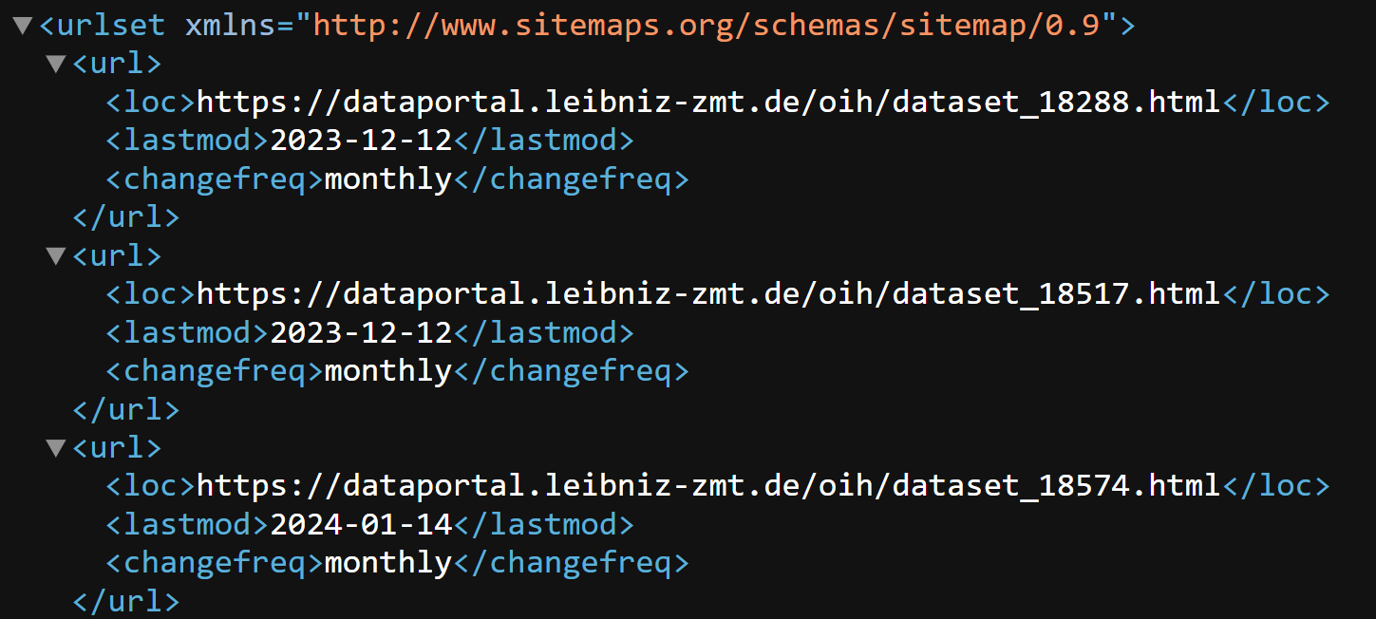
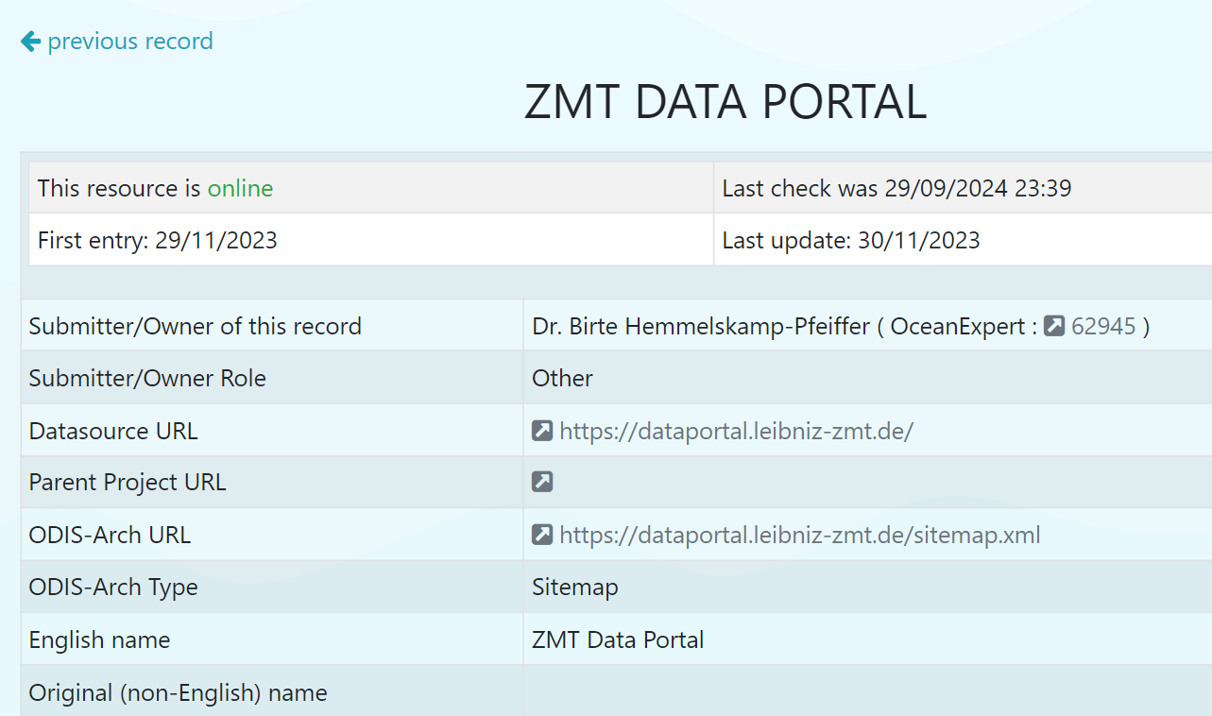
Map of data flow (Simplified)

Slide 12
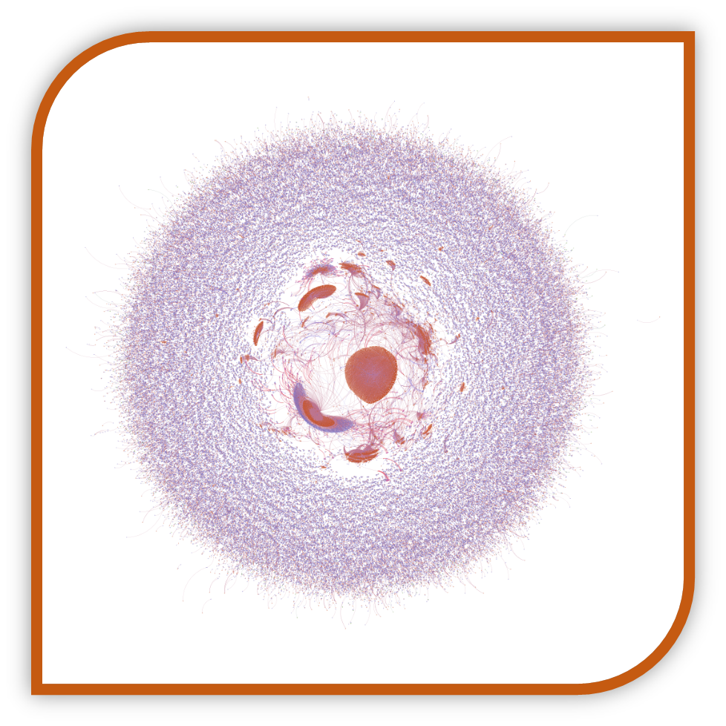
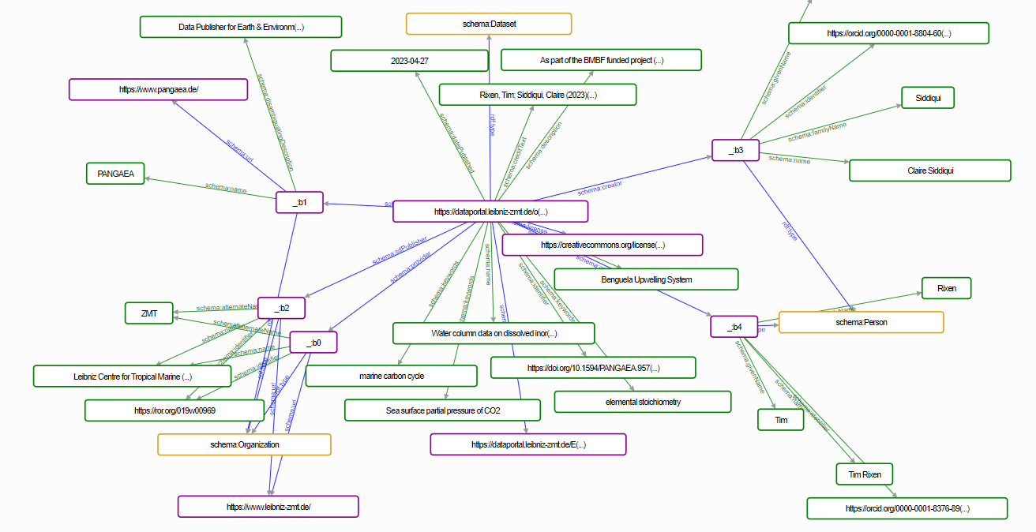

Slide 13
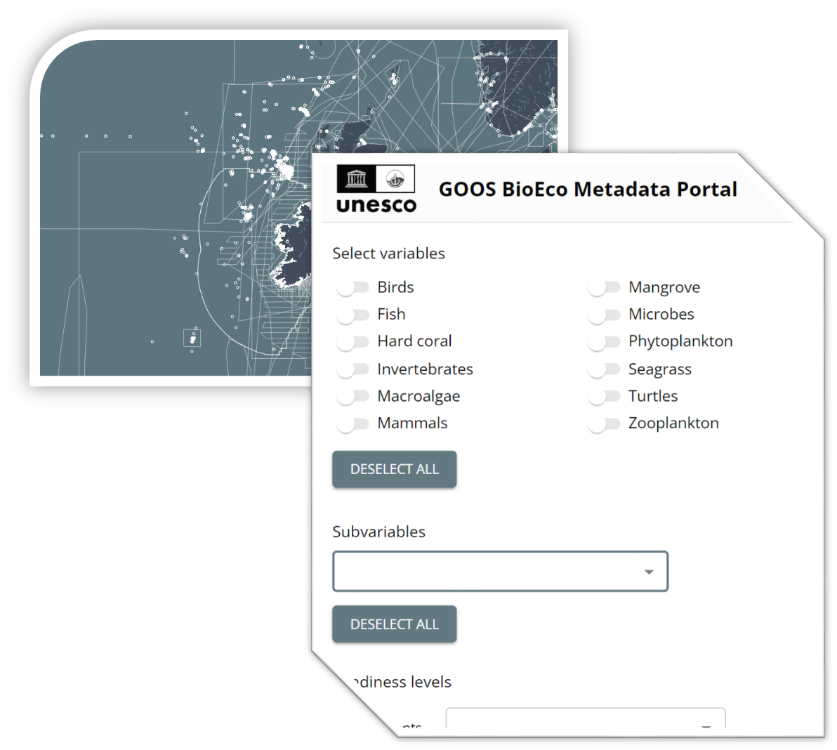


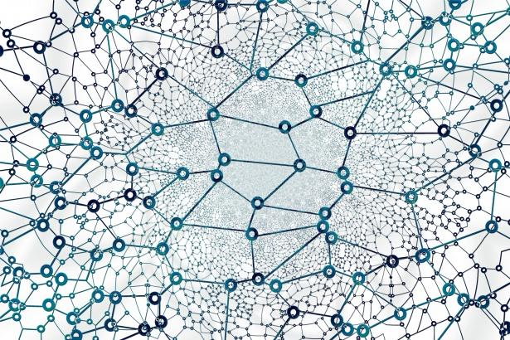
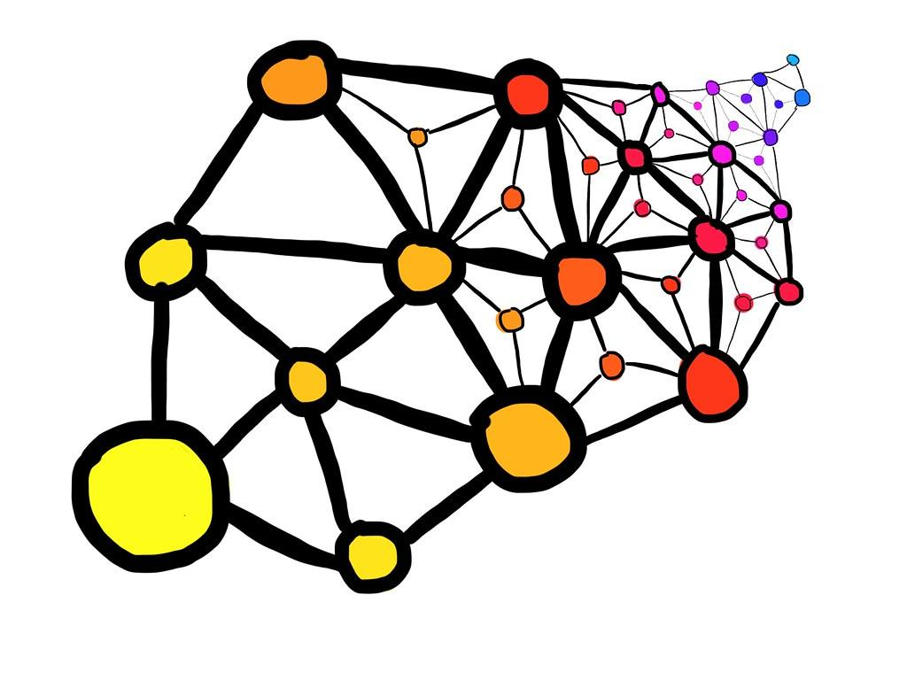

Interconnections - GOOS-IODE
WIMS 2.0
BioEco Portal
hypernode
Network switch mode
WESR

Slide 14
Who are the key users/how ensure data reaches them
Clean up the ocean internet
Everyone

Slide 15
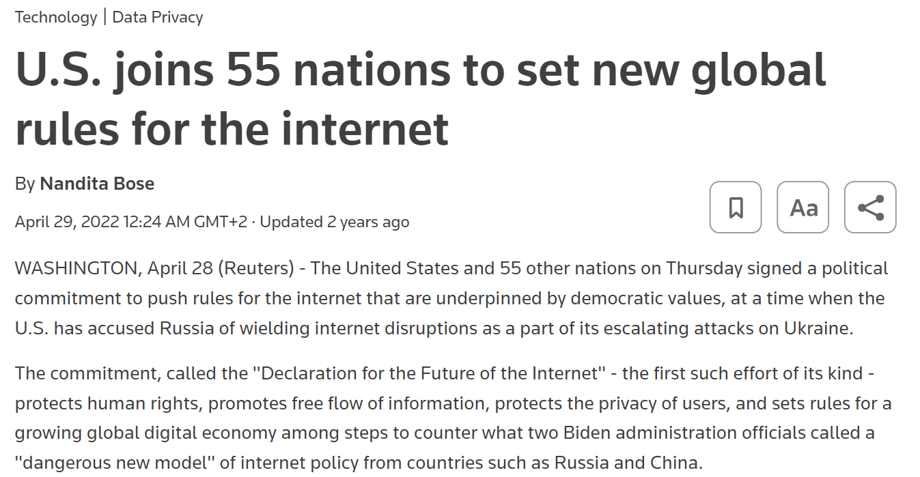
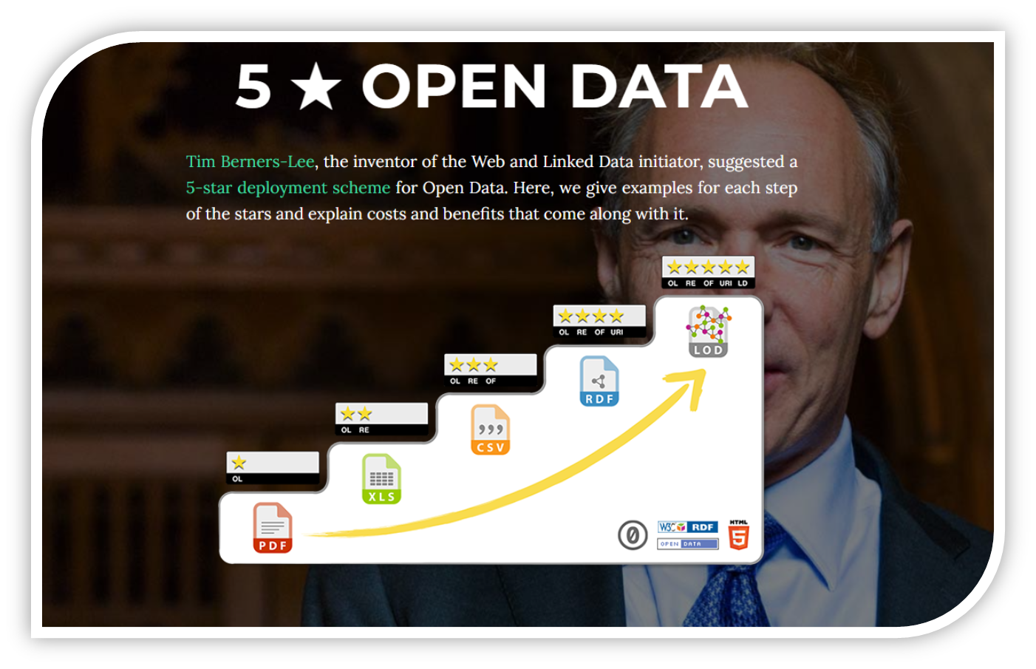
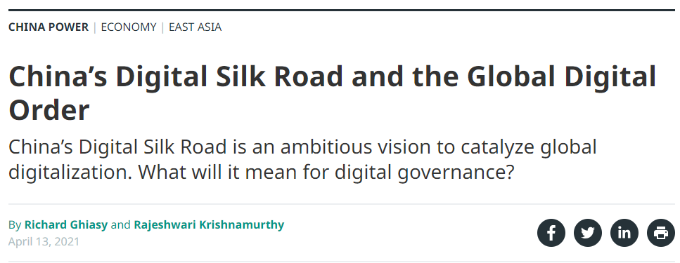
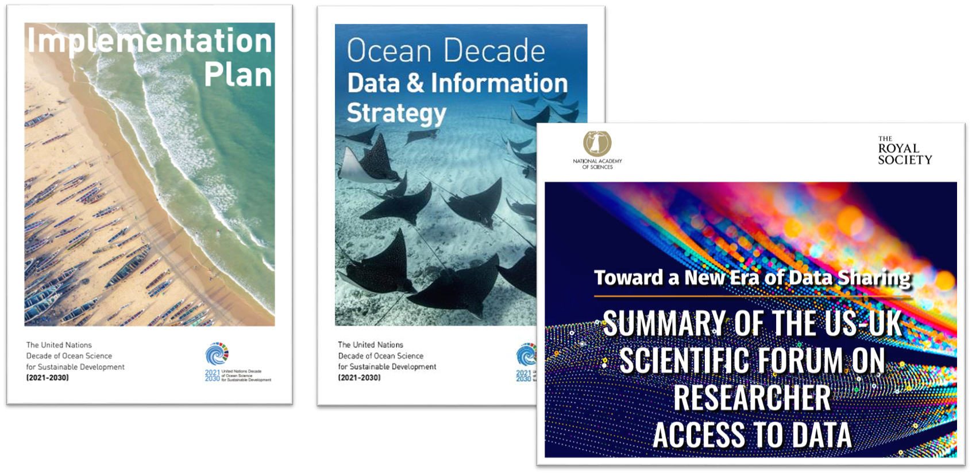

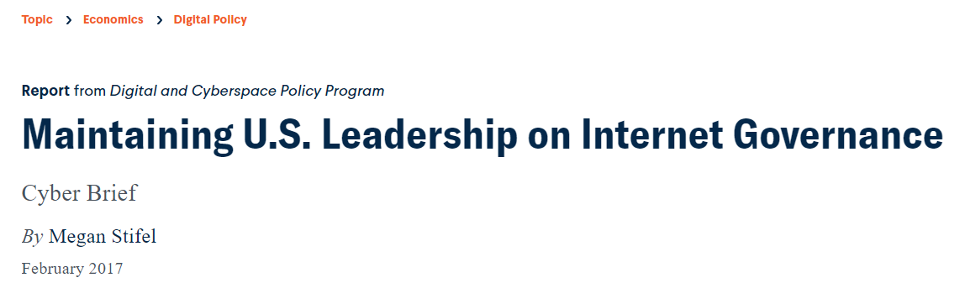
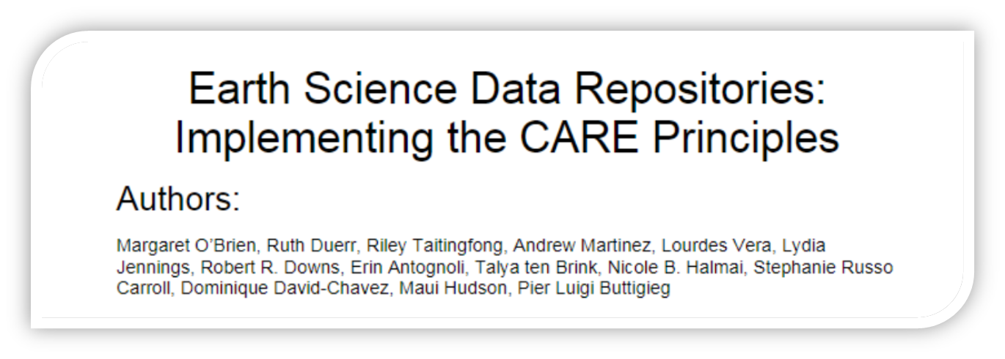
What would be your vision for an integrated digital ecosystem

Slide 16
What would be your vision for an integrated digital ecosystem
A splinternet with negotiated data spaces
An IOC-coordinated linked data mesh for the global ocean data space

Slide 17
What are the opportunities and the issues in creating an integrated digital ecosystem
Us, in this room, with ODIS v1.0
IOC’s poor capacity to dance with cyber-Balkanisation - focus mismatched with real needs

