Slide 1
WMO WIS2
Tom Kralidis
Senior Geospatial Architect
Meteorological Service of Canada
tom.kralidis@ec.gc.ca
@tomkralidis
Chair, WMO Expert Team on Metadata Standards
Architect, WIS2 Architecture and Implementation
Technical Lead, WIS2 in a box
2024-09-30

Slide 2
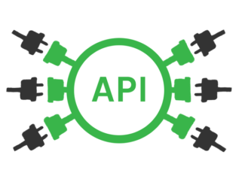
Evolution of WMO data exchange
1963 World Weather Watch
1970s Global Telecommunication System (GTS)
2007 WMO Information System (WIS)
2019 WMO Reform (Earth System Approach)
2021 WMO Unified Data Policy (Core, Recommended)
WIS 2.0
… collaborative system of systems using Web-architecture and open standards to provide simple, timely and seamless sharing of trusted data and information …
Open Standards (OGC, W3C, IETF, …)
Free and Open Source tooling
Data sharing through Web and real-time notifications with publication/subscription (Pub/Sub) protocols
Cloud ready (turn-key solutions)
Web APIs (Application Programming Interface)
Notes:
The exchange of weather, hydrological and climate data has continued to this day, now under the WMO, the successor to the IMO within the UN system.
Formation of world weather watch following start of satellite era and truly global coverage of weather and meteorological conditions.
Development of the WMO Global Telecommunication System in the 1970s
Evolution to the WMO Information System in the 2000s in an attempt to modernize the exchange of data. Due to the success of the GTS this was only partly successful with the GTS remaining as the main method for exchanging operational data.
However, the GTS is now struggling under the volume and variety of data to be exchanged.
In order to meet the future needs the WMO Information System is now undergoing another evolution, leveraging open standards, developments with cloud computing and cloud based infrastructure, OTS tools and open source software.
As part of this development and evolution reference implementations of the different components are being developed alongside the WIS 2.0 specifications.
----
WMO Strategic Plan (2020-2023): “Technological advances and the increasing demand for more and more diverse services from increasingly sophisticated and capable users changes rapidly the service delivery and business models in many parts of the world.”
Cg-17: “Most Members are ill-prepared for the explosion in data volumes and the growing diversity of new data sources.”
CBS led review of emerging data issues: “Cloud computing, Web services, data analytics, machine learning and other technologies present new operating concepts that will improve operational efficiency, information sharing and service delivery, and enable users to more effectively exploit data.”

Slide 3
WIS Architecture
Discovers data from
Subscribes to
Global Services
Receives notifications of new data from
Downloads data from
Downloads data from
Receives notifications of new data
Subscribes to
WIS2 node

Slide 4
WIS2 Nodes
WIS2 Components: WIS2 Nodes
Data users
Each WMO Member shall implement at least one WIS2 Node to share data in WIS2
Publishes real-time notifications about data
A WIS2 Node replaces the GTS Message Switching System
Publishes Core and Recommended data
Advertises what data is available (discovery metadata)
Data and metadata are shared using a WIS2 Node
A WIS2 Node shares data via an HTTPS service and sends notifications to MQTT subscribers
WIS2 Node
WIS2 Node
WIS2 Node

Slide 5
Global Services
WIS2 Components: Global Services
Data users
Global Monitoring
Discovers datasets
Subscribes to topics
Downloads core data
Global Discovery Catalogue
Global Broker
Global Cache
Downloads recommended data
Downloads recommended data
Downloads recommended data
Provides an API to discover datasets and services
Sends notifications of new data to be downloaded from Global Caches or WIS2 nodes
Provides users HTTP download of core data cached from WIS2 nodes
WIS2 node
WIS2 node
WIS2 node
Scale to highly-available, global data sharing

Slide 6
WIS2 Components and Standards
Component | Protocol/Interface/API | Content/Encoding(s)
Global Discovery Catalogue | HTTP/S OpenAPI OGC API – Records | WCMP2 / OGC - API Records Topic Hierarchy Notification message (GeoJSON)
Message Replay API | OGC API – Features | Notification message (GeoJSON)
Global Broker | MQTT/S | Notification message (GeoJSON)
Global Cache | HTTP/S | Programme specific: GRIB2 BUFR4 WaterML2 CF/NetCDF GeoJSON
WIS2 Node | HTTP/S MQTT/S (OpenAPI) (OGC API) | WCMP2 / OGC - API Records Topic hierarchy Notification message (GeoJSON)
Global Monitoring | HTTP/S | OpenMetrics

Slide 7
WIS2 progress: Pilot Phase complete
Pilot Phase
Pre-operational
2030
2033
Operational
Pre-oper Global Brokers
2025
Pilot Global Brokers
Global Brokers operation
90% of Members migrated to WIS 2.0
Stop transition infrastructure and GTS transmission
Pilot Global Discovery Catalogue
Pre-oper Global Caches
Global Caches operation
Pilot Global Caches
2023
2022
2024
Technical Regulations
Pre-oper Global Discovery Catalogue
Global Discovery Catalogue operation
WIS 2.0
Guidelines
NCs
DCPCs
Q1
Q2
Q3
Q1
Q2
Q3
Q1
Q2
Q3
WIS2 box release 1.0
Transition Infrastructure
WIS2 Monitoring
NCs & DCPCs
NCs & DCPCs
Workshops and training
INFCOM-2
EC 75
Cg-19
EC-76
EC 77
WIS 2.0 Tech- Reg approved
Guidelines for WIS 2.0
implementation published
INFCOM-3
EC 78
technical guidance in the Guide to WIS
Report on WIS2 progress
NCs/DCPCs may stop WIS1 functions if migrated to WIS2
GISCs contributing to Global Services may stop WIS1

Slide 8
WIS2 Global Service instances
Brazil
France
China
USA
Global Discovery Catalogue
Canada
China
Korea
Global Broker
China
Germany
Japan
Korea
USA/UK
Global Cache
Global Monitoring
China
Morocco

Slide 9
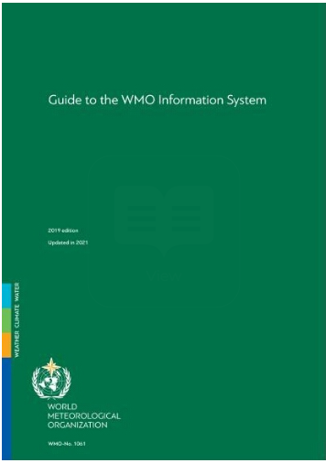
WIS2 regulatory material
June 2023 Cg-19
Manual on
WIS
April 2024 INFCOM-3
Guide to
WIS
Volume I
WIS 1.0
Volume I
WIS 1.0
Transition from WIS/GTS
to WIS2
Manual on
WIS
Guide to
WIS
1
2
3
4
5
6
Manual on
WIS
Guide to
WIS
Volume II
WIS 2.0
doc 8.3(2) TRANSITION FROM WIS 1.0 AND GTS TO WIS 2.0, INCLUDING CAPACITY DEVELOPMENT
Volume II
WIS 2.0
Manual on WIS Volume II WMO Information System 2.0
All documents have been endorsed by INFCOM 3 (April 2024)
doc 8.3(1) AMENDMENTS TO THE MANUAL ON THE WMO INFORMATION SYSTEM
doc 8.3(3) UPDATE OF THE GUIDE TO THE WMO INFORMATION SYSTEM
 | ‹#›

Slide 10
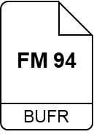
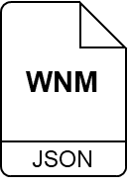
Publishing data
For WIS2 I see that my collection of real-time observation data is called a ‘Dataset’¹
But I still don’t know anything about your Dataset!
Following instructions in the WIS2 Guide², I establish a WIS2 Node to share my Dataset
files in BUFR, GRIB2, NetCDF, GeoJSON, XML, etc.
HTTPS
00110001
00110000
» »
interactive API
OGC API
WIS2 Notification Messages
MQTTS
¹ Guide to WIS (WMO No. 1061), Vol II, §1.1.4 Why are datasets so important [draft]
nl-knmi-nmc
² Guide to WIS (WMO No. 1061), Vol II, §1.3.1 How to get started [draft]

Slide 11
Publishing metadata
Ahh, good point! The next section in the WIS2 Guide³ says that I need to provide ‘discovery metadata’⁴ about my Dataset
Description of the Dataset
Identifier
Title
Description
Keywords
Geometry (extent)
Time (extent)
HTTPS
That’s great. I can find the description of your Dataset …
Who to contact
OGC API
Publisher contact
How to access
Data access (files)
Data access (API)
Data access (notifications)
MQTTS
Conditions of use
Data policy
Rights
License
nl-knmi-nmc
How to attribute
search engines
Citation
WCMP2
«publish»
Global
Discovery
Catalogue
«index»
³ Guide to WIS (WMO No. 1061), Vol II, §1.3.2 How to provide discovery metadata to WIS2 [draft]
JSON
⁴ Manual on WIS (WMO No. 1060), Vol II, Appendix F: WMO Core Metadata Profile 2 [draft]

Slide 12
WMO Core Metadata Profile 2.0 (WCMP2)
The new standard for WIS Metadata
Description of the Dataset
WCMP2 is an extension of the International Standard OGC API - Records
Discovery metadata describes a given dataset or collection
Aligning with the WIS 2.0 Principles, discovery metadata will be published to the Global Discovery Catalogue
Identifier
Title
Description
Keywords
Geometry (extent)
Time (extent)
Who to contact
Publisher contact
How to access
Data access (files)
Data access (API)
Data access (notifications)
search engines
WCMP2
«publish»
Global
Discovery
Catalogue
«index»
JSON
Conditions of use
Data policy
Rights
License
Guide to WIS (WMO No. 1061), Vol II, §1.3.2 How to provide discovery metadata to WIS2 [draft]
How to attribute
Citation
Manual on WIS (WMO No. 1060), Vol II, Appendix F: WMO Core Metadata Profile 2 [draft]

Slide 13
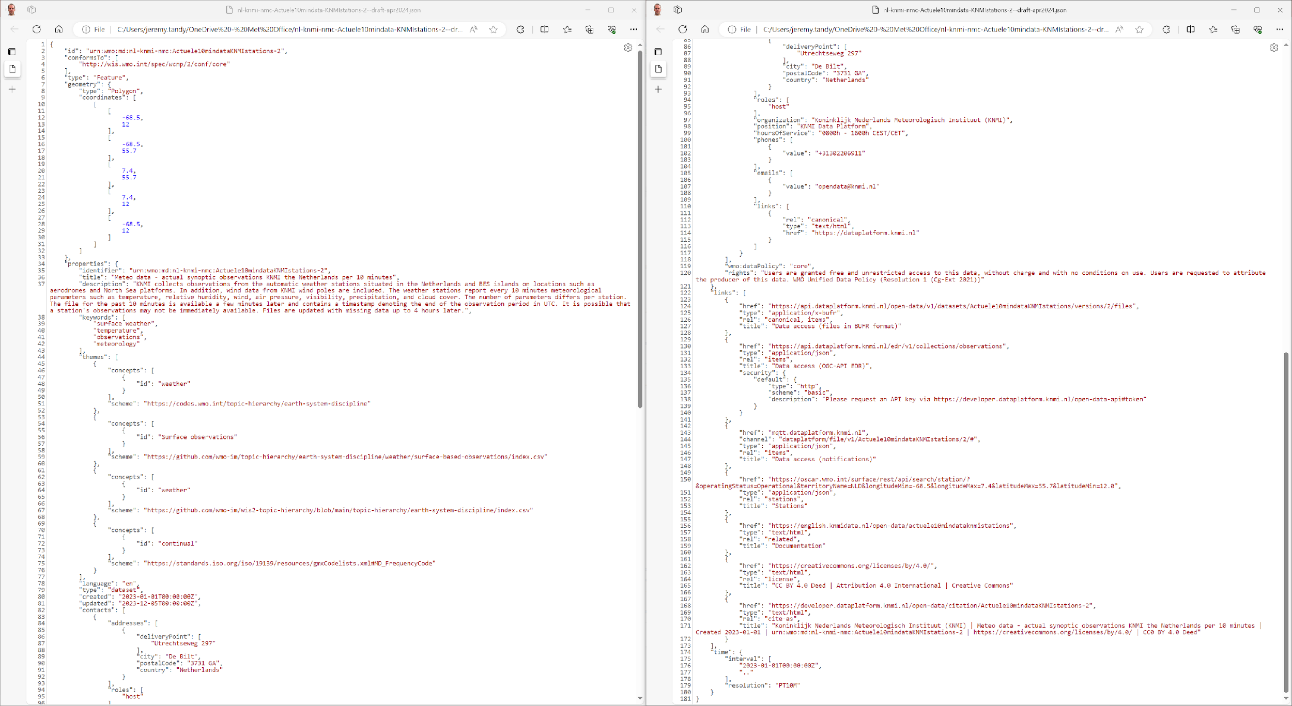
--------------------------------------
--------------------------------------
Geometry (extent)
Publisher contact (cont.)
Identifier
Data policy
Title
Rights
Description
Data access (files)
Keywords
Data access (API) with security info
Data access (notifications)
Additional info (OSCAR/Surface)
Additional info (Developer docs)
License
Publisher contact
Citation
Example: KNMI dataset (draft)
Time (extent) and update frequency

Slide 14
Topic Hierarchy and Notification Message
Publisher 1
Publisher 2
Publisher 3
Lagrangian Drifter Laboratory
WIS2 Topic Hierarchy – “Backbone” of the notification architecture where the messages will be available
WIS2 Notification Message – Format of the Notification Messages
Message Broker
Publish
Publish
Publish
surface-based-observations/buoy
Topic 1
Topic 2
Topic 3
Subscribe
Subscribe
Subscribe
User 1
User 2
User 3
Ocean users
Notification Message

Slide 15
WIS 2.0 topic hierarchy
Level | Name | Description
1 | channel | Location of where the data originates from (data providers [origin] or global services [cache])
2 | version | Alphabetical version of the topic hierarchy (currently a)
3 | system | Fixed value of wis2 for WIS2
4 | centre-id | Acronym as specified by member and endorsed by the PR of the country and by WMO
5 | resource-type | WIS2 resources types (data, metadata, report [from monitoring activities])
6 | data-policy | Data policy as defined by the WMO Unified Data Policy. Notifications for core and recommended data are available by subscription to Global Brokers. recommended data are downloaded from the original NC/DCPC and may require authentication/authorisation
7 | earth-system-discipline | As per Annex 1 of resolution 1 Cg-Ext-2021 ('atmospheric-composition', 'climate', 'cryosphere', 'hydrology', 'ocean', 'space-weather', or 'weather')
8 | earth-system-discipline-category | As proposed by domain experts and further approved by INFCOM
Example:
origin/a/wis2/ca-eccc-msc/data/core/weather/ surface-based-observations/synop
cache/a/wis2/int-ecmwf/data/core/weather/prediction/forecast/medium-range/deterministic/global

Slide 16
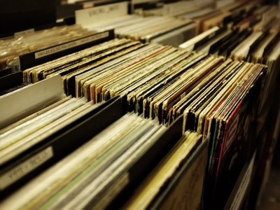
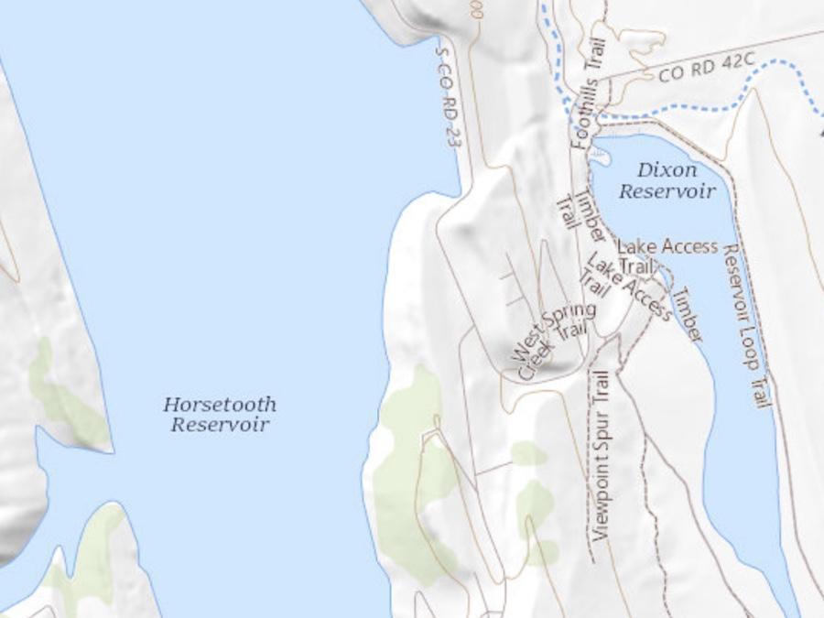
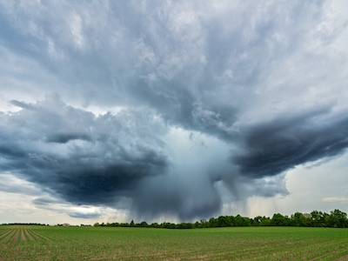
OGC Standards Implementation
Replay API
OGC API – Features
Data Access
OGC API - EDR, Features, etc. (recommended)
Pub/Sub (pending)
OGC API – Pub/Sub
Discovery Metadata encoding
OGC API – Records – Core (Record)
GeoJSON
Notification Metadata encoding
GeoJSON
Global Discovery Catalogue API
OGC API - Records
OGC Modular Specification (ModSpec) development adoption
Core + extension
Requirements, recommendations, permissions
Notes:
OGC-API pub/sub discussion paper is partly rooted in WIS2

Slide 17
WIS 2.0 Interoperability with ODIS
OceanInfoHub
System to system interoperability
schema.org

Slide 18
Integrating data and metadata publishing pipelines
Data
Generate/transform data (to BUFR, NetCDF, etc.)
Publish data to a web server (HTTP)
Publish notification message of data (MQTT)
Metadata
Create WIS2 discovery metadata (WCMP2)
Publish notification message of metadata (MQTT)

Slide 19
Standalone tooling
Components of wis2box modular architecture
Can be used standalone
Flexible, can work with files or streams, tighter integration
Data
BUFR tools (csv2bufr, synop2bufr, ecCodes)
Metadata
pygeometa (geopython.github.io/pygeometa)
Publishing
pywis-pubsub (github.com/wmo-im/pywis-pubsub)

Slide 20
Putting it all together: examples
MSC wis2node: github.com/ECCC-MSC/msc-wis2node
BUFR data and WIS2 metadata created externally
Data / metadata publisher
Uses pywis-pubsub and pygeometa and minimal Python to chain together publication workflows
wis2node-metadata-mgmt: github.com/wmo-cop/wis2node-metadata-mgmt
Metadata management and creation/publication
Uses GitHub Pages to for HTTP/storage

Slide 21
ERDDAP / ODIS / WIS2 Considerations
Extending ERDDAP with WIS2 support
MQTT broker/service
wis2box Component reuse
ODIS
Metadata
Federation
ERDDAP +
WIS2 enhancements
WIS2
Data

Slide 22
The WMO Information System (WIS2)
Reference Implementations

Slide 23
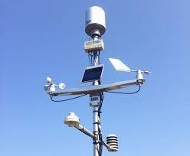
WIS2 in a box: enabling broad participation in WIS2
“WIS2 in a box” is a Reference Implementation of a WIS2 Node
MQTT
HTTP
Software (not hardware)
Publishing facility/capability compliant to WIS 2.0 Architecture
Provides basic data transformation
Can integrate with existing data management systems
Adds API and user interface
Core and recommended data (access control)
Cloud or on-premises
wis2box
CSV to BUFR
BUFR
SYNOP to BUFR
GeoJSON
Data Services
WEB API
WEB
ACCESSIBLE
FOLDER
Message
Queuing
Protocol
notification
download
subscribe
Global Cache
Global Broker

Slide 24
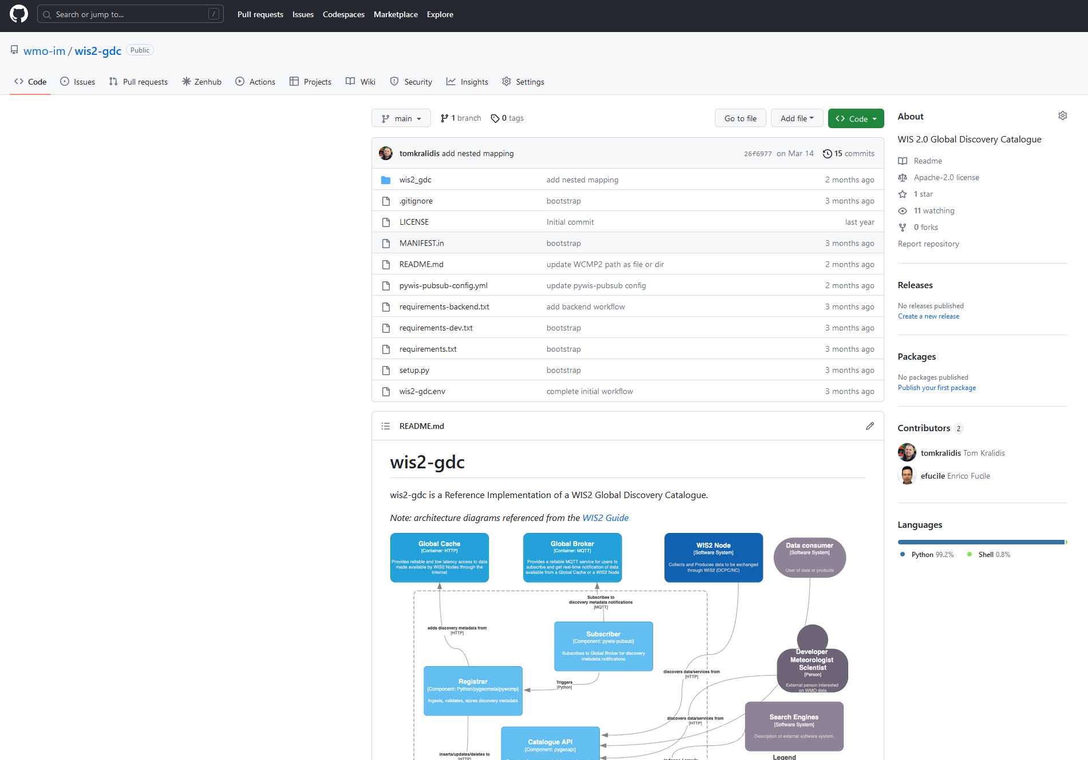
WIS2 Global Discovery Catalogue
github.com/wmo-im/wis2-gdc
Free and Open Source
Python
Subscriber: pywis-pubsub
Broker: mosquitto
Registrar
pygeometa
pywcmp
API: pygeoapi
Metrics
Prometheus
Grafana

Slide 25
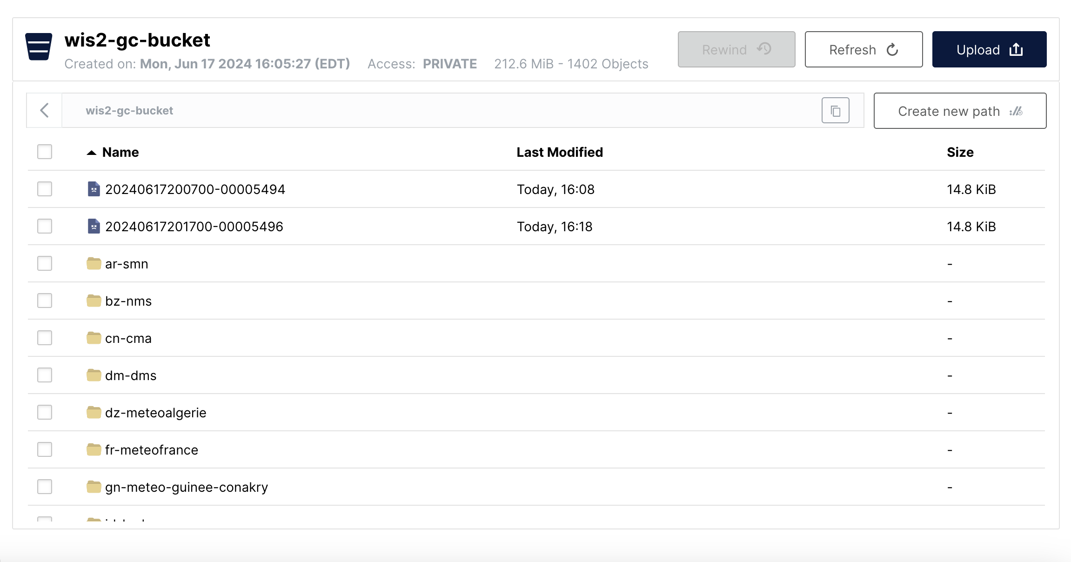
WIS2 Global Cache
github.com/wmo-im/wis2-gc
Free and Open Source
Python
Broker: mosquitto
Subscriber:
pywis-pubsub
MinIO (HTTP/S3)

Slide 26
WIS2 Global Replay
github.com/wmo-im/wis2-grep
Free and Open Source
Python
Subscriber:
pywis-pubsub
API:
pygeoapi
MinIO (HTTP/S3)

Slide 27
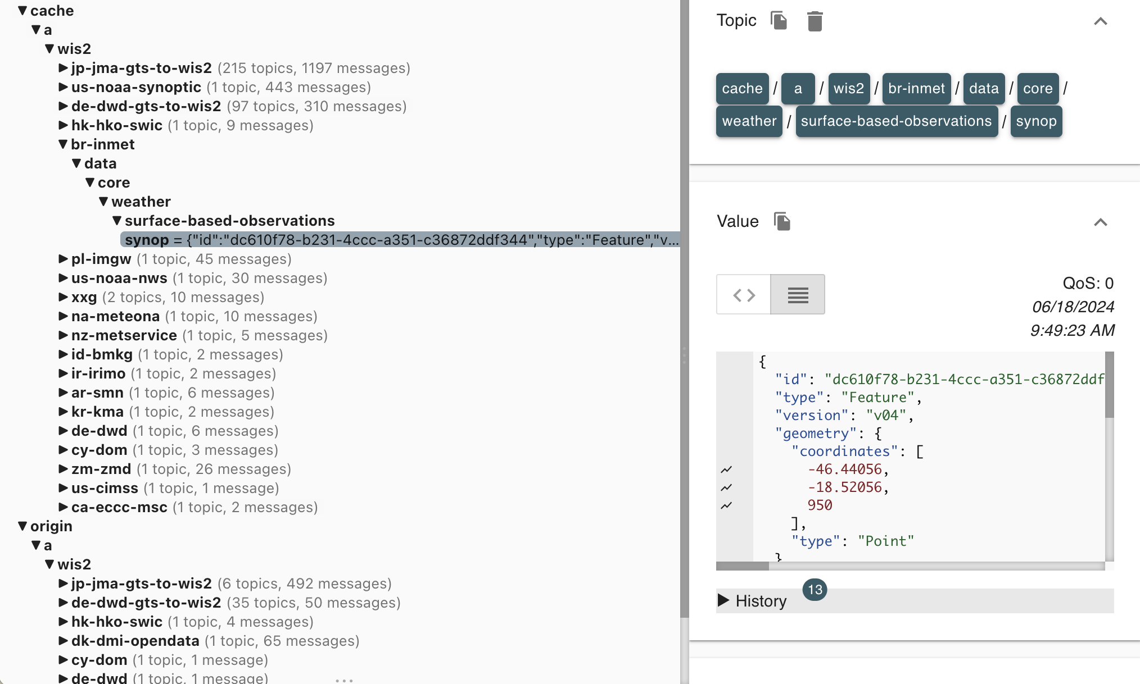
WIS2 Global Broker
github.com/wmo-im/wis2-gb
Free and Open Source
Python
mosquitto
Subscriber
pywis-pubsub
Coming soon

Slide 28
Thank you
Merci
Gracias
شكرا
谢谢

