Slide 1
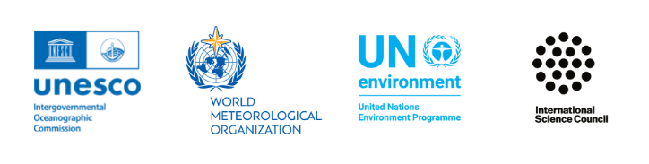
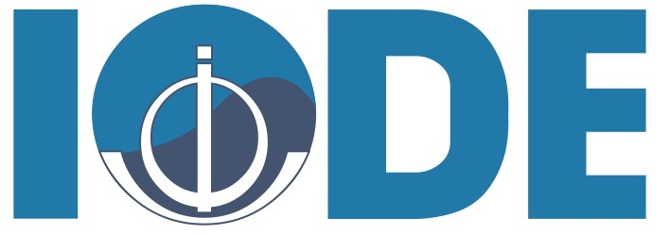
OCG and OceanOPS
Session 4: Mapping the current situation
Presenters and contributors
IOC IODE/GOOS Data Workshop
30 September - 02 October 2024, IODE Project Office/VLIZ, Ostende, Belgium

Slide 2
Contents
Map of data flow/infrastructure and explanation of principals/function/technologies
Interconnections - GOOS-IODE, cross GOOS components, where is there convergence between components, how is your system linked to others, who are the key partners
Data strategies created/using - list, link
Who are the key users/how ensure data reaches them
What would be your vision for an integrated digital ecosystem
What are the opportunities and the issues in creating an integrated digital ecosystem

Slide 3
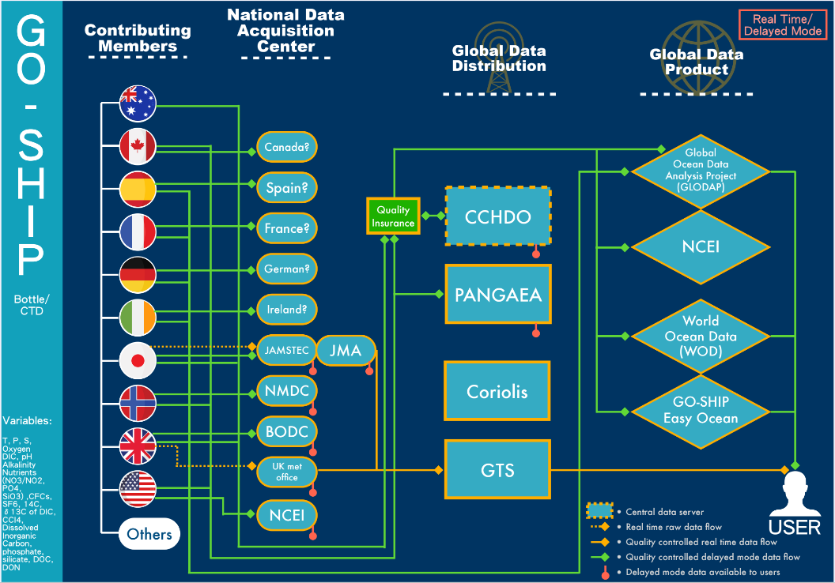
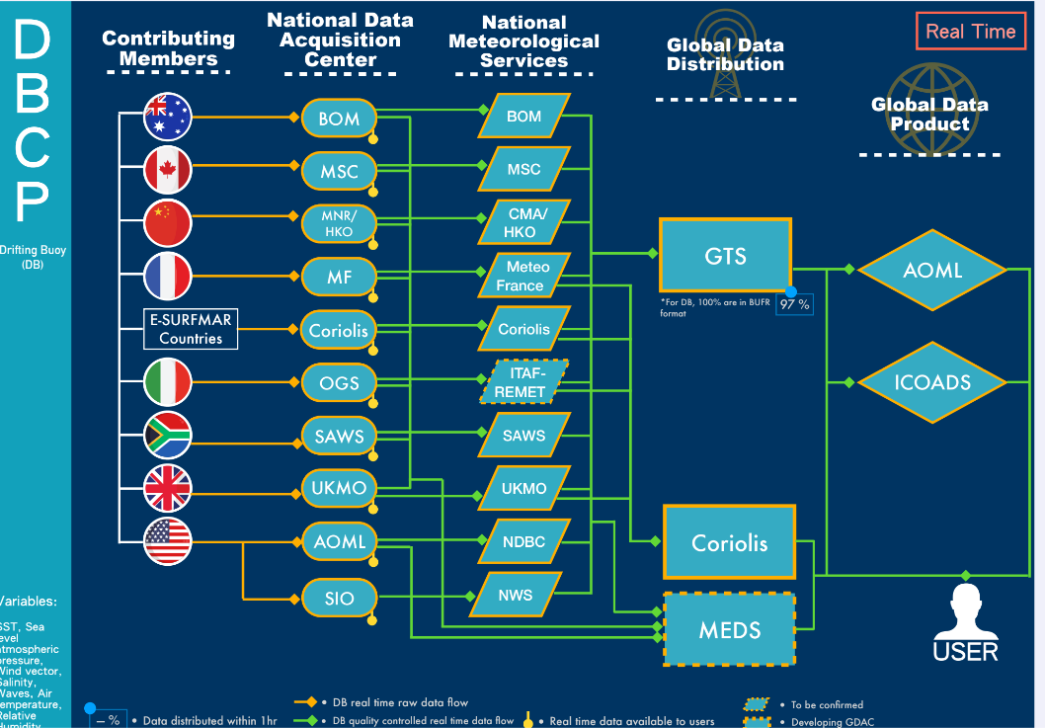
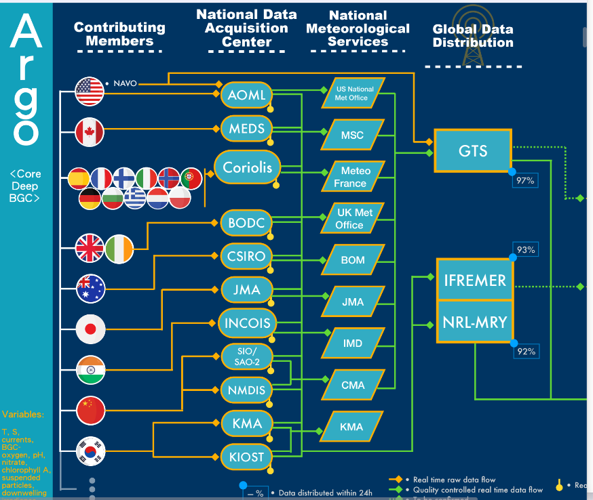
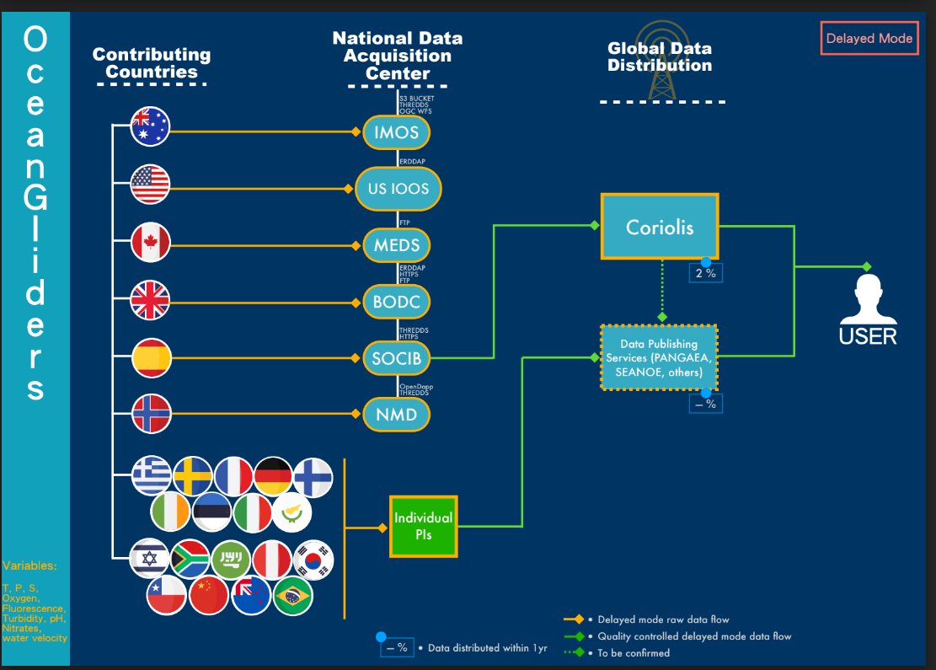
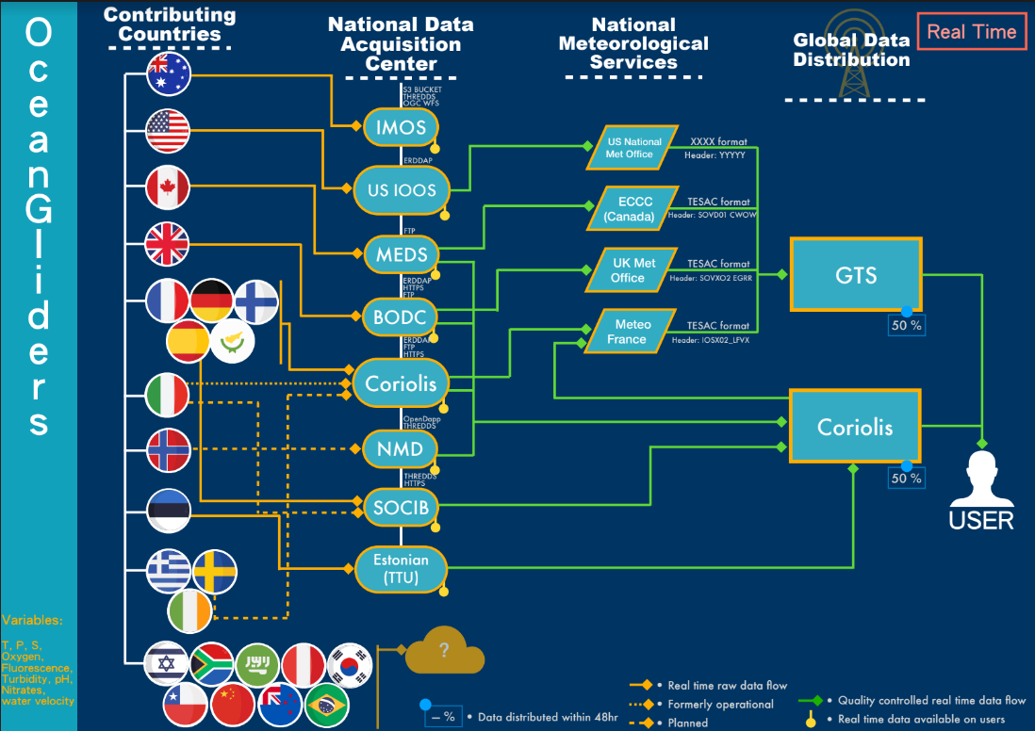
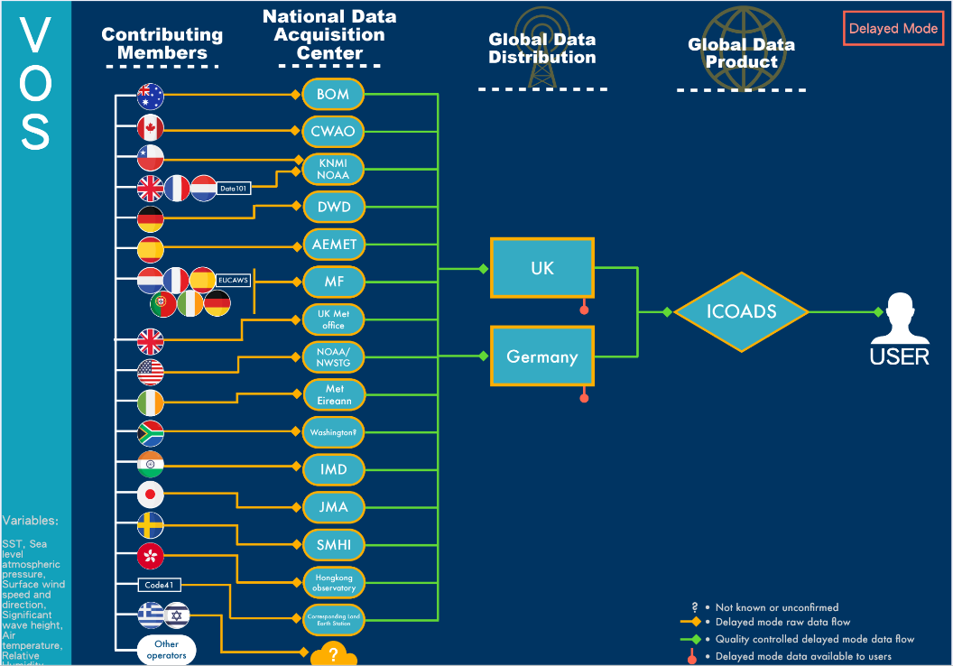
OCG Data flows
OCG data mapping exercise:
  Identify gaps in data/metadata flow and recommended best practices
  Identify potential efficiencies to improve metadata and data access, discovery and use (to be documented in OCG data strategy)
Already out of date (new emerging OCG networks approved)
https://goosocean.org/document/31176

Slide 4
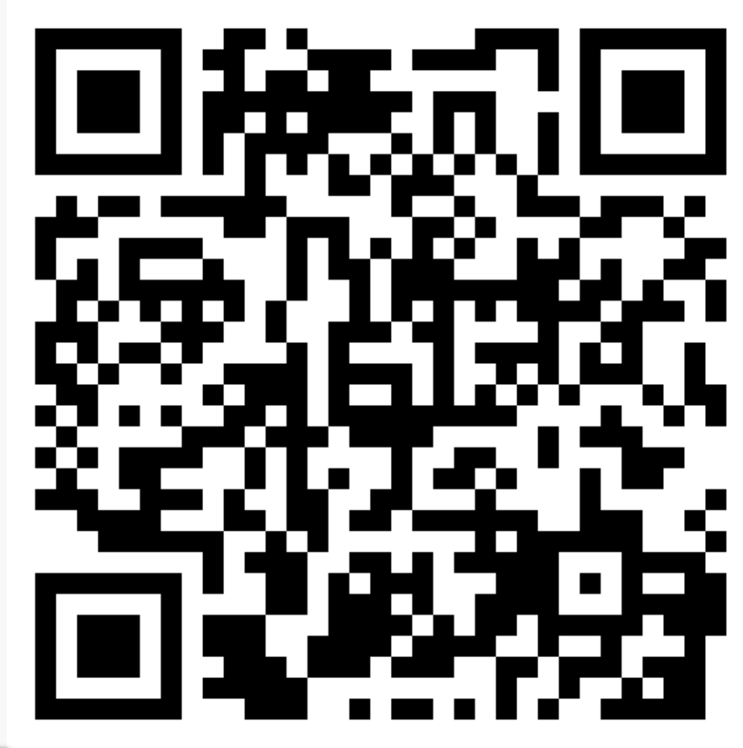
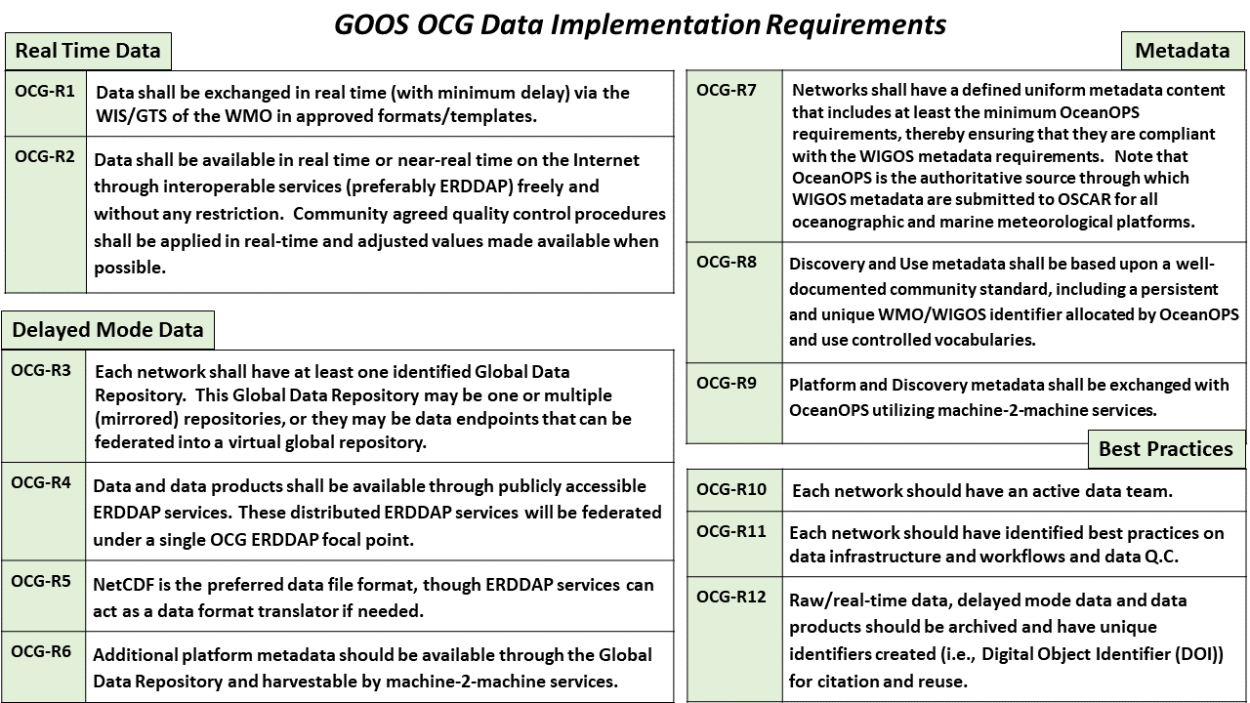
OCG Cross-Network Data Implementation Strategy
Why?
Many existing or developing data strategies
  WMO Unified Data policy
  Revision of IOC Strategic Plan For Data
  UN Decade Data Strategy
Ocean community pushing for compliance with FAIR data principles - what does that mean?
This Implementation Plan is an effort to define specific and actionable ways OCG network/programs can move towards FAIR compliance
Improve (meta)data discovery, accessibility and usability for all stakeholders
Improve access to distributed (meta)data endpoints through federated, uniform data services
Data and Metadata
Implementation Requirements:
Real Time Data (2)
Delayed Mode Data (4)
Metadata (3)
Best Practices (3)

Slide 5
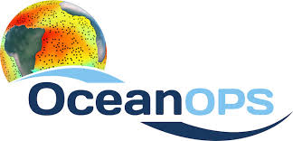
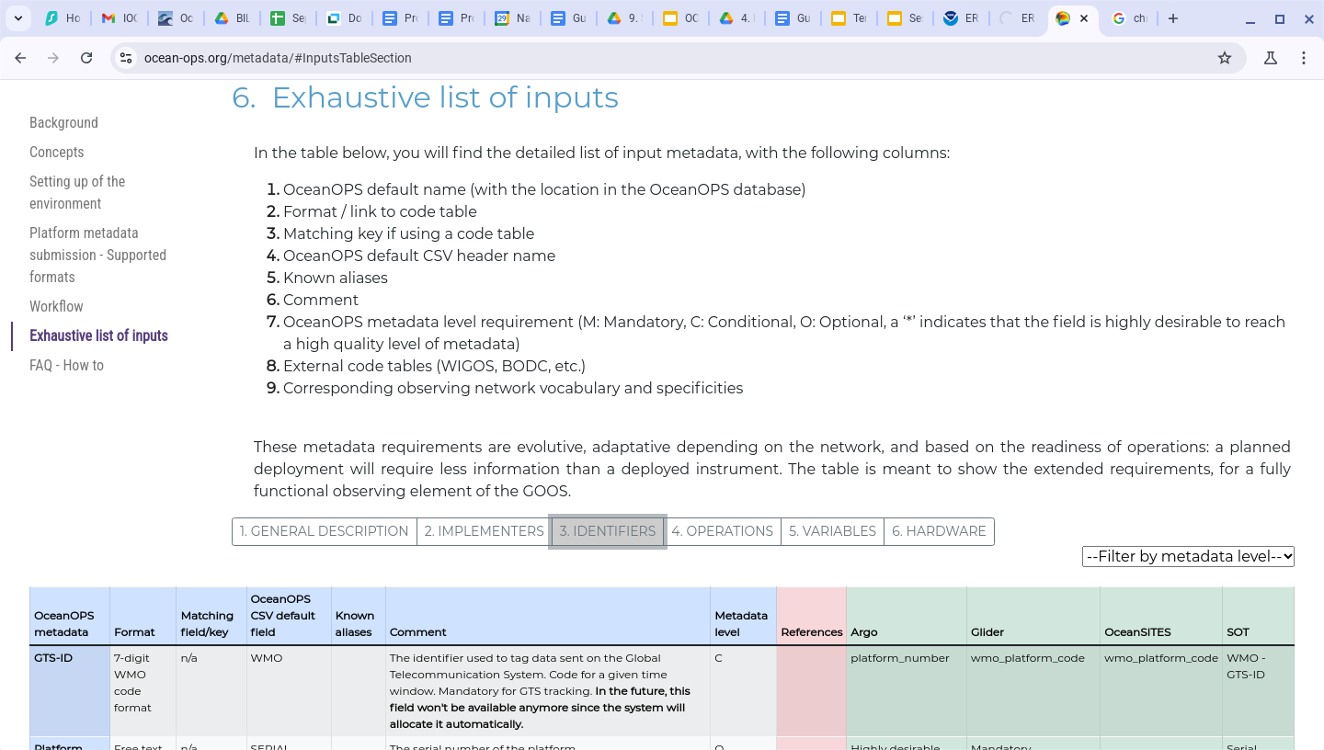
OceanOPS is the heart of GOOS platform metadata
GOOS network platform metadata flows through OceanOPS and into WMO OSCARS
Used to track RT data flows and provide feedback on data QC to providers
Metadata available through API (soon ERDDAP?)
We are working to
Implement uniform content for networks to provide
Improve m2m exchange of the metadata with networks/OceanOPS
Metadata content defined:
www.ocean-ops.org/metadata

Slide 6
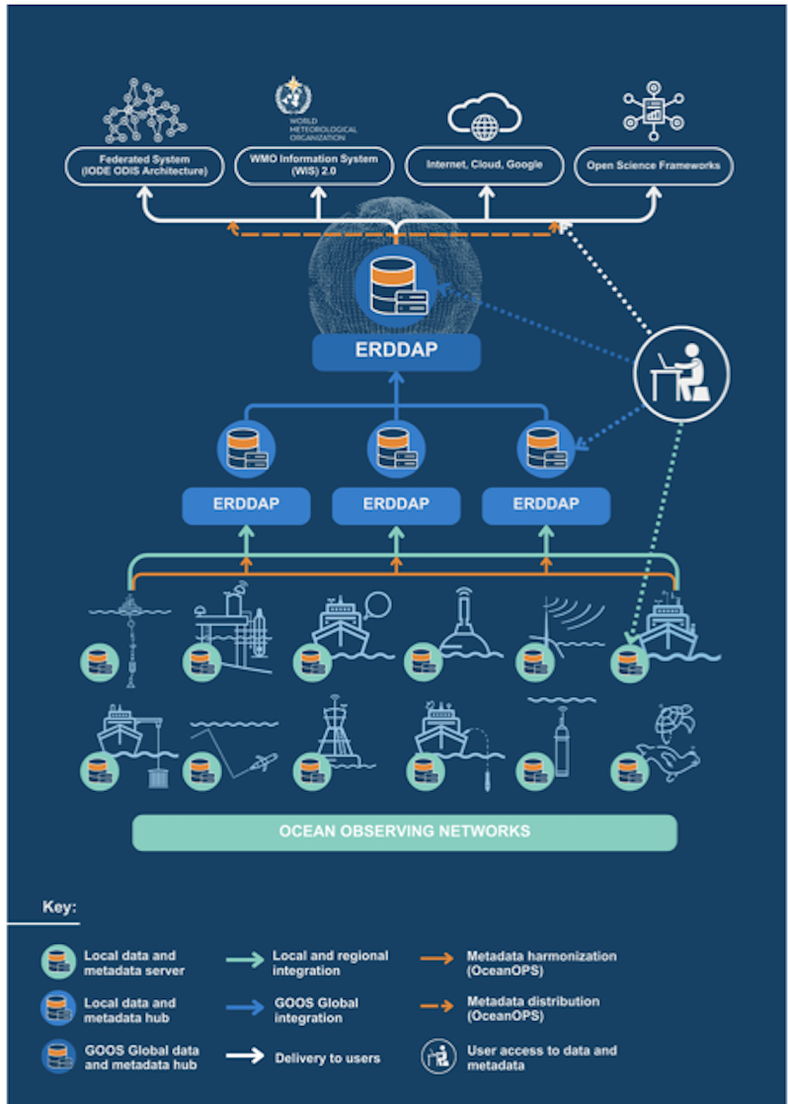
OCG Cross-Network Data Implementation Strategy
Next step: Implementation!
ERDDAP services where needed for delayed mode data and metadata
Federate distributed ERDDAP nodes in OCG focal ERDDAP
  Datasets from AniBOS, DBCP, GLOSS, GO-SHIP in place
Leverage these ERDDAP services for metadata exchange with OceanOPS as well as IODE Ocean Data Information System (ODIS)
OCG Data Task Team being formed

Slide 7
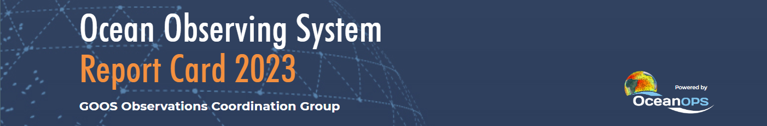
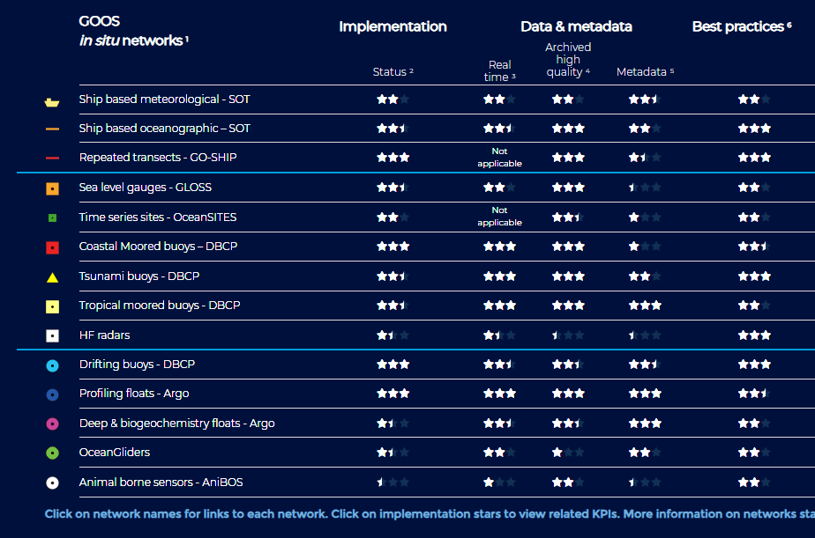
Tracking Progress towards Implementation

Slide 8
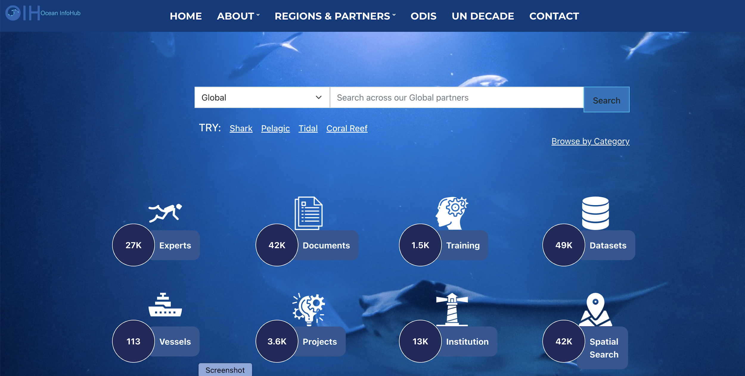
OCG Linking with IODE/ODIS
Integration with IODE Ocean Data and Information System (ODIS)

Slide 9
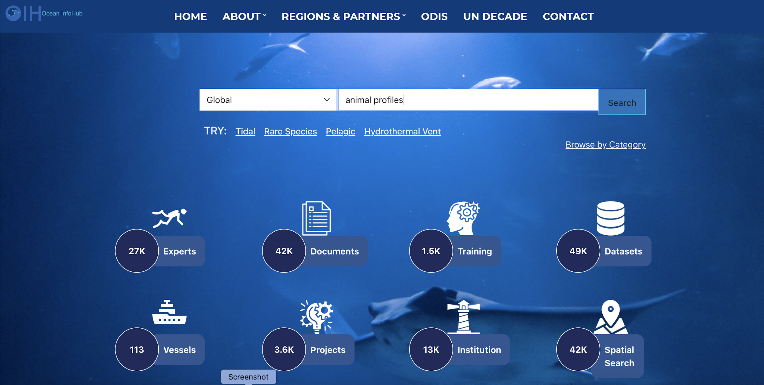
OCG Linking with IODE/ODIS
Integration with IODE Ocean Data and Information System (ODIS)

Slide 10
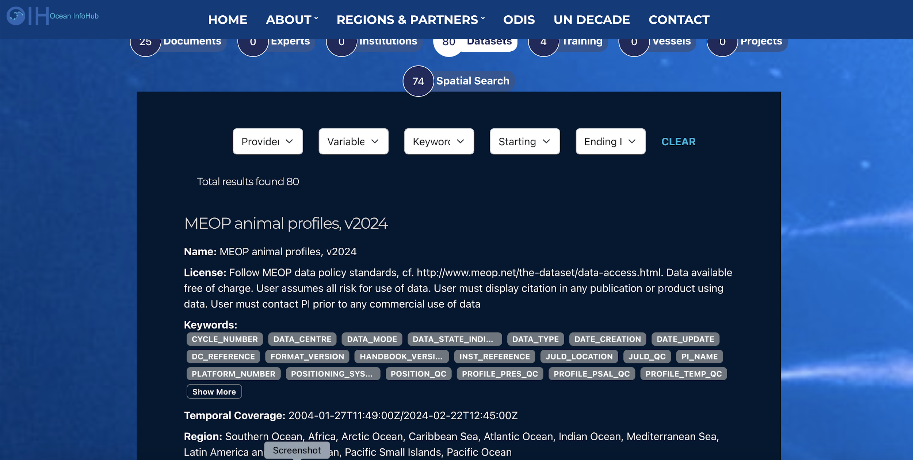
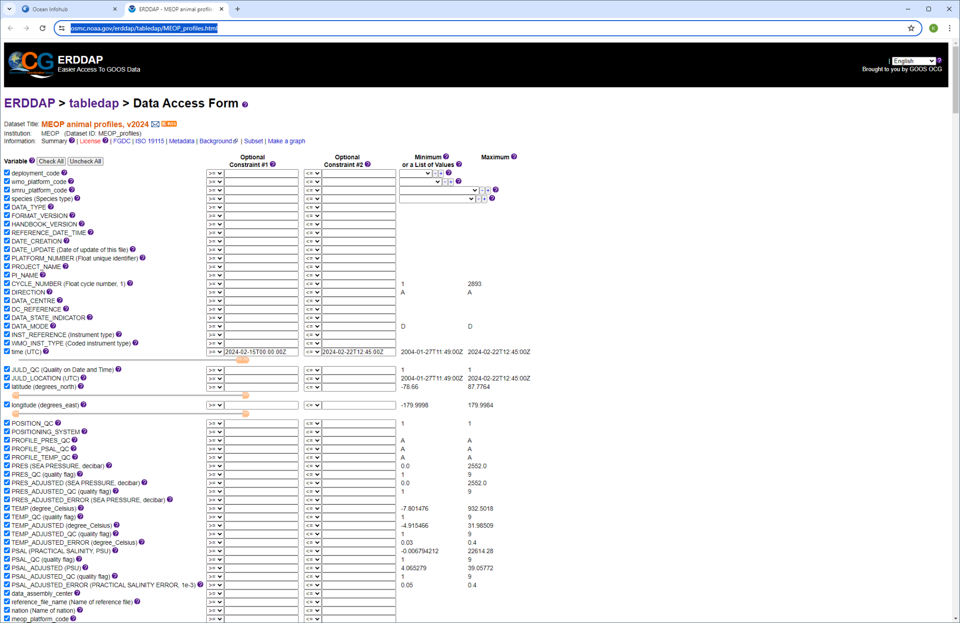
OCG Linking with IODE/ODIS
Integration with IODE Ocean Data and Information System (ODIS)

Slide 11
OCG links to WMO
Important link is from OceanOPS to WMO - metadata submission
WIS 2.0 evolution
  ERDDAP can be used as a data exchange service on the WIS 2
  A pilot project is in early stages to demonstrate this connection

Slide 12
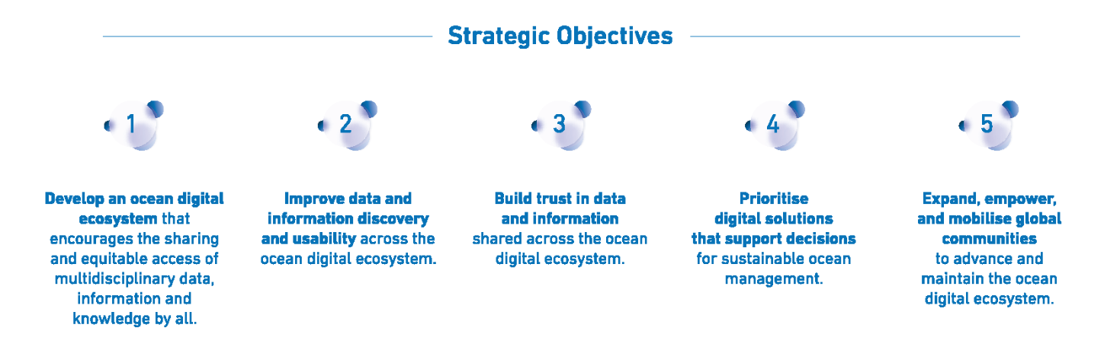
Integration with UN Decade Data Strategy and Implementation
Ocean Decade Data
Strategy Implementation
GOOS Cross-Network Data Implementation Strategy
Action: Data publishers should deploy free and open (non-proprietary) data dissemination tools, capable of data mediation….services should provide data users easy access to enable discovery and use of data/metadata in preferred tools…..

Slide 13
What could a cross-GOOS infrastructure look like?
Within GOOS, we will
harness the power of
ERDDAP to provide
easy federation of
distributed data nodes
ODIS seems well placed to act as the glue
between disparate systems
ODIS
GOOS/OCG ERDDAP
OBIS
OceanOPS
BioEco Portal
GOOS RAs
One common element is potentially a platform (ship, mooring, USV, animal, drifter, etc)
How to link data at several repositories to the observing platform?
Could a unique OceanOPS platform ID link all of these datasets back to the observing platfom?

Slide 14
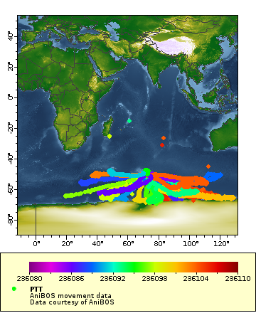
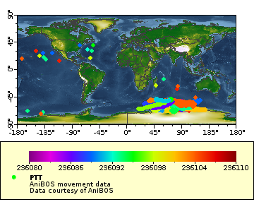
AniBOS Movement data added to OCG ERDDAP
An agreed “first attempt” to as a link between the Bio-Eco community and GOOS OCG data processes

Slide 15
GOOS OCG Data Users
Members of the GOOS Networks
Cross-network projects
Global stakeholders
  WMO
  ODIS
  UN Decade projects (DiTTO, etc)
Who knows?
\

Slide 16
Opportunities …..
….. and Issues
People have begun to galvanize around the issue of open data and metadata
Ocean data community is moving in roughly the same direction (ie, FAIR, etc)
We have defined strategies and implementation plans
How to effectively and efficiently connect the BioEco community and Physical ocean communities?
How to bring the National/Local data repositories/producers into the conversation?
How to integrate third party and/or commercial data?

Slide 17
Dank je wel
Thank you

