Slide 1


BGC
Session 4: Mapping the current situation
Nico Lange, Véronique Garçon, Steve Jones and Maciej Telszewski
IOCCP BGC GOOS Panel
IOC IODE/GOOS Data Workshop
30 September - 02 October 2024, IODE Project Office/VLIZ, Ostende, Belgium

Slide 2
BGC Data Landscape – Present Status
Data collected by GOOS networks provided by
National and regional data centers (BSH, BCO-DMO, SeaDataNet)
Specific GDACs (Ifremer, NCEI, CCHDO)
Data products (WOD, GLODAP)
Data collected outside of GOOS networks with limited impact on global products, could be uneasy to access them sometimes
Multiple synthesis products developed (terminated; living)
Cross-platform and/or cross-EOV
Specific scientific rationales in mind
Often underfunded (i.e., based upon substantial ‘volunteer work’)
→ Varying interconnections between data sources
→ Multiple data submissions – too much work, and leads to data duplication
→ Different data/metadata schemes; levels of quality
→ Weak (non-existent), often unstructured, chaotic (meta)data links from data source to global provision
Notes:
Mention SPOTS here as an example of data missed out on currently

Slide 3
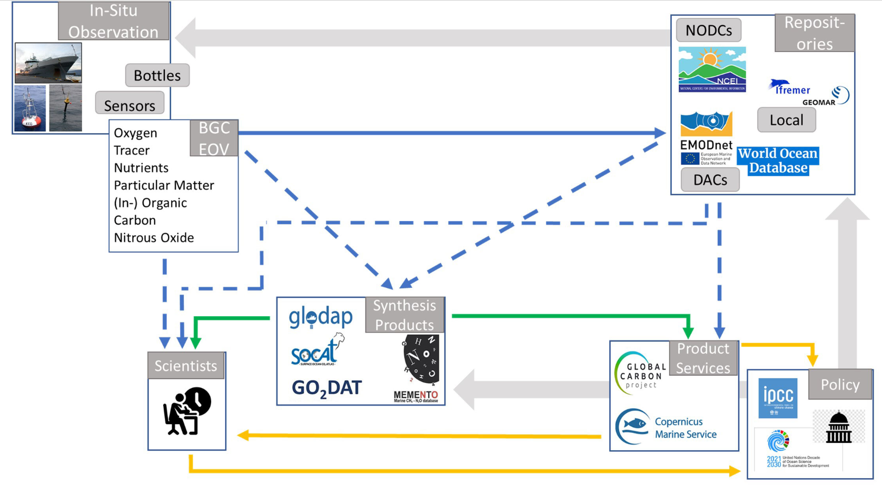
BGC Data Landscape – Present Status
Heterogenic
FAIR, QC’d & Consistent
Users
WOD
Information & Service
Feedback
From Lange et al., 2023
Notes:
No clear functions to each entity assigned, i.e., multiple entities doing similar work but differently; Relies upon multiple submissions, i.e., not using a federated system
Different levels of data has different type of users; Single access points for different levels/users would increase impact, usability
Many more synthesis efforts that are not linked to a GOOS observing network nor to IODE
Making use of IODE network not really in place

Slide 4
BGC Data Landscape – SOCAT
In situ surface ocean fCO2 measurements from ships, moorings and autonomous surface vehicles
38.6 million fCO2 values with an estimated accuracy of < 5 μatm in the main synthesis
8.1 million fCO2 values with an accuracy of 5 - 10 μatm are separately available
Community-led, expert quality-control and EOV-focused synthesis
Ingestion software available and in use
+ 800 citations
SOOP/ SOT (SOCONET)
SOCAT
OCADS
SOCOM
SDG14.3.1 Data Portal
Notes:
Main Use Case(s): Quantification of ocean CO2 uptake and acidification
Evaluation of climate models and sensor data

Slide 5
BGC Data Landscape – GLODAP
Provides access to quality-controlled surface to bottom ocean biogeochemical data, with an emphasis on seawater inorganic carbon
1.4 million water samples from the global oceans collected on 1108 cruises
Community-led, expert quality-control and platform-focused synthesis
Manual ingestion
Develops uncertainty estimates (GLODAPv3)
+ 600 citations
GO-SHIP
CCHDO
GLODAP
SDG14.3.1 Data Portal
Notes:
Main Use Case(s): Quantification of ocean interior (anthropogenic) carbon storage → Confines (long-term) estimated surface fluxes
Evaluation of climate models and sensor data
Critical for WMO Global Greenhouse Gas Watch

Slide 6
Vision - BGC (Meta)Data Portal
Defined, separated and specific tasks for different data management entities (generator, archive, DAC, ETL, broker service, access point)
FAIR principles implemented
Templates for structured metadata across EOV's and platforms (schema.org)
Use of (partly non-existing) controlled vocabularies
Use of ERDDAP services
Improved uncertainty attribution
Improved synergies with existing entities (OceanOPS, GOOS, ODIS, Argo, EMODnet, etc)
Established automated links from NODCs to (partly non-existing) GDACs
Implemented “submit once – use many times”
Brokerage services utilizing structured metadata to enable more automated data flows (ETL: extract; transform; load) developed
Notes:
GOOS Strategic Objective 7.3
Etc.: WOD, OceanSites, OceanGliders, Saildrone, etc…
Uncertainties based either upon instrument precision, or crossover consistencies, or replicate measurements, are not comparable. Collect a precise information on precision (based on replicate measurements, indicated by the relative variability) and on accuracy (based on a fit with golden standard which could be e.g. GO-SHIP cruises).

Slide 7
GO₂DAT Prototype
A global ocean oxygen database and atlas for assessing and predicting deoxygenation and ocean health in the open and coastal ocean The GO₂DAT Project
Transforming our knowledge of ocean O₂ changes for sustainable ocean management

Slide 8
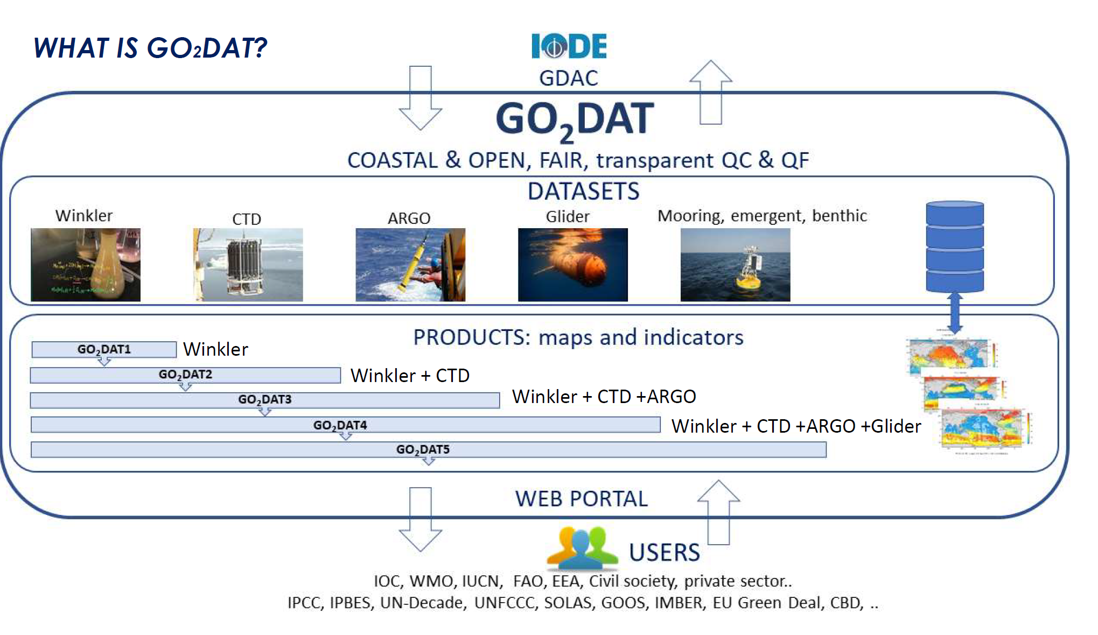
GO₂DAT Prototype
Grégoire et al., 2021
…to be updated to align with ODIS federated system within the OceanData2030 framework

Slide 9


Garçon et al., 2024, in prep : GO₂DAT: A best practices, documented metadata format
and consistent quality control procedure and quality flagging (QF) system
for open and coastal ocean oxygen data
Abstract
Introduction
EOV Oxygen measurement best practices
Best practices for meta and data formats, vocabularies
Data quality control of oxygen observations and assessment, including flagging system
GO₂DAT Data Flow
Discussion and conclusion
Box 1- Survey list of questions and answers about oxygen measurements SOP and best practices
Box 2 Survey answers on Quality control checks and flags specification
Institute of Oceanology of Polish Academy of Sciences, ul. Powstańców Warszawy 55, 81-712 Sopot, Poland
Phone: +48 58 731 16 10 / Fax: +48 58 551 21 30, www.ioccp.org
Biogeochemistry
Panel
Notes:
ocean observations (data) and ocean predictions are indivisible if we want a significant breakthrough in our understanding of the ocean machinery. Of course data assimilation, use of data for models validation, use of data for deep learning into models, use of data for emerging constraints are obvious tracks to follow.

Slide 10
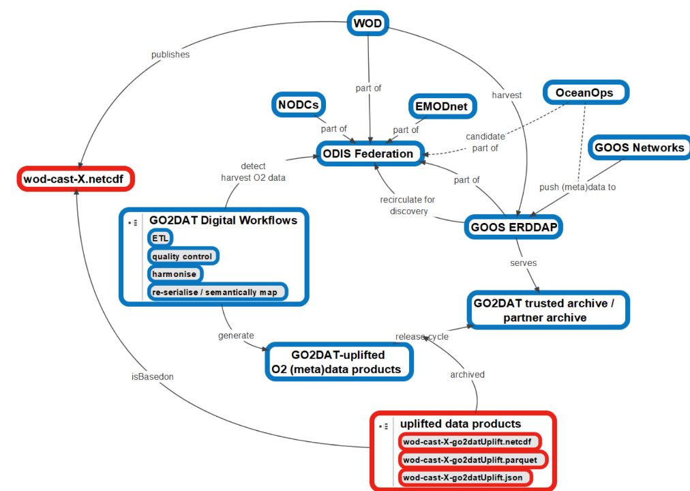
GO₂DAT Prototype
O2 highest ranked EOV in feasibility and impact
Builds upon existing structures and common structured metadata
Utilizes ODIS-federation for (meta)data harvesting
Automates data ETL
Utilizes ERDDAP as a service for flexible data extraction
Provides single access point for O2 data
Establishes feedback loops to original data sources
Roadmap: Grégoire et al., 2021 to be updated within GOOS digital ecosystem infrastructure framework

Slide 11
Integrated Digital Ecosystem – Opportunities and Issues
Use structures and tools developed for GO₂DAT as basis for other EOVs
GEF-FAO CHO_IP (Clean and Healthy Ocean Integrated Project) project starting spring 2025, 1 FTE to work on data gathering, QC, QF, uncertainty attribution
Insertion within the GOOS Digital Infrastructure/Ecosystem Strategy for all EOVs, tight collaboration with IODE/ODIS
DataExpo: A deep learning-based tool, using natural language processing technology for extensive machine reading of webpages (Lu, B. et al., 2023, DataExpo: A One-Stop Dataset Service for Open Science Research).
Visualization, mapped data products as part of new EU proposal led by Toste Tanhua: BioGeoSea “Enhancing Biogeochemical Essential Ocean Variables for European and Global Assessments” - just submitted

Slide 13
Expanding global oxygen minimum zones restrict marine habitats under climate change
Yuntao Zhou et al., Nature Communication (under review)
All known data bases and extraction of observations from over 2,000 published papers through DataExpo
DataExpo : deep learning-based tool known as DataExpo, which uses natural language processing (NLP) technology for extensive machine reading of webpages on the internet.
Collection of domain-specific keywords and submitted "keyword + dataset OR database" to the search engine as a query.
>>> large amount of website information related to dissolved oxygen through web crawling
To identify whether the webpages contain datasets : multi-view deep learning classification model that integrates text and webpage structure information.
Use of a hierarchical Convolutional Neural Network (CNN) architecture to learn the implicit representation of each webpage in the feature space.
Design of a specific schema and annotation of a set of samples to fine tune the T5-based pretrained large language model Universal Information Extraction (UIE)
>>>> an automated extraction of webpage metadata, such as titles, descriptions, Digital Object Identifiers (DOIs), references, and data links.
Additionally, DO data information including DO concentration, geographic locations, and timeframes were automatically extracted from the data links by parsing a variety of data file formats.

Slide 14
Expanding global oxygen minimum zones restrict marine habitats under climate change
Yuntao Zhou et al.,submitted to Nature Communication

