Slide 1
Strategic Priorities for GOOS
Session 3
Joanna Post, Emma Heslop, IOC/UNESCO
IOC IODE/GOOS Data Workshop
30 September - 02 October 2024, IODE Project Office/VLIZ, Ostende, Belgium

Slide 2
GOOS: A critical infrastructure for ocean observing
Global Ocean Observing System
Ecosystem of providers Observation infrastructure
Beneficiaries of ocean information
GOOS Management Team
Coordination – Integration - Advocacy
Ocean observing community & partners
Research, Decision makers, Users, Investors

Slide 3
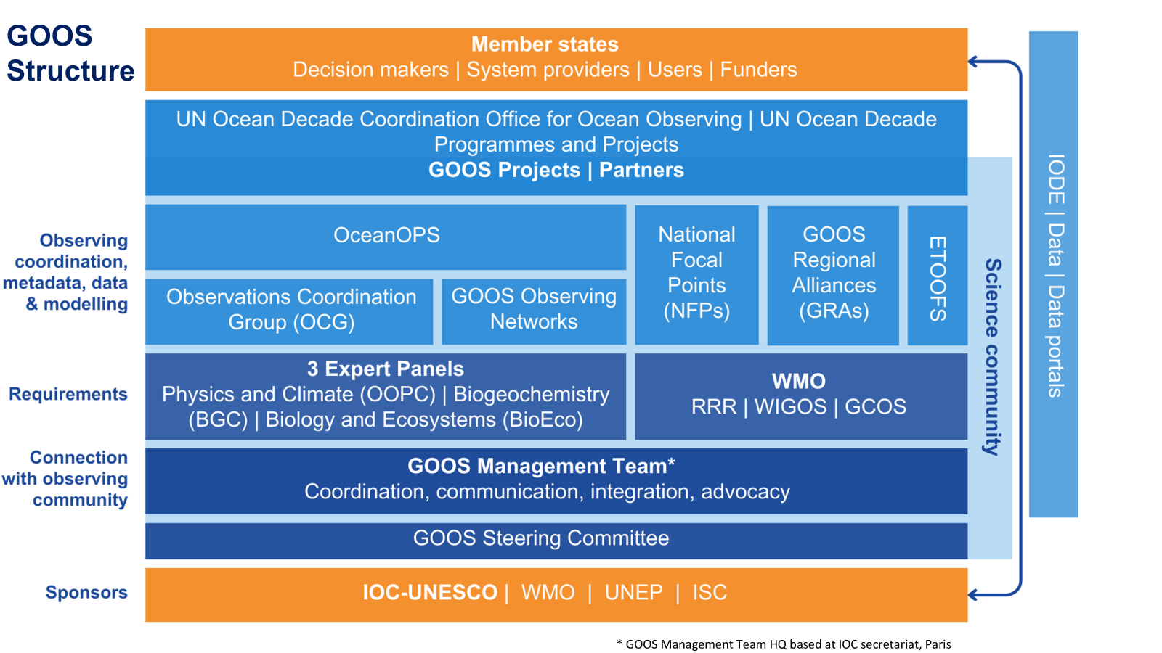
Global Greenhouse Gas Watch (G3W)
Operational national and regional forecasting
Post-2020 Biodiversity Framework
Global Environmental Monitoring Service (GEMs)
International Legally Binding Instrument on Plastic Pollution 2024
Biodiversity Beyond National Jurisdiction
Notes:
Earth system research, modelling, prediction
Sustainable development in the face of triple planetary crisis
Operational forecasts for multi-hazard risk
Sustainable ocean economy
Science-based mitigation and adaptation to climate change
Climate resilient marine protected areas
Human health and food security
Essential variables, data products and indicators to inform decision making and policy

Slide 4
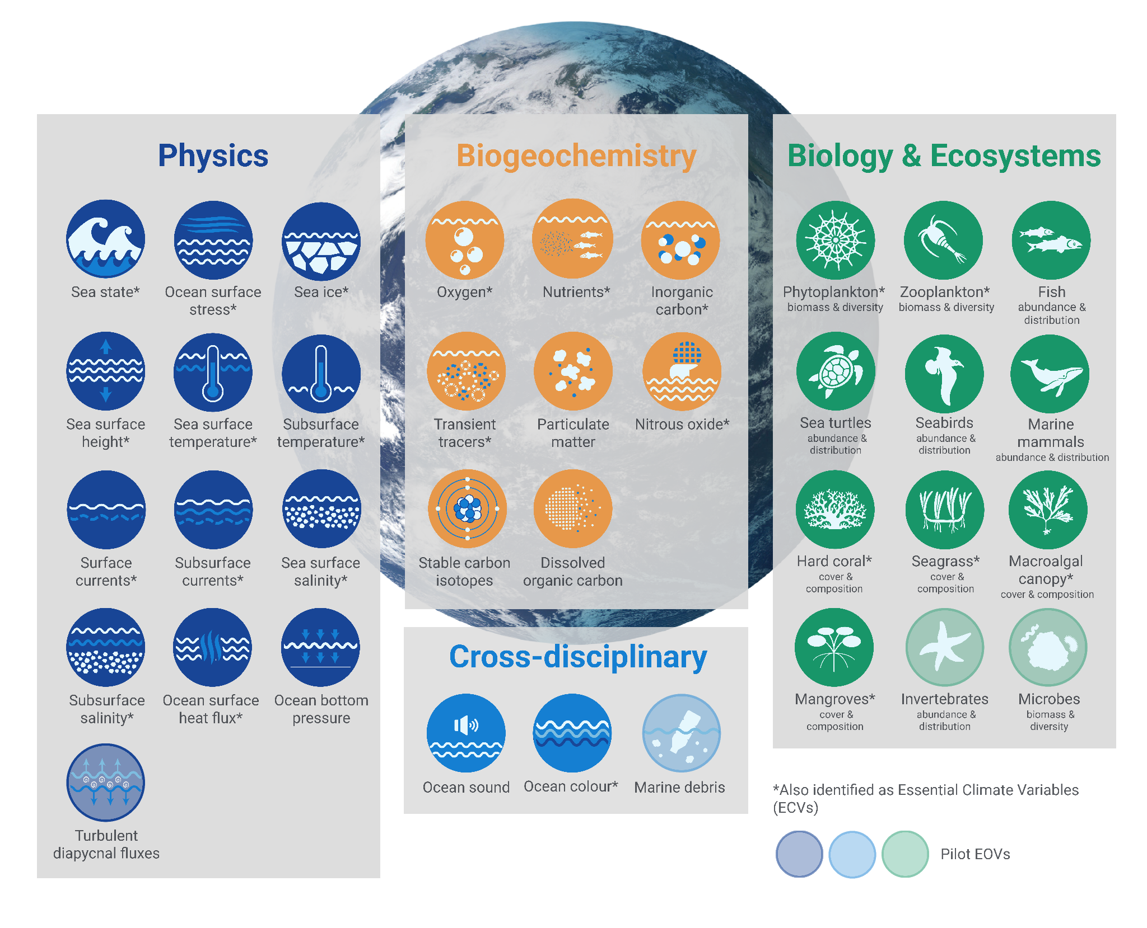
36 Essential Ocean Variables (EOVs)
Reference for ocean observing community globally, supporting harmonisation and collaboration
Minimum set of ocean variables that are needed to assess ocean state & variability for important global ocean phenomena, and to provide data for applications to benefit society
Notes:
GOOS has established a framework of Essential Ocean Variables - critical ocean measures that allow the efficient monitoring of the state and health of the ocean.
These physical, biogeochemica, biological and cross-disciplinary variables contribute to various international frameworks and conventions, such as the Sendai Framework for Disaster Risk Reduction, United Nations Framework Convention on Climate Change, Convention on Biological Diversity, etc.
Move beyond a focus on single platforms, programs or regions a connected & coordinated system.
Established critical ocean measures that allow efficient monitoring of the state and health of the ocean

Slide 5
GOOS Today
84 countries
8,000+ observing platforms
13 global observing networks (+3 emerging)
638 long-term biological monitoring programmes across 12 EOV observing networks
>120,000 observations per day – reach operational systems
Notes:
In the last 30 years, GOOS developed - …
13 mature ocean observing networks under GOOS include drifting buoys, voluntary observing ships, tide gauges, Argo floats, HF Radar, ocean gliders, animal-borne sensors… and emerging networks.

Slide 6
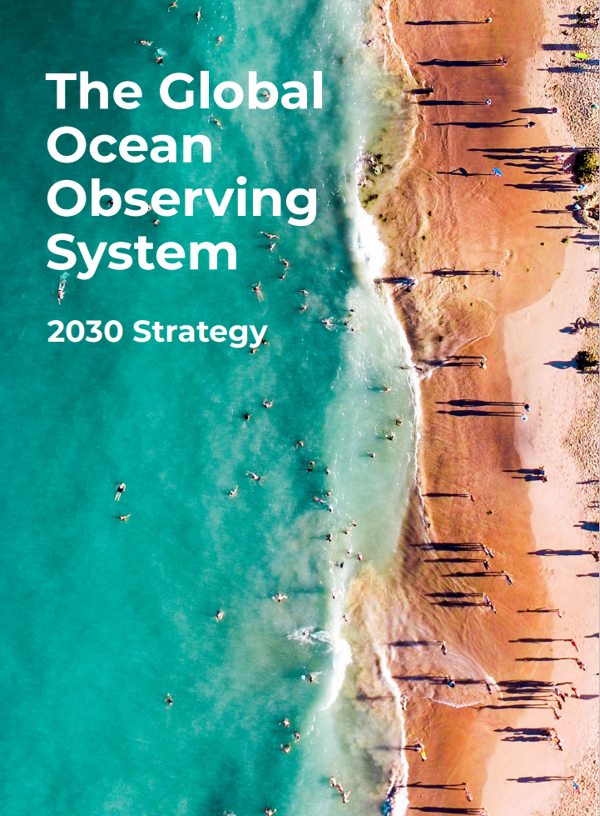
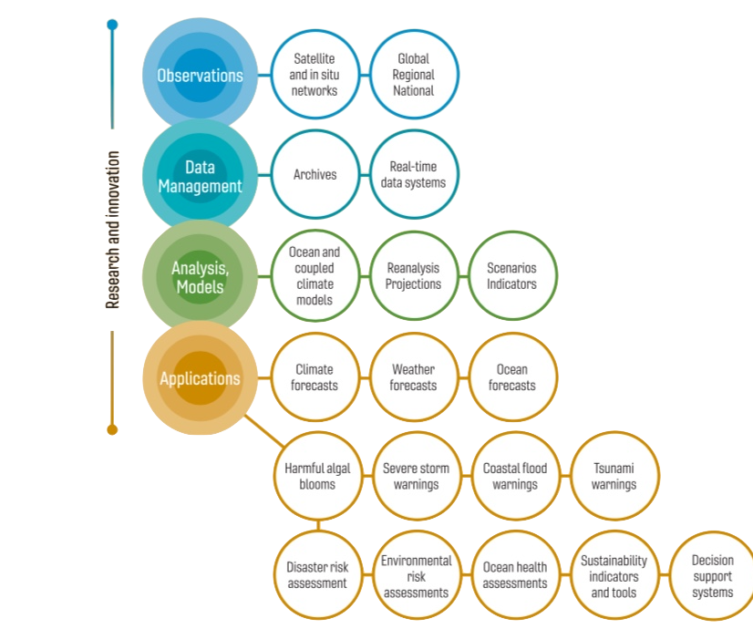
Underpinning a wide range of applications
Vision: A truly global ocean observing system that delivers the essential information needed for our sustainable development, safety, wellbeing and prosperity
Notes:
2019 IOC Assembly adopted a Global Ocean Observing System 2030 Strategy which now informs our work
Ambitious – need a step change to deliver a fit-for-purpose system
Eleven Strategic Objectives guide our planning
System integration and delivery are the ‘core’ of GOOS ‘business’ today
Deepening engagement and impact are key priority - only achievable through partnership with key stakeholders
Going to look at 3 important axis of this partnership with stakeholders – co-design of fit for purpose system, increasing partnership with private sector and across the UN

Slide 7
2030 Strategy
Goal 2: System integration and delivery, provide authoritative guidance on integrated observing system design, sustain, strengthen and expand observing system implementation, and ensure FAIR data
SO7. Ensure GOOS ocean observing data and information are FAIR with appropriate quality and latency
Outcomes foreseen:
An identified GOOS data architecture as part of broader oceanographic, atmospheric, and earth system data architectures
Data products based on EOVs/ECVs
More data available, more appropriately, to more users
Meaningful data metrics
Notes:
(findable, accessible, interoperable, and reusable)

Slide 8
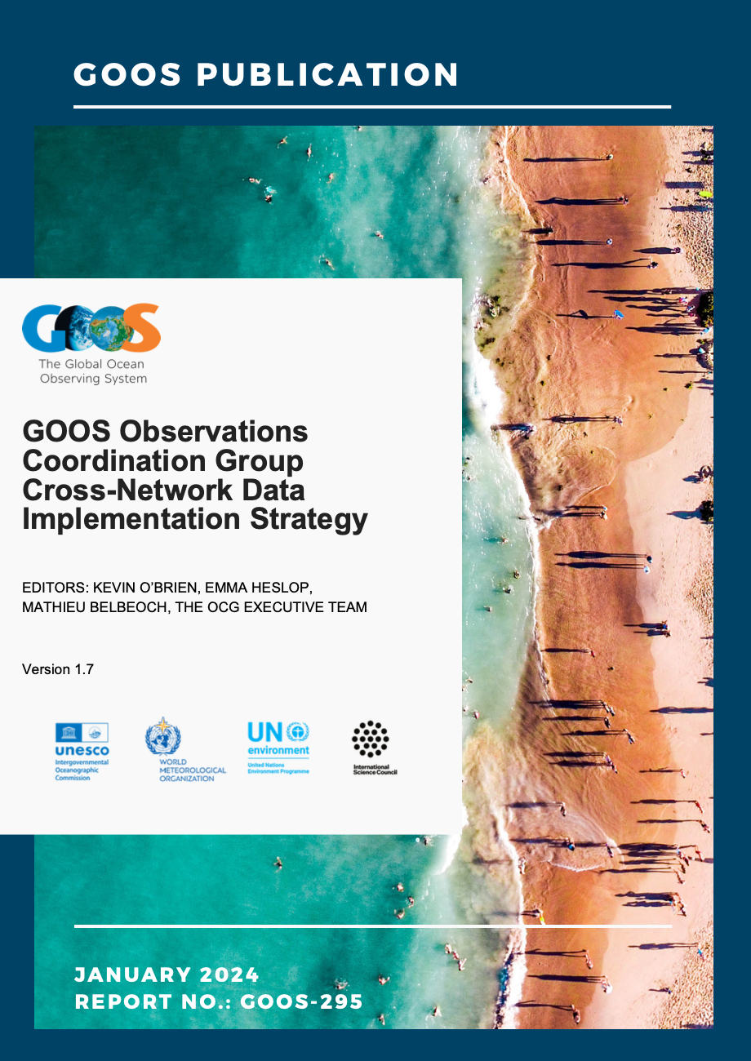
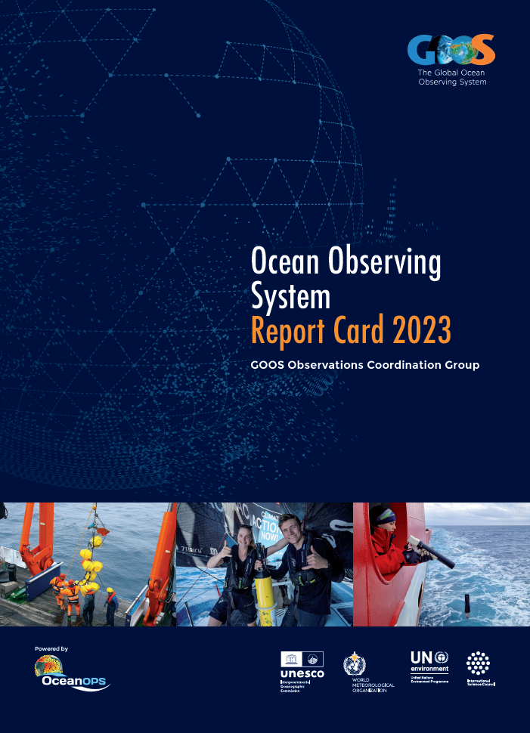
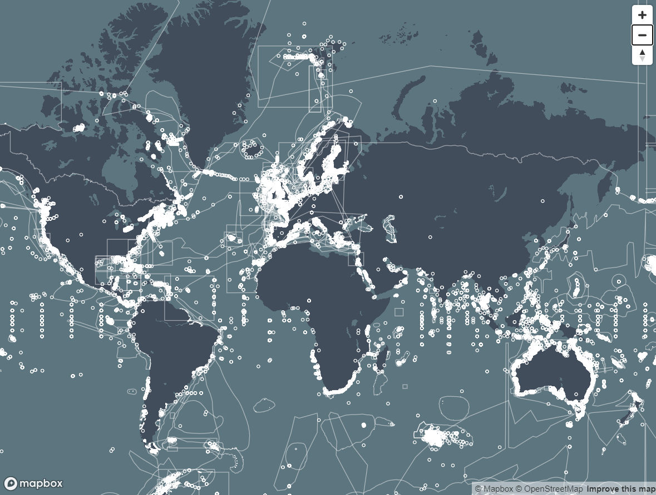
Developments – building blocks - since 2019
GOOS Observations Coordination Group (OCG)
GOOS Biology and Ecosystems Expert Panel
GOOS Biogeochemistry Expert Panel
OCG network data mapping
OCG Data Implementation Strategy
WMO unified Data Policy - EOVs
Open GTS – piloted WMO
OCG ERDAAP server
Report Card – cross GOOS
Best practices documented
BioEco Portal launched - metadata
BIoEco network data flows integrated with OBIS
Best practices documented
BGC Panel working towards BGC value chains (not stable) GDAC and products
Best practices documented
Not yet fully integrated, sustained or trackable…
GOOS has been provided with increased funding to achieve greater impact

Slide 10
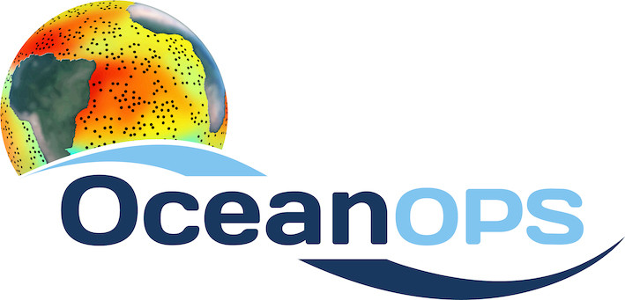
GOOS data connected to support alignment
16 OCG Networks
12 BioEco EOV networks
Data strategies
WMO Unified Data policy
Revision of IOC Strategic Plan For Data
UN Decade Data Strategy
Task Team members
WMO
IODE
Decade
Cross membership
OBIS – BioEco Panel
OCG - IODE
Adoption standard/open technologies:
ODIS architecture
federated system approach
ERDDAP
OceanOPS
BioEco Portal
15 GRAs
76 National Focal Points
Many connections to support alignment
Developments based on this knowledge
Not all parts of GOOS or partners are connected & even across GOOS roles not well understood
Notes:
OCG - IODE ODIS / TT
OceanOPS - WMO unique identifiers
OceanOPS - WMO TT
OceanOPS/networks - WMO GTS
OCG - WMO Data Policy
OCG - WIS2.0
OCG - Decade Data Group
BGC active in supporting BGC GDAC
BioEco Panel have strong connections to OBIS - integral to
BGC panel active in developing partnerships for Marine plastics data management
BioEco - MarcoBOLO - eDNA
All - Standards and best practices
All - EOV concept broadly adopted
OceanOPS ensuring quality metadata

Slide 11
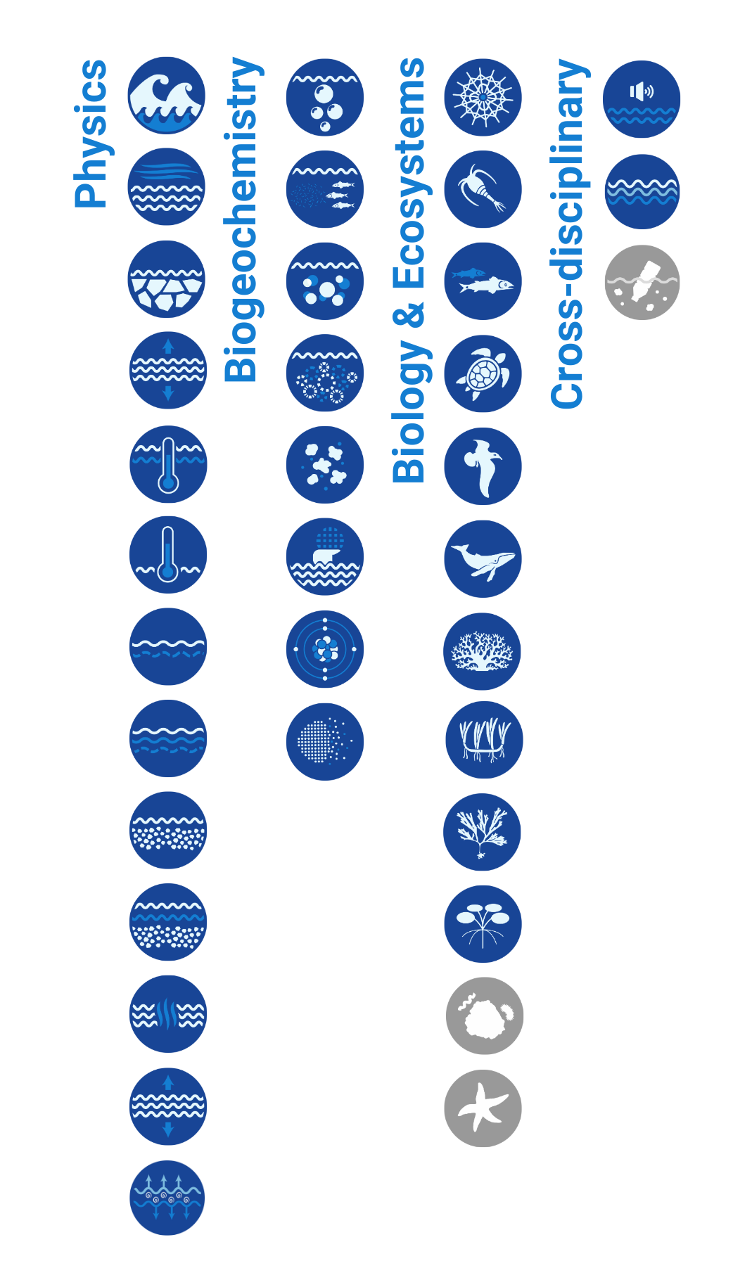
GOOS SC-13 (2024) - start shaping ideas for:
? cross-GOOS digital system
What do our users want from a GOOS digital ecosystem infrastructure?
Access for each EOV to all observational data, from wherever in the world, with a known uncertainty documented in the metadata
GOOS ocean data ecosystem that is foundation for the IODE 2030 Data, Decade 2030 Data Implementation Plan, WMO WIS 2.0
EOV products that are user-led
Notes:
Not going to go through them all, many on track or work underway
Two perhaps of more concern

Slide 12
GOOS SC-13 cont.
What are the main barriers to a cross-GOOS strategy?
Having a cross-GOOS strategy + standards, vision, governance
Building EOV data from the platform-based, evolve beyond single discipline
What are the opportunities?
Use our skilled people + existing building blocks
Adopt ODIS framework - metadata aggregator - key for cross Bio-Physics-BGC
Harmonise metadata. inc. GRAs, and extend metadata standards to sensor manufacturers
Harmonise best practices with OBPS
Notes:
Not going to go through them all, many on track or work underway
Two perhaps of more concern

Slide 13
GOOS SC-13 - outcomes
Action 9.1 Create and adopt a cross GOOS Digital Infrastructure/Ecosystem Strategy in alignment with IODE, Ocean Decade Data Strategy and other partners.

Slide 14
Executive Council 57 Decision: Proposal for Assembly 2025 and ongoing outreach
A first step – is a proposal for assembly 2025 – whilst building coordination, integration and advocacy
Proposal for evolving GOOS (outlining what needs to be done as a first step)
Focus GOOS to be fit for purpose to meet the needs of Member States
Review components and revise TOR, as well as MoUs with sponsors and partners
Create a functioning Digital Ecosystem to enable end user applications
Evolve a user and uptake strategy
Determine a process to set a new GOOS strategy synergised with Decade Challenge 7 and across IOC processes

Slide 15
A sustained and sustainable critical ocean observing infrastructure
From the coast to the open ocean – From the surface to the sea floor
national – regional – global
Co-designed ocean observing system for operational services, as well as research
FAIR data for the Essential Ocean Variables with clear standards, QA and QC
Equitable, federated global ocean digital ecosystem and data community
Global, regional and national coordination, integration and advocacy
Build new economic thinking, literacy, capacity, innovation and partnerships
Notes:
Why do we need to strengthen and evolve GOOS?

Slide 16
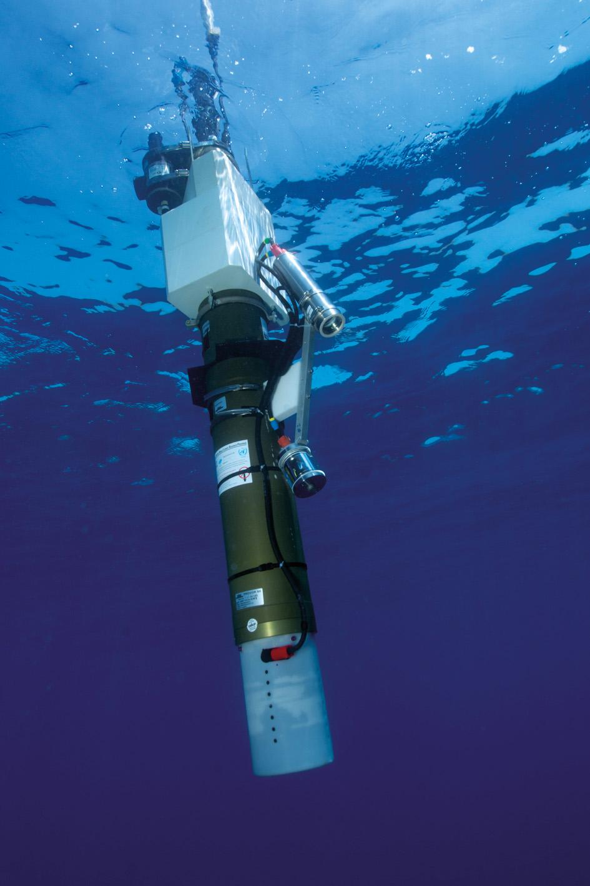
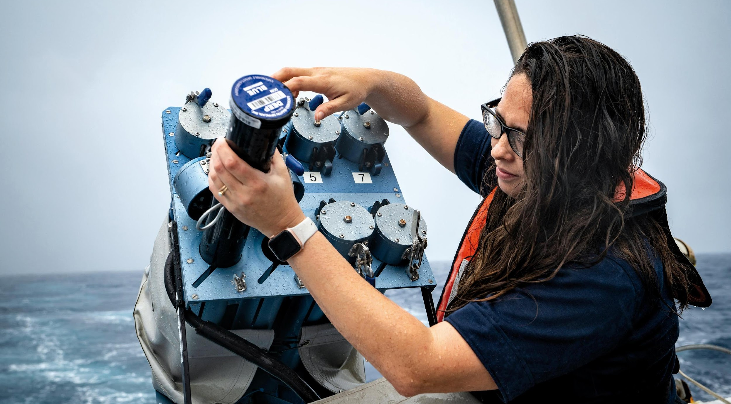
Thank you
goosocean.org

Slide 17
WMO Unified Policy for the International Exchange of Earth System Data (Resolution 42)
Single ‘unified’ data policy across multiple domains: Weather, Climate, Hydrology, Atmospheric Composition, Cryosphere, Oceans and Space Weather that aims to broaden and enhance the free and unrestricted international exchange of Earth system data
For oceans - covers in situ and remotely sensed observational data both in and above the ocean and at the sea-surface, from the open ocean to the coast, along with other data that provide necessary input to ocean monitoring and prediction and for a variety of other Earth system applications
Acknowledges the right of governments, based on their national laws and policies, to choose the manner by, and the extent to which, they make data available domestically or for international exchange – so does not override national data policies
Approved by WMO INFCOM I(III) 12 to 16 April 2021 to go to WMO EC-73 in June for consideration, aim is for final approval by WMO Congress in October
Core data (shall be exchanged on a free and unrestricted basis) | Recommended data (should be exchanged)
Marine meteorological and oceanographic observations, as defined in the WIGOS Manual (WMO-No. 1160) | Physical GCOS ECV and GOOS EOV observations that have been collected outside of designated GOOS activities
All other physical GOOS EOVs and GCOS ECVs collected as part of a GOOS observational network, programme or project consistent with the IOC Oceanographic Data Exchange Policy (IOC Resolution XXVI 8) | All other observed biogeochemical and biological/ecosystems GCOS ECVs and GOOS EOVs;
Ocean analysis and prediction fields provided by global NWP systems operating under the auspices of the GDPFS, as defined in the Manual on the Global Data-processing and Forecasting System (WMO-No. 485); | Observations of pH, chlorophyll-A, suspended particles and downwelling irradiance which are fundamental to address significant scientific and societal ocean/climate-related issues
All ocean reanalysis fields provided by the Global Processing Centres of the GDPFS;
All watches, warnings, advisories and alerts for public safety (protection of life and property) issued by Members’ designated warning and alerting authorities according to WMO Technical Regulations

Slide 18
36 Essential Ocean Variables (EOVs)
Post-2020 Biodiversity Framework
International Legally Binding Instrument on Plastic Pollution 2024
+ Biodiversity Beyond National Jurisdiction
Notes:
Convention on Biological Diversity - add the post-2024 framework

