Slide 1
46th RA IV Hurricane Committee
Ocean Panel
Consolidating the value chain:
From ocean observations to coastal inundation forecasting
Scott Glenn & Cheyenne Stienbarger, Co-leads
GOOS Ocean Observing Co-Design Programme - Tropical Cyclone Exemplar
Thursday, 21 March, 10h15-12h00
Panama City, Panama

Slide 2
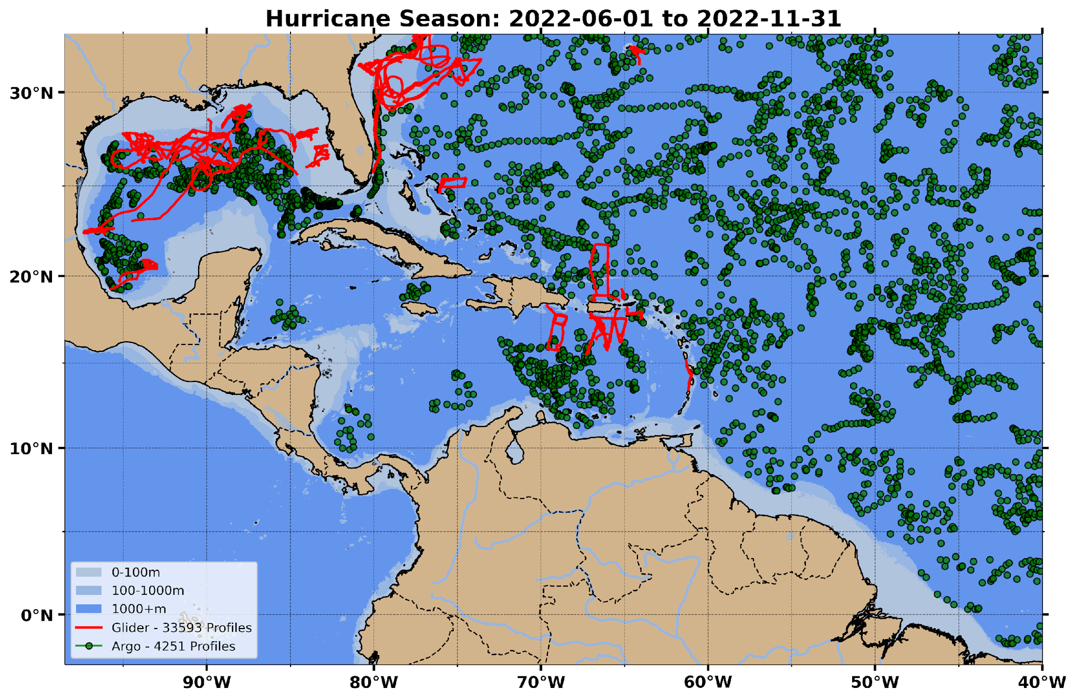
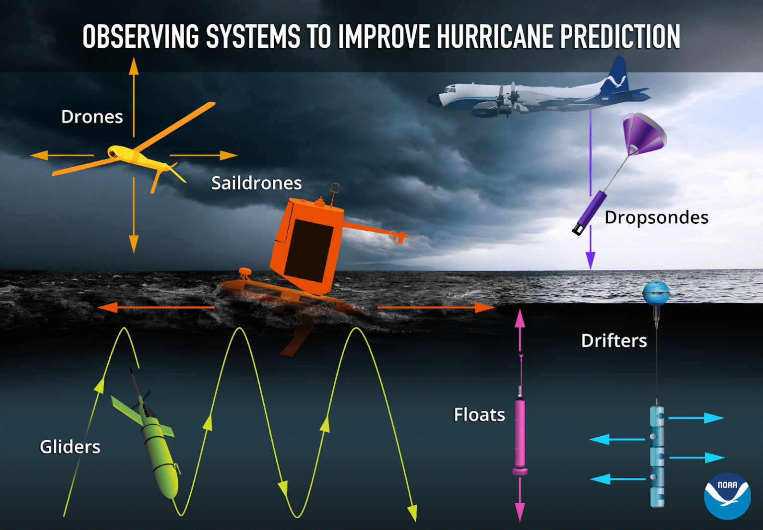
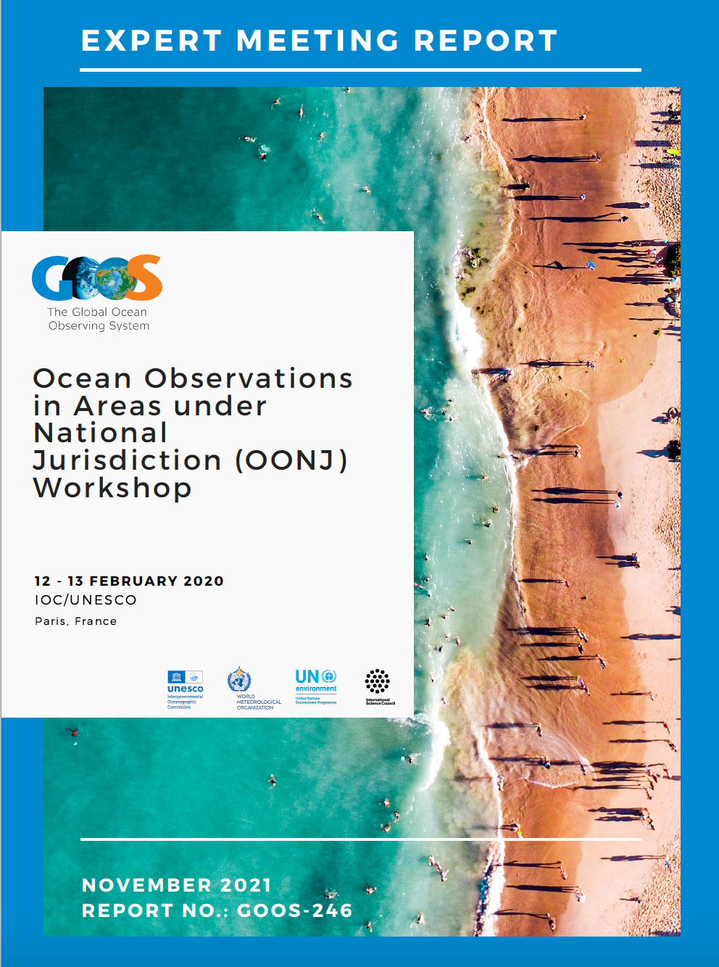
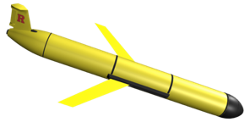

Slide 3
Why do we need more ocean observations in the Caribbean?
Hurricanes are coupled atmosphere-ocean events, including co-evolution
Ocean dependencies include upper ocean heat, salt, stratification, mixing, …
Essential Ocean Features impacting Caribbean hurricanes identified
Upper ocean heat, river plumes, global conveyor belt - passages, eddies, WBCs
Hurricanes, and the ocean beneath them, are impacted by climate change
Caribbean upper ocean is warming, subsurface ocean is saltier
Coupled atmosphere-ocean hurricane models require ocean initial conditions
Data-assimilative ocean models limited by a “dearth of subsurface profile data”*
Caribbean is a chronically undersampled for multiple applications
Uncrewed systems for subsurface profile data demonstrated in U.S. jurisdictions
* Quote from NOAA Environmental Modeling Center (EMC)
during the 2022 GOOS Co-Design Programme Kick-off Meeting

Slide 4
What are the key barriers to implementation and how can they be lowered?
Barrier: Caribbean is one sea with numerous National Jurisdictions
Response: Foster international collaboration within WMO & IOC organizations
Barrier: Technology exists, but customs fees & import duties are significant
Response: Share knowledge of ATA Carnet process for visiting technologies
Barrier: Marine Scientific Research (MSR) permits (18 so far) temporary; responsibility on researchers; not designed for sustained operations
Response: Develop regional multi-national agreements as in OONJ*
Barrier: Local ocean observing technology centers are required for logistics
Response: Capacity building is possible now – leverage existing training centers
* Ocean Observations in areas under National Jurisdiction
(OONJ) Workshop, 2020, Report no. GOOS-246.

Slide 5
What is needed to strengthen the link between ocean observations, data assimilation, modelling and coastal and marine services?
Characterize the ocean obs value chain* - identify requirements and gaps
Obs > Modeling Centers > Forecast Centers > Response Centers > People
Improving the model guidance requires ocean data ahead of the storm
Soccer analogy; aircraft chase the ball; uncrewed ocean systems protect the goal
Develop pilot projects to demonstrate value
Collect real-time observations that flow downstream through the operational centers with Observing System Experiment (OSE) follow-up at research centers
* GOOS Co-Design Programme developed several versions
that can be leveraged as starting points

Slide 6
Practical recommendations for consolidating the value chain: from ocean observations to coastal inundation forecasting
Foster WMO (Early Warnings for All) & IOC (UN Ocean Decade) collaborations
WMO Region IV, IOCARIBE-GOOS, Co-Design TC Exemplar, TAC-OOFS, …
Embrace autonomous and uncrewed systems for sustained in situ sampling
Increased coverage needed now - Develop OONJ multi-national agreements
Expand Co-Design processes to demonstrate pathways to the future
Leverage existing excess capacity, engage funding agencies and foundations, conduct observation-to-impact pilot studies*
Leverage existing training programs and co-develop technology centers
Enable training center participation (e.g., Marine Technology Society (MTS), University of Virgin Islands, etc), invite researchers to jumpstart technology centers
* U.S. National Academies Understanding Gulf Ocean Systems
(UGOS) field program in Yucatan Strait is an example of a
co-designed activity with U.S., Mexico & Cuba

Slide 7
Gracias Thank you Merci
^{wmo.int}

