Slide 1
Tsunami Service Provider Report
Pacific Tsunami Warning Center
Charles McCreery, Director
NOAA Pacific Tsunami Warning Center
charles.mccreery@noaa.gov

Slide 2
Staffing as of
Management Team .
Director Chip McCreery
Science Officer Stuart Weinstein
Electronics System Analyst vacant
24x7 Duty Scientists .
Lead Duty Scientist Dailin Wang
Lead Duty Scientist David Walsh
Lead Duty Scientist Nathan Becker
Lead Duty Scientist Jonathan Weiss
Lead Duty Scientist Stanley Goosby
Duty Scientist Andrei Natarov
Duty Scientist Carolina Hincapie
Duty Scientist Caroline Jackson, in training
Duty Scientist Hannah Weinstein, in training
Duty Scientist Kayla Besong, starting 9/23/24
Support Staff .
Administrative Support Assistant Melissa Behnken, starting 9/23/24
Electronics Technician Karl Abrahamzon
Information Technology Specialist Aaron Beers
Contract Support .
Information Technology Contractor Sean Gleason

Slide 3
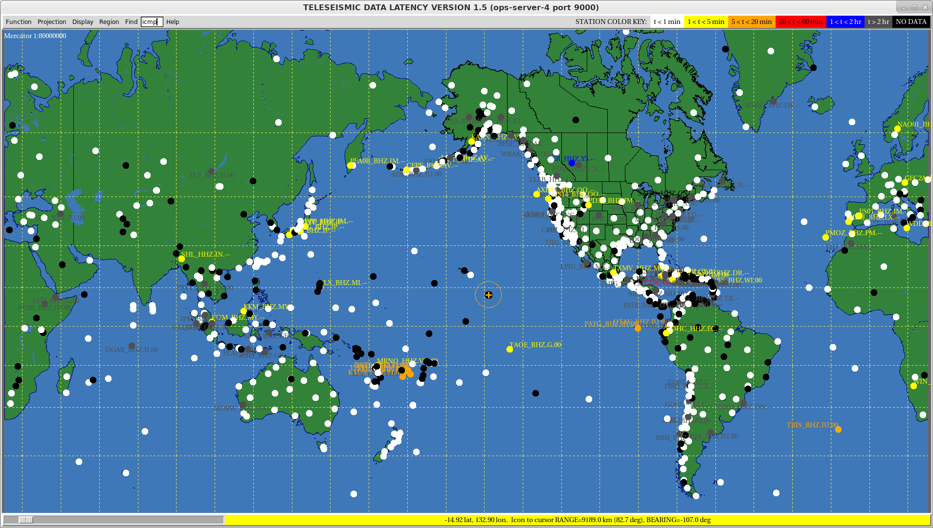
Seismic Network Used by PTWC – 9/14/24
Snapshot on 6/5/22
White Dots are Active
Each dot is a seismic station. At the time of this snapshot, PTWC was receiving digital seismic waveform data from all the white-colored stations within a minute. No data was being received from black-colored stations.

Slide 4
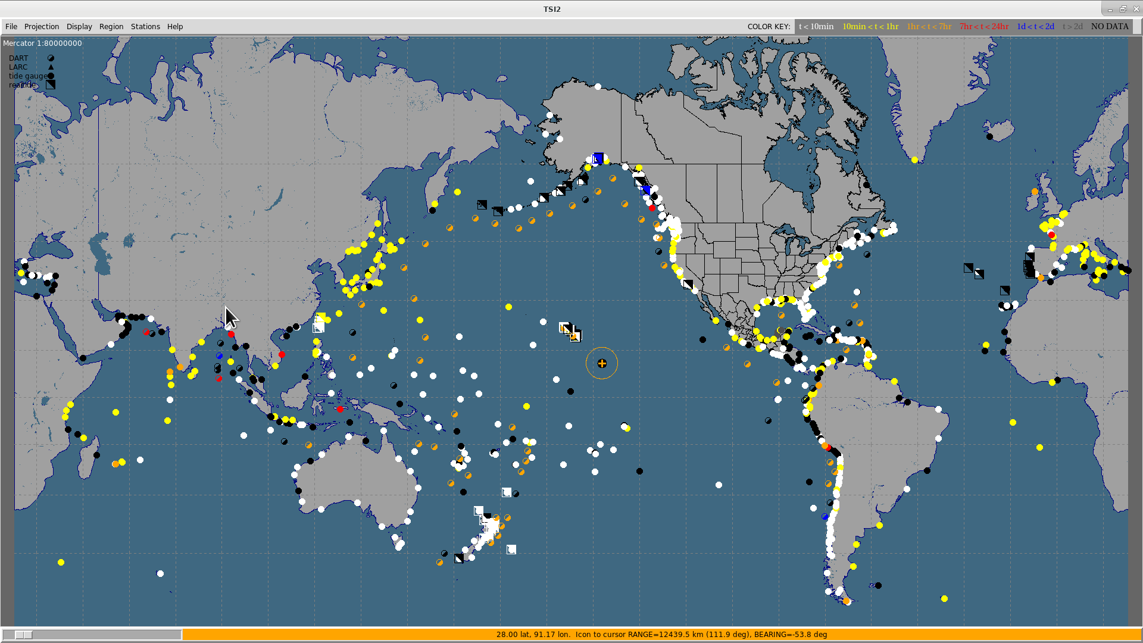
Sea-Level Gauges Monitored by PTWC – 9/14/224
Snapshot on 6/5/22
White Dots are Active
Small dots are coastal sea-level stations. Larger dots are deep-ocean tsunameters (DARTs). At the time of this snapshot, the white and yellow coastal stations and the orange DART gauges were sending timely data. Black stations were not functioning.

Slide 5
PTWC Messages Issued since September 2023
37 Tsunami Information Statements issued
6 Tsunami Threat Message sequences issued
12/02/23 – Mw 7.6, Philippines, 3 Messages, 8 cm Davao, Philippines
12/07/23 – Mw 7.1, Vanuatu, 2 Messages, 8 cm Lenakel, Vanuatu
01/01/24 – Mw 7.5, Japan, 5 Messages, >1.2 m Wajimako, Japan
04/02/24 – Mw 7.4, Taiwan, 4 Messages, 1.0 m Hualien, Taiwan
06/28/24 – Mw 7.2, Peru, 3 Messages, 20 cm Arequipa, Peru
08/17/24 – Mw 7.0, Kamchatka, 3 Messages, 3 mm DART 21416

Slide 6
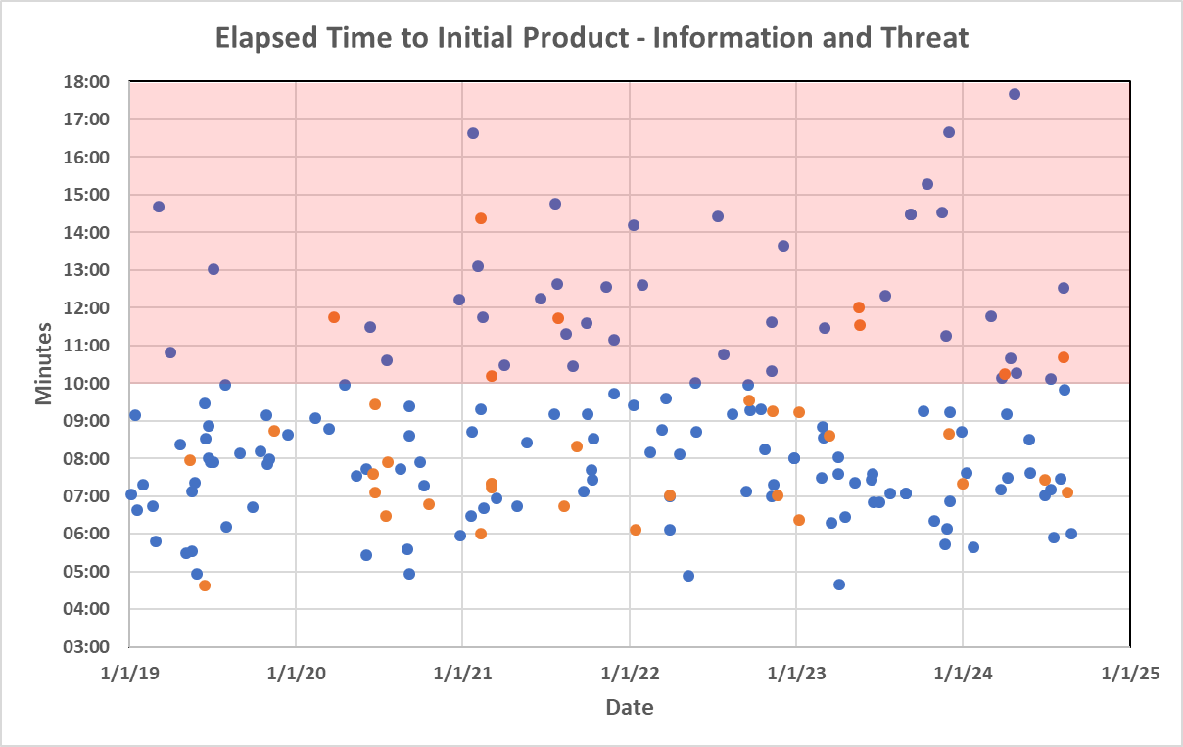
Key Performance Indicator – Elapsed Time
Blue dots are Information Statements, red dots are Threat Messages.

Slide 7
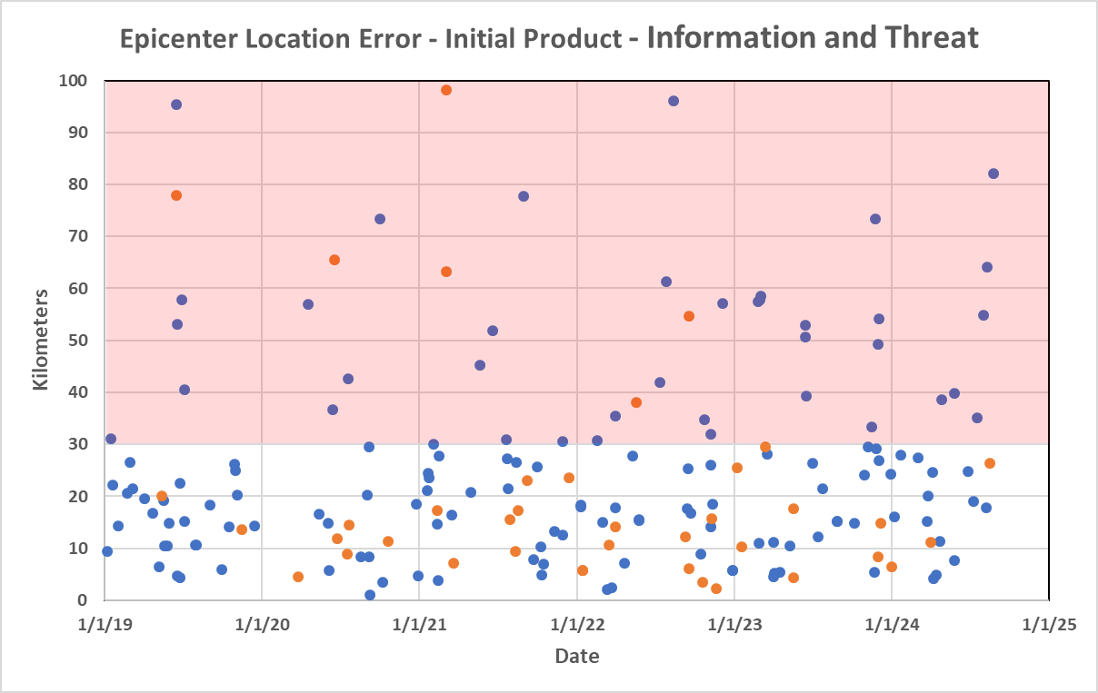
Key Performance Indicator – EQ Location
Blue dots are Information Statements, red dots are Threat Messages.
PTWC real-time parameters compared with USGS parameters published later

Slide 8
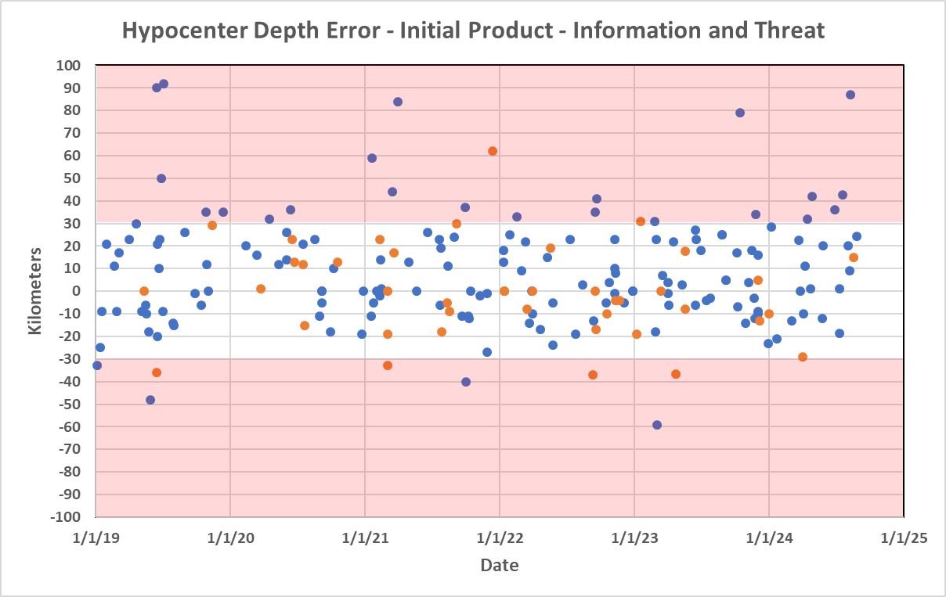
Key Performance Indicator – EQ Depth
Blue dots are Information Statements, red dots are Threat Messages.
PTWC real-time parameters compared with USGS parameters published later

Slide 9
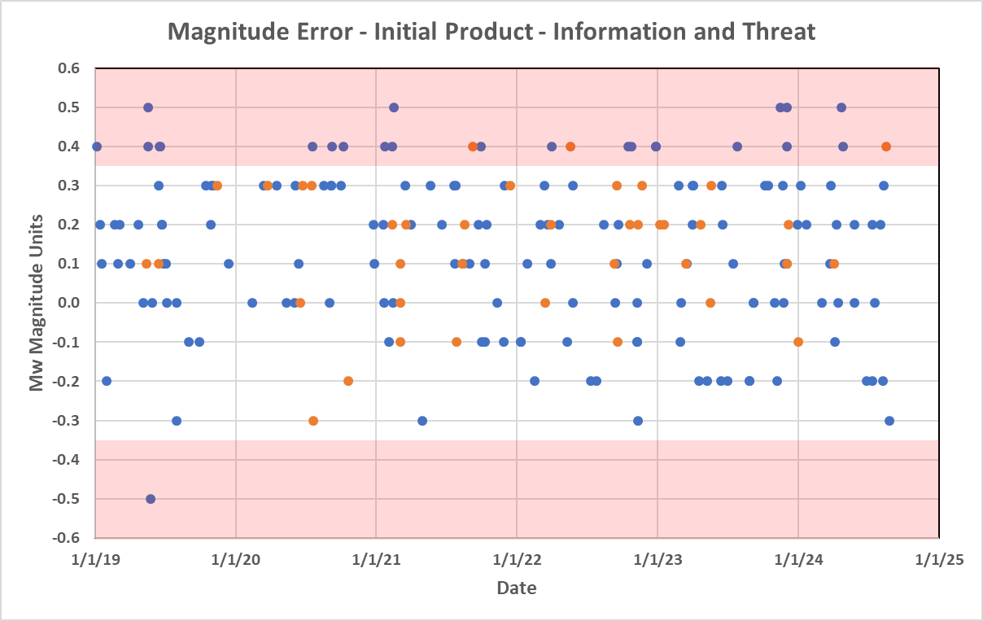
Key Performance Indicator – Mw from Mwp
Blue dots are Information Statements, red dots are Threat Messages.
PTWC real-time parameters compared with USGS parameters published later

Slide 10
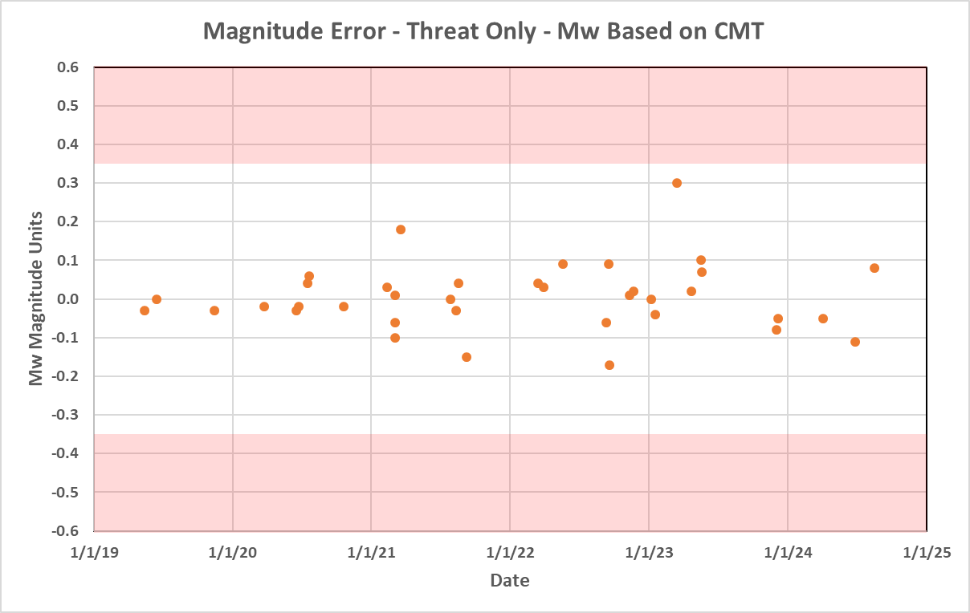
Key Performance Indicator – Mw from WCMT
PTWC real-time parameters compared with USGS parameters published later

Slide 11
Other Noteable Activities
Reorganization of PTWC, ITIC and USNTWC under common management structure
Common Message Creation and Dissemination Software for PTWC and USNTWC
Enterprise Supported
More Seamless Backup between PTWC and USNTWC
More Standardized Products including CAP
Common Analysis System for PTWC and USNTWC
Enterprise Supported
More Seamless Backup between PTWC and USNTWC
Improved Tsunami Forecasting (Probablistic Forecasts?)
Complete redo of the tsunami.gov website
Enterprise Supported
More information – operational and background
Ease of Use
Reimplement Un-announced Communication Tests

Slide 12
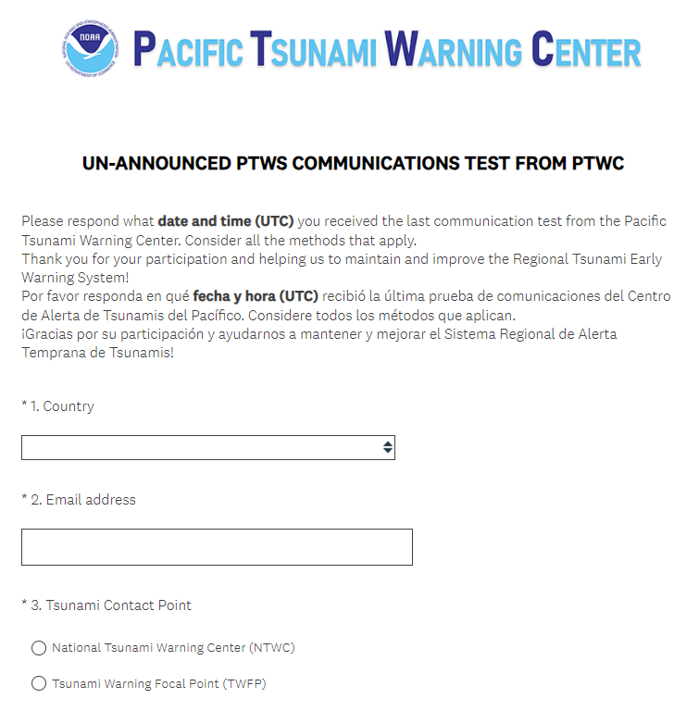
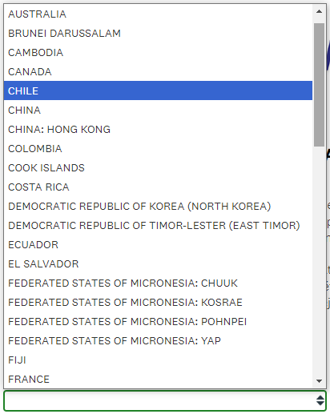
https://www.surveymonkey.com/r/testPTWS

Slide 13
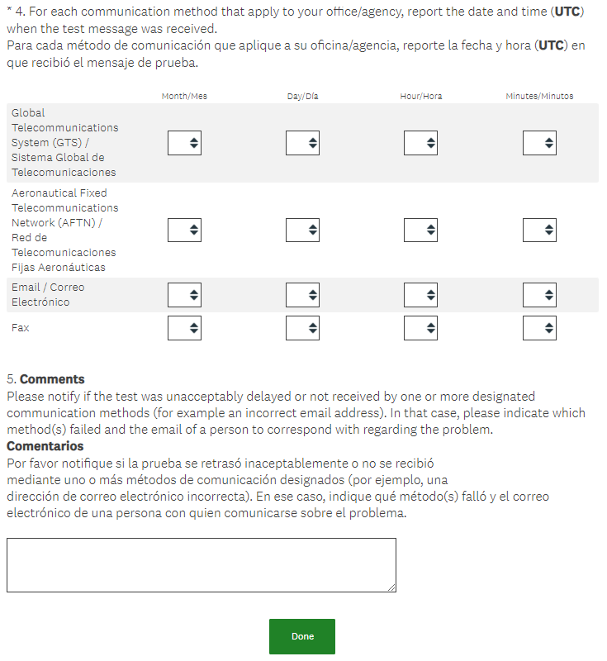

Slide 14
Covered Tomorrow in SC Agenda
Expansion of Earthquake Source Zone to Scotia Arc
Changes to PTWC Threat Message Content and Format
Ceasing of Telefaxes
Revision of PTWC User’s Guide
Maritime Products

Slide 15
Thank You
Charles McCreery, Chair
NOAA Pacific Tsunami Warning Center
charles.mccreery@noaa.gov

