Slide 1

2025 PTWS
Capacity Assessment
Tsunami Preparedness
2024 Indian Ocean
Tsunami Warning & Mitigation System
(IOTWMS) Capacity Assessment
To be completed Nov 2024
Survey findings and Recommendations through Capacity Assessment Validation Workshop, 4-6 Sep 2024, Bangkok, Thailand
Laura Kong, Lara Bland, Suci Dewi Angurah

Slide 2

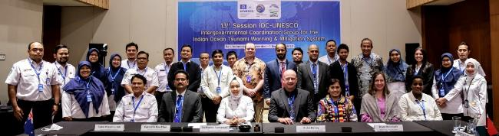
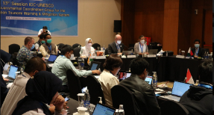
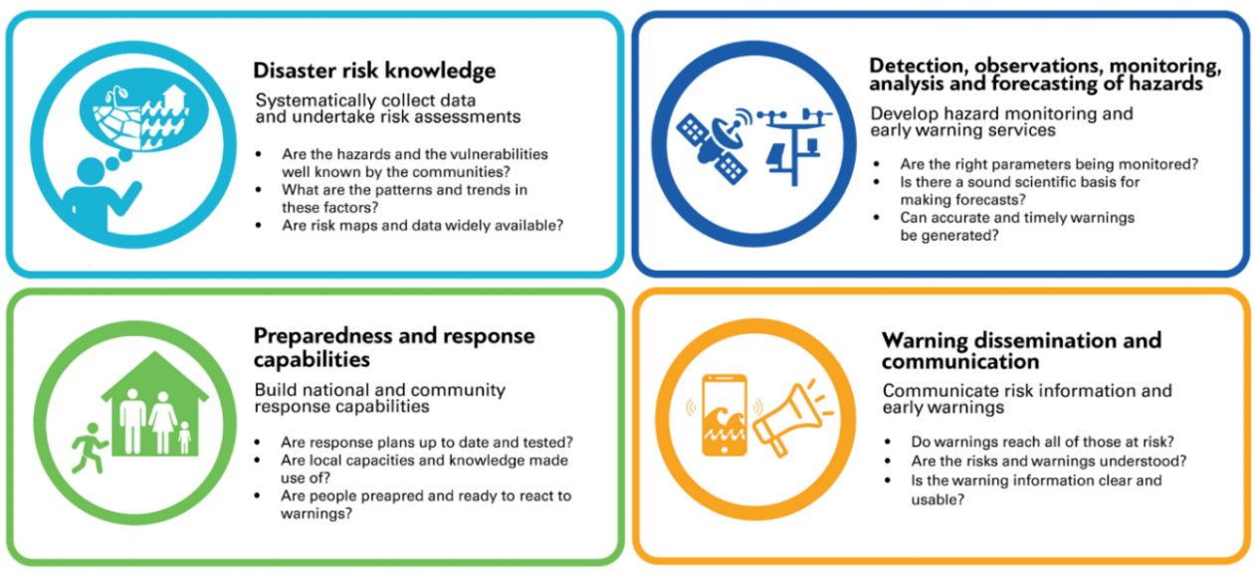
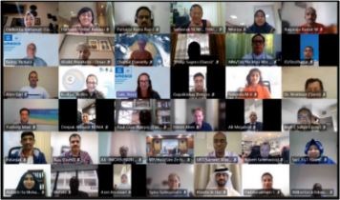
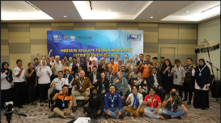
UNESCO-IOC ICG/IOTWMS (Established 2005)
ICG/IOTWMS Work Programmes
Working groups and task teams work across four pillars
across four pillars
Pillar 1
WG 1
Pillar 2
WG 2
Pillar 4
WG 1 + 3
Pillar 3
WG 2
26 Member States (24 of which active)
Indian Ocean Regional Decade Conference,
Hyderabad, India, 1-3 February 2024
2

Slide 3





re
Capacity Assessment Tsunami Preparedness
Indian & Pacific Oceans Project
ESCAP Multi-Donor Trust Fund for Tsunami, Disaster and Climate Preparedness

Slide 4

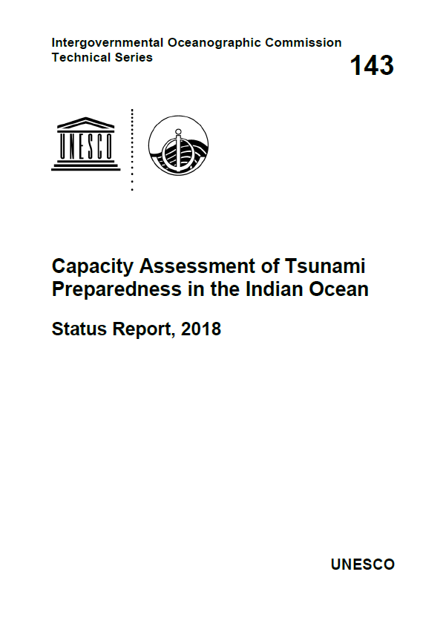

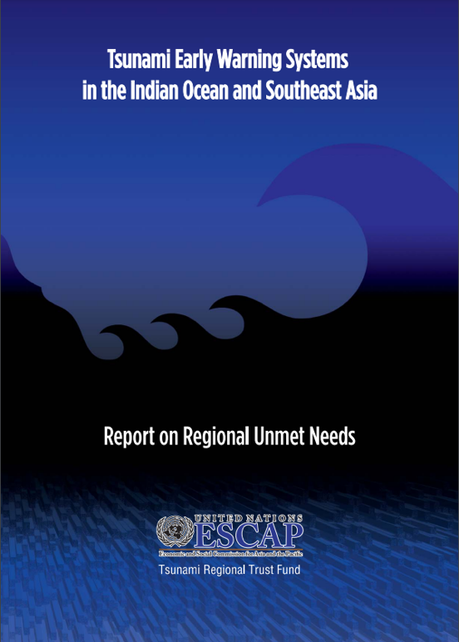
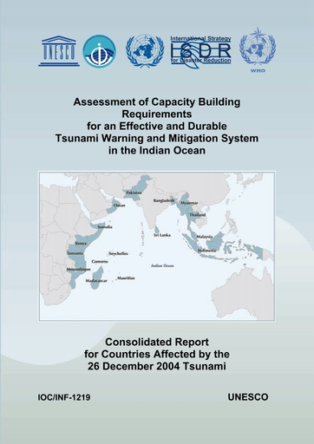
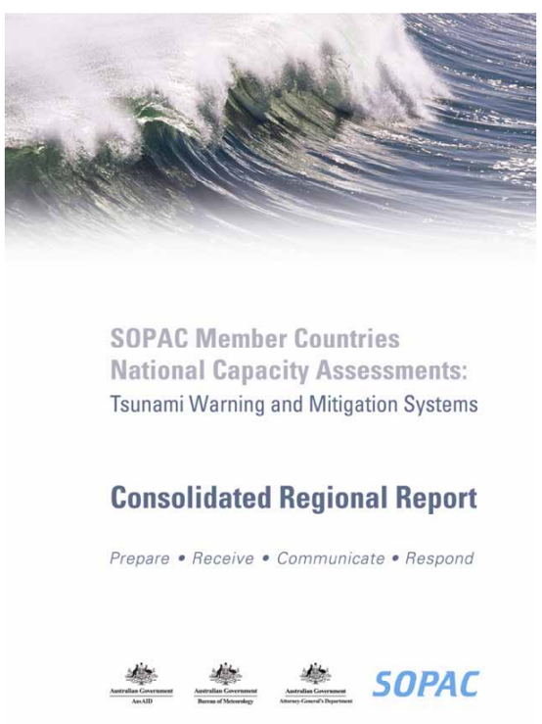
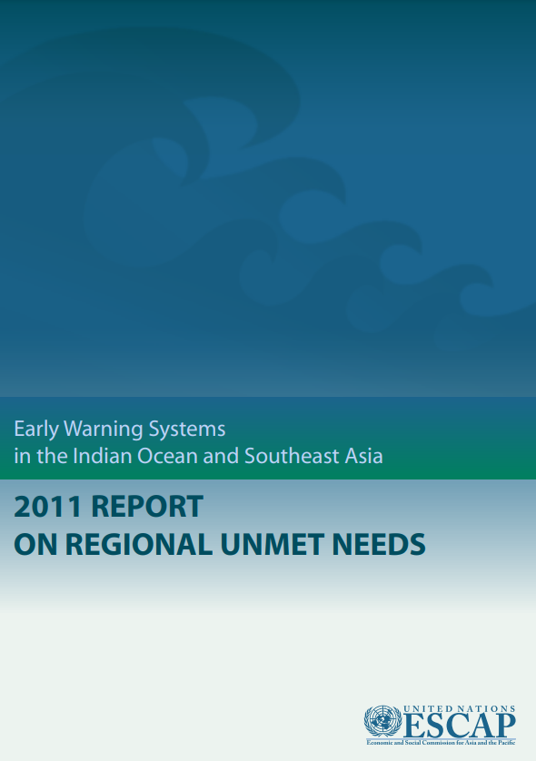
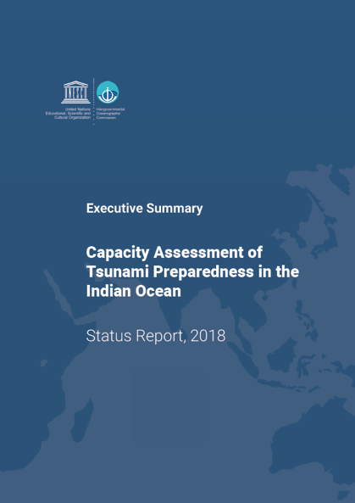
Previous Comprehensive Assessments
PTWS
National capacity assessments for 14 Pacific countries and consolidated regional report in 2009/2010 funded by Australia
ESCAP
Unmet needs survey for the region conducted in 2008 and 2011
IOTWMS
- Full capacity assessments in 2005 and 2018 and commitment to undertake 2024
Capacity assessment framework and tools already developed
Notes:
Several comprehensive capacity assessments have been undertaken for both the IOTWMS and PTWS:
The Australian Government in 2009/2010 conducted a capacity assessment of tsunami preparedness for 14 SW Pacific countries.
ESCAP in 2011 conducted a survey Immediately following the aftermath of the 2004 Indian Ocean tsunami, UNESCO-IOC in 2005 conducted a baselines capacity assessment of tsunami preparedness for the Indian Ocean.
To evaluate progress since 2005, in 2018 the ICG/IOTWMS conducted a 2nd capacity assessment of tsunami preparedness for the Indian Ocean.
In 2011

Slide 5




Capacity assessment of tsunami preparedness
OBJECTIVES
  To evaluate the existing technical capacity of the UNESCO-IOC Indian Ocean Warning and Mitigation System (IOTWMS) and Pacific Tsunami Warning & Mitigation System (PTWS) and highlight the progress made since 2004 Indian Ocean Tsunami and subsequent assessments.
  To identify specific gaps and capacity development requirements at regional and national levels for strengthening the technical and policy aspects of the tsunami warning and mitigation systems in the region
  To reinvigorate political commitment and provide recommendations for investments in tsunami preparedness, aiming to address the identified gaps in Asia and the Pacific through regional and subregional cooperation.

Slide 6
Capacity assessment of tsunami preparedness
2024 OUTPUTS - IOTWMS
1.A_ Member States Survey Analysis for IOTWMS (IOC)
1.B_ IOTWMS assessment summary and comparative analysis (IOC)
3.A_ Tsunami preparedness recommendations for ASEAN policymakers (UNESCAP)
3.B_ Tsunami preparedness recommendations for SAARC policymakers (UNESCAP)
2025 OUTPUTS - PTWS
2.A_ Member State Survey Analysis for PTWS (IOC)
2.B_ PTWS assessment summary and comparative analysis (IOC)
3.C_ Tsunami preparedness recommendations - for PIF policymakers (UNESCAP), ??? (for other parts of Pacific)

Slide 7
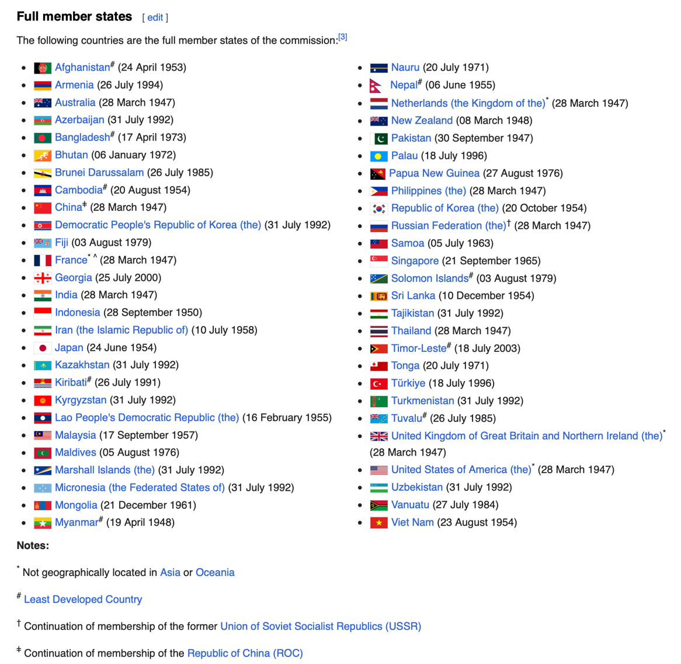
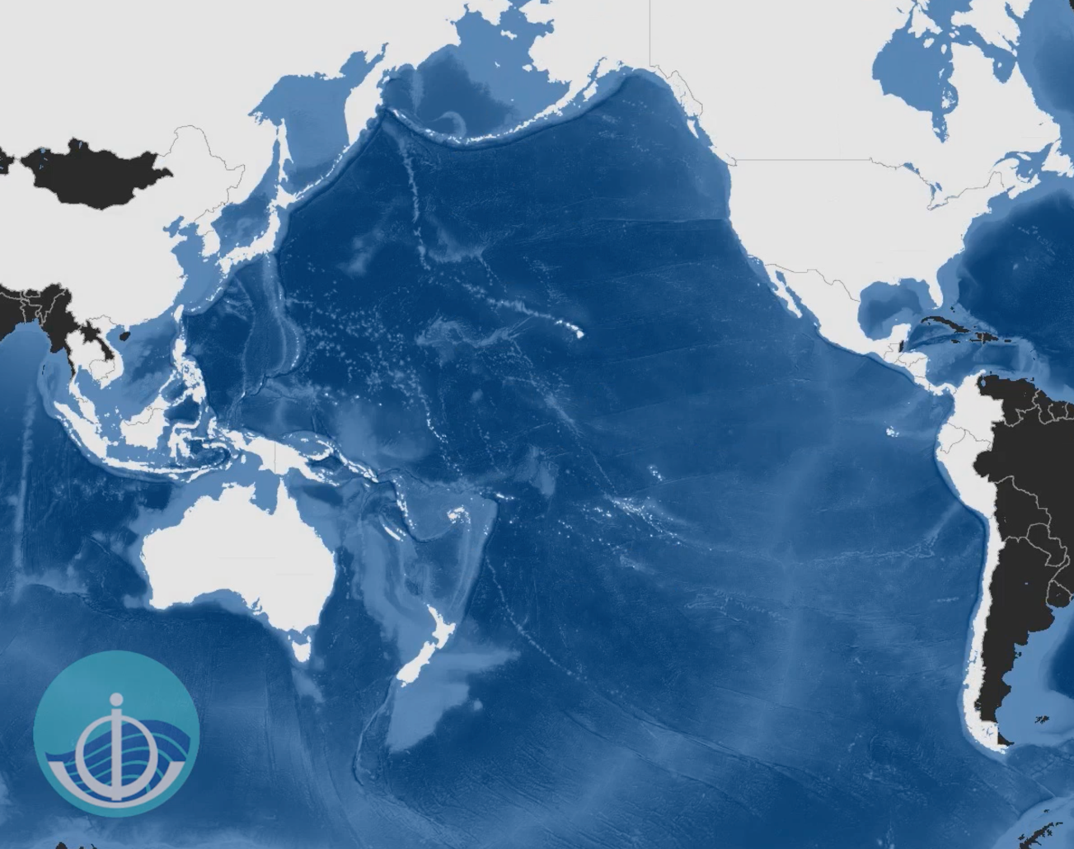
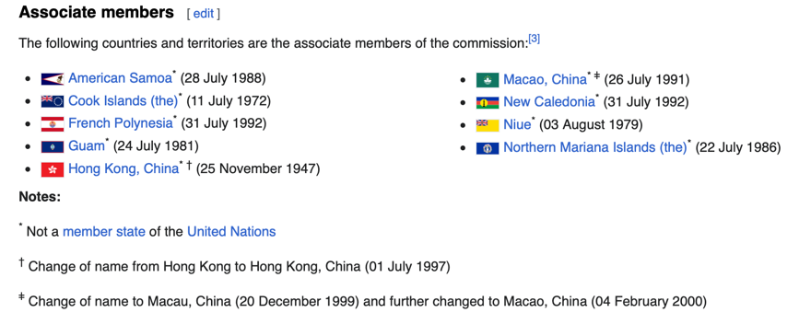
PTWS Scope – 46 Member States – Pacific Ocean, incl Marginal Seas
PTWS: 46 member states, Pacific Ocean and its Marginal Seas
Of 46, 4 are UNESCO, not IOC (Brunei, Cambodia, RMI, FSM), 1 is UNESCO Assoc MS, not IOC (Tokelau)
UNESCAP: 53 member states (extend east to Tonga/Samoa, 9 associate (Cook Island, FP/NC, Niue)
UNESCAP, incl also Netherlands, UK, USA

Slide 8
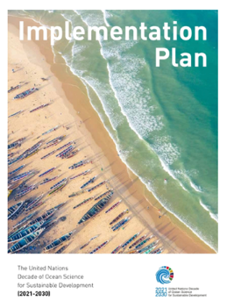
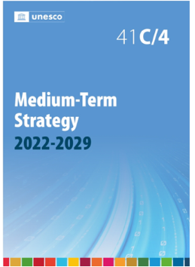
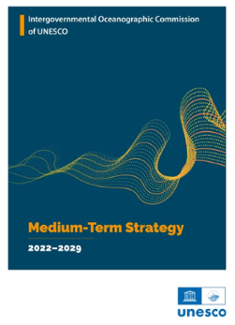
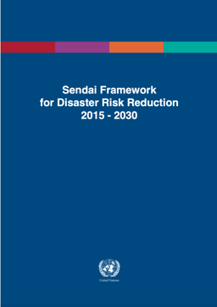
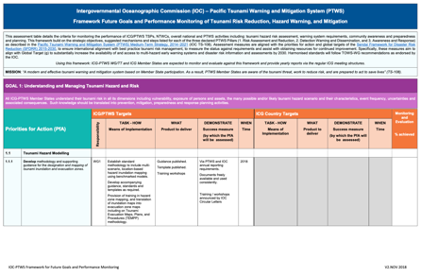
PTWS Medium Term Strategy, 2022-2030 (TS 172)
Aligned with
  United Nations Decade of Ocean Science for Sustainable Development (2021– 2030): Implementation Plan
  UNESCO’s Medium-Term Strategy for 2022–2029 (41 C/4).
  Intergovernmental Oceanographic Commission (IOC) Medium-Term Strategy 2022–2029 (PTWS parent body’s Strategy) that identifies early warning systems as an important part of its strategic vision - Framework for Global Tsunami and Other Ocean Hazards Warning and Mitigation Systems.
  Global targets and priorities for action of Sendai Framework for Disaster Risk Reduction (SFDRR) 2015–2030 – specifically SFDRR Target G, which is to Substantially increase the availability of and access to multi- hazard early warning systems and disaster risk information and assessments to people by 2030)
  ICG/PTWS Framework Future Goals and Performance Monitoring of Tsunami Risk Reduction, Hazard Warning, and Mitigation (2018)

Slide 9

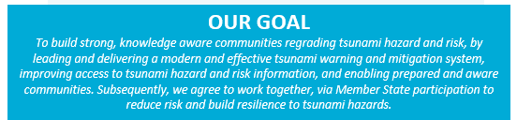
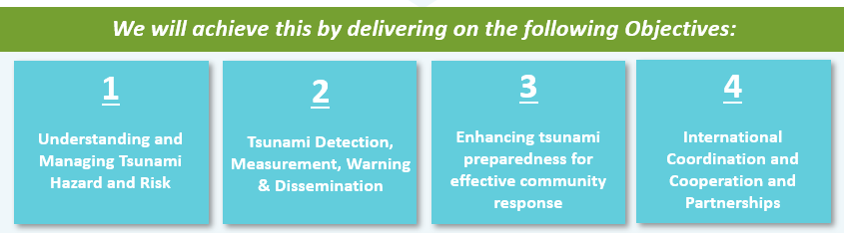
PTWS Vision, Goal, Objectives

Slide 10
Major PTWS Milestones - PROPOSED
End
by XX 2025
Approval PTWS Steering Commitee
Sep 2024
Budget and timelines for ESCAP meeting
8 Oct 2024
Review findings and draft recs
by xx Apr 2025
SC accepts recs
TBD
Finalise questions
by 31 Dec 2024
Validation Workshop
TBD – when, who ?
Planning and Inception
Validation and Review
Initial findings to ICG/PTWS-XXXI
7 – 11 Apr 2025
Finalisation and Communication
IOC Circular Letter distributes survey
1 Feb 2025
Survey completion by MSs
1 – 28 Feb 2025
Final report
Review IOTWMS questions
20 Sep – 30 Oct 2024
Data Collection and Analysis
Compilation/ analysis of survey findings
1 Mar – 1 Apr 2025
Policy report
Tabled at IOC General Assembly Jun 2025

Slide 11
Capacity assessment input
Member States Survey:
  The official Tsunami National Contacts (TNCs) of the UNESCO-IOC ICG/IOTWMS were requested to coordinate the completion of an online survey (based on 2018 survey to enable comparisons), in consultation with other national stakeholders involved in end-to-end tsunami early warning and mitigation within the country.
  22/24 Member States completed and submitted the survey in May/June 2024.
  The survey data was analysed by the University of Huddersfield
National tsunami warning chains review:
  As part of three SOP training workshops for all Member States in 2023, national tsunami warning chains and associated SOPs were forensically reviewed.
  A report was prepared on the status of national tsunami warnings and SOPs, which is used for the current capacity assessment
ICG/IOTWMS Work Programmes:
Capacity gaps have been identified by the WGs and TT of the ICG/IOTWMS and reflect Member State needs

Slide 12
Review Process and Drafting Recommendations - Proposed
based on IOTWMS Capacity Assessment process
ICG/PTWS Workshop to review Survey findings / analysis, discuss identified gaps, draft recommendations. Workshop participants are chairs of PTWS Working Groups and Task Teams + invited guests. Review outcomes consistent with PTWS Medium Term Strategy (2022-2030, IOC TS 172)
Draft recommendations to address identified gaps produced by Workshop Then, further review by all members of Working Groups, Task Teams
Draft recommendations reviewed by ICG/PTWS Steering Group. Steering Group advises Chair of ICG/PTWS Steering Group whether to endorse recommendations (since full ICG/PTWS not able to convene)
Final report on outcomes of capacity assessment, including Executive Summary Tabled at XXX YYY (location, date, such as IOC Assembly 2025?)
UN ESCAP to produce Summary of for policy- and decision-makers to facilitate uptake of outcomes of assessment for action and hopefully funding support from key donors

Slide 13
PTWS Tsunami Preparedness Capacity Assessment - Funding
  UNESCAP
    Workshop (UNESCAP member travel, venue)
    Consultants:
      Technical Assessment (Facilitate Workshop, Write Final Report)
      Policy Paper
    Other – international staff, report editing/design, misc
  IOC
    Workshop (Remainder IOC PTWS member travel)
  Other Activities needed?

Slide 14

Example from IOTWMS
Online Survey Structure and Procedures
Nora Gale
Assistant Programme Specialist
Indian Ocean Tsunami Warning & Mitigation System Secretariat Intergovernmental Oceanographic Commission of UNESCO
n.gale@unesco.org
Briefing: UNESCO-IOC 2024 Survey of Capacity Assessment of
Tsunami Preparedness in ICG/IOTWMS Member States, 22 May 2024

Slide 15
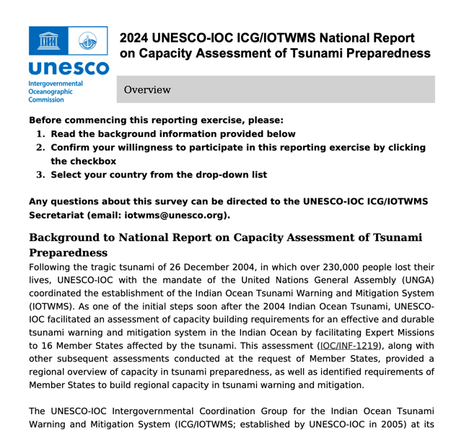
Survey Structure - IOTWMS
Survey has six (6) distinct parts
Each part may need inputs from different stakeholders based on their national responsibility in the end-to-end tsunami warning and mitigation system.
Basic Information
Risk Assessment & Reduction
Detect, Warning & Dissemination
Public Awareness, Preparedness & Response
Tsunami Ready Recognition Programme
Narrative

Slide 16
Parts I – III - IOTWMS
Part | Topic of the Survey Stakeholder Inputs
I | Basic Information: TNC / NTWC / TWFP contact details | Tsunami National Contact Secretariat will follow up separately to formally incorporate any updates on Member State nominations of TNC through official channels.
II | Risk Assessment & Reduction Inputs to be obtained from Disaster Management Agency and/or other Hazard Assessment, Risk, Country Assessment, Policies, Plans, Guidelines
III | Detection, Warning & Dissemination | Inputs to be obtained from National Tsunami Warning Centre and/or other agency responsible for generation and dissemination of tsunami early warnings within country.

Slide 17
Parts IV – VI - IOTWMS
Part | Topic of the Survey Stakeholder Inputs
IV | Public Awareness, Preparedness & Response: SOPs, Evacuation Infrastructure, Tsunami Exercises, Public Awareness | Inputs to be obtained from the Disaster Management Agency and/or other agencies responsible for public awareness, preparedness, and response in the country.
V | Tsunami Ready Inputs to be obtained from Tsunami Ready Focal Point (TRFP) and/or other Recognition Programme agency responsible for the TRRP or other recognised similar initiative in (TRRP) country.
VI | Narrative: Important development since last report and summary of future plans | Tsunami National Contact

Slide 18
Online Survey – IOTWMS (generalized)
Survey conducted online using Survey Monkey platform.
Unique online survey links shared with all Tsunami National Contacts on XXX (date)
  Subject: Survey of Capacity Assessment of Tsunami Preparedness in the IOTWMS (PTWS) Member States
  From: XXX via SurveyMonkey
Survey is passport protected.
Password shared with TNCs on XXX in separate email from XXX

Slide 19
PTWS Capacity Assessment – PTWS SC Considerations / Actions
  Approve Process – follow IOTMWS? (Survey, Review Workshop for Recommendations, Approval by SC, Sharing)
  Establish Timeline. Deadlines:
    PTWS Proposal for ESCAP approval (funding) – before 8 Oct
    Survey process (when, who, how)
      Pre-inform countries (IOC CL, PTWS Chair?)
      Conduct Survey (when, who to announce)
      Survey Results review workshop (when, who)
      Survey report, w/recommendations for gaps (when, approval by?)
  Decide who is involved? Lead(s), Workshop, Review
  Finalize Survey Questions – Review, Modify – who, when, how (method)
  Confirm funding: UNESCAP (Member States), IOC (remaining PTWS), other?
  Other ?

Slide 20
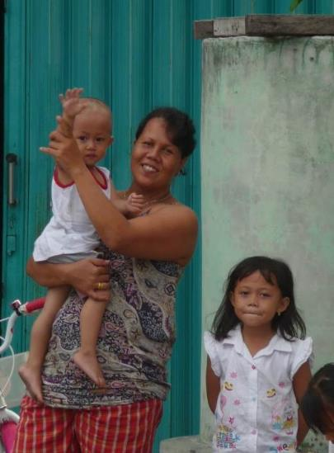


We all need to work together to make the world’s at-risk coastal communities
Tsunami Ready

