Slide 1

ICG/PTWS Steering Committee September 2024
8.2.1 Tsunami Ready
Task Team Tsunami Ready Co Chairs:
Laura Kong, ITIC
Ashleigh Fromont, NZ NEMA

Slide 2
ICG/PTWS Steering Committee September 2024
DISCUSSION ITEMS
1. Status Review (ICG/PTWS-XXX & TOWS-WG)
Tsunami Ready Toolkit
Standardized Training – Ocean Teacher Global Academy
2. Progress & Tsunami Ready Survey
3. The Equivalency Guidance

Slide 3
ICG/PTWS Steering Committee September 2024
Status of Actions & Decisions – ICG/PTWS-XXX
ICG/PTWS-XXX in September 2023 established the WG3 Task Team: Tsunami Ready to facilitate and coordinate efforts relating to the Tsunami Ready Recognition Programme and within the ICG/PTWS, in support of the UN Ocean Decade Goals (ICG/PTWS-XXX.1)
Also, through ICG/PTWS-XXX.5, the ICG:
Encouraged member states to continue to share outcomes and progression towards “100% Tsunami Ready Goal” with WG3, including communities already considered compliant through national standards
Mandated the ITIC to continue to facilitate implementation and data collection regarding TR in the PTWS
Noted & Endorsed the proposed Tsunami Ready Equivalency Approach that seeks to enable reporting of tsunami preparedness in a manner compatible with the UNESCO/IOC Tsunami Ready Recognition Programme
Recommends the TT TR to develop formal guidance for the application of this approach, in consultation with the Regional Working Groups.
The task team has representation from Chile, China, Ecuador, France, Japan, Malaysia, New Zealand and USA and met three times in 2024.
Please see full recommendation in ICG/PTWS-XXX.5
https://oceanexpert.org/event/3920

Slide 4
ICG/PTWS Steering Committee September 2024
TASK TEAM ON TSUNAMI READY - TERMS OF REFERENCE
This expert Task Team will facilitate and coordinate efforts relating to the Tsunami Ready Recognition Programme and within the ICG/PTWS, in support of UN Ocean Decade Goals.
Develop formal PTWS guidelines following the 'Tsunami Ready Equivalency Approach’ for recognition of tsunami readiness of communities not implementing the IOC Tsunami Ready Recognition Programme,
Monitor Tsunami Ready campaigns and outcomes, and report results,
Ensure the advocacy for Tsunami Ready is aligned with other PTWS and IOC documents,
Advise on the Tsunami Ready workflow as it pertains to the PTWS and regions,
Support ITIC in its efforts to facilitate the implementation of Tsunami Ready in PTWS Member States,
Support ITIC’s efforts to develop standardized training supporting Tsunami Ready under the framework of OTGA, such as through feedback on content and helping to test trainings before officially deployed,
Help to identify sources of funding in support of the implementation of Tsunami Ready,
Report progress on encouraging the standard text in the UNESCO-IOC Tsunami Ready signage for vertical evacuation, such as “Go to the designated building for vertical evacuation”,
Report progress toward informing the public on the validity of the recognition, to be indicated on Tsunami Ready signage and on the certificate under the UNESCO-IOC Tsunami Ready logo.
The Group will be composed of members nominated by the Member States, representative of ITIC, with two co-chairs to be elected by the ICG.

Slide 5
ICG/PTWS Steering Committee September 2024
Status of Actions & Decisions – TOWS-WG-XVII
The WG encourages synergy with Making Cities Resilient (2030), and recommended ICGs advocate for member states implementing Tsunami Ready to link with this (such as agency representation on NTRB).
The WG recommended text for signage for locations that will not feel the earthquake, such as ‘In case of any official tsunami message, go to high ground or inland’.
(PTWS ITIC recommendation from working with Micronesia (Chuuk, Pohnpei) that has distant threat)
ICG/IOTWMS have established National Tsunami Ready Focal Points to facilitate coordination and communication.
TT-DMP have been asked to consider the introduction of a Tsunami Ready Evaluation Form, as currently run in ICG/CARIBE.
There is an ISO 22328-3 which is targeting the large-scale private sector to be tsunami ready
Please see full recommendation in the TOWS-WG-XVII report.

Slide 6
ICG/PTWS Steering Committee September 2024
Status of Actions & Decisions – TOWS-WG-XVII
Progress on Tsunami Ready implementation was presented at the TOWS TT-DMP and TOWS-WG-XVII.
The Group noted “the progress made by ICG/PTWS concerning exploring mechanisms of how to include national tsunami preparedness and readiness programmes and initiatives in the UN Ocean Decade Programme, and that the Tsunami Ready Equivalency Approach framed under similar initiatives seeks to enable reporting on tsunami preparedness in a manner compatible with the TRRP”
And recommended that ICG/PTWS Task Team Tsunami Ready share the ICG/PTWS guidance on Tsunami Ready Equivalency for further consideration by TT-DMP, as a potential mechanism for reporting toward this goal;
The Groups also requested that the Secretariat, led by TICs, develop and share a Tsunami Ready Toolkit to assist Member States with implementation, such as standard procedure for the submission of an application, and clarification on the definition of ‘community’ .
Please see full recommendation in the TOWS-WG-XVII report.

Slide 7
ICG/PTWS Steering Committee September 2024
Tsunami Ready Toolkit - contents so far
.
TR Application and NTRB approval process
Efficient Application Submission – enable online, automated, std file-naming
Language requirements / flexibility for application / supporting documents
Accompanying Letter templates for required submitted documents
NTRB Tsunami Ready Application Review process – guidance for verification and approval with examples
How to start Tsunami Ready - what to do 1st, 2nd, etc
Guidance how to define Community
Use of baseline survey to document what is available and/or done
Confirm/obtain data for Inundation Modeling (bathymetry, topography, sources)
Confirm/obtain data for Evacuation Mapping – GIS data layers
TR Work flow (between country and IOC Secretariat)
Signage guidelines (std colors, size, fonts, words, etc for common signs)

Slide 8

ICG/PTWS Steering Committee September 2024
Standardized Training supporting Tsunami Ready – ITIC
IOC Ocean Teacher Global Academy (OTGA)
Intl Oceanographic Data and Information Exchange (IODE) programme
Implements IOC Capacity Development Strategy
Online, global platform; 17 regional and specialized centres around the world
ITIC is OTGA Specialized Training Centre (STC) for Tsunamis
UNESCO-IOC Tsunami Awareness (foundational) - live Aug 1
ITIC with Tsunami TRS (Bernardo Aliaga)
UNESCO-IOC Tsunami Ready (requires Tsunami Awareness) - live Sept 1
ITIC and IOTIC (Ardito Kodijat)
UNESCO-IOC Tsunami Warning Center Staff Competencies – 2025/2026
Implement PTWS NTWC Minimum Staff Competency Framework(2023)
ITIC and PTWS Member States, request from PICT
Series of self-paced and Hybrid pre-requisites, culminate in in-person course

Slide 9

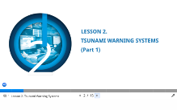
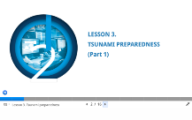
UNESCO-IOC Tsunami Awareness
ITIC and IOC TSR Joint work
Self-paced, no instructor – 6 hrs
UNESCO-IOC Tsunami Awareness certificate required for later UNESCO-IOC courses
Pre-Quiz
Lesson 1: Tsunami Basics (Parts 1 and 2)
Lesson 2: Tsunami Warning Systems (Parts 1 and 2)
Lesson 3: Tsunami Ready Preparedness (Parts 1 and 2)
Post-Test
Tsunami
Awareness
2 parts (18, 23 Slides)
2 parts (14, 18 Slides
2 parts (15, 23 Slides
All Lessons have Activities, Knowledge review checks, Narration

Slide 10

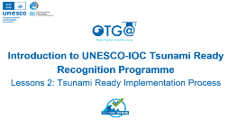
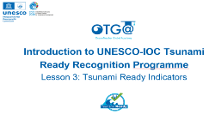
UNESCO-IOC Tsunami Ready
ITIC and IOTIC Joint work
Self-paced, no instructor
Course 1
Introduction to UNESCO-IOC Tsunami Ready Recognition Programe
Lessons 1: Tsunami Ready Background
Lessons 2: Tsunami Ready Implementation Process
Lessons 3: Tsunami Ready Indicators
Course 2
Facilitating Tsunami Ready
Lessons 1: Approach to Tsunami Ready Community Capacity Building
Lessons 2: Assessment Indicators
Lessons 3: Preparedness Indicators
Lessons 4: Response Indicators
planned
Course 1
23 Slides
19 Slides
22 Slides
All Lessons have Activities, Knowledge review checks, Narration

Slide 11
ICG/PTWS Steering Committee September 2024
PROGRESS & SURVEY

Slide 12
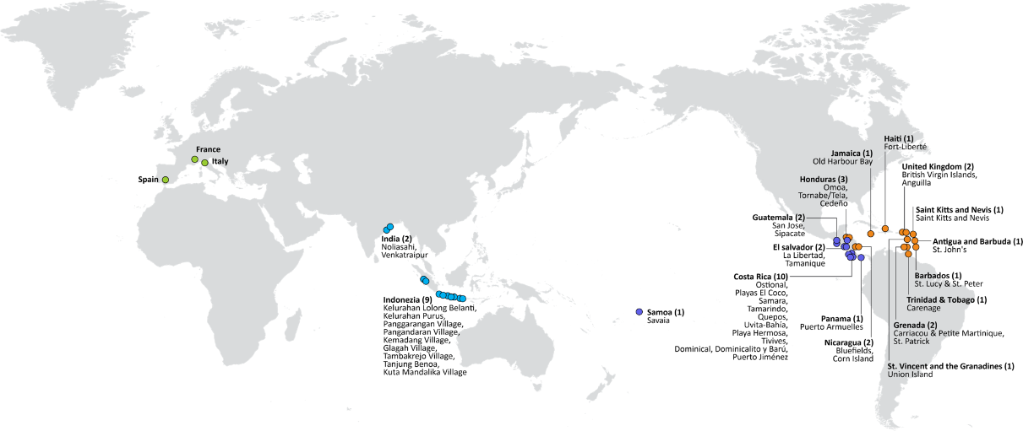


UNESCO/IOC TSUNAMI READY RECOGNITION PROGRAMME (TRRP)
54
TSUNAMI READY COMMUNITIES
11 – IOTWMS
20 – PTWS (16/46 countries)
20 – CARIBE-EWS
3 – NEAMTWS
Türkiye
United Kingdom (2)
British Virgin Islands, Anguilla
Dominica (1): Portsmouth
Saint Lucia (1): Laborite
Greece
Israel
– in progress (next yr)
Egypt
MAJOR ACTIVITIES IN 2021-2024+
Kiribati (1)
Tarawa
Ramp-up for Tsunami Ready
Development of a global Tsunami Ready Interactive Map Viewer
Hosting by ITIC of the Tsunami Ready web site
Development of a new Tsunami Ready Board Game
Publication of the IOC Manuals and Guides 74 «Standard Guidelines for Tsunami Ready Recognition Programme»
Palau (1)
RMI (1)
Majuro
FSM (4)
Yap, Chuuk, Pohnpei, Kosrae
Barbados (2)
St. Lucy & St. Peter
Christ Church West
Vanautu (10)
Efate, Santo
Ecuador (3) Galapagos
Solomon Islands (9)
Western Provinces
Honiara
Samoa (1+)
Savaia
New Caledonia
Fiji (2)
Naevuevu
Sila
Tonga
Cahuita
St. Vincent and the Grenadines (2)
Union Island
Saint George
Frolov, 2023; ITIC, June 2024
Notes:
Note that despite the PTWS encouraging Member States to share outcomes and progression towards 100% Tsunami Ready goal with WG3, including communities that are already considered compliant through national standards, it is remains challenging to report on this progress, as there is no mechanism for this reporting outside of national reporting at ICG.

Slide 13
ICG/PTWS Steering Committee September 2024
Action: PTWS Tsunami Ready Implementation Survey
The Task Team propose that questions about Tsunami Ready implementation should be included in the Pacific Capacity Assessment, to inform overall progress and identify where efforts might be most impactful.
This would support monitoring and reporting on Tsunami Ready across the pacific, and also ensure that TT TR activities are representative of whole Pacific needs. Consideration could then later be made to conduct a regular PTWS-wide survey on tsunami ready, in advance of ICG reporting.
Questions need to be to the effect of:
Intent & progress with implementing the Tsunami Ready Recognition Programme
Barriers and challenges with Tsunami Ready Recognition implementation
Whether there is a national programme instead of Tsunami Ready
The Task Team can support the development of these questions.
Notes:
We also suggest that the PacWave24 survey does not include these questions

Slide 14
ICG/PTWS Steering Committee September 2024
Summary of Implementation Learnings
At the meeting of the Task Team in July, implementation challenges in the Pacific and globally were discussed.
Key challenges reported across ICGs include:
Hazard assessment, esp. Inundation modelling and GIS capacity (+ data layers)
Application process is cumbersome / time consuming
Communities can’t be too small as that uses high levels of admin to roll out across a country but must also be meaningful (not too large)
Sustainability in effort, expertise and funding
Awareness & education both in community and government

Slide 15
ICG/PTWS Steering Committee September 2024
Action: Further support to inundation modelling
The Task Team discussed the difficulties that inundation modelling presents to tsunami preparedness, and Tsunami Ready Recognition.
Accurate inundation modelling requires the availability of high-resolution bathymetry and topography, which often isn't available at every location, or is very expensive to obtain. Advances in satellite-derived bathymetry which, when chart survey data is also available, can be used for inundation modelling, other options are being considered, including taking offshore wave amplitudes from PTHA tools and extrapolating to the coast using accepted scaling procedures.
The group agreed the provision of new or collation of existing guidance on these techniques would be useful. We have discussed this with Working Group One.

Slide 16
ICG/PTWS WG3 Task Team on Tsunami Ready July 2024
EQUIVALENCY GUIDANCE

Slide 17
ICG/PTWS WG3 Task Team on Tsunami Ready July 2024
TRRP “Equivalency”
The UN Ocean Decade Goal is to make ”100% of communities at risk of tsunami prepared for and resilient to tsunamis by 2030 through the implementation of the UNESCO/IOC Tsunami Ready Recognition Programme and other initiatives.”
For the proposed ‘equivalency’ concept, the 12 indicators of the Tsunami Ready Recognition Programme are taken as the definition of ‘prepared and resilient’
The purpose of this ‘equivalency approach’ is to ensure that every country can contribute to progress reporting for the UN Ocean Decade Goal.
This process does not require application to IOC/UNESCO for formal TR recognition but will support ICG reporting.
.

Slide 18
ICG/PTWS WG3 Task Team on Tsunami Ready July 2024
TRRP “Equivalency”
The approach proposed at ICG/PTWS-XXX (September 2023) has the following principles:
Countries have a strong motivation to ensure tsunami resilience
Builds upon existing programmes, capacities and strengths
We use the 12 indicators of the Tsunami Ready Framework
Contributes to ICG progress reporting for UNOD Tsunami Programme
Where possible, the TRRP should be implemented as a first option

Slide 19
ICG/PTWS WG3 Task Team on Tsunami Ready July 2024
TRRP “Equivalency” is a country action
Approach proposed at ICG/PTWS-XXX had 4 steps, since simplified to 3:
Identify / establish national governance
Assess tsunami preparedness & resiliency against TRRP indicators
Report progress toward UNOD Goal to ICG.
This process would be applied to the most pragmatic definition of community, so that the assessment can be conducted in a meaningful but sustainable manner.
It is important that this is appropriate for each countries existing disaster management context
The Tsunami Ready Recognition Programme gives similar flexibility.
Notes:
There was discussion at the Task Team meeting about the challenges of this definition, and for some cases, it may not be possible to apply this meaningfully, and still have the resources to apply the equivalency. This is not dissimilar to some of the resourcing challenges facing the Tsunami Ready Recognition Programme as well.
As part of this process, the community will be defined, and the total number of at-risk communities calculated. Before the ICG we intend to include some examples of communities from different contexts

Slide 20
ICG/PTWS WG3 Task Team on Tsunami Ready July 2024
1. Identify or Establish Governance
National governance should be in place in order to provide oversight of this process. In many cases an existing governance body may be able to be identified for this purpose to avoid duplication, or a bespoke National Tsunami Ready Board could be established.
The functions of this governance group will be to:
Provide expert interpretation of the tsunami ready indicators in the country's own context
Provide expert commentary on the definition of community in the country’s own context
Approve the implementation of this equivalency process
Should formal Tsunami Ready Recognition appropriately wish to be pursued by any individual community, this governance structure may be able to be utilized for the recognition process as per IOC MG 74.

Slide 21
ICG/PTWS WG3 Task Team on Tsunami Ready July 2024
2. Cross-Referencing Process
A cross-referencing guide is provided in the documentation, which is intended to be broad enough for multiple contexts, while remaining a high standard of tsunami preparedness. For example, if it is believed that the preparedness activities conducted by the communities in accordance with the law contribute appropriately to an indicator in the communities, this can be appropriately recorded as justification to meet the overall indicator.
This process is a self-assessment, and countries are encouraged to apply it according to the principles of the equivalency process.
This review, along with supporting documentation such as plans, should then be reviewed by the established governance mechanism.
The cross-referencing process should be completed at least once every four years, in alignment with the Tsunami Ready Recognition Programme renewal timeframe.
Notes:
At a national level, a review should be conducted of all existing activities and strategies that contribute to tsunami preparedness as described by the Tsunami Ready Recognition Programme indicators. The purpose of this is the identification of where Tsunami Ready indicators are already being met through existing national or community disaster management or tsunami preparedness efforts. Before the ICG we will be trying to provide examples of how this might practically be applied in a few countries

Slide 22
ICG/PTWS WG3 Task Team on Tsunami Ready July 2024
3. Reporting
PTWS Member States should report the progress of the preparedness and resilience of at risk communities either through the Tsunami Ready Recognition Programme Implementation or through the equivalency approach through national reporting to the ICG.
Ideally, these should be integrated with future PTWS KPI and National Reporting frameworks, but reporting could be along the lines of the following:
What % of your at risk communities are ‘prepared for and resilient to tsunami’?

Slide 23
ICG/PTWS WG3 Task Team on Tsunami Ready July 2024
Next Steps
It will be important to use all representatives of the task team, as well as the Regional Working Groups, to hypothetically apply the guidance to different country contexts to ensure it is applicable across the Pacific. We would like to request Regional Working Group feedback on the draft guidance.
The Task Team will be providing examples of community definitions, and an indication of the usability of this guidance in their own context by the time of the ICG
The guidance will be presented at ICG/PTWS-XXXI, and the recommendation will likely be to run as a couple of pilots in countries with existing DRR programmes before final approval at ICG/PTWS-XXXII.
We will continue to engage globally as the guidance is developed through TOWS TT-DMP and others
Alongside this, the Task Team will also look into whether there is more that can be done to recognise and celebrate the benefits of formal Tsunami Ready Recognition.

Slide 24
ICG/PTWS WG3 Task Team on Tsunami Ready July 2024
Example in Practice

Slide 25
ICG/PTWS WG3 Task Team on Tsunami Ready July 2024
Tsunami Ready in New Zealand
New Zealand has an existing Tsunami governance group called the National Tsunami Reference Group, consisting of national and local NDMO offices, the national tsunami warning centre, and the science community.
We will modify their terms of reference to include:
Verification of an analysis of tsunami preparedness, in the context of the Tsunami Ready Framework
New Zealand are prepared to use this Board to also approve formal Tsunami Ready Recognition should a community want to pursue that.

Slide 26
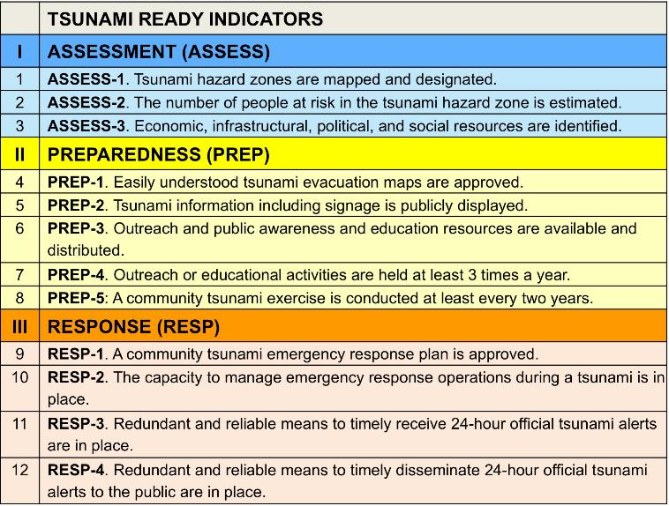
ICG/PTWS WG3 Task Team on Tsunami Ready July 2024
Early comparison against indicators
Risk assessment is legally required by all communities.
These variably occur across communities depending on their risk and will need investigation community by community relative to their risk. We will do this through our usual community engagement
Legally required across all communities, and reported on a 5-year cycle
In place for all communities (national capability)

Slide 27
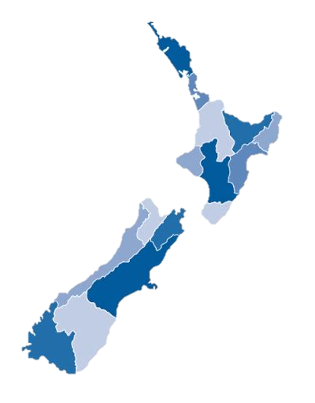
ICG/PTWS WG3 Task Team on Tsunami Ready July 2024
Early comparison against indicators
We are working to be able to say:
XX out of 16 communities ( %) are prepared & resilience to Tsunami
(or are consistent with the Tsunami Ready Framework)

