Slide 1
PTWS-SC Working Group 1
Understanding Tsunami Risk
Honolulu, HI Sep 17, 2024
Co chairs: Christopher Moore, Silvia Chacón

Slide 2
Co-chair voted in during July 8th meeting
Dr. Silvia Chacón-Barrantes,
Professor and Researcher
Sistema Nacional de Monitoreo de Tsunamis (SINAMOT), Costa Rica

Slide 3
Terms of Reference
Develop and promote best practice tsunami risk assessment material, programmes standards, and tools for understanding tsunami risk, to support emergency management and early warning, including but not limited to:
hazard assessment and coastal inundation models and products
risk assessment methodology and risk forecasting
scenario assessments including maximum credible events to
understand likely exposure, vulnerability, and event frequency
forecast and threat models
evacuation and inundation modelling
use of new and improved data including DEM, GNSS and paleotsunami information
Work with scientific experts to support Member State tsunami risk assessment.
Improve best practice for assessing risk of local source and non-seismic tsunami sources.
Develop projects to address gaps or areas for improvement in tsunami risk assessment, this may include land-use planning, vertical evacuation or supporting early warning improvements.

Slide 4
Terms of Reference
Develop and promote best practice tsunami risk assessment material, programmes standards, and tools for understanding tsunami risk, to support emergency management and early warning, including but not limited to:
hazard assessment and coastal inundation models and products
risk assessment methodology and risk forecasting
scenario assessments including maximum credible events to
understand likely exposure, vulnerability, and event frequency
forecast and threat models
evacuation and inundation modelling
use of new and improved data including DEM, GNSS and paleotsunami information
Work with scientific experts to support Member State tsunami risk assessment.
Improve best practice for assessing risk of local source and non-seismic tsunami sources.
Develop projects to address gaps or areas for improvement in tsunami risk assessment, this may include land-use planning, vertical evacuation or supporting early warning improvements.

Slide 5
ICG-XXX Requests WG1 to:
● Continue to support Tsunami Hazard Assessment (THA) studies in the Pacific as part of
comprehensive risk assessment, consistent with the first objective of the UN Ocean
Decade Tsunami Programme (UN ODTP), to achieve 100% coverage for coasts at risk of
tsunamis.
● Support and encourage regional workshops of seismic experts in tsunami sources. Such
regional workshops are best way to include local experts into THA studies.
● Support further development of the tsunami hazard and risk assessment tools for use in
THA (TsuCAT, ComMIT, Tweb and others).
● Encourage development of new and improved methods and promote use of best practices for THA.
● Encourage creation of a clearing house for access to the results of the THA studies.
● Encourage use of THA results for use in various IOC programs such as ITIC training,
Tsunami Ready Program, IOC/ICG/PTWS WG 2 and WG 3 activities and UN ODTP.

Slide 6
Agenda
Outcome of New Hebrides/Solomon/New Britain Tsunami Sources meeting
Discussion on PTHA
Possible Tsunami Source workshop to include PTHA
Gathering info on all regional PTHA efforts
"Tiered" recommendations on hazard assessments: inundation mapping should not rely on stochastic. best-practice ideas, gold/silver/bronze standards,
TsunamiReady crossover:
TsuCAT release 4.5, use in
Needs regional assessment: can it be based on PTHA work (Matthieu Peroche’s GIS study in the Caribbean)
Volcanogenic tsunami assessment - WG2 connection
Proposal on an Experts Meeting for the Scotia Arc and South Sandwich Islands region inter-ICG with the Caribbean
Social scientists involved with this WG, improve risk and vulnerability assessments

Slide 7
Tsunami Sources meeting, Vanuatu May 13-17th
Review of latest research on New Britain, Solomon Islands, New Hebrides trenches and related tectonic features
Overall tectonics considered, including arrangement and rates of the tectonic plates and likely segmentation. Multi-segment ruptures will be added.
Landslides and VGTs catalogued
Mmax(min) and Mmax(max) updated - another refinement will be considered from the regional strain budget work

Slide 8
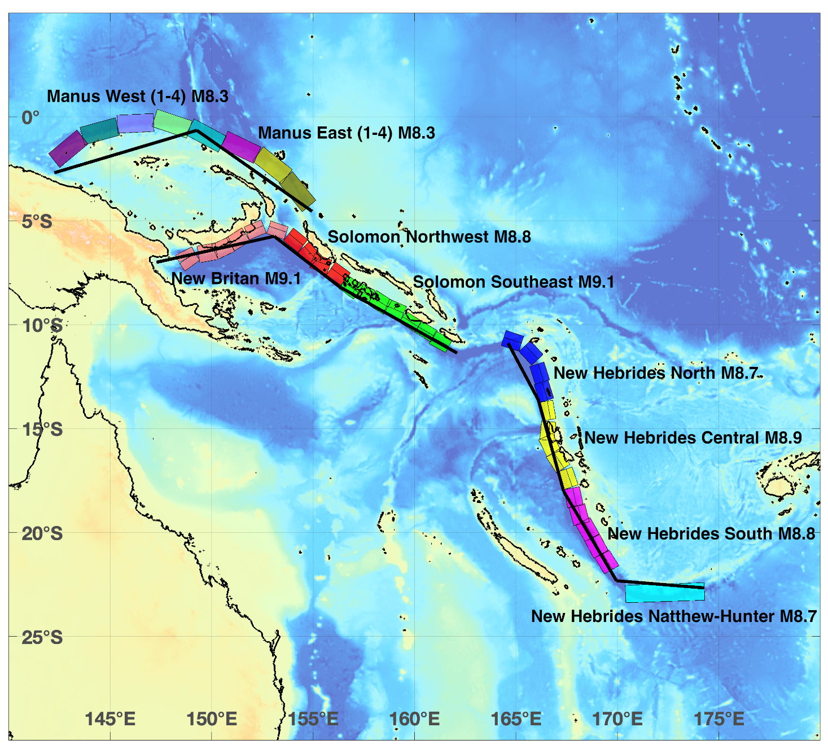

Slide 9
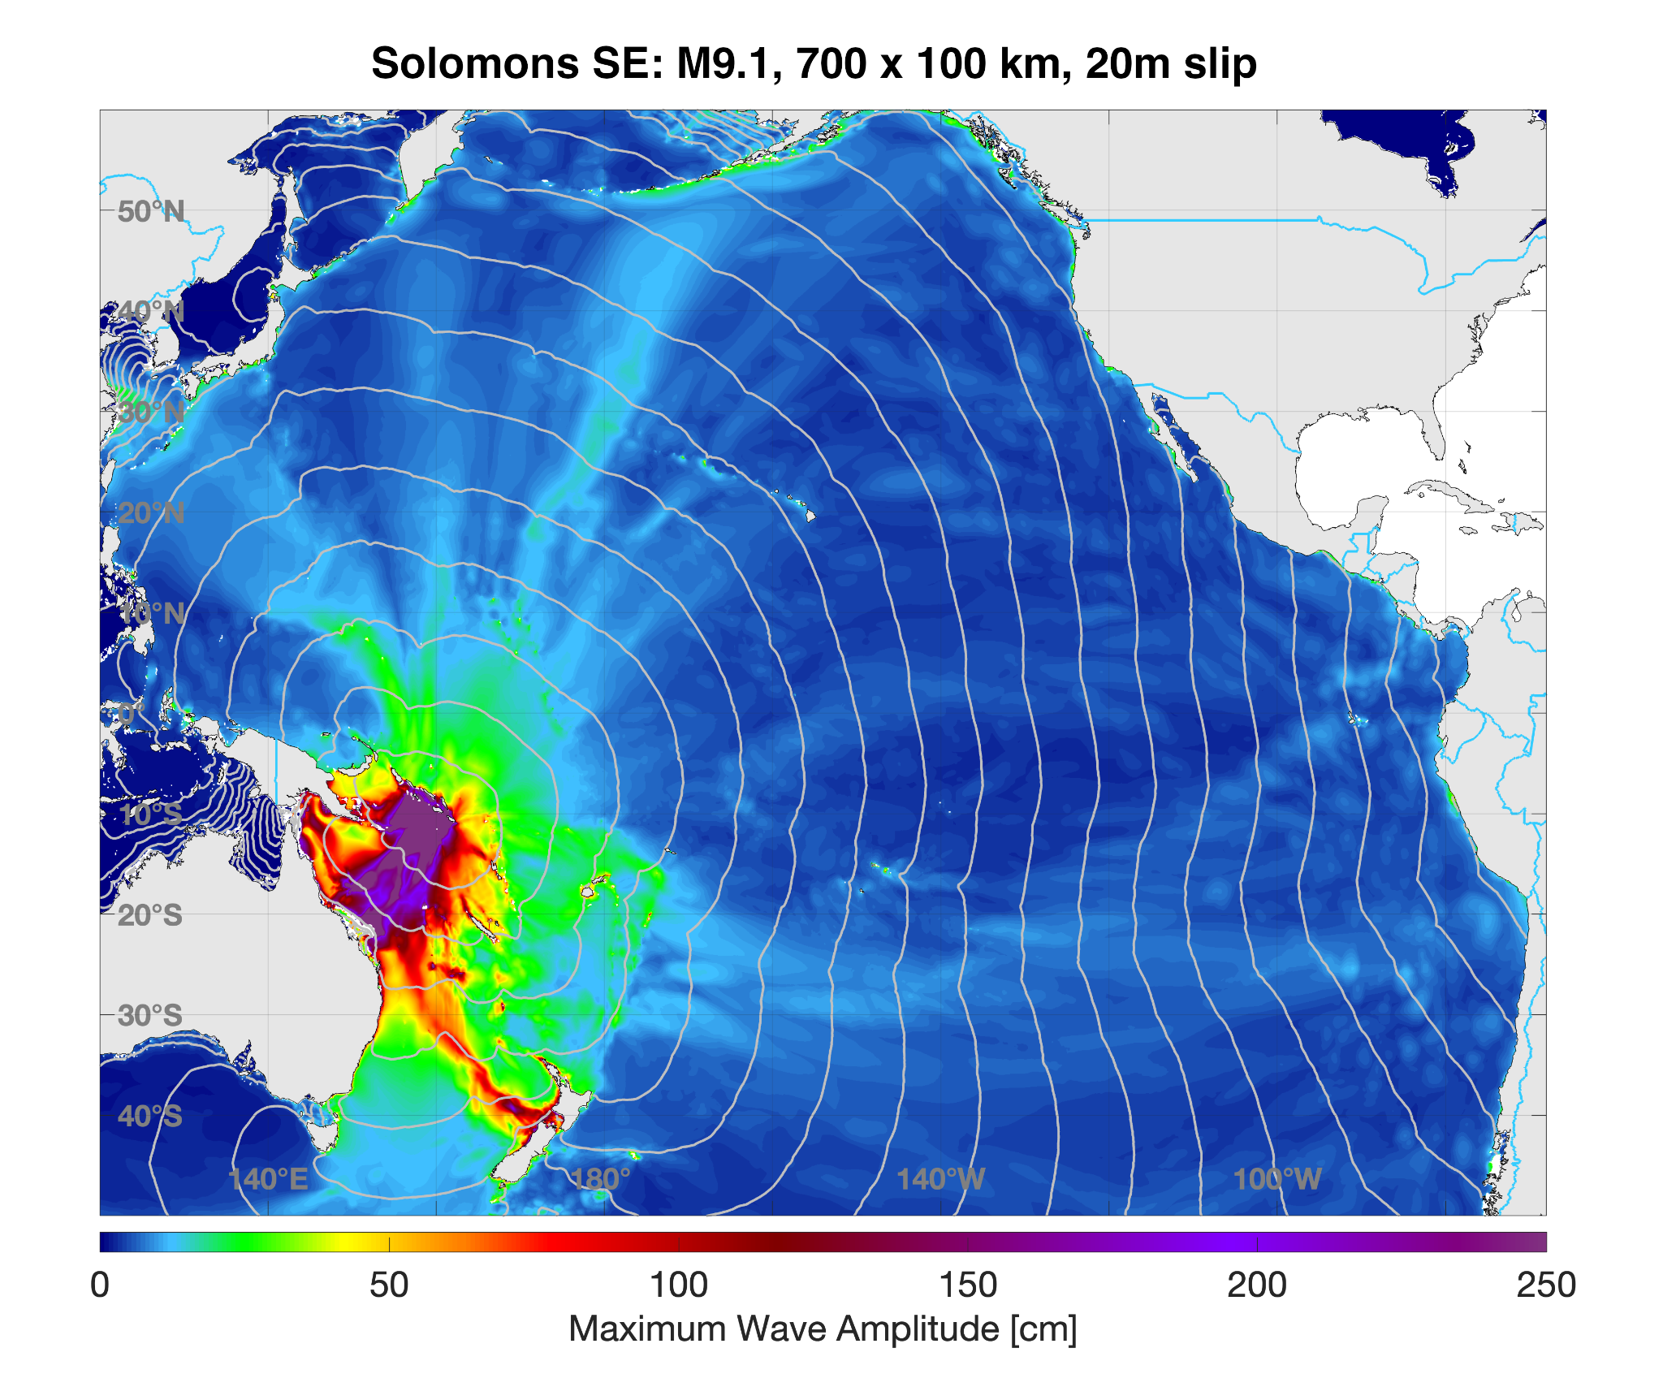

Slide 10
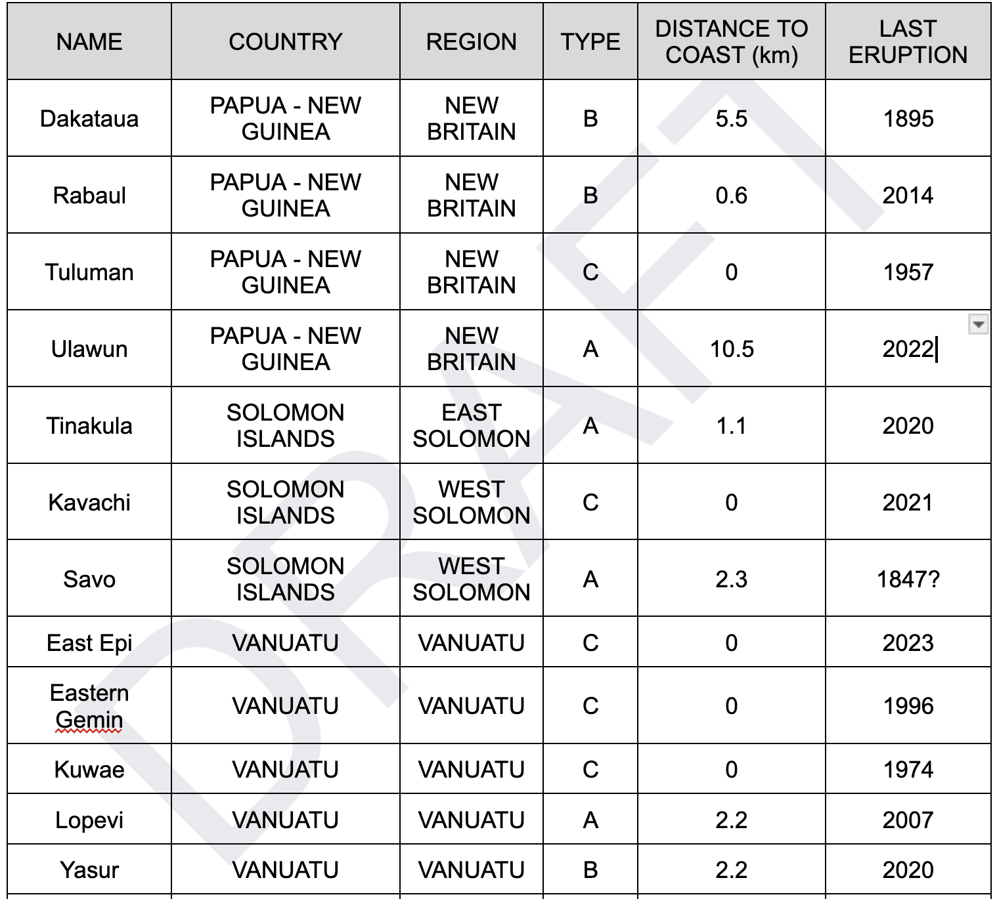
Volcanogenic/Landslide tsunami assessments

Slide 11
PTHA/M: Tiered Hazard Assessments / Models
"Tiered" recommendations on hazard assessments:
inundation mapping should not rely on stochastic assessment - we need ideas for cheaper engineering soln’s: tiered best-practice ideas gold, silver, bronze standards
Recommendation:
Gathering info on model resolution, isobath depth, tools available
Catalogue the sources used in each: Circum-Pacific Source Model
Possible Tsunami Source workshop to include PTHA

Slide 12
UNESCO/IOC Tsunami Ready needs/crossover
TsuCAT release 4.4
use in TRRP
Exercise messages feature
Real-time event notification

Slide 13
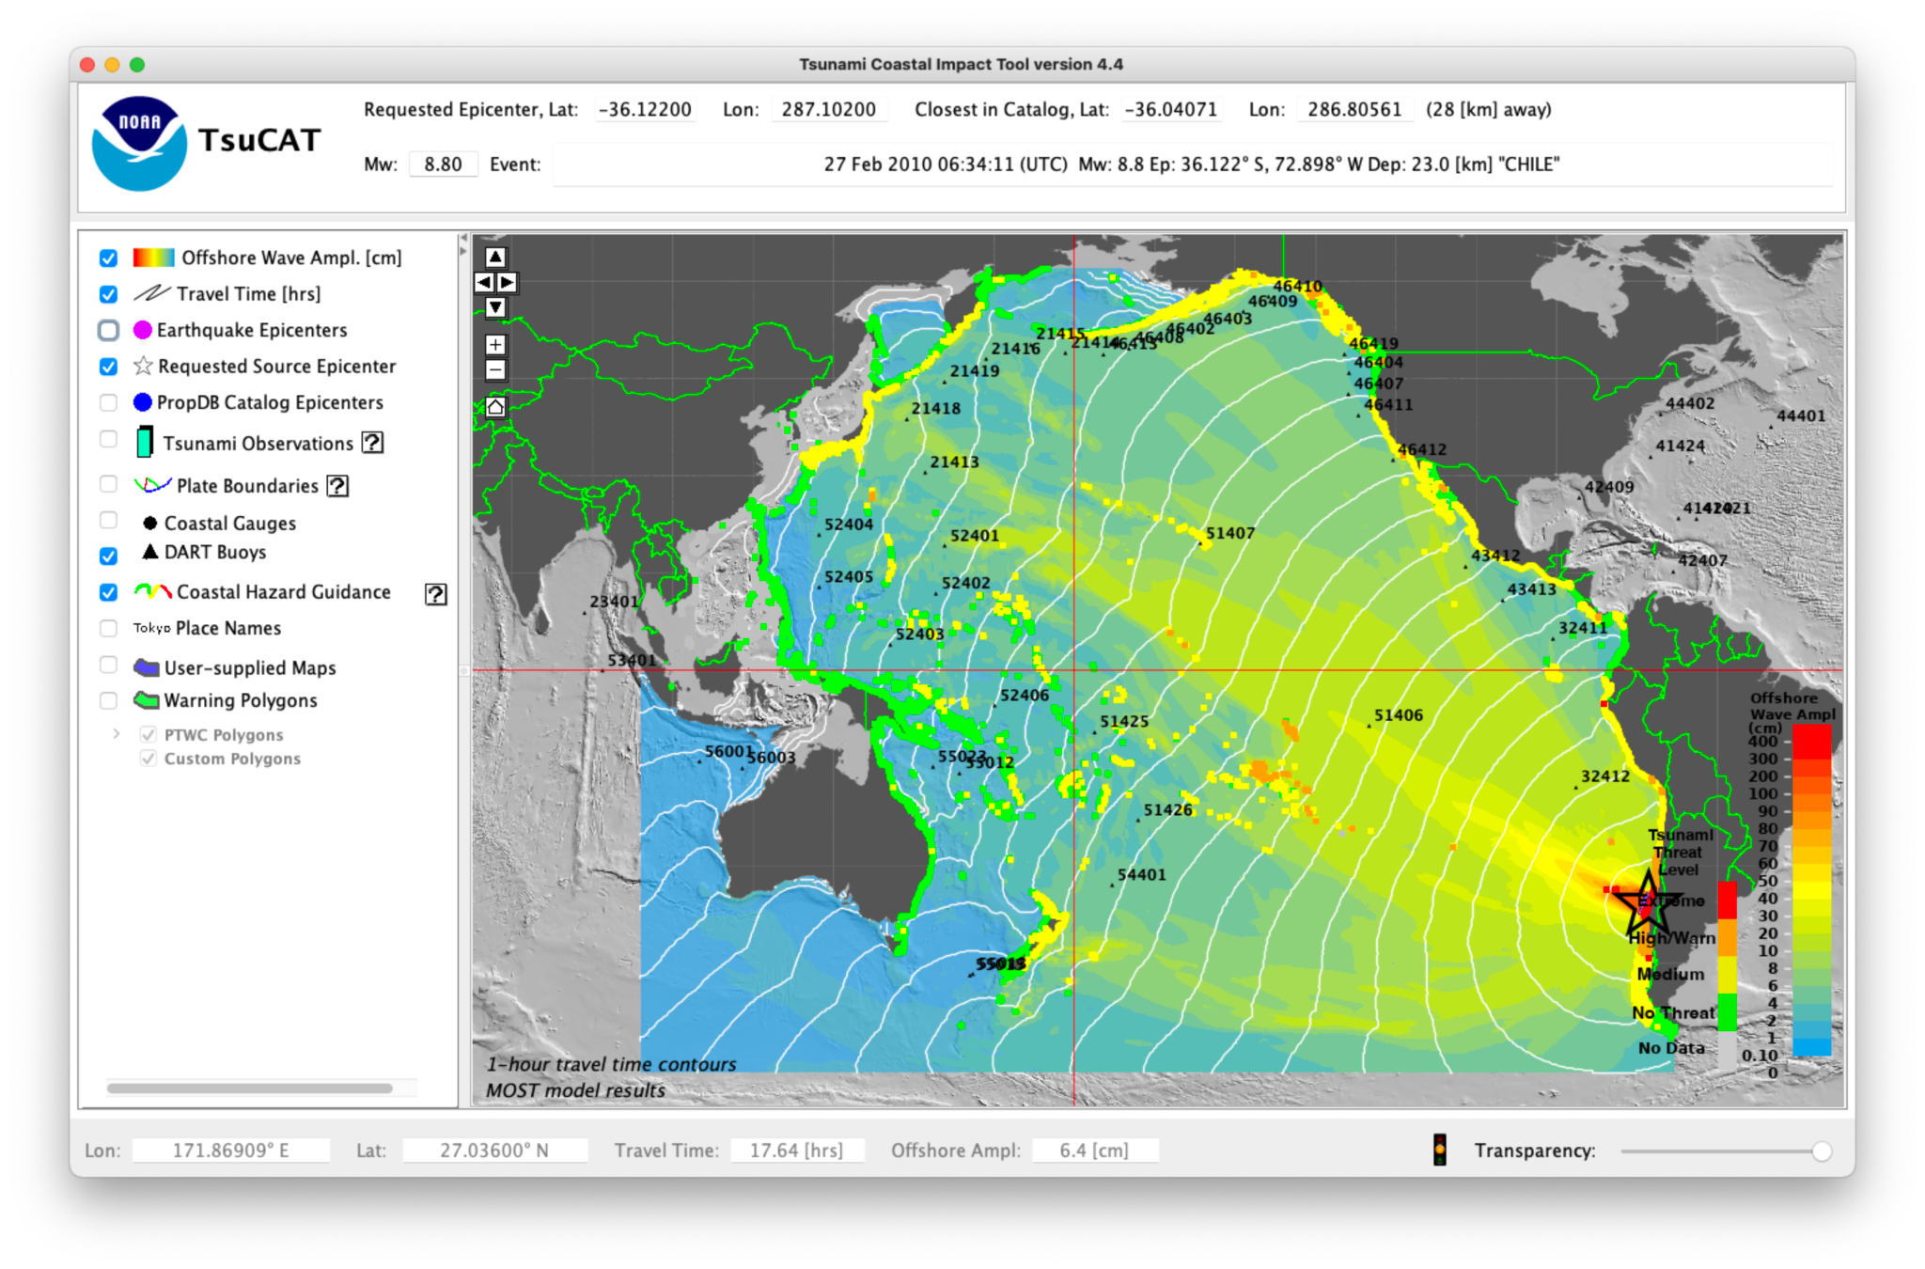

Slide 14
PTHA/M use case for TR
From the catalog of tsunami sources database
Provide tools to allow easy comparison of impact of a source on a given coastline to aid in choosing a return period/probability
Provides open-ocean/deep-water wave amplitudes offshore
Allow for varying needs from member states:
No high resolution DEM …. or no hydrodynamic modeling support:
Extend PTHA wave amplitudes by extrapolation to the coast
Some high-resolution DEM:
Provide MCE for a given probability to allow modeling
High-res DEM and full hydrodynamic modeling resources:
Full multi-source inundation probabilistic modeling assessment

Slide 15
Need to focus on Risk
Social scientists involved with this WG, and vulnerability assessments:
Search methodologies for tsunami vulnerability/risk assessments
Connect with WG2: Forecast to tie into impact-based forecasts

Slide 16
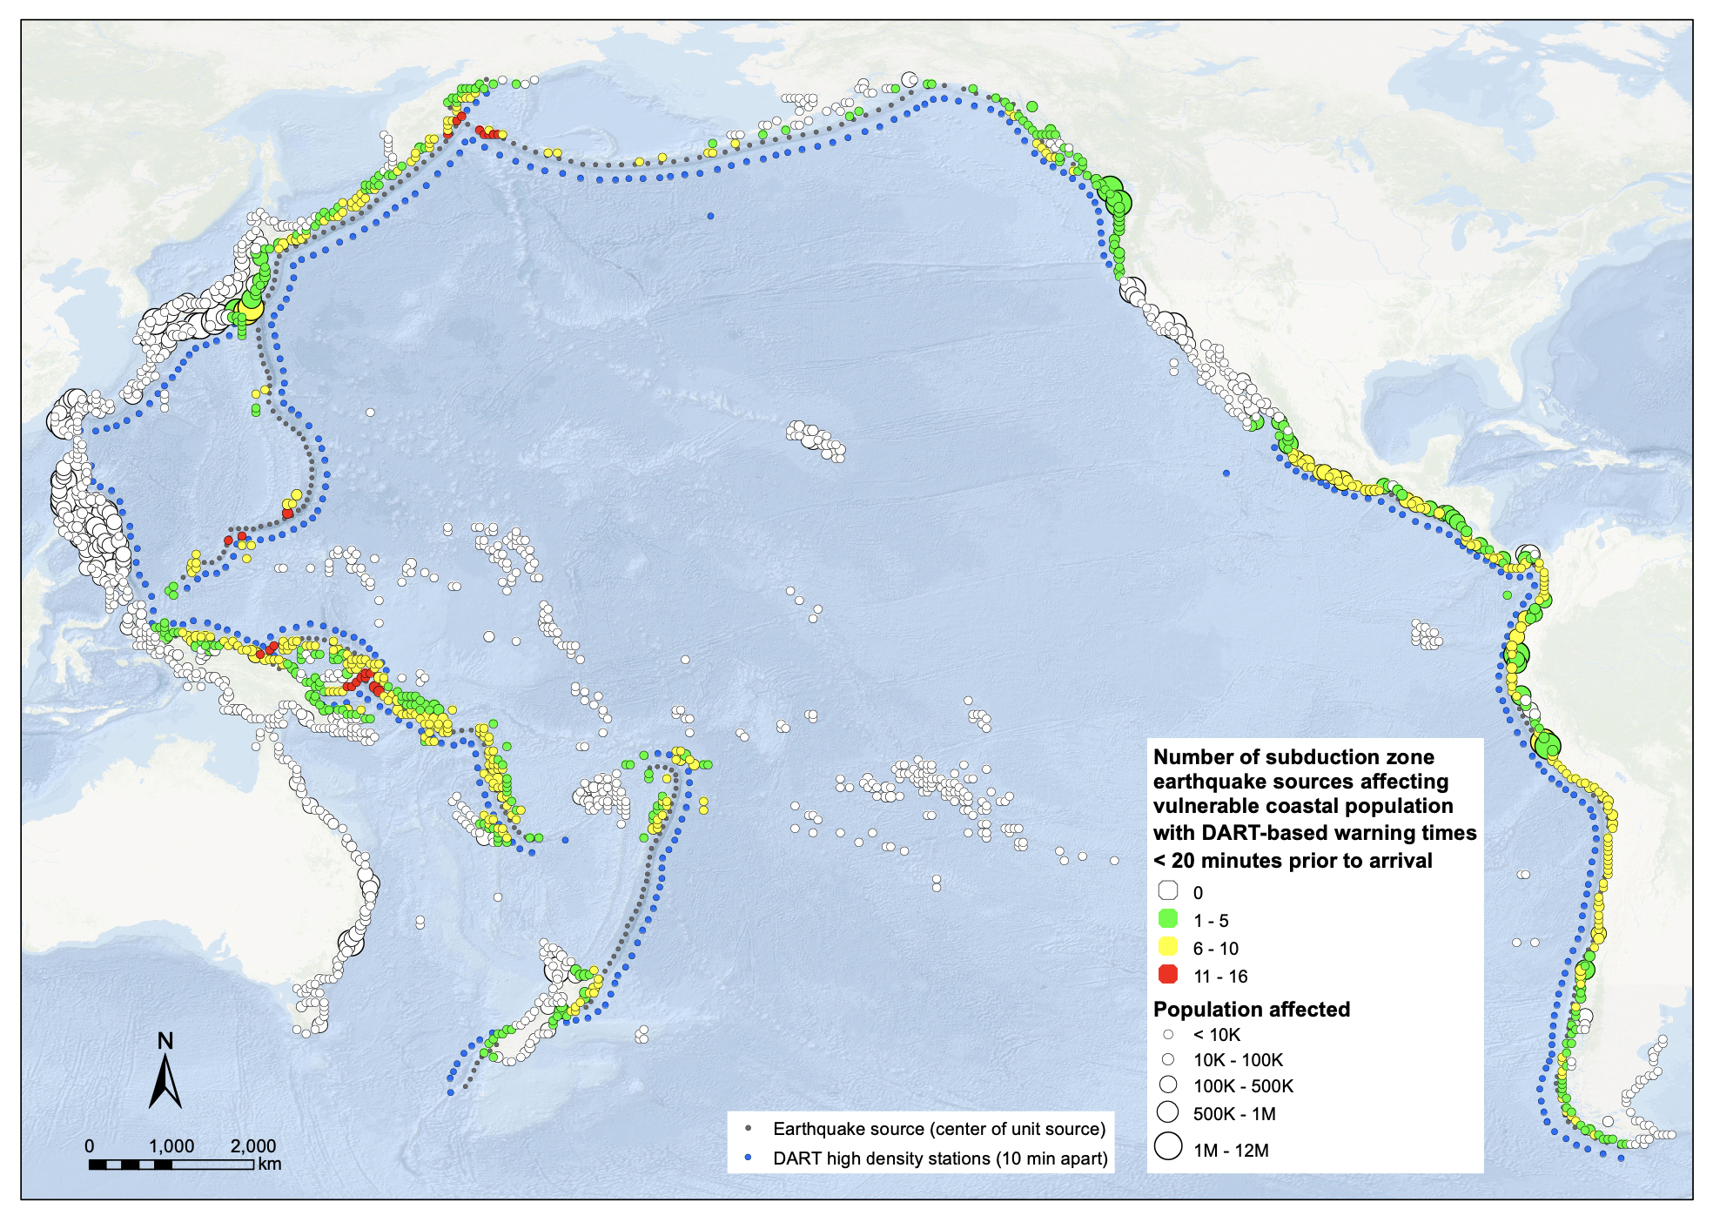

Slide 17
Next Regional Experts Meeting reccomendation
We propose an Experts Meeting for the Scotia Arc and South Sandwich Islands region inter-ICG joint with the Caribbean
Multi-basin impact
Discussion in SC
(EC57 decision associated during IOC-EC 2024 regarding hosting and regional impact)

