Slide 1
4. Chair’s Report on the TOWS-WG XVII session and the IOC 57th EC
ICG/PTWS Steering Committee
18 - 20 September 2024
NISHIMAE Yuji
ICG/PTWS Chair

Slide 2
Past meetings attended by the Chair since September 2023
Date | Meeting
15 December 2023 | ICG/PTWS Officers Meeting (online)
06 February 2024 | ICG/NEAMTWS XVIII Session (online)
19 – 20 February 2024 | TOWS-WG Task Team on Tsunami Watch Operations (in person)
22 – 23 February 2024 | TOWS-WG XVII Session (in person)
26 March 2024 | ICG/PTWS Steering Committee (online)
23 April 2024 | ICG/PTWS Officers Meeting (online)
06 May 2024 | ICG/CARIBE-EWS XVII Session (online)
24 – 28 June 2024 | IOC EC 57 Session (in person)
4 – 6 September 2024 | Joint WMO-IOC Collaborative Board (JCB) (in person)

Slide 3
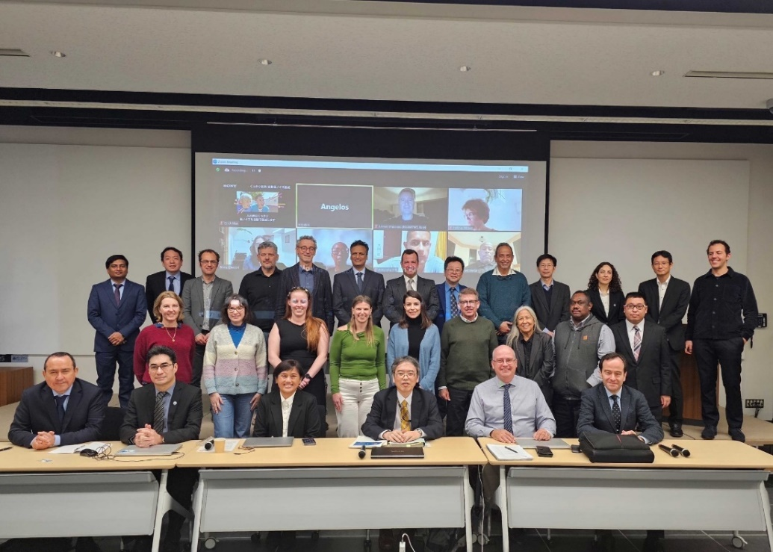
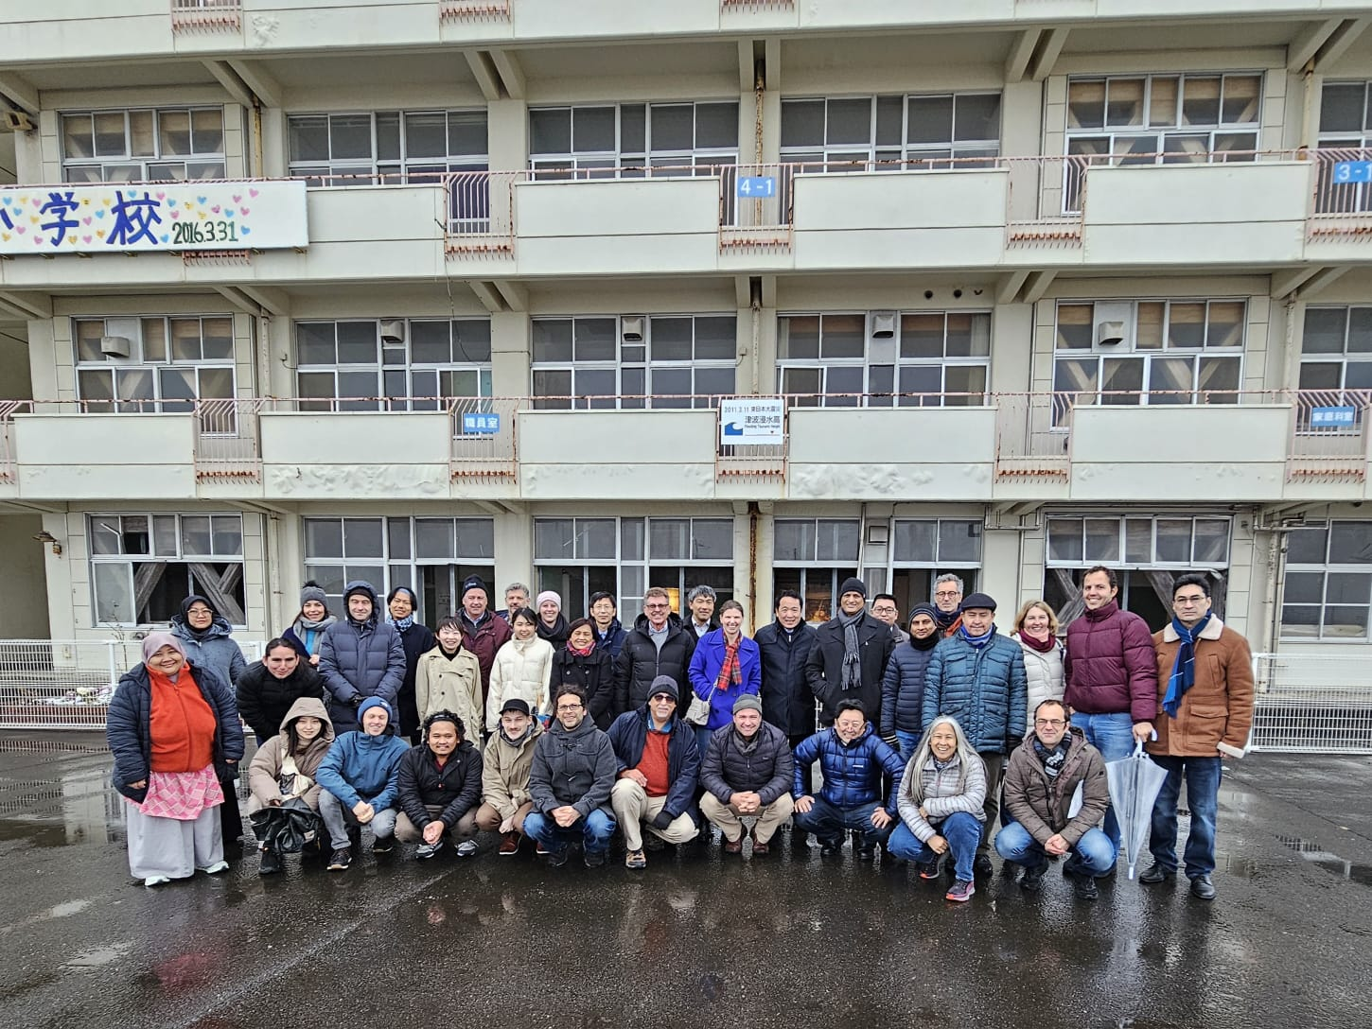
TOWS-WG 17th Session (19 – 23 February 2024, Sendai Japan)
Venue: International Research Institute of Disaster Science (IRIDeS) of Tohoku University
19 - 20 February 2024: Task Team on Tsunami Watch Operations and Task Team on Disaster Management and Preparedness
21 February 2024: Seminar “Findings from the 2024 Noto Peninsula Earthquake and Tsunami” organized by the IRIDeS
21 February 2024: Scientific Tour to damaged places by the 11 March 2011 Tohoku earthquake organized by the IRIDeS
22 – 23 February 2024: TOWS-WG 17th Session

Slide 4
Sea Level Observation
The Group recommended to Intergovernmental Coordination Groups (ICGs):
once the optimal sea level and seismic networks design has been completed for the Area of Service (AoS), work with Member States to fill identified gaps, including the strategic and coordinated submission of projects to the UN Ocean Decade and potential funding sources for support;
TSPs routinely monitor as frequently as possible (at least every 6 months) the status of sea level and seismic observing networks and the quality of the data to meet existing and enhanced tsunami warning requirements in their AoS, including the provision of status summaries for the Secretariat to follow-up with relevant Member States to correct data issues (coverage gaps and data quality);
utilise exercises and communication tests as an opportunity to simultaneously monitor data availability and quality;
routinely monitor as frequently as possible (at least every 6 months) the status of national sea level and seismic observing networks and the quality of the data to meet existing and enhanced tsunami warning requirements, correcting any issues with outages, quality and real-time accessibility of data as soon as possible, desirably within 6-months;
utilise and promote the use of multi-purpose sea level monitoring stations in support of MHEWS to enhance data coverage and reduce costs;
sample sea level data at one second intervals and transmit this in real-time, given the critical need to resolve and understand the near-field threat to high at-risk communities where a tsunami may arrive within 5-30 minutes;
share information and procedures on deployments of new technologies to monitor sea level variations used for tsunami warning purposes, such as the ongoing project of the CAM SMART cable off Portugal, TAM TAM SMART cable between New Caledonia and Vanuatu, undersea cable installations being deployed by Indonesia and India, and the Insea wet demo smart cable in the Ionian Sea offshore Sicily;

Slide 5
Tsunami Ready Recognition Program
The Group recommended to Intergovernmental Coordination Groups (ICGs):
ICG/PTWS Task Team Tsunami Ready to share the ICG/PTWS guidance on Tsunami Ready Equivalency for further consideration by TT-DMP, as a potential mechanism for reporting toward this goal;
ICGs and TICs to advocate Member States implementing Tsunami Ready to link with Making Cities Resilient 2030 (MCR2030);
ICG/IOTWMS WG1 and WG3 to develop and share guidelines for Tsunami Ready Critical Infrastructure

Slide 6
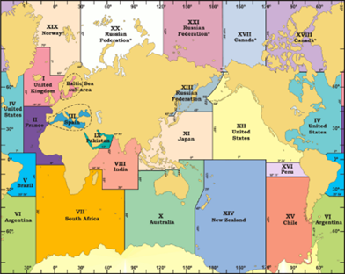
TSP Messages for the Maritime Community
IOC Decision A-32/3.4.1
Warning and Mitigation Systems for Ocean Hazards
Instructs the regional Intergovernmental Coordination Groups (ICGs) to;
Recommendation ICG/PTWS-XXX.4
Recommends the PTWC to finalize necessary preparations to provide special tsunami maritime safety products specifically for ships for all NAVAREA Coordinators in the Pacific and in the Southwest Atlantic (e.g. NAVAREAs VI, X, XI, XII, XIII, XIV, XV, and XVI) to transmit to the NTWCs to be forwarded to the NAVAREA Coordinators of their countries, or upon their request directly to the NAVAREA Coordinators in the absence of a NTWC,
IOC/TOWS-WG-XVII DECISIONS AND RECOMMENDATIONS
The Group recommended to Intergovernmental Coordination Groups (ICGs):
TSPs in collaboration with NAVAREA operators of the International Hydrographic Organization (IHO) test the tsunami maritime safety products in 2023/24, with a view to operationally implementing them in 2024-2025
TSPs identified for each ICG to trial dissemination of maritime bulletins to respective NAVAREA operators in their Area of Service (AoS) in the second half of 2024 for full operational implementation in 2025;
Trial Transmission of a dummy message to the NAVAREA coordinators in the PacWave24

Slide 7
PTWS-SC meeting in 26 March 2024
The ICG/PTWS-SC
Agrees with acceptance of the IOC/UNESCAP Tsunami Capacity Assessment Project and decides to appoint the ICG/PTWS Chair as the Point of Contact,​
Recommends that the Regional WGs consider to change the ToR related to the SMART Cable and recommends that the WG2 researches capability of the SMART Cable for observation of tsunamis,
Decides to provide special tsunami maritime safety products to NAVAREA coordinators through the NTWC from the PTWC and requests the PTWC to finalize preparation for providing special tsunami maritime safety products and decides to conduct the trial dissemination of the dummy message from the PTWC to the NAVAREA coordinators through the NTWCs during the Pacific Wave 24,
Requests the TSPs to begin to edit/revise the Users’ Guide according to the common structure,
Confirms membership of WGs and TTs in the ICG/PWS and requests the Regional WG Chairs to identify the contact information of the member states and to inform the IOC secretariat,
Encourages the Member States and the Regional WGs to submit actions related to the UNODTP and recommends that the Chair convenes the ICG/PTWS Officers meeting to discuss the allocation for the UNODTP among the Officers,
Reconfirms approval of the NTWC Competency Framework in the ICG/PTWS XXX and requests the Secretariat to describe approval of the NTWC Competency Framework in the Executive Summary and the Summary Report of the ICG/PTWS-XXX Session,
Appreciates the offer from the ITIC to host the next PTWS-SC and decides to hold the next meeting including some WG and TT meetings in Hawaii in September, 2024.

Slide 8
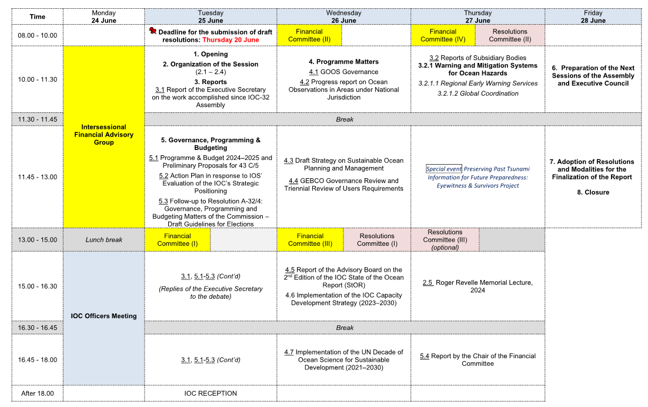
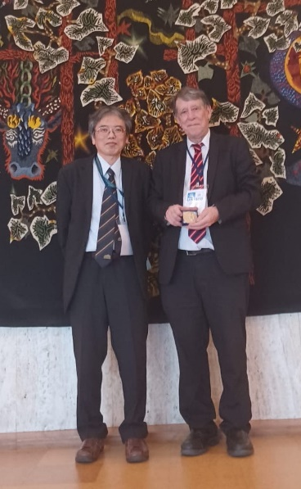
IOC EC 57th Session (25 June to 28 June 2024)
20 YEARS since SUMATRA:
Advances in Tsunami Science and Mitigation
Emile A. Okal
Northwestern University

Slide 9
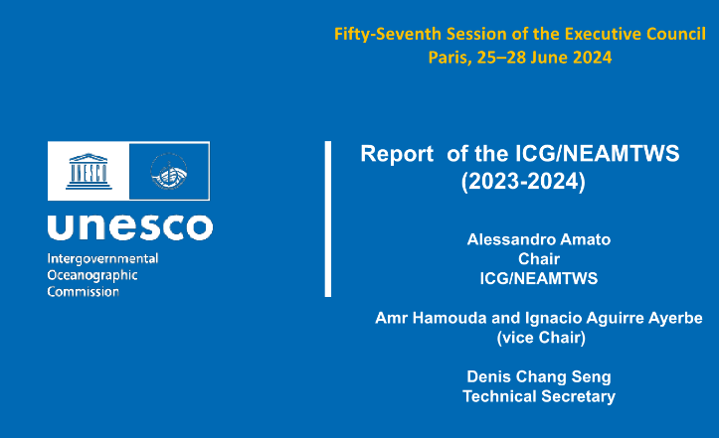
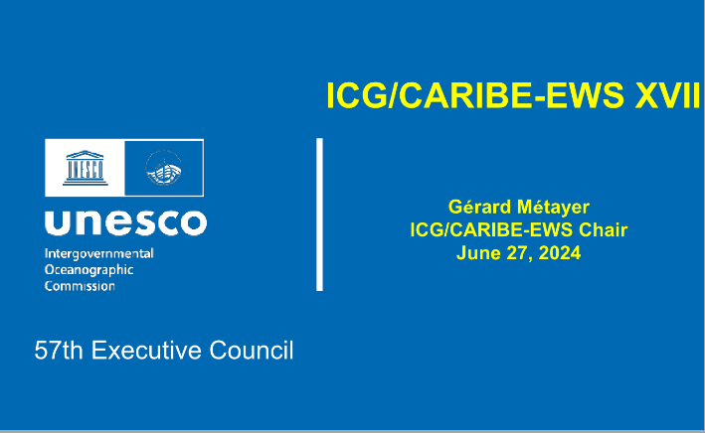
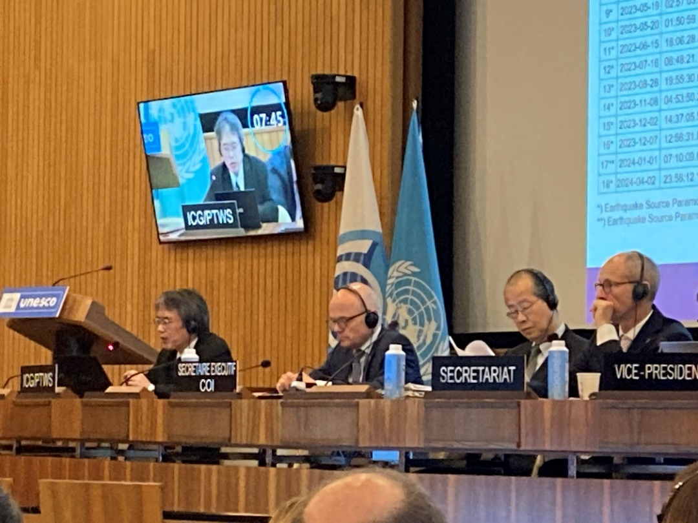
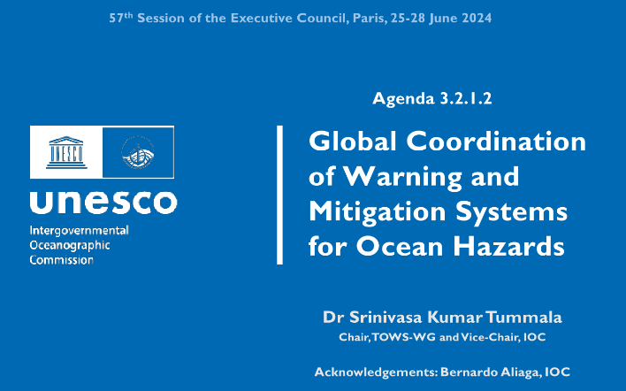
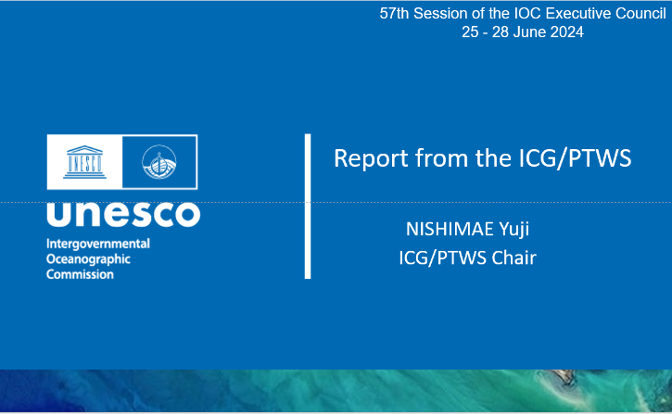
IOC EC 57th Session (25 June to 28 June 2024)
ICG and | Session | Reporter
ICG/CARIBE-EWS | XVII Session | Dr. Regina Browne on behalf the Chair
ICG/NEAMTWS | XVIII Session | Dr. Alessandro Amato
ICG/PTWS | XXX Session | Mr. Yuji Nishimae
TOWS-WG | XVII Session | Dr. Srinivasa Kumar Tummala

Slide 10
Reported items
Significant Earthquakes from January 2022 to May 2024 ( M>7.0)
1st January, 2024 Noto Peninsula Earthquake in Japan
15 Jan 2022 – Hunga Tonga – Hunga Ha’apai Event
Establishment of the Task Team on TGV under the WG2
Hunga Tonga Hunga Ha’apai’ Volcano Permanent Monitoring and Warning Procedures of the Pacific Tsunami Warning Center was published
Expansion of the ICG/PTWS Earthquake Source Zone
TSP Messages for the Maritime Community
Start of Operation of Central America Tsunami Advisory Center (CATAC)
Minimum competency levels for National Tsunami Warning Centre (NTWC) operations staff
IOC/UNESCO Tsunami Ready Recognition Program
Establishment of the Task Team on Tsunami Ready under the WG3
Exercise Pacific Wave 22 and Exercise Pacific Wave 24

Slide 11
IOC Fifty-seventh Session of the Executive Council Decisions (IOC Decision EC-57/3.2.1)
Part lll: Intergovernmental Coordination Group for the Pacific Tsunami Warning and Mitigation (ICG/PTWS)
Notes with appreciation:
the eleventh Exercise Pacific Wave in 2024 (PacWave 24) scheduled in the months of September through to November 2024 to support International Disaster Risk Reduction Day (13 October) and World Tsunami Awareness Day (5 November), as reflected in the Terms of Reference;
the offer of China to host the 31st Session of the ICG/PTWS in April 2025 in Beijing and the offer of France to host the 32nd Session of the ICG/PTWS in 2027 in Nouméa, New Caledonia;
the hosting by Vanuatu of the Expert Meeting on Tsunami Sources, Hazards, Risk and Uncertainties Associated with Vanuatu, San Cristobal and New Britain Subduction Zones, 14–17 May 2024;
the ICG/PTWS decision to start official full functional operations of Central America Tsunami Advisory Centre (CATAC), with the specific starting date to be decided after the coordination with the ICG/CARIBE-EWS;
the approval of the PTWS National Tsunami Warning Centre competencies, framework, and training requirements, as described in IOC/ICG/PTWS-XXX Working document: Report from the Task Team on the Minimum Competency Levels for National Tsunami Warning Centre (NTWC) Operational Staff;
Requests PTWC to finalize necessary preparations to provide special tsunami maritime safety products specifically for ships for all NAVAREA Coordinators in the Pacific and in the Southwest Atlantic (e.g. NAVAREAs VI, X, XI, XII, XIII, XIV, XV, and XVI) to transmit to the NTWCs to be forwarded to the NAVAREA Coordinators of their countries, or upon their request directly to the NAVAREA Coordinators in the absence of a NTWC;

Slide 12
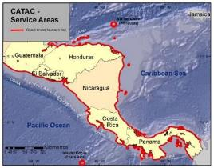
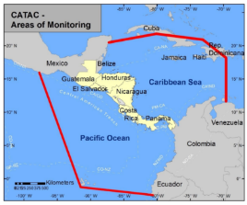
Start of the official full functional operation of the Central America Tsunami Advisory Center (CATAC)
Recommendation ICG/PTWS-XXX-6
Decides to admit the start of the official full functional operations of CATAC, starting after the IOC governing body meeting in 2024, with the specific starting date to be decided after the coordination with the ICG/CARIBE-EWS
Recommendation ICG/CARIBE-EWS-XVII.8
Recommends CATAC to continue with the implementation of EEW methods for the acceleration and improvement of the tsunami warning for Central America.
Recommends the use of additional methods for the transmission of CATAC’s products to its users.
Recommends that CATAC continues full functionality in an interim manner to be able to support the National Tsunami Warning Centers (NTWCs), Tsunami Warning Focal Points 18 (TWFPs), and emergency management authorities of Central America in addressing those challenges,
Further recommends the consideration of CATAC as a TSP in its XVIII Session in 2025 to enable the IOC Assembly to consider the final admission of CATAC as TSP in June 2025

Slide 13
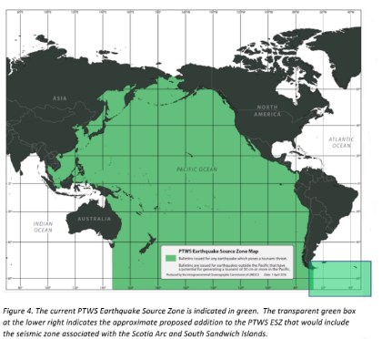
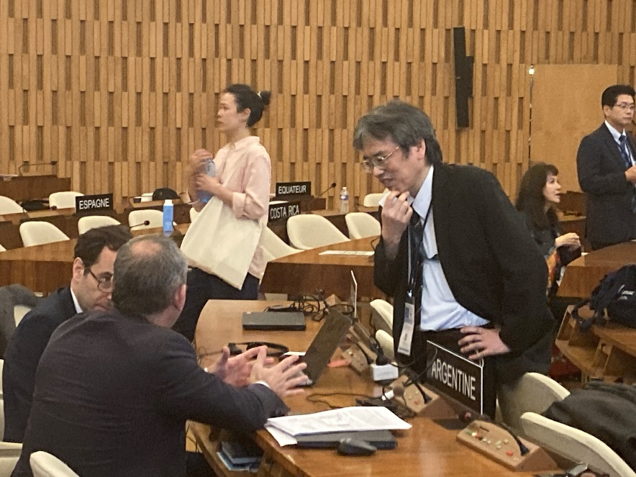
Expansion of the ICG/PTWS Earthquake Source Zone
Recommendation ICG/PTWS-XXX.3
Decides to expand the PTWS Earthquake Source Zone to include an area from 63º to 52º south latitude and from 72º to 18º west longitude to include the Scotia Arc and its adjacent seismic zones.
Adopted decision about the ESZ
The related paragraph to the Recommendation ICG/PTWS-XXX.3 was deleted.
Notes:
(i) the concerns of ICG/PTWS regarding the seismic activity in the Scotia Arc region as reflected in the Executive Summary of the ICG/PTWS-XXX (IOC/ICG/PTWS-XXX/3s);
(ii) that tsunami bulletins are issued by the PTWC for the ICG/CARIBE-EWS and ICG/PTWS for earthquakes in the Scotia Arc and its adjacent seismic zones for events fulfilling certain criteria as reflected in the IOC Technical Series, 130, ‘Tsunami Watch Operations-Global Service Definition Document’;
(iii) the need for the active engagement of Argentina with the ICG/CARIBE-EWS and ICG/PTWS regarding Argentinian Search and Rescue (SAR) and NAVAREA VI coordination responsibilities;

Slide 14
Joint WMO IOC Collaborative Board (4 to 6 September 2024)

Slide 15
Joint WMO IOC Collaborative Board (4 to 6 September 2024)
Recommendations at the TOWS-WG related to meteotsunamis
(TOWS-WG XVI Session)
The Group acknowledged that meteotsunamis are a meteorological driven phenomenon, and as such, better clarifying the roles of NMHS and WMO will be critical in supporting the development of any potential future detection and alerting service for meteotsunamis;
The Group decided to continue the Ad Hoc Team on Meteotsunamis to finalise its report, recommended that WMO experts be engaged to assist in this task, and also acknowledged that WMO requests the WMO-IOC Joint Collaborative Board to discuss tsunami related issues with respect to meteotsunami, to clarify the roles and responsibilities for the WMO and UNESCO/IOC, and how best to strengthen collaboration for supporting Member States;
(TOWS-WG XVII Session)
The Group requested the Task Teams:
TT-TWO Ad Hoc Team on Meteotsunamis in consultation with WMO and IUGG JTC to review the term and definition of meteotsunami for consideration by TOWS-WG and to inform discussions on this topic by the IOC/WMO JCB, taking into account the historical derivation and use of the term, any potential confusion with other existing products/services, and the public understanding of any associated warnings, with a view to updating future versions of the Tsunami Glossary;
TT-TWO Ad Hoc Team on Meteotsunamis to complete a draft of the report for offline review by the TOWS-WG to be utilised as background information for consideration of the recommendations by the next meeting of IOC/WMO JCB in third quarter of 2024;

Slide 16
Joint WMO IOC Collaborative Board (4 to 6 September 2024)
WMO draft “meteotsunami” definition
(pre-decisional; still in development)
A meteorological tsunami (“meteotsunami”) is a technical term sometimes used to refer to long waves generated by weather disturbances.
These long waves can be produced by pressure jumps associated with frontal passages, squalls, cyclones, or other meteorological sources.
These unusual events have the same temporal and spatial scales as tsunami waves and can cause coastal inundation similar to seiches or storm surges, especially in bays and inlets with strong amplification and well-defined resonant properties.
In issuing alerts for these long waves, meteorological services focus on their coastal impacts and in general do not use the term “meteotsunami” to avoid confusion with tsunami events generated by disturbances such as undersea earthquakes, volcanic eruptions, or landslides, which occasionally lead to devastation.
These weather-driven long wave events are sometimes referred to as rissaga, abiki, marrobbio based on regional language.

