Slide 1
JOINT WMO-IOC COLLABORATIVE BOARD MEETING
4-6 September 2024
Vidar Helgesen, Executive Secretary, IOC-UNESCO

Slide 2
IOC Statutes
Article 2 Purpose
1. The purpose of the Commission is to promote international cooperation and to coordinate programmes in research, services and capacity-building, in order to learn more about the nature and resources of the ocean and coastal areas and to apply that knowledge for the improvement of management, sustainable development, the protection of the marine environment, and the decision-making processes of its Member States.
2. The Commission will collaborate with international organizations concerned with the work of the Commission, and especially with those organizations of the United Nations system which are willing and prepared to contribute to the purpose and functions of the Commission and/or to seek advice and cooperation in the field of ocean and coastal area scientific research, related services and capacity-building.

Slide 3
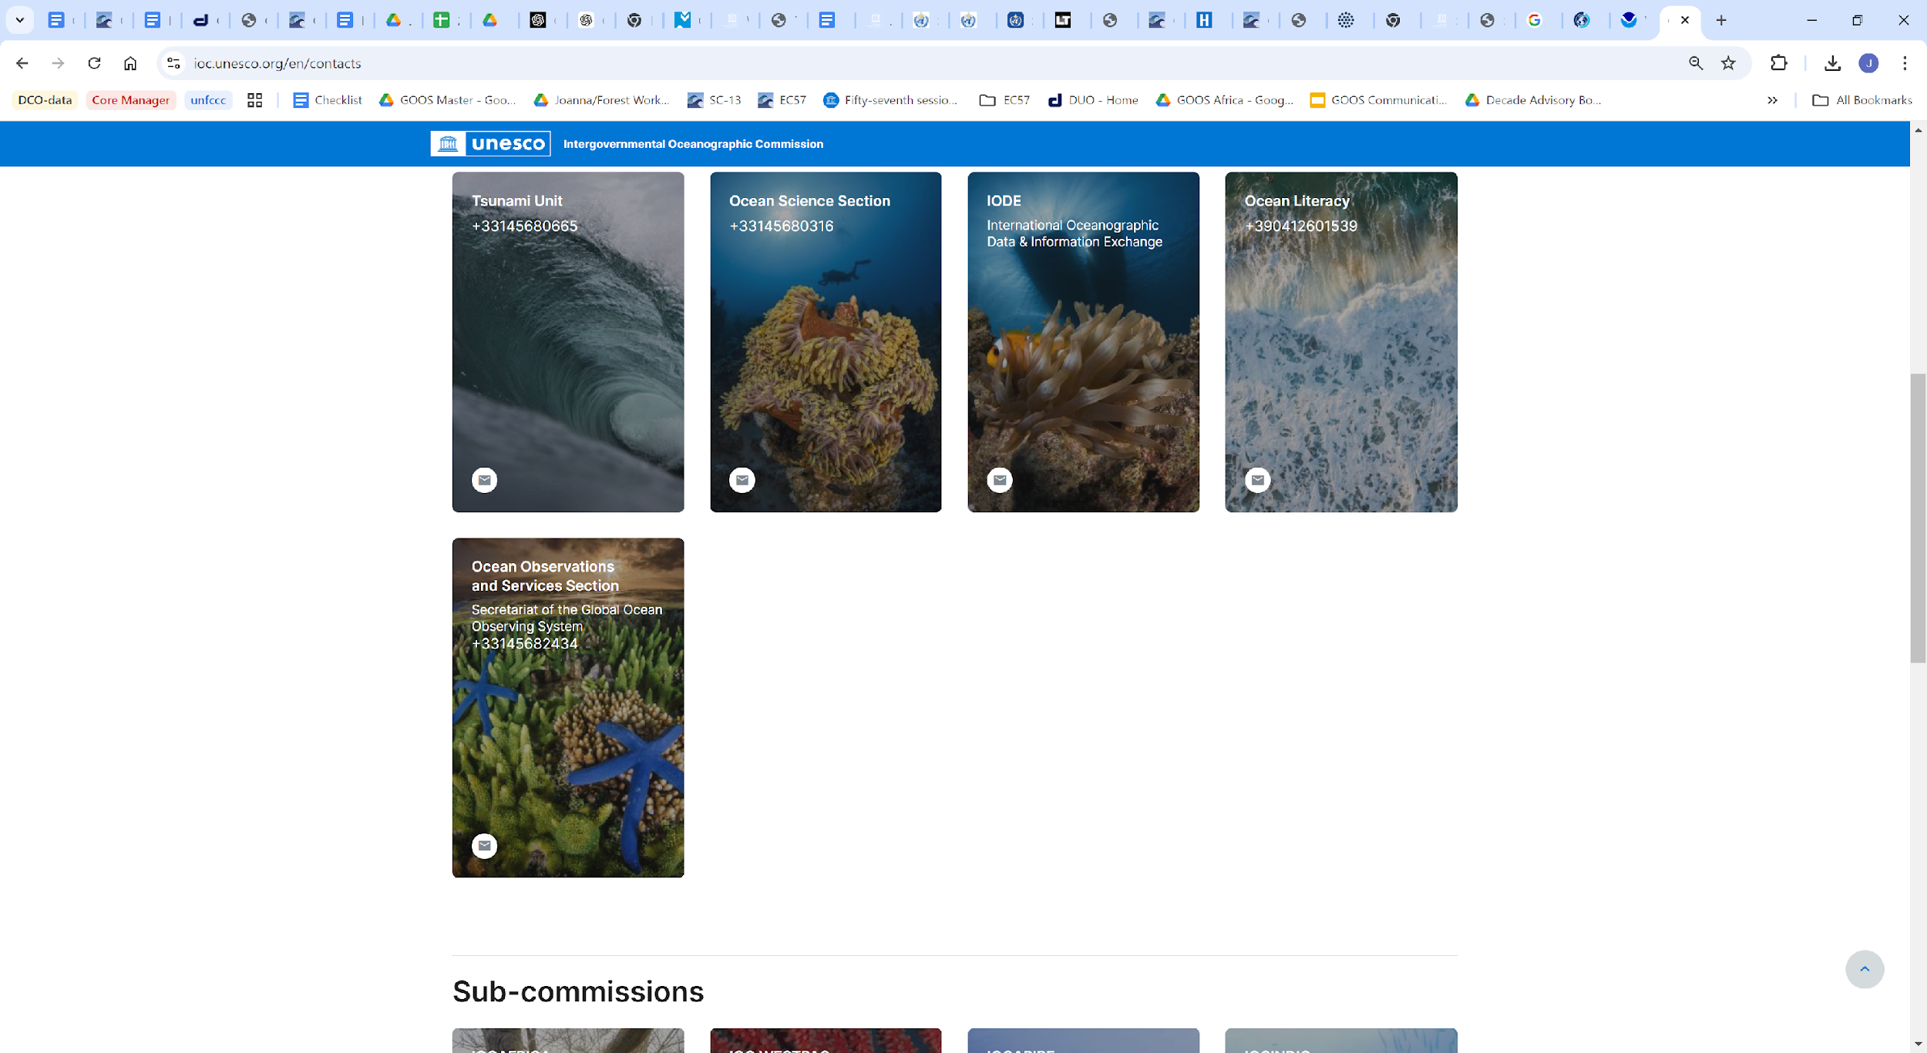
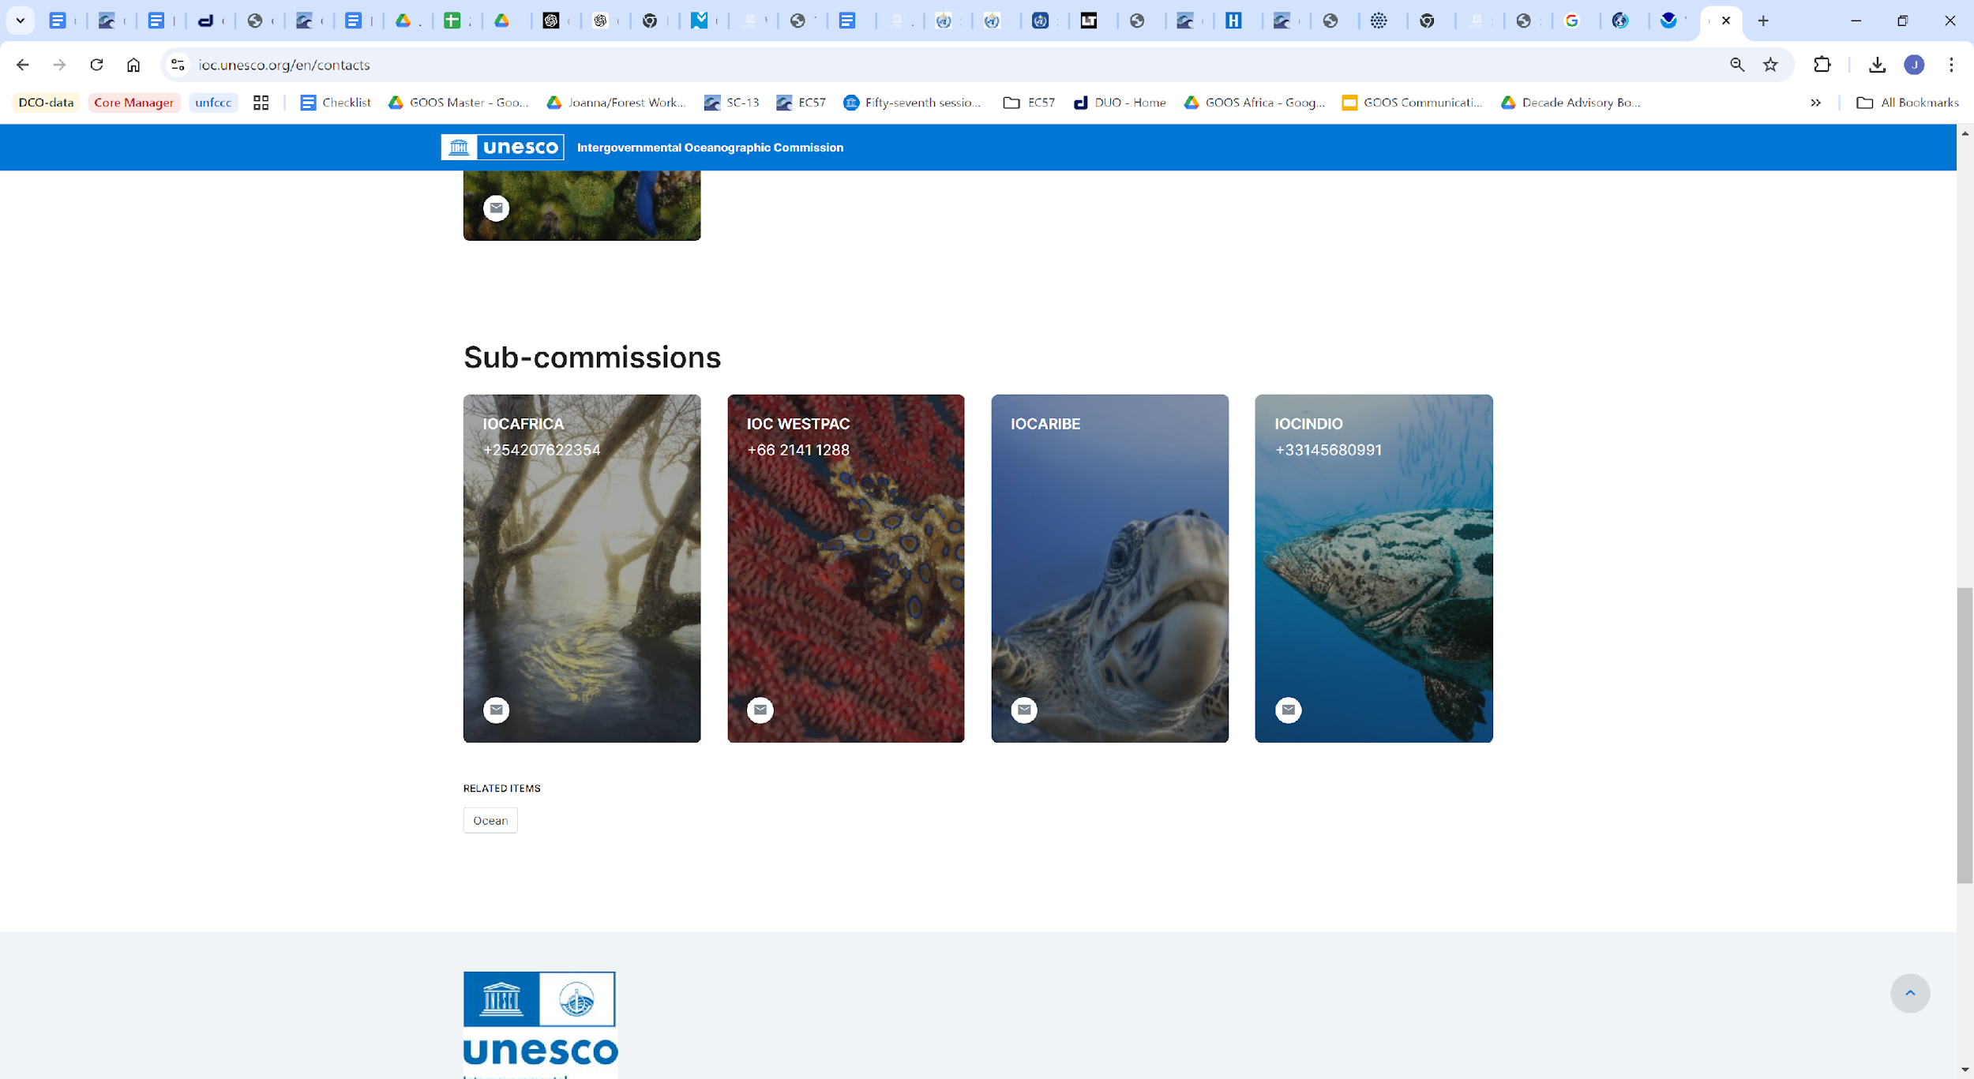
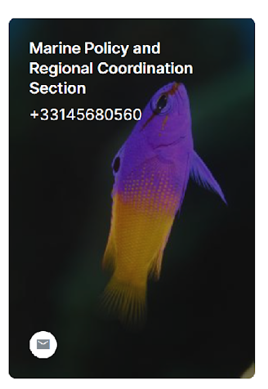
IOC

Slide 4
IOC High Level Objectives
Healthy ocean and sustained ocean ecosystem services;
Effective warning systems and preparedness for tsunamis and other ocean-related hazards;
Resilience to climate change and contribution to its mitigation;
Scientifically-founded services for the sustainable ocean economy;
Foresight on emerging ocean science issues.

Slide 5
Looking forward
Responsive to Member States and the need for knowledge-based decisions in public and private sectors
Focus on challenges and responses along the value chain from observations to services
Promoting Ocean Decade vision and mobilisation of global ocean science for sustainable development
Proactive support for UN processes

