Slide 1
WMO-IOC Joint Collaborative Board Agenda Item 1.2: JCB mandate & Modus Operandi Dr. T. Srinivasa Kumar Dr. M. Mohapatra (Co-chair, IOC) (Co-chair, WMO)
JCB-3 part 2 (hybrid), 4-6 September 2024
Paris, France

Slide 2
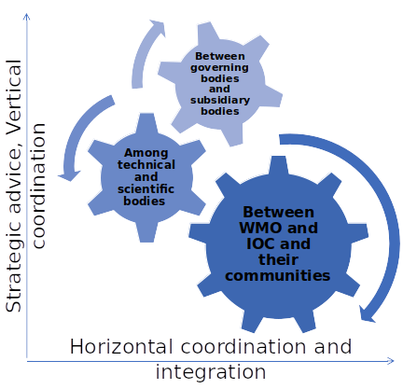
WMO Resolution 9 (Cg-18) / IOC Resolution XXX-2: WMO-IOC Joint Collaborative Board (JCB)
Requests the JCB to:
Facilitate the continued work of all JCOMM functions and activities, by recommending connections to appropriate working structures on both sides
Make recommendations on evolving the governance for the Global Ocean Observing System, in consultation with all co-sponsors, to further develop the partnership and functional connections between GOOS and WIGOS
Prepare, in consultation with WMO and IOC technical, scientific and regional bodies, a comprehensive and coordinated WMO-IOC Collaborative Strategy, based on existing sectoral strategies, and submit in two years to WMO and IOC governing bodies for adoption
Mandate of the JCB:
To coordinate, through a quadrennial WMO-IOC collaborative strategy, the collaborative development, integration and implementation of the activities related to oceanographic and meteorological observation, data and information management, services, modelling and forecasting systems as well as research and capacity development carried out by WMO and IOC
To provide the WMO and IOC governing bodies with strategic advice on joint work between WMO and IOC to achieve relevant objectives, including proposing new actions, as required, e.g. by preparing coordinated draft resolutions and/or decisions for both the WMO and IOC governing bodies,
To review work plans and provide technical and scientific recommendations for WMO and IOC subsidiary bodies and programmes, including proposing cross-cutting projects, and
To engage in liaison or consultation required with relevant intergovernmental and international stakeholders.
Mechanism for strategic advice, coordination and integration

Slide 3
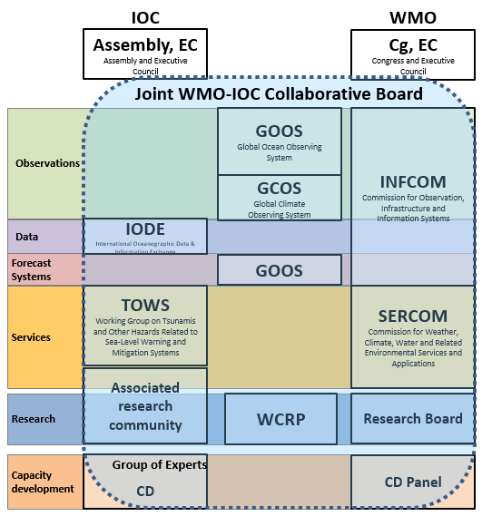
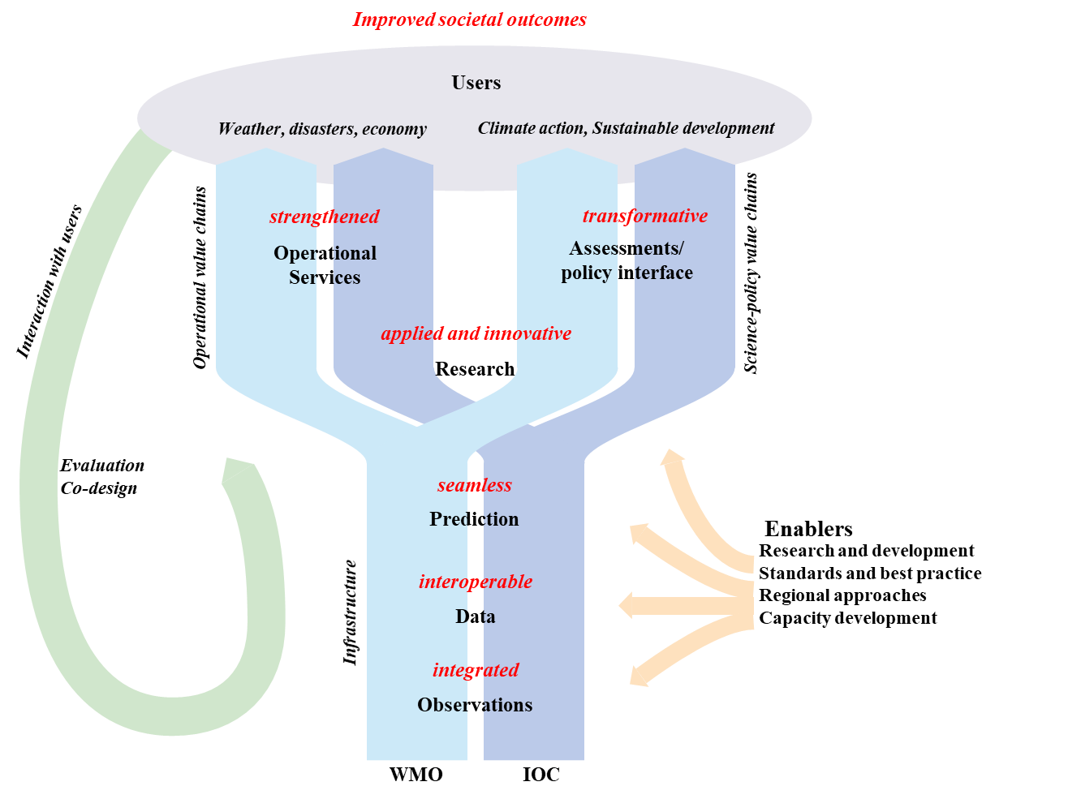
WMO-IOC Collaborative Framework in Met & Ocean Domains
Maximize opportunities to co-design joint work to improve provision of information and services for societal benefit
Suggest initiatives to improve end-to-end links; enhance connections with research
Influence how WMO and IOC jointly enable the delivery of information and services
Consideration of regional needs across these themes
WMO-IOC COLLABORATIVE STRATEGY
WMO and IOC create societal benefits with value chains of operational services and policy interface through met and ocean infrastructure such as observations, data management and forecasting systems, enabled by research, capacity development and regional collaboration

Slide 4
Current Membership of the JCB
WMO |  |  | IOC
Co-Chairs | Dr. Mrutuynjay Mohapatra | India (Region-II, Asia) |  | Dr. T. Srinivasa Kumar | India (IV, Asia and Pacific)
Observing system | Estelle Grueter Chair SC-ON INFCOM | Switzerland (Region VI Europe) | Observing system | Toste Tanhua Co-chair, GOOS SC | Germany (I W. European and North American States)
Data processing & management | Jeremy Tandy V-Chair SC-IMT INFCOM | United Kingdom (Region VI Europe) | Data and information management | Lotta Fyrberg, Paula Cristina Sierra Co-chairs, IODE | Sweden (I W. European and North American States), Colombia (III Latin America and Caribbean)
Forecasting systems | David Richardson Chair SC-ESMP INFCOM | United Kingdom (Region VI Europe) | Forecasting systems | Fraser Davidson Co-chair, OceanPredict | Canada (I W. European and North American States)
Services | Allison Allen Chair SC-MMO SERCOM | USA (Region IV North America, Central America and the Caribbean) | Early warning and services | Yuji Nishimae Chair, TOWS WG | Japan (IV Asia and Pacific Sates)
Research | Matthew Wheeler Member of Research Board | Australia (Region V South-West Pacific) | Research | Christopher Sabine IOC Research Team | USA (Group I W. European and North American States)
WMO Executive Council Members | Dwikorita Karnawati | Indonesia (Region V South-West Pacific) | IOC Member State Representatives | David Farrell | Barbados (Group III Latin America and Caribbean)
 | Albert Martis | Curaçao (Region IV orth America, Central America and the Caribbean) |  | Dr. Suzan Mohamed El-Gharabawi | IOC Regional Representative from Group V
 | Ishaam Abader | South Africa (Region I Africa) |  | Dr. Alexander Frolov | IOC Regional Representative from Group II

Slide 5
JCB Timeline
May- July 2020
Sep 2020 - May 2021
1-2 March 2022
Nov 2023
2019
Creation of JCB
WMO Resolution 9 (Cg-18) / IOC Resolution XXX 2
Joint Collaborative Strategy
JCB-2
Online meetings to identify practical actions
JCB-1
(9 online meetings)
Adopted by IOC and WMO
Review and Implementation
How does JCB catalyse collaboration
.
Ongoing
April- July 2024
27-29 Feb
2024
4-6 Sept
2024
20 Aug
2024
Theme-based meetings
JCB-3 Part-2
(Physical)
Co-chairs meet
JCB-3 Part-2 Agenda
JCB-3 Part-1
(virtual)

Slide 6
JCB-2: 1 – 2 March 2022
Observation | Data | Forecasting Systems, Services & Research | Capacity Development & Regional Cooperation
Enhanced synergy between GBON/RRR process and GOOS Co-Design Increased focus on ocean carbon research and observing capacity Development of proposals for Satellites ocean position white paper | Harmonization of WMO and IOC data policy, guidance and consultations; Collaboration on interoperability between IOC/IODE OIH/ODIS and WMO WIS; Collaboration between IOC/IODE and WMO on ocean best practices (OBPS); Enhanced involvement of all JCB members in developing WIS 2.0 and ODIS Implementation Plan; Joint development of an ocean data map; | Advancement of ocean prediction & forecasting to benefit end-users and Members Strengthened response & resilience to coastal flooding hazards including tsunamis Facilitate integration across models & observations in the coupled system Facilitate the co-design of services and products including new products | Increased regional collaboration between WMO and IOC Generation of links and harmonization of capacity development activities, programmes & strategies Increased avenues for marine meteorology and oceanography expert community to come together at regional/local level Establishment of JCB Webinar Series across the value chain
Intensified leveraging of existing strategic plans from WMO and IOC to achieve stronger contribution Co-hosting of big ocean events between WMO and IOC and co-lead in other big event/conferences (e.g. COP)

Slide 7
JCB-3 (Part 1): 27 – 29 February 2024
Self-Evaluation: The JCB agreed to the self-evaluation presented in the SWOT analysis and agreed to bring this to the attention of the IOC and WMO governing bodies, as well as using it as the basis for future work.
In-person Meeting: The JCB accepted the proposal of the co-chairs to meet the week of 2-6 September (later finalized as Wednesday-Friday 4-6 September 2024, hosted by IOC/UNESCO in Paris, France)
Joint Action Plan: The JCB agreed to use a series of online meetings and the September 2024 in-person meeting to elaborate a more detailed joint action plan around the above topics, for action by the bodies represented on the JCB.
Changes to ToR: After discussion of suggestions from various members of the JCB, the meeting decided not to recommend any changes to its Terms of Reference, concluding that they should be more fully exercised, and may be amended at a later stage based on the progress achieved.

Slide 8
JCB-3 (Part 1): Self Evaluation & SWOT Analysis
Strengths
Can suggest harmonized decision of the WMO and IOC
Can create a high-level strategic (long-term) joint view
Can advise Members/Member States of joint opportunities
represent a broad community covering the entire value chain-the JCB can cover cross-cutting issues
Unique body that works between 2 United Nations specialized organisations
Weaknesses
Works through virtual meetings only
Mechanism to influence work plans of WMO/IOC not clear
JCB’s links with INFCOM and SERCOM not clear
Lack of visibility with community and governing bodies
Members are not empowered to act on behalf of the Board
Less ability than JCOMM to force collaborations
Priorities not defined/ no a work plan/ no ways to measure advancement
Opportunities
Advise / advocate / receive feedback from Members/Member States with respect to ongoing initiatives led by WMO or IOC
Having common messages into relevant political fora (UNFCCC, UNCLOS, ...),
A relaunch: With communication on value and unique role – taking advantage of new IOC and WMO leadership
be more specific about proposed actions, with identified responsibilities and timelines.
Indicate and emphasise the value of the JCB
Threats
Lack of relevance to Members/Member States
Disappointment from JCB members and the bodies they represent on the lack of progress or relevance
Lack of clear funding lines for work in both WMO and IOC secretariats
Unique role not well defined
Functions/bodies are working without the JCB, so a perceived lack of relevance, can be ignored

Slide 9
Procedural & Substantive Ways forward
Procedural
Set a regular meetings schedule (virtual and 1 in person per year), dependent on resources - with meetings to focus on specific topics
Focus on a high level of strategic actions
Develop clear reporting mechanisms to and from the JCB to relevant governing bodies (with actions and timelines)
Foster better communication and understanding between IOC and WMO
JCB can choose to invite experts to focus on specific actions
Substantive
Strengthen and accelerate marine and coastal services (operational prediction, developing multi-hazard Early Warning Systems (MHEWS))
Strengthen engagement with the UN Decade of Ocean Science for Sustainable Development
Tackle interoperable data systems and standards
Address coordination on the High Seas (areas of global commons) including for observations (GBON, G3W), EW4ALL, etc.
Work with non-governmental and non-UN organizations
Perform a gap analysis along the WMO and IOC value chain

Slide 10
JCB-3 (Part 2): 04 – 06 September 2024
Objective of JCB-3 (Part 2):
Identify a short list of priorities where the JCB can uniquely impact and promote feasible action by IOC and WMO on issues of joint importance.
Develop methods to influence work plans and track action.
Major discussions planned:
Mapping areas of joint work for JCB action raised by different communities (Observations, Data, Prediction, Services, Research and Regions
Identification of 4-6 criteria to prioritize areas of joint work
Ranking and prioritizing areas of joint work using criteria identified
Goals and solutions for identified areas of joint work; setting of timelines (planning, timetable, cost, people, responsibilities, tracking mechanisms)
Recommendations to governing bodies and next steps

Slide 11


